Slide 1


July 14, 20201. 2PM EST

Slide 2
Housekeeping
For closed captioning, select “live caption” option on zoom.
This webinar is being recorded and will be made available for free on AACTE’s website within 48 hours. You will receive an email with the link.
  If you prefer, you are free to change your name as it appears on your screen. The recording will be shared, but not the transcript or individual’s names without their consent.
In order to ensure you can engage and keep yourselves confidential, use CHAT function to ask questions and share resources you’ve found helpful. All info and resources shared in the chat and by the panelists will be compiled and shared in a follow-up email.

Slide 3

Informal Affinity Groups
In Professional Development across fields, including education, informal affinity groups by racial identity can help us:
Understand how our identities influence our work
Provide a safe space for everyone to learn and discuss identity in the workplace so that individual intent in a conversation can be separated from impact.
Account for disproportionate representation in our workplaces and classrooms.
Increase the frequency and effectiveness of diverse collaboration among colleagues to address systemic issues that threaten our collective interests.
Notes:
Before we begin with our panel, I want to frame the use of affinity groups in this series for our audience.
You may be familiar with affinity groups based on subject area, but why do we use affinity groups by race in professional development?
Read/Discuss 1-4
Lack of space to move through a race-reckoning
We always know more than we did before,
If this is totally new to you, I want us to think of a white racial affinity group as a safe space for white folks to work through “white fragility” without unintentionally retriggering our friends and colleagues of color.
Because, just like any other effort we make to improve as individuals or a community, it takes vulnerability, discomfort, and time.
We also want to be bold! But as individuals, we don’t have collective power…
So I want to highlight #4.
Affinity Groups Synthesis Matrix - Google Sheets

Slide 4
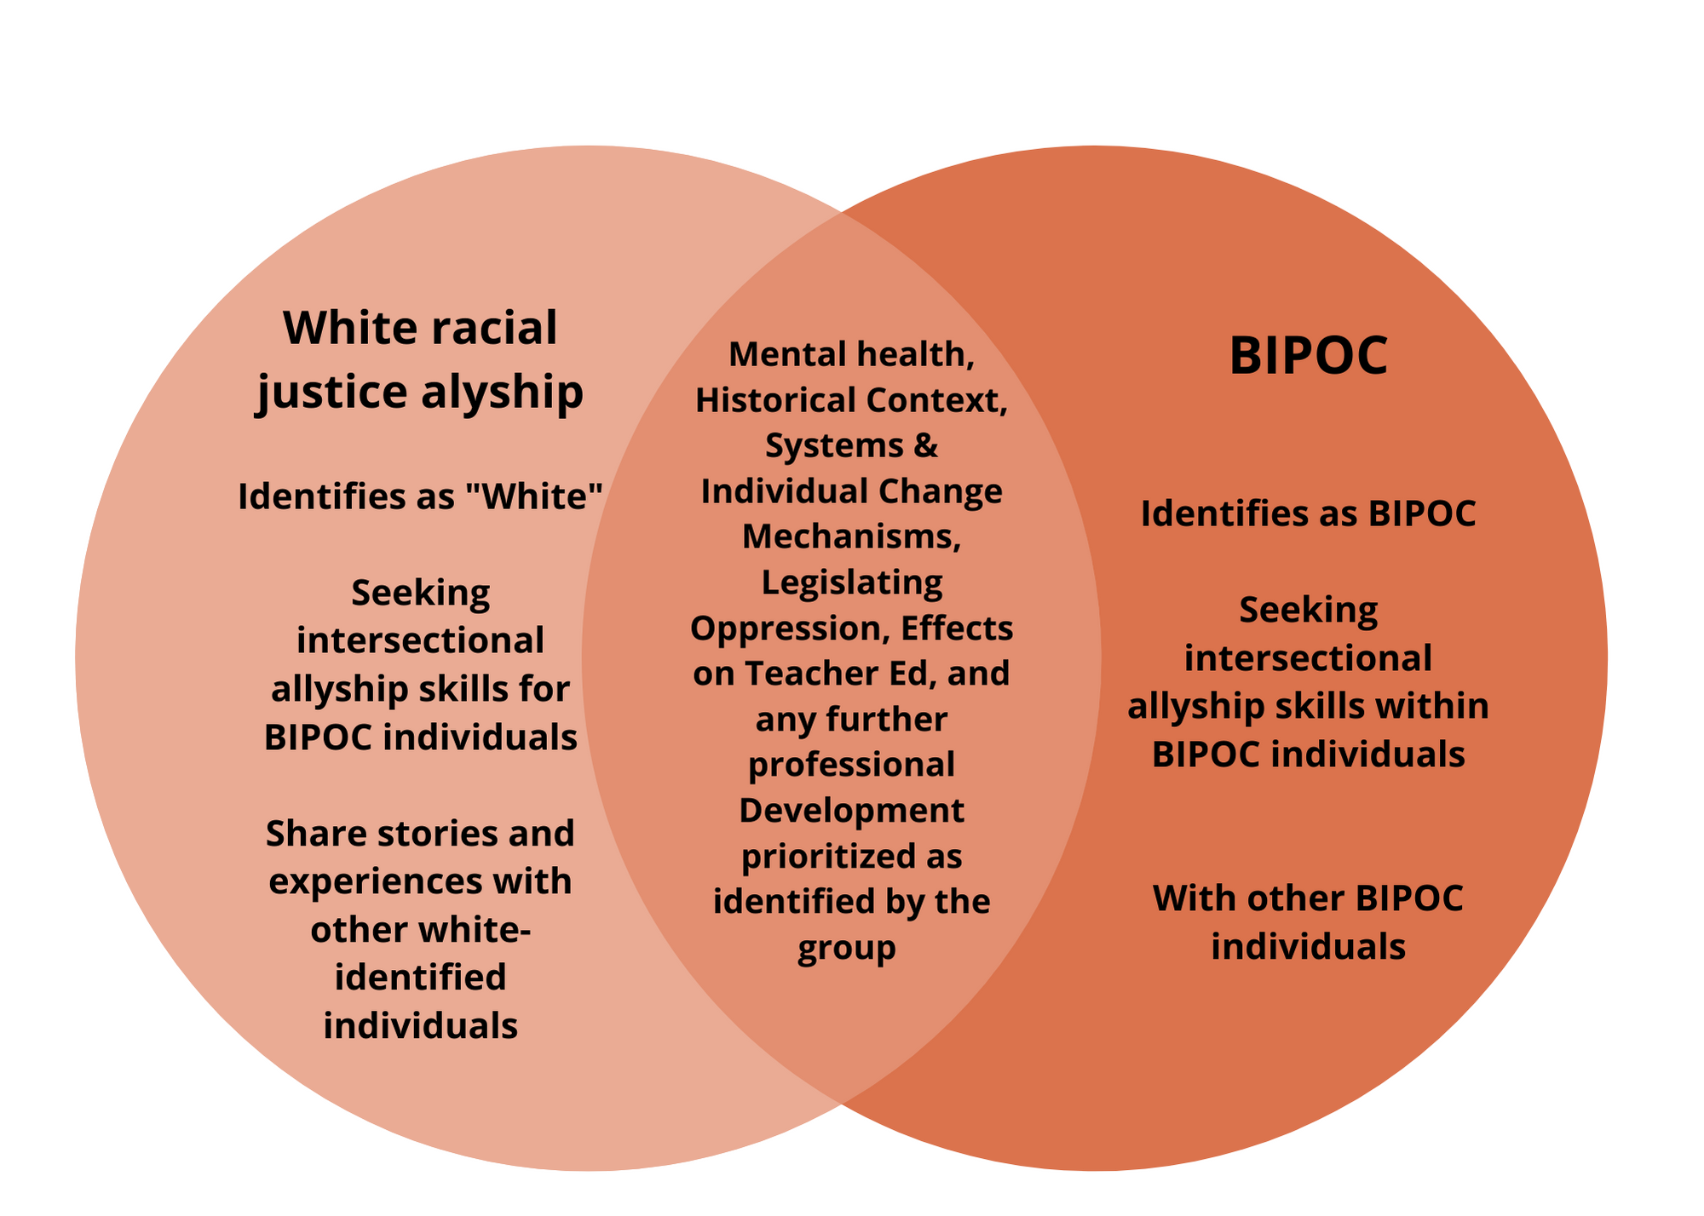
INFORMAL AFFINITY GROUPS
#4: Increase the level and effectiveness of diverse collaboration among colleagues to address systemic issues that endanger our collective interests.
Notes:
For the Combating Racism in Ed Prep series, we want to make sure we hold these informal affinity groups when necessary (at the direction of our member experts) in order to accomplish that 4th goal.
Basically, in order for us to come up with solutions that can break through the noise of those who say this isn’t an issue, so we can accomplish systems change we have to collectively strategize.
We need space to challenge ourselves and each other about
the Eurocentric narratives within which we learn about and understand race historically been used (in the U.S. specifically) and how our egos (as humans) (define)
work together to create a barrier to this goal.
And that’s what this is… this is that starting space…
So throughout today, show up as your authentic selves with a growth mindset to accomplish our objectives today.
Affinity Groups Synthesis Matrix - Google Sheets

Slide 5
Center Ourselves for The Objectives of Today’s Webinar
Discuss the importance of language and introduce working terms we use in this series and the field
Explore the dimensions of Whiteness, and their effects in Ed Prep
Build on the two of three sites of learning: self, systems, and skills to take action.
Provide strategies and resources to support your efforts to combat racism in your classrooms, programs, institutions across the country
*** Watch AACTE’s previous webinar, Critical Consciousness in Educator Prep. https://aacte.org/events/combating-racism-critical-consciousness-in-educator-preparation/
Notes:
In focusing on the self, our goal is to help participants investigate their identities and ways of knowing and explore their power, privilege, and biases that connect to their lived experiences and social identities. •
The second site of learning centers on understanding how social systems are structured in ways that privilege some and marginalize others–exploring the realities of other people’s lives and experiences. •
Finally, participants engage in developing the skills needed to take action to shift systems towards equity, by focusing on people, policies, and practices

Slide 6


PANEL
Dr. Kate Kedley
Rowan University
Victoria Kirby York
National Black Justice Coalition
Notes:
Everyone can read your bios at our website, but I’d love for you each to give a brief introduction and let us know what brought you to this work, and this webinar today?
I’ll begin with myself…

Slide 7
If a student asked you to define and distinguish between:
racism & prejudice
how would you answer?
Notes:
I am always hearing the argument that “white academic folks” should already know how to address and discuss racism, but as someone who has been doing professional development on this for awhile, that just isn’t true. This is my subject of focus and I still am constantly learning and practicity. We don’t have a consensus because (1) institutionally there have always been iterations of systems and ways of living that divide us and discourage us from talking about this issue and (2) we bring our individual perspectives (both good and bad) when we do.
The expectation is not that YOU KNOW EXACTLY WHAT TO SAY ALL THE TIME< RIGHT NOW! So let’s start here!

Slide 8
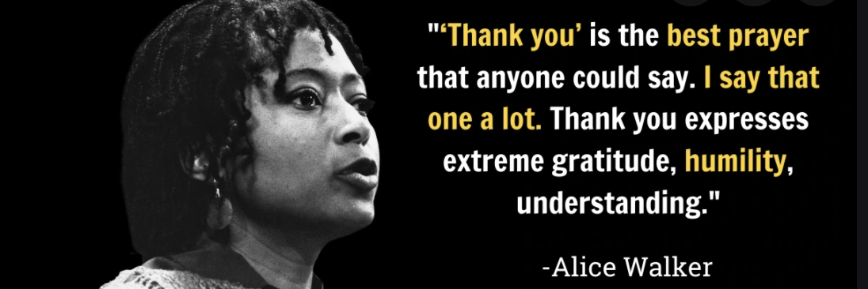
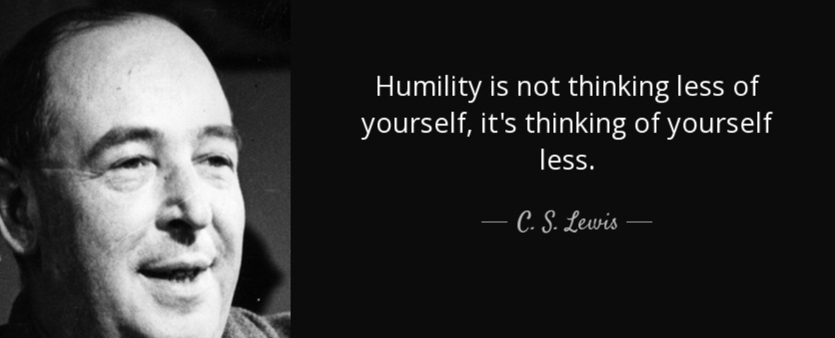
Vulnerability/Humility & Moving Forward
Notes:
KATE Model: Share first year teaching multicultural literature to Latino and Chicano students in Arizona. The sharing itself is vulnerable, but also so was the moment where students began guide their own learning and materials, and I had to humble myself and let them share. We never arrive at a moment of completion, it is always in process, looking for places where we are problematic and how we can be better.
White Racial Affinity Group: A space to process and analyze or actions and possibilities, not on the backs or the time of People of Color.

Slide 9
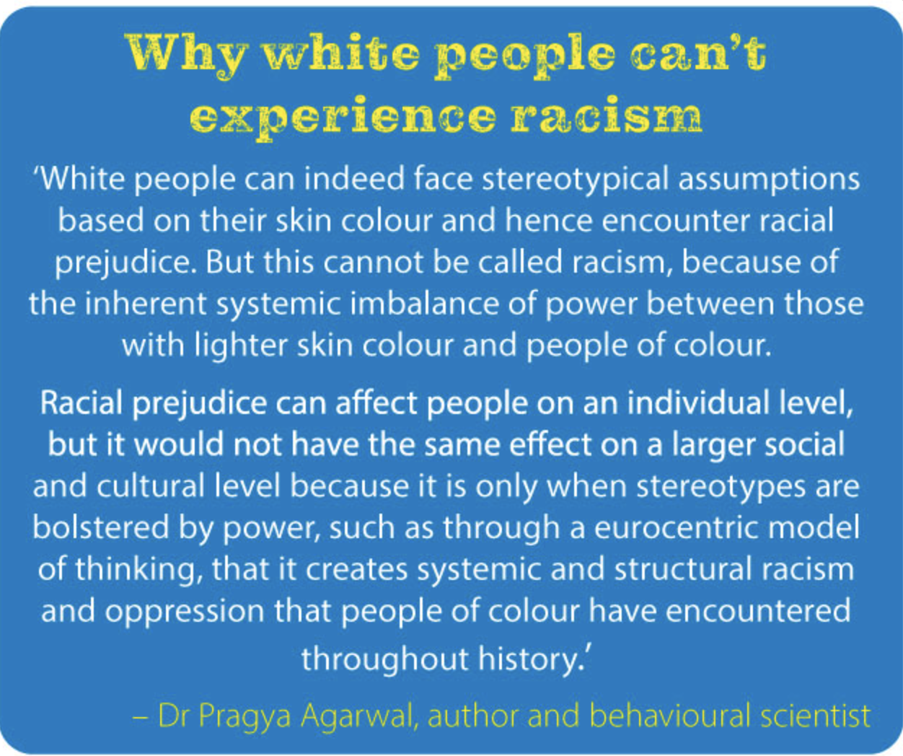
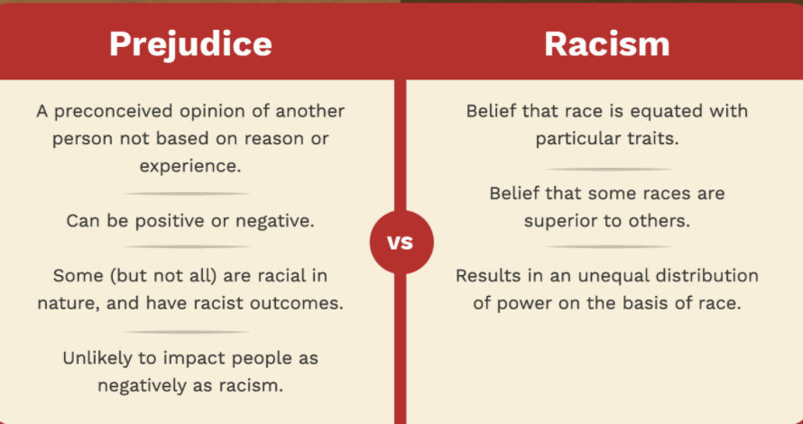
Prejudice? Racism?
Notes:
KATE

Slide 10
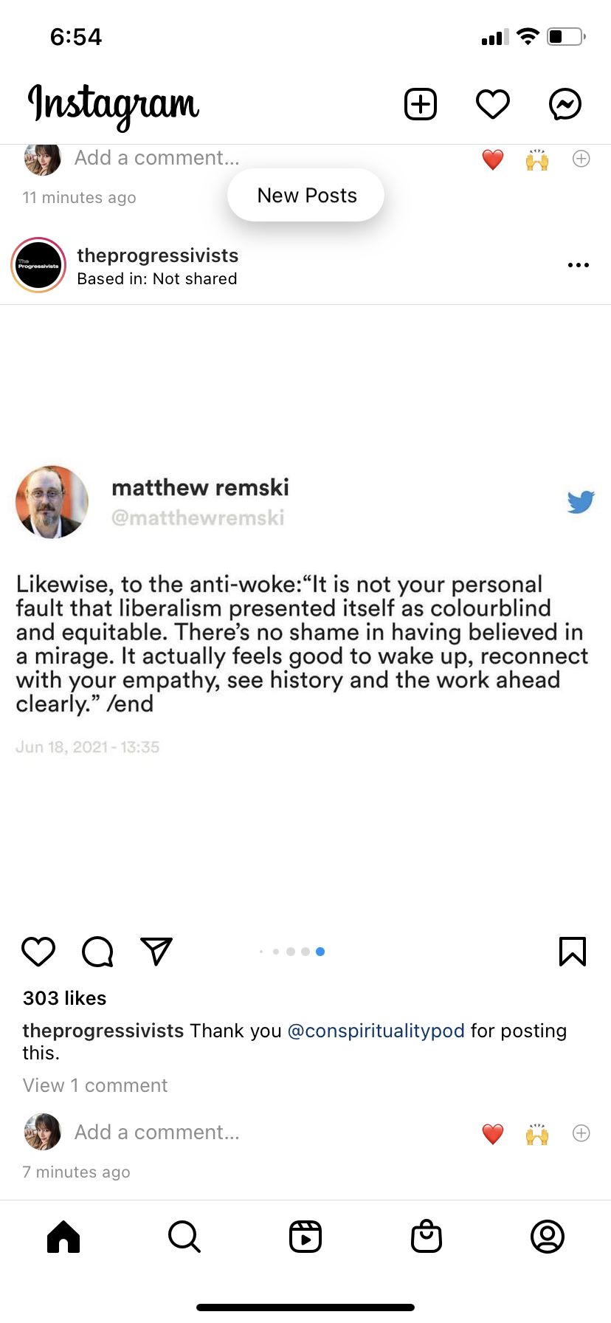
Notes:
KATE Admit that we all have racist tendiencies and that we benefit from the system (even if we didn’t contribute to it).

Slide 11
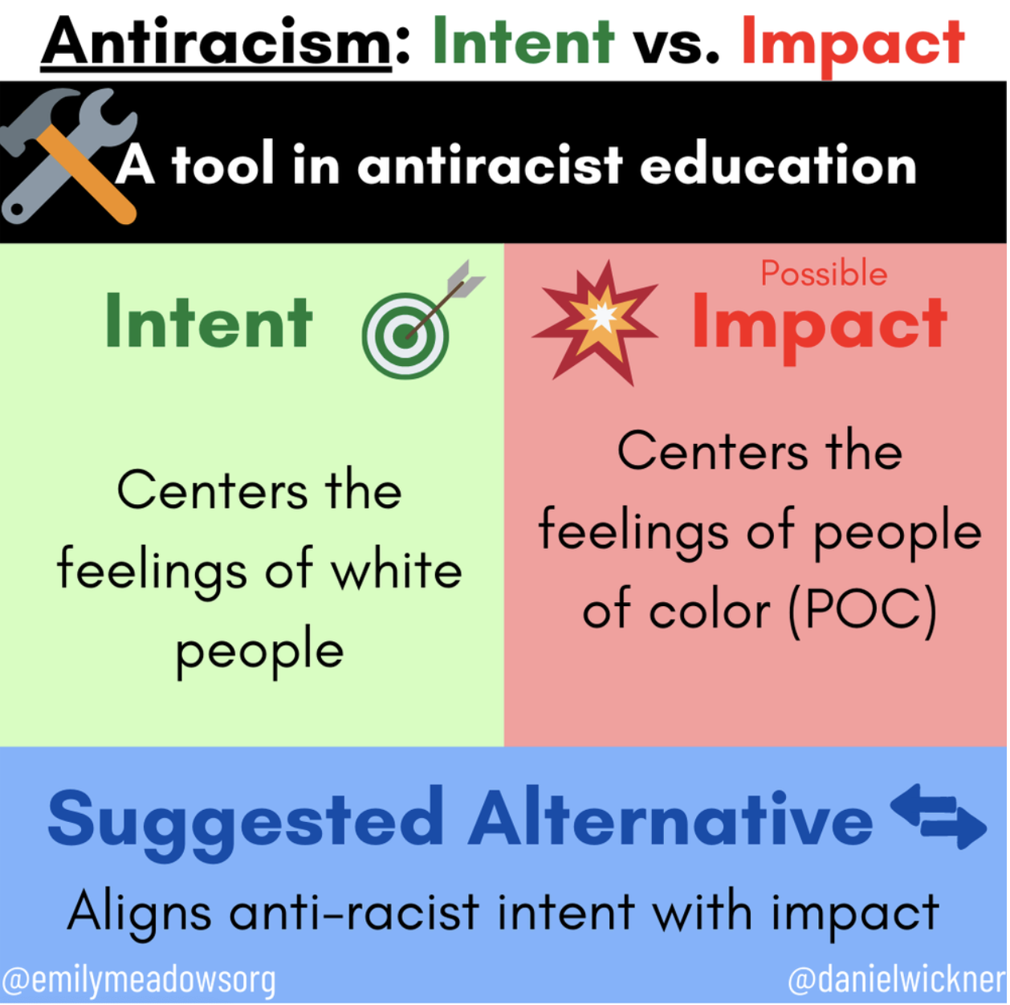
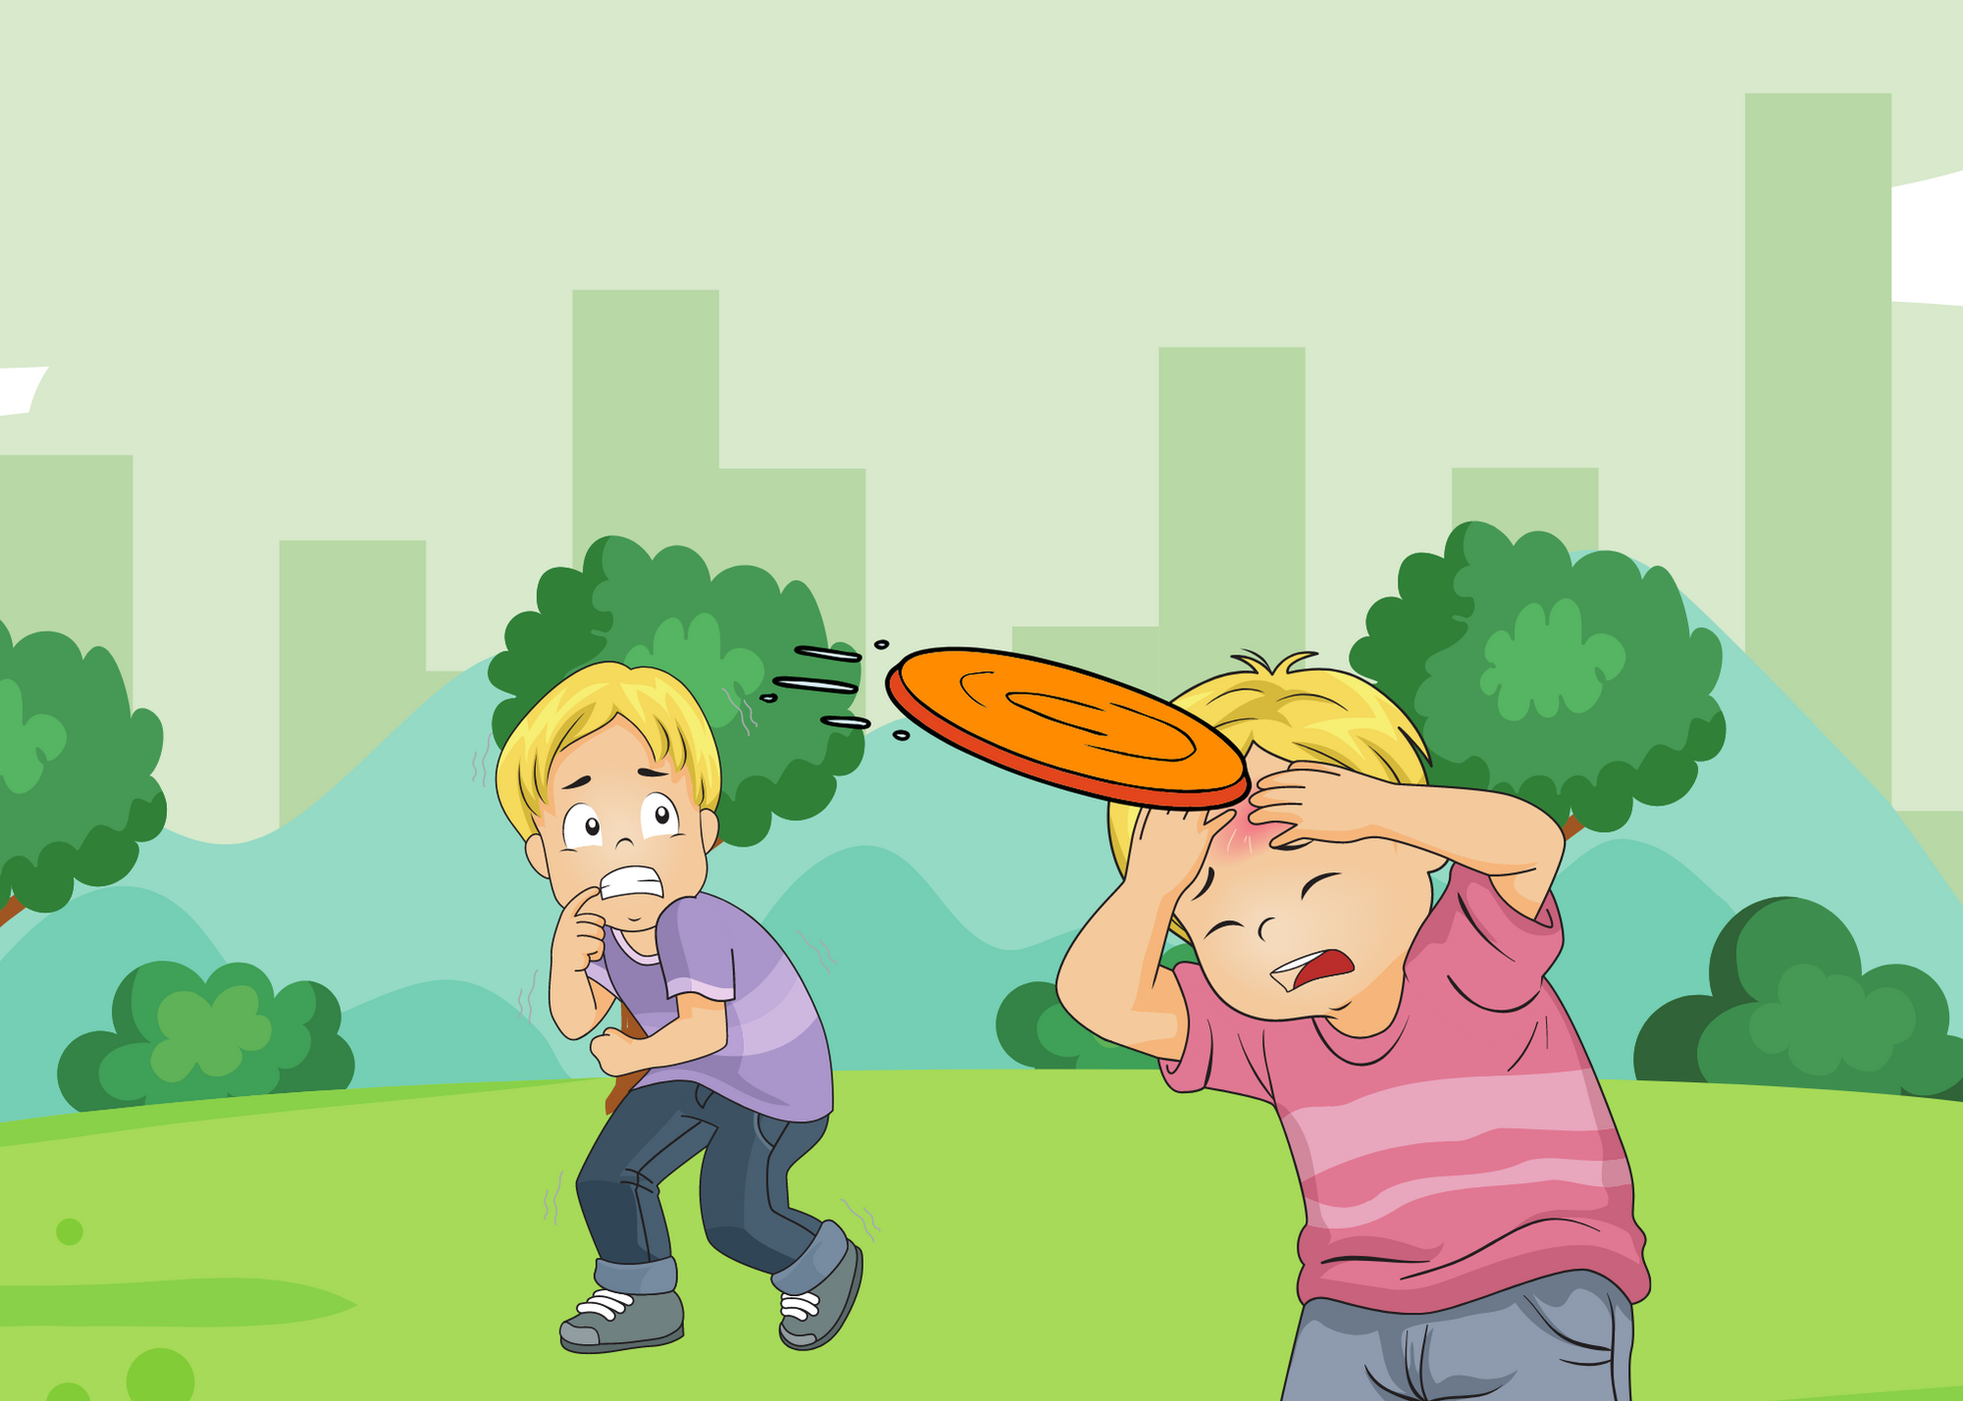
Notes:
Katein Face, return to book example in Arizona
(As we go through the rest of this webinar, and any future conversation we have here together, or you have your in your own life)
Multicultural lit anecdote from Kate (return)
Victoria’s section: lifting up themes as they surface

Slide 12
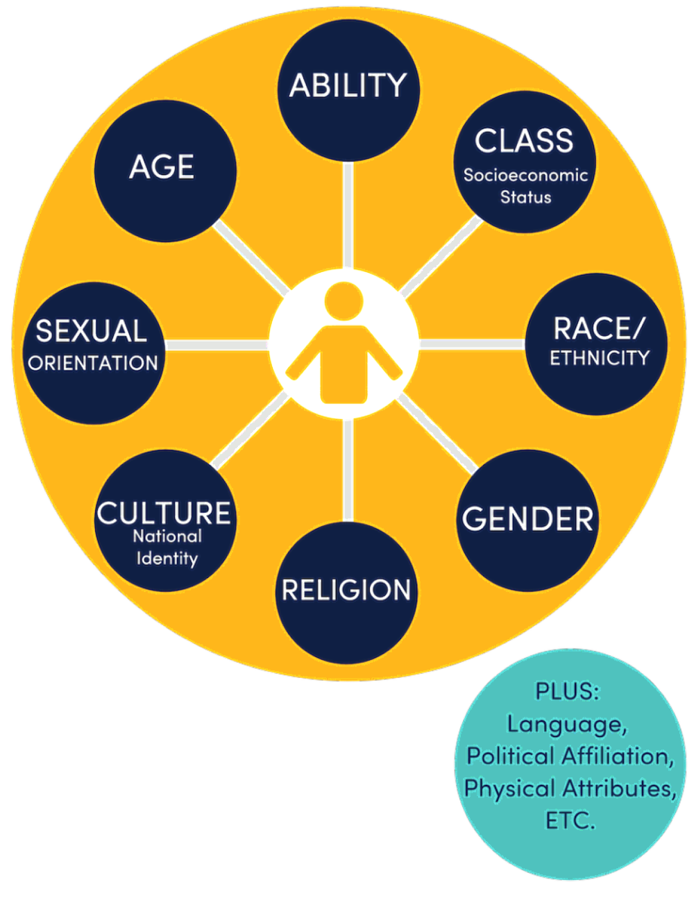
Dimensions of Identity:
Big 8
Notes:
Victoria

Slide 13
If a student asked you to define
whiteness
how would you answer?
Notes:
Anonymous Poll:

Slide 14
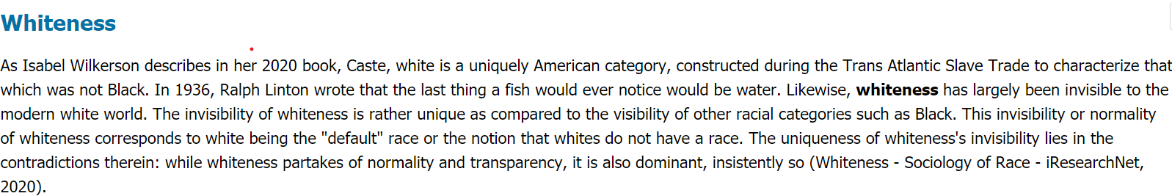
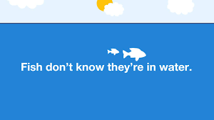
Notes:
The The definition of whiteness has changed over the years, even with regards to WHO is considered white in the U.S. as people immigrated from various countries in waves, or were brought here in the trans-Atlantic slave trade.
Prior to defining whiteness… there was a long hisotry white on white bodily trauma in Europe → indentured servitude → Those in power have always used a divide and conquer strategy to appease the poor and powerless. So when we think about the invention of race and whiteness in the U.S. the main historical point is the creation of the peasent class in the 1600/1700’s
Creation of Race and the Great Othering - Ariella Tilsen
One common enemy = those who are gaslighting us, our colleagues, our students, into thinking this isn’t an issue. They are propogating this divide-conquer strategy (with new iterations) that white male land-owners created to suppress the poor, of all races and creeds.

Slide 15
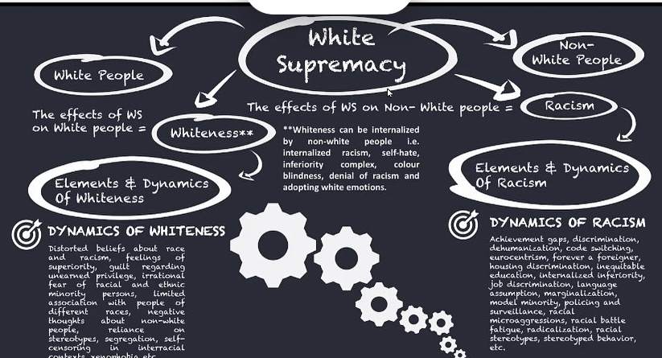
Language
Notes:
So when we talk about Whiteness, in the U.S.… we are often talking about the creation of white supremacy by our european immigrant ancestors in “The Great Othering”. and how that acts on us as “white folk” today.
What does this graphic raise for you?
My colleague is going to talk more about the dynamics of white supremacist culture but I want to point out…

Slide 16
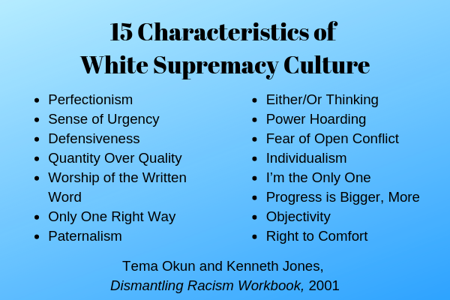

Slide 17


Slide 18
Reflect: How to the Dynamics of Whiteness show up in your life? at work?
Distorted beliefs about race and racism
feelings of superiority
guilt regarding unearned privilege
irrational fear of racial and ethnic minority persons
limited association with people of different races
reliance on stereotypes
segregation
self-censoring in interracial contexts
Notes:
Pause recording. You may sense your body tense up? or sense of anxiety? these are difficult feelings for us to reconcile with from a cognitive behavioral standpoint. So we need to get comfortable with these dynamics on our own… and practice them (give example of how it still shows up in my life) so we can strategize how to have these conversations with our white colleagues.
Kate is going to give us one example as we go through And that starts with intent and impact.

Slide 19
Know When You Go
A recording and consolidation of all resources (links and references) will be made available within 48 hours on our website aacte.org.
The next webinars in the Combating Racism in Ed Prep series will b:
  Justice and Joy, Sustaining Social Justice Work in Education for BIPOC Individuals. July 20th @ 2pm EST
  Legislating Oppression: What does the CRT Debate Mean for Ed Prep Next Fall? Date/Time: August TBD
We want to know what you think! Drop your feedback in a 1 minute survey: tinyurl.com/mmf3kj83
If you would like to provide more in depth feedback and/or engage with AACTE on this or other equity initiatives, please email Nicole Dunn at ndunn@aacte.org
Notes:
Social media handles
Next webinar

