Slide 1

COME JOIN US!
UNITED ADVANCED PRACTICE REGISTERED NURSES OF WEST GEORGIA
16th Annual Educational Conference
March 4, 2023
7a-5p EST
Piedmont Columbus Regional-Midtown Campus
  710 Center Street, Columbus, GA 31901
Registration Fee
Students/Retirees $75
UAPRN Members $100
Non-Members $150
Up to 7 CE units with Pharm credit hours
Breakfast, lunch and snacks provided.
Register at https://uaprnwg.enpnetwork.com

Slide 2
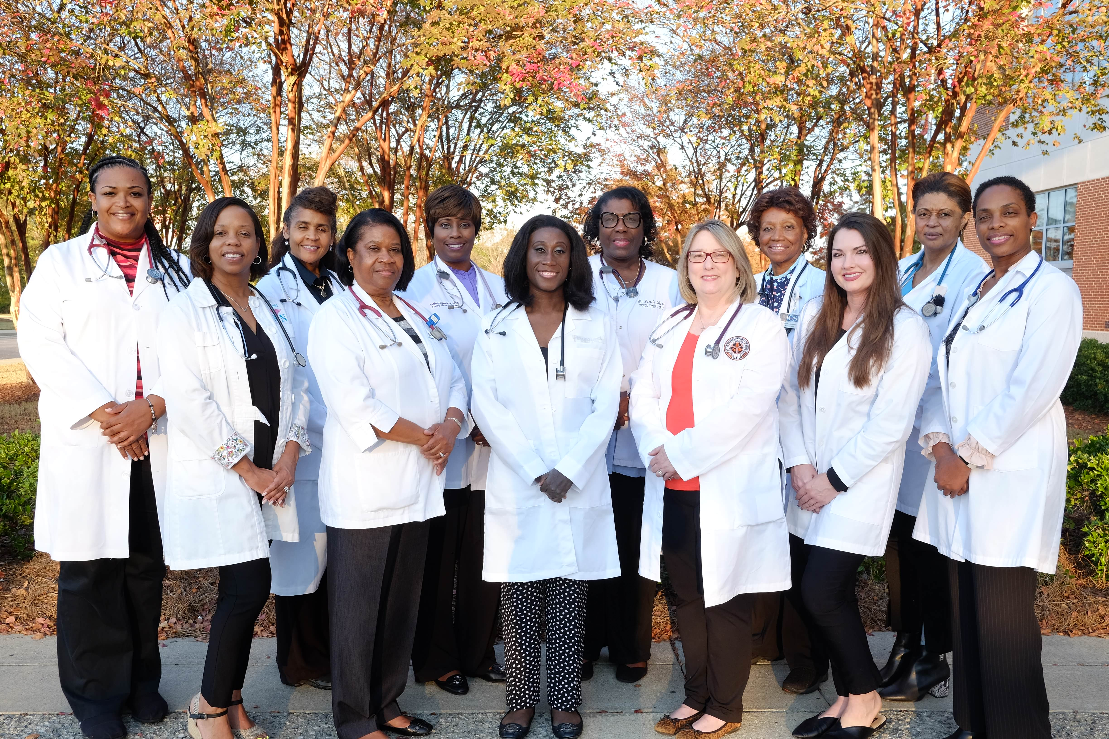
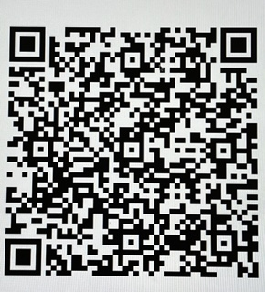
Proudly serving our communities and each other.
Join us for this wonderful event.
Registration QR Code

