Slide 1

AGEND
10:00 Call to Order - Co-Chairs Jean Aertker & Vernon Langford
10:05 Co-Chair Reports & Review of Final Days of Legislature and CH/SB 607 Bill Signing (SHORT PPT ZOOM)
10:25 Discuss Surgeon General Emergency Order: DOH No. 20-004 (PLEASE READ)
10:50 Impact of COVID-19 from APRNs groups - summarize & action requests (1-2 MIN EACH)
APNA, ANPB, ACNM,CFANPC, FACNS, FANA, FANNP, FLANP, FNA, FNPN, GAPNA, NAPNAP,
SFCAPN, TBAPNC
11:00 Lobbyist Reports: NCSBN, FANA, FNPN, FNA, (GROUP LEADERS - PLEASE SEND INVITES)
11:45 Review and Prepare Summer Legislative Educational Sessions of 2019 –
Appoint committee members
12:00- Wrap Up
2020 Report of Activity
April 2020 Meeting
Florida Coalition of Advanced Practice Nurses
A consortium of supporting organizations working together as one united voice for better healthcare
www.FLCAPN.enpnetwork.com

Slide 2
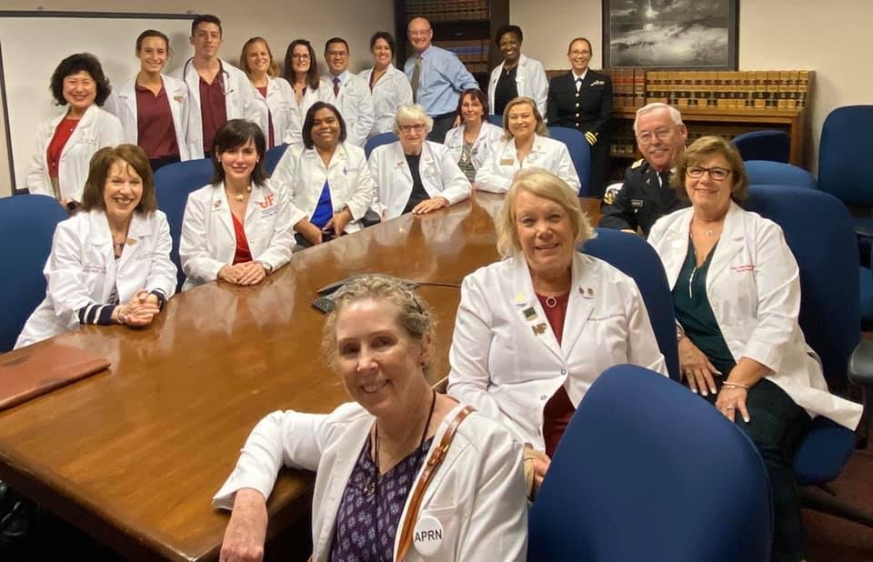
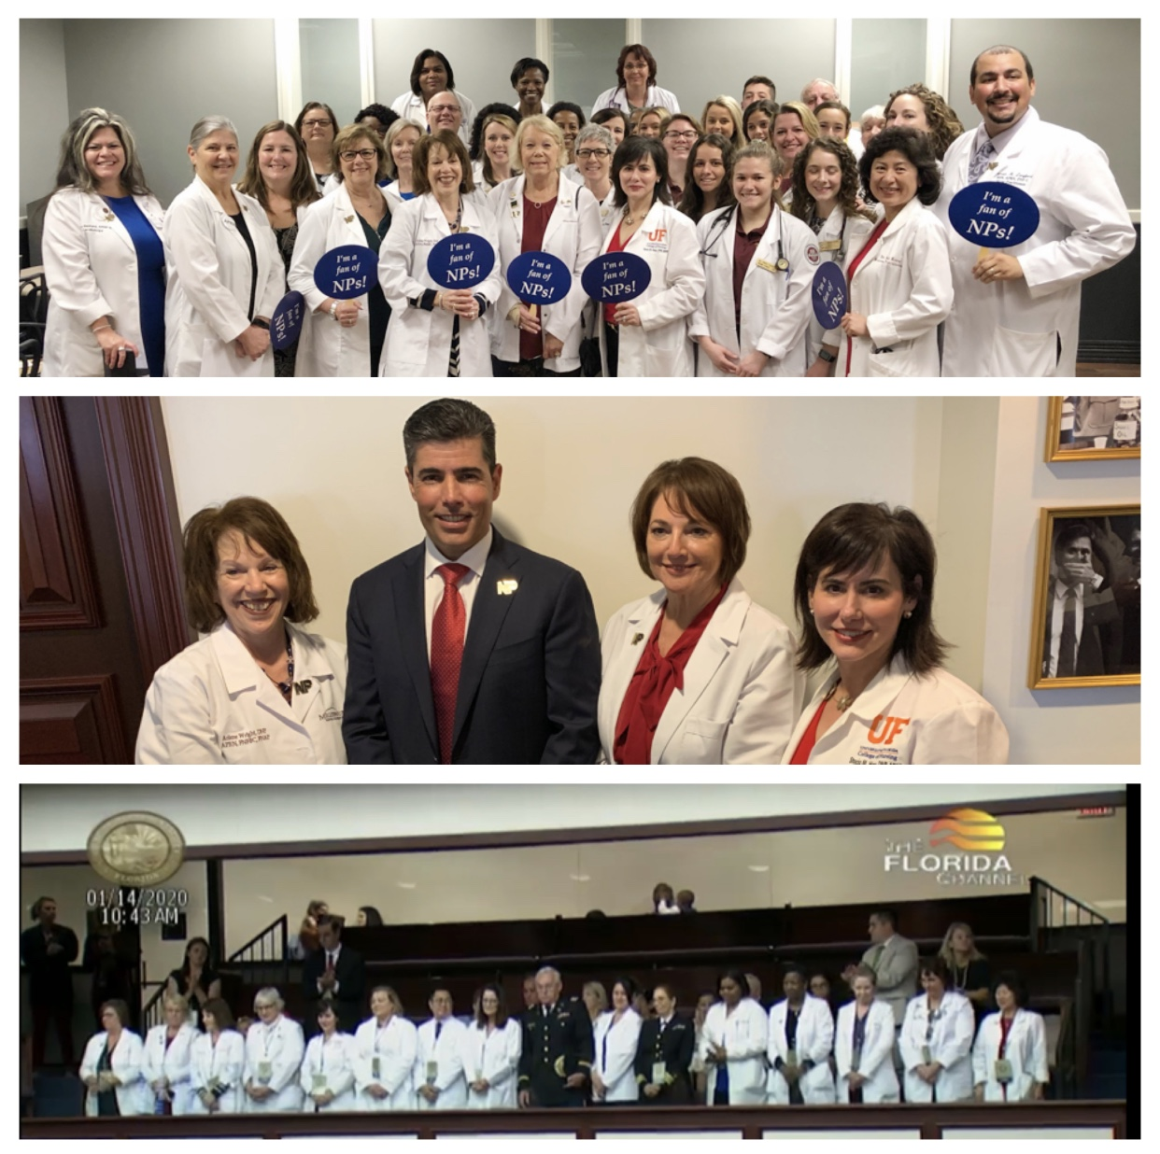
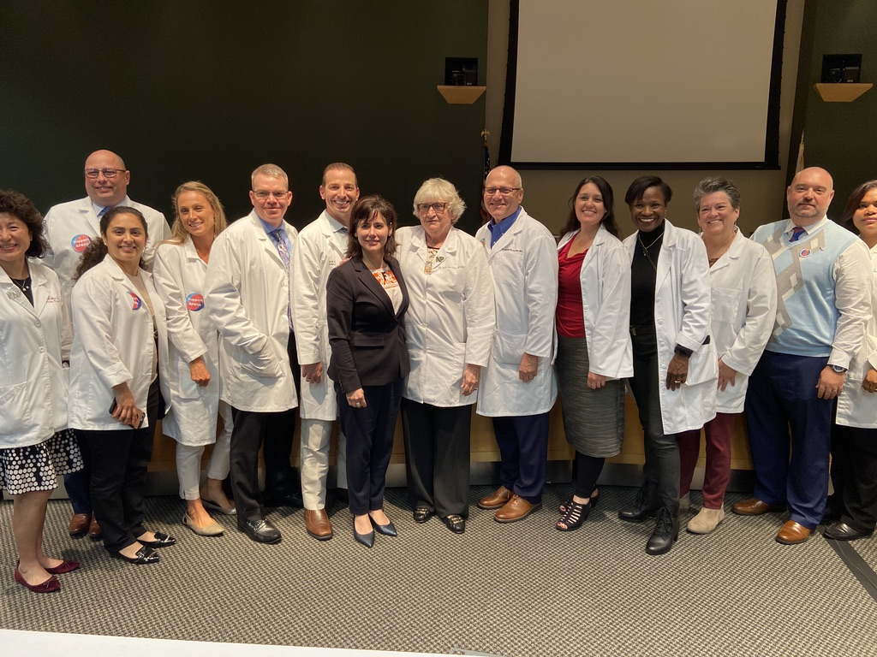
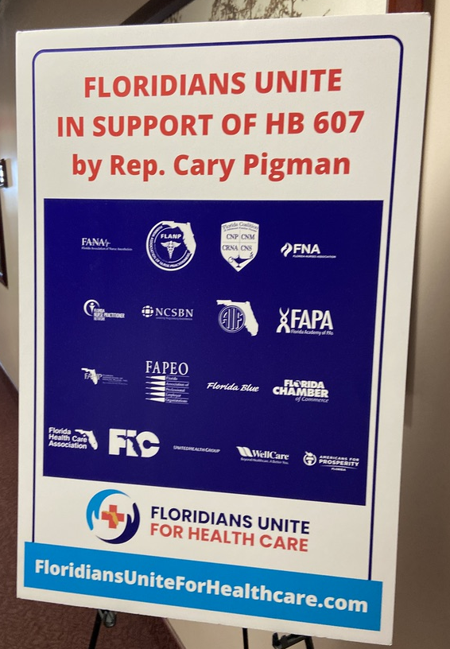
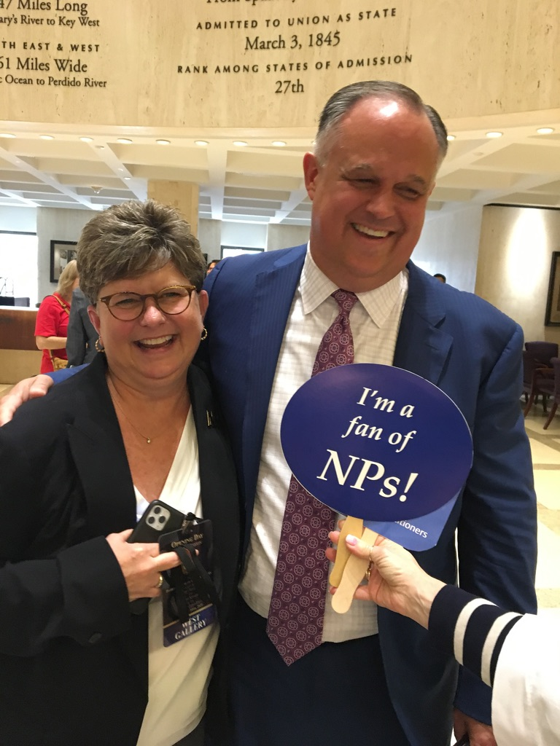
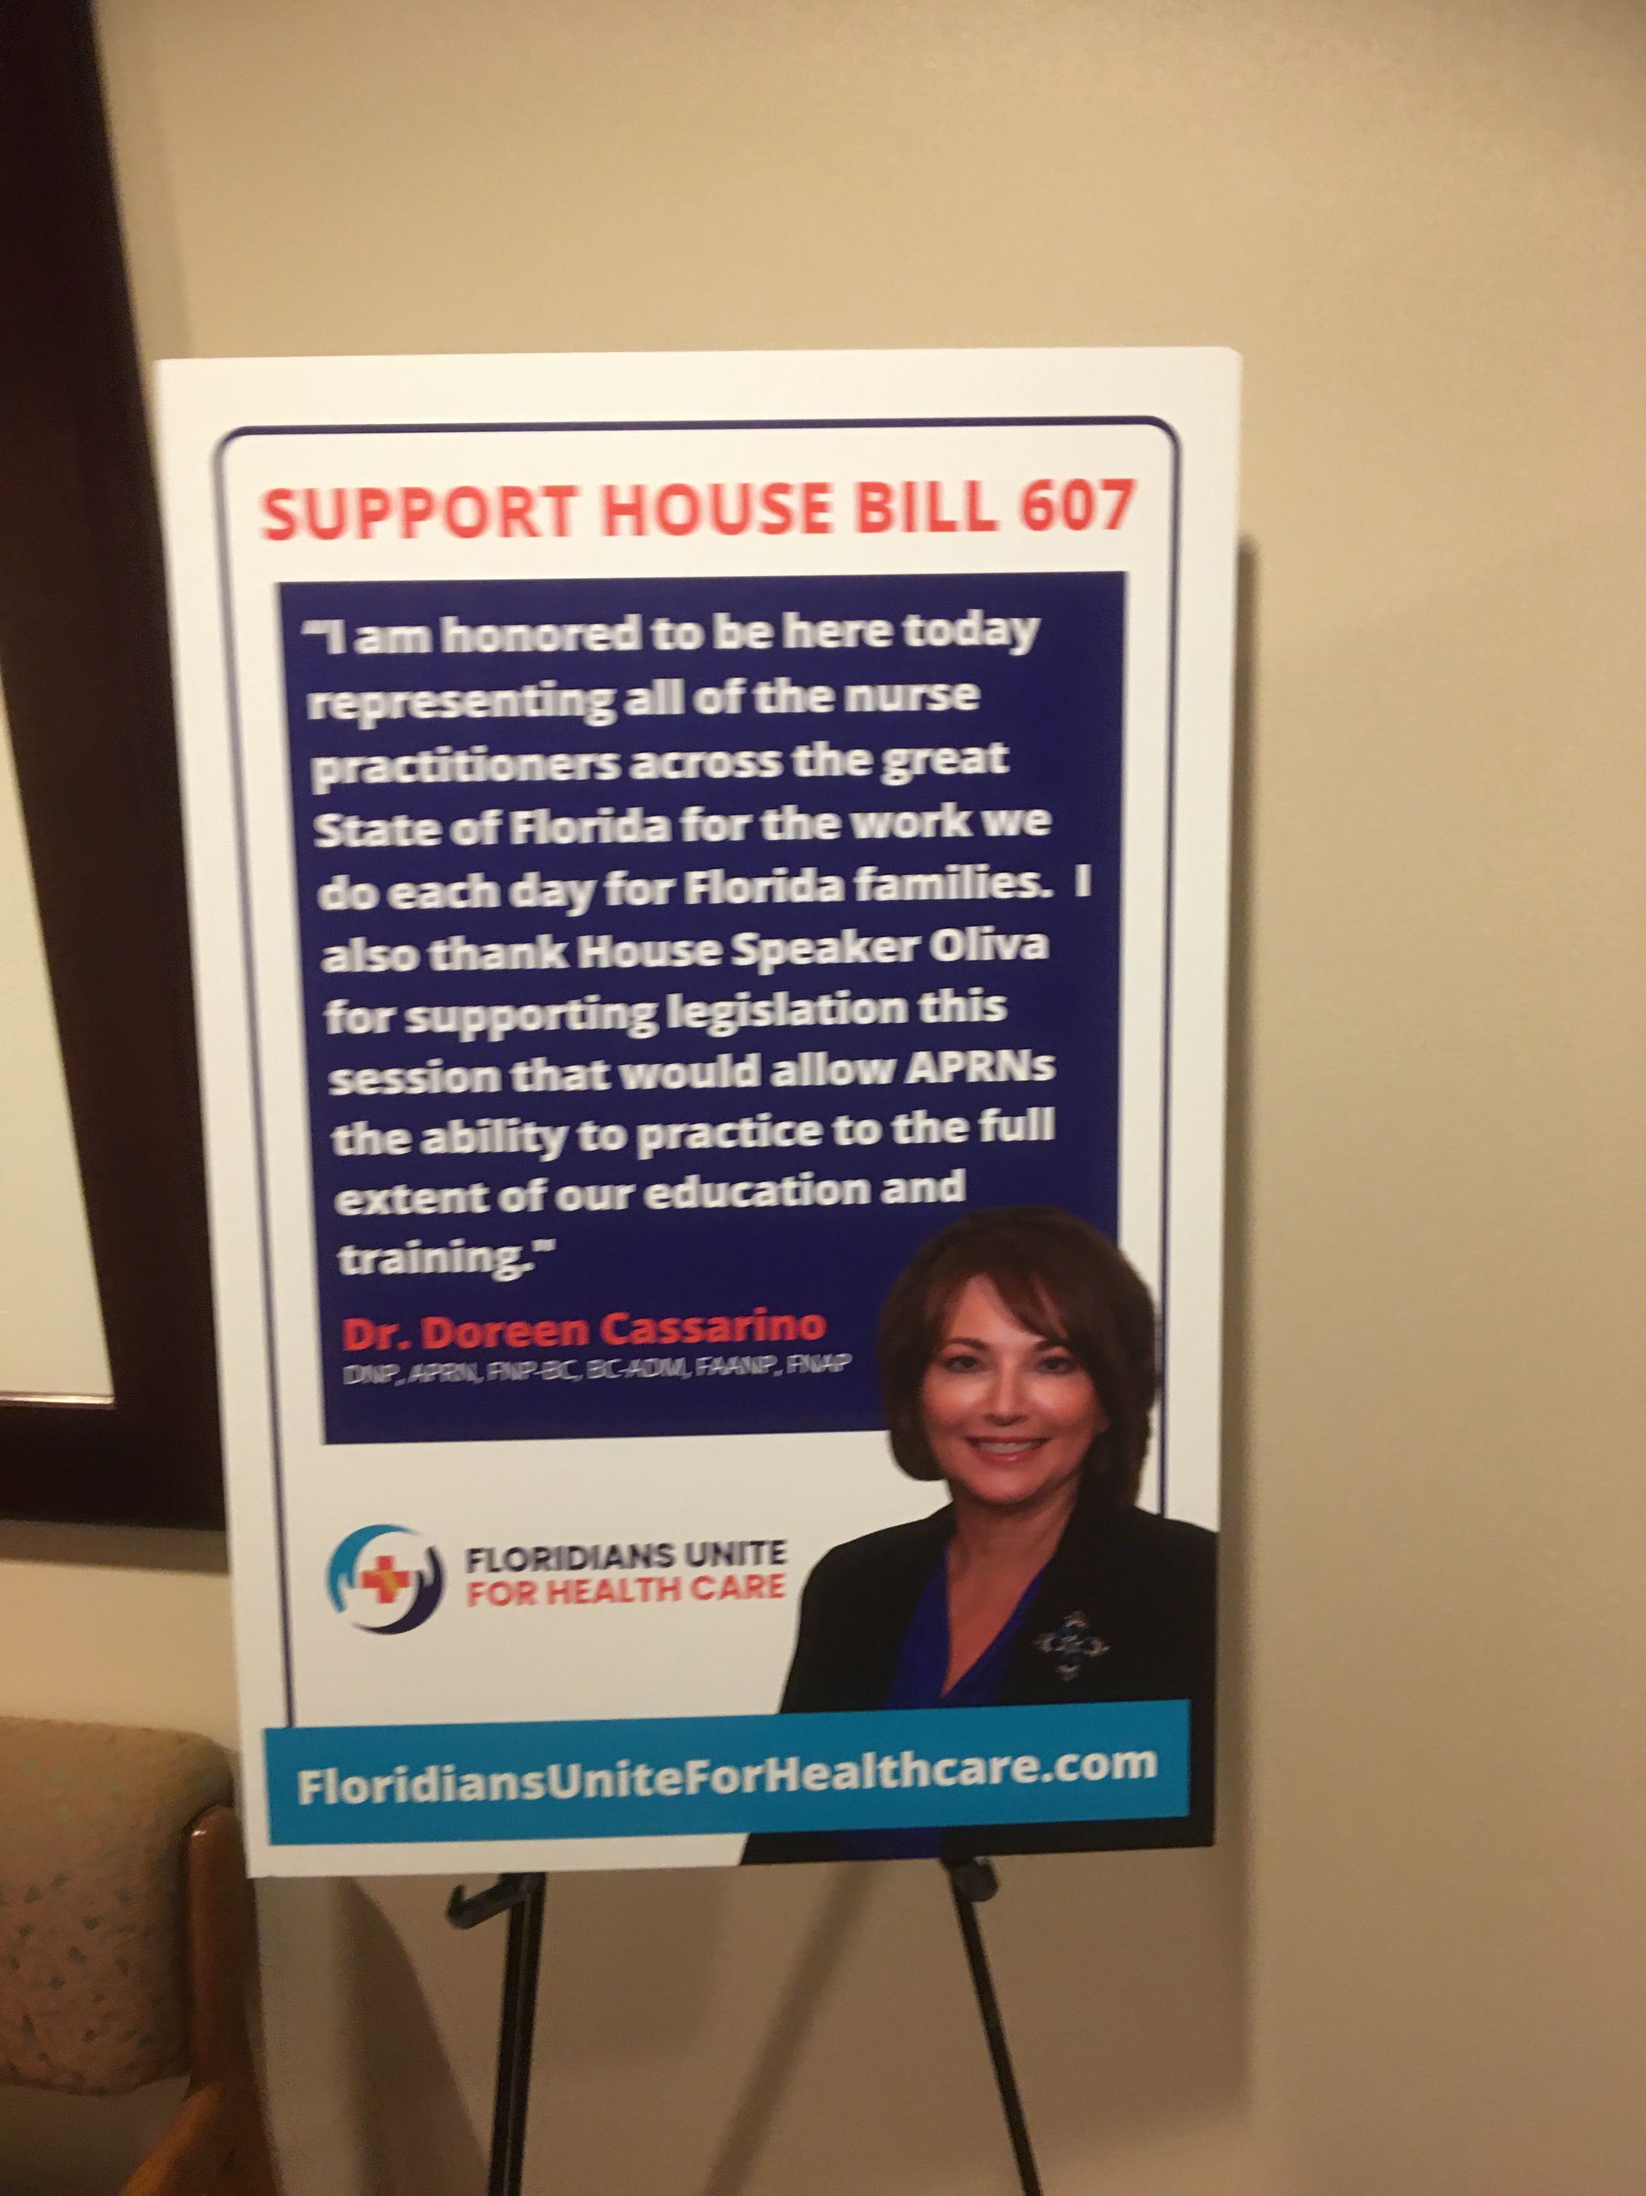
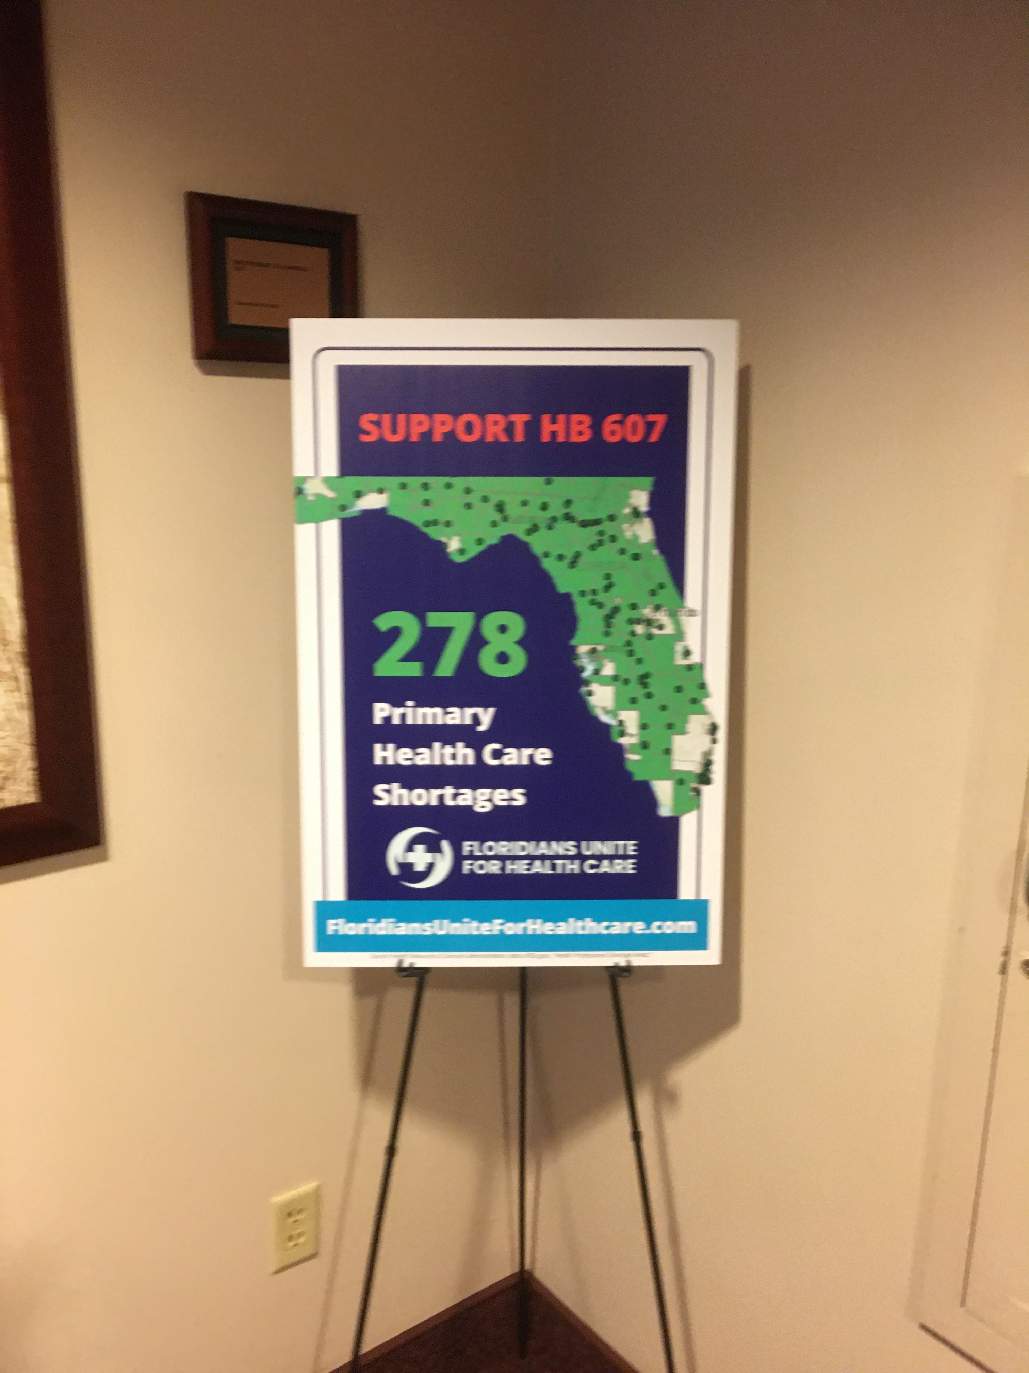
SUMMARY OF 2020 LEGISLATIVE SESSION
Notes:
Doreen Cassarino FNPN VP Legislation and AANP Region Director is Honored on Floor of House and Named NP of the Day for the Capitol Medical Clinic.
Meetign with Dr Rep Cary Pigman
NCSBN’s efforts strong and founded new Coalition Floridians United for Health Care

Slide 3
Speaker Oliva & Rep Pigman bring NPs to work in the Capital
CRNA DAYS JANUARY 27-28

Slide 4
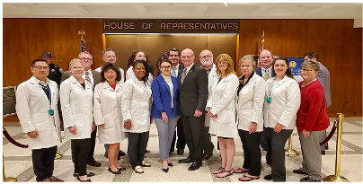
SIGNING CHB 607 MARCH 11, 2020
Speaker Oliva thanks Gov. DeSantis, President Galvano after Governor Signs APRN Bill Into Law
Notes:
Bill passed 107-8

Slide 5
COALITION ACTION DURING SESSION
ALL APRN GROUPS REPRESENTED IN TALLY DURING SESSION
SEVERAL FIRST TIMERS JOINED US
Letters to Governor & Key Legislators mailed & Emailed March 23
Thank you notes sent via email to all supporting Legislators
VOTING ON FINAL BILL 3/11/20:
  Senate- YEAS 30
    NAYS 10 {Baxley-12, Berman-31, Cruz-18, Farmer-34, Harrell-25, Hooper-16, Montford-3, Pizzo-38, Taddeo-40, Torres-15}
  House- YEAS 107
    NAYS 8 {Fernandez-114, Geller-100, Good-72, Gottlieb-98, Grall-54 , Massullo-34 Stark-104 , Valdes-62 (Not Voting 5)}
  “Lessons learned and practice changes”

Slide 6
U. S. Sen. Rick Scott Releases Daily Update on Coronavirus Growth Rate by
State and Florida County https://www.rickscott.senate.gov/sen-rick-scott-releases-daily-update-coronavirus-growth-rate-state-and-florida-county-2

Slide 7
4/3/2020 COVID STATE STATS
Confirmed COVID-19 Cases
State | 3/26/20 | 4/2/20 | Rolling 7-Day Growth Rate in Confirmed Cases (3/26-4/2) | Rank by Growth Rate (Highest=1st) | Change from Previous Ranking
Wyoming | 23 | 150 | 552% | 1 | ↑1
Idaho | 146 | 776 | 432% | 2 | ↓1
Puerto Rico | 64 | 316 | 394% | 3 | –
Indiana | 645 | 3038 | 371% | 4 | –
West Virginia | 52 | 216 | 315% | 5 | ↑1
Pennsylvania | 1795 | 7268 | 305% | 6 | ↑1
Maryland | 583 | 2331 | 300% | 7 | ↑1
Rhode Island | 165 | 657 | 298% | 8 | ↑3
Louisiana | 2304 | 9159 | 298% | 9 | ↑15
Florida | 2357 | 9008 | 282% | 10 | ↑3
IN MEMORIUM: ARACELI BUENDIA ILAGAN APRN, AGE 63,MIAMI
AND DR. HSU, AGE 67, INTERNAL MEDICINE IN MARGATE
Notes:
Today, Senator Rick Scott released an update on the growth rate of cases of the Coronavirus by state, and by county in Florida, as of April 3, 2020, according to Johns Hopkins Center for Systems Science and Engineering and Florida Department of Health data. Senator Scott is releasing this information daily to show which states are slowing the growth of Coronavirus. Please note: data provided from Johns Hopkins is compiled from federal data and may have discrepancies from latest state updates.
IN MEMORIMUN We lost a NP at Jackson Memorial Hosp Miami-
Araceli Buendia Ilagan, 63 YRS OLD who recently died from complications of COVID-19,” the hospital said in a prepared statement. “Araceli dedicated nearly 33 years of her life treating some of our most critically ill patients.”

