Slide 1
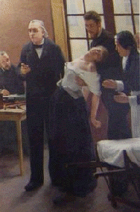
Neurologic Disease in the Arts
By Scot D. Hines, MD
ANMC
Coastal Neurology and Neurosurgery
Notes:
The man in the picture is Charcot, the founder of neurology. This is a detail from a painting where he’s lecturing to students. He is holding up an unresponsive womanwho has her arms twisted behind her. I ask for a diagnosis at this stage. The answer: hysteria. It’s impossible to casually hold up an unconscious person with one arm. About half of neurologic admissions then were for hysteria and conversion reactions. It was a time where there was rampant abuse, including sexual, and there were few socially acceptable outlets. One was medical. In fact, the neurology board is still formally, “The American Board of Psychiatry and Neurology” because of the overlap

Slide 2
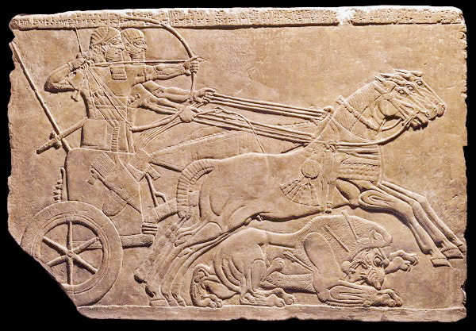
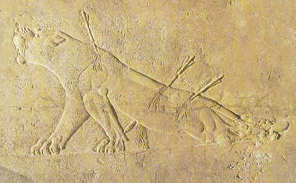
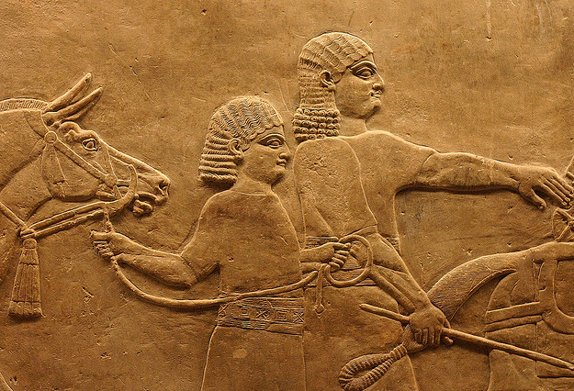
The Dying Lioness
Nineveh 645 BC British Museum
Notes:
Details from the British Museum of a lioness with a thoracic paraplegia. The etiology is obvious. To the left are the archers hunting lions. Below, holding the animals and looking on dissapprovigly are the first PETA protesters.

Slide 3
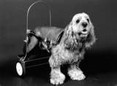
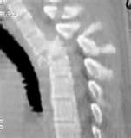
Differential Diagnois of Thoracic Paraplegia
7th century BC: Trauma; infections
21st century
1. trauma (MVA, GSW…)
2. Tumors (Metastatic, 1º)
3. Transverse myelitis
Notes:
Trauma and infection would be the causes of a paraplegia in ancient times. One of the leading sources of infection would have been Pott’s Disease: TB of the spine. In the twenty first century, infections are much less common, but trauma is still rampant, especially from high speed MVA. Tumors are common given the increased longevity. Most spinal tumors are in the thoracic spine (breast, prostate, etc) because simply the thoracic spine is the longest. Transverse myelitis could be infectious, autoimmune, or from MS. Another important cause of infectious parapegia is epidural abscess secondary to drug abuse.

Slide 4
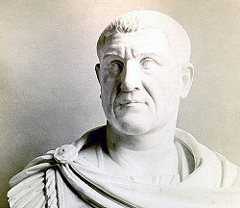
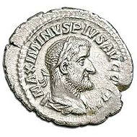
Maximinus II
Emperor of Rome 235-238 AD
Notes:
Maximinus II was the first of the “Barracks emperors”: He rose to the position from the military. A highly regarded general, he was also the biggest man in the Roman empire: ancient texts put him between 7’6 and 8’2. But when he became emperor, he developed paranoia and had some of his closest friends put to death. He had legendary banquet where he’d consume enormous quantities of food and drink, and by this time his hands were so big he wore his wife’s bracelet on his thumb like a ring. He was finally killed by his own Pretorian Guard. Note the leonid (lion-like) fascies and the jutting jaw and prominent brow…

Slide 5
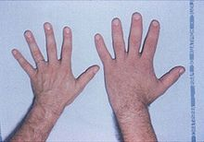
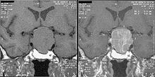
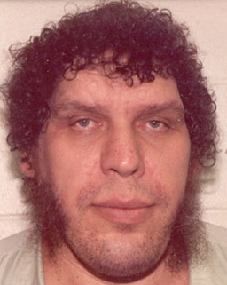

Acromegaly/Giganticism
Giganticism: Growth hormone hypersecretion before puberty
Acromegaly: Excess GH secretion after puberty
Notes:
A pituitary tumor secreting growth hormone (acidophils) will give giganticism before puberty and acromegaly afterwards: The growth plates have fused everywhere but the distal limbs and face, which continue to grow. If the tumor erodes into the hypothalamus there can be mental status changes and disorders of appetite. Did Maximinus II have acromegaly? Who knows. If we had his skull we could look for erosion in the sella, but it’s a good story for it. Examples of acromegalic giants are Andre the Giant (professional wrestler and in “The Princess Bride”) and Richard Keil (James Bond’s, “The Spy Who Loved Me” and others). The both died of cardiac disease, as do many acromegaic giants.

Slide 6
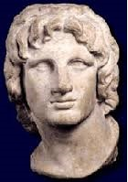
Alexander the Great 356-323 BC
Conqueror of his known world, he only let the sculptor Lysippos create his likeness
Physical attributes: Stocky, powerful, heterochromia, head was pulled slightly to the left and upward. (Plutarch claimed he was looking at the heavens)
When Augustus became the first Roman emperor, one of his first acts was to travel to Alexandria and gaze at the body of Alexander
He confirmed the identity by observing that the head was twisted to the left
Notes:
Some medical authorities theorize that Alexander had scoliosis; this is unlikely, since only his head was pulled to the left. When Augustus became the first emperor of Rome, he immediately made a pilgrimage to Alexandria, Egypt to gaze upon the preserved body of Alexander the Great. Removing the crystal lid, he confirmed the identity by making sure the head was pulled to one side. Then, awestruck, he reached out to touch the great conqueror’s face…and broke off his nose!

Slide 7
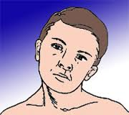
Torticollis
“Twisted neck” in Latin
The head is persistently pulled to one side
Usually with prominent opposite SCM
Idiopathic or associated with cervical pathology
Rx: Botox
Notes:
Almost certainly, Alexander had a form of torticollis. Often idiopathic, it is sometimes associated with underlying spinal pathology. One ancient source claims it occurred after a spear thrust to the shoulder. It might have frequent jerking associated with it called “spasmodic torticollis”. Injecting the ipsilateral splenus capitus muscles (back of the neck) and ipisilteral SCM with botox will lesson the symptoms.

Slide 8
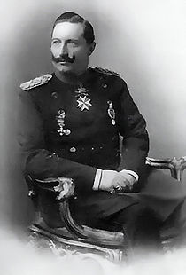
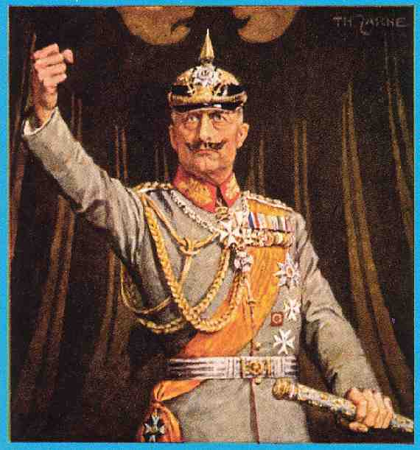
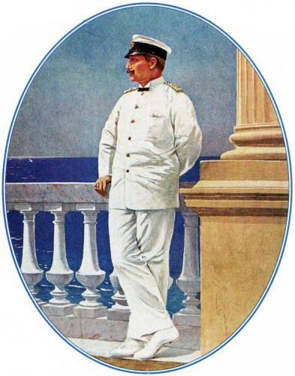
Kaiser Wilhelm II
1859-1951
Notes:
Kaiser Wilhelm II was the militaristic force in Prussia that led to the formation of Germany. As a result of a traumatic breech birth, his left arm was left withered. Some claim that this disability led to emotional disturbances, and he compensated for this weakness by making Germany stronger, leading to WWI. Note that the painters and photographers would hide his injury by having his hand behind him or grasping something.

Slide 9

Erb’s Palsy (Erb-Duchenne)
Usually birth related (shoulder dystocia)
Upper plexus (C5/6) usually involved
Atrophy of deltoid, biceps, brachioradialis
“Porter’s tip” positioning
Stalin? Queen Victoria? Martin Sheen
Notes:
Erb’s Palsy is usually associated with a breech delivery or shoulder dystocia injuring the upper brachial plexus. The affected limb will twist around backwards with the hand partially open in the “porter’s tip” position. Martin Sheen had a mild Erb’s Palsy. In some scenes you may note him putting on his coat raising it on the right, but unable to do so with his weaker left side. Stalin and Queen Victoria were hypothesized to have the affliction as well, but that is unclear.

Slide 10
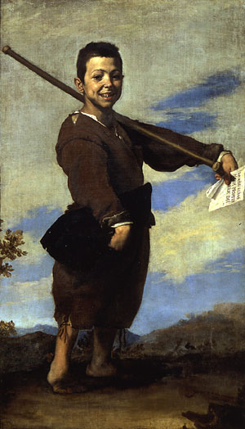
Jose Ribera
The Clubfoot 1642 (Louve)
Notes:
“The Clubfoot” by Jose Ribera hangs in the Louvre. His right foot is indeed abnormal, but if you note, it is simply shortened. He is standing on his toes, and his right arm is still to his side as well: a spastic hemiparesis on the right. And he is aphasic! How do we know from a painting? Because he is holding a note that says in Latin, “Please give me alms for the love of God.” So instead of a clubfoot, he has a right hemiparesis and aphasia: a classic left middle cerebral artery distribution injury. And it occurred in early childhood, not at birth. How do we know? If it were at birth or before language was established, he’d have used the right hemisphere for language. And there is atrophy/shortening of the limbs on the right, so it happened during growth rather than adulthood. Possibly at 3-5 years of age.

Slide 11
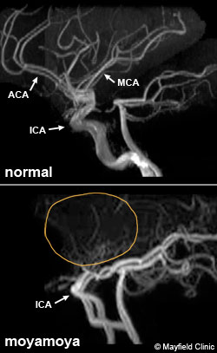
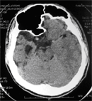
Childhood Stroke
17th century Europe: Infectious most prevalent (meningoencephalitis)
21st century: Congenital heart disease, hematologic (sickle cell, coagulopathy), vascular (moya moya, Kawasaki)
Notes:
Far and away, the most likely etiology in the 1600’s would have been a bacterial meningoencephalitis and subsequent stroke. Meningiococcus is a likely culprit, or possibly H. Flu. In the 21st century infectious causes are less likely, and a childhood stroke is more likely to result from underlying heart disease or congenital vascular malformations such as moya moya disease.

Slide 12
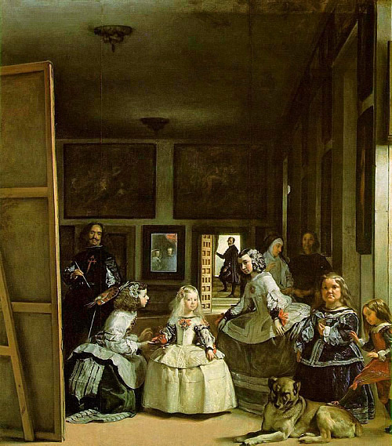
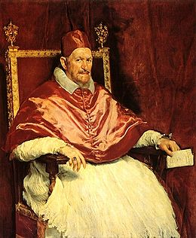
Diego Velazquez, 1656
The Maids of Honor
Phillip IV
Notes:
Diego Velaquez was the leading painter of his day and the court painter of Phillip IV of spain. One of his most famous works is “The Maids of Honor”. A very unusual painting, it shows the painter himself with a sly grin, the king and queen dimly reflected in the mirror, and the princess almost eclipsed by the dog. Her “maids of honor” are acondroplastic dwarfs. It was a fad at the time for the nobility to use them as staff for their children. To the right is another painting Velazuez did of the Pope. But instead of a majestic pose, he’s painted slumped in his chair and appearing much as a common man. His contemporaries were aghast…it was the time of the inquisition, and they were sure the painter had gone too far and would end up on the rack. Instead, the Pope loved the painting and placed it behind his desk in his study

Slide 13

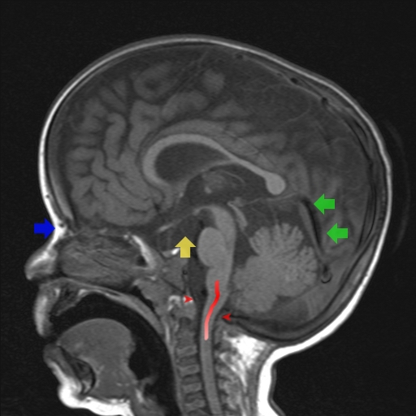

Achondroplasia
Dwarfism
Spinal Stenosis (adult)
Upper airway obstruction/sleep apnea (children)
Foramen magnum stenosis: pain, ataxia, swallowing trouble, poor head control
Notes:
Achondroplastic dwarfs often have lower brainstem difficulty at birth from crowding at the foramen magnum and may require a surgical correction. As adults, they are prone to develop lumbar spinal stenosis. Dachshunds are canine achondroplasts (note the long torso and short limbs) and can also develop lumbar stenosis

Slide 14
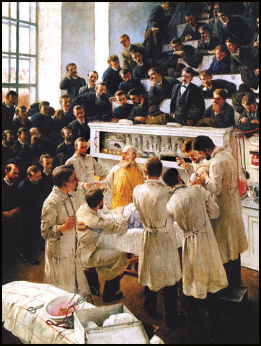
Adalbert Franz Seligmann
Theodor Billroth, 1890
Notes:
Billroth is pictured here in surgery. Though better known for his GI surgeries, he is doing a surgery here for trigeminal neuralgia. Note the open air operating room, lack of gloves. The anesthesia would be chloroform dripped down on a paper cone covering the patient’s face.

Slide 15
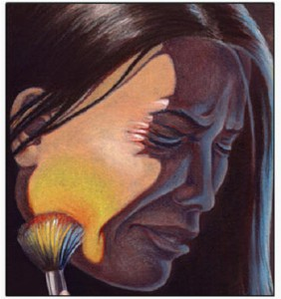
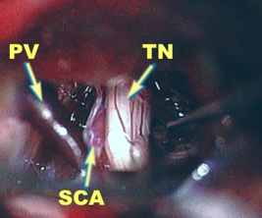
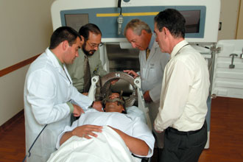
Trigeminal Neuralgia
Medical management: Anticonvulsants (carbamazepine, oxcarbazine, valproate…)
Surgical: Posterior fossa decompression (superior cerebellar artery/trigeminal rootlet); radiofrequency rhizotomy
Radiosurgery
Notes:
Trigeminal neuralgia is an extremely painful affliction affecting the V1, V2 or V3 dermatome. It’s usually from the mechanical compression of the superior cerebellar artery against the trigeminal nerve rootlet. Surgically, the two structures can be separated out (as Billroth was doing), but now radiosurgery or rhizotomy are options in the event of medication failure.

Slide 16
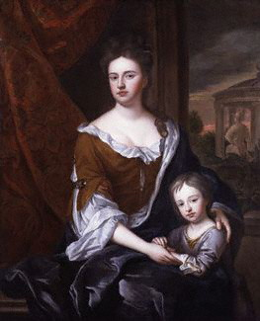
Queen Anne and Prince William
Sir Godfrey Kneller; 1684
Notes:
Queen Anne was the last of the House of Stewart. She had 11 pregnancies, but the only child who survived the neonatal period was Prince William. He suffered a devastating febrile illness at a year and a half, and thereafter suffered developmental delay and seizures. He didn’t walk and talk until between 4 and 6 years of age and court records recount that this head was “very much bigger than that of a man’s”. This is the only painting that included William, and shows a rather large, bulbous head as one might see in an arrested hydrocephalus. William died at 11 years of age, and the throne passed to the Hanovers, and eventually to George III. So the history of the world was changed for want of a shunt.

Slide 17
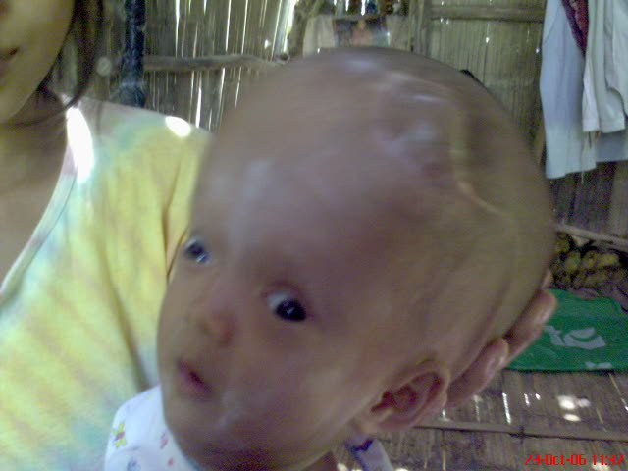
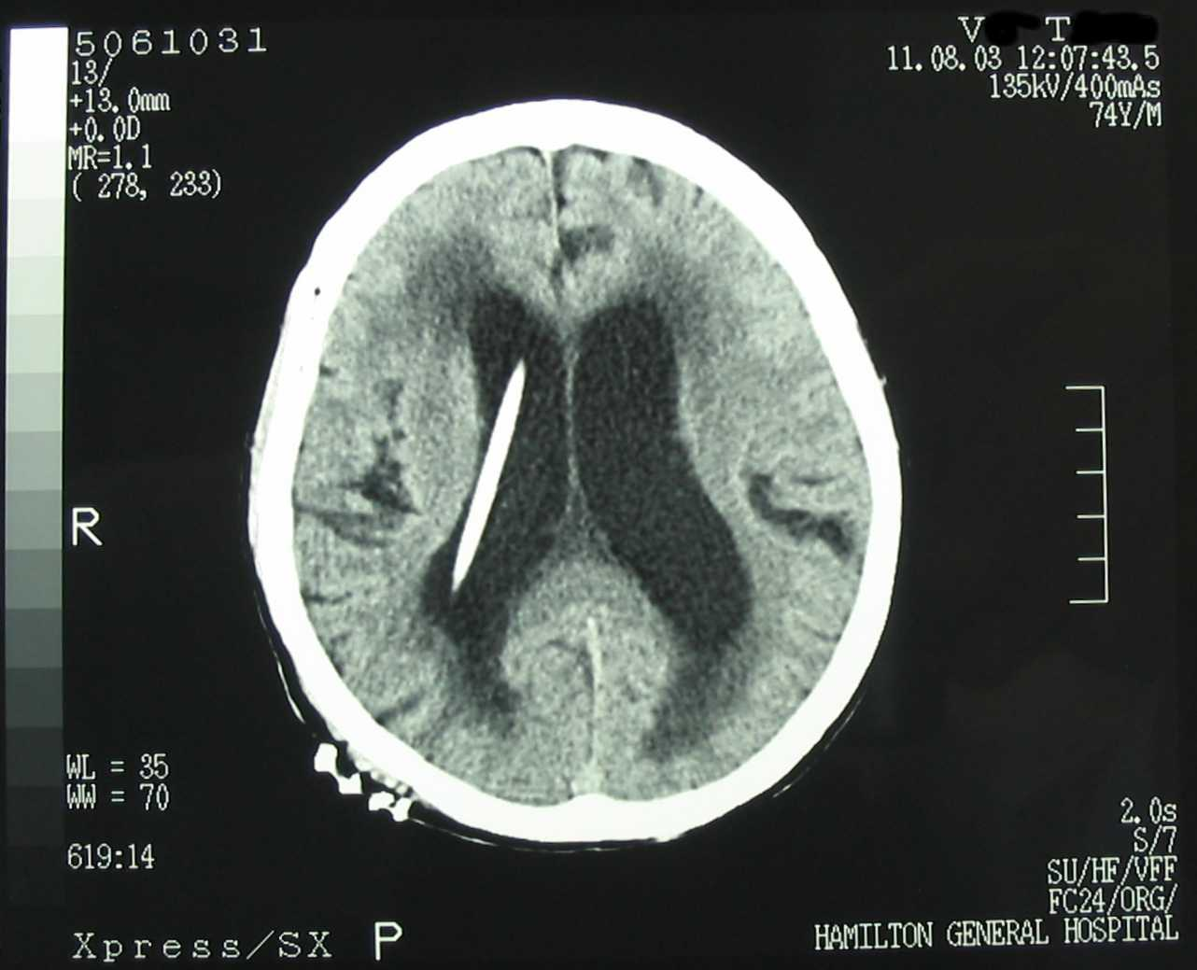
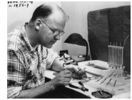
Meningitis and Hydrocephalus
Most common causes of meningitis in young children pre-antibiotics:
-postbirth: Group B Strep, E. Coli, Listeria
-after one month: Pneumococcus, N. Meningidis, H. Flu
John Holter: Improved Spitz valve (ball and spring) using a silicon one-way valve in 1956: The Spitz-Holter valve
Notes:
Clearly infections (meningitis) would have been the dominant cause of hydrocephalus in Prince William’s day. Today, it is most often premature births and hemorrhage from the fragile germinal matrix into the ventricular system, though infections still play a role. The first modern/successful shunting was the Spitz-Holter valve. John Holter was a Yale Locksmith, and his son, who had hydrocephalus, died after unsuccessful shunting and seizures. Knowing that the shunts then failed because of lack of flow control, he invented (in his garage) an effective one-way valve that is still used in shunts today, saving tens of thousands of lives and letting hundreds of thousands more develop normally.

Slide 18
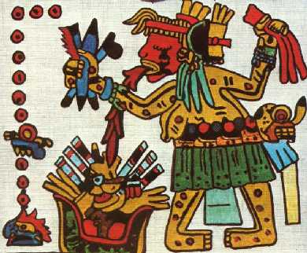
Aztec goddess Tlazolteotl
Florentine Codex, mid 16th century
Notes:
This is the Aztec goddess of Epilepsy. Note the postical foaming going from her to the epileptic. After the Spanish conquest of the Aztecs, some priests asked the Aztec priests to recreate their pantheon of gods and their science, which they hid. At the time, the works would have been considered heretical. They were called “codexes”

Slide 19
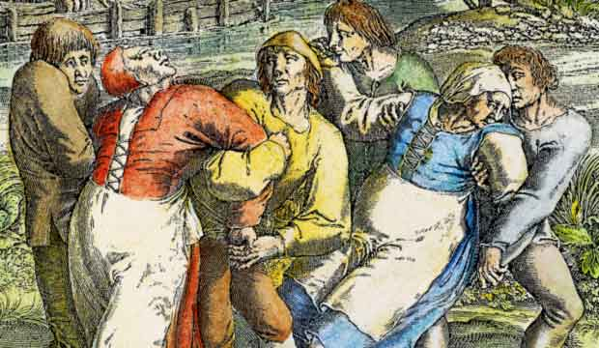

Etiology of Epilepsy:
Precombian Aztecs: Originates from the Gods
Western theory: Originates from the Gods
Scientific Era: Victorian England
-A consequence of masturbation or ‘sexual excitement’ (1857, Charles Locock, Queen Victoria’s physician); bromides used until phenobarbital developed in 1912
Notes:
In ancient times, epilepsy was believed to be an affliction of the gods. But in scientific Victorian Great Britain, Charles Locock knew that since epilepsy was a consequence of excessive masturbation, substances that inhibited erection should be potent anticonvulsants. So Locock prescribed bromides. And guess what…they worked! Bromides were first line anticonvulsants until 1912, and are still used today, though primarily in Europe and in veterinary medicine.

Slide 20
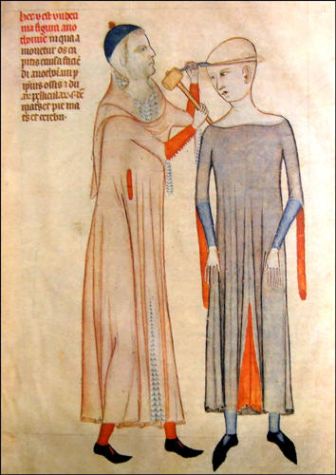
Trephination, Guido of Vigevano (1345)
Notes:
Trephination, opening the skull, was done in medieval Europe for a variety of reasons which probably included migraine headaches and madness. I hope they didn’t have the patient standing and alert!

Slide 21
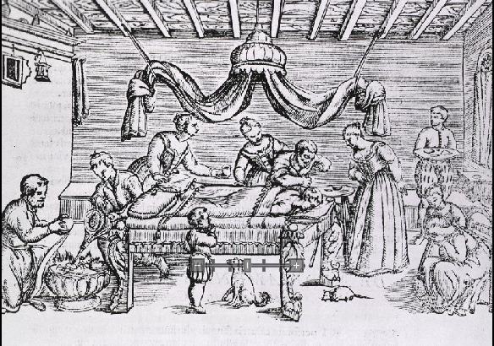
Trephination 1573 (Giovanni Croche)
Notes:
Two hundred years later, not much better. Though the patient is flat, there are rats and other animals running around

Slide 22
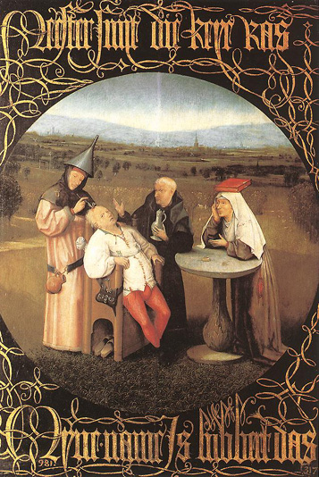
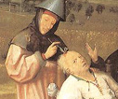
The Stone of Madness
Hieronymus Bosch c. 1478 Prado, Madrid
Notes:
Charlatans and quacks used trephination. They would make a sham incision on the scalp of an insane or demented person, palm a rock, and announce the patient cured, then leave town. This is the origin of the phrase “he must have rocks in his head.” This painting by Bosch shows the sham procedure. The quack has an inverted funnel on his head, an allegory for the fact that knowledge flows from God above, so this sinner can’t avail himself of heaven’s grace. The inverted funnel is the forerunner of the dunce’s cap. His accomplice has a book on her head, also demonstrating that knowledge is all around, but can’t be seen or used by these sinners. Far in the background is the gallows, suggesting what’s in store for the duo.

Slide 23
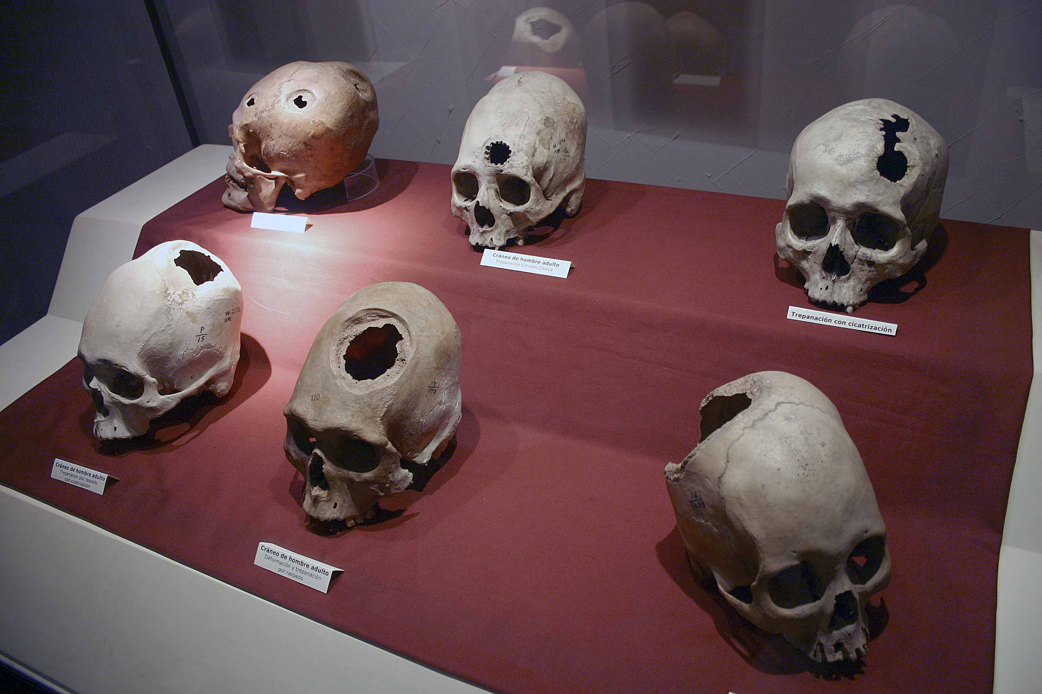
Notes:
Meanwhile, the Incas were doing fine trephonation for the right reasons. They knew to operate ipsilateral to the blown pupil following trauma, or contralateral to the paresis. Likely they used coca extract for anesthesia. Using stone tools, many of these patients lived for decades afterwards, judging by the remodeling of bone.

Slide 24
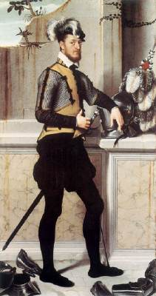

Moroni, Knight with his Jousting Helmet c. 1558; Natn’l Gallery of Art, London
Notes:
This knight has a makeshift device for his left foot drop: note the cord tied below the knee that is attached to the front of his foot.

Slide 25
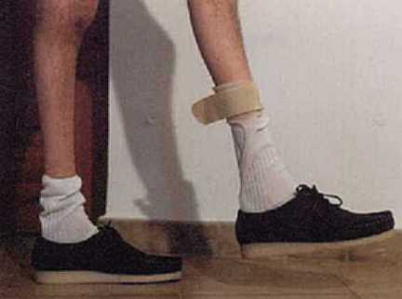
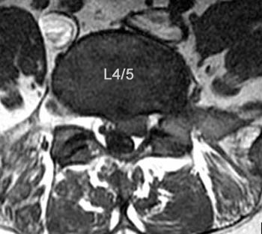
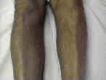
Foot Drop: Etiology
Peroneal neuropathy
-compressive
-hereditary (CMT)
Lumbar radiculopathy
-L5
-Often part of spinal stenosis
Notes:
CMT is a common hereditary cause of foot drop, but most are acquired: either peroneal nerve palsy, or more likely, an L5 radiculopathy. The MRI shows a lateral disc at L4/5 and the pic shows atrophy of the anterior compartment of the left leg

Slide 26
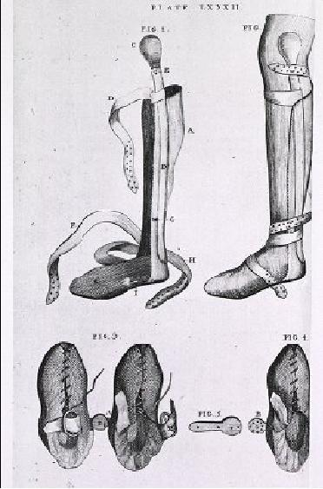
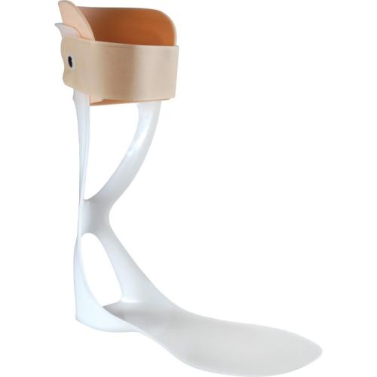
Benjamin Bell, 1791
Notes:
Benjamin Bell was a revolutionary war physician who patented the first AFO brace

Slide 27
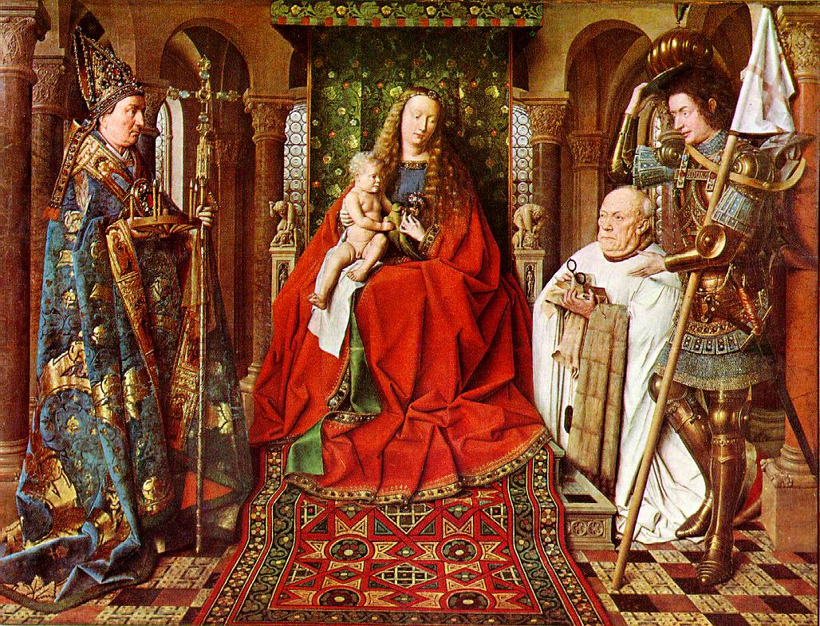
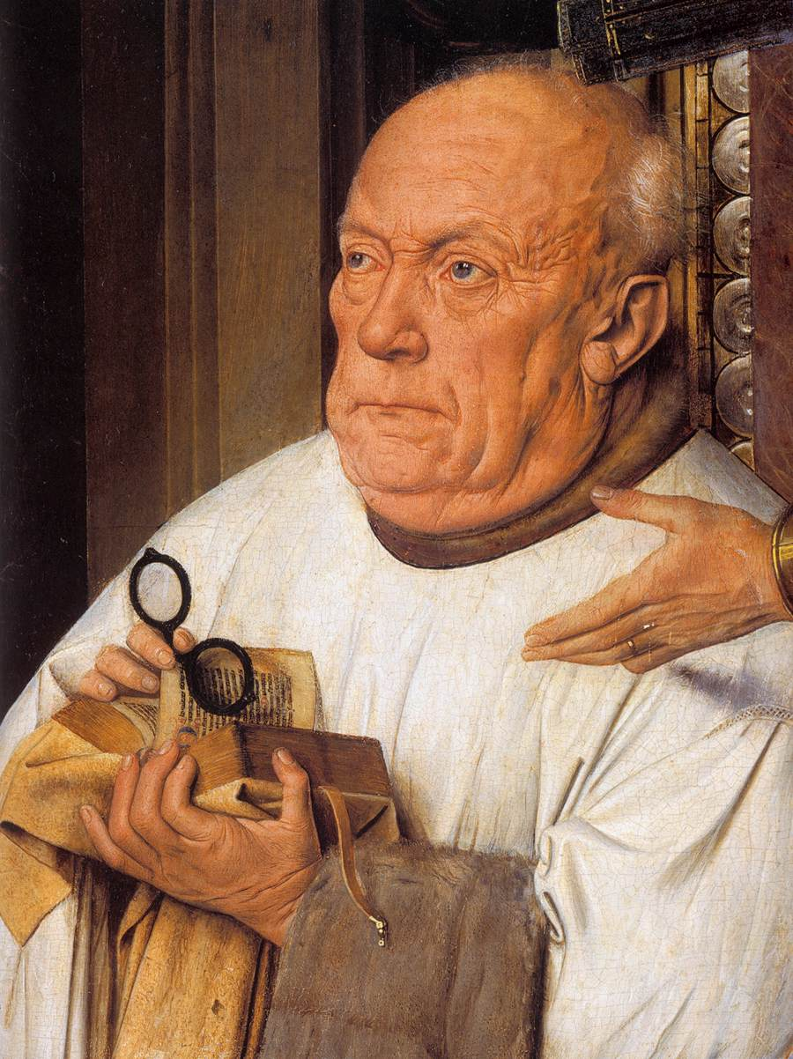
The Canon and the Virgin
Jan Van Eyck 1436
Bruges, Belgium
Notes:
This painting is by Jan Van Eyck. It is incredibly detailed, and shows the first eyeglasses in Western art. In fact, you can figure out how myopic the old boy was by reading the text through the lenses. The saint to the left is Saint Donation, and to the right is Saint George with his hand guiding the Canon Van der Paele. The Canon was very powerful in the Catholic church, and during this time the man had failing health: He suffered from myalgias, blinding headaches, and visual loss. Note the prominent temporal arteries and atrophy of the temporalis muscles.

Slide 28
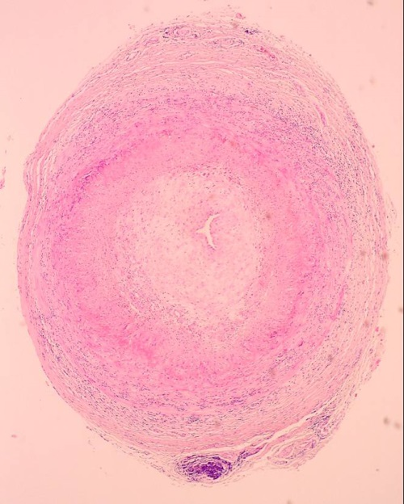
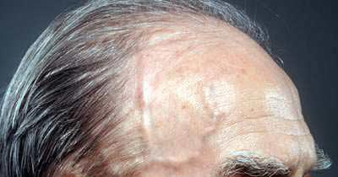
Giant Cell Arteritis
Older age groups
High ESR, CRP, WBC’s
Headache (temporal)
Jaw claudication
Visual loss
Sometimes associated with PMR
Notes:
It’s a good story for Giant Cell Arteritis (temporal arteritis). Often associated with PMR, it is associated with headaches and visual loss. However, all telephone requests to the museum for permission to biopsy the canvas for giant cells have thus far been unreturned…

Slide 29
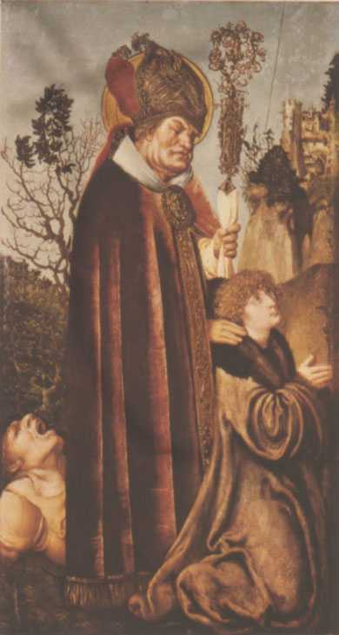
Cranach, St. Valentine
1502 Academy of Fine Arts, Vienna
Notes:
This is St. Valentine, the patron saint of epilepsy. Note the man behind him with the ictal cry of a seizure onset. To this day in Europe, if someone has an unexpected fall the jokingly refer to it as a “Valentine moment.”

Slide 30
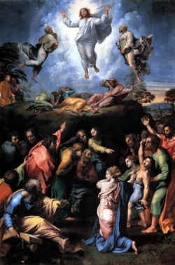

Raphael, The Transfiguration
1520 The Vatican
Notes:
Charcot and Bell, the English neurologist, argued about Raphael’s painting, The Transfiguration. Charcot thought the boy in the right was possessed, not epileptic. Bell favored epilepsy. Raphael died while finishing this painting and didn’t disclose what the child had. Charcot pointed out that epileptic movements are “in phase” clinically, not out of phase (one arm up, one down) such as the boy shows.

Slide 31
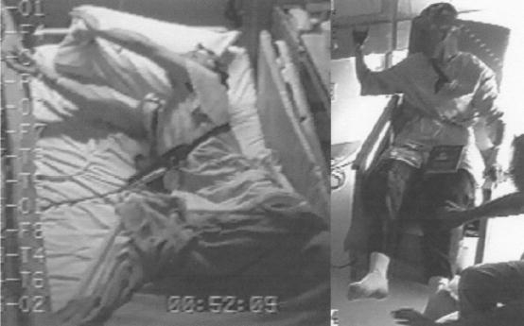
Supplemental motor cortex seizures
“Fencing Posture”: asymmetric tonic posturing
Notes:
But you can actually see a “fencer’s posture” in supplemental motor epilepsy as is demonstrated in these video EEG’s.

Slide 32


Brughel the Elder
1564 Albertinium, Vienna
Ergotism? (Saint Anthony’s Fire)
Notes:
Brughel the Elder painted “The Dancing Mania” and a version was later colorized by his son (Brughel the younger). In the middle ages, entire villages would sometimes stop their efforts and would dance wildly in a line for days until they collapsed from exhaustion. It has been theorized that ergot poisoning was responsible. It was a time of little food, and in northern Europe, rye and other crops sometimes grew fungus that secreted ergots. The ergots vasoconstricted the feet, and even today, those with ergot poisoning stomp their feet around because of the uncomfortable dysesthesias. It was so common there was a saint assigned to the affliction: St Anthony

Slide 33


Ergotism
“Saint Anthony’s Fire”
Grain products can be contaminated with the fungus Claviceps purpurea
Peripheral neuropathy, distal vasoconstriction; mental status changes, convulsions, diarrhea, vomiting
“The examination of Sarah Good”
Notes:
Though it was likely the middle age “Dancing mania” was group psychosis, there is good evidence that the Salem witch trials may have started with ergotism. The girls initially thought to be accused of possesion had delusions and psychosis, and black spots on their skin, “the devil’s pinches”. These were all classic signs of ergotism, though clearly later the hysteria was religious in nature and driven by desire for wealth. Erogotism was an established affliction at the time of the Salem Witch trials. Note in the picture, the prosecuters are pointing to the “devil pinches” on Sarah Good.

Slide 34


Gerritt Dou, The Dropsical Woman
1633 The Louve
Notes:
In 17th century, the height of medical sophistication was diagnosis by examining…and tasting…the urine.

Slide 35


“Piss Prophets”
Notes:
In fact, it was so common that people made their living by tasting urine: “Piss Prophets”. They even had their own guild! And you think your job sucks….

Slide 36


Michelangelo and the Sistine Chapel
Notes:
Michalango’s most famous work was the Sistine Chapel. And the most important panel, over the alter, was God separating darkness from light. But historians have wondered for five centuries why God had lumps in his throat? A goiter? And a hem in the front of his robe, a mundane feature since clothing was closed by latches then, not buttons. Michalangelo had never portrayed such features in other works.

Slide 37

Michelangelo and Neuroanatomy
Notes:
Then…the truth comes out centuries later in the journal Neurosurgery

Slide 38

Notes:
Michalangelo had hidden the human brain within his painting! This was exactly what the brain was believed to look like in his time (of limited autopsies). The brainstem and cerebral peduncles predominated, and the hem of God was the sulcus of the spinal cord!

Slide 39


Michalangelo and hidden images
Notes:
This was considered high blasphemy in his day. But Michelangelo was known for his sneaky works or art. His own visage is visible in a side view of the flowing beard of Moses, and he inserted himself as an observer in his painting, “The Crucifiction of St. Peter”

Slide 40

Siptah, c. 1400 BC (Memphis)
Notes:
Note this man, Siptah, the head priest of the goddess Astarta in ancient Egypt. His leg is atrophied and short. What is the diagnosis?

Slide 41



Polio
“Infantile Paralysis”
Fecal-oral spread of enterovirus
Karl Landsteiner 1908
CNS involvement 3%
Notes:
The first representation of polio in art. If all goes well, it may be extinct, like smallpox, before the decade’s end.

Slide 42




Phineas Gage: 1848
Notes:
Phineas Gage was a God-fearing, hard working foreman who worked on the Burlington and Vermont railroad in the nineteenth century. When tamping down a nitroglycerin vial to blast a way through the pass
shown, the rod was hurled though is left eye and out the top of his brain. He was brought home to die, and as his family wept over him, he awoke after a couple of days and recovered, returning to work. But he was not the same man…

Slide 43

Harlow, 1868
“Previous to his injury, although untrained in the schools, he possessed a well-balanced mind, and was looked upon by those who knew him as a shrewd, smart businessman, very energetic and persistent in executing all his plans of operation. In this regard his mind was radically changed, so decidedly that his friends and acquaintances said he was "no longer Gage."
Notes:
Gage was no longer Gage. He was labile and impulsive. He lived decades more, and his case was used to demonstrate the importance of the frontal lobes to personality and emotion. When he died in California, his skull was dug up by physician grave robbers and sent to Harvard, where it remains in the medical history museum

Slide 44




Ludwig II of Bavaria
Notes:
Ludwig II of Bavaria was called the “Mad King”. But he built (and designed) many incredible castles including the famous Neuschwanstein. He was the patron of Wagner who composed his Ring Cycle in a Lugwig II castle, “La Favorite”. But when Bavaria approached bankruptcy, Ludwig II was declared insane by the Bavarian parliament, and his uncle was appointed as regent

Slide 45



Bernhard von Gudden
Notes:
Bernard von Gudden was appointed his physician. Von Gudden was the man who first documented the decussation of the optic chiasm and treated the insane humanely, removing their chains. The Mad King knew him well, and the two were moved to the Castle Berg for treatment

Slide 46





Death of Ludwig II and von Gudden: 1886
Notes:
Ludwig II had been suicidal but improved with his neurologist’s treatment. One day, he was allowed to walk along the lake with von Gudden, without the accompaniment of guards. But evening approached and they had not returned. The guards found the two men dead, floating off shore. Von Gudden had been strangled and held under the water. The king was presumed to have swam out afterwards and drowned himself. But conspiracy theories abounded then and remain today.

Slide 47


Erin Brady Worsham
Breathtaking Metamorphosis
Contemporary; Tennessee
Notes:
This is a woman who has ALS. She was able to use a LED light trigger on her forehead to use a computer and create a picture rising above herself like a butterfly…

Slide 48

Native Alaskan Art (Inupiaq)
Tony Pushruck, c 1950’s
Notes:
In the extreme north of the USA, the Alaskan natives have traditionally crafted masks showing asymmetric facial features. Bells Palsy and facial nerve weakness from mastoiditis were common there. The young were brought into a central area and lectured as to the importance of the community, and how everyone was to be respected, and nobody should be separated out on the basis of illness or deformities. Then an elder would emerge wearing such a dance, capering about comically. If a child laughed, he or she was whipped.

Slide 49

“You can sure see a lot, just by looking”
Yogi Berra

Slide 50

Questions or Comments?

