Slide 1

Formulation of Suicide Risk: Synthesizing Today, Anticipating Tomorrow
Hill Country Nurse Practitioner Association
Pamela K. Greene PhD, RN, NEA-BC
Assistant Professor
July 13, 2016
Texas A&M University-Corpus Christi
College of Nursing & Health Sciences
Notes:
Not “THE” essentials. (Overstated…?)
Always a work in progress
Risk Factor handout
ED handout
Safety Plan

Slide 2
Objectives
At the end of this presentation, participants will be able to:
1. Use evidence to determine warning signs for suicide risk Identify the
2. Formulate acute and chronic suicide risk
3. Discuss resources and tools available for assessing and managing suicide risk
Notes:
– In order to successfully achieve Objective one, you need to know the warning signs, we will go over those.
You can have acute together with chronic or each separately – we will address putting the right pieces together to come up with your formulation. With the process we use, it can also guide your documentation.
You have so many things to keep current with – I want you to leave here tonight with some readily available tools that you can put into place, based on the population you serve and type of facility where you work

Slide 3
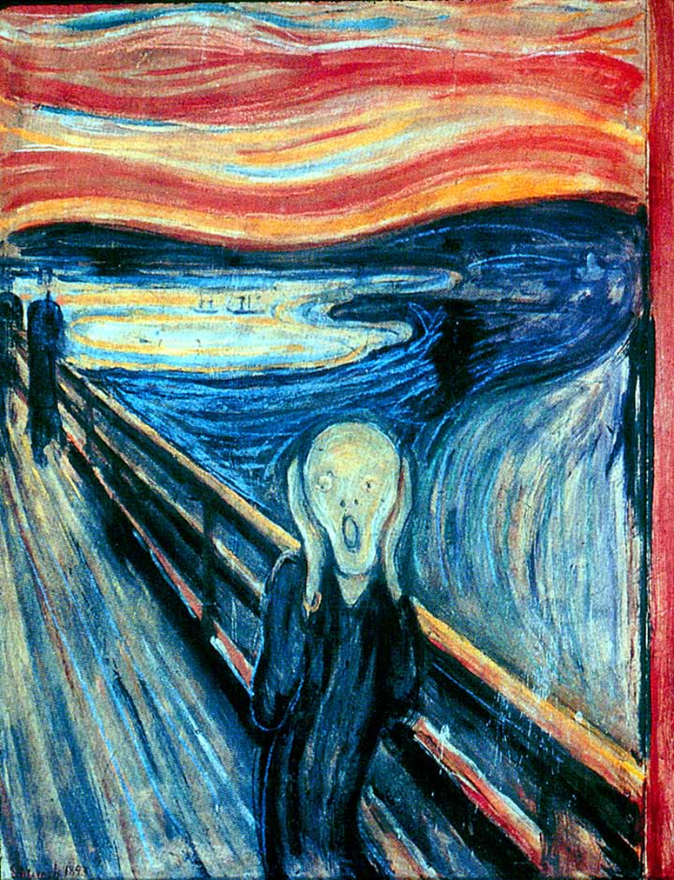
Models/Theories
Notes:
We will talk further about risk factors and warning signs, but I want to be sure we have a shared model of understanding of what contributes to death by suicide.
Theories are not just what someone conjures up – the ones we will address are real, based in research – and lay the infrastructure for even more research – and even more importantly – they lay the groundwork for our work.
By way of giving a little background information, I want to set the stage with 3 theories or models that help explain suicide.

Slide 4
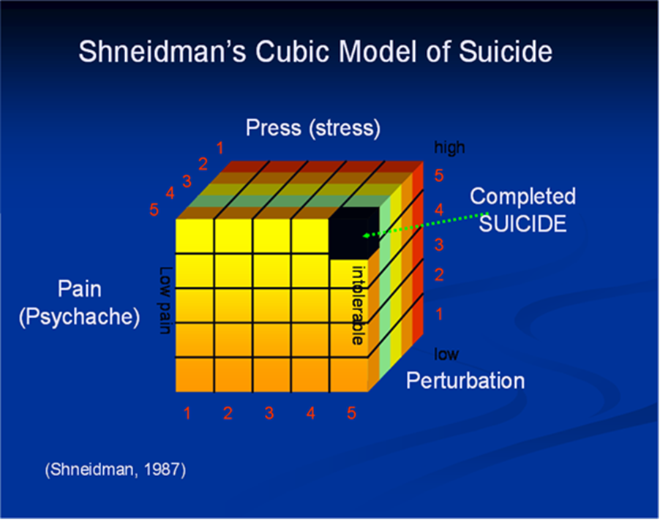
Notes:
One of the earliest theories – and one that others continue to build from was one formulated by Schneidman, who is referred to as the father of suicidology. (1987 – really realtively new in many ways – book – in the references is 1993)
We look at the Pain (Psychache)
(Hurt, lonely,hopelessness)
Perturbation – that is the upset/distress part
Press or stress
When all are acting at once – it is too much! Pressure valve – for some – suicide – and
There are those individuals in this space of intolerability – that do not become suicidal.
Suicidality is the result of multiple factors and risks.
TAKE A MINUTE AND REFLECT ON THIS - Jot a note to yourself about something that you think of in terms of how this informs your practice

Slide 5




Interpersonal Model
D
E
S
I
R
E
Lack of
Connectedness
Perceived
Burdensomeness
Capability
Lethal
Van Orden, Witte, Cukowicz, Braithwaite, Selby, & Joiner, (2010).
Notes:
The Interpersonal Model – also known as the Interpersonal Psychological theory.
Lack of connectedness – what are you looking for? (EXAMPLES)
Perceived Burdensomeness – “My family would be better off without me.”
Desire alone = not enough
Inborn drive to survive! Capability of Suicide – over ride preservation instinct – habituation (exposure/practice)
Lack of connectedness – what are you looking for?
Perceived Burdensomeness – “My family would be better off without me. Desire alone = not enough
Inborn drive to survive! Capability of Suicide – over ride preservation instinct – habituation (exposure/practice)
Self harm – rehearse – attempts (relief is experienced)
TRAUMA – another way to acquire that exposure to emotional pain
High physical pain tolerance
The suicidal individual must also acquire the capability to actually inflict lethal self-injury. This requires an override to the preservation instinct. There are a number of factors that impact the capability, including genetics, motivation, and
pain perception.

Slide 6
Fluid Vulnerability Theory
Distinguishes the difference between acute and chronic suicidality.
Chronic: enduring vulnerability and heightened susceptibility
Acute: intense, escalated intent to die
    Rudd (2006)
Notes:
David Rudd has developed the Fluid Vulnerability theory (FVT) is useful in helping to gain understanding as to the nature of risk over time. It distinguishing the difference between acute and chronic suicidality. FVT addresses chronic suicidality; the enduring vulnerability and heightened susceptibility as well as acute suicidality during which time an individual experiences an intense, escalated intent to die.
Each suicidal individual has static personal variables that will not change. For instance, a person who has made two or more suicide attempts is considered a “multiple attempter” and that fact will not change. Their baseline risk is higher than the person who has had thoughts of suicide, but made no attempts. An individual who experiences great suffering with a loss, could engage in treatment that results in reducing the suffering. The suicide risk for that individual subsequently is reduced as the suffering becomes less intense.
Implications from your perspective?

Slide 7
Nature of Suicidal Thinking:
Get Specifics!
Ideation:
  Frequency, intensity/severity, duration, specificity
  Presence vs. Absence not necessarily useful
  Relationship to intent to die
Method:
  availability/accessibility,
  Multiple methods
Active behaviors
  Preparation and rehearsal
From thinking
to doing
Notes:
When you are assessing warning signs and risk, you will ask about ideation and
Frequency, intensity/severity – duration, specificy = get the plans!!
Presence is helpful, absence is not so useful – get the detail and get it specifically
I worked with a psychiatrist who was assessing someone for admission to a hospital. She acknowledged the patient’s history of suicidal ideation – the patient did not deny she had ideation – but said she probably would not actually kill herself because she knew it would really hurt her parents.
Knowing that – what would you think?
The psychiatrist went at the assessment from another angel and acknowwledged the patient’s comment about probably never actually killing herself – but I wonder if you ever gave any thought to how you might kill yourself, if you were to do it?
OH yes! The woman described a guilliten she had constructed in her garage and had practiced with melons to be sure it worked! Now what are you thinking?

Slide 8
UNDERSTANDING SUICIDE INTENT
Critical to recognize:
Fluid nature of suicide intent and motivation to die
Ideation is NOT necessarily a good measure of intent/risk
Central role of shame/self-hate/stigma
Intent can persist after a suicide attempt and is related to risk for a subsequent attempt
  “Residual intent”
Notes:
As we talk further about risk and warning, it is important to keep in mind SLIDE
Fluid nature – Phone call can change things in an instant!

Slide 9


Risk & Protective Factors
Risk – Biological, Psychological, social, and cultural factors that are associated with suicidal behavior and ideation –
  NOT predictors or causes.
Protective –those factors associated with decreased occurrences of suicidal behaviors.
Clinical interventions: risk & protective factors
Notes:
Protective factors are those that counter risk factors in a sense.
This is an important area to think about –
An important protective factor has to do with the family – the structure. It Is not so important – that is single parent or blended etc. But what is important is how the family functions:
Family cohesion – adaptability and communication and
all three are associated with what is termed emotional bonding – or here we would refer to the degree and or type of attachment. The sustainable family is further characterized re. the ability to cope with stress and crisis along with spiritual well being.
Finding meaning or purpose in life is another protective factor – but will not necessarily be enough to prevent suicide.
Other Examples: ___________________

Slide 10
Mental Status Exam
The Mental Status Exam is an essential part of the evaluation, formulation of risk, particularly where there may be a subtle hint of a thought disorder or cognitive impairment.
Notes:
The MSE is a hallmark of patient psychiatric evaluations, Mental status observations are essential to the evaluation and formulation of risk, particularly where there may be subtle hints of a thought D/O or cognitive impairment.
A thought disorder can end up being a risk factor – and at times warning.
We do parts of the MSE with each re-assessment.
We need to appreciate how important this data can be

Slide 11

Notes:
Let’s talk a little about heart disease for a minute.
Obese
Smokes
High Cholesterole
Hypertension
Family History
RISK FACTORS - some can be modified and decrease the risk
(NOT PREDICTORS)
_________________________________________________
Short of breath
Dyaphoretic
Red faced
Elephant on Chest
??
WARNING SIGNs – Heart attack is happening or is immenant
Keep this in mind -

Slide 12
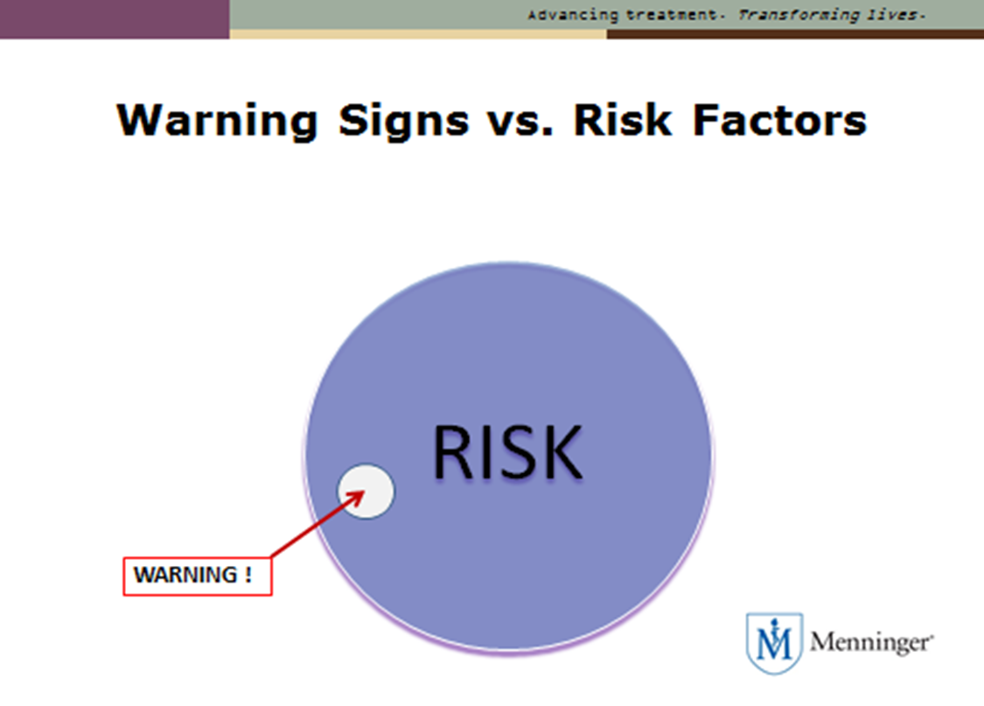
Warning Signs
Warning Signs as a subset of Risk Factors
WARNING!
RISK
Notes:
Think about the 2 scenarios with the cardiac patient

Slide 13
WARNING SIGNS
Warning signs suggest here and now there is a risk.
“Imminent” risk is associated with active intent
Can be:
Subjectively expressed
Behaviorally implied
AMSR (2014)

Slide 14
IS PATH WARM
Ideation
S _________________
P _________________
A _________________
T _________________
H _________________
W _______________
A _______________
R _______________
M ________________
American Association of Suicidology
http://www.suicidology.org/
resources/warning-signs
Notes:
Originally developed for the public – but certainly relevant for clinicians
I – ideation – however – lts have ideation and never act…. – further assessment
Substances – an increased use in particular – (alcohol or other drugs – especially binge)
Purpose - Without purpose or meaning – no reason for living
Anxiety – agitated – difficulty sleeping – becoming a separate, distinct warning sign – we are going to address this further
Trapped – feeling like there is no way out
Hopelessness
Withdrawing/Worthlessness – becoming avoidant of family and friends and society
Anger (Seek revenge) – rages -
Recklessness – engaging in in risky activities – seemingly without thinking (Impulsive)
Mood (change) – dramatic

Slide 15
Screening Tools
Reliable/Valid/appropriate for your setting and population
  PQR9 (depression screen)
  PQR2
  Columbia
  Many others
Notes:
Joint Commission and the National Patient Safety Goals

Slide 16

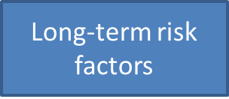
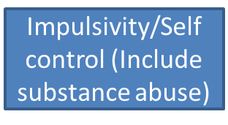
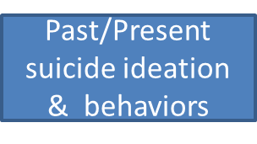
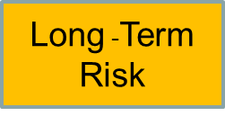

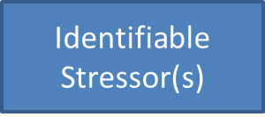

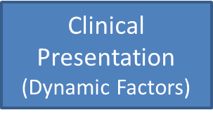

Formulation
> 2 internal or social strengths or supports to aid safety and treatment planning
> 2 signs, situations or changes that would increase acute risk
+
+
Notes:
Taken directly from the Assessment and Management of Suicide Risk (AMSR) Competencies
The Suicide Prevention Resource Center We often do not like to actually make a specific risk determination, but we have to. One way to doe this, suggested by Suicide Prevention Resource Center in the AMSR competencies is using the information or data you collected in your assessment.
You have the long-term risk factors such as a family history of suicide or trauma history, you have information about issues related to impulsivity and that does include substance abuse, remember especially if the person has tended to binge use. You will have asked about past history of suicide and current suicide ideation and actual plans and behaviors. What are the current stressors? Has there been loss of some sort or other substantial stress? When you look at clinical presentation, we are talking about the mood and behaviors we are seeing, and have seen if they have been in the hospital for a number of days – are they labile, gradually improving? And then how well are they relating to us? Have we been able to establish an alliance or foster engagement? Are there any reasons for this person to exaggerate or minimize? (Ask the participants for examples of these)
Example could be – There is a sudden drop in temperature and it is snowing – the person has no place to go and they know “suicidal ideation” keeps them in the hospital where it is warm. The person may minimize or not disclose – maybe they have been on 1:1 before and they know how intrusive that can be.
From the data, you make a judgment. Yes or no – long term risk (chronic) and Yes or now acute risk. Another way to think of these has to do with “state” and “Trait”
We like to try to say low – medium- high. There is no empirical evidence for these levels.
The next part of this determination of risk has to do with looking at the protective factors and those things that support or help the individual and could be used with safety planning which we will talk more about. And finally, what are two (could be more) changes that would increase the risk. When we work on role plays keep this model in mind. It can help you think through the judgment of risk and serve as a template for documentation. You could use each of the blue boxes on the left as bullet points for instance.

Slide 17
What do I do if I suspect this person is considering suicide?
Acknowledge –
  take the person seriously and listen
Care –
  voice concern.
  reassure, they are not alone.
Treatment – Help access help immediately
  Call 1-800-273-TALK (8255)
  911
www.StopASuicide.org
American Foundation for Suicide Prevention (AFSP)
Notes:
Acknowledge – The individual will be more willing to seek help if you have taken time to listen.
Care – Let them know you care and want to understand. Reassure they are not alone – you want to help.
You do want to know if they have a plan – for instance – are they armed?
It is a myth that talking about suicide “causes” suicide
Treatment – you really do want to have them seek help immedicately - crisis line– adult protective services can help identify resources
911 – remember the heart attack??

Slide 18
DO NOT:
“Cheer up” or “Snap out of it”
Assume things will work out
Act shocked
Challenge or dare
Argue or debate moral issues
Allow yourself to be sworn to secrecy
Risk your personal safety
American Foundation for Suicide Prevention (AFSP)
Notes:
“gesture”
“attention seeking”

Slide 19
Facilitates HOPE
  HELP:
  Flexible and Calm
and
By making:
  the implicit explicit
  the complex simple
  the confusing understandable
  the inaccessible available
National Action Alliance for Suicide Prevention: Suicide Attempt Survivors Task Force. (2014)
Notes:
People who are suicidal are often struggling with cognition – thoughts are slowed – that means it takes longer to process – so responses to questions may take time.
Problem solving is quite limited.
Shame is often present
we deliberately want to make the implicit – explicit
The complex – simple
The confusing - understandable (When any of us is overwhelmed – things that are typically clear – are confusing.)
The inaccessible – available.
This also serves to facilitate a little hope.
Instilling hope offers a sense of possibility or the capacity to have a desire with anticipation.
We use the word hope – we know it is a powerful component in treatment and because it is so important , sometimes we need to stop and reflect on what hope is – as both a noun and a verb.
Flexibility all of these interventions are fluid – as the person may be labile an
so our interventions and expectations have to be nimble
SEGUE into some things to consider having right on hand – you will not have time in the moment to look them up – have a folder or clipboard handy with the references and resources YOU decide are best in your own setting

Slide 20
Safety Plan
Warning signs/triggers
Coping Strategies (adaptive)
Socialization
People who may help resolve a crisis
  Phone #’s
Mental Health Professionals or agencies
Phone #’s
6. Ensure the environment is safe
  Safety Plan Treatment Manual: Barbara Stanley and Gregory Brown
  Manualhttp://www.mentalhealth.va.gov/
  docs/va_safety_planning_manual.pdf
http://www.suicidepreventionlifeline.org/learn/safety.aspx
Notes:
What sorts of thoughts, images, situations, indicate to you that a crisis may be developing? (Write in own words)
What are some simple things you can do on your own to help you NOT act on urges to harm yourself? (Physical & Practice)
Socializing with others who may be supportive and also serves as a distraction – make a list of those people and social settings. Phone #
List of family who are supportive and who you feel you can talk to when stressed
Locations of clinics, Emergency dep. Crisis hot line =
Life line number 1-800-273-8255
6. Safe Environment – Have you thought of ways you would use to kill yourself? - Ways to limit access
MANUAL
SIT Side-by-side

Slide 21
Sample Programs
CALM
Counseling on
Access to
Lethal
Means
Program Description:
1.5 to 2 hour workshop designed to help providers implement counseling strategies to help clients at risk for suicide and their families reduce access to lethal means, particularly (but not exclusively) firearms.
Notes:
Programs – You may not use directly – but there are all sorts of networks you are part of – so I want you to know!

Slide 22
Sample Programs
ZERO SUICIDE
“Tools exist to improve care for those struggling with suicide, and there is evidence that a comprehensive approach works.”
“Suicide is preventable, and health care systems need to embrace and work towards the aspirational goal of preventing ALL suicide deaths for patients in their care.”
Julie Goldstein Grumet – Director of Prevention and Practice, SPRC and leader for the Action Alliance’s Zero Suicide priority.
Notes:
I have been interested in the prevention of Suicide since I was 9 years old and my friend found his father in the livingroom, shortly after his father had taken a shotgun and killed himself.
I have been working in hospitals off and on for 40 years. When I started, suicide was one of the most reported sentinal events – those events that should not happen in the hospital – and today – suicide in hospitals remains one of the most reported sentinal events.
When I became active with the Suicide Prevention Resources Center – a center supported by federal dollars, annually there were about 36,000 suicides. Now, more than 10 years later, that figure has risen to at least 41,000.
Preventing Suicide has been part of Healthy People 2000, and HP 2010 and now HP2020. The Surg. General figured we were not making great progress toward the goal of reducing suicide, so a few years ago, the Suicide Action Coalition was formed. This is a federally funded task force .
They did comprehensive assessments of all sorts of things from the gaps in the formal education of Mental Health Providers to the impact of bullying and what grade schools could do and community centers.
We now have a national strategy for suicide Prevention.
There are all sorts of places and ways we can reduce suicide. T
Today, by your willingness to explore suicide and prevention you are contributing to this national goal of suicide prevention. Thank-you! I know you had many other options.

Slide 23
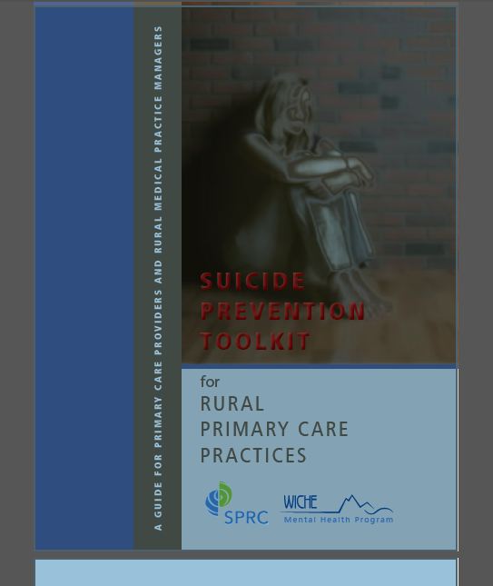
Suicide Prevention Toolkit
FREE PDF
www.sprc.org/settings/primary-care/toolkit
Notes:
SPRC
Has the safety plan, resources for patients, and other very useful resources – depending on your setting.

Slide 24

Sample Programs
Project Semicolon (Tattoo Trend)
Started by Project Semicolon, which describes itself as "a faith-based non-profit movement dedicated to presenting hope and love to those who are struggling with depression, suicide, addiction and self-injury."
“A semicolon is used when an author could've
chosen to end their sentence, but chose not to.”
The author is you and the sentence is your life.
In the case of these tattoos, it is a physical representation of personal strength in the face of internal struggle.
Notes:
When talking about suicide, there are no jokes, it is a heavy topic. So I wanted to bring in this message – a message that carries a bit of optimism.

Slide 25
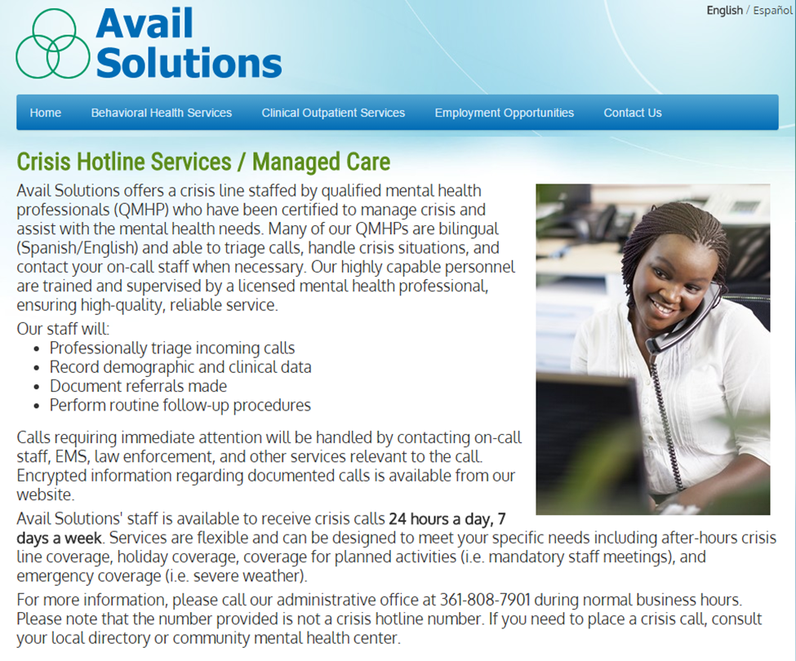
Notes:
Avail Solutions – “headquarters” if you will Is right here in CC. They have centers all over Texas and in other states.
They Also have an e-mail crisis chat from morning until late in the evening.
Depending on your setting – the non-emergency number here for more information
Avail and Bayview Hospital – this past fall helped pull together a group of intereseted people, from the university, the VA and others to have our first ever education event dedicated to Understanding and preventing suicide on the WORLD-WIDE suicide prevention day – Sept 10.

Slide 26

Millions of Americans are affected by mental health conditions every year. NAMI, the National Alliance on Mental Illness, is the nation’s largest grassroots mental health organization dedicated to building better lives for the millions of Americans affected by mental illness through education and support for both the individual and the family.
Find Help, Find Hope.
STATE:
www.namitexas.org

Slide 27
Visit:http://www.mentalhealthchannel.tv/

Slide 28
References
Assessing & Managing Suicide Risk: Core Competencies for Mental Health Professionals (2014). Suicide Prevention Resource Center Health and Human Development Programs Education Development Center, Inc.
Fowler, J.C. (2013). Core principles in treating suicidal patients. Psychotherapy. Vol. 50, 33, 268-272.
Jobes, D. (2006). Managing suicidal risk: A collaborative approach. NY: Guilford Press.
National Action Alliance for Suicide Prevention: Suicide Attempt Survivors Task Force. (2014). The Way Forward: Pathways to hope, recovery, and wellness with insights from lived experience. Washington, DC: Author.
Rudd, M.D. (2006). The Assessment and Management of Suicidality.Seneca, Fl: Professional Resource Press.
Rudd, M.D., Williams, B., Trotter, D. (2011). The psychological and behavioural treatment of suicide behaviour: What are the common elements of treatments that work? In D. Wasserman & C. Wasserman (Eds.), Oxford textbook of suicidology and suicide prevention: A global perspective (pp.427-437). Oxford University Press.

Slide 29
SAMHSA: National Suicide Prevention Lifeline
www.suici.aspxdeprevntionlifeline.org/learn/safety
Sarchiapone, M., Mandelli, L., Iosue, M., Andrisano,C. & Roy, A. (2011). Controlling access to suicide means. International Journal of Environmental Research and Public Health. 8, 4550-4562.
Schrank, B., Bird, V., Rudnick, A., & Slade, M. (2012). Determinants, self- management strategies and interventions for hope in people with mental disorders: Systematic search and narrative review. Social Science & Medicine, 74, 554-564.
Shneidman, E. (1993). Suicide As Psychache: A clinical approach to self- destructive behavior. Northvale, NJ: Jason Aronson Inc.
Stanley, B. & Brown, G.K. (2008). The Safety Plan Treatment Manual to Reduce Suicide Risk: Veteran Version. Washington, D.C.: United States Department of Veterans Affairs.
Van Orden, K.A., Witte, T.K., Cukowicz, K.C., Braithwaite, S., Selby, E.A., & Joiner, T.E. (2010). The interpersonal theory of suicide. Psychological Review 117(2): 575-600.

Slide 30
CALM:
Suicide Prevention Resource Center: www.sprc.org
Project Semicolon
http://www.huffingtonpost.com/2015/07/07/project-semicolon-tattoos_n_7745358.html
Pamela.greene@tamucc.edu

