Slide 1
Evaluation, Assessment and Treatment of Headaches in the Pediatric Population
KAY TAYLOR, MSN, BSN, RN
Pediatric Neurology, P.A.
Orlando, Fl

Slide 2
Objectives
Review basic aspects of migraines such as epidemiology, nomenclature and pathophysiology
Propose a diagnostic approach and highlight “flags” of concern
Review abortive, preventive and nonpharmacologic options of therapy
Develop a therapeutic pharmacologic regiment

Slide 3
Headaches in Children: Epidemiology
Estimated 7-10% children experience HA
Typical age onset between 7-10 yrs old
Evenly split in males vs females in young children
30-50% teens complain of 1 h/a per week
More common in female teens vs male
May be months before formal DX made

Slide 4
Headaches in Children:
Features
Often Bilateral frontal or temporal
Pain can be brief (<2hr criteria) such as 30 minutes only
Pain can be either pressure or throbbing
Phonophobia or photophobia present, not both
Nausea present but vomiting usually not

Slide 5
Headaches in Children:
Features
Positive family history
Triggers are rare, although may see bright light, loud noises and smells
Pain can occur at anytime
50% children will have analgesic abuse/rebound complicating therapy

Slide 6
Headaches in Children:
Types
Migraine with or without aura
Migraine variants
Childhood periodic syndromes
Chronic daily headache
Status migranosious
Analgesic abuse headache

Slide 7
Headaches in Children:
Migraine Variants
Hemiplegic migraine:
  +aura with hemiparesis
  Precipitated with head trauma
  Hallucinations, delusions and aphasia
  Symptoms can last for days

Slide 8
Headaches in Children:
Migraine Variants
Opthalmoplegic Migraine:
  Painful opthalmoparesis present
  Blurred vision, diploplia or eye rubbing
  3rd Cranial nerve involvement, ptosis seen
  More often seen in teens
  Rare subtype overall
  Acute therapy may require IV steroids

Slide 9
Headaches in Children:
Migraine Variants
Basilar Migraine:
  Attacks cause brainstem or cerebellar dysfx
  Girls>boys; peaks adolescence
  gait ataxia, change LOC, visual loss or diploplia
  Must r/o occipital epilepsy

Slide 10
Headaches in Children:
Migraine Variants
Retinal migraine:
  More common in children than adults
  Monocular gray or blackouts
  30-60 minutes late mild-moderate H/A occurs
  Pain retro-orbital and unilateral

Slide 11
Headaches in Children:
Periodic Syndromes
Benign paroxysmal vertigo:
  Brief attacks of vertigo with postural instability
  Headach often not reported
  Frightened, pale appearance
  Rotary nystagmus, lasting seconds-minutes
  Self-limited extending 1-2 years
  Positive family hx migraine

Slide 12
Headaches in Children:
Periodic Syndromes
Cyclic vomiting:
  Recurrent, explosive bouts vomiting with normal health between
  Strong family hx migraine
  Headache, phonophobia and photophobia may not be seen
  75% pts respond to migraine prophylaxis
  Overlap features with abdominal migraine

Slide 13
Headaches in Children:
Chronic Daily H/A
Prevalence of 4-5% in adults, <1% in kids
Pain is daily (minimum 15/30 days)
Bifrontal pain with all constellation symptoms present
Typical migraine hx present
Average age 12 yrs, females more common

Slide 14
Headaches in Children:
Pathophysiology
Theories included vascular and spreading cortical depression
Neurovascular mechanism
Genetic features such as triggers to sensitive brain

Slide 15
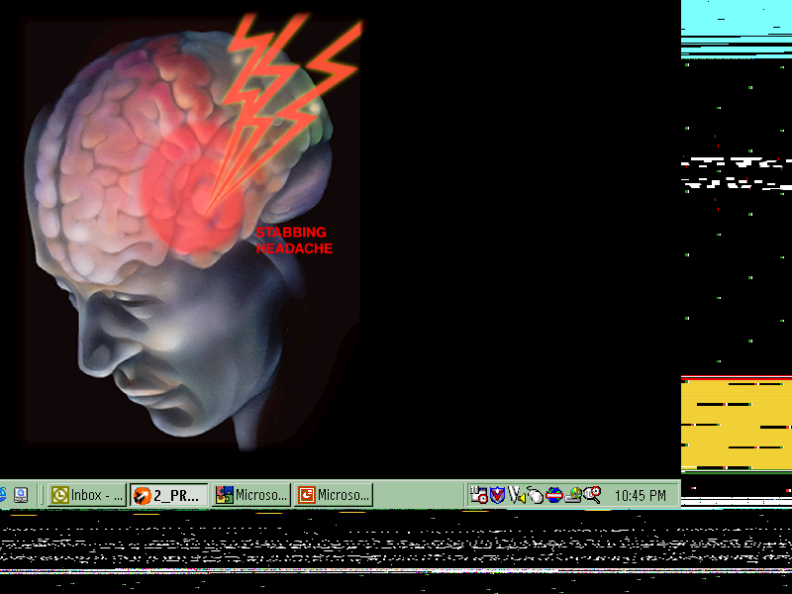
THE SENSITIVE BRAIN
Pain control mechanisms are partially
defective in migraine patients

Slide 16
THE NEUROVASCULAR THEORY
Migraine is a neurovascular pain syndrome
Referred pain from dura mater and blood vessels
Peripheral neural processing
  Neurogenic plasma protein extravasation (PPE)
  Neuropeptides
Central neural processing
Notes:
The central concepts in our current understanding of migraine pathophysiology are based on the anatomical and physiological relationships of the trigeminovascular system.
The key aspects of the trigeminovascular system are as follows:
1. The pain-producing, cranial vessels and dura mater, which refer pain mainly to the first (ophthalmic division) of the trigeminal nerve;
2. The peripheral branches of the trigeminal nerve, which are activated during migraine and have been modelled using studies of neurogenic plasma protein extravasation (PPE) and neuropeptide release;
3. The central processing of pain signals in the trigeminocervical complex, in which second-order neurons receive input and project rostrally to transmit the pain signal within the central nervous system.
These three aspects serve as the basis for understanding the pain and, thus, for understanding how acute anti-migraine drugs might act (1).
1. Goadsby PJ. Current concepts of the pathophysiology of migraine. Neurol Clin. 1997;15:27-42.

Slide 17
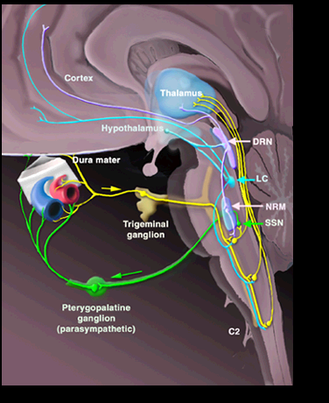
CNS MODULATION
OF MIGRAINE
Goadsby, 2000.
Notes:
Activation of the rostral brainstem in patients with spontaneous migraine has been demonstrated using positron emission tomography (PET). This region was active during the acute attack, and activation persisted after successful treatment but was not present between attacks (1). These findings suggest that there are brainstem regions that play a pivotal role in either initiation or termination of the acute attack of migraine. Indeed, migraine may well be a defect of normal control mechanism for suppressing input because similar regions in the experimental animal gate trigeminal nociceptive information.
Weiller C, May A, Limmroth V, Juptner M, Kaube H, Schayck RV, Coenen HH, Diener HC. Brainstem activation in spontaneous human migraine attacks. Nat Med. 1995;1:658-660.

Slide 18
Headaches in Children:
“Red Flags”
Retrospective Study of outpt H/A records
Approx 300 pts reviewed
3 major red flags noted:
  Sudden H/A onset <6 weeks duration
  Positive night time awakening from sleep with pain
  Focal deficit neurologic exam

Slide 19
Headaches in Children:
Evaluation
Comprehensive Hx and PE (neurologic)
Basic metabolic panel, Mg, Thyroid
Migraine panel (MTHFR, Homocystein, Folate)
Neuroimaging ( MRI, MRA)
EEG
Lumbar puncture with opening pressure

Slide 20
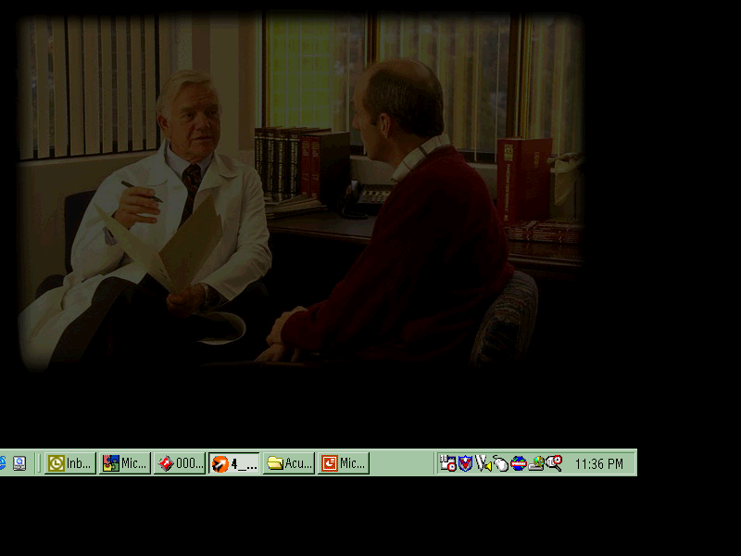
PRINCIPLES OF MIGRAINE MANAGEMENT
Patient education and behavioral management
  Strategies for identifying and avoiding triggers
  Behavioral strategies
    Regular sleep, exercise, meals
    Stress management, biofeedback
    Cognitive behavioral therapy
Pharmacologic management
  Acute treatment
  Preventative strategies
Notes:
An effective migraine management plan is based on establishing a therapeutic partnership with the patient. Therapy can be optimized through a management program that encompasses education and behavioral treatments as well as pharmacologic therapy.
Educating patients on the nature and mechanism of their illness will help to encourage dialogue and also empower the patient to actively participate in their own headache management program.
Patients should be encouraged to keep a headache diary for both diagnostic and treatment purposes. Review of the diary may yield previously unrecognized patterns to headache, including migraine triggers. Work with the patient to identify possible triggers and discuss possible strategies to avoid or minimize exposure.
Behavioral strategies should be initiated, which include establishing more regular sleep patterns, improvement in diet and an exercise program. Patients should be encouraged to participate in behavioral modification programs that have been proven to be very successful. These include cognitive-behavioral therapy, stress management, relaxation training or biofeedback therapy. While active participation in nonpharmacologic treatment may produce a slower response than pharmacologic treatment, it encourages an active role for patients. These strategies are particularly important when pharmacologic interventions are limited (eg, comorbid conditions precluding specific migraine drugs).
Pharmacologic treatment of migraine can involve both acute and preventive interventions. Patients with frequent headache may require both approaches. Acute treatment is aimed at aborting the headache, while preventive treatment is geared towards reducing the frequency and severity of anticipated attacks.
In summary, education, behavioral management and acute therapy are the cornerstones of good migraine management.

Slide 21
MIGRAINE TRIGGER PREVENTION
Physical exertion
Diet
Hormonal changes
Head trauma
Stress and anxiety
Sleep deprivation or excess
Environmental factors
Notes:
More than in any other headache disorder, migraineurs identify triggers. Dietary factors are frequently reported triggers, although few have been scientifically validated. While their impact is probably not great for the population, they could be for the individual. Oversleeping and sleep deprivation are commonly recognized triggers. Patients should maintain a routine bedtime and avoid sleeping in.
Hormonal headaches are triggered by variations in female estrogen level and possibly other hormonal factors. Noise, bright lights, and fumes are commonly identified migraine triggers. Physical exertion can cause headache with subtype exercise-induced migraine. Stress is the trigger most commonly listed by patients.

Slide 22
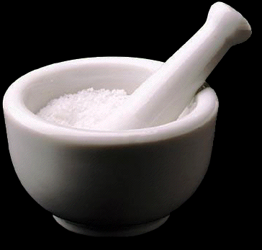
ACUTE MIGRAINE MEDICATIONS
Nonspecific
  NSAIDs
  Combination analgesics
  Opioids
  Neuroleptics/antiemetics
  Corticosteroids
Specific
  Ergotamine/DHE
  Triptans
Notes:
A number of medications are available to treat migraine, and choice depends on the severity and frequency of headaches. These categories of medications include nonspecific and specific treatments.
Nonspecific treatments are those effective for any pain disorder and include nonsteroidal anti-inflammatory drugs (NSAIDs), combination analgesics, opioids, neuroleptics/antiemetics and corticosteroids. Specific therapies, such as ergotamine-containing compounds, DHE and triptans, are effective only for the treatment of migraine and related disorders.

Slide 23
ACUTE THERAPIES FOR MIGRAINE
GROUP 1: Substantial empirical evidence and pronounced clinical benefit
Over-The-Counter Analgesics
  Acetaminophen, aspirin, plus caffeine
Migraine Specific Medications
Triptans
  Naratriptan
  Rizatriptan
  Sumatriptan SC, IN, PO
  Zolmitriptan
Nonspecific Prescription Medications
  Ibuprofen
  Naproxen sodium
DHE
  SC, IM, IN, IV (plus antiemetic)
US Headache Consortium
Notes:
A recent government funded meta-analysis of acute migraine therapies allowed for the characterization of treatments into several groups. Group 1 demonstrated the best evidence for efficacy-consistent statistical significance and moderate to large effect size.
Included in Group 1 are aspirin/acetaminophen/caffeine (Excedrin), aspirin, naproxen sodium, ibuprofen, DHE, all of the available triptans and butorphanol.
US Headache Consortium Guidelines. Neurology. 2000. In press.

Slide 24
ACUTE THERAPIES FOR MIGRAINE
GROUP 2: Moderate empirical evidence and clinical benefit
Opioids
  Acetaminophen plus codeine
  Butalbital, aspirin, caffeine, plus codeine
Other
  Naproxen
  Ansaid
  Midrin
  Reglan
  Ergotamine/caffeine
US Headache Consortium
Notes:
Group 2 agents had evidence of less significant clinical effect and include a number of narcotics, several nonsteroidal agents, prochlorperazine and intranasal lidocaine.
US Headache Consortium Guidelines. Neurology. 2000. In press.

Slide 25
ACUTE THERAPIES FOR MIGRAINE
Hospital migraine protocols: First line treatment
  Toradol 30mg IV
  Benadryl 25-50mg IV
  Compazine 10mg IV
  Solumedrol 20mg/kg to 1 gm IV
Second line treatment:
Propofol 0.5mg/kg q 15 min. IV
Magnesium 2gms in 250ml Normal Saline IV
Third line treatment:
  DHE IV
  Depakote 100mg q 8 hours IV
US Headache Consortium
Notes:
Group 3 drugs showed either mixed results in studies or small effect sizes. In the case of butalbital-containing agents, there were no migraine studies. Consensus was reached that although these agents are effective in migraine treatment, the possibility of drug-induced headache (rebound) is an indication that use should be restricted.
Acetaminophen is a Group 4 drug with evidence that it is ineffective in migraine. Group 5 is comprised of steroids whose effect is unknown.
US Headache Consortium Guidelines. Neurology. 2000. In press.

Slide 26
ACUTE TREATMENT PRINCIPLES
✓
Treat early in attack
✓
Use correct dose and formulation
✓
Use a maximum of 2-3 days a week
✓
Everyone needs acute treatment
✓
Add on preventive therapy in selected patients
Notes:
The general principles of acute migraine care include the following:
Treat the headache as early as possible in the attack to reduce the intensity and duration of the attack as well as the accompanying features. Tailor the treatment to both the individual and the individual attack. Failure to use effective therapy early may increase the pain, disability and impact of the headache.
Use the correct dose and formulation. The route of administration is especially important in patients experiencing severe nausea and vomiting.
Generally, the use of acute therapy should be restricted to a maximum of 2-3 days per week to avoid rebound.
Everyone needs acute treatment. This is in addition to patient education and, in many cases, nonpharmacologic intervention.
Consider the addition of preventive therapy for selected patients to treat break-through attacks.

Slide 27
GUIDELINES: WHEN TO USE PREVENTIVE MANAGEMENT
Migraine significantly interferes with patient’s daily routine, despite acute R_{x}
Acute medications contraindicated, ineffective, intolerable or overused
Frequent headache (≥ 2 attacks per week)
Uncommon migraine conditions
Patient preference
Silberstein SD et al. Wolff’s Headache and Other Head Pain. 2000.
Notes:
Previously accepted recommendations for migraine prevention have focused on patients who have two or more attacks per month. Some patients with up to four to eight attacks per month do well on symptomatic treatment alone. This suggests that recommendations are arbitrary and that preventive treatment should be tailored to account for individual patient needs or other migraine characteristics.
Preventive therapy may be more appropriately guided by one or more of the following circumstances: recurring migraines that, in the patients opinion, significantly interfere with their daily routine, despite receiving acute treatment; frequent headaches; contraindication to or ineffectiveness or overuse of acute therapies; adverse events with acute therapies; cost of both acute and preventive therapies; patient preference; and the presence of uncommon migraine conditions, including hemiplegic migraine, basilar migraine, migraine with prolonged aura or migrainous infarction. Use of acute treatment more than twice per week may also warrant initiation of preventive therapy.
Silberstein SD, Lipton RB, Goadsby PJ. Headache for the Primary Care Physician. Oxford, England: ISIS Medical Media Ltd; 2000.
Silberstein SD, Lipton RB, Dalessio DJ. In: Silberstein SD, Saper JR, Freitag F. Migraine diagnosis and treatment. 7th ed. New York, NY: Oxford University Press; 2000.

Slide 28
GENERAL PRINCIPLES OF PREVENTIVE TREATMENT
Start low and increase dose slowly
  Use long-acting formulation if compliance an issue
Need adequate trial (2 to 3 months)
Avoid interfering, overused and contraindicated medications
Evaluate therapy
  Use calendar
  Attempt to taper and discontinue treatment when headaches well controlled
Silberstein SD et al. Headache in Clinical Practice. 1998.
Notes:
Therapy should be initiated with the lowest effective dose of the chosen pharmacologic agent. Increase the dose slowly until clinical benefits are achieved in the absence of adverse events or until limited by adverse events. Give each treatment an adequate trial. A clinical benefit may take as long as two to three months to manifest itself. It is not uncommon for patients to take new treatments for one to two weeks without seeing an effect and then discontinue prematurely, with both the physician and patient believing the medication was not effective.
Avoid interfering medications (eg, overuse of certain acute medications such as ergotamine). Long-acting formulations may improve compliance.
Maximize compliance. Discuss the rationale for a particular treatment with the patient, including when and how to use the treatment, and what adverse events are likely. Address and establish patient expectations. Discuss the expected benefits of therapy and how long it will take to achieve them. Create a formal management plan based on patient preferences.
Monitor the patient’s headache by having them keep a user-friendly diary to measure attack frequency, severity, duration, disability, response to type of treatment and adverse medication effects. After a period of stability, consider tapering or discontinuing treatment.
Silberstein SD, Lipton RB, Goadsby PJ. Headache in Clinical Practice. Oxford, England: ISIS Medical Media Ltd; 1998.

Slide 29
PREVENTIVE MEDICATIONS:
DRUG CLASSES
Anticonvulsants
Periactin
Antidepressants
Diet changes
Other
  Vitamins
  Minerals
  Herbs
Beta-Blockers
Ca²⁺-Channel Blockers
Silberstein SD. Cephalalgia. 1997.
Notes:
The major medication groups for preventive migraine treatment include ß-adrenergic blockers, antidepressants, calcium channel antagonists, serotonin antagonists, anticonvulsants, NSAIDs and others (including riboflavin, minerals, and herbs).
If preventive medication is indicated, the agent should be preferentially chosen from one of the first-line categories, based on the drug’s side effect profile and the patient’s coexistent and comorbid conditions.
Silberstein SD. Preventive treatment of migraine: an overview. Cephalalgia. 1997;17(2):67-72.

Slide 30
PREVENTIVE TREATMENT:
DRUG CHOICE
 |  |  |  | COMORBID CONDITION
DRUG |  | EFFICACY* | SIDE EFFECTS* | RELATIVE CONTRAINDICATION | RELATIVE INDICATION
Anticonvulsants
 | Divalproex | 4+ | 2+ | Liver disease, bleeding disorders | Mania, epilepsy, anxiety disorders
 | Topiramate | 3+ | 2+
 | Gabapentin | 2+ | 2+ |  | Epilepsy, mania?
Antidepressants
 | SSRIs | 2+ | 1+ | Mania | Depression, OCD
*On a scale of 0 to 4
Silberstein SD et al. Headache for the Primary Care Physician. 2000.
Gray RN et al. US Dept of Health and Human Services. 1999.
Notes:
As discussed earlier, other disorders are more common in persons with migraine. If present, select a drug to treat both disorders. Look at the side effect profile of the drug and balance it against its efficacy. Establish that the coexistent disease is not a contraindication for the selected migraine therapy. For the patient with migraine and epilepsy or migraine and manic depressive illness, divalproex sodium should be considered. Topiramate and gabapentin are alteratives of less proven efficacy. Older patients with cardiac disease may not be candidates for TCAs, calcium channel or ß-blockers, but could easily use divalproex, gabapentin or topiramate. Monoamine oxidase inhibitors are drugs reserved for patients with refractory depression.
Silberstein SD, Lipton RB, Goadsby PJ. Headache for the Primary Care Physician. Oxford, England: ISIS Medical Media Ltd; 2000.
Gray RN, Goslin RE, McCrory DC, Eberlein K,Westman EC, Hasselblad V. Drug treatments for the prevention of migraine headache.Technical Review 2.3. Duke University: US Dept of Health and Human Services, Agency for Health Care Policy and Research under Contract No. 290-94-2025; February 1999. NTIS Accession No. PB99-127953.

Slide 31
PREVENTIVE TREATMENT:
DRUG CHOICE
 |  |  |  | COMORBID CONDITION
DRUG |  | EFFICACY* | SIDE EFFECTS* | RELATIVE CONTRAINDICATION | RELATIVE INDICATION
Calcium channel blockers
 | Verapamil | 2+ | 1+ | Constipation, hypotension | Migraine with aura, HTN, angina, asthma
*On a scale of 0 to 4
Silberstein SD et al. Headache for the Primary Care Physician. 2000.
Gray RN et al. US Dept of Health and Human Services. 1999.
Notes:
Methysergide is effective but is not a first-line drug because of the risk of development of fibrosis with long-term use. When migraine and hypertension and/or angina occur together, ß-blockers or calcium channel blockers are useful. In the asthmatic or depressed patient or insulin-dependent diabetic, ß-blockers should be used with caution. Verapamil is often used in migraine with aura and hemiplegic migraine.
Silberstein SD, Lipton RB, Goadsby PJ. Headache for the Primary Care Physician. Oxford, England: ISIS Medical Media Ltd; 2000.
Gray RN, Goslin RE, McCrory DC, Eberlein K,Westman EC, Hasselblad V. Drug treatments for the prevention of migraine headache.Technical Review 2.3. Duke University: US Dept of Health and Human Services, Agency for Health Care Policy and Research under Contract No. 290-94-2025; February 1999. NTIS Accession No. PB99-127953.

Slide 32
PREVENTIVE TREATMENT:
DRUG CHOICE
 |  |  |  | COMORBID CONDITION
DRUG |  | EFFICACY* | SIDE EFFECTS* | RELATIVE CONTRAINDICATION | RELATIVE INDICATION
NSAIDs
 | Naproxen | 2+ | 2+ | Ulcer disease, gastritis | Arthritis, other pain disorders
Other
 | Riboflavin | 2+ | 1+ |  | Preference for natural products
 | Magnesium, | 2+ | 2+
*On a scale of 0 to 4
Silberstein SD et al. Headache for the Primary Care Physician. 2000.
Gray RN et al. US Dept of Health and Human Services. 1999.
Notes:
NSAIDs are often used for menstrual migraine or in the presence of other pain disorders, but would not be used in the presence of ulcerative disease. Riboflavin and feverfew are often used by patients with a preference for natural products.
Silberstein SD, Lipton RB, Goadsby PJ. Headache for the Primary Care Physician. Oxford, England: ISIS Medical Media Ltd; 2000.
Gray RN, Goslin RE, McCrory DC, Eberlein K,Westman EC, Hasselblad V. Drug treatments for the prevention of migraine headache.Technical Review 2.3. Duke University: US Dept of Health and Human Services, Agency for Health Care Policy and Research under Contract No. 290-94-2025; February 1999. NTIS Accession No. PB99-127953.

Slide 33
PREVENTIVE TREATMENT:
USE OF ACUTE MEDICATION
Preventive treatment does not eliminate all attacks
Breakthrough attacks need treatment
Can use acute and Preventive treatment together
  Limit acute drug use to prevent drug-induced headache
  Certain drugs require caution if used together
  Some drugs cannot be used together
Silberstein SD. Cephalalgia. 1997.
Notes:
Patients treated with preventive medication may continue to have attacks of episodic migraine. Menstrual migraine attacks often persist to a greater extent than nonmenstrual attacks. Preventive medication may also decrease the intensity and duration of the attacks, and may make acute medications more effective. Using preventive and acute medication together presents a new set of complexities.
The amount of acute medication must be limited to prevent the development of drug-induced daily rebound headache and loss of efficacy of the preventive medication. This is one of the causes of secondary failure of preventive medication.
Silberstein SD. Preventive treatment of migraine: an overview. Cephalalgia. 1997;17:67-72.

Slide 34
Headaches in Children:
Summary
Headache is common in children
Multiple types of Headaches exist with various features and presentations
Be on the lookout for the “flags”
Diagnostic evaluation depends on features that may be specific for type of H/A

Slide 35
Headaches in Children:
Summary
Remember sensitive brain and trigger avoidance
More than 2 H/A requires preventive RX
Tiered approach for abortive RX is goal
Nonpharmacologic therapy can also be very important
Referral to Neurologist always available

