Slide 1
LANP Nominations
A step by step guide

Slide 2
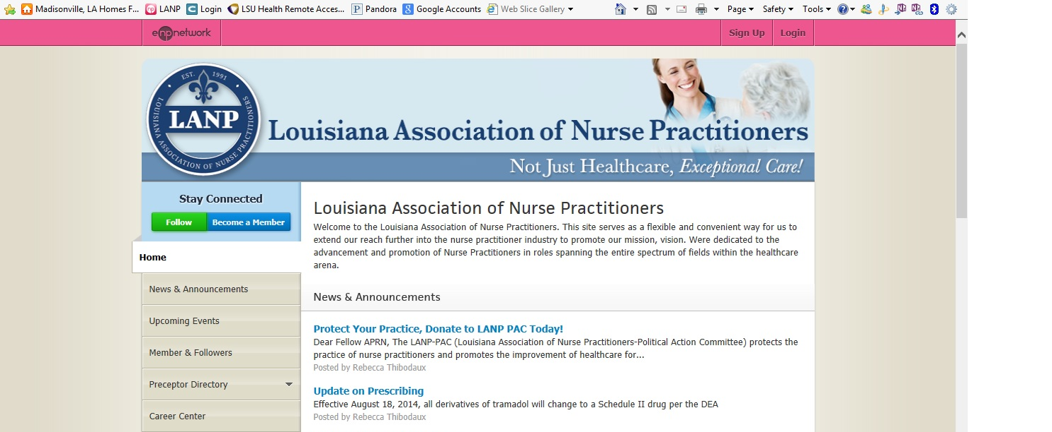
Step 1 Go to www.lanp.org and log into your account

Slide 3
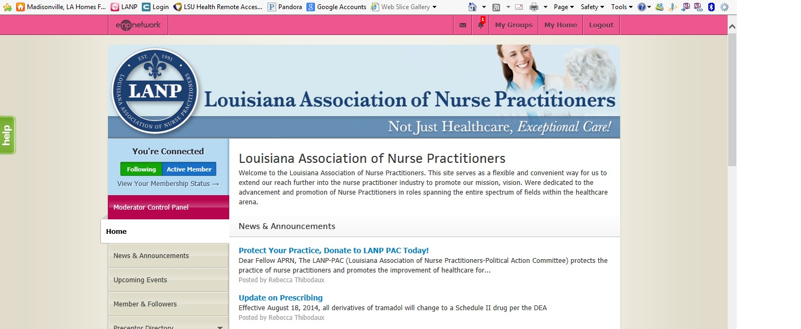
Step 2: Go to My Groups and Select your Region

Slide 4
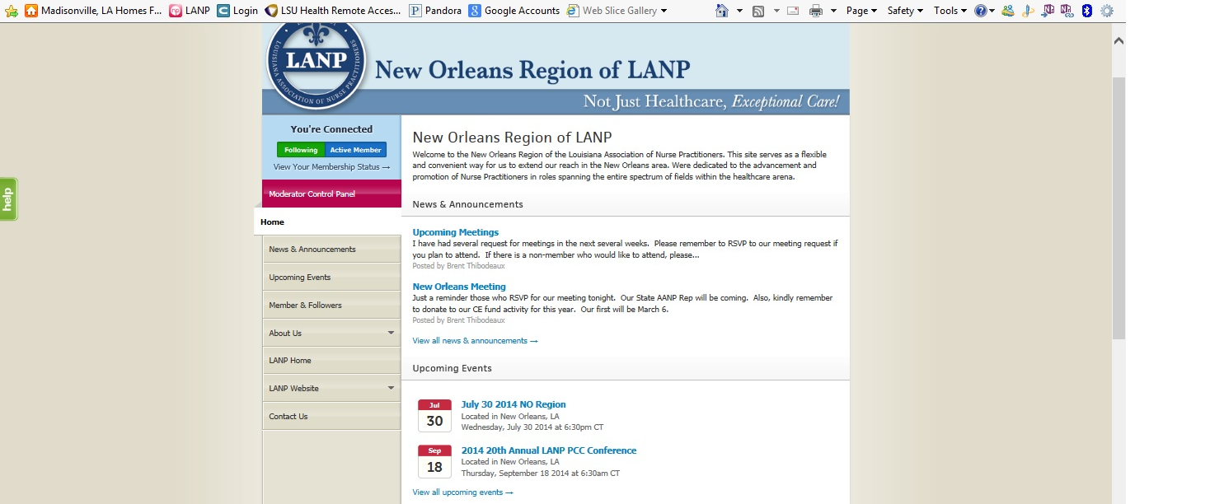
Step 3: Select LANP Website and you will see a drop down menu

Slide 5
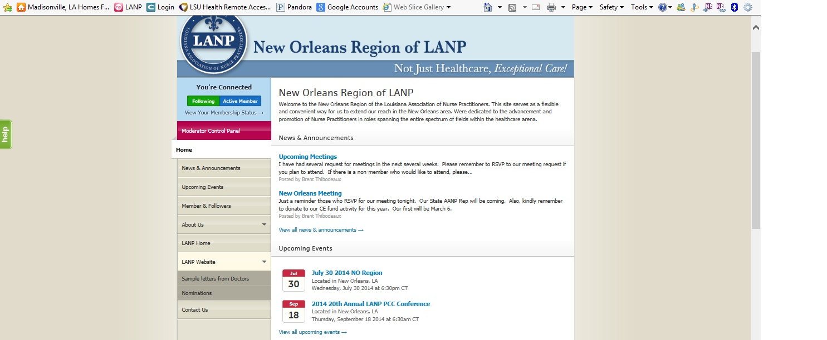
Step 4: From drop down menu Select Nominations

Slide 6
Your specific region nomination form will then populate.
Please fill out the form and submit.
The nominations committee will verify the eligibility of the nominee and add qualified nominees to the ballot for voting.
Please make sure the person you are nominating is willing to hold office.
Please direct any questions to office@lanp.org and/or webeditor@lanp.org
Thank you.

