Slide 1

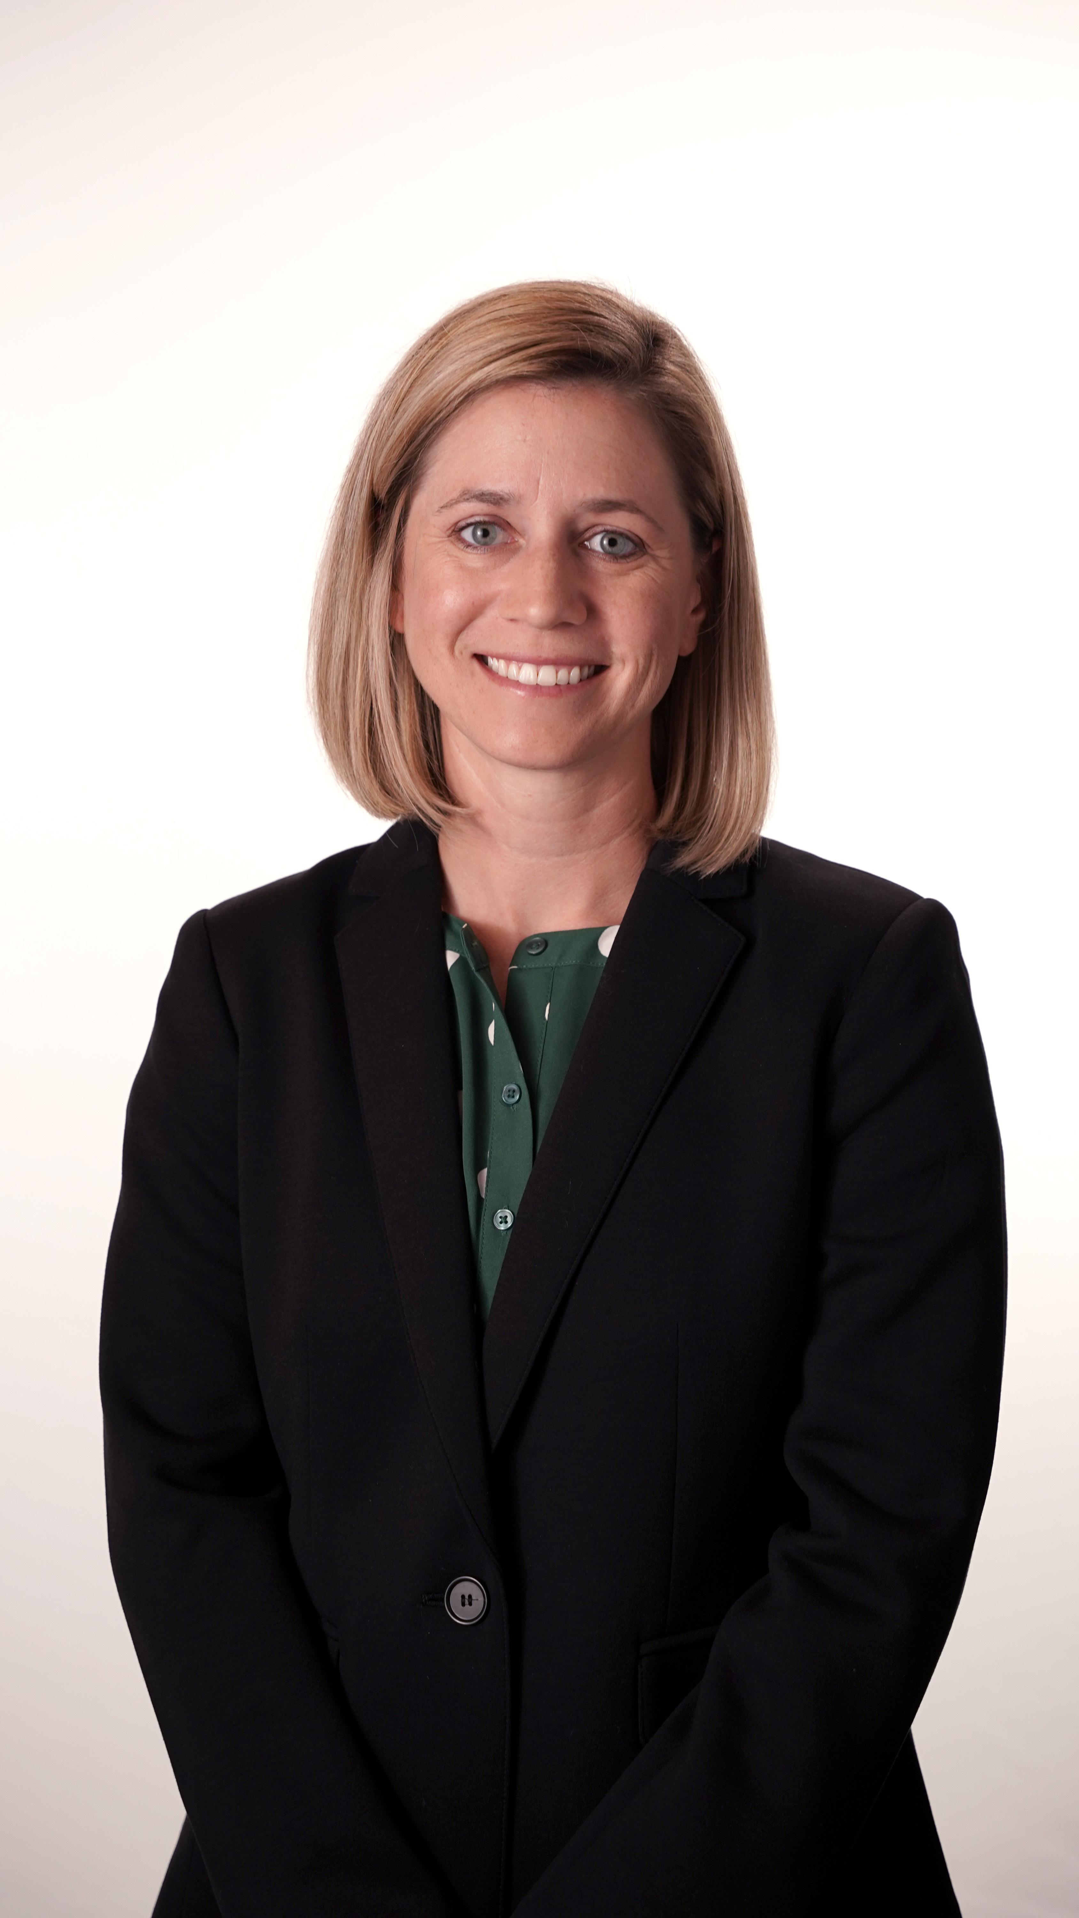
Louisiana Association of Nurse Practitioners-Acadiana Region
Host: Acadiana Vascular Clinic
Presenter: Dr. Angelle Hogan
Topic: Carotid Disease: TCAR
Marcellos Italian Restaurant
Thursday March 26th 6 p.m.
340 Kaliste Saloom Rd Lafayette
Dr. Angelle Hogan
Vascular Surgeon
CTA

