Slide 1

Navigating Psychiatric Disorders in
Primary & Urgent Care Settings
Dr Laura G Leahy, APN
DrNP, APRN, PMH-CNS/FNP, CARN-AP, FAANP, FAAN
Board Certified Psychiatric/Addictions Advanced Practice Nurse
Forum of Nurses in Advanced Practice
2025 Annual Conference—Atlantic City
14ht November 2025

Slide 2

Faculty Contact
Laura G Leahy, DrNP, APRN, PMH-CNS/FNP, CARN-AP, FAANP, FAAN
Fellow in the American Academy of Nursing
Psychiatric & Addictions Advanced Practice Nurse
NEIGlobal Master Clinician in Psychopharmacology
Fellow of the American Association of Nurse Practitioners
APNSolutions, LLC
123 Egg Harbor Road
Suite 703 Tower Commons
Sewell, New Jersey 08080
Phone/Text: 856.556.0860
Fax: 844.276.7656
Email: LGLeahy@APNSolutions.com
Website: www.APNSolutions.com

Slide 3
Faculty Disclosures
The presenter does have commercial support to disclose related to this presentation.
Discussion of off-label medication uses may occur in this presentation.
Presenter may receive royalties from American Psychiatric Publishing, Inc. related to the sale of her book
Presenter Services on Advisory Board for Johnson & Johnson (Mood Disorders) & Speakers Bureaus for Sage/Biogen (Zurzuvae) & Otsuka (Rexulti)
Mechanism of Action Slides are Used with Permission of NEIGlobal & Stephen Stahl, MD

Slide 4
Overall Objectives
After this presentation, attendees will be able to:
Identify & Discuss the Brain’s Neurochemistry Associated with Psychiatric Symptoms
Identify & discuss 3 psychotropic medications & what symptoms it might hypothetically Improve
Apply the principles of matching a patient’s psychiatric symptoms with the associated neurochemicals to choose a medication for your patient

Slide 5
Physical Disorders
Substance Use Disorders

Slide 6
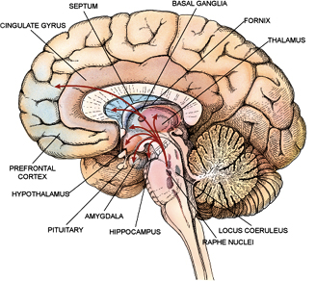
Used with permission: Carol Donner (2013).
Notes:
BRAIN IS BUILT FROM BOTTOM UP (brain stem to PFC)
Brain Stem Basic functions
Limbic System Emotional responses
Cerebral Cortex Gray Matter (3/4ths of entire brain)
4 Lobes occipital – visual processing
parietal – movement, orientation, recognition, perception of stimuli
temporal – perception & recognition of auditory stimuli, memory speech
frontal – reasoning, planning, exec functions, speech, movement, emotions, prob solving

Slide 7
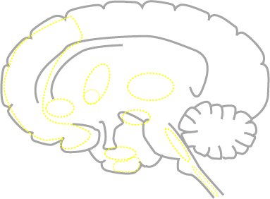
Key Behaviors Linked to Specific Brain Regions
Nucleus Accumbens
delusions
hallucinations
pleasure
interests
libido
fatigue
euphoria
reward
motivation
Septum
motor
critical relay site from PFC
Thalamus
pain
sensory relay to and from cortex
alertness
Prefrontal Cortex
executive function
attention
concentration
emotions
impulses
obsessions
compulsions
motor
fatigue
ruminations
worry
pain
negative symptoms
guilt
suicidality
PFC
Neurotransmitter
NT
S
T
BF
NA
Hy
C
Cerebellum
A
NT
motor
Basal Forebrain
memory
alertness
H
Amygdala
Spinal Cord
fear
anxiety
panic
Hypothalamus
pain
Hippocampus
SC
memory
reexperiencing
sleep
appetite
endocrine

Slide 8
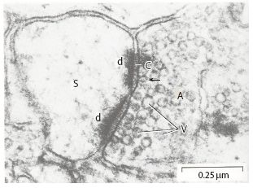
The Synapse: Where the Action is!!

Slide 9
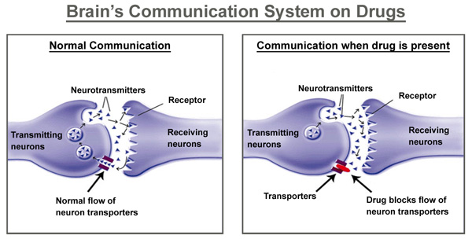
Neurochemical modulation
http://hamrah.co/en/pages/science-of-addiction/
Notes:
Chemical messages are blocked impacting reactions, emotions, judgment, perception

Slide 10
***JOHN***
37 yo male line supervisor for large manufacturer
Presents with the following symptoms:
Difficulty falling asleep (+/- 2 hours) & staying asleep (wakes 3x)
Low motivation & energy over past 6 weeks, fatigued
Long-term girlfriend is expecting 3rd child in 2 months
Feeling worthless, hopeless, stressed about finances
More irritable, ”I snap at nothing & everything…especially the kids”
Drinking more (2-3 beers/night) to “numb myself”
Isolating self “I didn’t even watch the superbowl”
Has called out of work x 4 in last 6 weeks
“I’m just not myself…I can’t think…I’m over stressed…my g/f thinks I’m depressed”

Slide 11
Depressive & Anxiety DIsorders

Slide 12

Symptoms of Major Depressive Episode Hypothetically
Associated with Malfunctioning Brain Circuits
pleasure
interests
fatigue/
energy
psychomotor
fatigue (physical)
concentration
interest/pleasure
psychomotor
fatigue (mental)
PFC
S
T
NA
BF
guilt
suicidality
worthlessness
C
psychomotor
Hy
A
NT
H
fatigue (physical)
mood
guilt
suicidality
worthlessness
mood
sleep
appetite
SC

Slide 13

Symptom-Based Algorithm for Antidepressants
SSRI/SNRI
MAOI
+ benzo
+ 2 antagonist
+ SDA/DPA
dual
5HT/NE
+ estrogen?
SNRI (e.g., desvenlafaxine)
vasomotor
5HT
GABA
anxiety
Sexual
Dys-
funcution
1) NDRI
2) 2 antagonist
3) SARI
4) MAOI
5) 5HT2A/5HT2C
antagonist/
5HT1A agonist
(NDDI)
6) add stimulant
7) stop SSRI/SNRI
pain
dual
5HT/NE
DA
sleepiness/
hypersomnia
SNRI
+ alpha 2 delta
(gabapentin/
pregabalin)
DA
NE
histamine
+ modafinil
+ stimulant
stop antihistamine,
antimuscarinic,
alpha 1 blockers

Slide 14
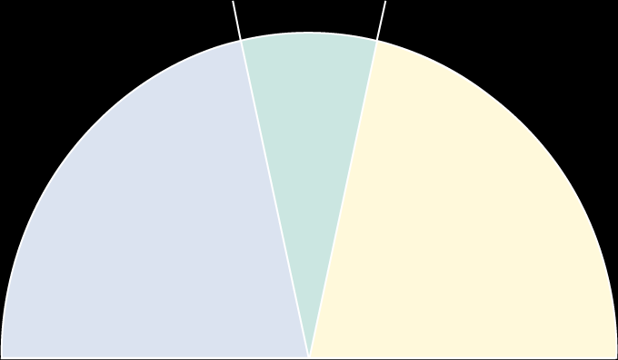
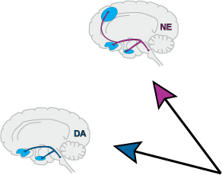
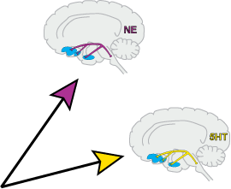

normal
mood
reduced
positive affect
increased
negative affect
-
-
-
-
-
+
+
+
+
+
depressed mood
guilt/disgust
fear/anxiety
hostility
irritability
loneliness
depressed mood
loss of happiness (joy)
loss of interest/pleasure
loss of energy/enthusiasm
decreased alertness
decreased self-confidence
NE
dysfunction
NE
dysfunction
DA
dysfunction
5HT
dysfunction

Slide 15

Symptom-Based Algorithm for Antidepressants
fatigue
NE/DA
concentration
NE/DA
NDRI
NRI
SNRI
MAOI
+ modafinil
+ stimulant
+ SDA
+ Li/thyroid/MTH-folate
+ 5HT1A agonist
sleep
5HT/GABA/histamine
hypnotics (e.g., eszopiclone)
sedating antidepressants
(e.g., trazodone, mirtazapine)
stop activating antidepressant

Slide 16
***JOHN***
37 yo male line supervisor for large manufacturer
Presents with the following symptoms:
Difficulty falling asleep (+/- 2 hours) & staying asleep (wakes 3x)
Low motivation & energy over past 6 weeks, fatigued
Long-term girlfriend is expecting 3rd child in 2 months
Feeling worthless, hopeless, stressed about finances
More irritable, ”I snap at nothing & everything…especially the kids”
Drinking more (2-3 beers/night) to “numb myself”
Isolating self “I didn’t even watch the superbowl”
Has called out of work x 4 in last 6 weeks
“I’m just not myself…I can’t think…I’m over stressed…my g/f thinks I’m depressed…I’m just worried all the time”

Slide 17
***JOHN***
Psychiatric Symptoms
NeuroChemistry & Brain Region
Insomnia/fatigue
Low motivation/energy
Worthless/hopeless
Stressed/worried
Depressed/irritable
Isolating/missing work
Increased ETOH intake
DA & NE HT & PFC
DA & NE HT & PFC
5HT & NE HT, NA, PFC
5HT & NE amygdala
5HT & NE amygdala, VMPFC
DA & NE BF & VMPFC
DA NA

Slide 18
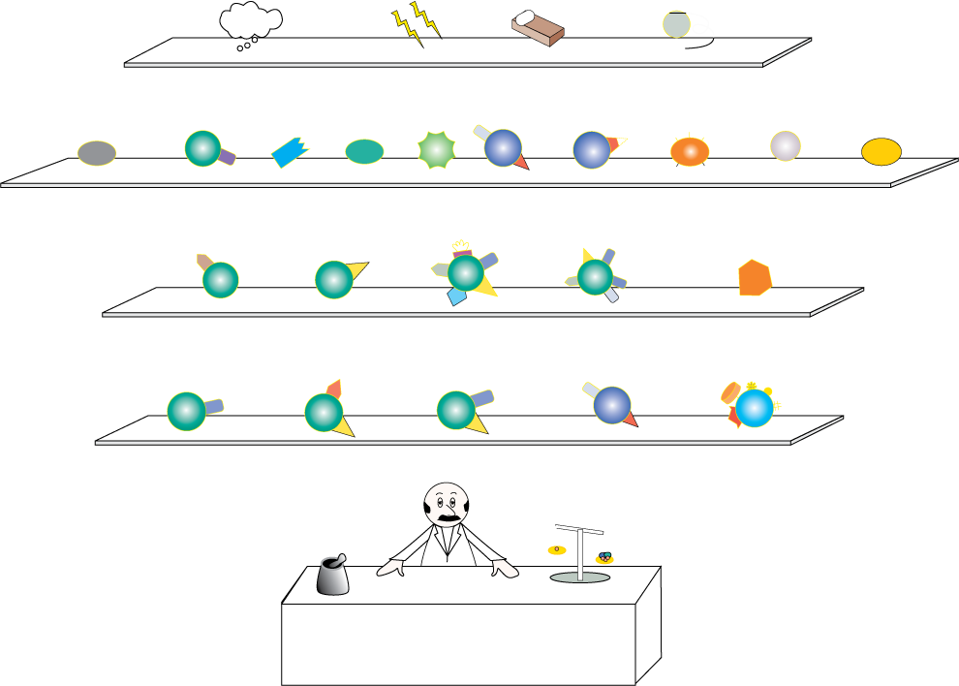
cognitive therapy
ECT
IPT
VNS
ancillary
SDA
UP
DPA
UP
hypnotic
5HT1A
Li
BZ
modafnil
MTHF
T3/4
stimulant
CH3
H
H
H
H
augmentation
2 antagonist
NRI
TCA
SARI
MAOI
monotherapies
2nd-line
SDA
BP
lamotrigine
BP
SSRI
NDRI
SNRI
monotherapies
1st-line
depression
pharmacy

Slide 19
What Might you Prescribe for JOHN??

Slide 20
Anxiety Disorders

Slide 21

Associate Symptoms with Brain Regions, Circuits, and
Neurotransmitters that Regulate Them
GABA
5HT
glutamate
fear
- panic
- phobia
amygdala-centered circuit
CRF/HPA
voltage-gated ion channels
NE

Slide 22


hypnotic
CBT
SDA/DPA
adjunctive
gabapentin/
pregabalin
TCA
mirtazapine
trazodone
2nd line
SSRI
BZ
SNRI
buspirone
1st line
GAD pharmacy

Slide 23


hypnotic
CBT
SDA/DPA
lamotrigine
topiramate
adjunctive
gabapentin/
pregabalin
MAOI
TCA
mirtazapine
trazodone
2nd line
SSRI
BZ
SNRI
1st line
panic pharmacy

Slide 24


mirtazapine
acamprosate
SDA/DPA
naltrexone
hypnotic
CBT
lamotrigine
topiramate
adjunctive
gabapentin/
pregabalin
beta blocker
MAOI
2nd line
SSRI
BZ
SNRI
1st line
social anxiety
pharmacy

Slide 25


mirtazapine
acamprosate
topiramate
1
antagonist
naltrexone
SDA/DPA
beta blocker
(pre-emptive)
hypnotic
lamotrigine
CBT
adjunctive
gabapentin/
pregabalin
TCA
MAOI
BZ
2nd line
SSRI
SNRI
1st line
PTSD
pharmacy

Slide 26


SDA/DPA
DBS
buspirone
lithium
hypnotic
BZ
adjunctive
clomipramine
MAOI
SNRI
2nd line
SSRI
1st line
OCD
pharmacy

Slide 27
Sleep & Wake Disorders

Slide 28
Symptom-Based Algorithm for Sleep
fatigue
NE/DA
concentration
NE/DA
NDRI
NRI
SNRI
MAOI
+ modafinil
+ stimulant
+ SDA
+ Li/thyroid/MTH-folate
+ 5HT1A agonist
sleep
5HT/GABA/histamine
hypnotics (e.g., eszopiclone)
sedating antidepressants
(e.g., trazodone, mirtazapine)
stop activating antidepressant

Slide 29





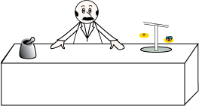
very low dose
doxepin
selective H1
antagonists,
inverse
agonists
selective
5HT2A/2C
antagonists,
inverse agonists
delta
selective
PAMs
very low dose
es-mirtazapine
indiplon MR
agomelatine
indiplon
future
gabapentin
trazodone
tiagabine
GHB
slow wave sleep
good sleep
hygiene
CBT
quetiapine
diphenhydramine
melatonin
adjunctive
temazepam
triazolam
trazodone
flurazepam
estazolam
quazepam
2nd line
zaleplon
zolpidem
ramelteon
1st line
sleep onset
zolpidem CR
eszopiclone
1st line
(sleep onset and
sleep maintenance)
hypnotic
pharmacy

Slide 30
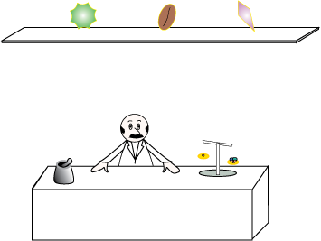
methylphenidate/
d-amphetamine
modafinil
caffeine
wake-up
pharmacy

Slide 31
Disorders of Attention & Impulse Control

Slide 32



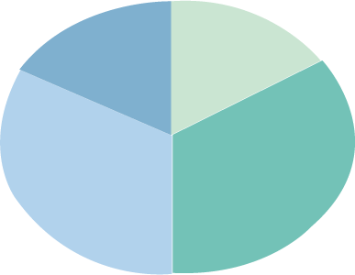
Chaotic Neurobiology of ADHD Comorbidities:
D1 & 2A Simultaneously Too High and Too Low
depression
elevated,
irritable,
expansive
mood
anxiety
tics
nicotine dependence
disordered
conduct
ADHD
alcohol abuse
oppositional
behavior
stimulant/other abuse
overactivation
insomnia
normal
hyper-
somnia
fatigue
baseline
hypoactivation

Slide 33







behavioral therapy
SDA
DPA
NDRI
SNRI
TCA
adjunctive/combos
3rd-line
nonstimulants
atomoxetine
clonidine
guanfacine ER
2nd-line
nonstimulants
MPH
d-MPH
d-amph
dl-MAS
2nd-line
stimulants
d-amph
spansule
dl-MAS-XR
lisdex
1st-line
stimulants
LA
dl-MPH-XR
transdermal
MPH
OROS-MPH
MPH
1st-line
stimulants
ADHD pharmacy:
children and adolescents

Slide 34






naltrexone
SDA
DPA
acamprosate
varenicline
adjunctive/combos
NDRI
SNRI
2nd-line
nonstimulants
MPH
d-MPH
d-amph
dl-MAS
2nd-line
stimulants
OROS-MPH
LA
d-MPH-XR
transdermal
MPH
MPH
1st-line
stimulants
d-amph
spansule
lisdex
dl-MAS-XR
1st-line
stimulants
atomoxetine
modafinil
guanfacine ER
1st-line
nonstimulants
comorbidity combo
ADHD pharmacy:
adults

Slide 35
Bipolar DisorderS

Slide 36
***JANE***
23 yo female in graduate school
Presents with the following symptoms over past week:
Lack of sleep (< 4hrs/night) over last 5 days
Extreme “productivity”
“it’s mid-terms & I finished everything for the semester”
Hyper-focused & impulsive but also distracted
Rambling speech
Hyperactive, restless
Scattered, racing thoughts
Irritable & agitated especially when behaviors are challenged
“I told my professor to speed up the course…I could take the final right now & pass it no problem…he said no so I slammed his office door…he’s such a Dumb A**”

Slide 37
Symptoms of Manic Episode Hypothetically Associated
with Malfunctioning Brain Circuits
racing thoughts
goal directed
grandiosity
motor/agitation
decreased sleep/arousal
racing thoughts
grandiosity
distractibility
talkative/pressured speech
PFC
S
T
NA
BF
decreased sleep/arousal
Hy
C
A
NT
mood
H
risks
grandiosity
talkative/pressured speech
racing thoughts
decreased sleep/arousal
SC
mood

Slide 38

Symptoms of Mania Hypothetically Associated
with Malfunctioning Brain Circuits
delusions
hallucinations
aggression
hypersexuality
substance abuse
overactivity
overactivity
PFC
S
T
NA
BF
impulsivity
substance abuse
aggression
hypersexuality
Hy
A
NT
H
SC
anxiety

Slide 39

Symptom-Based Algorithm for Mood Stabilizers
all others
delusions/
hallucina-
tions
1) naltrexone
2) acamprosate
3) varenicline
lithium
impulsivity
substance
abuse
SDA
block
VSSC
over-
activity
hyper-
sexual
block
glutamate
aggression
socially
uninhibited/
life of the
party
self-
confident
GABA
anxiety
novelty
seeking
more plans &
ideas
1) benzo
2) gabapentin/
pregabalin
eating disorder,
weight gain
impatient
1) topiramate
2) zonisamide

Slide 40
***JANE***
23 yo female in graduate school
Presents with the following symptoms over past week:
Lack of sleep (< 4hrs/night) over last 5 days
Extreme “productivity”
“it’s mid-terms & I finished everything for the semester”
Hyper-focused & impulsive but also distracted
Rambling speech
Hyperactive, restless
Scattered, racing thoughts
Irritable & agitated especially when behaviors are challenged
“I told my professor to speed up the course…I could take the final right now & pass it no problem…he said no so I slammed his office door…he’s such a Dumb A**”

Slide 41
***JANE***
Psychiatric Symptoms
NeuroChemicals & Brain Regions
Insomnia
Extreme “Productivity”
Hyper-focus, impulsive
Distracted
Rambling Speech
Hyperactive, Restless
Scattered, Racing Thoughts
Irritable, Agitated
5HT PFC & HT
GABA & GLU PFC & striatum
GABA & GLU BF & PFC
5HT & NE PFC
GABA & GLU BF, NA & PFC
5HT & NE. Amygdala, VMPFC
DA, GABA & GLU Striatum, BF, PFC
5HT & DA. NA, BF & PFC

Slide 42

Atypical Antipsychotic Actions in Bipolar Depression
pharmacologic actions
NE and DA
disinhibition
antihistamine
5HT1A
5HT2A
H1
NE and DA
disinhibition
2
5HT
disinhibition
5HT1D
SERT
inhibition
SRI
NRI
5HT2C
NET
inhibition
NE and DA
disinhibition
5HT6
5HT7
trophic
factors
circadian
rhythms

Slide 43
Atypical Antipsychotic Actions in Bipolar Depression
clinical actions
mood and
cognition
insomnia
5HT1A
5HT2A
H1
mood
2
mood
mood
5HT1D
SRI
NRI
5HT2C
mood
mood and
cognition
5HT6
5HT7
neurogenesis?
sleep, mood?

Slide 44
WHAT MIGHT YOU PRESCRIBE FOR JANE??

Slide 45
Psychotic Disorders

Slide 46

Positive Symptoms: Neurotransmitters
and Other Molecules that Regulate
Relevant Brain Circuits
positive
symptoms
DA
5HT
mesolimbic
GABA
glu
Notes:
9-13

Slide 47

Hypothetical Mediations of Therapeutic Actions
Of Atypical Antipsychotics
5HT1A
5HT2A
H1
2
5HT1D
SRI
NRI
5HT2C
D1
5HT3
5HT6
D2
5HT7
D4
D3

Slide 48

Hypothetical Mediations of Atypical Antipsychotic
Side Effects
X
M1
M3
H1
1
5HT2C
D2

Slide 49

Receptors which Hypothetically Mediate
Cardiometabolic Risk
X
M3
H1
5HT2C

Slide 50

Receptors which Hypothetically Mediate Sedation
M1
H1
1
D2

Slide 51


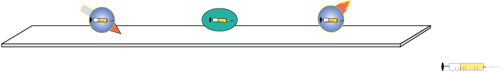
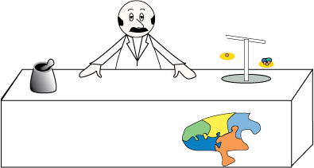
polypharmacy
combos
3rd-line treatment
D2
clozapine
2nd-line treatment
SDA
D2
Noncompliant
(depot)
SDA
DPA
1st-line treatment
SDA
BZ
D2
in case of emergency
positive symptom
pharmacy

Slide 52


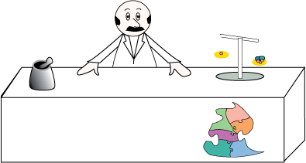
clozapine
BZ
D2
mood stabilizer
2nd-line treatment
SDA
DPA
1st-line treatment
SDA
BZ
D2
in case of emergency
aggressive symptom
pharmacy

Slide 53


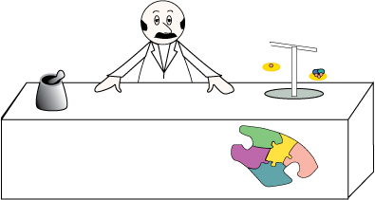
antidepressant
NRI
modafinil
amisulpride
clozapine
2nd-line treatment
SDA
DPA
1st-line treatment
negative symptom
pharmacy

Slide 54

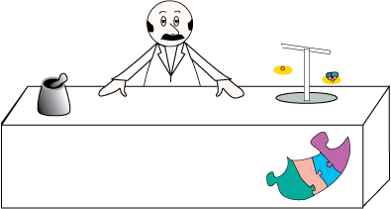
alpha 2 agonist
5HT1A
NRI
modafinil
AChEI
ACh
2nd-line treatment
SDA
DPA
1st-line treatment
cognitive symptom
pharmacy

Slide 55




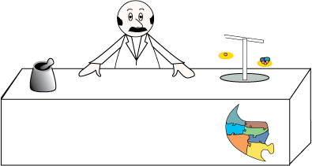
clozapine
SSRI
SDA
mood stabilizer
+
2nd-line treatment
schizophrenia
SDA
DPA
1st-line treatment
schizophrenia
clozapine
lithum
suicide
lithum
mood stabilizer
SDA
DPA
1st-line treatment
bipolar disorder
affective symptom
pharmacy

Slide 56



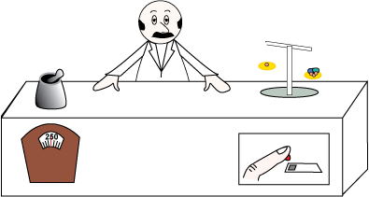
clozapine
olanzapine
D2
3rd-line treatment
risperidone
paliperidone
quetiapine
2nd-line treatment
ziprasidone
aripiprazole
1st-line treatment
metabolic
pharmacy

Slide 57



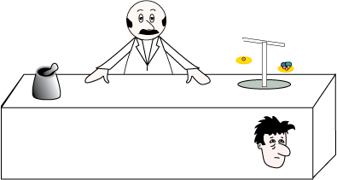
quetiapine
clozapine
olanzapine
to produce sedation
BZ
to use sedation
as needed
risperidone
paliperidone
to avoid sedation:
2nd-line
ziprasidone
bifeprunox
aripiprazole
to avoid sedation:
1st-line
sedation
pharmacy

Slide 58
Clinical Pearls
Treat Symptoms from the “Top Down”
Match Symptom with Brain Circuits/Regions & Neurochemistry to Guide Psychopharmacologic Decision Making
There are no “Right or Wrong” Choices as long as you can justify & support your Prescribing

Slide 59


Slide 60
References
NEIGlobal (2023). Teaching Slide Sets. Retrieved from: https://www.neiglobal.com/Members/TeachPracResources/TeachingSlidesTests/tabid/183/Default.aspx
Stahl, S. (2021). Stahl's Essential Psychopharmacology: Neuroscientific Basis and Practical Applications (5th ed.). Cambridge: Cambridge University Press.

