Slide 1



Breaking the Chains of
Human Trafficking
Teresa Davidson, ARNP, MSN, MA
CEO, Chains Interrupted

Slide 2
Objectives
Briefly review a few basics about human trafficking
Describe potential signs of a trafficking situation that healthcare workers should be watching for
Discuss options and resources for staff after identification of a possible trafficking situation
Implement Trauma-Informed and Survivor-Centered Care within the action steps
1
2
3
4

Slide 3


Have you ever encountered someone victimized by Human Trafficking?

Slide 4


Slide 5


Why is this important?
May be only contact
May be only time left alone
Already trained in similar areas
Those victimized by HT need us

Slide 6

Iowa Code 710A

Slide 7
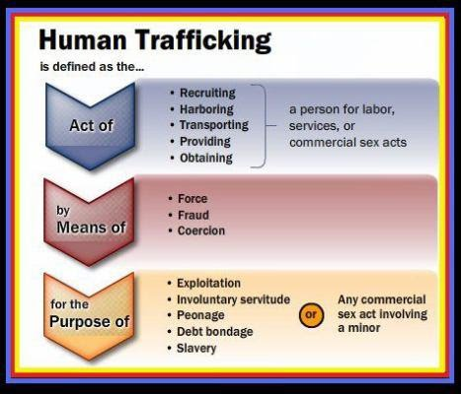

Slide 8

What if the person victimized is a minor (<18)?
Commercial Sexual Exploitation of Children (CSEC)

Slide 9

18 U.S. Code 1591
Any commercial sex act with a minor is defined as human trafficking
A commercial sex act is “any sex act, on account of which anything of value is given to or received by any person”

Slide 10
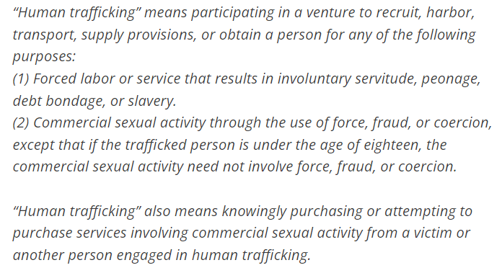
IOWA CODE 710A

Slide 11

Certain sex acts with a minor = Abuse
Sex act with a minor + payment = Human Trafficking
  money, food, clothing, shelter, drugs, etc.

Slide 12


Slide 13
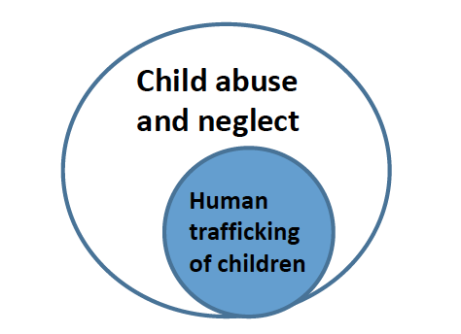
Mandatory Reporter
Iowa Code 232.68-71
Iowa Code 710A.1

Slide 14
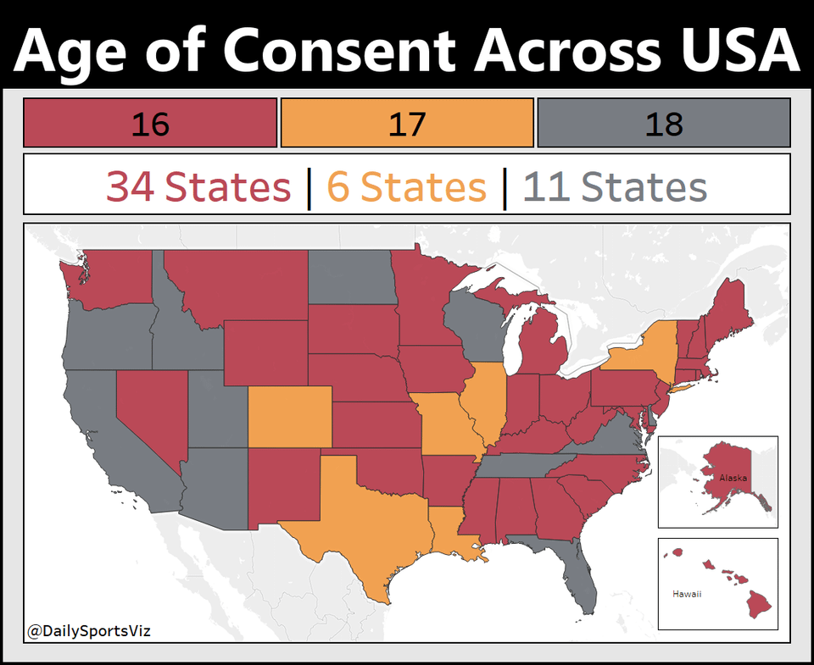

Slide 15

REMEMBER THREE THINGS: WDC²
Worth
Desperation
Control
Change

Slide 16



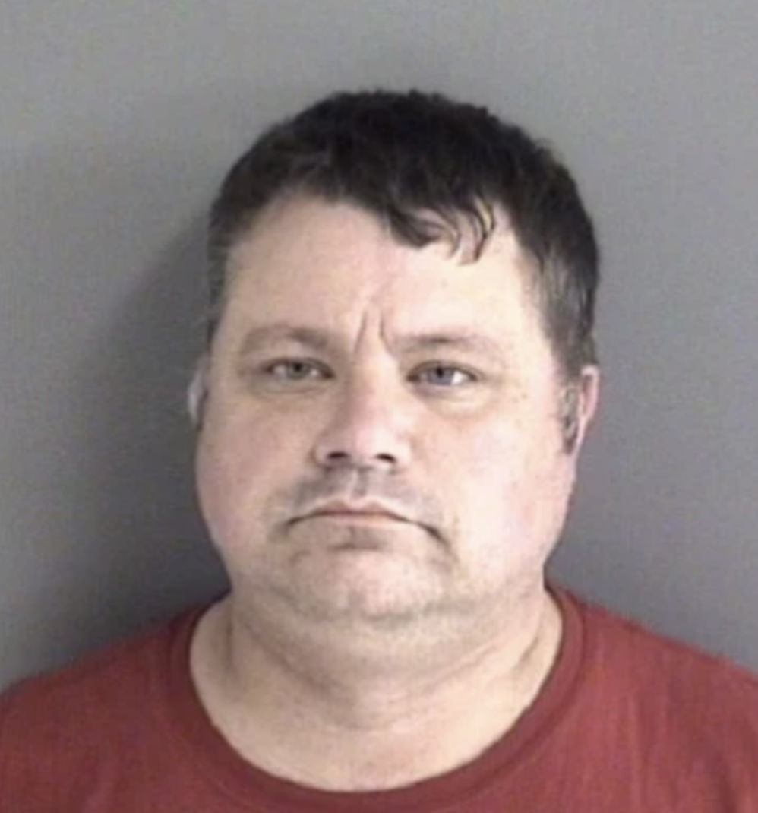
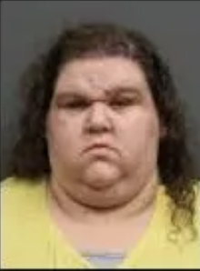
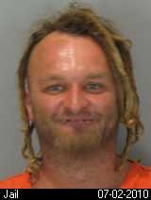
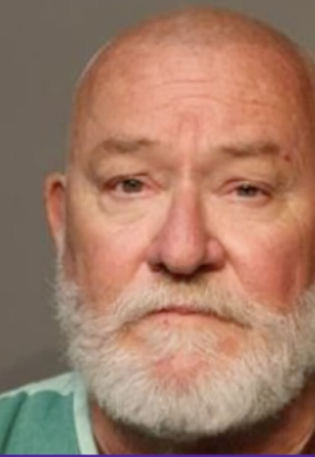
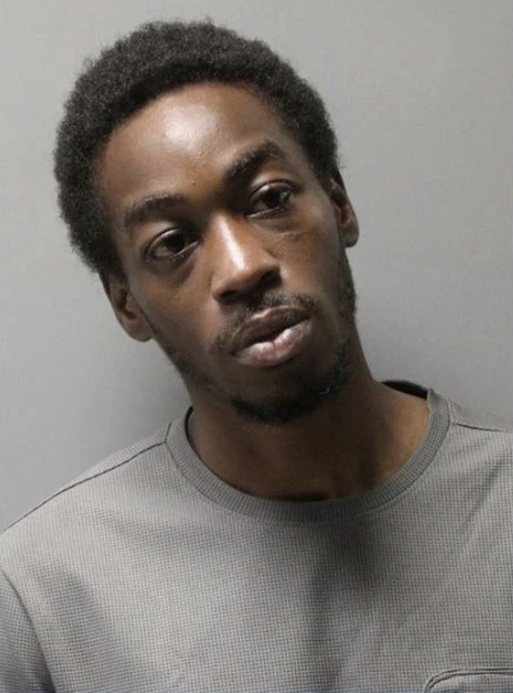
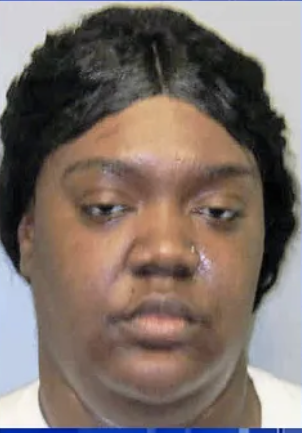
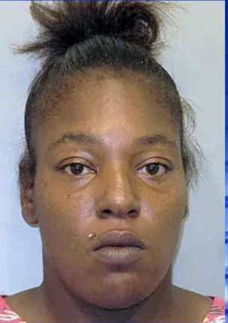
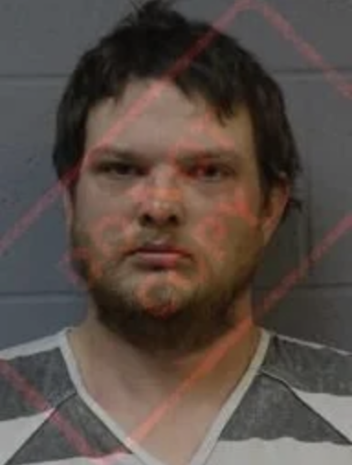
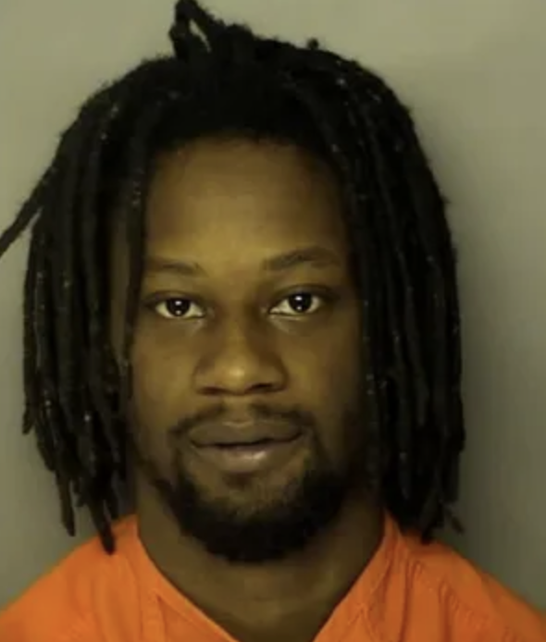


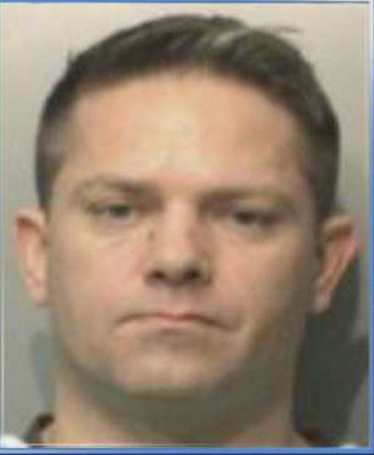
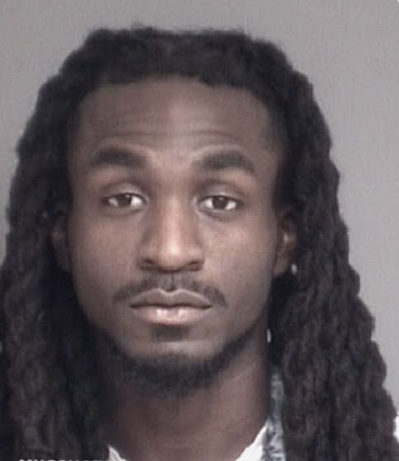
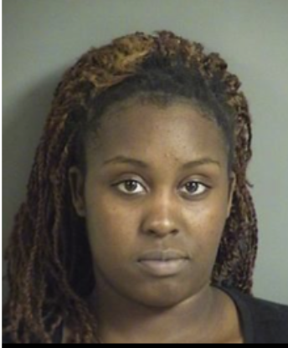
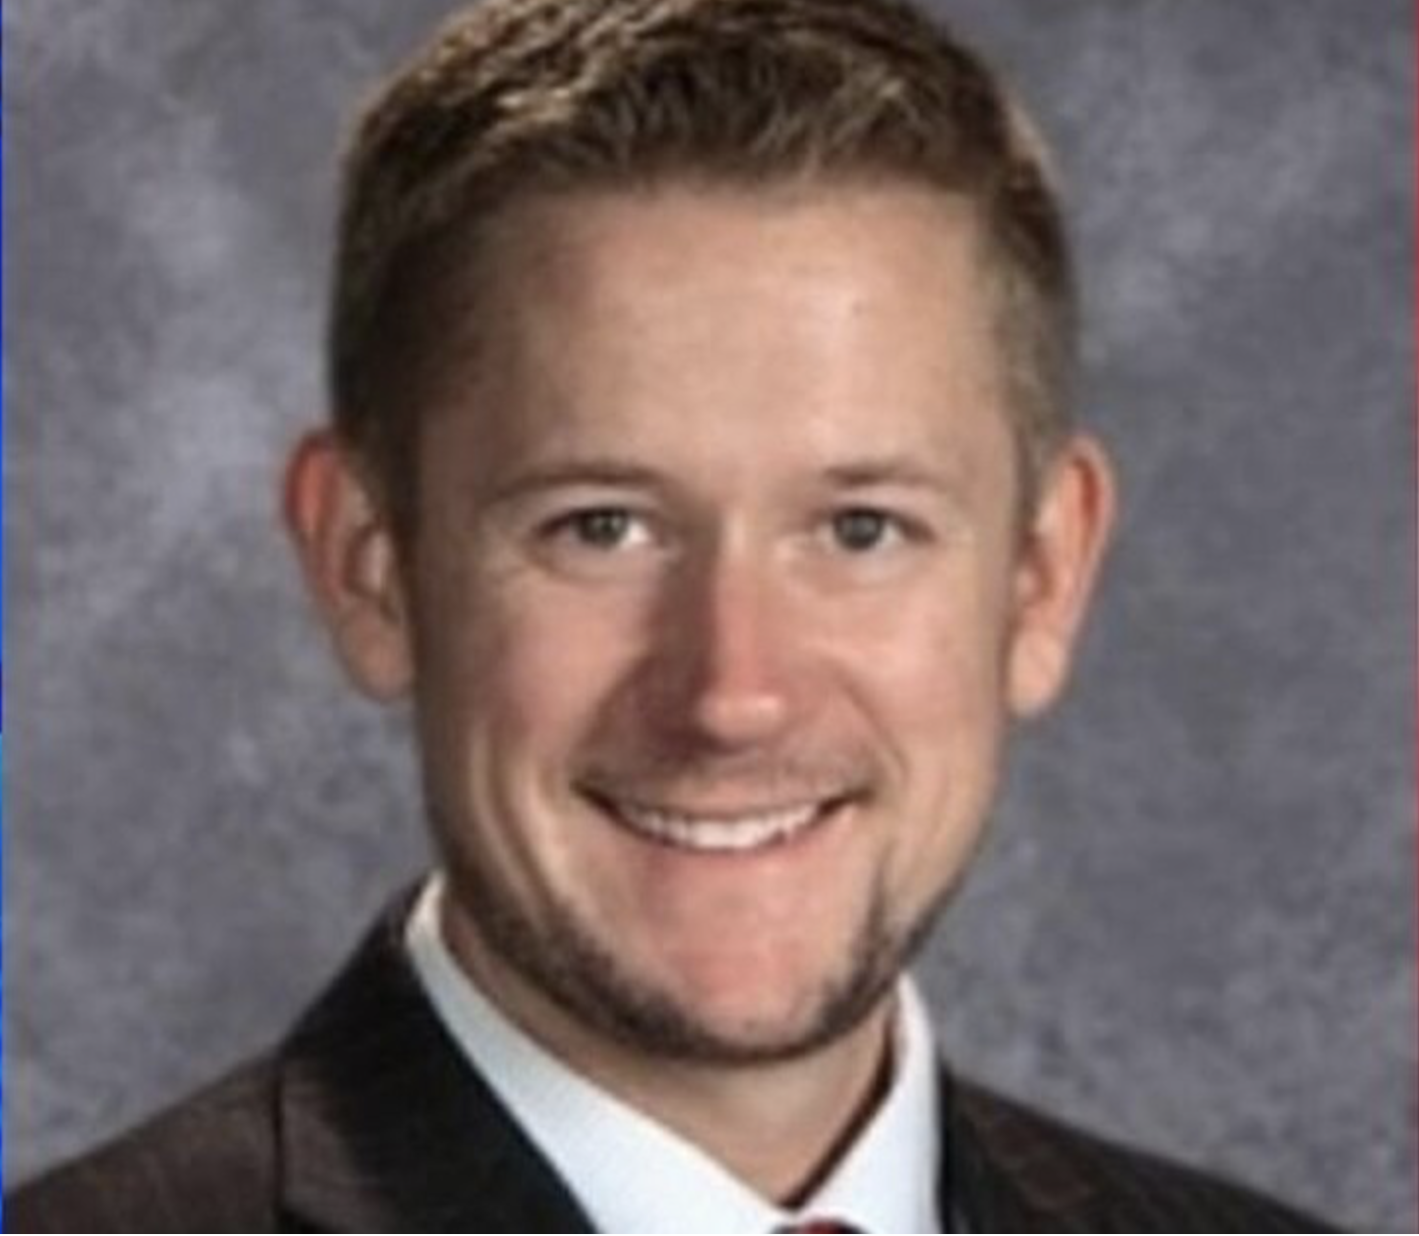
What do traffickers look like?

Slide 18
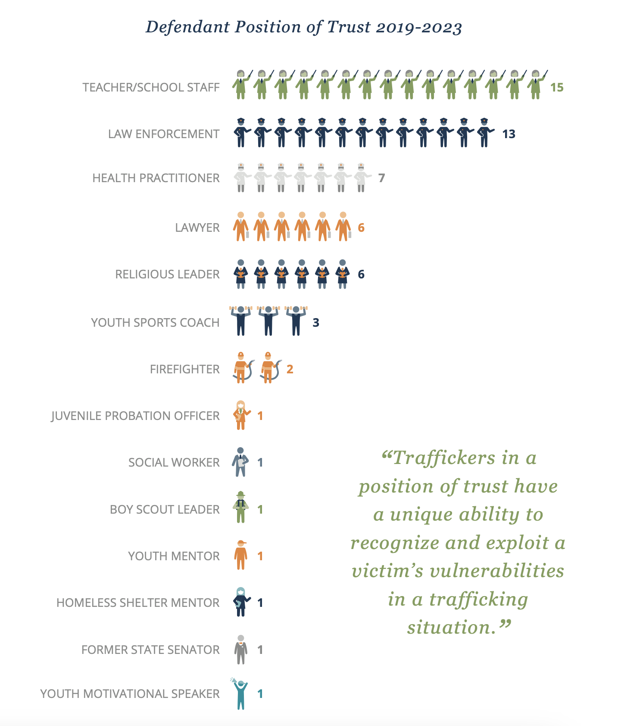

Slide 19
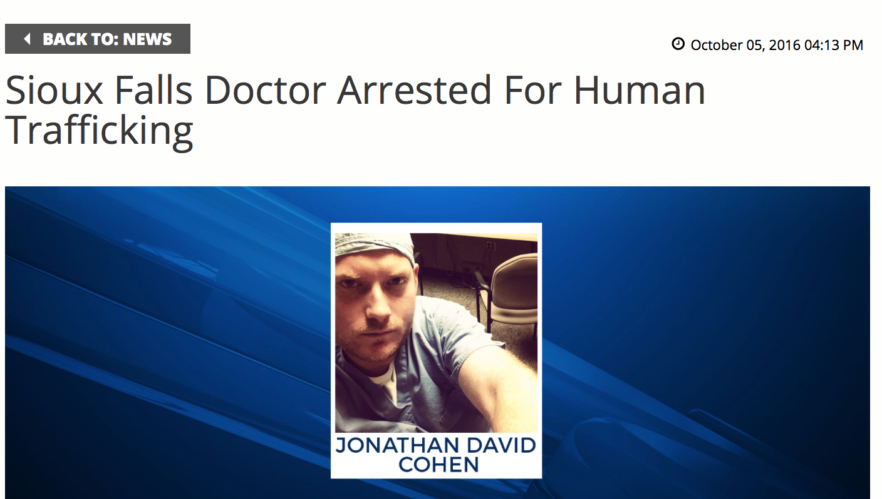
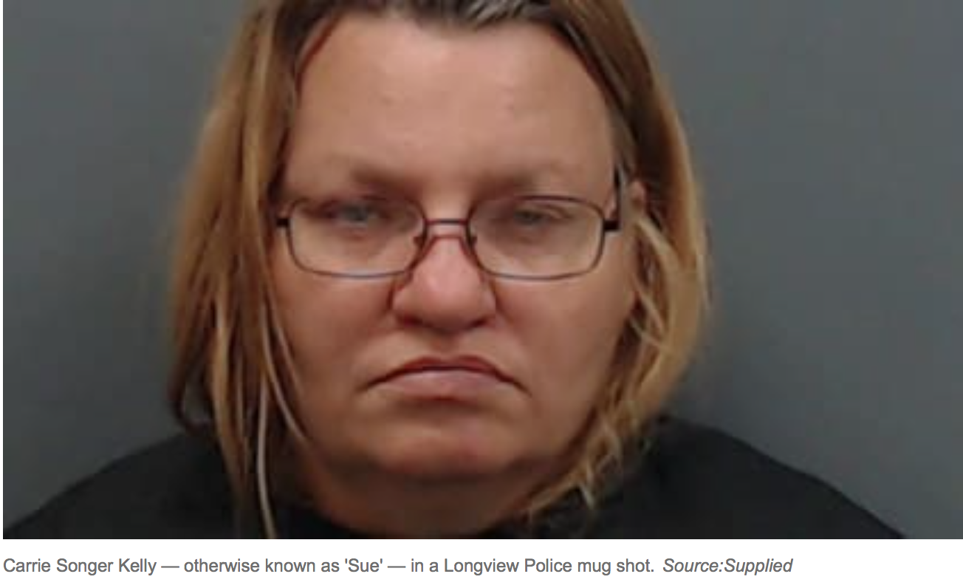


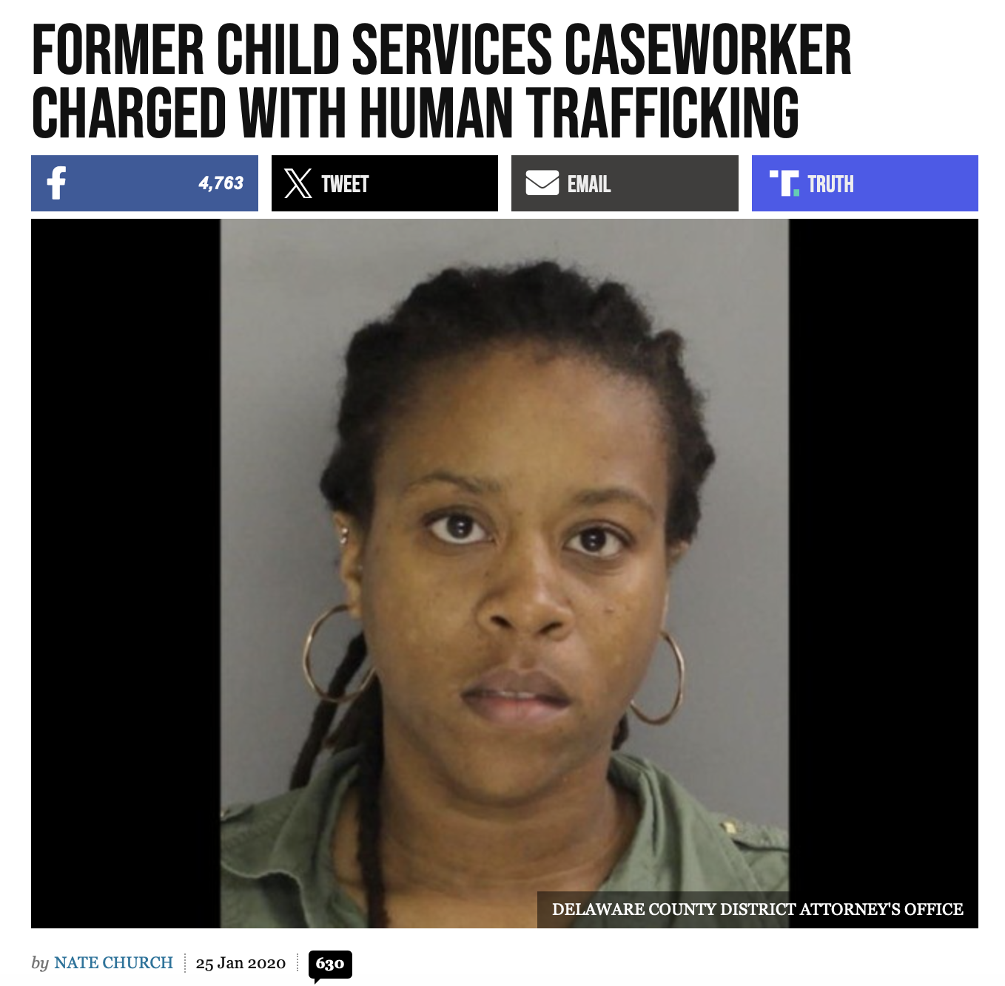

DOCTORS
FAMILY MEMBERS
NURSES
TEACHERS
PASTORS
HHS Case Workers

Slide 20

Allies.com

Slide 21

Referrals in Iowa Hospitals
Nursing student
Hospital staff
Construction worker
Back of semi
Husband businessman
Whipped with cord
Sexual assault

Slide 22

POTENTIAL ACTION STEPS

Slide 23


Slide 24

PROTOCOLS/ GUIDELINES

Slide 25


Slide 26


Slide 27
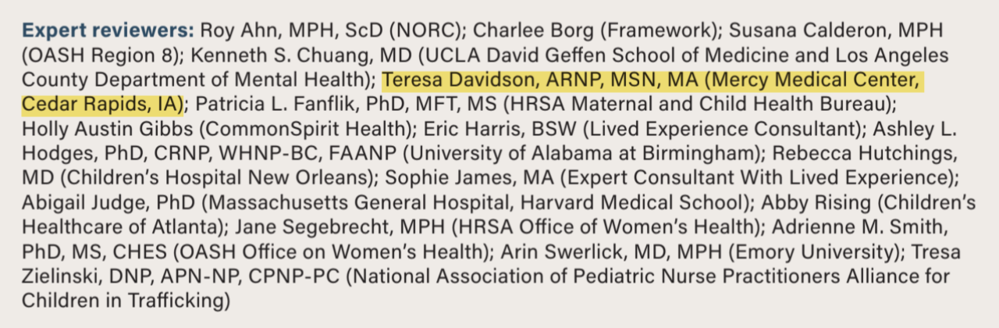

Slide 29


Slide 30
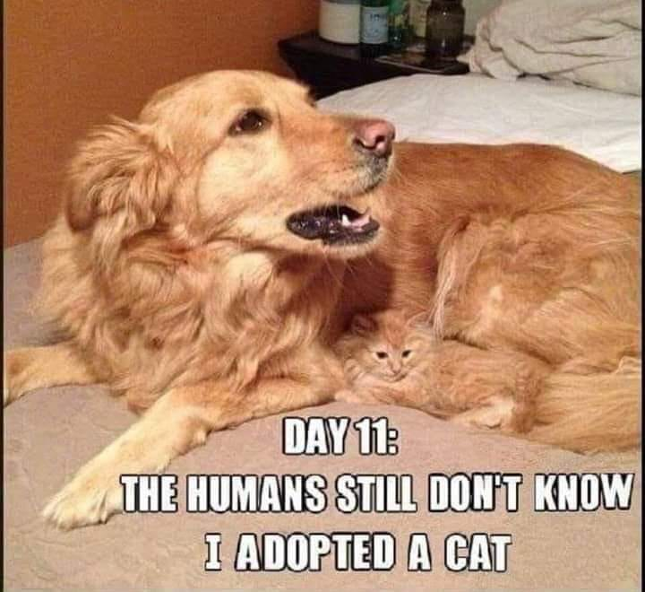

Slide 31
Why Don’t We Identify More People Victimized?
We don’t see what we don’t believe is there…or look for
Hidden in plain sight
“Prostitute,” “Runaway,” “Throwaway,” “Addict,” “Delinquent,” “Frequent Flyer”
Lack of training, time, resources
Lack of resources once identified
Rarely self identify
Under threats
Don’t understand they are being victimized
Face criminal charges
Face deportation
Loss of stability
Trauma Bond

Slide 32
Other Diagnoses
Homicide
Suicidal attempt/ideation
Substance abuse
Preterm labor
Multiple/ frequent abortions
Sexual assault
Sexually Transmitted Diseases
Urinary Tract Infections
Somatic Symptoms

Slide 33

Provide Multiple Opportunities to Identify
Staff trained and observing
Screening tool
Nonverbal opportunity

Slide 35
LOOK DEEPER - CONNECT THE DOTS
Sexual Assault
Mental Health Issues
Suicidal Ideation
Abusive Parent/ Guardian
Substance Abuse
Frequent moving
Fake relationship
Force
Fraud
Coercion
Poorly tx diabetes
Running Away
Under threat
Chronic Migraines
Chronic Trauma
Blackmail
Reason for patient visit
Addiction
2) Potential underlying cause
Indebted
3) Is there someone else involved?
4) Force, Fraud, or Coercion?

Slide 36

Strong Recommendation!

Slide 37
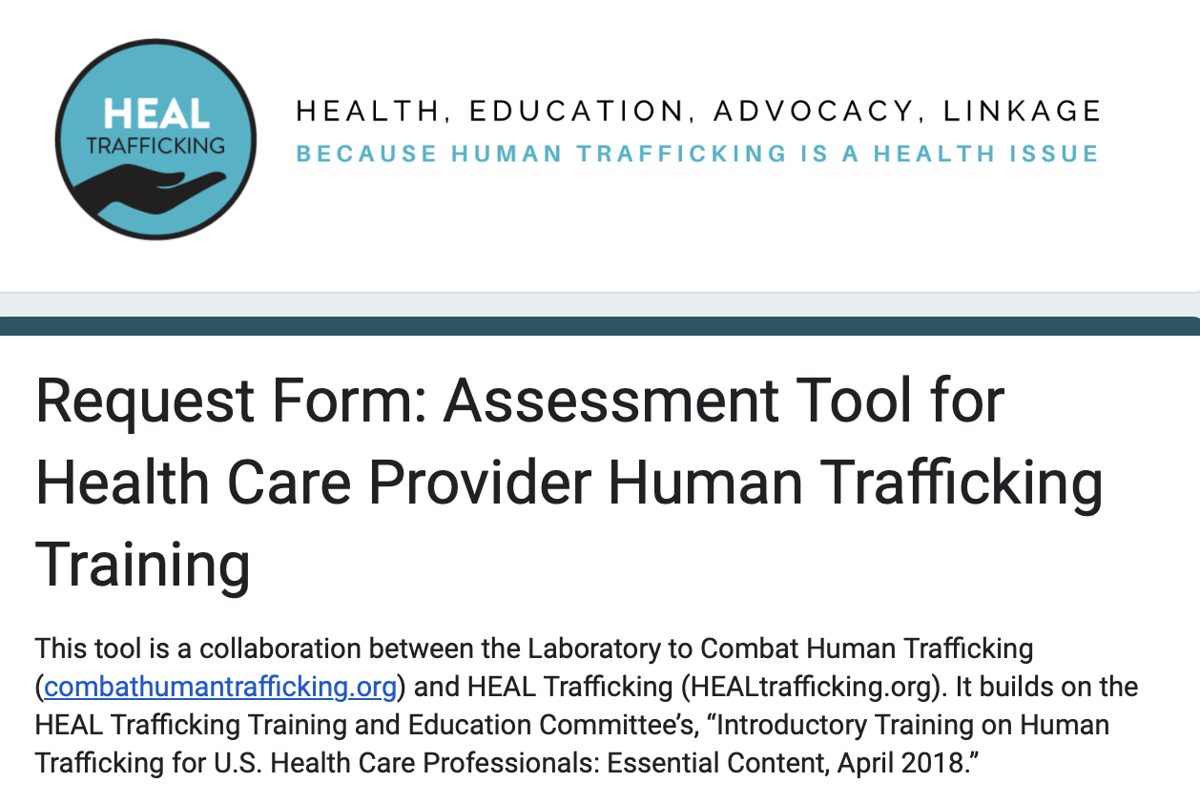

Slide 38
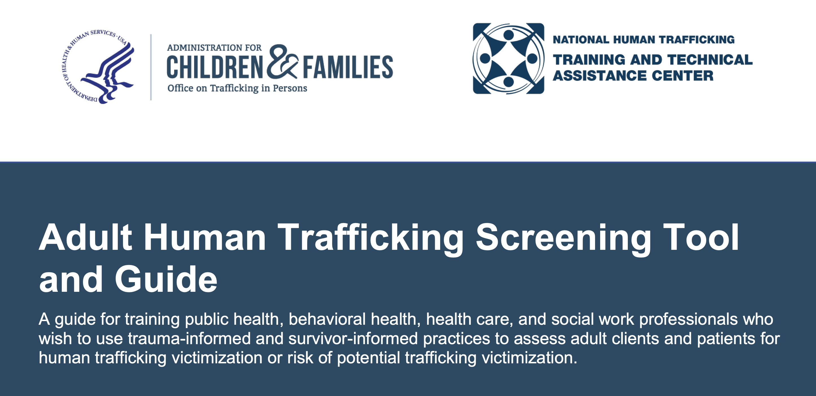

Slide 39

Priority is the patient’s medical needs

Slide 40
Talking with someone about potential victimization
Only talk to someone when they are alone
This includes addressing the cell phone
Tips and Tricks to get patients alone
“Hospital Policy” to do a private exam
Send accompanying person on an errand
Radiology

Slide 41
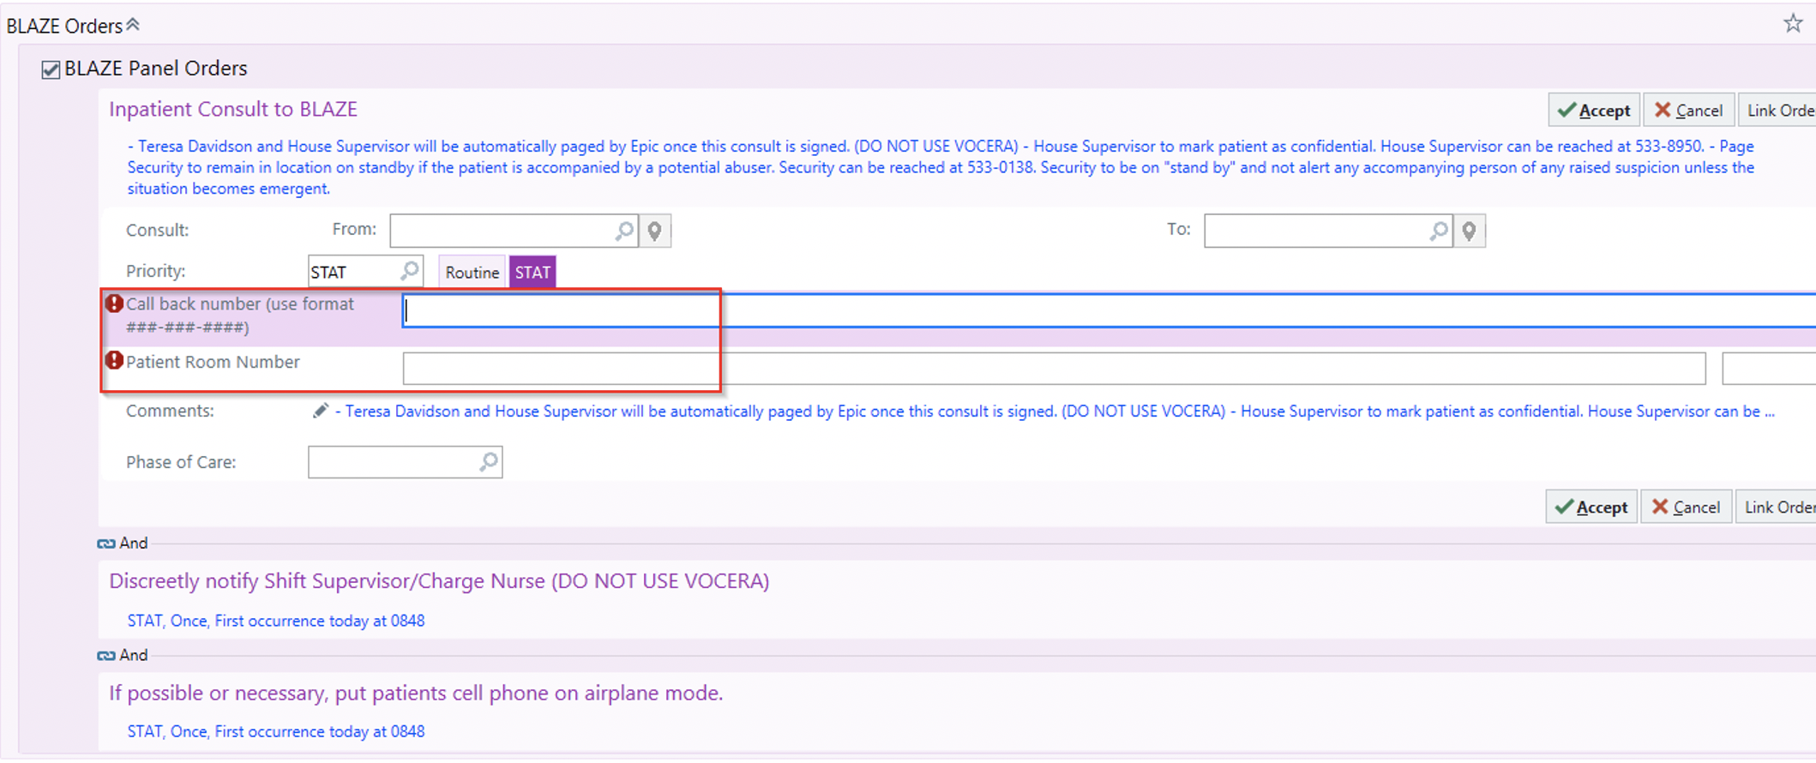

Slide 42

Act as if everything is normal and routine while you seek assistance

Slide 43

CODE WORD

Slide 44

DOCUMENTATION

Slide 45
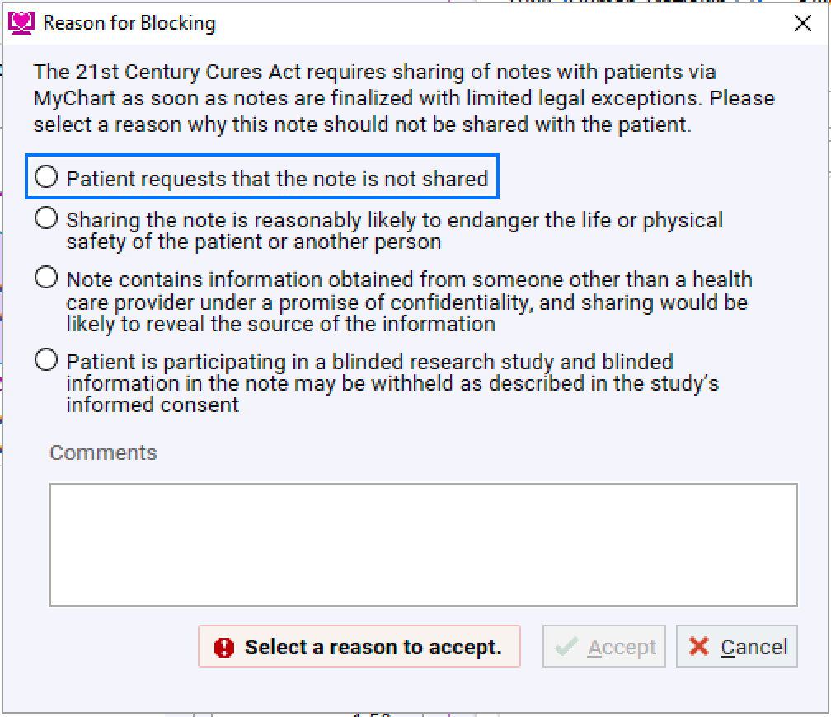

Slide 46

Trauma–Informed
Care
“A strength-based framework of thinking and interventions grounded in an understanding of and responsiveness to the impact of trauma.”

Slide 47

Common Effects of Complex Trauma
Extreme anxiety and fear
Changed relationships with others
Self-destructive behaviors
Changed feelings or beliefs about oneself
Changed perception of the perpetrator
Despair and hopelessness

Slide 48
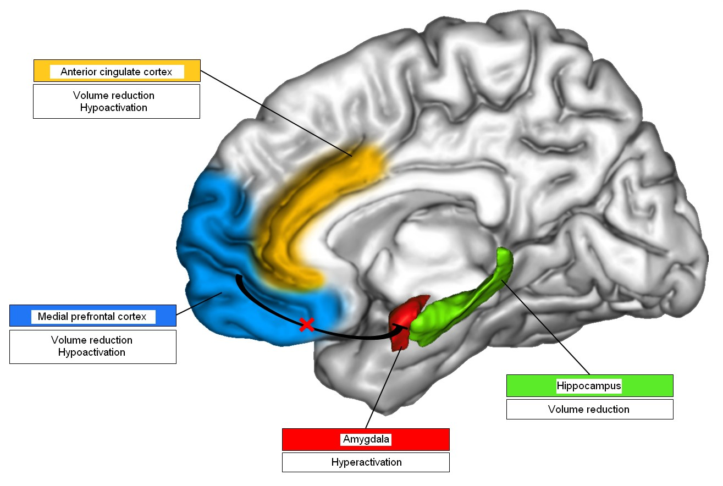
TRAUMA

Slide 49
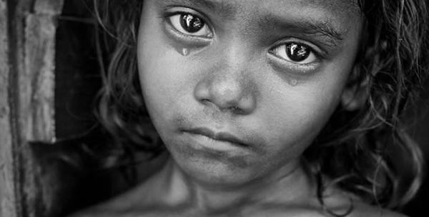



Slide 50





Slide 51


Slide 52
Trauma-Responsive Care Application
  Understand complex trauma and response
  Ensure patient understands confidentiality policies (including mandatory reporting)
  Take time to build a rapport
  Be open, transparent and aware of body language
  Allow them choices as possible
    Ask permission before touching them
    What gender of person they are examined by
  See the person victimized as the expert in their own story
  Recognize and address your own bias

Slide 53


Slide 54
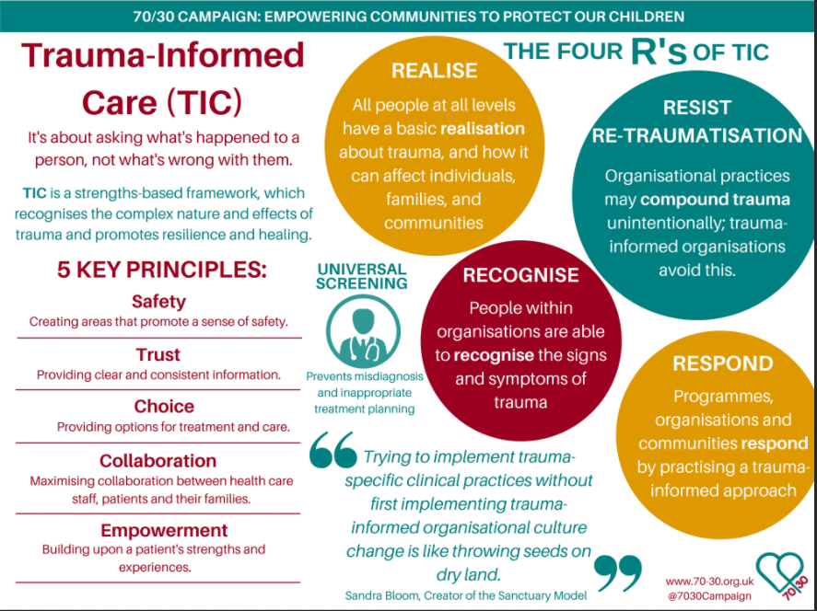

Slide 55
Everybody
Identify
Look Beneath the Surface
Breakdown Stereotypes

Slide 56
Response team
Able to Get Out? Children? SA Issues?
Want Police Involved? Undocumented?
Admitted to Hospital? Safety
Adult?
Minor?
Accompanied?

Slide 57

SAFETY PLANNING

Slide 58

National HT Hotline
1-888-373-7888
Text: BeFree (233733)
Iowa Victim Service Hotline
1-800-770-1650
Text: 20121
Iowa Tip Line
      1-855-614-4692
Teresa
      (319)-361-2806

Slide 59
Main Takeaways
No such thing as a child prostitute
Look deeper! Connect the dots. Screening tool
Worth, Desperation, Control, and Change (WDC²)
Keep patient safe: question alone, code word, documentation
First, Do No Harm
Always use Trauma-Informed Care

Slide 60


Slide 61


Slide 62

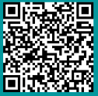
Chains Interrupted
Contact info:
(319) 361-2806 (personal cell)
Teresa@ChainsInterrupted.com
www.ChainsInterrupted.com

