Slide 1

Strengthening the Role of Pediatric Nurse Practitioners Through Workforce Innovation and System Change
Kristin Hittle Gigli, PhD, APRN, CPNP-AC, CCRN
University of Texas at Arlington, UT Southwestern
Arlington, Texas

Slide 2
Objectives
Examine trends in the pediatric provider workforce in the context of changing pediatric healthcare needs.
Identify challenges in pediatric nurse practitioner practice that limit their ability to care for children.
Discuss opportunities to address challenges in pediatric care delivery that support future workforce growth and greater interdisciplinary collaboration.

Slide 3

Pediatric Healthcare Landscape
The health of children has changed in the United States
Family stress is more widely taken into consideration
Changing pediatric practice patterns
A comprehensive approach is
needed to improve pediatric health!
National Academies of Sciences, Engineering, and Medicine (NASEM), 2023
Notes:
Changing health – chronic and lifelong conditions, mental health and suicide, violence-related injury
More than 1 in 5 children are obese
Nearly 18% have a developmental disability
Prevalence of type 2 diabetes doubled
Significant increases in anxiety, depression
Rising rates of hospitalization for attempted suicide, suicidal ideation or self-injury diagnoses
Serious conditions that were once lethal are now treatable or curable
Vaccines prevent illness and deaths
Family stress – poverty, language barriers, racism…insurance coverage…can increase the complexity of care
Pediatric health care “system” - perceived shortage of pediatricians, maldistribution, triage of disease management (PC/Subspec), medical schools and regionalization of care
I spend my time thinking about the workforce, interdisciplinary care, and access to care…

Slide 4
Towards an Adequate Supply
General Pediatricians
Pediatric Subspecialists
Advanced Practice Providers
Physician Trainees
Mental Health Provider
NASEM, 2023; Orr et al., Pediatrics, 2024
Notes:
2023 56,882 general pediatricians
29,021 subspecialists. - currently certified
4,012 child and adolescent psychologists; 9,956 CA Psychiatrists
12,000 pediatric trainees
NPs – AANP less than 4%, 2.4% PC, 0.6% AC – 70.3% FNP
PAs - 1.8% general peds, 1.6% pediatric subspecialty

Slide 5
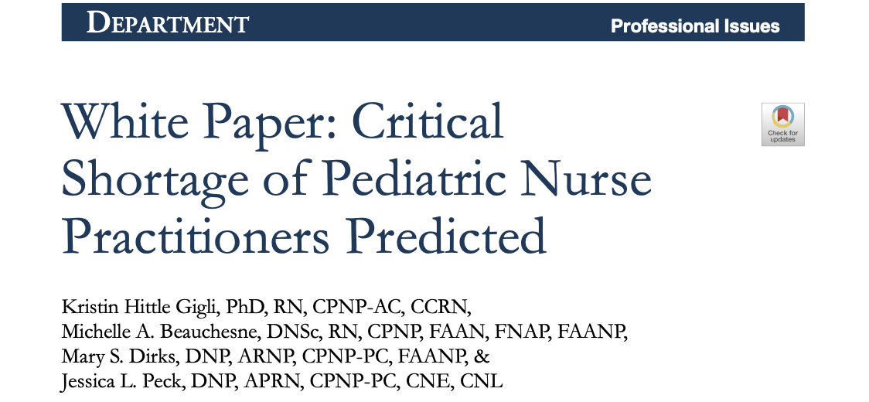
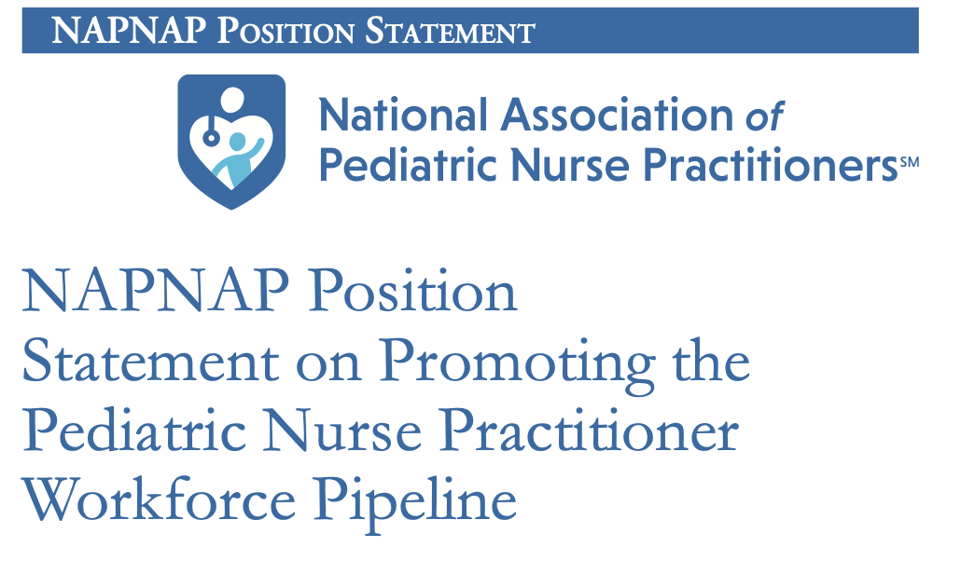
Advanced Practice Providers are increasingly part of the pediatric workforce
Desire to support and expand the pediatric nurse practitioner workforce
Freed et al., Pediatrics, 2011; Gigli et al., JPHC, 2019 & 2022; NASEM, 2023; Orr et al., Pediatrics, 2024
Notes:
Give nod to early work in 2010s by Gary Freed and team at Michigan – showed pediatricians and subspecialists desired to increase APP presence.
2019 – bring attention to the trend in PNP workforce population relative to other NP types
2022 – COVID – and challenges but individual, academic programs, organizations, professional organizations
** Also limited data on PA workforce – but ~3% of workforce is in pediatrics PAs - 1.8% general peds, 1.6% pediatric subspecialty. *In subspeciality care, increasingly providing care…

Slide 6
The Pediatric Nurse Practitioner workforce is growing, but it’s small
Nurse Practitioner Certification | 2020 n (%) | 2024 n (%) | Change in Population n (% change)
Pediatric Primary Care | 19,673 (6.8) | 21,875 (5.7) | +2,202 (11.2)
Pediatric Acute Care | 4,053 (1.4) | 5,252 (1.4) | +1,199 (29.6)
Family | 202,130 (69.7) | 264,495 (68.7) | +62,265 (30.9)
Total Workforce | 290,000 | 385,000 | +115,000 (32.8)
American Association of Nurse Practitioners, 2020 & 2024; Pediatric Nursing Certification Board, 2020 & 2024

Slide 7
70,000 Pediatric-focused Nurse Practitioners
Gigli et al., J Peds, 2023

Slide 8
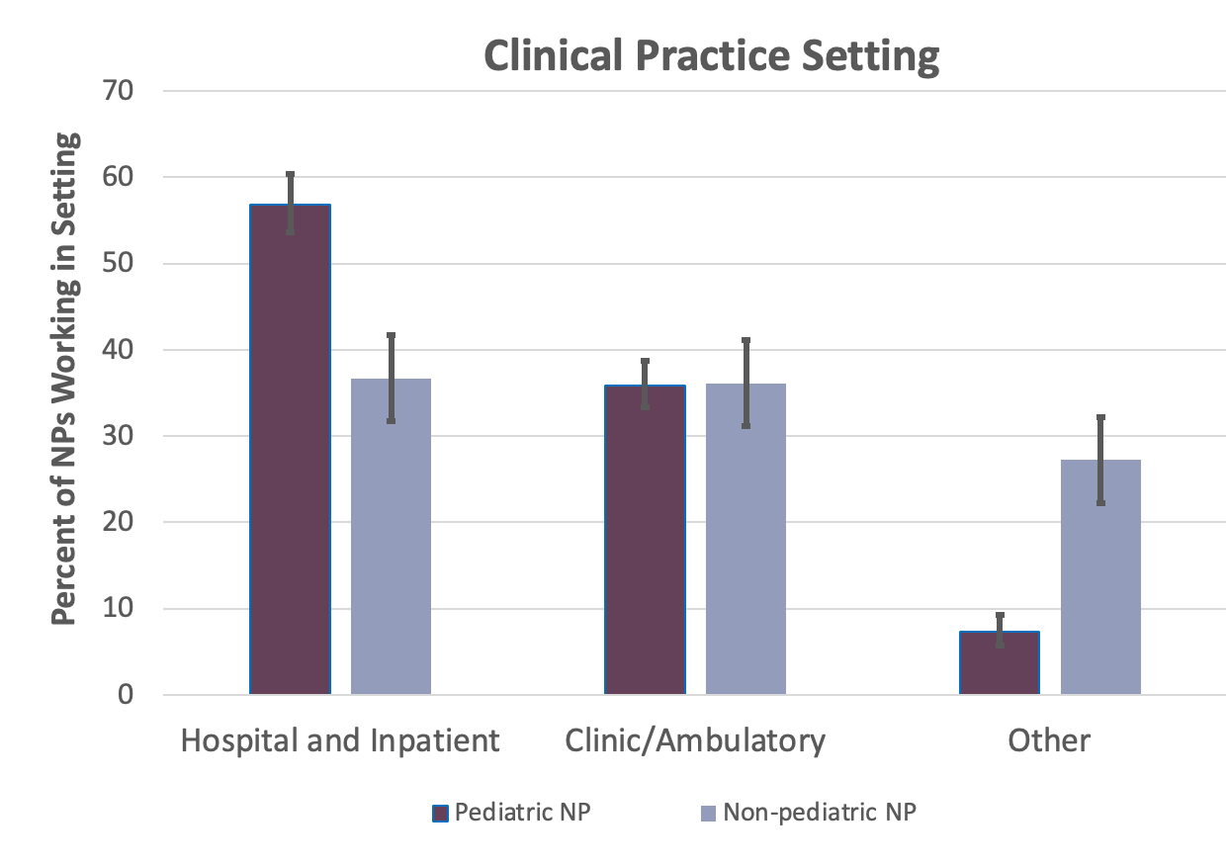
70,000 Pediatric-focused Nurse Practitioners
Gigli et al., J Peds, 2023
Notes:
30,000 in the hospital
23,000 – clinic/ambulatory
17,000 other

Slide 9
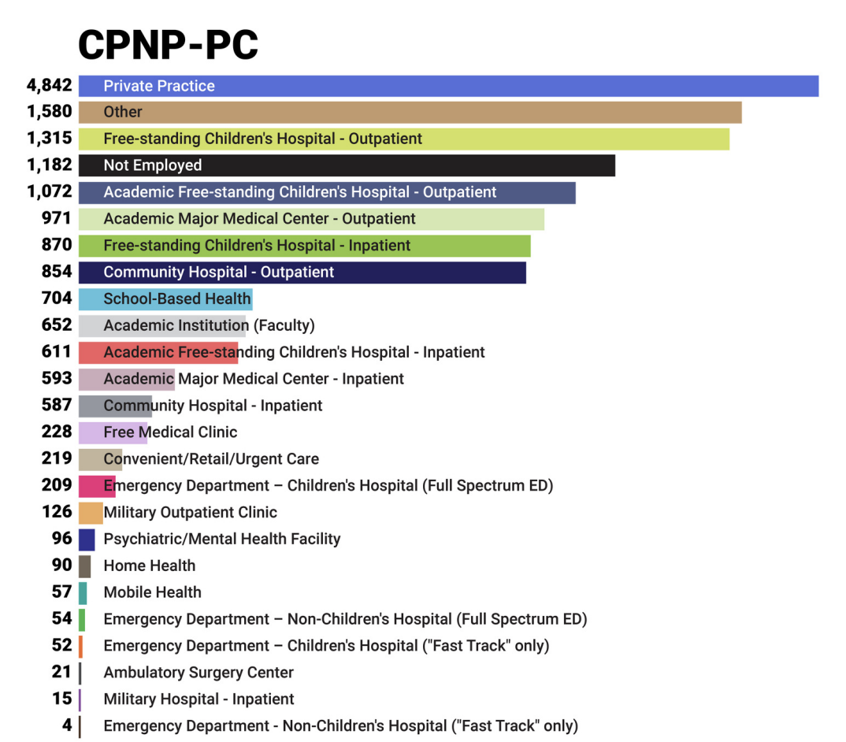
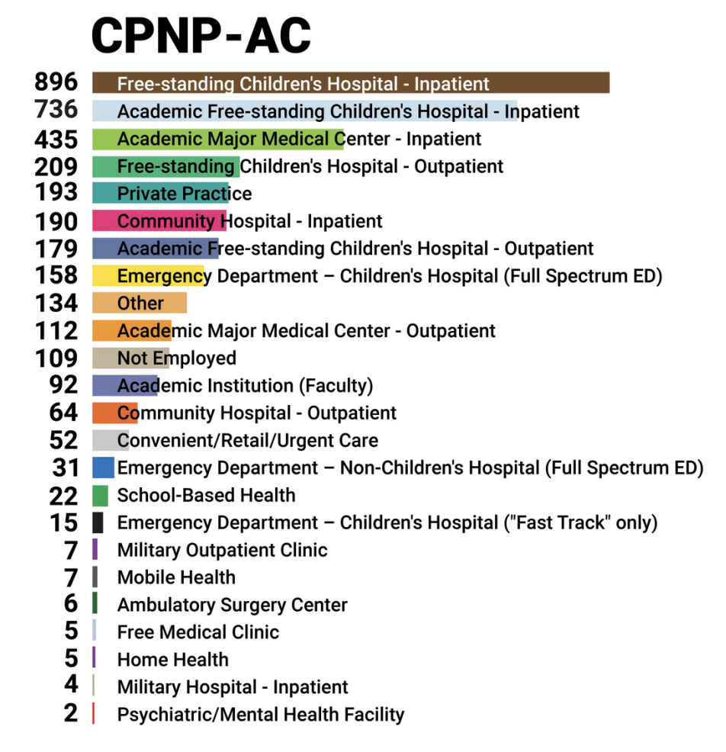
Diverse Practice Settings
PNCB, 2022

Slide 10
Top 10 Pediatric NP Clinical Subspecialties
Primary Care Pediatric Nurse Practitioner | Acute Care Pediatric Nurse Practitioner | Primary/Acute Pediatric Nurse Practitioner
Hematology/Oncology | Critical Care | Critical Care
Neonatology | Cardiovascular | Cardiovascular
Behavioral/Mental Health | Hematology/Oncology | Hematology/Oncology
Neurology/Neurosurgery | Emergency | Emergency
Adolescent | General Surgery | General Surgery
Cardiovascular | Neurology/Neurosurgery | Neonatology
Emergency | Neonatology | Neurology/Neurosurgery
Gastroenterology | Pulmonology | Pulmonology
Endocrinology | Transplant | Urgent Care/Convenient Care
Developmental | Trauma | Trauma
PNCB, 2022
Notes:
We need all pediatric providers

Slide 11

Challenging Environment
Notes:
What is the biggest challenge to the pediatric-focused NP role?
980 respondents…

Slide 12
“Who we are”
Role Recognition
  Having our role be secondary to MD role. That it [is] so often still asked- is it ok if you see the nurse practitioner instead? As if it is less good alternative.
  Nurse Practitioner is not commonly understood. Also, patients don't know what to call me so they call me "doctor" even though they know I'm a NP.
Workforce Size and Capacity
The workforce pipeline is under threat with exponential growth of FNP.
Need for PNPs who represent the people we serve (racial, gender, culture, ethnic, etc.)
Preserving, protecting, and growing the PNP role.
Bowman & Gigli., JAANP, 2025
Notes:
Historically and to this day nurses are suffering from an identity crisis. As NPs the waters get even murkier as we become nurses who practice medicine. I believe our profession needs to do a better job of first identifying and connecting with our roles and then project this to colleagues and the general public more accurately.

Slide 13
“What we can do”
Value of Pediatric Expertise
Others (non NPs) seeing the value and training of P[ediatric] NP vs F[amily] NP in pediatric positions. MDs in my area have limited understanding of training and scope of different types of NPs.
Seems as if so many PNPs are losing out [on job opportunities] to FNPs.
Work to our Full Scope of Practice
[State] the law prohibits us from prescribing most controlled substances, so treating ADHD is complicated. We have to ask a physician to send a prescription every time..
…most of the hospitals not granting PNPs admission privileges. It is not practical to have a PNP on call if they cannot admit the patient to the hospital by themselves.
Right now it would be finding clinic positions that allow us to work to our full potential.
Bowman & Gigli., JAANP, 2025
Notes:
Family NPs getting PNP jobs, and no set policy for what jobs truly require AC vs PC certification. There is no standard across the country.

Slide 14
”What we need to do our jobs”
Time and Support
…more burden (administrative, documentation) has been placed on NPs. Because we have been nurses it is assumed that we can do it all…we are asked to constantly be more productive.
Adequate clinical nursing and administrative support…
Reimbursement
Equal pay for doing the same work as physician colleagues.
Providing quality health prevention and maintenance vs business focus and profit.
Not enough time to provide excellent care related to reimbursement issues.
Work-life Balance
Provider burnout and juggling seeing enough patients for the time the offices want and feeling you've provided adequate care.
Work-life balance and transitioning from a floor nurse to NP where you have more responsibilities and often taking work home.
Bowman & Gigli., JAANP, 2025

Slide 15
Implementing Pediatric NP Roles
Work Factors | Pediatric NPs | Non-Pediatric NPs Caring for Kids | p-value
Primary provider for a patient panel | 47.5 % (45.0 – 50.8) | 47.6 % (44.0 – 51.2) | 0.97
Hospital admitting privileges | 16.8 % (14.7 – 19.1) | 26.1 % (23.3 – 30.0) | < 0.001
Bill using a personal NPI | 53.5 % (50.3 – 56.7) | 58.3 % (55.4 – 61.1) | 0.09
Work to full scope of practice | 88.8 % (86.4 – 90.8) | 85.1 % (82.8 – 87.2) | 0.02
*Weighted national estimates based on 2018 NSSRN

Slide 16
Satisfaction
Equal Colleagues
Understand Role
Understand Scope of Practice
How are teams working in pediatrics?
93%
42%
81%
72%
*Weighted national estimates based on 2018 NSSRN
Notes:
Significant factors of APP job satisfaction are (1) a good working relationship with administrators, physicians, and learners, (2) support for APP autonomy, (3) clear role definition, and (4) clinical practice at the top of licensure and education
Understand – department chair

Slide 17
Barriers limit role implementation, access to care, and increase healthcare costs.
A lack of perceived value in the clinical expertise of pediatric-focused nurse practitioners
Statutory and institutional policies
Limited organizational support
Time
Resources
Education
Reimbursement
Career longevity

Slide 18

Opportunity abounds!
Notes:
Workforce growth and interdisciplinary collaboration…visibility and value

Slide 19
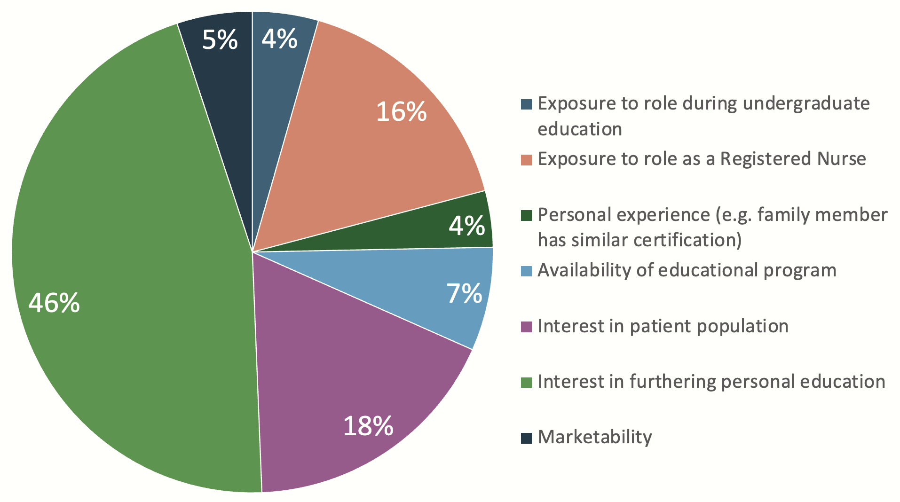
What was your primary motivation to be a PNP?
Armstrong et al., J Ped Health Care, 2023

Slide 20
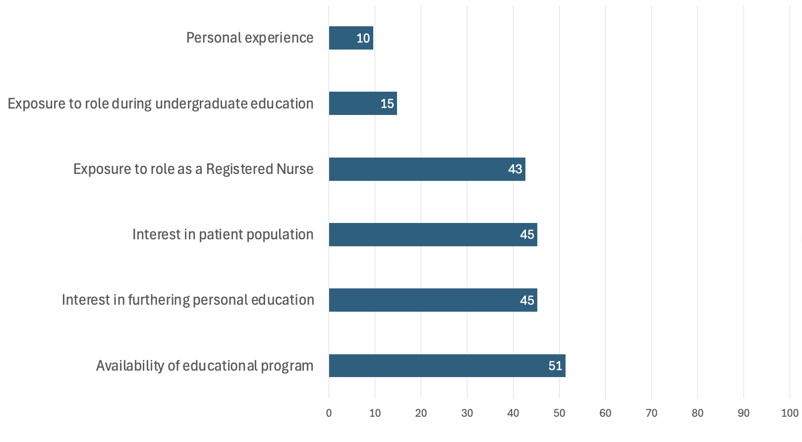
Additional motivators were numerous
Armstrong et al., J Ped Health Care, 2023

Slide 21
NP inclusive models of care
Independent Practice
Independent Initial –Supervised Wrap
Tail/Established
True Care Team
Procedure Based
Chaney et al., J Ambul Care Manage, 2022
Notes:
Independent practice…Iowa Full Practice State but…collaboration higher in FPA, particularly in FPA states (Park et al., Med Care Res & Rev, 2016)

Slide 22
NP and training physician models
Full compliment
Fellows, Residents, and APPs with Attending
In Adjunct
Residents and APPs with Attending
In Lieu
APP with Attending
Inpatient Team Construction Models
Gigli et al, Med Care, 2021

Slide 23

Create Role Visibility
Notes:
Promote the PNP role within personal and professional networks.
Highlight the benefits of precepting PNP students to the PNP profession and health care agencies through scholarship and advocacy efforts.
The PC PNP is educated to optimize child health outcomes, promote growth and development, and maintain the holistic health and relationships of children, families, and communities
The AC PNP is educated to provide comprehensive, holistic, culturally appropriate, family-centered care for children with episodic, critical, and complex chronic illness or injury.
Know your resources – NAPNAP, PNCB, IPN…be everywhere and know who you are

Slide 24
Improving NP inclusive pediatric care
Demonstrate quality and value
Courtwright et al., JPHC, 2024
Notes:
Quality and value of pediatric subspecialty care –vs other types of providers (adults), APP specifically…
Systematic review
26 studies, mostly published before 2013 and observational. Prescriptive privileges, training program availability, organizational climate, and telehealth are facilitators. Mandated physician supervision, reduced pediatric curricula, geographically disparate training programs, and poor data infrastructure are barriers. The sample is limited by a moderate to high risk of bias.

Slide 25
Measuring NP outcomes
Reflect on NP role for a specific areas of focus
Identify outcomes impacted by role
Select evaluation method
Assess data gathering opportunities
Collect, analyze and evaluate date
Disseminate to stakeholders
AANP, 2014

Slide 26
Measuring NP Contributions to Care
Quality/Safety Metrics
Hospital-acquired conditions
Patient satisfaction scores
Health Care Outcomes
Length of stay
Care-specific Metrics
Rates of EBP protocol adherence
Nurse/staff satisfaction
Role-specific metrics
Left without being seen
Primary care
Asthma clinic
Cost of car
Readmission rates
Clinic wait times
30-day mortality rates
Asthma-related ED visits and hospitalizations
Rapid Response Team
Immunization rates
Mental health screenings
Inpatient codes, ICU admissions
Inpatient
Lab / imaging use, timely discharge
Patient knowledge
Adverse events (unplanned extubation)
Screening rates
Turnover
Kleinpell et al., HCA Health J of Med, 2024; Thompson et al., Collegian, 2025

Slide 27

Improving NP inclusive pediatric care
Demonstrate quality and value
Appropriate reimbursement for care
Everyone works to fullest scope
Expand interprofessional teams
Notes:
Quality and value of pediatric subspecialty care –vs other types of providers (adults), APP specifically…
Systematic review ***
2. NASEM reimbursement for pediatric and APP care RVUs that reflect time and resource use of ped subspecialty; pay for models of care coordination
3. What does full scope mean? How can we empower pediatricians to manage pediatric chronic illness; in hospital settings – how do we maximize the skills of each team member – facilitating attending physicians ability to manage and care for the most complex, highest need patients
4. Who is on the team, what skills and knowledge do they bring (deep and wide analogy)
Inpatient and outpatient roles
Educate and advocate for APP role
Research – what outcomes – patient and organizational

Slide 28

Thank you!!

Slide 29
For more information on this subject, see the following publications:
American Academy of Physician Associates. (n.d.). PA practice modernization. https://www.aapa.org/advocacy-central/pa-practice-modernization/
American Association of Nurse Practitioners. (2014). NP Patient Outcomes Toolkit.
American Association of Nurse Practitioners. (2020). 2020 AANP National Nurse Practitioner Sample Survey Results.
American Association of Nurse Practitioners. (2024). Practice Report.
American Nurses Association. (2015). Pediatric Nursing: Scope and Standards of Practice (2nd ed.). American Nurses Association, Inc.
Armstrong, A. B., Bowman, A., Goreth, M., Trabosh, T., & Gigli, K. H. (2023). Career Choices and Experiences in Role Transition: A Multistate Survey of Pediatric-Focused Hospital-Based Nurse Practitioners. Journal of Pediatric Health Care, 37(3), 319–327. https://doi.org/10.1016/j.pedhc.2022.12.005
Bowman, A. F., & Gigli, K. H. (2025). Perceptions of the challenges facing nurse practitioners in providing care to children. Journal of the American Association of Nurse Practitioners, 37(7), 395–403. https://doi.org/10.1097/JXX.0000000000001114
Bowman, A. F., Goreth, M. B., Armstrong, A. B., & Gigli, K. H. (2022). Hospital Regulation of Pediatric-Focused Nurse Practitioners: A Multistate Survey. Journal for Nurse Practitioners, 18(5), 558-562.e1. https://doi.org/10.1016/j.nurpra.2022.01.016
Chaney, A., Beliles, G., Keimig, A., & Porter, I. (2022). Advanced Practice Provider Care Team Models: Best Practices From an Academic Medical Center. Journal of Ambulatory Care Management, 45(2), 126–134. https://doi.org/10.1097/JAC.0000000000000412
Courtwright, S. E., Turi, E., Barr, E. A., Burns, J. C., Gigli, K. H., Bennett, C. R., Sonney, J., Francis, L., & Poghosyan, L. (2024). Facilitators and Barriers to Pediatric Nurse Practitioner Practice in the United States: A Systematic Review. Journal of pediatric health care : official publication of National Association of Pediatric Nurse Associates & Practitioners, 38(4), 520–543. https://doi.org/10.1016/j.pedhc.2023.12.003

Slide 30
Freed, G. L., Dunham, K. M., Loveland-Cherry, C., Martyn, K. K., Moote, M. J., Althouse, L., Balistreri, W., Cohen, A., First, L., Land, M., Lister, G., McGuinness, G., McMillan, J., Miles, P., St Geme, J., & Stockman, J. (2011). Nurse practitioners and physician assistants employed by general and subspecialty pediatricians. Pediatrics, 128(4), 665–672. https://doi.org/10.1542/peds.2011-0329
Gigli, K. H., Beauchesne, M. A., Dirks, M. S., & Peck, J. L. (2019). White Paper: Critical Shortage of Pediatric Nurse Practitioners Predicted. Journal of Pediatric Health Care, 33(3), 347–355. https://doi.org/10.1016/j.pedhc.2019.02.008
Gigli, K. H., Davis, B. S., Martsolf, G. R., & Kahn, J. M. (2021). Advanced Practice Provider-inclusive Staffing Models and Patient Outcomes in Pediatric Critical Care. Medical Care, 59(7), 597–603.
Gigli, K. H., Martsolf, G. R., Vinci, R. J., & Buerhaus, P. I. (2023). A Cross-Sectional Examination of the Nurse Practitioner Workforce Caring for Children in the United States. In Journal of Pediatrics (Vol. 257). Elsevier Inc. https://doi.org/10.1016/j.jpeds.2023.02.020
Health Resources and Services Administration, & National Center for Health Workforce Analysis. (2019). 2018 National Sample Survey of Registered Nurses Brief Summary of Results. http://bhw.hrsa.gov/healthworkforce/index.html.
Kleinpell, R., Kapu, A., & Borum, C. (2024). Measures of Success: Making the Case for Advanced Practice-Sensitive Quality Indicators. HCA Healthcare Journal of Medicine, 5(5). https://doi.org/10.36518/2689-0216.1900
National Association of Pediatric Nurse Practitioners, Gigli, K. H., Sonnet, jJ., Lee, A. M., Sheehan, A., McNamara, M., Hunter, J., & Peck. J. L. (2022). NAPNAP Position Statement on Resilience and the Postpandemic Pediatric Nurse Practitioner Workforce. Journal of Pediatric Health Care, 36(2), 205-209. https://doi.org/10.1016/j.pedhc.2024.06.003
Orr, C. J., McCartha, E., Vinci, R. J., Mink, R. B., Leonard, M. B., Bissell, M., Gaona, A. R., & Leslie, L. K. (2024). Projecting the Future Pediatric Subspecialty Workforce: Summary and Recommendations. Pediatrics, 153. https://doi.org/10.1542/peds.2023-063678T
Park, J., Athey, E., Pericak, A., Pulcini, J., & Greene, J. (2018). To What Extent Are State Scope of Practice Laws Related to Nurse Practitioners’ Day-to-Day Practice Autonomy? Medical Care Research and Review, 75(1), 66–87. https://doi.org/10.1177/1077558716677826

