Slide 1
State of Legislation—State and Federal
NAPNAP Iowa Chapter Annual conference
September 19, 2025
IMU
Iowa City, Iowa

Slide 2
Objectives:
Upon completion of the session participants will be able to:
Identify State and Federal legislation impacting women and children
Discuss potential impact of Medicaid cuts
Discuss advocacy opportunities for ARNP’s/APRN’s regarding legislation

Slide 3
Financial disclosure
I have no financial conflicts or conflicts of interest to disclose

Slide 4
Iowa Legislature and Iowa Federal Delegation

Slide 5

Thank you to Kate Walton for the generous use of her slides regarding the State Legislature and the Iowa Federal Delegation

Slide 25
Federal Issues Facing Children and Families

Slide 26
HR 1
One big Beautiful Bill Act
According to estimates from the Congressional Budget Office (CBO),
the "One Big Beautiful Bill Act" (OBBBA), signed into law in July 2025,
is projected to cause up to 13.7 million Americans to lose their health insurance by 2034.
Sources note that other estimates suggest coverage losses could be higher,
especially when accounting for the expiration of enhanced Affordable Care Act (ACA) subsidies.
The loss of health coverage is attributed to provisions in the law
that alter Medicaid, Medicare, and the ACA marketplace.

Slide 27
Medicaid Cuts Enacted in H.R. 1
H.R. 1 includes an estimated $1 trillion in Medicaid cuts over 10 years.
Freezes provider taxes at current levels for two years and reduces for expansion states by .5% each year from FY 2028 (5.5%) to 2032 (3.5%).
Sets a new payment limit for state directed payments at 110% of Medicare for non-expansion states and 100% of Medicare for expansion states. Existing state directed payments would be reduced by 10% until they reach the Medicare levels noted above beginning 1/1/28.
Creates a Rural Health Transformation Fund of $50 billion for 5 years ($10 billion for each year FFY 2026-2030).
Reduces retroactive coverage for children from 90 to 60 days (30 days for adults).
Includes new restrictions on eligibility for lawfully residing noncitizens who have been covered through Medicaid for decades.
Imposes Medicaid work requirements for expansion and expansion-like adults ages 19 to 64 beginning 1/1/27.
Requires more regular eligibility reviews for Medicaid expansion adults.

Slide 31
Immunizations
Recent significant changes to the Advisory Committee on Immunization Practices (ACIP) include the reconstitution of the committee, replacing all 17 existing members with new appointees, along with a shift to a "shared clinical decision-making" model for some vaccines, like the COVID-19 vaccine for healthy children. These changes, which have also affected the inclusion of liaison experts and led to concerns about the loss of vaccine expertise, are part of the new administration's effort to restore public trust in the vaccine process.

Slide 32
AAP Immunization Schedule
The American Academy of Pediatrics (AAP) has released its own evidence-based immunization schedule with updated recommendations for 3 respiratory viruses.
According to the AAP, the immunization schedule, “Recommended Childhood and Adolescent Immunization Schedule: United States, 2025” differs from the recommendations provided from Centers for Disease Control and Prevention’s Advisory Committee on Immunization Practices (ACIP). In June, the US Department of Health and Human Services (HHS)’s Secretary Robert F. Kennedy Jr removed all 17 sitting members of the ACIP, replacing them with 8 new members, some of whom were reported to be vaccine skeptics tied to groups spreading vaccine misinformation.
“The AAP will continue to provide recommendations for immunizations that are rooted in science and are in the best interest of the health of infants, children and adolescents,” said AAP President Susan J. Kressly, MD, FAAP. “Pediatricians know how important routine childhood immunizations are in keeping children, families and their communities healthy and thriving.”
The new AAP schedule provides guidance for routine immunization against 18 diseases, including updates for respiratory syncytial virus (RSV), influenza, and COVID-19 immunization.
AAP-Immunization-Schedule.pdf
NAPNAP has endorses the AAP Immunization schedule

Slide 33
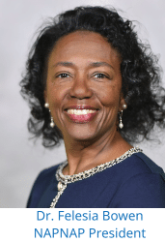
Official Statements / By NAPNAP Leadership
NAPNAP Official Statement on ACIP’s Claims of Organization Liaison Bias
The National Association of Pediatric Nurse Practitioners (NAPNAP) strongly objects to Advisory Committee on Immunization Practices’ (ACIP) latest attempt to silence volunteer subject matter experts. For more than two decades, NAPNAP has been a valuable participant in ACIP, as both a voting member and liaison member. Our infectious disease and immunization experts have joined representatives from other leading health care organizations to provide CDC scientists with real-time clinical experiences, collaborative analysis of the evidence and discussion about life-or-death implications in vaccine recommendations.
In spite of NAPNAP’s unblemished record of public service and expertise in optimizing child health and well-being, on July 31, the ACIP Secretariat notified all liaison organizations that their volunteers are now prohibited from participating in ACIP workgroups because the organizations are considered “special interest groups” and “expected to have a ’bias’ based on their constituency.” The subject matter experts who represent NAPNAP and other health care organizations are clinicians with highly valuable expertise and experience who volunteer their time to collaborate with CDC staff in detailed analysis and discussion of infectious disease data and related vaccine information. Locking these experts out of ACIP workgroups is yet another attempt to keep evidence-based, widely accepted science out of vaccine discussions and decision making.
After 20+ years of faithful service, the ACIP Secretariat now considers NAPNAP a special interest group susceptible to bias. We vehemently reject this accusation of bias. We and our 8,000 members are proud to fight for increased access to health care services and improved child health outcomes. We remain grateful for our liaisons’ dedicated participation in ACIP’s meetings and workgroups.
Aug. 4, 2025

Slide 34
Make America Healthy Again
MAHA
MAHA Commission
President Trump established the MAHA Commission by Executive Order 14212^{[ws]} on February 13, 2025. The commission is chaired by Robert F. Kennedy Jr. and includes other Trump officials, including secretary of education Linda McMahon and director of the Office of Management and Budget Russell Vought.^{[6]} Vince Haley, director of the United States Domestic Policy Council, is executive director.^{[7][8]} The order directed the commission to examine the "prevalence of and threat posed by the prescription of selective serotonin reuptake inhibitors, antipsychotics, mood stabilizers, stimulants, and weight-loss drugs" within 100 days.^{[9]} The commission was also tasked with researching childhood diseases and mental disorders, including autism.^{[10]} A few days after the announcement of the Executive Order, Kennedy stated that he would use the commission to critically assess childhood vaccine schedules and psychiatric medicines.^{[11]}

Slide 35
Make America Healthy Again
Key Focus Areas of the Strategy:
Restoring Science & Research: Expanding NIH and agency research into chronic disease prevention, nutrition and metabolic health, food quality, environmental exposures, autism, gut microbiome, precision agriculture, rural and tribal health, vaccine injury, and mental health.
Historic Executive Actions: Reforming dietary guidelines; defining ultra-processed foods; improving food labeling; closing the GRAS loophole; raising infant formula standards; removing harmful chemicals from the food supply; increasing oversight and enforcement of direct-to-consumer prescription drug advertising laws; improving food served in schools, hospitals, and to veterans; and reforming Medicaid quality metrics to measure health outcomes.
Process Reform & Deregulation: Streamlining organic certification; easing barriers to farm-to-school programs and direct-to-consumer sales; restoring whole milk in schools; supporting mobile grocery and processing units; modernizing FDA drug and device approval; and accelerating EPA approvals for innovative agricultural products.
Public Awareness & Education: Launching school-based nutrition and fitness campaigns, Surgeon General initiatives on screen time, prioritizing pediatric mental health, and expanding access to reliable nutrition and health information for parents.
Private Sector Collaboration: Promoting awareness of healthier meals at restaurants, soil health and land stewardship, and community-led initiatives, and s
https://www.hhs.gov/press-room/maha-commission-report-childhood-disease-strategy.html

Slide 36
US Department of Education
The U.S. Department of Education is canceling millions of dollars in grants for special education teacher training, parent resource centers and more saying that they don’t align with Trump administration priorities.
The agency’s Office of Special Education Programs terminated grants for 25 programs funded under Part D of the Individuals with Disabilities Education Act. The money, totaling more than $14.8 million, was for the fiscal year beginning Oct. 1 and was expected by state education departments, nonprofits, universities and other entities across 16 states.
The Education Department’s Rehabilitation Services Administration also ended another nine grants for disability-focused initiatives worth over $3.5 million.
The canceled grants include funding for community parent resource centers, preparing special education teachers and related service providers, Braille and interpreter training and programs supporting those who are deafblind, among other initiatives.
Source: Disability Scoops

Slide 40
So You Want to be an Advocate

Slide 41
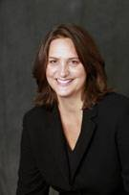
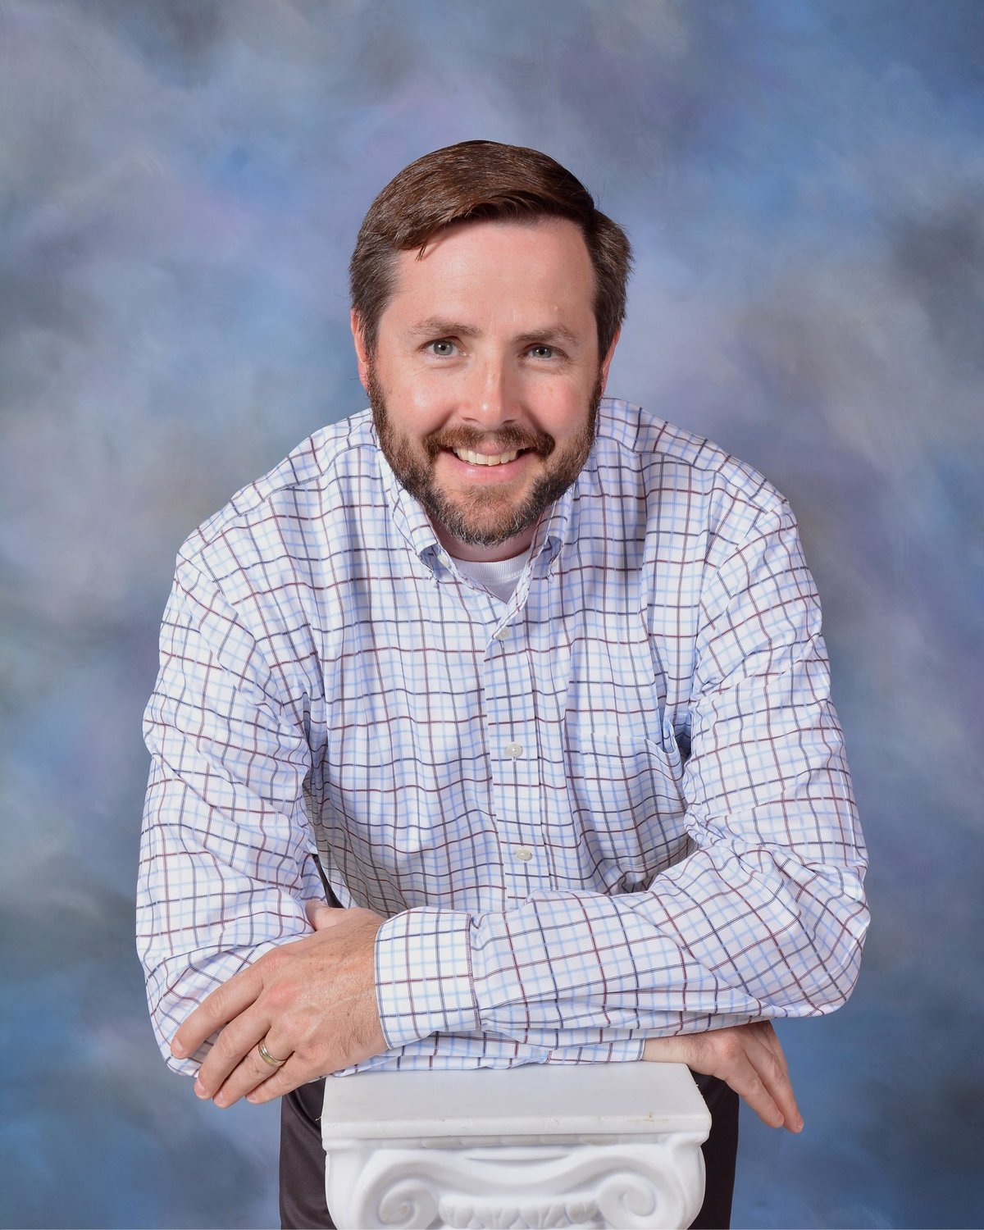
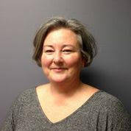
Lobbyists
Amy Campbell almost four decades of experience in public policy, government processes, and political campaigns, including 31 years a multi-client lobbyist. Amy received the US Government Services Agency's "Hammer Award" in 1996 (given to participants in a team effort that contributes dramatically to improving the way government works) and the Governor's Award for Outstanding Service and Leadership in 1998 (from Governor Terry Branstad).
Craig Patterson has more than 30 years of experience in public policy and political campaigns, including more than four years in Washington DC working first for Iowa Congressman Jim Nussle's staff (Legislative Director & Legislative Assistant) and then as a lobbyist on the Federal level (working on transportation industry issues). He moved to Iowa in 2001 and has since worked as a multi-client lobbyist at the state level.
Tori Squires has more than 30 years experience in grant writing, community development, public policy, and advocacy for non-profit organizations, including 11 years for the Iowa Primary Care Association. In addition to her work as a bill tracker, Squires operates Squires Consulting, LLC, providing grant writing and community development consulting primarily for Federally Qualified Health Centers across the country.

Slide 42
Understand and Research the Issues
Know your issue
Build your case with supportive facts
    Quick bullet statements that support your position and personal stories of the impacts are successful advocacy strategies—information overload can be counterproductive
Know your opposition and counter their arguments proactively

Slide 43
Build a Relationship With Elected Officials
Get to know your elected officials
If you don’t know who your Representative and Senator are, go to Iowa Legislature web site or contact your county auditor
Relationships are developed over time and that means developing them before they are needed

Slide 44
Know When To Advocate
Advocacy is a year-round continuous activity
Build your efforts throughout the year, not just when a bill is to be debated or vetoed or the legislature is in session
The Iowa Legislature is normally in session from the second Monday in January until late April or early May
Congress is in session year-round but takes breaks at various times during the year.
Time is valuable—both yours and the elected official
Find a balance between “bugging” and ignoring

Slide 45
Know How To Advocate
Write
E-mail
Phone calls
Fax
Meetings
Invite elected officials or their staff to visit your place of work
Media strategies
Coalition building

Slide 46
Remember
Your opinion counts
Be brief
Be timely
Be honest
Don’t use jargon
You’re the expert
Don’t assume
Bi-partison

Slide 47
Mark Your Calendar
Iowa NAPNAP/INPS/Nurse Midwives Legislative day on the Hill--Jan 27, 2026 noon to 2 PM
IPHA/ Iowa Immunizes—Feb 16. 2026

Slide 48
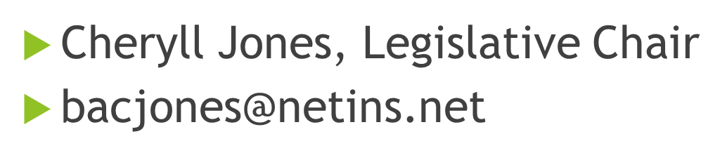
Thank You

