Slide 1
Prenatal Substance Exposure: Current Strategies and Future Directions for Substance Exposed Infants
Laura Pabich DNP, ARNP, NNP-BC
Blank Children's Hospital

Slide 2
Disclosures
I have no relevant financial or non-financial relationships to disclose

Slide 3
Objectives
Discuss the national trends of substance abuse amongst pregnant women and NAS
Define neonatal abstinence syndrome and neonatal opioid withdrawal syndrome
List the most common licit and illicit substances used by pregnant women and their impact on the fetus and newborn
Review the recent advances in the evaluation and management of the newborn with NOWS
Identify the short term and long term outcomes for infants with NAS and NOWS
Reflect on the unique role of the Advanced Practice Nurse in NOWS management
Discuss the importance of improving care coordination and long-term follow-up to improve outcomes for patients and families affected by neonatal abstinence syndrome

Slide 4







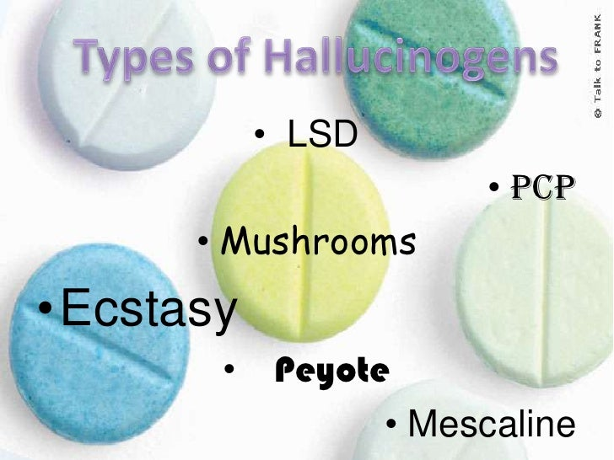

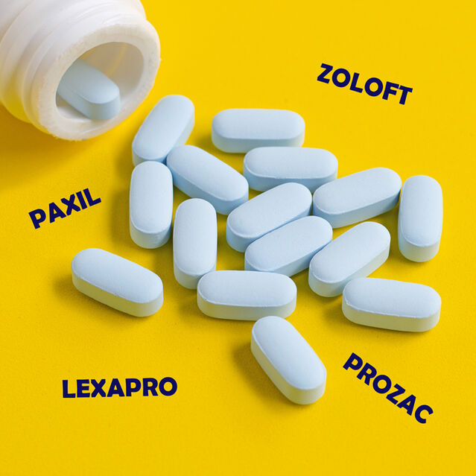

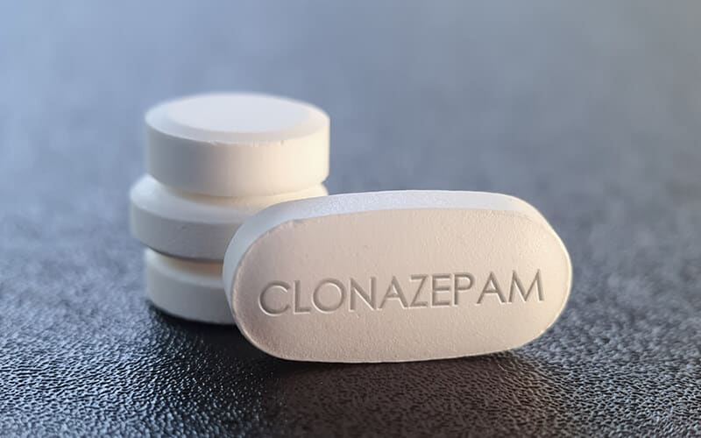






Slide 5

Defining the Problem
Addictive disorders have continued to rise globally over the last 2 decades
A high percentage of drug-dependent individuals are of child-bearing age
Maternal substance use
  Exposes the fetus to drugs of dependence during critical times of development
  Results in short and long-term negative effects

Slide 6

Definitions
Neonatal Abstinence Syndrome (NAS)
Previously described as withdrawal symptoms from in utero opioid exposure
Now includes withdrawal symptoms from any dependence-inducing substance
Neonatal Opioid Withdrawal Syndrome (NOWS)
New term
Describes withdrawal from opioids alone

Slide 7
Background
Although estimated rates of NAS have declined nationally, rates of prenatal substance exposure have increased
  There is considerable state-level variation incidence of NAS
  Literature estimating national NAS rates since 2018 is lacking
Opioid and non-opioid drug use trends have shifted with the substance abuse crisis post COVID-19
    Shift towards methamphetamines and other psychostimulants
    Increases in binge drinking and cannabis use in pregnant woman (West et al. 2023)

Slide 8
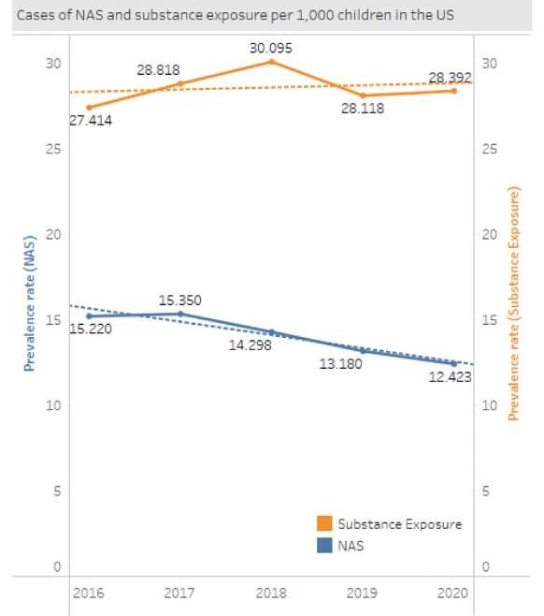
NAS and Substance Exposure Trends
West et al. (2023) estimated prenatal substance exposure birth rates and rates of NAS among Medicaid covered births between 2016-2020
Medicaid covers more than 80% of all NAS births
Rates of NAS recorded Medicaid claims declined nationally
  28 states had declining NAS rates
However, rates of prenatal substance exposure increased
  38 states increased
  10 states declined
Notes:
Prenatal Substance exposure was defined as the use of illegal and legal substances during pregnancy based upon select ICD-10 codes. Including newborn affected by maternal use of anxiolytics, anticonvulsants, opiates, antidepressants, amphetamines, sedative hypnotics, tobacco, alcohol, cocaine, hallucinogens and unspecified drugs of addiction, cannabis. This data suggests substances other than opioids are affecting the trends seen.

Slide 9
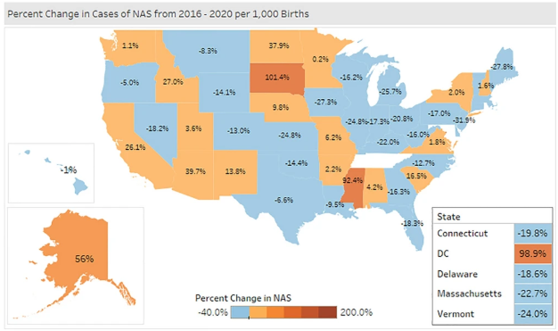
West et al. (2023)

Slide 10
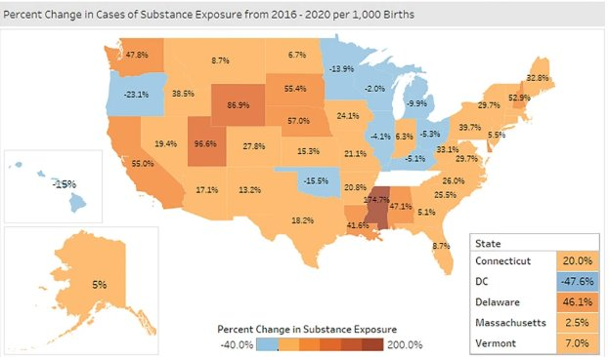
West et al. (2023)

Slide 11
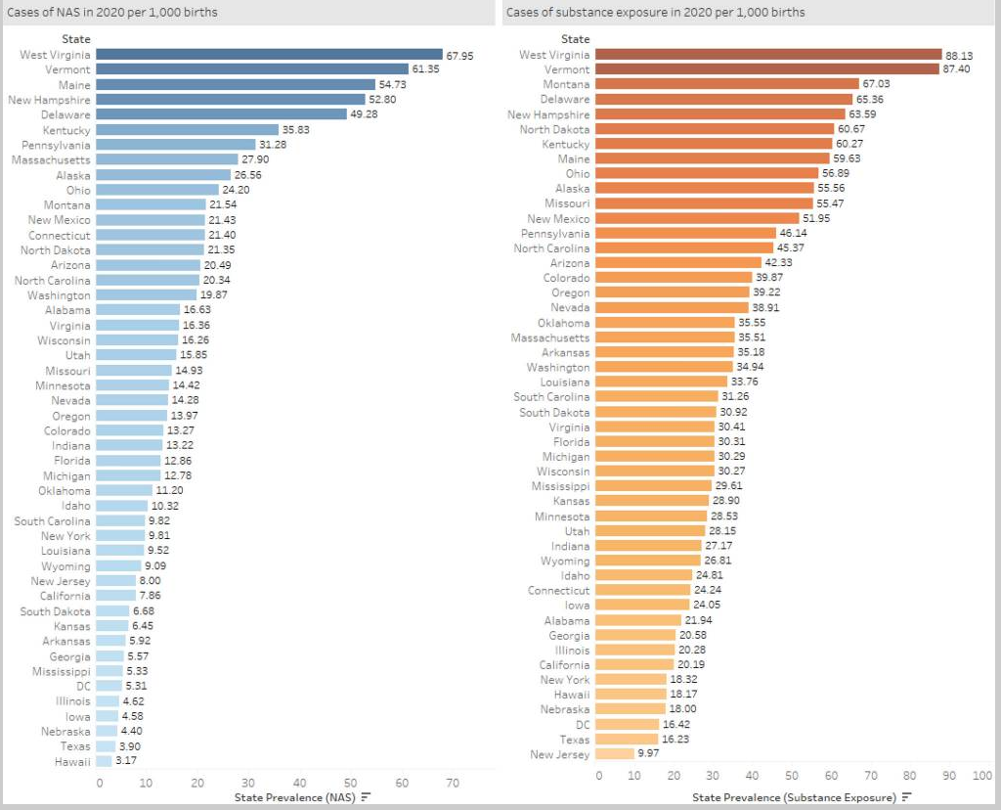

Slide 12
Background
Licit Substances | Illicit Substances
Tobacco | Marijuana/cannabis/hashish
Caffeine | Cocaine (including crack)
Alcohol | Heroin
Prescription opiates | Hallucinogens and inhalants
Stimulants | Prescription-type psychotherapeutics used nonmedically
Amphetamines
Benzodiazepines
Classification of Licit and Illicit Substances
Oji-Mmuo, Corr & Doheny (2017)

Slide 13
Licit Substances
Caffeine
  The most common substance that causes psychological dependence
  Caffeine consumption < 200 mg/day does not appear to be a major contributing factor in miscarriage or preterm birth
Nicotine/Tobacco
  Most common licit substance amongst women who are pregnant or of childbearing age
  Impairs oxygen and nutrient delivery to the fetus
  Linked to preterm birth, stillbirth, IUGR and low birth weight
  Withdrawal symptoms are similar to opiates
    Irritability, tremors, stress dysregulation and increased muscle tone
Oji-Mmuo et al. (2017)

Slide 14
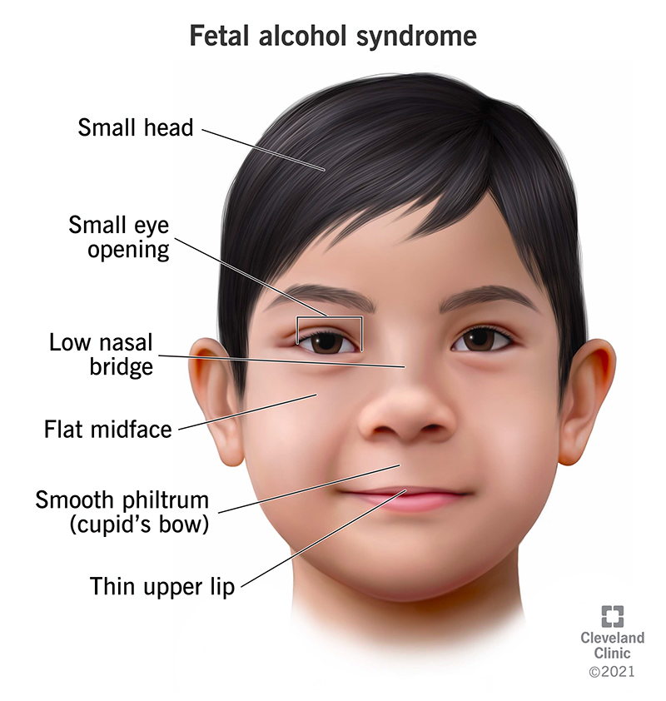
Licit Substances
Alcohol
Fetal alcohol spectrum disorders
Classic FAS features: abnormal facies, limb anomalies, cognitive deficiencies and poor growth
Range of outcomes
Recommended to avoid entirely during pregnancy or when trying to conceive
Antipsychotics, Anxiolytics and Antidepressants
Pharmacologic treatment is common in pregnant women
Benzodiazepines can lead to lethargy and sedation in the infant
Withdrawal seen in the first 24 hours of life
Neonatal effects are not well-understood
Withdrawal symptoms seen within the first 24 hours with abnormal motor movements (jitters) and increased muscle tone (Oji-Mmuo et al, 2017)

Slide 15
Selective Serotonin Reuptake Inhibitors
10-15% of women will experience a major depressive disorder in the perinatal period
Selective Serotonin Reuptake Inhibitors
First line psychopharmacologic treatment for mood and anxiety disorders
Most commonly used antidepressants in pregnancy with a 4-fold increase between 1996 and 2005
Risk of teratogenicity is low
Exposure in the 3rd trimester associated with
Neonatal Abstinence Syndrome
Persistent pulmonary hypertension of the newborn
Controversial, weak relationship and a rare outcome
Lebin et al. (2022) and Rodrigues-Kovacs et el. (2018)

Slide 16
Selective Serotonin Reuptake Inhibitors
Breastfeeding
  All SSRIs are excreted into breastmilk
  Estimated relative dose is < 2% of weight-adjusted maternal doses
  Fluoxetine and citalopram are excreted in larger amounts
    Infant plasma levels can exceed 10% of the maternal concentration
  Infant doses are low for fluvoxamine, paroxetine and sertraline
  Breastfeeding should be used to assist neonatal adaptation
Rodriguez-Kovacs et al. (2018)

Slide 17
Illicit Substances
Cannabis
  THC readily crosses the placenta
  Fetal and neonatal effects are not fully understood
  Animal studies suggest exposure may have abnormal CNS effects leading to low language and memory scores
Cocaine
  The 3rd largest illicit drug of abuse in the US
  0.3% of substance addiction of women of childbearing age
  Crosses the placental and blood brain barrier and is teratogenic
  An estimated $26 million per year is spent on special education services in the US due to long-term cognitive effects of cocaine use
  Fetal growth restriction, preterm birth, LBW, microcephaly, placental abruption, neonatal stroke, poor neurodevelopmental outcomes
Oji-Mmuo et al. (2017)

Slide 18
Methamphetamine
Methamphetamine (MA)
  A derivative of amphetamine
  Highly addictive psychostimulant
  Rapidly cross the placenta and into the developing nervous system
MA use amongst pregnant women has increased alonside nationwide rates have increased (Zhang et al, 2021; Perez et al, 2021)
MA overdose deaths during pregnancy have also increased
  Increasing percentages of heroin treatment admissions involving MA
    2.8% in 2008 to 15.1% in 2017 (Wouldes & Lester, 2023)

Slide 19

Methamphetamine
Effects on Lactation
  Amphetamine concentrations in breastmilk are 3 to 7 times higher than maternal plasma
  There are reports of infant intoxication and death after acute maternal MA use without maternal intoxication (Perez et al, 2021)
Breastfeeding is not recommended if there has been long term use or use in the third trimester (Wouldes & Lester, 2023)

Slide 20
Methamphetamine
Studies are limited on outcomes to the newborn throughout childhood
Birth Outcomes
  May decrease birth weight, head circumference and body length
  Pattern of withdrawal differs from opioids and antidepressants
    Poor neurologic adaptation, lower arousal and excitability
    Drowsiness may persist for a few months
    Feeding and arousal difficulties, poor growth
  Increased rates of infections in the first 12 months (Perez et al., 2021; Wouldes & Lester, 2023; Zhang et al., 2021)

Slide 21

Methamphetamine
Considerable evidence that specific regions of the brain are persistently altered in children with prenatal MA exposure
Lower cortical and striatal volumes persist through school age
Linked to attention processing and cognitive difficulties
Childhood Outcomes
Cognitive, behavioral, executive, motor and impulse control problems
Long term evaluation and follow-up is strongly recommended (Perez el al., 2021)

Slide 22
Opioids: Heroin, prescription opioids, methadone and buprenorphine
Prenatal opioid exposure (POE) has increased over the last 2 decades
The fetal and neonatal effects of chronic opioid use in pregnancy are well studied
Increased risk for
  Preeclampsia
  Preterm birth
  Fetal growth restriction
  Stillbirths
  Neonatal Opioid Withdrawal Syndrome
Mascarenhas et al. (2024); Oji-Mmuo et al. (2017)

Slide 23

Methadone
Exposure leads to a significantly longer duration of treatment for NOWS compared with traditional opiates
24%-100% show signs of NOWS
54%-85% require pharmacologic treatment for alleviation of symptoms
Methadone increases the risk for
  Preterm birth
  Small size for gestational age
  NOWS
  NICU admission (Wouldes & Lester, 2023)

Slide 24
Polysubstance Use
Common with substance abuse disorders, including pregnant women
Often co-exists with mental health disorders resulting in prenatal exposures to psychoactive medications
Polysubstance abuse may provide a synergistic effect, or individual drugs may counteract or modify the effect of another drug
  Results in different patterns of NAS and NOWS
Additional Factors
  Maternal mental illness
  Poverty
  Poor nutrition
  Involvement with child protective services
  Domestic violence (Wouldes & Lester, 2023)

Slide 25
NAS and NOWS
The signs of Neonatal Abstinence Syndrome vary depending upon the substance
Some substances do not produce the classic NAS/NOWS symptoms at birth, but may still have long-term neurodevelopmental consequences
  Methamphetamines
  THC

Slide 26
Guidelines and Policy Recommendations
Screening pregnant women for substance abuse
Clinical rationales for toxicology testing for mother and newborn, including if and how consent will be obtained
NOWS/NAS assessment protocol
NOWS nonpharmacologic and pharmacologic treatment algorithm
Duration of observation for NOWS
Breastfeeding recommendations in the setting of recent substance abuse
Discharge and follow-up criteria (Mascarenhas et al, 2023)

Slide 27
Evaluation and Diagnosis
Prenatal identification is the preferred approach to identifying infants with in-utero opioid exposure at risk for NOWS
Validated screening tools given verbally or written questionnaire during prenatal care and delivery
Toxicology testing should only be completed when it will assist with clinical management
Due to pervasive racial and ethnic disparities in perinatal toxicology testing
Hospitals should establish clear guidelines
Actions after a positive verbal screen or test result
Communicate risks and benefits of testing clearly to the parents
Obtain consent prior to obtaining a biologic sample for toxicology testing
Mascarenhas et al. (2024)

Slide 28
Toxicology Testing
Urine
Opioids may no longer be detectable after the first few days of life
A positive screen may only reflect recent exposures
Meconium
Drugs excreted in the hepatobiliary system and by the fetal kidneys into the amniotic fluid
Sample collection takes longer
Exposures back to 20 weeks and generally considered the gold standard of testing
Umbilical cord testing
Alternative to meconium
Readily available at time of birth
Collect as soon as possible after birth
Cheng et el. (2025)

Slide 29
Iowa Toxicology Testing and Mandatory Reporting
Is substance abuse during pregnancy or prenatal substance exposure considered child abuse or neglect under Iowa Law?
Yes, Iowa CODE Chapter 232, Section 68
"child abuse" or "abuse" means an illegal drug is present in a child's body as a direct and foreseeable consequence or the acts or omissions or the person responsible for care of the child
However, substance abuse or use during pregnancy is NOT considered a crime

Slide 30
Iowa Toxicology Testing and Mandatory Reporting
According to the law, for a newborn to be tested without parental consent a practitioner must document “physical or behavioral symptoms of the effects of exposure to (illicit drugs).
Iowa Code 232.77
  If I health practitioner discovers in a child physical or behavioral symptoms of the effects of exposure to cocaine, heroin, amphetamine, methamphetamine or other illegal drugs or combinations of derivatives thereof, which were not prescribed by a health practitioner, or if the health practitioner has determined through examination of the natural mother of the child that the child was exposed in utero, the practitioner may perform or cause to be performed a medically relevant test on the child. The practitioner shall report any position results to the department, which shall begin an assessment on such a report. A positive test result obtained prior to birth of a child shall not be used for the criminal prosecution of a parent for acts or omissions resulting in intrauterine exposure of the child to an illegal drug
  If a health practitioner involved in the delivery or care of a newborn or infant discovers in the newborn or infant physical or behavioral symptoms that are consistent with the effects of prenatal drug exposure or a fetal alcohol spectrum disorder, the practitioner shall report such information to the department

Slide 31
Clinical Presentation of NAS
Drug | Signs | Onset of Signs | Duration of Signs
Alcohol | Hyperactivity, crying, irritability, poor suck tremors, seizures, poor sleeping, hyperphagia, diaphoresis | 3-12 hours | 18 months
Barbiturates | Irritability, severe tremors, hyperacusis, excessive crying, vasomotor instability, diarrhea, restlessness, increased tone, hyperphagia, vomiting, disturbed sleep | 1-14 days | 4-6 months
Caffeine | Jitteriness, vomiting, bradycardia, tachypnea | At birth | 1-7 days
SSRIs | Crying, irritability, tremors, poor suck, feeding difficulty, hypertonia, tachypnea, sleep disturbance, hypoglycemia seizures | Hours-Days | 1-4 weeks
AAP Clinical Report: Neonatal Drug Withdrawal; Hadak et al (2017)

Slide 32
Clinical Presentation of NOWS
NOWS occurs following chronic exposure to opioids
Clinical presentation and risk of NOWS varies by
  Opioid use (sustained release, immediate release, maintenance)
  Maternal metabolism
  Net transfer of drugs across the placenta
  Placental metabolism
  Infant metabolic, and excretions
Maternal use of other substances may influence onset, severity or duration of withdrawal syndrome
  Tobacco, benzodiazepines, Gabapentin, SSRIs, etc (Mascarenhas et al. 2024)

Slide 33
Diagnosis of NOWS
Newly proposed definition by an expert consensus panel at the US Department of Health and Human Services
  Exposure to opioids during pregnancy
    Identified via self-report or toxicology testing
  The presence of at least 2 of the most common clinical signs of withdrawal including:
    Excessive crying
    Fragmented sleep
    Tremors
    Hypertonia
    GI dysfunction (Mascarenhas et al, 2023)

Slide 34
NOWS Clinical Presentation
Central Nervous System Irritability | Gastrointestinal Dysfunction | Autonomic Nervous System Activation | Sleep and Wake Cycle Disturbances
High-pitched, continuous crying | Feeding difficulties | Sweating | Fragmented Sleep
Decreased Sleep | Vomiting | Fever | Difficulty maintaining quiet alert state
Tremors | Loose or watery stools | Yawning, sneezing | Short sleep cycles
Increased muscle tone |  | Increased respiratory rate
Hyperactive Moro Reflex |  | Nasal stuffiness and flaring
Seizures
The main clinical signs are due to the concentration of opioid receptors in the central nervous system and gastrointestinal tract
Presentation is variable with multisystem involvement
Mascarenhas et al. (2024)

Slide 35
Assessment Tools
Known or concern for prenatal exposure
  Begin assessment shortly after birth
  Assess every 3-4 hours timed with awake times and after feedings
  Continue for 4 to 7 days if no pharmacologic treatment is required
Monitor in the hospital for 24 to 48 hours after pharmacologic treatment is stopped
Finnegan Scoring
Eat Sleep Console
Mascarenhas et al. (2023); Patrick et al. (2020)

Slide 36
Finnegan Neonatal Abstinence Scoring Tool
21 item tool
Characterizes all clinical signs possibly associated with withdrawal
Signs weighted on perceived severity
Confounding factors
  Polysubstance abuse
  Use of additional substances like nicotine, SSRIs and benzodiazepines leads to elevated scores

Slide 37
Eat, Sleep and Console
Prioritizes functional needs
  Ability to eat the expected amount based upon gestational and postnatal age
  Sleep undisturbed after a feeding for at least 1 hour
  Being consoled within 10 minutes of soothing attempt
Focus on nonpharmacologic interventions
Has been implemented across the country via Statewide NOWS QI collaboratives
Multicenter clinical trial using a randomized design across 26 hospitals
  ESC reduced time to infant discharge readiness by 6 days compared with Finnegan
  No significant increase in in-hospital safety events
  Decreased pharmacological treatment
Mascarenhas et al. (2023)

Slide 38
Nonpharmacologic Interventions
First line treatment for NOWS
Feeding Methods
  Breastfeeding is preferred
  Attention to not over or under feeding
Environmental modifications to decrease stimulation
  Reduce noise and bright lights
  Swaddling and Skin to skin time to reduce hyperarousal
  Clustering cares to limit sleep disruptions
Castañeda Sandova et al. (2024); Mascarenhas et al. (2024)

Slide 39


Nonpharmacologic Interventions
Vibrated crib mattress and SNOO Bed
Social Integration
  Rooming in with caregivers
    Increased parental presence during hospitalization
    Increase in breastfeeding initiation rates
    Reduces the need for pharmacologic treatment by 20 to 60%,
    Decreases total opioid treatment days
    Shortened length of hospitalization
  Skin to skin contact
  Promote maternal-infant bonding
Soothing Techniques
  Holding, swaddling, comforting, rocking, gentle rubbing, pacifiers
Castañeda Sandova et al. (2024); Mascarenhas et al. (2024)

Slide 40

Breastfeeding
Should be encouraged if the mother has not had a relapse in > 90 days
Discouraged if there has been a relapse in the last 30 days
Breastfeeding has been associated with decreased severity and duration of symptoms
  Should be supported if there is no ongoing use at time of delivery
Safe for mothers who take methadone and buprenorphine
  Excreted in human milk in low concentrations
  May reduce clinical signs of NOWS and reduce hospital stay

Slide 41

Nonpharmacologic Interventions
Formula Feeding
  Lack of consensus as to the best type
  Recent studies examining the use of low lactose or partially hydrolyzed formulas compared with standard infant formulas have not shown differences in NOWS hospitalization outcomes
  Lack of census in the literature as to the efficacy of higher calorie formula
NG feeds should be considered for infant unable to meet the minimal goal volumes or those with excessive weight loss

Slide 42
Pharmacologic Interventions
60% infants exposed to opiates require pharmacologic therapy
Morphine is the most commonly used primary agent
Short half life
More frequent dosing tailored to symptoms
Longer length of treatment compared to morphine
Methadone shows improved short-term NOWS outcomes compared to morphine
Longer half life so cannot be used for symptomatic dosing
Shorter length of stay
Shorter duration of treatment
Castañeda Sandova et al. (2024); Mascarenhas et al. (2024)

Slide 43
Pharmacologic Interventions
Buprenorphine
Recently evaluated as a first line agent
Single-site studies show a reduction in the length of stay attributable to NOWS compared with morphine and methadone
Clonidine and Phenobarbital
Secondary agents
Phenobarbital is associated with adverse developmental outcomes
Clonidine is increasing n use throughout the US and is an alpha-2-adrenergic receptor agonist
No risk for sedation or developmental delays
Can cause hypotension, hypertension and arrhythmias
Mascarenhas et al. (2024)

Slide 44
Dosing Regimens
Dosing regimens have changed over the past 5 years from standard, scheduled dosing to symptom-triggered, as needed dosing
  Several studies using morphine and methadone show infants on average requiring 2 doses of medication
  A multicenter retrospective analysis compared the use of as needed morphine to as needed methadone and did not find any differences in short-term hospitalization outcomes
The OPTimize NOW Study
  Randomized controlled trial to assess symptom-based dosing compared with scheduled dosing is in process
  Includes 23 centers across the US
Mascarenhas et al. (2024)

Slide 45
Short and long-term impacts of NOWS
Recent studies examining the first year after birth have found
  A lower rate of attendance at well-child visits and at recommended developmental follow-up visits
  Higher rates of emergency department visits and hospital admissions
  Increased risk of mortality Increased risk of ocular abnormalities, including strabismus, nystagmus and reduced visual acuity
Increased risk of hospital readmission (Mills-Huffnagle et al. 2025)

Slide 46
Discharge Planning
Observation times for infants exposed to opioids
Immediate-release: at least 3 days
Buprenorphine and sustained release: 4-7 days
Methadone: 5-7 days
Involve a multi-disciplinary care team
Pediatrician/Neonatologist, PNP, NNP, PT/OT, SLP, Social Work, Dietician
Education on signs of withdrawal, safe sleep environments, period of purple crying
Plan of safe care coordinated with child welfare
Federal law mandates the use of a safety plan for all infant with POE (Zahn, 2025)

Slide 47
NOWS Discharge Planning
Follow-up visit within 48 hours of discharge and again 1 week later
Outpatient lactation support
Developmental surveillance and early intervention services are indicated
Zahn (2025)

Slide 48
Discharge Planning: Home Pharmacotherapy
Vermont Oxford Network collaboration focused on improving care for NOWS in nearly 200 centers​
  25% were discharged home on medications by the end of the 2-year collaborate​
  Discharging home on medication reduces length of stay but may increase the total length of treatment​
Literature lacks support for home tapers given lack of long-term follow-up data​

Slide 49
Call to Action
Infants are being exposed to more substances prior to birth
Many of these substances have short and long term neurodevelopmental consequences
Standardized protocols for NAS/NOWS focus primarily on care immediately after birth
No protocol address the long-term consequences, follow-up care or barriers to follow-up care
(Huffnagle et al., 2025)

Slide 50
Future Directions
Consensus on the best clinical diagnosis for NOWS
Optimal feeding support bundles
Objective measures of withdrawal
Addresses NAS/NOWS with polysubstance abuse
Evaluation of short and long term effects of as-needed dosing for NOWS
Studies to evaluate the long-term neurodevelopmental impact

Slide 51
Future Directions
Provide education for providers and childcare teams on the barriers of care for families and provide guidance on how to discuss and problem-solve with families to ensure follow-up care
AAP bright futures guideline updated to assess for developmental deficits at 6 months rather than beginning at 9 months
  Infant with POE have a known incidence of visual and oculomotor deficits exceeding 10 times the risk in the general population
  As risk for neurodevelopmental delays as soon as 6 months
Consider leaving diagnostic codes of prenatal substance exposure left active in the medical record to allow for follow-up (Mills-Huffnagle et al., 2025)

Slide 52

Thank You! Questions?

Slide 53
References
Castañeda Sandoval, M. P., González Gonzalez, D. F., Peña Suarez, K. J., Rosero Medina, D. F., Arias Torres, D., & Calderón Farfán, J. C. (2023). Neonatal Abstinence Syndrome and non-pharmacological nursing care. A scoping review. Journal of Neonatal Nursing, 30(1). https://doi.org/10.1016/j.jnn.2023.07.015
Cheng, F. Y., Beagan, R. A., & Grossman, M. R. (2025). Neonatal Opioid Withdrawal Syndrome. Pediatric Clinics of North America, 74(4). https://doi.org/10.1016/j.pcl.2025.03.006
Gallant, S. M., DeCoste, K., Norris, N., McConnell, E., Al-Rassi, J., Churchill, M., Higgins, A., Rothfus, M., Mann, C., Benoit, B., Curran, J., Aston, M., & Cassidy, C. (2025). Implementing the Eat, Sleep, Console Model of Care: A Scoping Review. Hospital Pediatrics, 15(3). https://doi.org/10.1542/hpeds.2024-008078
Hudak, M. L., & Tan, R. C. (2012). Neonatal Drug Withdrawal. Pediatrics, 129(2), e540–e560. https://doi.org/10.1542/peds.2011-3212
Lebin, L. G., & Novick, A. M. (2025). Selective serotonin reuptake inhibitors (SSRIs) in pregnancy: An updated review on risks to mother, fetus, and child. Current Psychiatry Reports, 24(11), 687–695. https://doi.org/10.1007/s11920-022-01372-x
Mascarenhas, M., Wachman, E. M., Chandra, I., Xue, R., Sarathy, L., & Schiff, D. M. (2024). Advances in the care of infants With prenatal opioid exposure and neonatal opioid withdrawal syndrome. Pediatrics, 153(2). https://doi.org/10.1542/peds.2023-062871
Mills-Huffnagle, S. L., Sullivan, R. E., Corr, T. E., & Nyland, J. E. (2025). Call to action: Standardizing follow-up care for infants prenatally exposed to opioids. Hospital Pediatrics, 15(3), e121–e125. https://doi.org/10.1542/hpeds.2024-008094
Oji-Mmuo, C. N., Corr, T. E., & Doheny, K. K. (2017). Addictive disorders in women: The impact of maternal substance use on the fetus and newborn. NeoReviews, 18(10), e576–e586. https://doi.org/10.1542/neo.18-10-e576

Slide 54
References
Patrick, S. W., Barfield, W. D., & Poindexter, B. B. (2020). Neonatal opioid withdrawal syndrome. Pediatrics, 146(5). https://doi.org/10.1542/peds.2020-029074
Perez, F. A., Blythe, S., Wouldes, T., McNamara, K., Black, K. I., & Oei, J. L. (2021). Prenatal methamphetamine—impact on the mother and child—a review. Addiction, 117(1). https://doi.org/10.1111/add.15509
Rodriguez-Kovacs, J., Tien, S. H., & Plunkett, B. A. (2018). Selective serotonin reuptake inhibitor use in pregnancy: Repercussions on the oblivious passenger. NeoReviews, 19(3), e160–e169. https://doi.org/10.1542/neo.19-3-e160
West, K., M. Masoom Ali, Blanco, M., Natzke, B., & Nguyen, L. (2023). Prenatal substance exposure and neonatal abstinence syndrome: State estimates from the 2016–2020 transformed medicaid statistical information system. Maternal and Child Health Journal, 27(27). https://doi.org/10.1007/s10995-023-03670-z
Wouldes, T. A., & Lester, B. M. (2023). Opioid, methamphetamine, and polysubstance use: Perinatal outcomes for the mother and infant. Frontiers in Pediatrics, 11(17). https://doi.org/10.3389/fped.2023.1305508
Zahn, C. (2025). The care and management of neonates experiencing neonatal abstinence syndrome and the role of the advanced practice registered nurse. Neonatal Network, 44(1), 54–60. https://doi.org/10.1891/nn-2024-0023
Zhang, Y., Gong, F., Liu, P., He, Y., & Wang, H. (2021). Effects of prenatal methamphetamine exposure on birth outcomes, brain structure, and neurodevelopmental outcomes. Developmental Neuroscience, 43(5), 271–280. https://doi.org/10.1159/000517753

