Slide 1
Dumbing Down Pediatric Mental Health
Scott Meskimen CPNP-PC, PMHS

Slide 2
Objectives
Develop an increased comfort for caring for children with basic mental health conditions
Identify and utilize practice guidelines
Discuss clinical pearls and personal experiences

Slide 3
Questions
How many years have you been in practice
1-5 years
5-10 years
10-15 years
>15 years
Are you taking care of Mental Health Conditions?
Do you have someone in your practice taking care of these kids?
How many of you have or have used the DSM-V?
How many of you feel comfortable taking care of Depression, Anxiety, ADHD?

Slide 4
It’s a Problem
In the United States, approximately 20% of children and 49% of adolescents experience a mental disorder.
Suicide is a leading cause of death in 10 to 24 year olds, and suicide attempts far outnumber those deaths.
Recent evidence shows increasing rates of emergency department visits among children and adolescents with a mental health concern as the primary diagnosis.
As early as 2008, staff at the World Health Organization and the World Organization of Family Doctors called for integration of services into primary care because:
Better health outcomes
Social integration is maintained
In 2009, the American Academy of Pediatrics published a policy statement recommending mental health competencies for primary care.
Not enough progress has been made.
Notes:
5,500 suicide/yr – more than cancer, congenital anomalies, chronic lung and heart disease combined
70% of incarcerated youth have mental illness
20% do not finish school
About 1 in 5 pediatric patients experience mental health concerns but only 15-20% receive evidence based treatment
On average there is an 8-10 year gap between symptoms onset to initiation of treatment
This is too long and has long term affects on growth and development
>50% adults with mental illness have symptoms onset before the age of 14 years
Cost is >$2.5 trillion of lost economic output d/t mental illness
Add in the obvious increase in chronic illness such as hearth disease, pain syndromes and strokes
Children with untreated mental health problems are 6x more likely to have at least 1 adverse outcomes in health, legal, financial, or social functions
The percentage of Pediatric visits related to DBMH is increasing faster than any other type of visit in primary care
¼ of patients seen in PC meet DSM for at least 1 MH condition
>40% experiencing functional issues at home or at school but don’t meet DSM criteria
At current pace MH will become one of the leading causes of pediatric morbidity and mortality in children

Slide 5
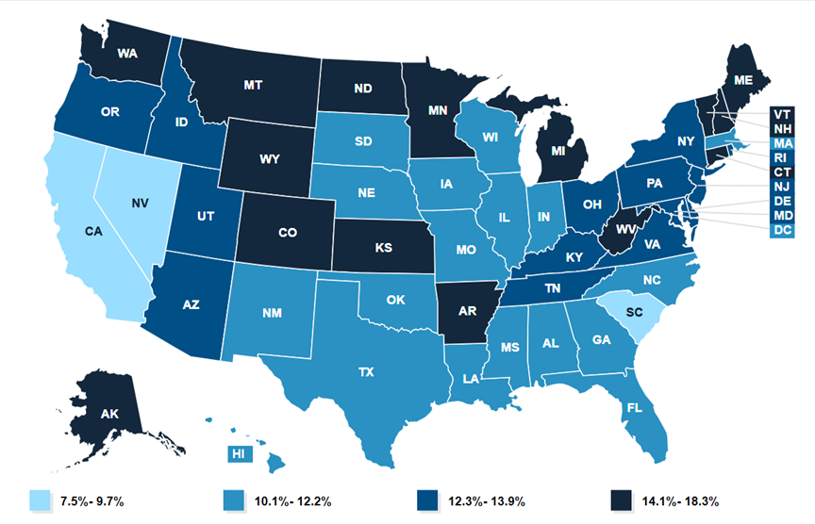
Percentage of children ages 3-17 years who received any treatment or counseling from a MH professional, 2022
Source: Kaiser Family Foundation (KFF) analysis of 2022 National Survey of Children's Health.
Notes: Indicator based on methodology developed by the [Data Resource Center for Child & Adolescent Health] (https://www.childhealthdata.org/learn-about-the-nsch/nsch-codebooks)
Notes:
20-50% of children-adolescents are experiencing mental health concerns but at most 18% are receiving counseling services

Slide 6
barriers
Mental health provider shortages, leading to long wait or travel times.
Lack of insurance coverage and associated costs.
Parents’ reluctance to seek help from a mental health specialist or concern about stigma.
Providers’ lack of training or confidence to manage common DBMH conditions without help from a specialist.
Notes:
Patients and families may feel shame related to mental illness visit
Poor f/u with mental health provider - referrals made, resources provided and they don’t go
As low as 20%
Not one state has adequate supply of child and adolescent psychiatrist (goal 47/100,000)
41 of the 50 states have severe shortages (1-17/100,000)
Only 1 state, Vermont, has mostly sufficient supply to meet the needs of patients

Slide 7
Child and Adolescent Psychiatrist
Workforce Maps by State

Slide 8
Sound Familiar
Pt comes in for annual well care visit with a PHQ-9 of 15 or with suicidal ideation
Pt comes in for annual well care and has cut marks on their inner thighs.
Pt being followed by therapist, is not responding to therapy and they recommend considering medical management but they can not get into see a prescriber for months.
Family comes with concerns that their child has a learning problem in reading and math, they were doing ok in early grade school but now struggling and falling behind in school.
Family of early grade school child with significant behavior concerns, defiance, and poor academic performance.
Family having significant difficulty with getting patient to go to school, and now the patient is refusing to go.

Slide 9
The Need is REAL
In 2022, 90% of children ages 18 and younger completed a well check in primary care.
DBMH concerns are often identified during well-visits, routine screening, or through “sick” visits in the primary care clinic.
The percentage of Pediatric visits related to DBMH is increasing faster than any other type of visit in primary care
25% of patients seen in Primary Care meet DSM for at least 1 Mental Health condition
>40% experiencing functional issues at home or at school but don’t meet DSM criteria
At current pace MH will become one of the leading causes of pediatric morbidity and mortality in children
Primary care offers a proactive environment for earlier identification of and intervention for DBMH concerns within the provider’s scope of practice.
Notes:
Discuss normal growth and development
Large body of evidence showing preventative care, early identification and intervention leads to better outcomes and decrease cost
Cost savings of $3,000/pt over 4 years with returns of $6.50 per $1 invest in integration of mental health into appointments
In 2015 a review of the literature showed little to no MH training for NPs in Primary Care
Most PCP know they need to identify MH conditions but don’t fee trained or responsible for treating
Certifications validates knowledge and increase provider confidence in clinical skills, increases professional credibility and improves patient outcomes.

Slide 10
Benefits of Treating In Primary CAre
Primary Care
Familiar
Reduced
Stigma
Timely
Close to Home

Slide 11
What do you have to Loose

Slide 12


Slide 13
Everything is Falls within the Big Three
BIG THREE
ADHD
Depression
Anxiety
Anxiety and Depression are treated with the same medications
ADHD – stimulants work the best and there only two major classes
JUST PICK ONE
They likely have all three
Pick the one that is driving and causing the most problems first
Move to the next condition when the driver switches

Slide 14


Slide 15
Screening tools…..Diagnostic tools??
My Three
Other tools
PHQ-9
GAD-7
Vanderbilt
PHQ-4
Adult ADHD screen
SCARED
Child SCARED
Connor’s
PSC -17
PSC -35

Slide 16
Pharmacologic Management ADHD/ADD
Stimulants
Alpha Agonists
SNRI
Concerta
Focalin XR
Vyvanse
Clonidine ER
Guanfacine ER
Clonidine
Qelbree
Strattera
Effexor
Notes:
Talk about the names but prescribe the generic

Slide 17
Pharmacologic Treatment
DEPRESSION
ANXIETY
Lexapro
Zoloft
Prozac
Escitalopram
Sertraline
Fluoxetine

Slide 18
ADHD
Vanderbilt
NICHQ_Vanderbilt_Assessment_Scales.pdf
Individuals with ADHD may have differences in brain structure and function, particularly in areas related to executive function, such as attention, planning, and impulse control
It’s GLOBAL they will come in for academics but discuss how if affects life, social skill, eating, sleeping, hyperfocus, risk taking behaviors
There are three types ADD (Predominately inattentive), ADHD (Predominately hyperactive-impulsive type), ADHD (Combined)
Doesn’t matter……they are all treated the same
Caused by a combination of Genetic and Environmental factors
Can’t control Genetics so control Environment
Neurotransmitters likely involved – Think medication management
Dopamine
Norepinephrine
Maternal smoking, alcohol consumption, and drug use during pregnancy can increase the risk of ADHD
Babies born prematurely or with low birth weight may have a higher chance of developing ADHD
Notes:
Parents likely have it as well

Slide 19
ADHD
Individuals with ADD struggle to focus on the things that don’t matter or interest them but they tend to HYPERFOCUS on the things that do interest them!
They struggle to get organized and manage time
Do well in the beginning (It won’t happen again)
Struggle in the middle (fall behind, get overwhelmed)
Push to finish at the end (greatest procrastinators)
Big swings in emotions, flame is there ADD is the accelerant!
Struggle socially because they don’t pay attention to social ques and impulsive behaviors can make it difficult to maintain friendships
Can’t fall asleep because they can’t organize the brain to sleep
Increased risk taking behaviors, think about driving, friendships, new situations
You don’t grow out of ADD you grow into it!!!

Slide 20


Slide 21
How Do StiMulants work
MOST studied psychotropic medication on the market
Enhance the effects of neurotransmitters, primarily dopamine and norepinephrine
Increased alertness
Increased attention
Increased energy
Stimulants primarily act on the prefrontal cortex
Methylphenidate primarily blocks their reuptake, amphetamine is more complex releasing more dopamine and norepinephrine and inhibiting their reuptake
Amphetamine may cause more activation
The dex (dexmethylphenidate/dexampheatamine) has more activity at the d-enantiomer of the drug which is more potent or purer

Slide 22

Stimulants Dumbed Down
Get a cardiac history
Get a family history – what has worked for others
Start low and go slow - kinda
Start with long acting – Unless they are really young
Nonstimulants can smooth patient experience on a stimulants
Sometimes stimulants can help you sleep
Booster dosing with short acting stimulant for afternoons
Too little they freak out, too much they zone out
Whatever happens you only have to deal with it for 24 hours
Notes:
Amphetamines are dosed about ½ the methylphenidate dose

Slide 23
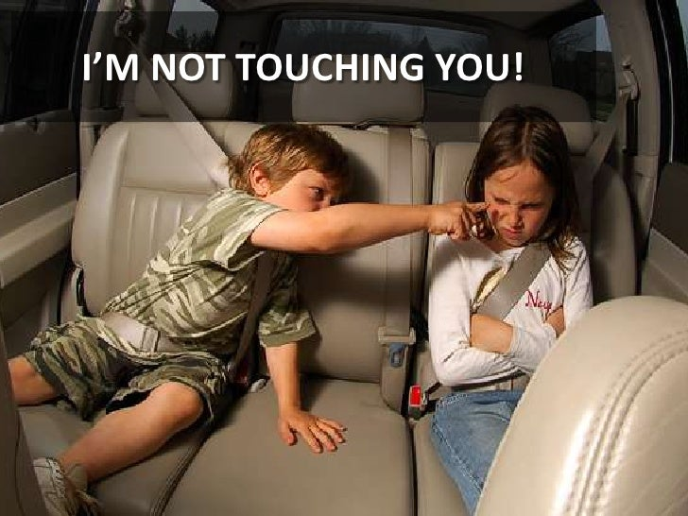

Slide 24
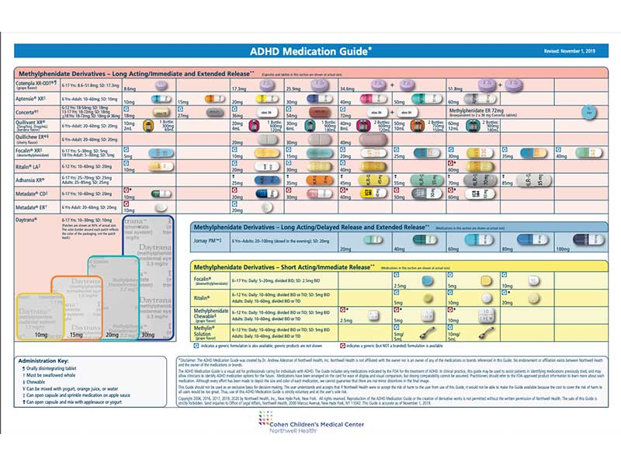
ADHD Medication Chart: Methylphenidate

Slide 25
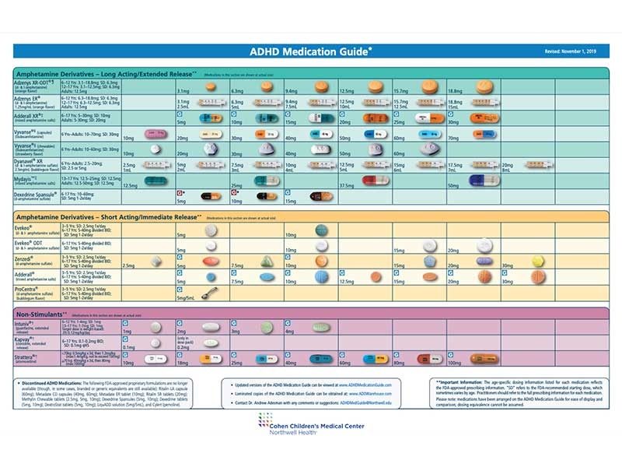
ADHD Medication Chart: Amphetamine

Slide 26
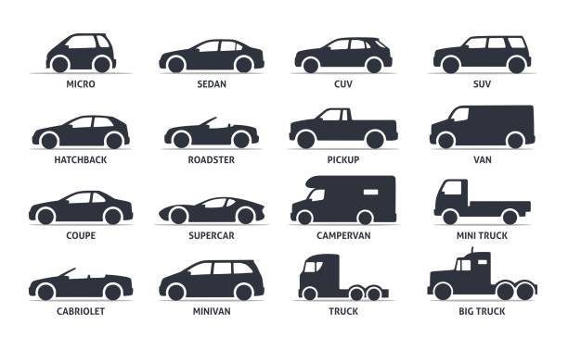
Think of the Different Stimulants Like different vehicles

Slide 27
How Do Alpha Agonist Work
Affect the prefrontal cortex acting primarily on norepinephrine
Stimulates the alpha-2 adrenergic receptors, reduces overall norepinephrine release, while also strengthening norepinephrine signals in the prefrontal cortex
Improving attention and reducing hyperactivity and impulsivity
More involved with regulation
Not nearly as affective as stimulants
These affects on norepinephrine reduce activity in the CNS and promotes relaxation

Slide 28
Alpha agonists Dumbed down
Using an immediate release clonidine can help with sleep in depression, anxiety and ADD/ADHD
Long acting medications must be taken daily to be affective
Very effective way to help with patients that have SE or activation with stimulants, smooths things out!
Can make the stimulants more affective and last longer (kinda like a basal rate)
Guanfacine is a good first start medication for younger patients
Unlikely to cause significant BP issues in children

Slide 29
How do SNRI’s work
Serotonin-Norepinephrine Reuptake Inhibitors – the name says it all
Increases the availability in the synaptic cleft, allows for improved binding to receptors and transmit signals.
Enhances alertness, focus, and memory, and helps regulate mood
Too much can cause anxiety, stress, and elevated blood pressure
Does have some affect on Dopamine

Slide 30

SNRI’s Dumbed Down
Qelbree and Strattera only two approved for ADD, but any in the class will have an affect
Not great for hyperactive
Can be a good medication when you aren’t exactly sure who is driving – anxiety, depression, ADD
Sexual SE are rare in kids
Will take longer to start working and make dosage adjustments
May help with sleep
Can cross taper – I don’t usually, may be time to refer

Slide 31


Slide 32
Anxiety
GAD-7
Patient Health Questionaire and General Anxiety Disorder (PHQ-9 and GAD-7)
Generalized Anxiety Disorder 7-item (GAD-7) scale
SCARED
SCARED-form-Parent-and-Child-version.pdf

Slide 33
Depression
PHQ-9
Patient Health Questionaire and General Anxiety Disorder (PHQ-9 and GAD-7)
PHQ-9 Questionnaire for Depression Scoring and Interpretation Guide

Slide 34
Suicide
Three steps to suicide
Thought
Plan
Action – your dead
Is the plan realistic
Ask them why do you want to live – it’s ok to want to live for someone else
Develop a safety plan who is going to keep you safe
The brain doesn’t work right if they want to kill themselves! It’s not normal coping,
They always say they would never do it when they feel good

Slide 35
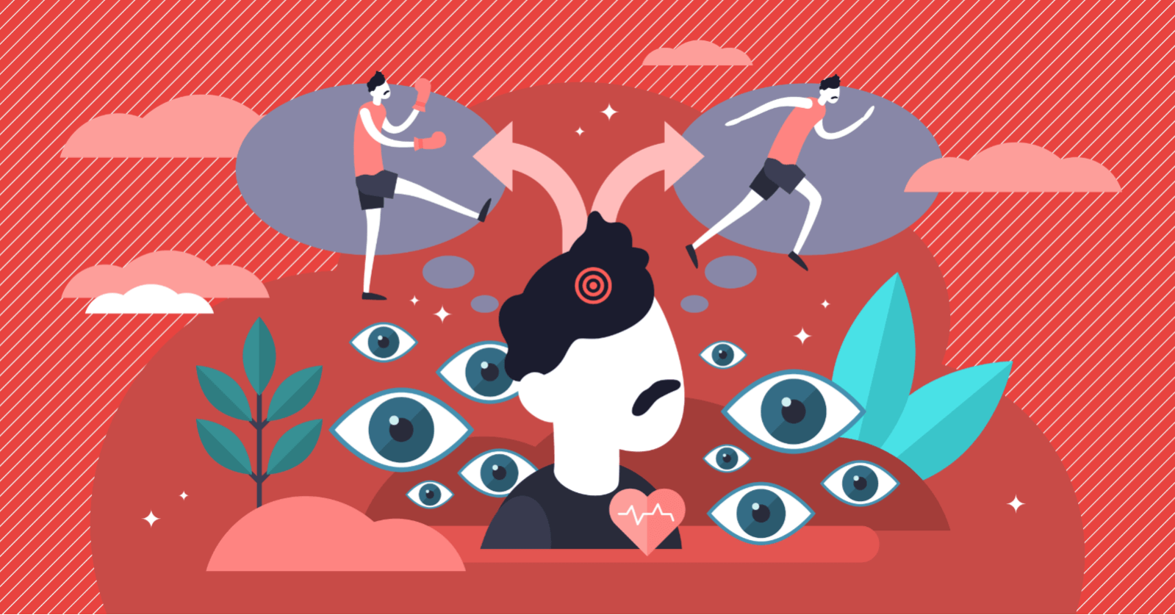
Fight of Flight https://www.calmclinic.com/anxiety/fight-or-flight-response

Slide 36
How Do SSRI’s Work
Selective Serotonin Reuptake Inhibitor (SSRI) – seriously it’s in the name
Promotes brain ability to change & adapt fostering neurogenesis, strengthening synaptic connections.
Stimulates the proliferation and differentiation of new neurons, especially in the hippocampus, which is linked to improved cognitive function.
Increasing the likelihood of neurons firing, helps regulate mood.
Enhanced neuroplasticity and neurogenesis associated with better cognitive performance.
Assists in the regulating of sleep-wake cycles and appetite
Can lead to changes in brain signaling
This is why they need to be on for about a year after meeting treatment goal prior to weaning off

Slide 37
SSRI’ Dumbed Down
Lexapro, Zoloft, Prozac - Think of Claritin, Zyrtec, and Allegra
Start Low and Go Slow – seriously this time
Going to take weeks to kick in, but if no change in 2 weeks increase the dose
Keep them on medication for at least a year from when you reach treatment goal
Prozac takes forever to start working and to go away – good for the forgetful teens (males especially)
Zoloft and Lexapro work pretty quick
Zoloft and Prozac can be given in higher doses
Zoloft works well with OCD (typically requires higher doses)
Can Cross taper……..think half-life

Slide 38
IT’s NOT Rocket Science It’s Primary CAre Nonpharmacological Interventions
SLEEP – Melatonin, Clonidine
DIET - If it looks like it came out of the ground or off a branch eat that
EXERCISE – Doesn’t have to be a gym membership
SOCIAL CONNECTION – We are meant to be together
PURPOSEFUL PARENTING – It’s scary when their sad, anxious, and it’s labor intensive
DECREASE SCREEN TIME – It’s like cocaine-------LITERALLY
SUPPLEMENTS – So many possibilities – Fish Oil is a good place to start
NATURE – Get outside, Get Grounded, Get Vitamin D

Slide 39
REfer
If you don’t feel like they fit in the BIG THREE
Younger patients outside your comfort level
Addiction
Bipolar
All kids are Bipolar
Be weary of any provider that makes this diagnosis early on in their treatment
Uncommon for kids to be bipolar even with Bipolar II
Schizophrenia
Rarely seen in kids

Slide 40
Practice Pearls
Don’t over think it
If possible fix sleep before starting meds
Sleep hygiene
Check for OSA
Melatonin
Sleep medication
Look for resources
Duke
KYSS
REACH
NAPNAP CARES
COPE
PNCB Peds Updates
Ask the questions you want to know
Make sure they know that you are there to keep them safe
It’s ok to say NO
No you don’t need medicine
No I can’t manage you
No medication isn’t going to help unless you do the work to get better
It’s ok to say Yes
Yes, it is normal to get distracted
Yes, it is normal to feel sad
Yes, it is normal to feel nervous
Yes, life is hard
Phone a Friend (first make a friends with a pysch prescriber)
BE HONEST
Counseling is pointless if they aren’t ready and willing

Slide 41
Affects of Electronics on the Brain
Sleep Disruption
Reduced sleep efficiency
Poor sleep quality
Shorter sleep duration
Attention Deficits
Impaired Cognitive Function “Brain Rot”
Language skills
Critical thinking and reasoning
Delays in Social and Emotional Development
When used to help calm children it hinders the ability to develop healthy emotional regulation skills
Addiction
Structural Brain Changes
Reduced Gray Matter
Decrease in functional connectivity in the brain involved in active thinking in areas responsible for memory and decision making
Delayed Development
Takes the place of activities crucial for development
Lower Academic Performance
Likely related to decrease sleep, attention span, critical thinking skills and increased distractions
Eye Strain
You blink less!!!
Lighting
Prolonged staring
Neck and back pain
Text neck or tech neck
Weight gain
Neurochanges causing emotional eating
Obesity
Social Isolation
Decreasing experience to develop
Decrease in Risk taking behaviors
Addiction
Anxiety
Depression

Slide 42
Resources
Books
Anxiety Relief for Teens (Regine Galanti)
ADHD Complex, Practicing Mental Health in Primary Care (Harlan Gephart)
Developmental and Behavior Pediatrics (Robert Voigt)
Pediatric Psychopharmacology (Mark Riddle)
Building Resilience in Children and Teens, 4th Edition (Kenneth R. Ginsburg)
Apps
Dailybean
Calm
Headspace
Insight Timer

Slide 43
Practice Guidelines
Practice Guidelines
Guidelines for Adolescent Depression in Primary Care (GLAD-PC): Part I. Practice Preparation, Identification, Assessment, and Initial Management | Pediatrics | American Academy of Pediatrics
Guidelines for Adolescent Depression in Primary Care (GLAD-PC): Part II. Treatment and Ongoing Management | Pediatrics | American Academy of Pediatrics
Clinical Practice Guideline for the Assessment and Treatment of Children and Adolescents With Anxiety Disorders - Journal of the American Academy of Child & Adolescent Psychiatry
Clinical Practice Guideline for the Diagnosis, Evaluation, and Treatment of Attention-Deficit/Hyperactivity Disorder in Children and Adolescents | Pediatrics | American Academy of Pediatrics
Stimulant Medication Chart
The ADHD Medication Guide [downloadable] - Childrens Health Council

