Slide 2
Disclosures
Owner of Revitalize Spine and Sports Care.
Otherwise, no disclosures to make.

Slide 3
Objectives
To learn the differential diagnoses of back and lower extremity pains
To effectively use the differential diagnoses, history and physical exam to determine the cause of back and lower extremity pains.

Slide 4
Definition of Low Back Pain (LBP)
Chronic LBP is LBP that lasts longer than 7-12 weeks

Slide 5
Epidemiology of Low Back Pain
Lifetime Prevalence: 60-85%
#1 cause of worker absenteeism
14% of population of US miss at least 1 day of work per year due to back pain:
  Highest in:
    Manual labor
    Low job satisfaction
    Poor workplace social support

Slide 6
Epidemiology of Low Back Pain
Leading cause of expenditures for worker’s comp
Chance of returning to work after disability:
  After 6 months: 50%
  After 1 year: 20%
  After 2 years: 3%

Slide 7
Economic Cost: $100 billion
Ratio of men to women: equal
  Younger: men
  After 60: women
  In both men and women, incidence increases with age.
Association between LBP and poor overall health

Slide 8
Predisposition to LBP:
  Obesity
  Low level of physical activity
  Poor strength and flexibility
  Heavy labor
  Certain sports such as wrestling and gymnastics

Slide 9
Pain Causing Structures
Annulus fibrosis
Facet Joints
Paraspinous muscles, other muscles, bursa
Periosteum of vertebral bodies
Nerve roots and Dorsal root ganglion
Ligaments (such as anterior and posterior longitudinal ligaments) and tendons
Sacroiliac joints
Etc.

Slide 10
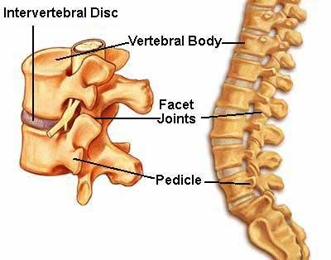

Slide 11
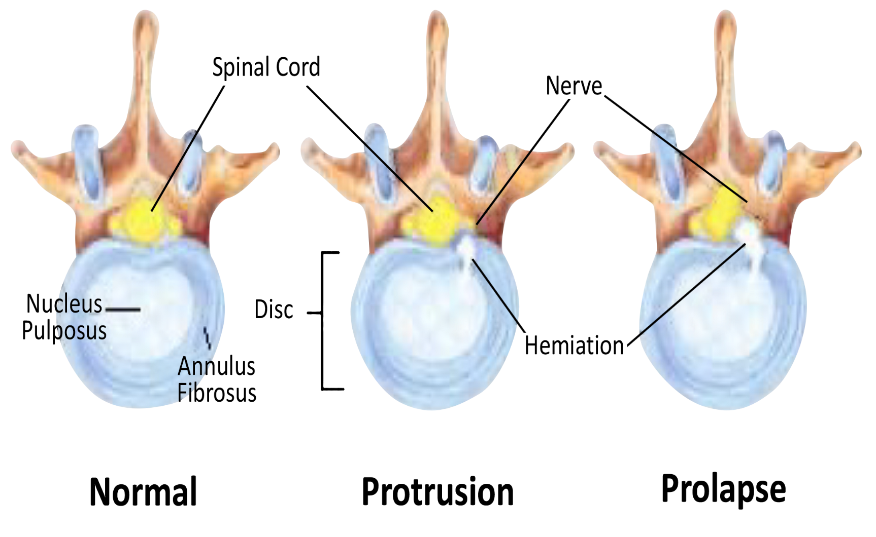

Slide 12
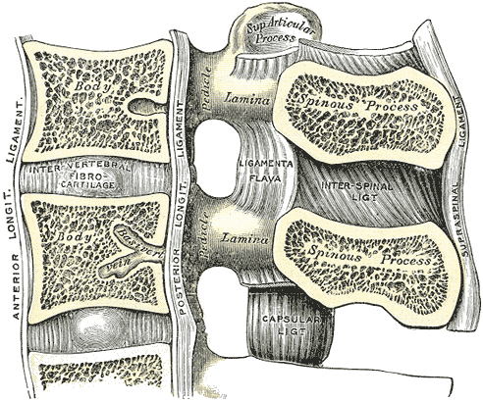

Slide 13
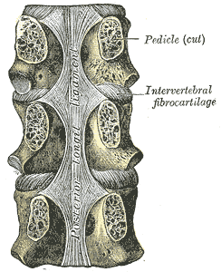

Slide 14
Differential Diagnosis of Low Back Pain
Mechanical:
  Muscle strain
  Disc bulge/herniation/protrusion/extrusion/sequestration
  Lumbar spondylosis/facet arthropathy
  Spondylolysis
  Spondylolisthesis
  Lumbar stenosis
  Scoliosis

Slide 15
Differential Diagnosis of Low Back Pain
Rheumatologic:
  Ankylosis spondylitis
  Reactive arthritis
  Psoriatic arthritis
  Enteropathic arthritis
  Rheumatoid arthritis
  Diffuse idiopathic skeletal hyperostosis
  Polymyalgia rheumatica
  Fibromyalgia

Slide 16
Differential Diagnosis of Low Back Pain
Infections:
  Lumbosacral osteomyelitis
  Discitis
  Pyogenic sacroiliitis
  Lyme disease

Slide 17
Differential Diagnosis of Low Back Pain
Tumors/Infiltrative Disease:
  Osteoid osteoma
  Osteoblastoma
  Osteochondroma
  Giant Cell
  Aneurysmal bone cyst
  Hemangioma
  Eosinophilic granuloma

Slide 18
Differential Diagnosis of Low Back Pain
Malignant:
  Multiple myeloma
  Chondrosarcoma
  Chordoma
  Lymphoma
  Skeletal metastases
  Intraspinal neoplasms

Slide 19
Differential Diagnosis of Low Back Pain
Endocrine/Metabolic:
  Osteoporosis
  Osteomalacia
  Hyperparathyroid
  Hypoparathyroid

Slide 20
Differential Diagnosis of Low Back Pain
Hematologic:
  Hemoglobinopathies
  Myelofibrosis
  Mastocytosis

Slide 21
Differential Diagnosis of Low Back Pain
Neurologic/Psychiatric:
  Neuropathy
  Psychogenic
  Malingering

Slide 22
Differential Diagnosis of Low Back Pain
Referred Pain:
  Vascular:
    Abdominal aortic aneurysm
  Genitourinary:
    Kidney stone
    Pyelonephritis
    Uretopelvic junction obstruction
    Renal infarction
    Renal cancer

Slide 23
Differential Diagnosis of Low Back Pain
  Ureter:
    Stone
    Vesicoureteral reflux
  Bladder:
    Urinary retention
    Urinary infection

Slide 24
Differential Diagnosis of Low Back Pain
Referred Pain:
  Prostate:
    Prostatitis
    Cancer
  Testis:
    Cancer
  Uterus:
    Leimyomas
    Retroverted
    Prolapsed
    Endometriosis
    Pregnancy
  Fallopian Tubes:
    Pelvic inflammatory disease
    Ectopic pregnancy

Slide 25
Differential Diagnosis of Low Back Pain
Referred Pain:
  Ovary:
    Benign neoplasm
    Malignant neoplasm
  Gastrointestinal:
    Pancreas
      Pancreatitis
      Tumor
    Gallbladder:
      Cholecystitis
    Hollow viscus/Stomach/Duodenum:
      Ulcer
    Colon:
      Diverticulitis
      Cancer

Slide 26
More Common Reasons for Low Back Pain
Herniated Disc
Myofascial Pain
Spinal stenosis
Lumbar spondylosis/Facet disease
Unknown
Spondylolisthesis

Slide 27
More Common Reasons for Low Back Pain
Discogenic pain
Lumbar instability
Spondylolysis Scoliosis
Psychiatric
Compression fracture
Other diagnoses

Slide 28
Herniated Discs
Most common cause of LBP: 36.7% of cases
L4-5 or L5-S1 discs: 90-95% of cases
Most common ages: 3rd and 4th decades
% of cases of disc herniation that result in radicular symptoms: Less than half

Slide 29
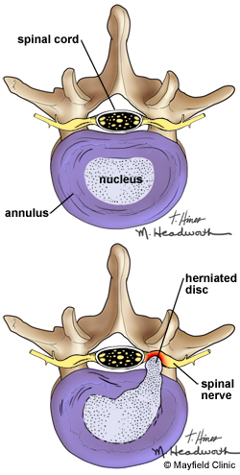

Slide 30
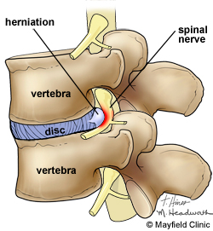

Slide 31
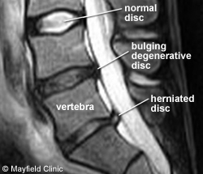

Slide 32
Herniated Discs
How do we diagnose a radiculopathy?
  Thorough history
  Thorough physical exam
  Together, these account for about 80% of diagnosis
  Imaging should confirm diagnosis made by history and physical exam.

Slide 33
Herniated Discs
History:
  Low back pain accompanied by radicular symptoms
  Usually sharp pain radiating down leg in dermatomal distribution
  Coughing, sneezing, sitting can increase pain

Slide 34
Herniated Discs
Physical Exam:
  Sensory loss, weakness, reduced reflexes
  Straight leg raise: sensitive but poor specificity
  Crossed straight leg raise: specific but poor sensitivity
Imaging: CT, MRI, myelography
EMG/NCS

Slide 35
Herniated Discs
How do we treat it:
  NSAIDs
  Muscle relaxants
  Oral steroids
  Neuropathic pain medications
  Opiates
  Epidural steroid injections
  Surgery: discectomy

Slide 36
Myofascial Pain
Second most common cause of back pain
  Prevalence of 20%
  Often associated with increased muscle tension

Slide 37
Myofascial Pain
History:
  Deep aching pain that is aggravated by activity and position changes
  Can be localized to the back or radiated into buttocks, sacrum, thigh, abdominal wall, and even calf.
  Can have weakness or even paresthesias or both

Slide 38
Myofascial Pain
Physical Exam:
  Tender, taut bands
  Deep transverse palpation or needle insertion can cause twitch response

Slide 39
Myofascial Pain
Treatment:
  Conservative:
    Manual therapy
    Massage
    Spray and stretch techniques
    Physical therapy
    Muscle relaxants
    NSAIDs/Tylenol
    Lidoderm patches
    Heat/Ice
    TENs
    Trigger point injections

Slide 40
Spinal Stenosis
Third most common reason for back pain: 14%
  From central stenosis or foraminal stenosis

Slide 41
Spinal Stenosis
History/Physical Exam:
  Central stenosis:
    Axial back pain and leg pain brought on by walking, especially downhill, or standing
    Usually bilateral and radiates to the ankles
    Improved with sitting or bending forward
    Can have numbness (usually in stocking distribution) or weakness
  Foraminal stenosis:
    Dermatomal distribution that may be sensory or motor or both

Slide 42
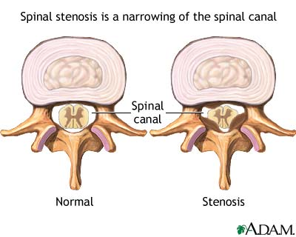

Slide 43
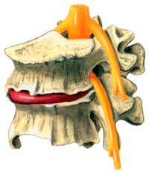

Slide 44
Spinal Stenosis
Causes of Spinal Stenosis:
  Disc space loss
  Facet disease
  Ligamentum flavum hypertrophy
  Herniated disc
  Osteophytes
  Spondylolisthesis

Slide 45
Spinal Stenosis
Imaging: MRI, CT
Treatment:
  Medications:
    NSAIDs
    Neuropathic pain medications
  Exercise program

Slide 46
Spinal Stenosis
Treatment:
  Epidural steroid injection
    Interlaminar – usually for central stenosis or multilevel stenosis
    Transforaminal – for radicular symptoms due to foraminal stenosis
  Surgical decompression

Slide 47
Facet Disease
Estimates of the percentage of LBP sufferers that have facet disease: 8-94% (more frequently quoted as 15-40%)
What these joints do:
  Limit rotation
  Resist compressive forces during lordosis
The load born by these joints: 3-25%

Slide 48
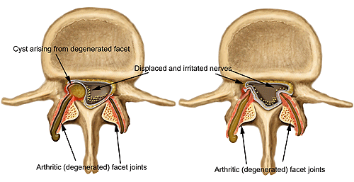

Slide 49
Facet Disease
History:
  Gradual onset of deep aching LBP
    May radiate to groin, hip, buttock or thigh
    May have morning stiffness
Physical Exam:
  May be aggravated by maneuvers which increase load borne by facet joints
    Hyperextension
    Rotation
  Tenderness to palpation in paraspinous region (over facet joints)

Slide 50
Facet Disease
Imaging: CT or MRI
Medial branch block:
  Only way to truly make diagnosis is by MBB (diagnostic block followed by confirmatory block if 1st block was positive).

Slide 51
Facet Disease
Treatment:
  Definitive: Radiofrequency ablation
  Other:
    NSAIDs
    Tylenol
    Physical therapy
    TENs
    Intraarticular facet blocks

Slide 52
Discogenic Pain
May affect up to 39% of chronic LBP patients.
History:
  Gradual onset, aching low back pain that is usually axial.
  However, can extend to buttock, hip, groin
  Worsened by sitting or bending forward.

Slide 53
Discogenic Pain
Physical Exam:
  Absence of focal neurologic deficits
Imaging:
  CT and MRI can show degenerative disc disease, but cannot make the diagnosis of discogenic disease
Definitive Diagnosis:
  Provocative discography

Slide 54
Discogenic Pain
Treatment:
  NSAIDs
  Tylenol
  Opioids
  Weight loss
  Physical therapy
  TENs
  Epidural steroid injection
  Discectomy

Slide 55
Sacroiliac Joint Pain
Cause of 15-30% of chronic LBP.
History:
  Usually a report of pain after a fall, lifting and turning, bracing with their legs during a MVA.
  An axial load with rotation
  Aching, low back or buttock pain that radiates into groin or thigh
  Made worse with prolonged sitting, standing or bending
  Can be seen in pregnancy

Slide 56
Sacroiliac Joint Pain
Physical Exam:
  Tenderness over the joints
  Special tests: FABER’s, Gaenslen’s, Yeoman’s, etc.
  Also associated with leg length discrepancy, scoliosis

Slide 57
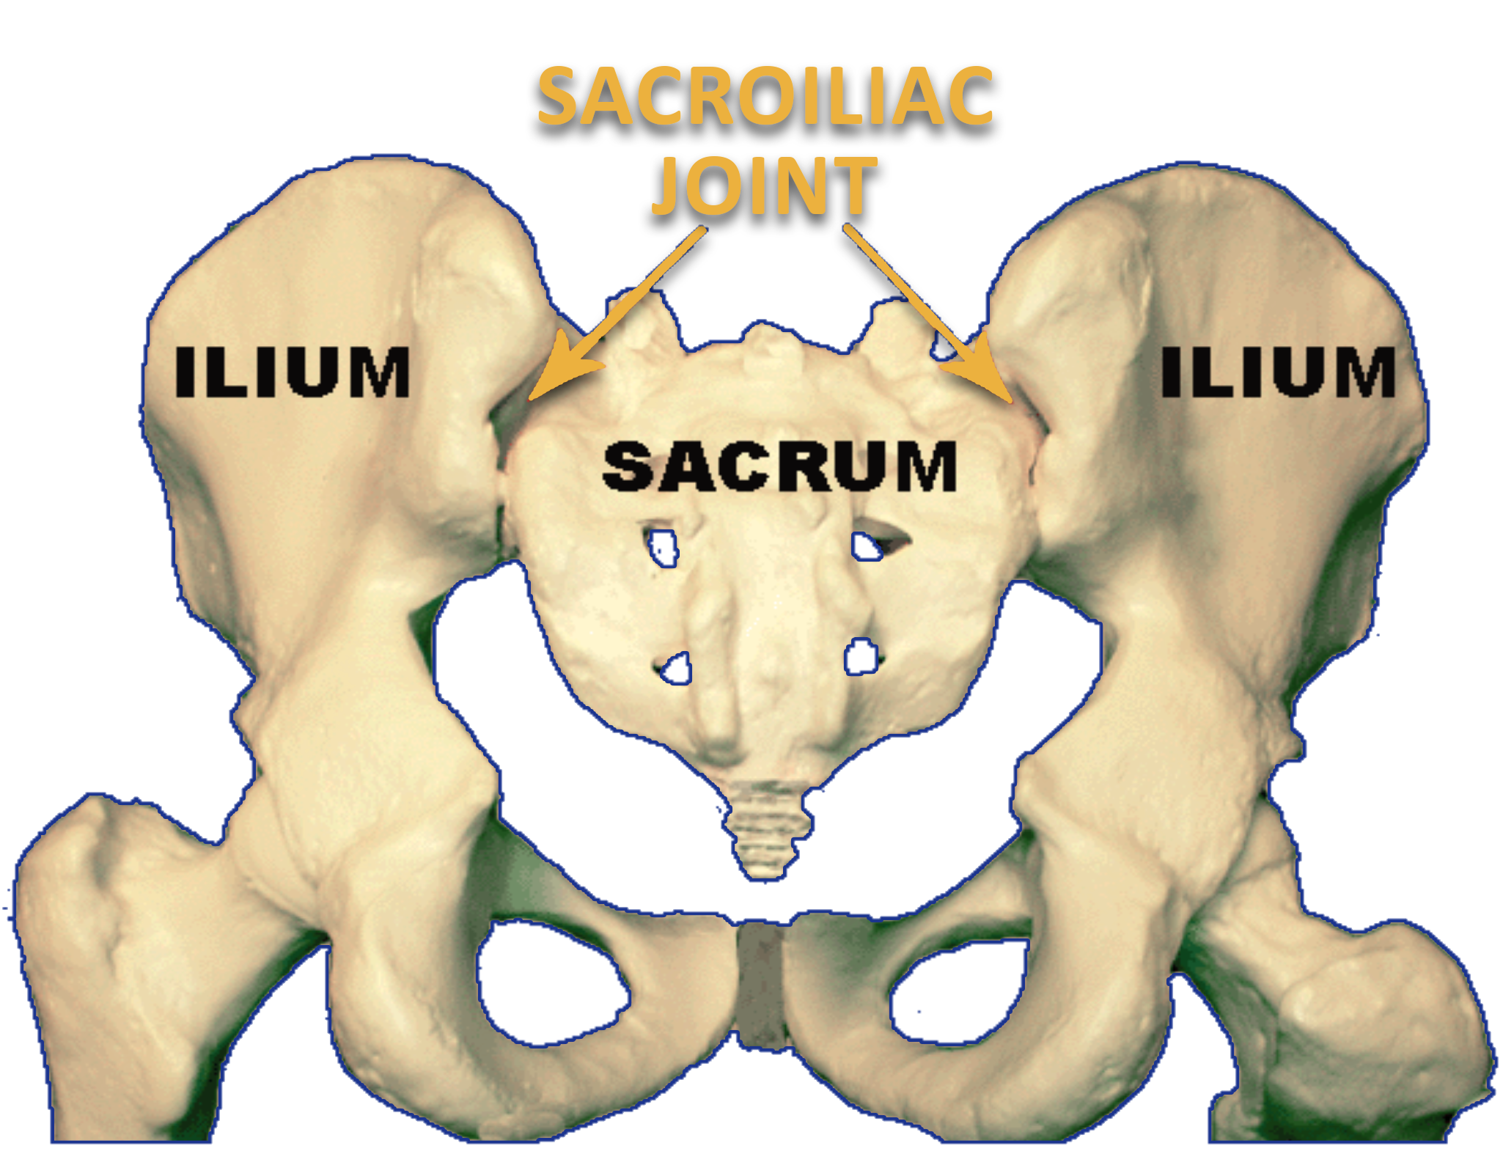

Slide 58
Sacroiliac Joint Pain
Imaging: Unreliable
Definitive diagnosis:
  Diagnostic SI joint injection under radiologic guidance

Slide 59
Sacroiliac Joint Pain
Treatment:
  NSAIDs
  Tylenol
  Treatment of leg length discrepancy or pelvic obliquity
  SI joint injection
  Physical therapy
  TENs
  Heat and ice
  Radiofrequency

Slide 60
Vertebral Fractures
Only 30% come to attention of physicians (lack of severe pain does not trigger imaging)
Most common locations:
  Thoracolumbar junction
  Mid thoracic spine
  Lumbar region
Prevalence highest in caucasian women due to increased incidence of osteoporosis

Slide 61
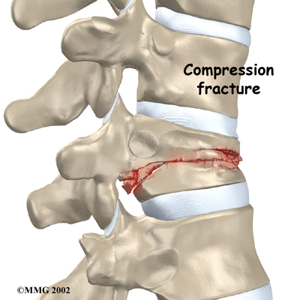

Slide 62
Vertebral Fractures
History:
  Acute pain over fracture site
  For sacral fractures: pain can radiate to buttock or leg
  Can cause radiculopathy

Slide 63
Vertebral Fractures
Treatment:
  Exercise Program
  Fall prevention
  NSAIDs
  Opioids
  Bisphosponates
  Calcitonin
  Vertebroplasty/Kyphoplasty

Slide 64
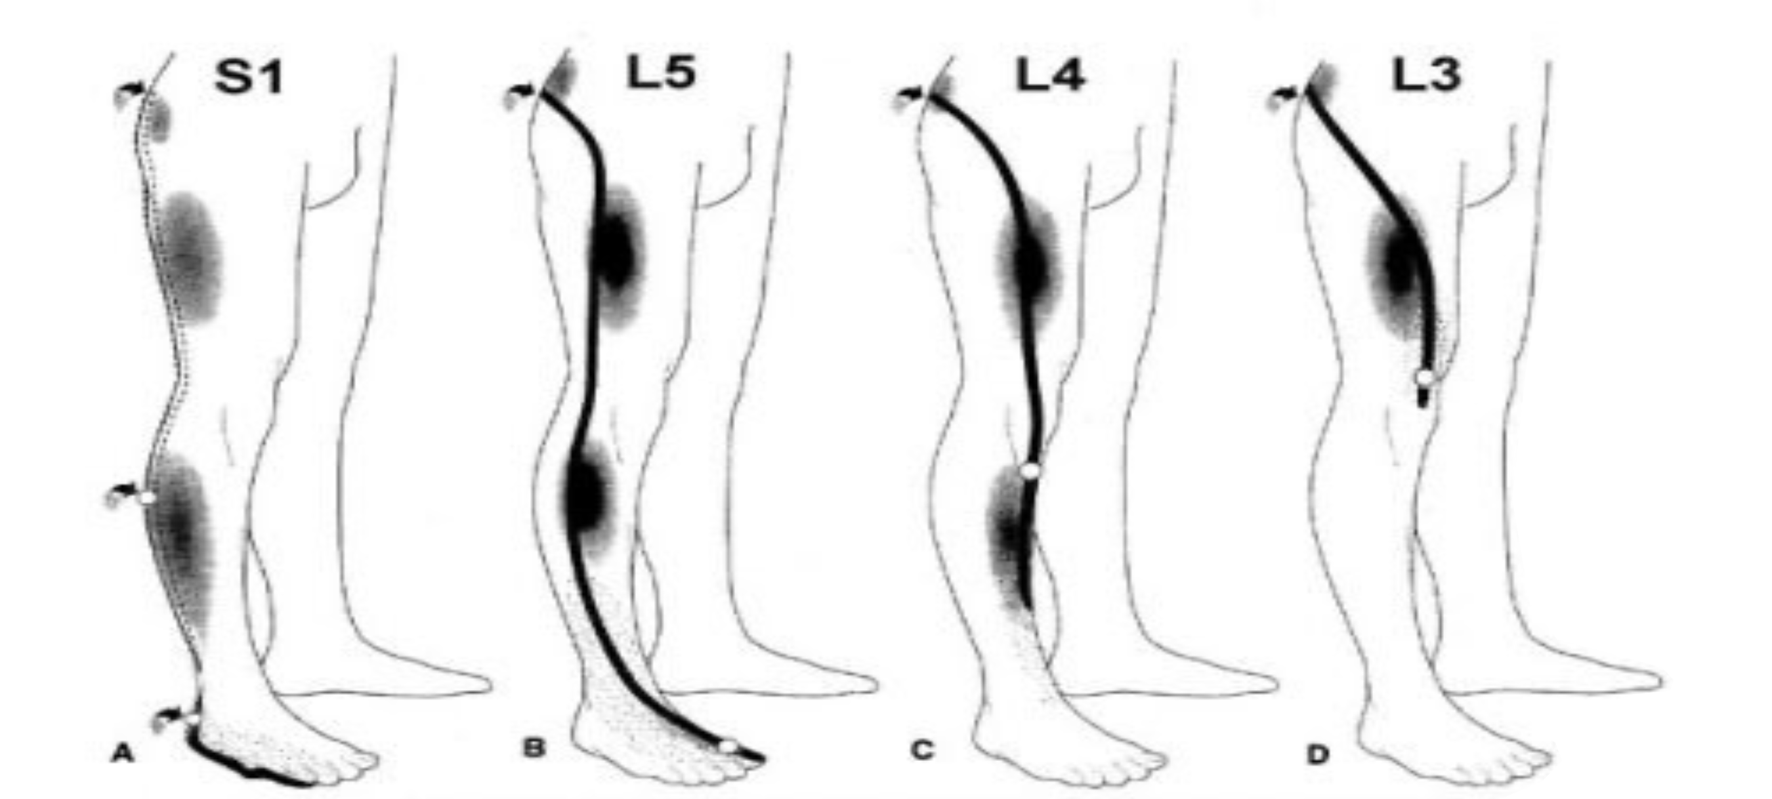
Lumbar Radiculopathy Referral Patterns

Slide 65
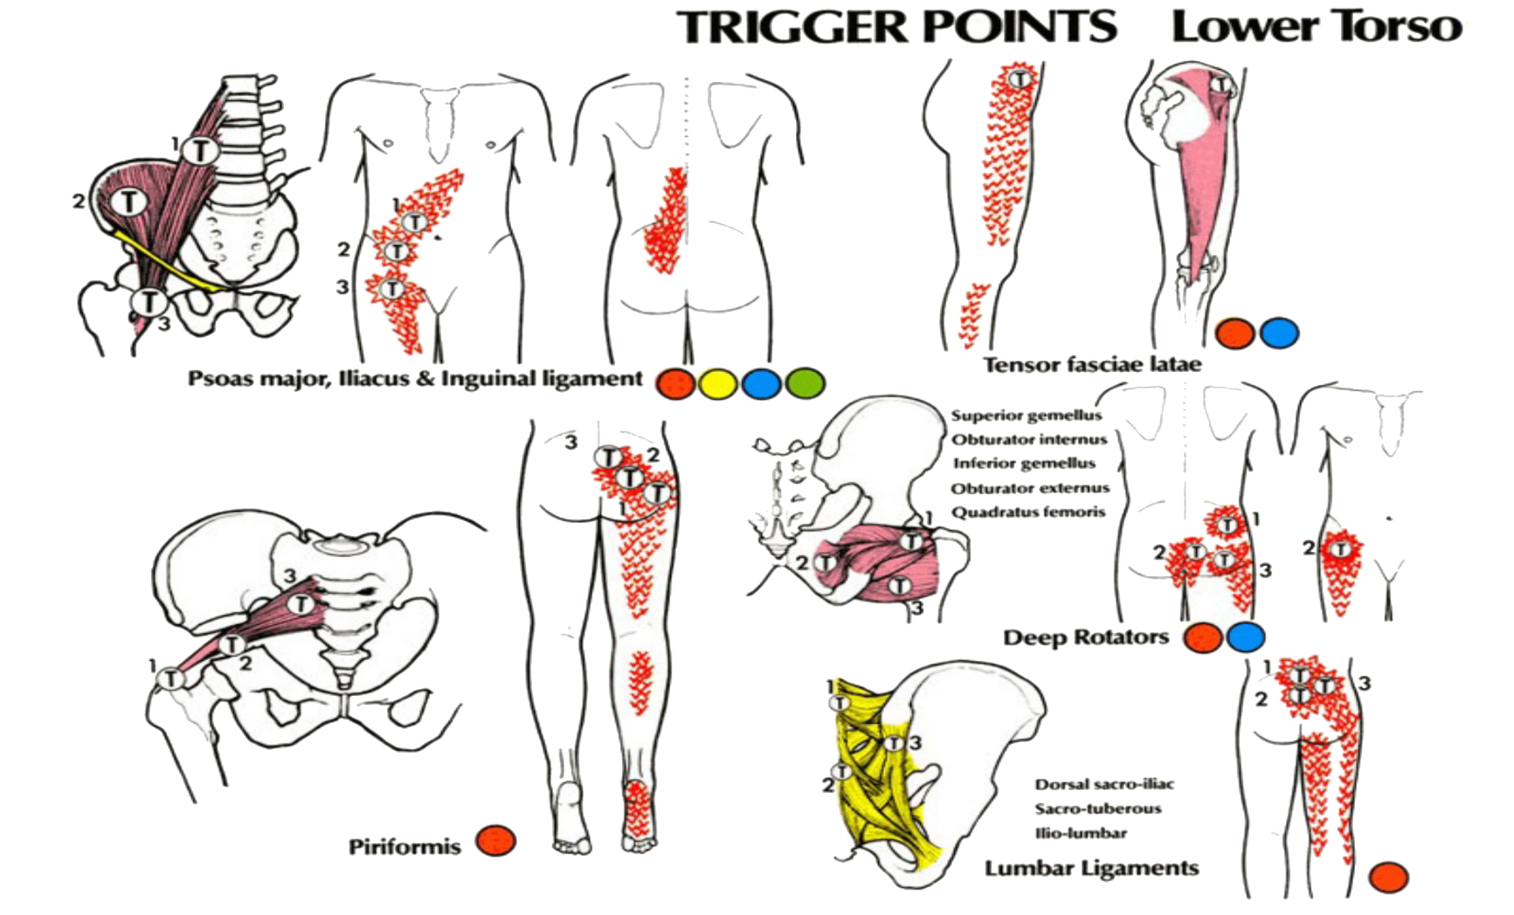
Myofascial Referral Patterns

Slide 66
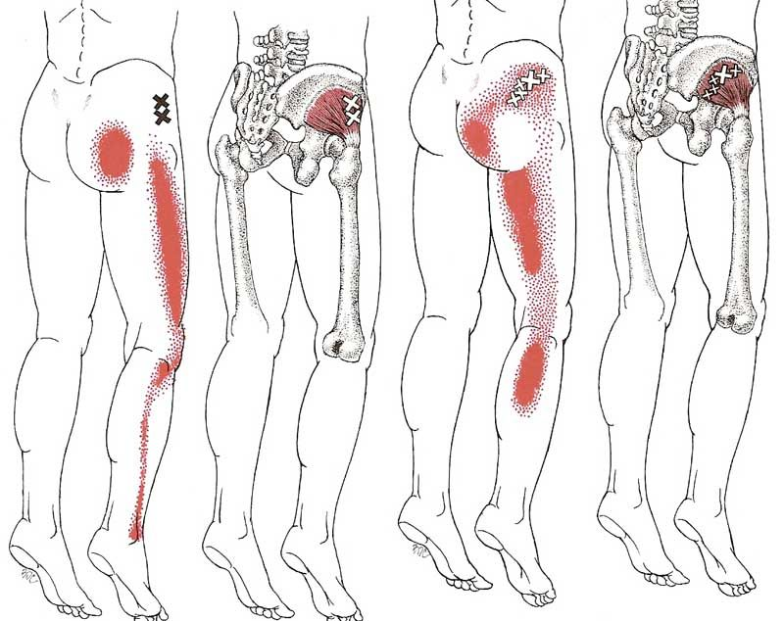
Myofascial Referral Pattern
Gluteus Minimus

Slide 67
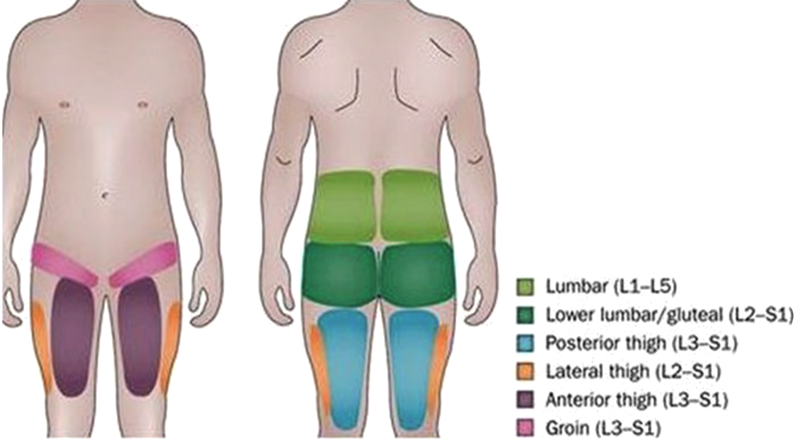
Lumbar Facet Joint Referral Pattern

Slide 68
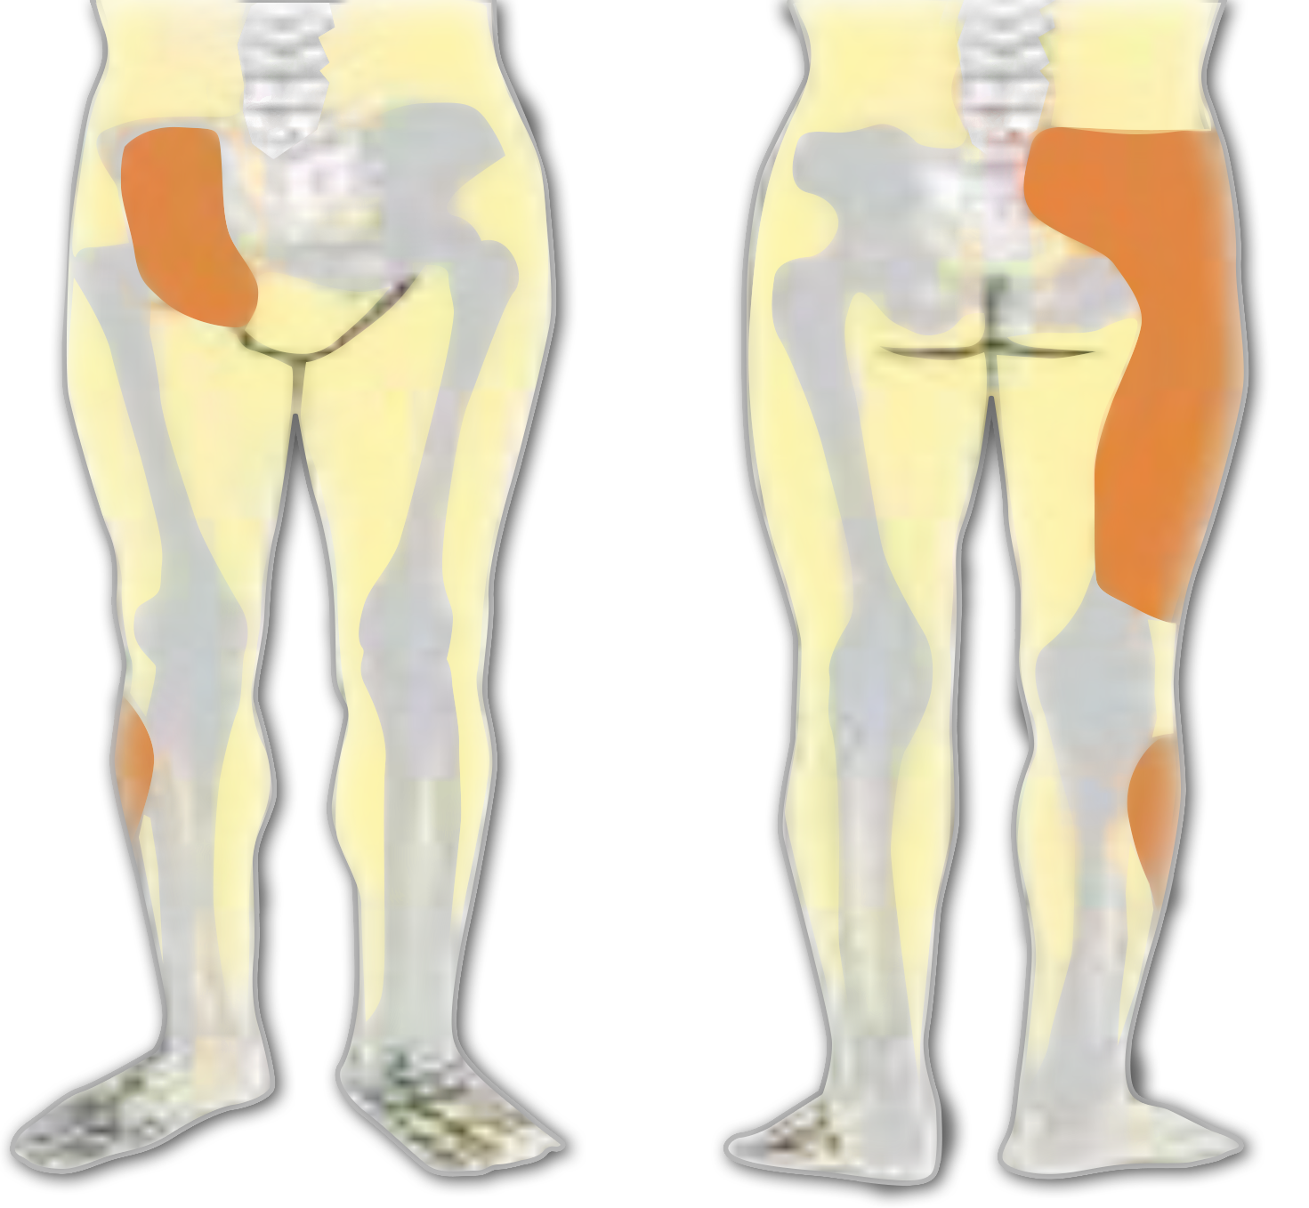
Sacroiliac Joint Referral Pattern

Slide 69
In analysis of the pain diagrams of 50 patients who responded to fluoroscopy guided SI injection, Slipman CW et al found the following common referral patterns of the SI joint.
94% Buttock pain
72% Lower lumbar pain
14% Groin pain
50% LE pain
28% LE pain below knee
Slipman CW. et al. Sacroiliac joint pain referral zones. Arch Phys Med Rehab. 2000;8 1:334-8.

Slide 70
Acute Hip and Groin Pain
Common Causes:
  Adductor muscles
    Muscle strain
      Presentation: Acute localized pain over belly of adductor longus, proximal musculotendinous junction
      Findings: Localized tenderness, pain on passive abduction and on resisted adduction
    Tendinopathy
      Presentation: Proximal groin pain with increasing activity
      Findings: local tenderness over adductor origin, pain on passive hip abduction and resisted adduction

Slide 71
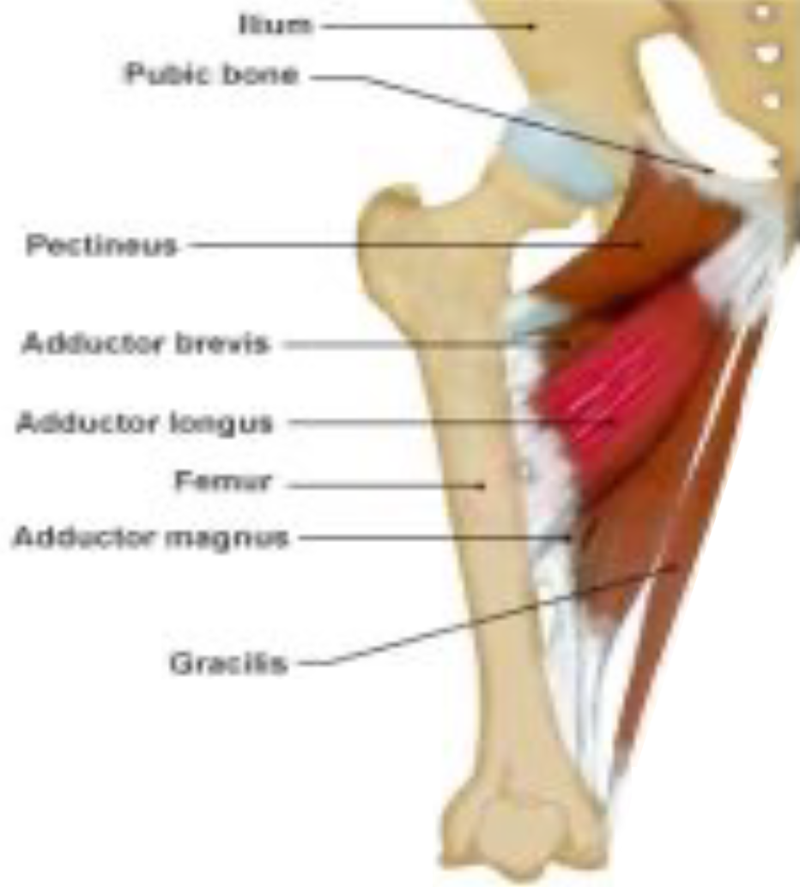
Groin Pull (Adductor Muscle Strain)

Slide 72
Acute Hip and Groin Pain
Common Causes:
  Hip joint
    Synovitis
    Labral tear
    Chondral lesion

Slide 73
Acute Hip and Groin Pain
Hip joint pain may be felt in a number of areas:
  Deep inside the hip (58%)
  Groin (51%)
  Outside the hip (45%)
  Low back (42%)

Slide 74
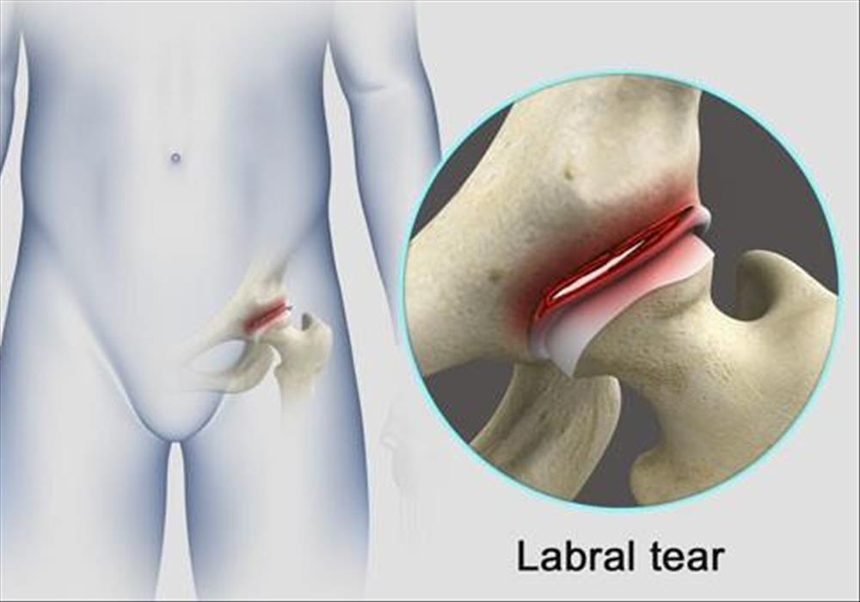

Slide 75
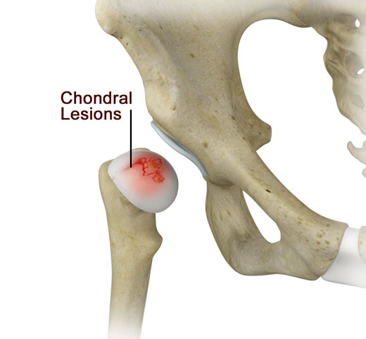

Slide 76
Acute Hip and Groin Pain
Less Common Causes:
  Iliopsoas strain
    Presentation: Poorly localized ache in one side of groin
    Findings: pain on iliopsoas stretch & resisted hip flexion
  Stress fracture
    Neck of femur
    Pubic ramus
    Acetabulum

Slide 77
Acute Hip and Groin Pain
  Referred pain
    Lumbar spine
    Sacroiliac joint
  Infection
    Osteomyelitis

Slide 78
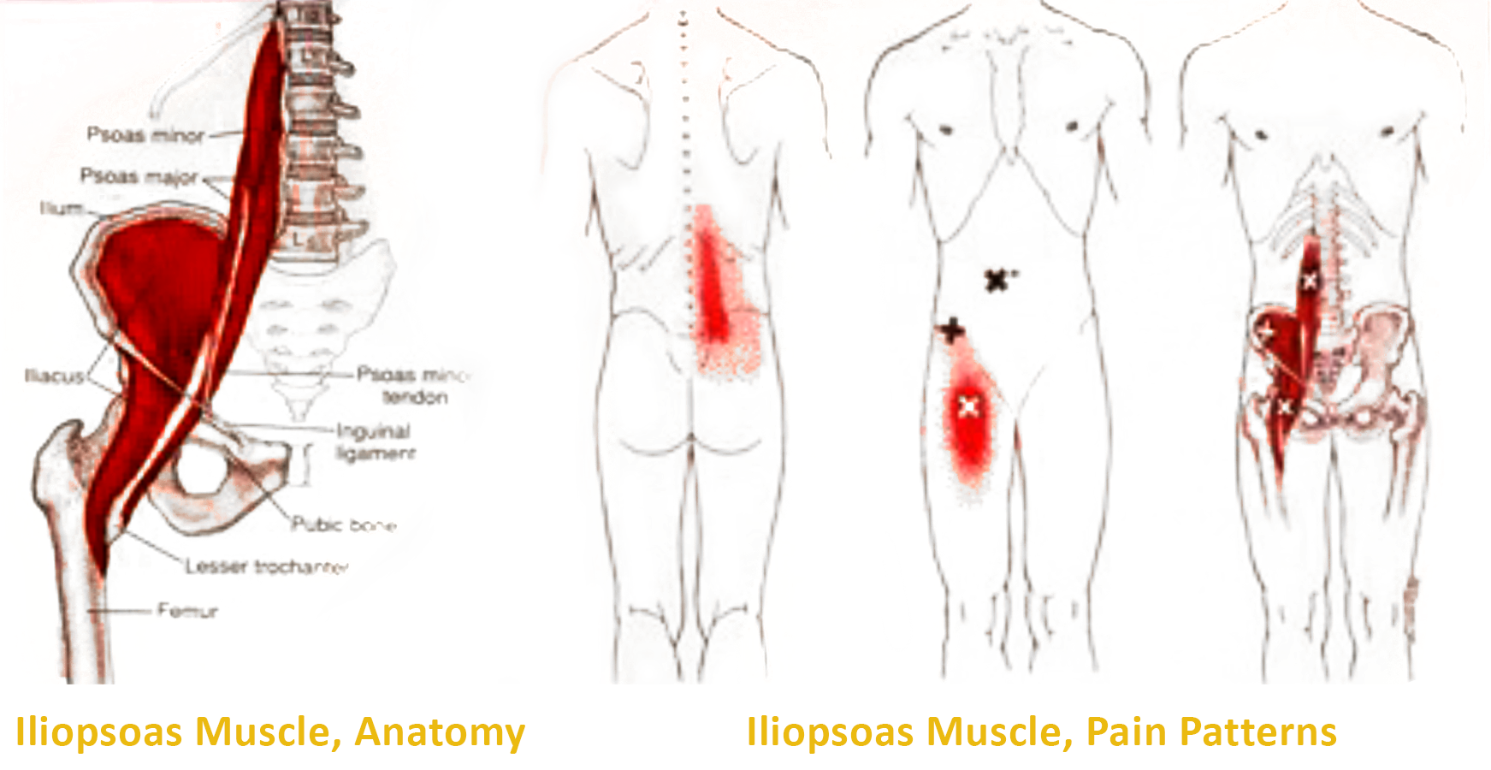
Iliopsoas

Slide 79
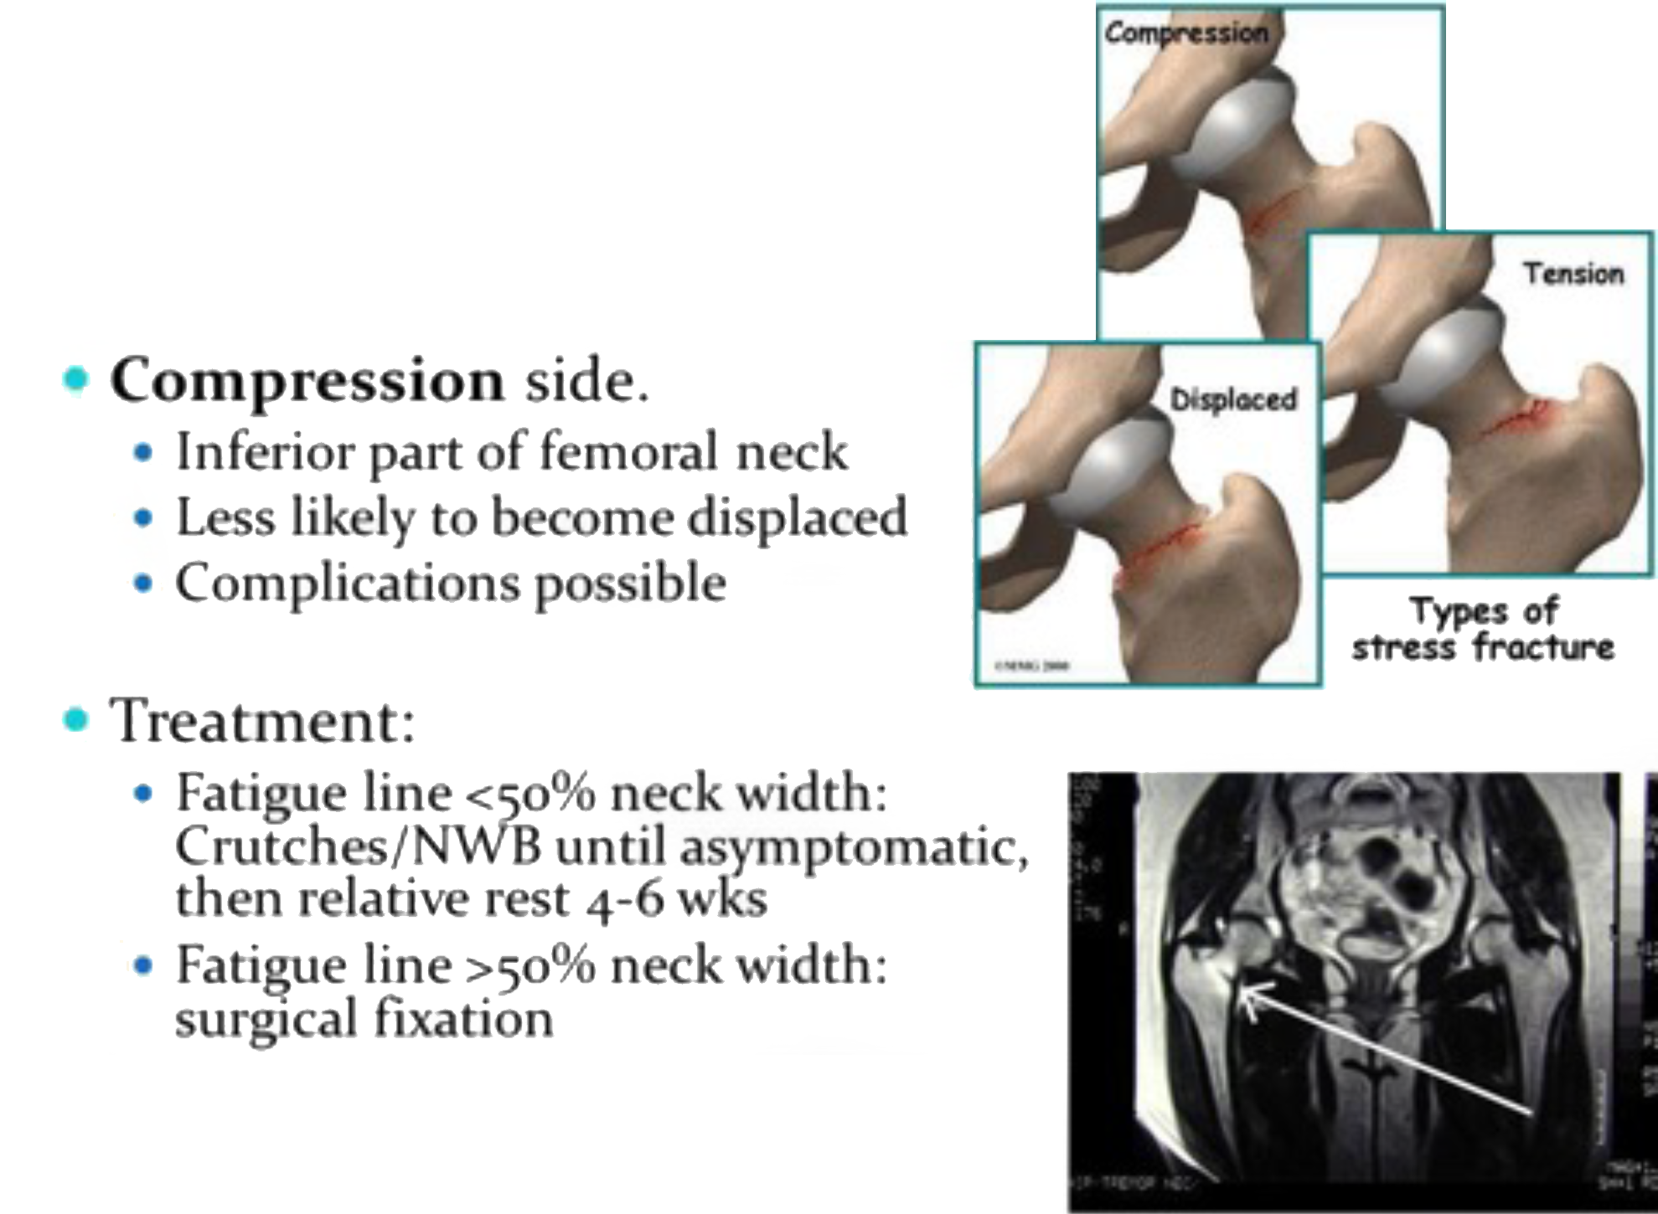
Femoral Neck
Stress Fractures

Slide 80
Acute Hip and Groin Pain
Less Common Causes:
  Snapping hip
  Rectus femoris muscle strain (upper third)
  Avulsion apophysitis/fracture
    Anterior superior iliac spine
    Anterior inferior iliac spine

Slide 81
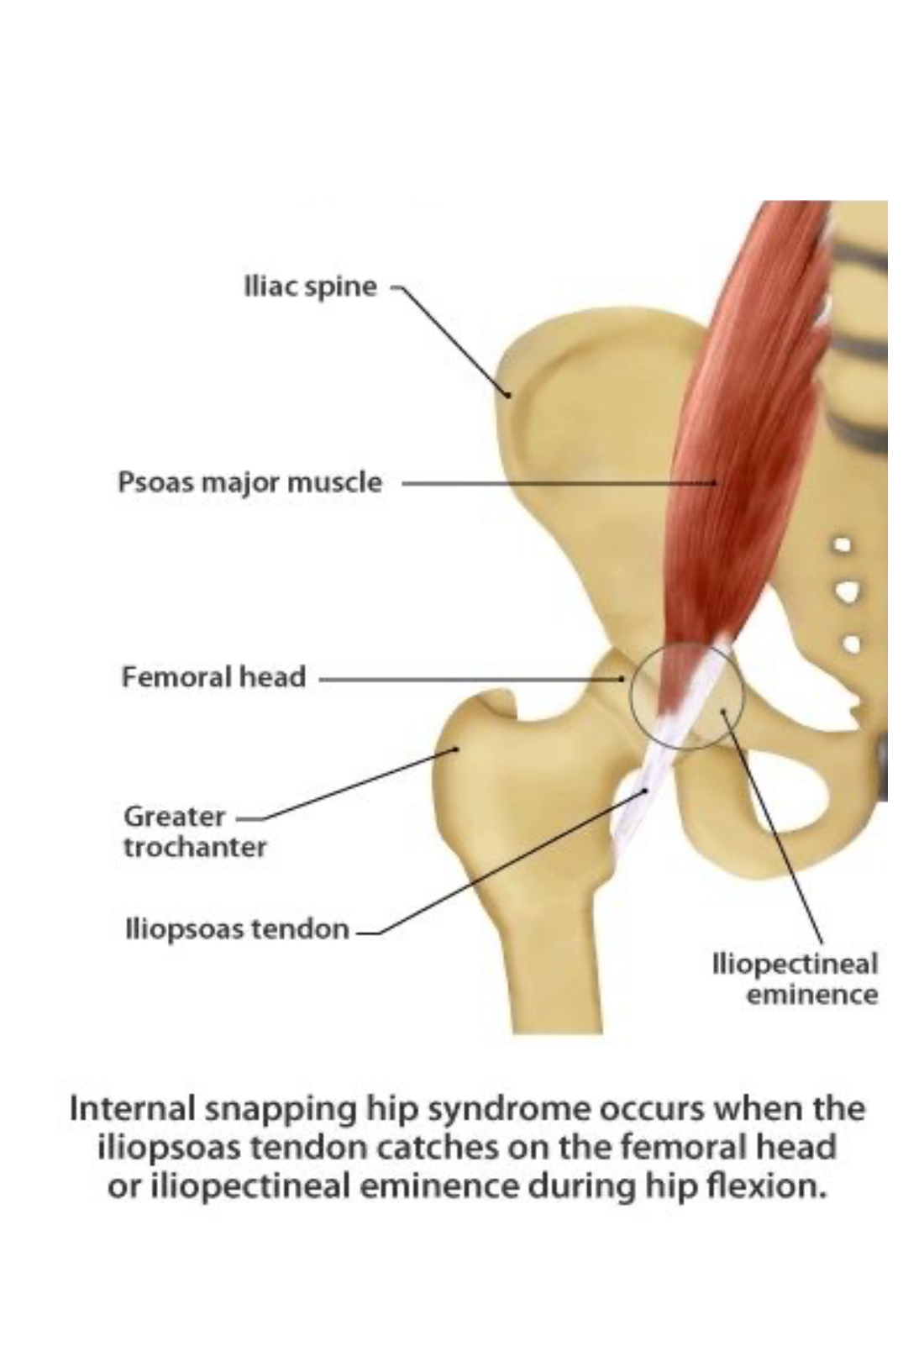
Internal Snapping Hip Syndrome

Slide 82
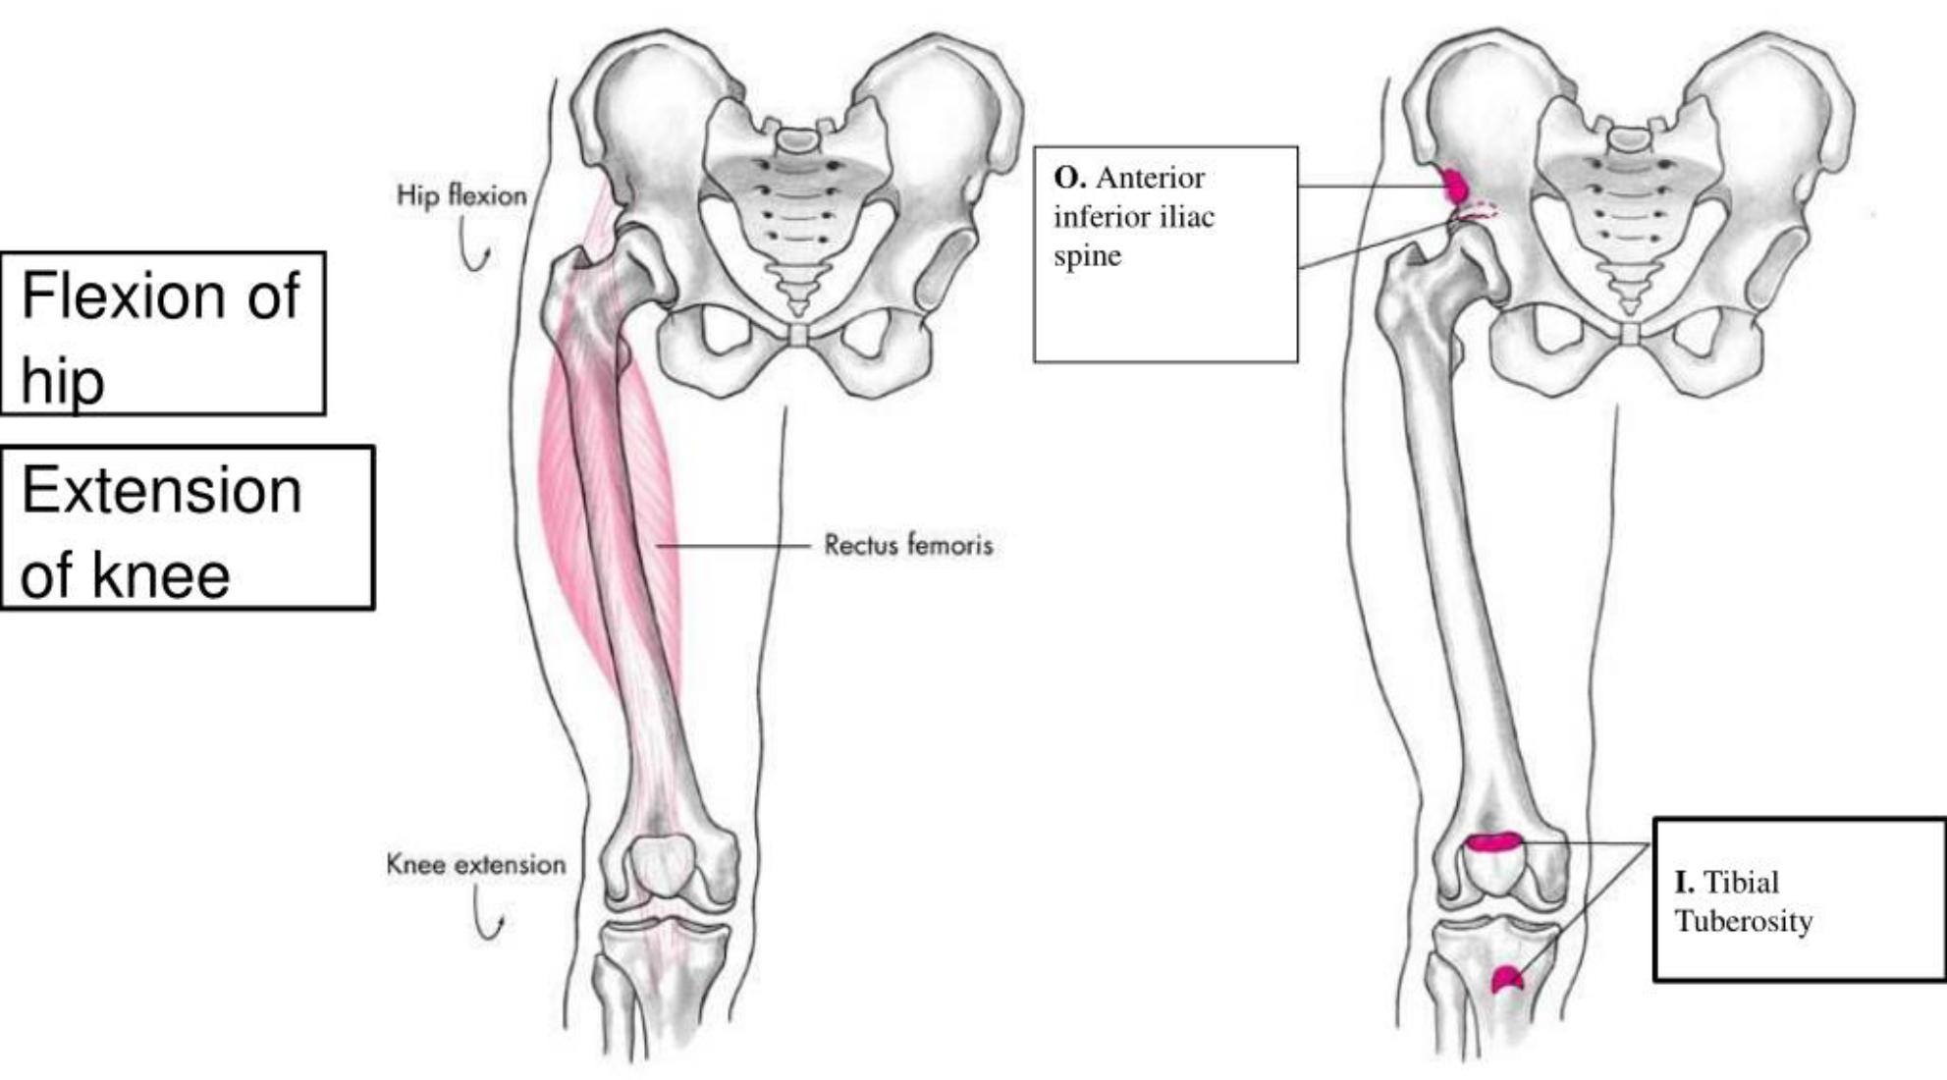
Rectus Femoris Muscle

Slide 83
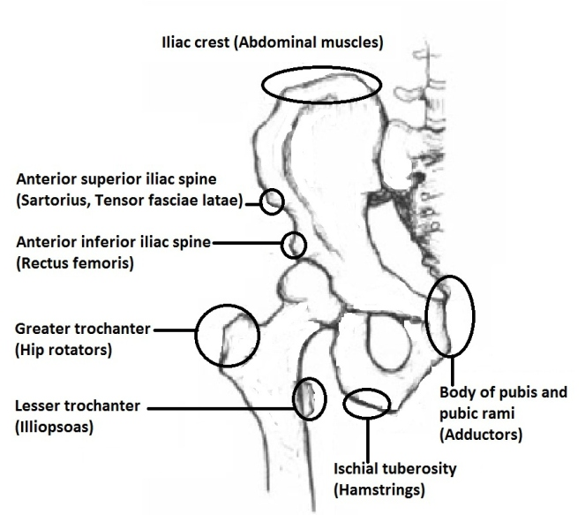

Slide 84
Acute Hip and Groin Pain
Not to be missed
  Slipped capital femoral epiphysis
  Intra-abdominal abnormality
    Appendicitis
    Prostatitis
    Urinary tract infections
    Gynecological conditions

Slide 85
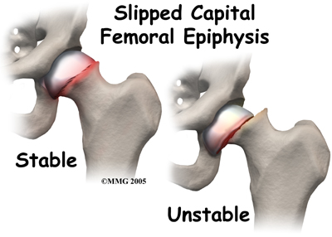

Slide 86
Longstanding Hip and Groin Pain
Common Causes:
  Adductor muscles
    Tendinopathy
    Neuromyofascial tightness
  Iliopsoas related
    Neuromyofascial tightness
    Tendinopathy
    Bursitis

Slide 87
Longstanding Hip and Groin Pain
Common Causes:
  Abdominal wall related
    Tear of external oblique aponeurosis
    Rectus abdominis tendinopathy
  Pubic bone related
    Pubic bone stress

Slide 88
Longstanding Hip and Groin Pain
Less Common Causes:
  Hip joint
    Osteoarthritis
    Chondral lesion
    Labral tear
    Snapping hip
  Stress fracture
    Neck of femur
    Pubic ramus
    Acetabulum

Slide 89
Longstanding Hip and Groin Pain
Less Common Causes:
  Nerve entrapment
    Obturator
    Ilioinguinal
    Genitofemoral
  Referred pain
    Lumbar spine
    Sacroiliac joint
  Apophysitis
    Anterior superior iliac spine
    Anterior inferior iliac spine

Slide 90
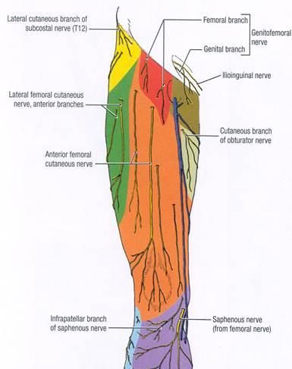

Slide 91
Longstanding Hip and Groin Pain
Not to be missed
  Slipped capital femoral epiphysis
  Perthes’s Disease
  Intra-abdominal abnormality
    Prostatitis
    Urinary tract infections
    Gynecological conditions

Slide 92
Longstanding Hip and Groin Pain
Not to be missed
  Spondyloarthropathies
    Ankylosing spondylitis
  Avascular necrosis of the head of the femur
  Tumors
    Testicular
    Osteoid osteoma

Slide 93
Anterior thigh pain
Common causes
  Quadriceps muscle contusion
  Quadriceps muscle strain
  Myositis ossficans

Slide 94
Anterior thigh pain
Less common causes
  Referred pain (upper lumbar spine, sacroiliac joint, hip joint)
  Stress fracture of the femur
  Sartorius muscle strain
  Gracilis strain
  Avulsion of the apophysis of rectus femoris

Slide 95
Anterior thigh pain
Not to be missed
  Slipped capital femoral epiphysis
  Perthes’ disease
  Tumor (like osteosarcoma of the femur)

Slide 96
Posterior thigh pain
Common causes
  Hamstring muscle strains
    Acute
    Recurrent
  Hamstring muscle contusion
  Referred pain
    Lumbar spine
  Gluteal trigger points

Slide 97
Posterior thigh pain
Less common causes
  Referred pain
    Sacroiliac joint
  Tendinopathy
  Bursitis
    Semimembranous
    Ischiogluteal

Slide 98
Posterior thigh pain
Less common causes
  Chronic compartment syndrome
  Apophysitis/avulsion of the ischial tuberosity
  Nerve entrapments
    Posterior cutaneous thigh
    Sciatic
  Adductor magnus strain

Slide 99
Posterior thigh pain
Not to be missed
  Tumors
    Bone tumors

