Slide 1

Nurse Practitioner conference
2023 Practice Update

Slide 2


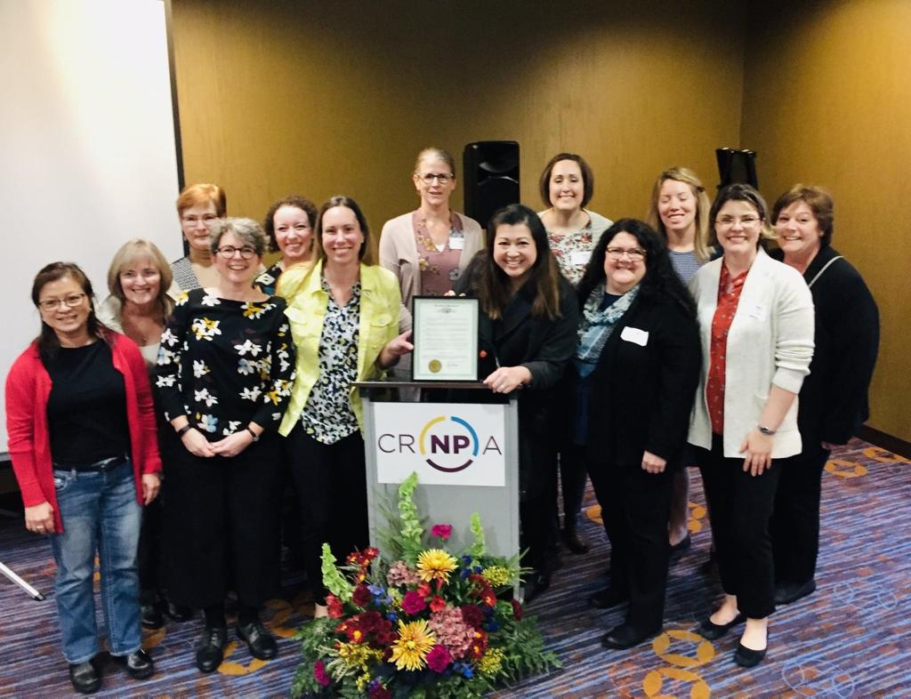


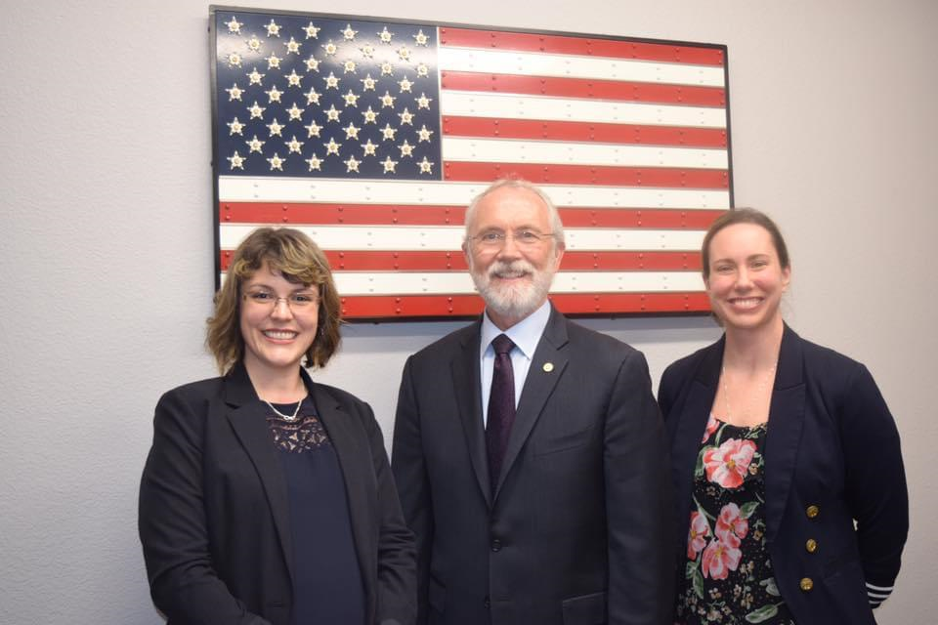
DISCLOSURES AND INTRODUCTION
No financial relationship to disclose
Julie Holgado, AGPCNP-BC, ARNP, CRNPA President

Slide 3
CRNPA: who we are
The purpose of CRNPA is to promote quality health care and to advance, support and promote the role of the Advanced Registered Nurse Practitioners (ARNPs) to provide such care.
Represent all ARNPs in the region including Tri-Cities, Walla Walla, Yakima, Hermiston, and surrounding communities
Promote excellence in the practice of and serve as a resource for ARNPs
Promote educational programs and activities to strengthen the growth and development of the Nurse Practitioner role
Promote communication among ARNPs
Advocate for access to health care for all citizens via legislative leadership and advancement of health care policy
Increase awareness and promote public understanding of the role of the ARNP
Foster a strong relationship among members of the healthcare community

Slide 4
Objectives
1. Review the events of 2023 legislation impactful to Nurse Practitioner practice
2. Identify ways to advocate for legislation impactful to Nurse Practitioner practice

Slide 5

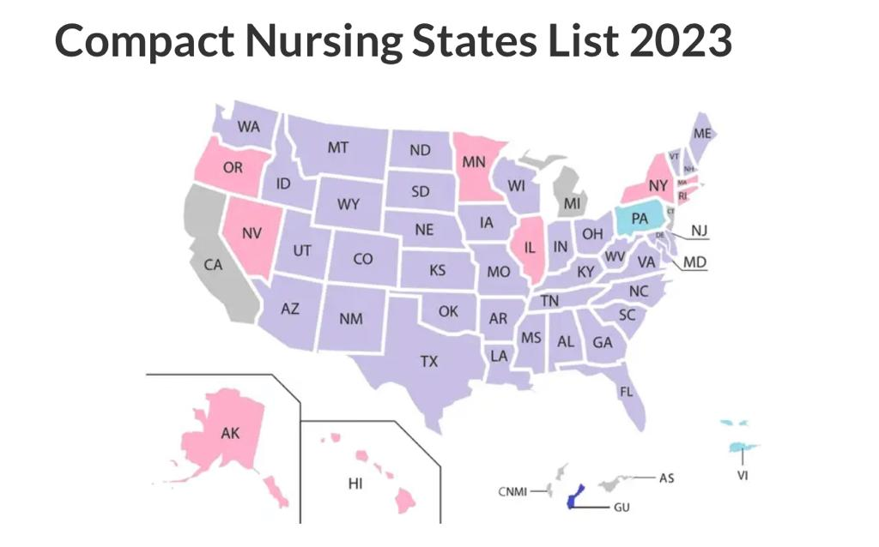

Slide 6

APRN compact still in revision…
Notes:
Problems identified include:
Need to eliminate the 2080 practice hour requirement for eligibility
Lack of acknowledgement that not all states license clinical nurse specialists and certified registered nurse anesthetists
An administrative structure that fails to guarantee the majority of, or any, compact commission members will be APRNs
Disparities in initial requirements for licensure and renewal
Differences in discipline standards among states with the potential to lead to disparities in how discipline cases are handled

Slide 7
ARNP Title Change
Board of Nursing Proposes a bill to change the title ARNP to APRN
If passed, the bill would become effective July 1, 2027

Slide 8
2023 Legislative Successes
SB 5179 Added ARNPs to the Death with Dignity Act to serve as either the attending or consulting provider and a psych NP can determine competency
SB 5036 Extends until July 1, 2024 for audio-only telehealth that a covered person has had at least one real-time interactive appointment using audio and video technology
HB 1340 Reproductive healthcare services or gender affirming treatment provided in Washington or other states does not constitute unprofessional conduct

Slide 9

HB 1141 Death with Dignity Act - Passed
Allows ARNPs to serve as an attending or consulting medical provider
Psychiatric NPs to offer a consultation to determine competency and that no mental health condition impairs judgement
Reduces waiting period between first and second requests for medication from 15 days to 72 hours
Prohibits an employer from preventing an employee to participate in DWD Act when outside of employment and not on the premise
Passed the House but not the Senate and was
returned to the House Rules Committee

Slide 10

SB 5373 /HB1495Restore parity reimbursement for ARNPs and PAs
Senate Bill has 19 sponsors House bill has 13
Passed by Senate Health and Long-Term Care
Died in Senate Ways and Means
Requires health carriers to pay ARNPS and PAs the same as physicians for the same service
2024 work both the Senate
and House bills

Slide 11

SB 5729 Cap on cost-sharing for insulin Passed
Cap on a health plan enrollee of $35 for a 30-day supply of insulin was made permanent

Slide 12
Legislative Funding Successes 2023
Graduate nursing programs received allocations
Preceptor grant program $3 million in each year of the biennium
Health Professionals Loan Repayment and Scholarship Program continued funding to primary care providers in health professional shortage areas
Nurse Educator Loan Repayment Program

Slide 13

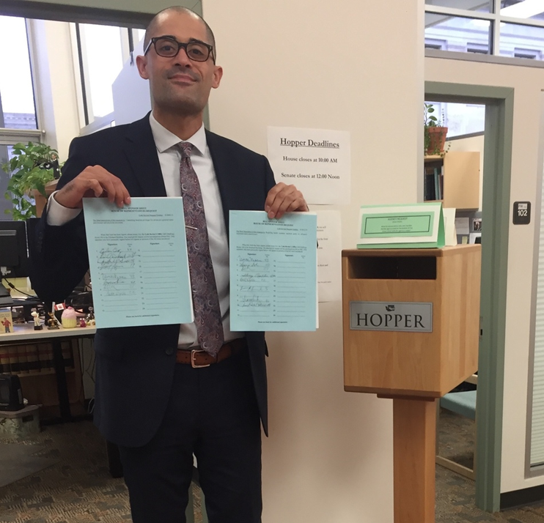


Slide 14

2024 AANP Health Policy Conference
January 28, 2024 – January 30, 2024 Washington, District of Columbia
Whether you're a seasoned advocate or a novice in the policy arena, this is a unique opportunity to expand your health policy knowledge and network with your peers. Space is limited, so save the date and plan to register early for the American Association of Nurse Practitioners® (AANP) premier policy event of the year.

Slide 15

Thank you

