Slide 1


HEART FAILURE
Quadruple Therapy
April L. Valdez, ARNP
APP Clinical Director of Medicine
Kadlec Clinic - Inland Cardiology
Richland, WA 99352
(509) 942-3272

Slide 2
Objectives
Pharmacologic management of systolic & Diastolic heart failure
Guideline directed medical therapy using Angiotensin Receptor Neprilysin Inhibitor (ARNI), sodium-glucose transport protein 2 inhibitors (sglt2), beta blockers & Minralocorticoid receptor antagonists (MRA)

Slide 3
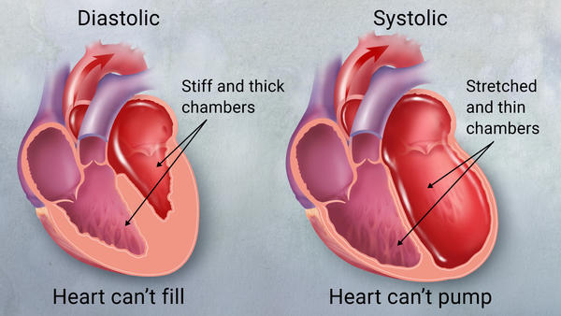
How do we manage these patients? Differentiating heart failure

Slide 4
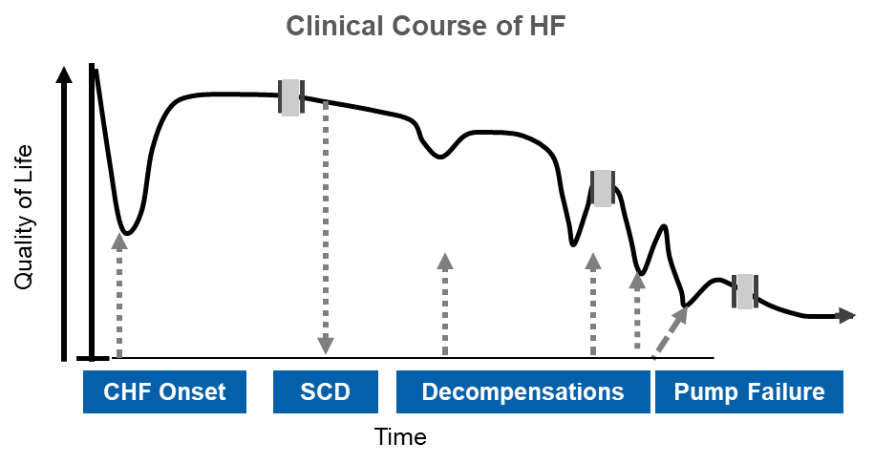
Is there such thing as a stable heart failure patient?
With each acute event, there is likely renal and myocardial damage that contributes to progressive LV or renal dysfunction, leading to an inevitable downward spiral of disease progression¹
Hospitalization for HF is associated with an increased risk of mortality²
HF, heart failure; LV, left ventricular
Adapted from Gheorghiade M et al. Am J Cardiol 2005;96:11G-17G
Ahmed A, et al. J.Card Fail 2008;14:211-228;

Slide 5
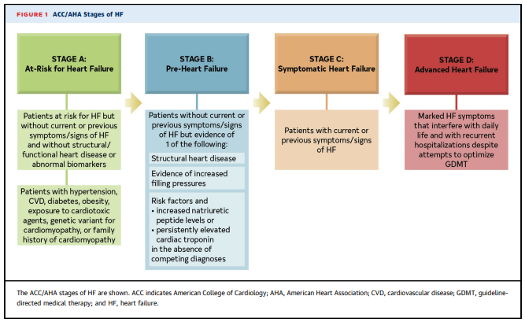
HF Stages

Slide 6
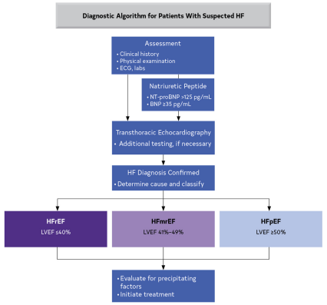

Slide 7
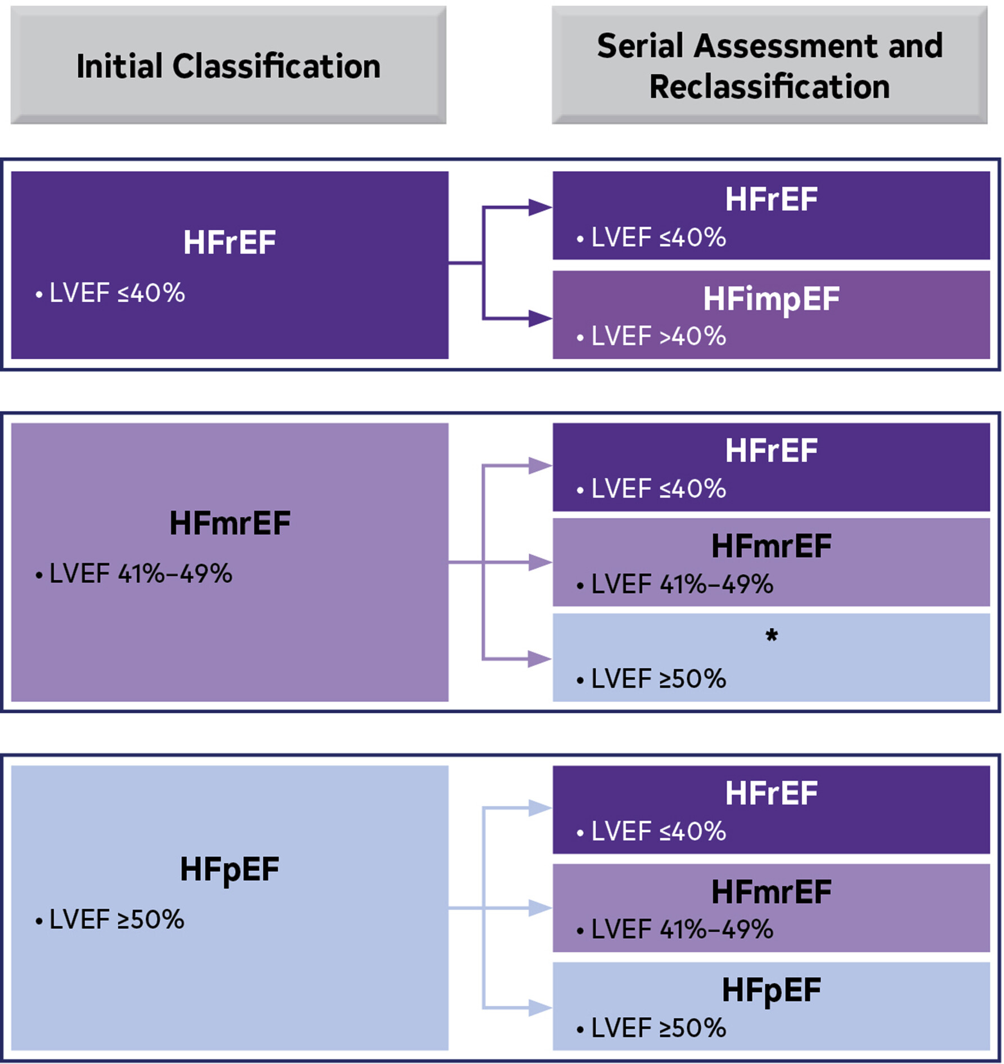
Left Ventricular Ejection Fraction (LVEF)
Heidenreich P, Bozkurt B, Aguilar D, et al. 2022 AHA/ACC/HFSA Guideline for the Management of Heart Failure. J Am Coll Cardiol. 2022 May, 79 (17) e263–e421.https://doi.org/10.1016/j.jacc.2021.12.012

Slide 8
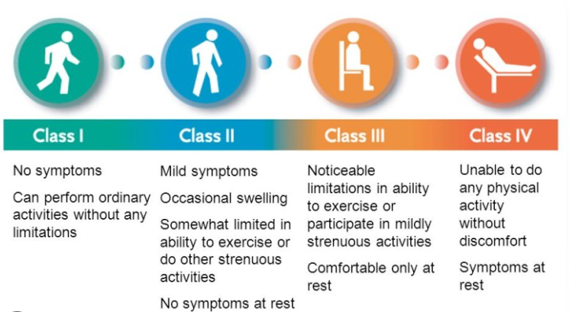
New York Heart Association Functional Class

Slide 9
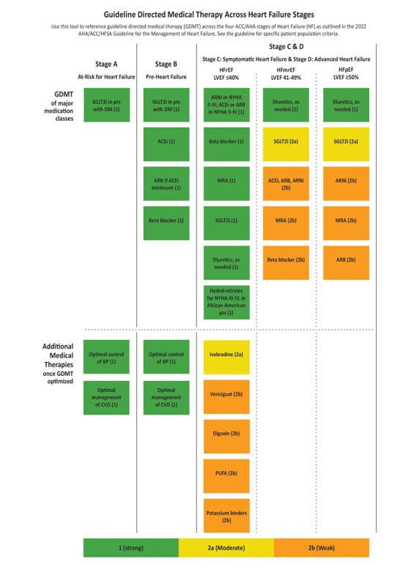
ACC/AHA Stages of HF A-D
Heidenreich P, Bozkurt B, Aguilar D, et al. 2022 AHA/ACC/HFSA Guideline for the Management of Heart Failure. J Am Coll Cardiol. 2022 May, 79 (17) e263–e421.https://doi.org/10.1016/j.jacc.2021.12.012

Slide 10
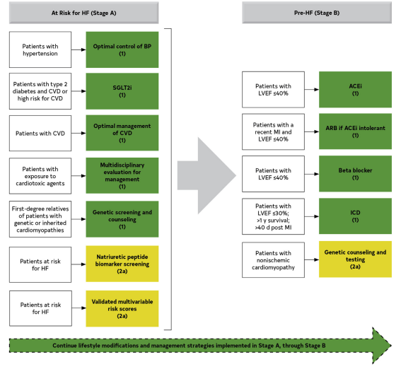
Stage A & B HF GDMT

Slide 11
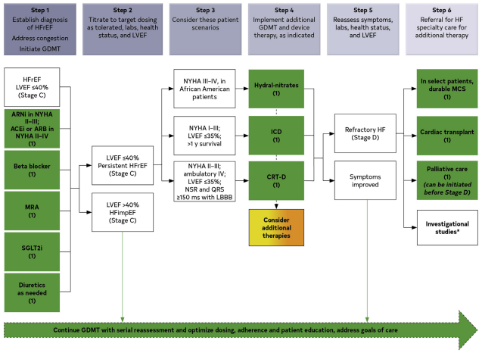

Slide 12
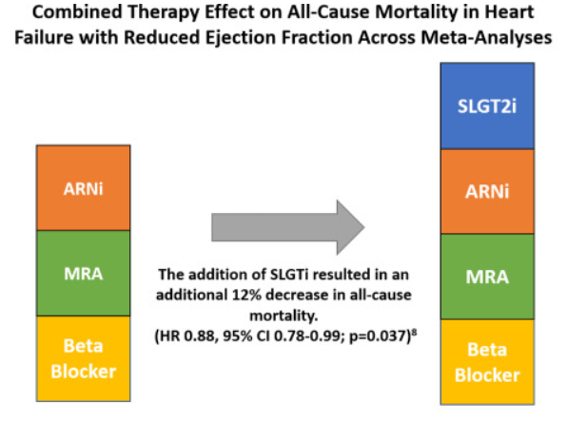
GDMT- Quadruple Therapy Benefit
The all-cause mortality is compared across 2 different guideline-directed medical therapy combinations based on data from 4 meta-analyses. Only 1 of these studies explored the additive effect of sodium-glucose cotransporter-2 inhibitors to the angiotensin receptor-neprilysin inhibitors + mineralocorticoid-receptor antagonists + beta-blocker combination, with a 12% decrease in mortality identified.

Slide 13
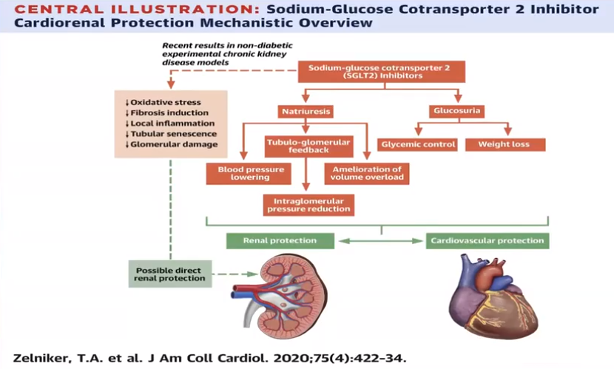
How do SGLT2 inhibitors work?
Reduces reabsorption of glucose and sodium by inhibiting SGLT2 in the proximal renal tubule, resulting in increased delivery of sodium to the distal tubule.
Downregulation of sympathetic activity
Decrease preload of the heart
Decrease afterload of the heart

Slide 14
Important SGLT2 trials
Trial | Entry Criteria | #pts/duration/drug | Outcomes
Empa-Reg NEJM 2015 | DM2+ASCVD risk eGFR>30 | 7020 pts/3.1y Empagliflozin | 38% CV death 35% HF hosp
Canvas NEJM 2017 | DM2+ASCVD risk eGFR>30 | 2059 pts/3.6y Canagliflozin | 14% CV death/MI/stroke 33% HF hosp
Declare- Timi 58 NEJM 2019 | DM2+ASCVD risk eGFR>60 | 17160 pts/4.2y Dapagliflozin | 27% HF hosp
Vertis- CV ADA meeting June 2020 | DM2+ASCVD eGFR>30 | 8426 pts/ Ertugliflozin | 35% HF hosp
What have we learned from these?
SGLT2I reduces HF in DM2 pts without HF…
What about heart failure patients without DM?

Slide 15

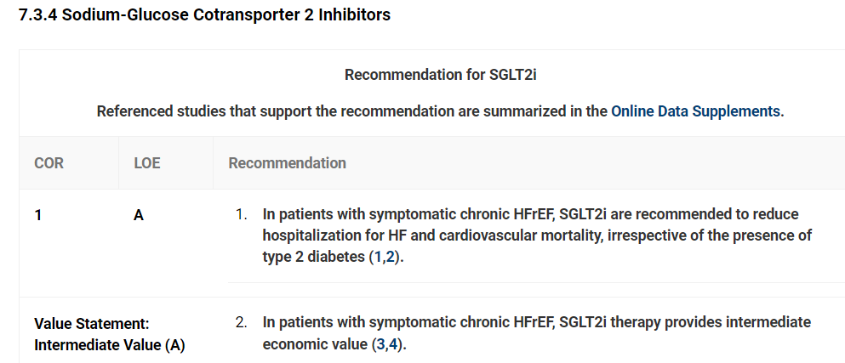
SGLT2i- American College of Cardiology

Slide 16
SGLT2 Inhibitor Choices
Considered a BP neutral medication
eGRF at Initiation
30 ml/min/1.73m2
25 ml/min/1.73m2
20 ml/min/1.73m2
Do start the meds early- first 30 days
OK to Combine with GLP 1 (per ADA standards)
DC Sulfonylureas
Check renal function- dialysis contraindicated
Hypoglycemia is unlikely for non-diabetics– On insulin reduce by 20%(?)
Treat mycotic infections and DC med if RECURRENT infection

Slide 17
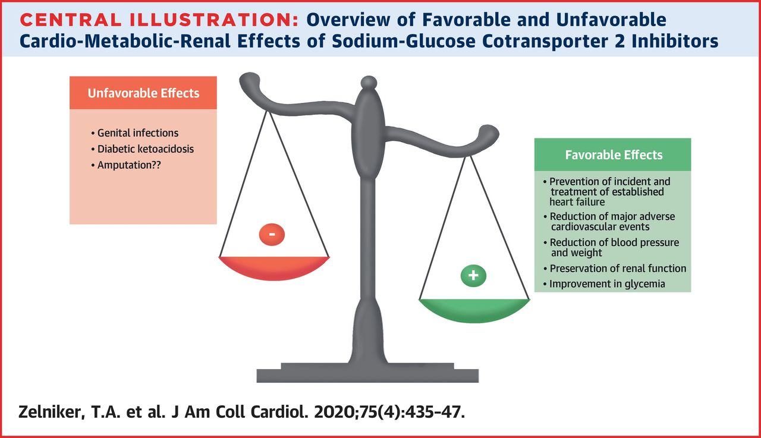
Monitoring? What and Who?
Volume Depletion/ hypotension- watch those who have reduced renal function, elderly, on diuretics.
Ketoacidosis in DM
Urosepsis and Pyelonephritis- UTI’s
Hypoglycemia- when given with insulin and secretagogues (lower dose?)
Necrotizing fasciitis of the perineum (Fournier’s Gangrene)- males and females at risk
Genital Mycotic Infections

Slide 18
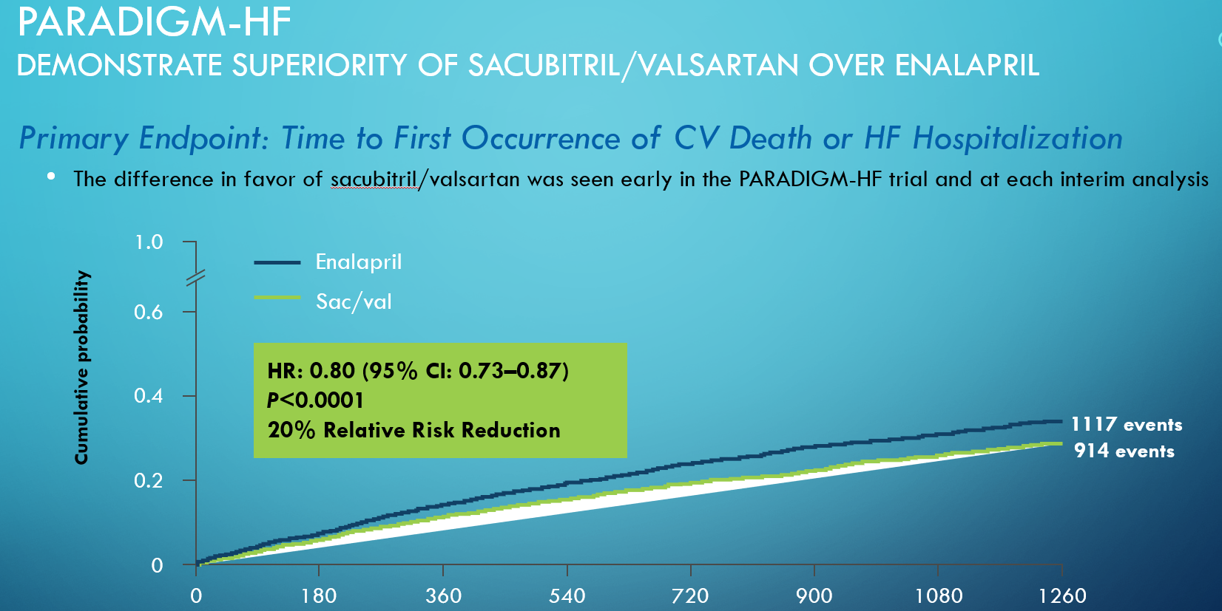
ARNI– Paradigm- HF
CI, confidence interval; HR, hazard ratio; HF, heart failure; CV, cardiovascular
McMurray JJ et al. N Engl J Med. 2014;371(11):993-1004.

Slide 19
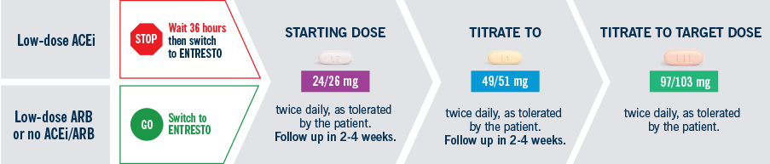
Entresto Dosing

Slide 20
Sacubitril/Valsartan- precautions
Adverse Reactions Occurring at an Incidence of ≥5% in the Double-Blind Period
Adverse Reactions Occurring ≥5% | Sac/Val N=4203 (%) | Enalapril N=4229 (%)
Hypotension | 18 | 12
Hyperkalemia | 12 | 14
Cough | 9 | 13
Dizziness | 6 | 5
Renal failure/acute renal failure | 5 | 5
Entresto (sacubitril/valsartan) [package insert]. East Hanover, NJ: Novartis Pharmaceuticals Corp; August 2015.

Slide 21
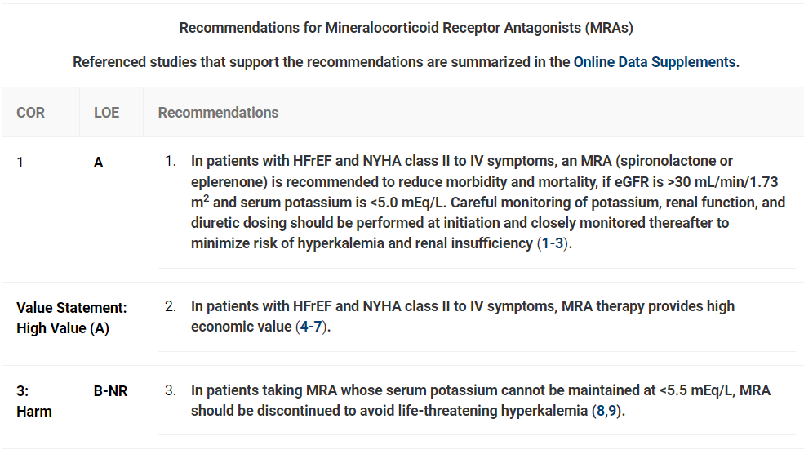
MRA- American College of Cardiology

Slide 22
MRA Choices
Daily Dosing

Slide 23
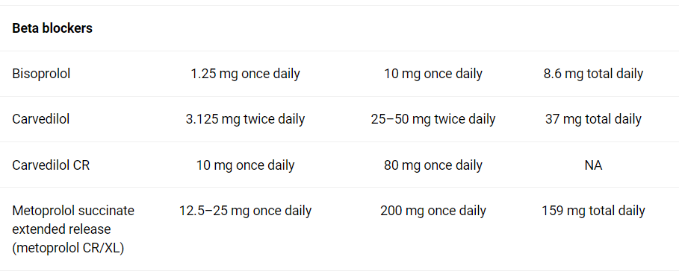
Appropriate Beta Blockers:
Initial
Target
Mean

Slide 24
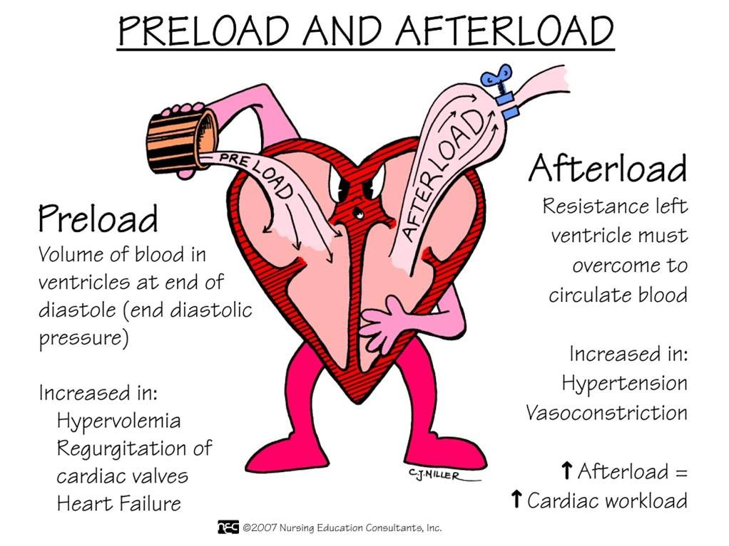
Treating the heart function not the blood pressure

Slide 25
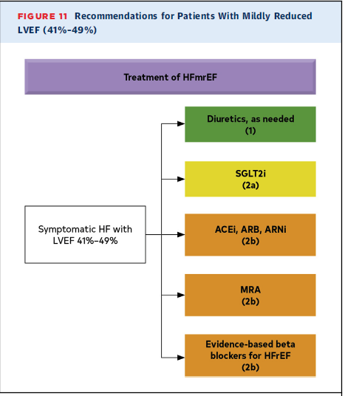
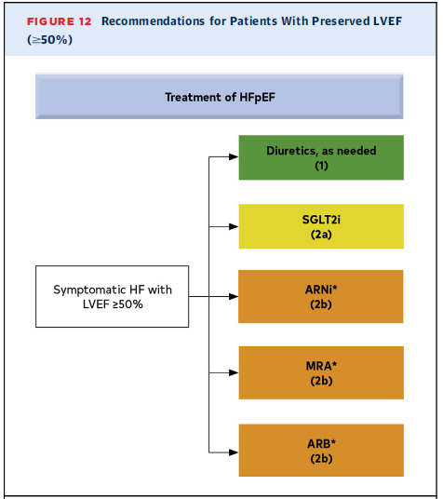
Mildly Reduced & Preserved HF

Slide 26

Heart failure treatment is a team sport
Cardiology
Primary care
Advanced Practice providers within these teams
Endocrinology
Nephrology

Slide 27
We Can Save Lives and improve QOL
 | Relative Risk | 2- Year Mortality in HFrEF
None |  | 35%
ARNI | 28% | 25%
+Beta Blocker | 35% | 16%
+Aldosterone antagonist | 30% | 11.5%
+SGLT2 inhibitor | 17% | 9.5%
Courtesy of Gregg Fonarow, MD

Slide 28
ThThank You!
April L. Valdez, ARNP
Kadlec Clinic - Inland Cardiology
Richland, WA 99352
(509) 942-3272
April L. Valdez, ARNP
Kadlec – Inland Cardiology

