Slide 1

NC-NACNS Excellence In Mentoring
Dr. Kathy Shaffer, DNP, APRN, AGCNS-BC, C-ONQS
Women’s Service Line
Atrium Heath’s Carolinas Medical Center, Charlotte, NC

Slide 2
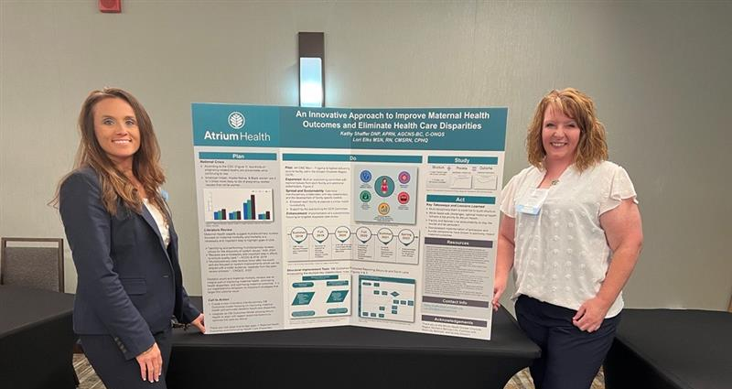
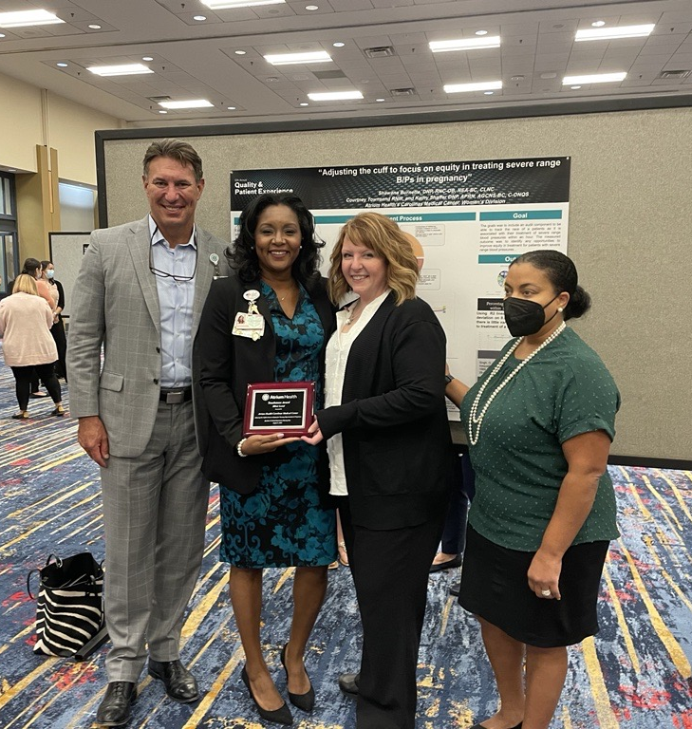
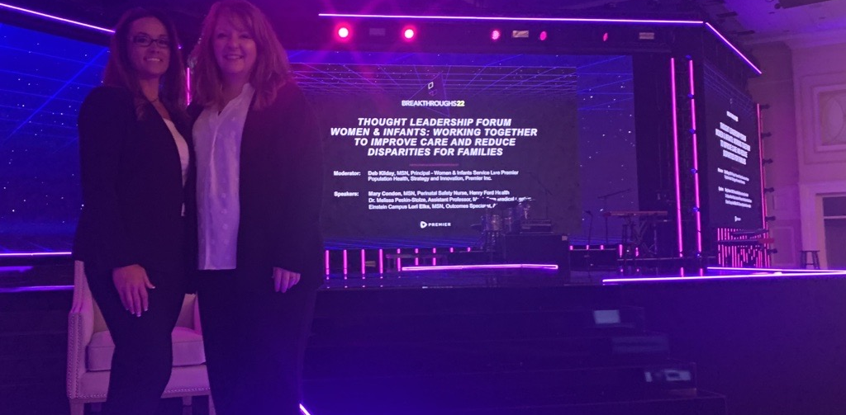

Slide 3
Excellence in Mentoring
Kathy is a true example of an excellent mentor. Her caring and nurturing nature helps to support both students and teammates... Kathy is more than deserving of the Excellence in Mentoring award and I am proud to say that she has helped me to where I am in my career today.
Kathy is an approachable and inspiring mentor to each CNS at our facility and across Atrium Health.
Dr. Shaffer's perseverance and dynamism are two traits that make her an excellent mentor.

Slide 4

NC-NACNS CNS of the Year
Julie Henderson, MSN, APRN, AGCNS-BC
Neurosciences and Post-Surgical Service Line
Atrium Health Cabarrus, Concord, NC

Slide 5
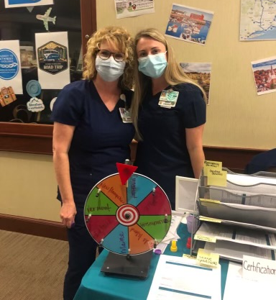
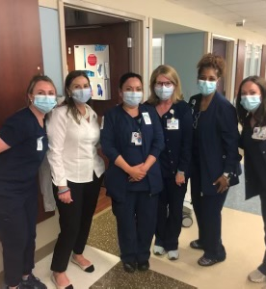

Slide 6
CNS of the Year
Julie is a role model who exemplifies the nursing profession.
Julie is dedicated to high quality outcomes for our patients, families, and teammates.
Julie cultivates evidence-based nursing interventions including driving CLABSI and CAUTI reductions, reducing length of stay, leading maintenance of disease specific certifications for bariatrics, stroke, and epilepsy
Julie is beyond worthy to be recognized as the NC-NACNS CNS of the Year as she embodies the attributes of the Clinical Nurse Specialist, leads with grace, always remains person-centered when driving outcomes, and is always advocating for nursing to be better

