Slide 1

Navigating Medication Safety
Chad Simpson, RPh, BSPharm, MBA

Slide 2
Conflict & Disclosures
Potential conflict: I’m employed by a local hospital that provides healthcare services to patients in your service area.
Disclosure: Content and opinions in this lecture are my own. Neither the lecture nor the presentation should be construed as representing my employer or any other organization with which I am affiliated
Where appropriate, illustrative examples have been deidentified and details have been modified to protect the privacy of those involved.

Slide 3

Objectives
Be able to identify what a medication error is and general terms associated with medication safety
Understand what is required to enhance safety in your practice
Understand the evolving landscape of the criminalization of errors
Understand the importance in selecting compounding pharmacies
Understand how to identify potential diversion

Slide 4

Making sense of the what drives our why

Slide 5
Two Major Cases Driving Criminalization
Emily Jerry and Charlene Murphey

Slide 6


Slide 7
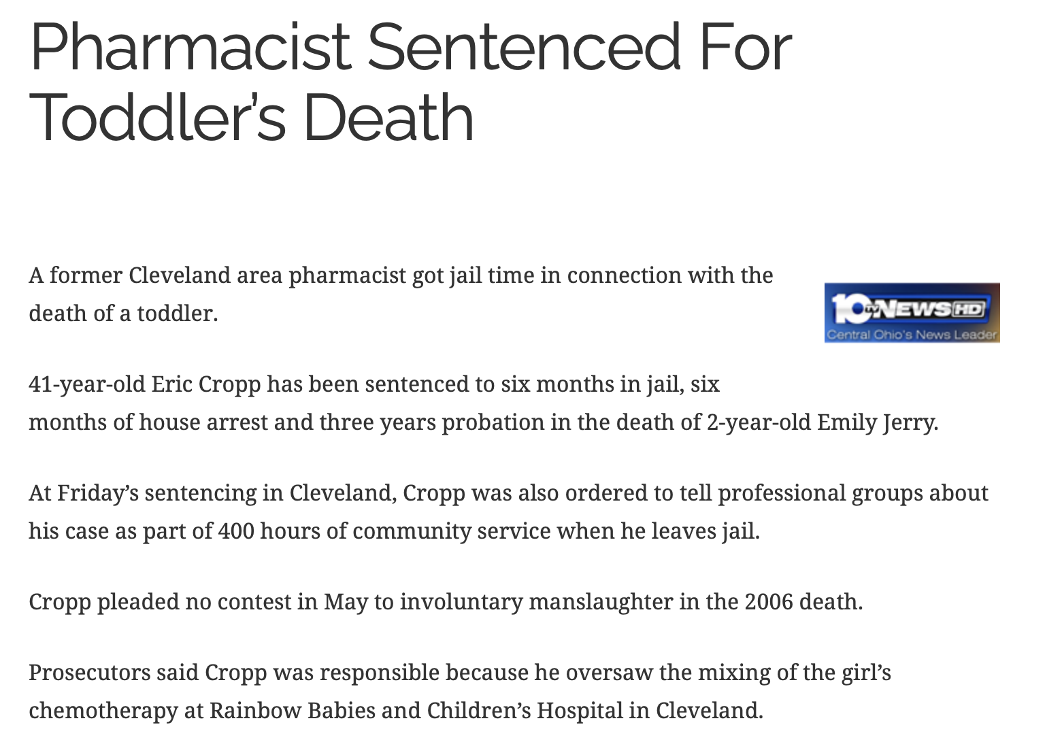
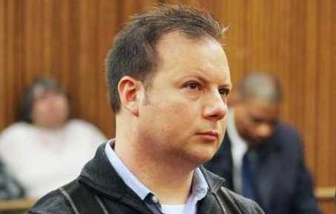

Slide 8


Slide 9
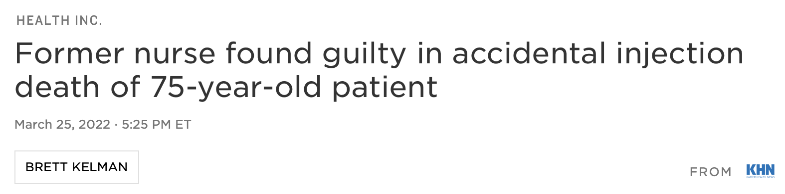
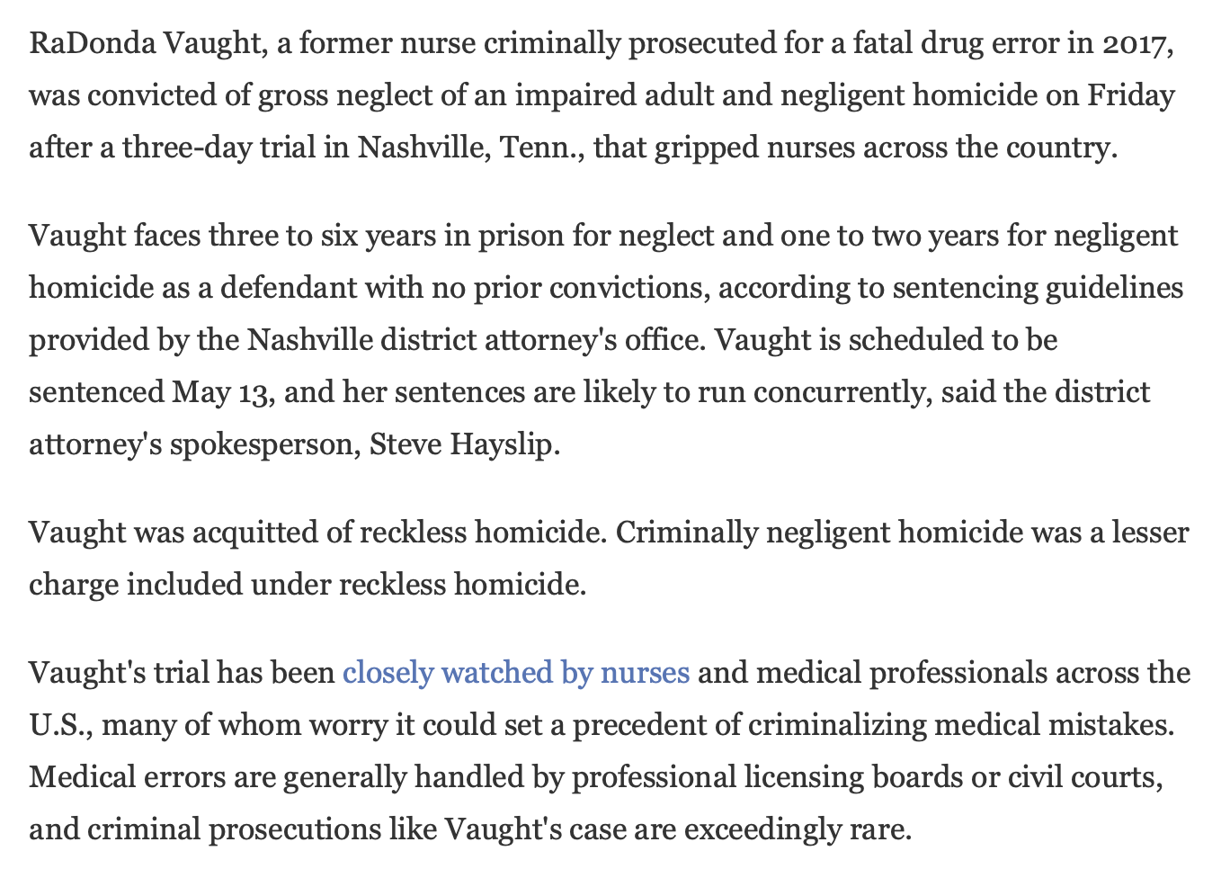


Slide 10
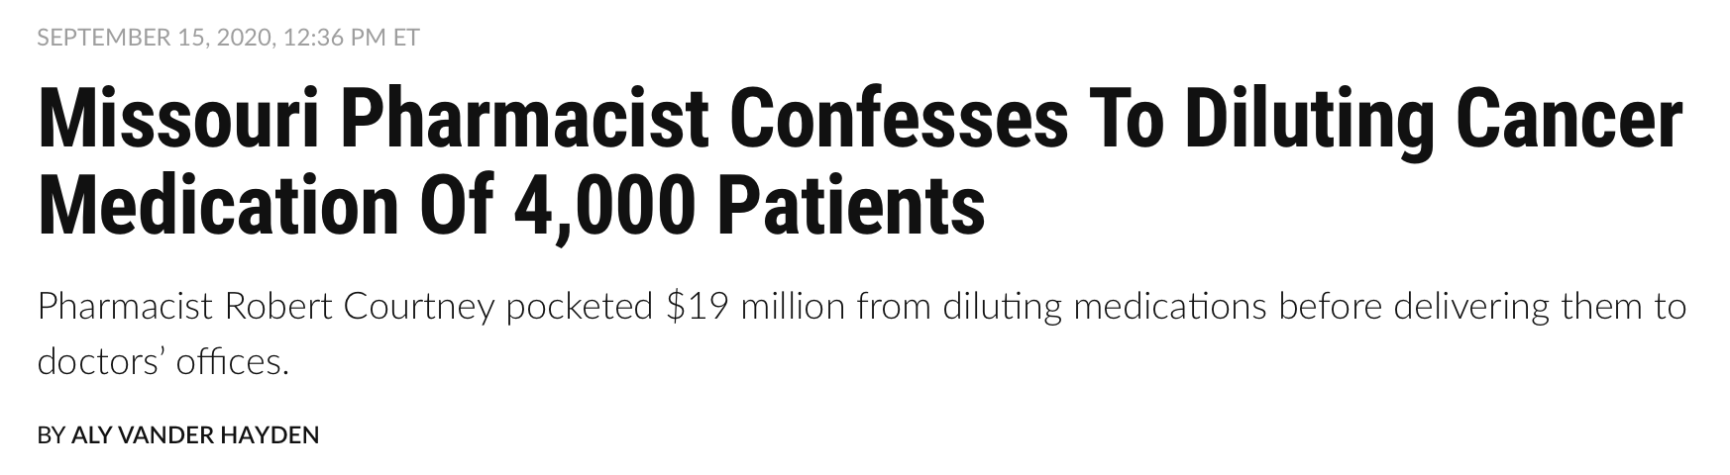
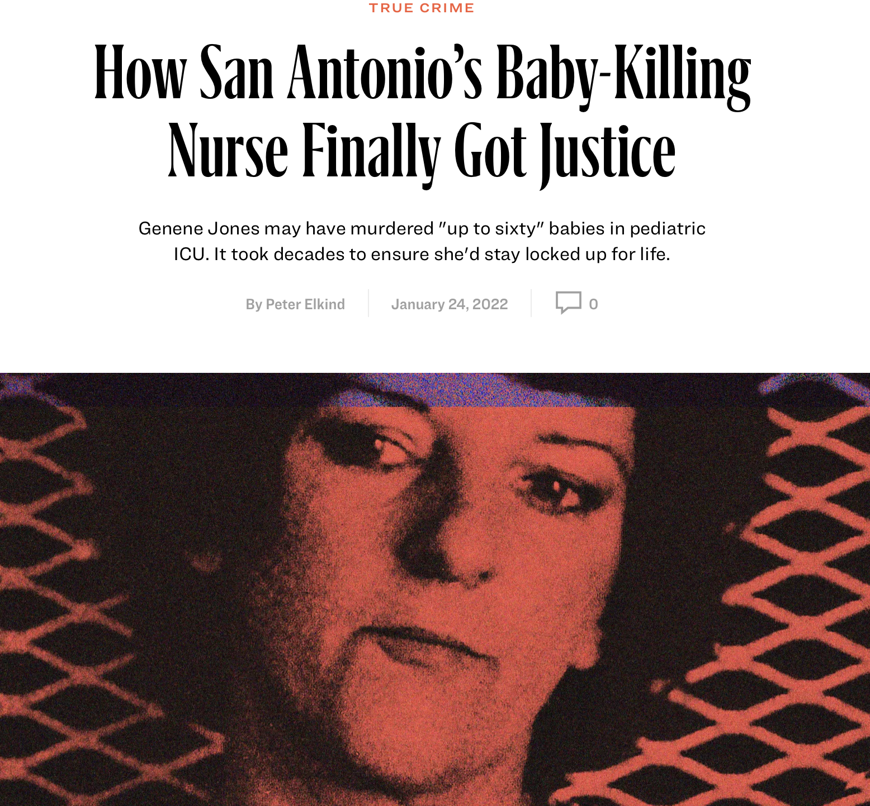
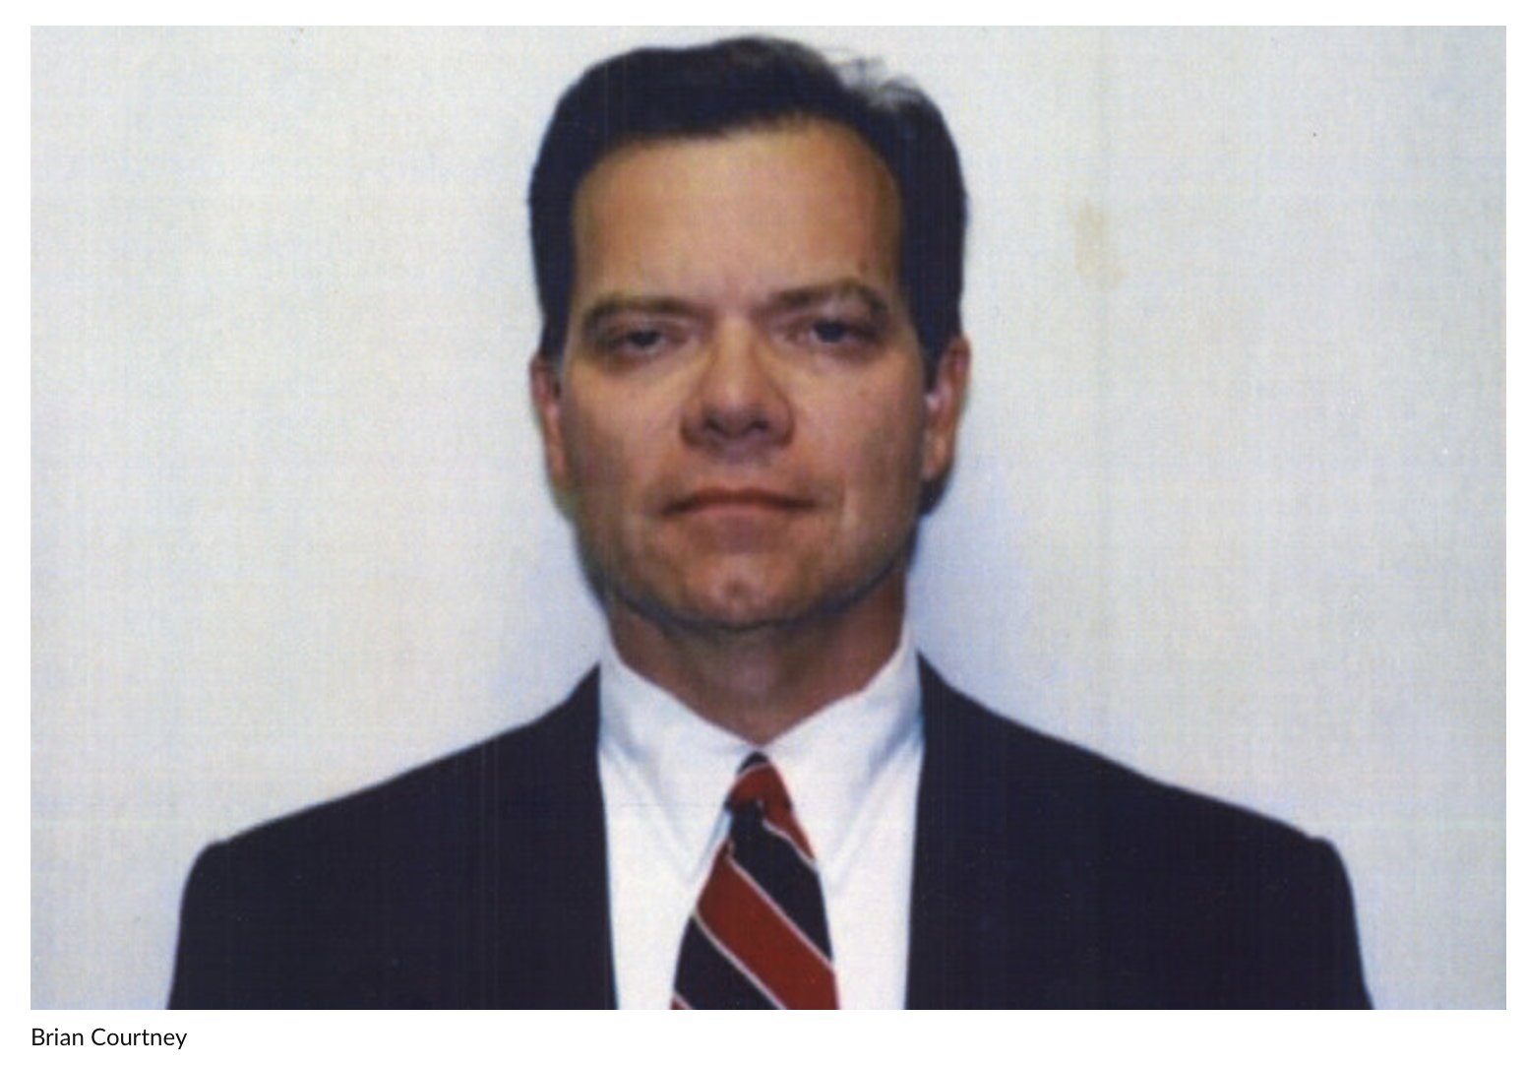

Slide 11
Criminalization of Medication Errors
What does this mean for you and me?

Slide 12


Slide 13
Selecting a Compounding Pharmacy
Do your due diligence in selecting compounding pharmacies
1
Reinvestigate compounding pharmacies frequently
2
Tour their compounding facilities to see for yourself
3

Slide 14

It started with a phone call
Lessons learned …

Slide 15
What can you do to identify diversion?

Slide 16

So, how can we be safer?

Slide 17
5 Medication Safety Tips You Can Quickly Implement Today
Listen
Listen to patients to learn – not to respond.
Volumetric
Eliminate volumetric dosing.
Technology
Don’t let technology replace your critical thinking skills.
Gut Instinct
If your gut is telling you something, listen!
The Big 5
Remember the big five.

Slide 18

Remember the Big Five
Read. Period.
Avoid workarounds & shortcuts
Avoid rushing & distractions
Avoid bypassing & overriding alerts
Remember the basics

Slide 19

Getting back to our why

Slide 20
Thank you!

Slide 21
Sources
Gaunt, M. J. (2021). Denial Is Not the Best Policy.
Cohen, M. R. (Ed.). (2000). Medication errors: causes, prevention, and risk management. Jones & Bartlett Learning.
Larson, C. M., & Saine, D. (2013). Medication safety officer’s handbook. American Society of Health-System Pharmacists.
Olaniran, B. A., & Scholl, J. C. (2014). New England compounding center meningitis outbreak: A compounding public health crisis. Journal of Risk Analysis and Crisis Response, 4(1).
Cole, B. E. (2001). Recognizing and preventing medication diversion. Family Practice Management, 8(9), 37.
Ruutiainen, H. K., Kallio, M. M., & Kuitunen, S. K. (2021). Identification and safe storage of look-alike, sound-alike medicines in automated dispensing cabinets. European Journal of Hospital Pharmacy, 28(e1), e151-e156.

