Slide 1

CDC Sexually Transmitted Infections Treatment Guidelines, 2021
Shelagh Larson, DNP, APRN, WHNP-bc, NMP

Slide 2
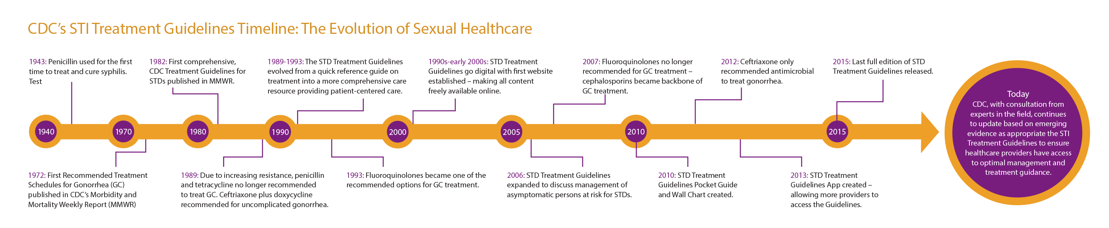
History of STD management by CDC
Expedited Partner Therapy in the Management of Sexually Transmitted
Recommendations for Providing Quality Sexually Transmitted Diseases Clinical Services,
Gonorrhea treatment update
https://www.cdc.gov/std/treatment-guidelines/timeline.htm

Slide 3
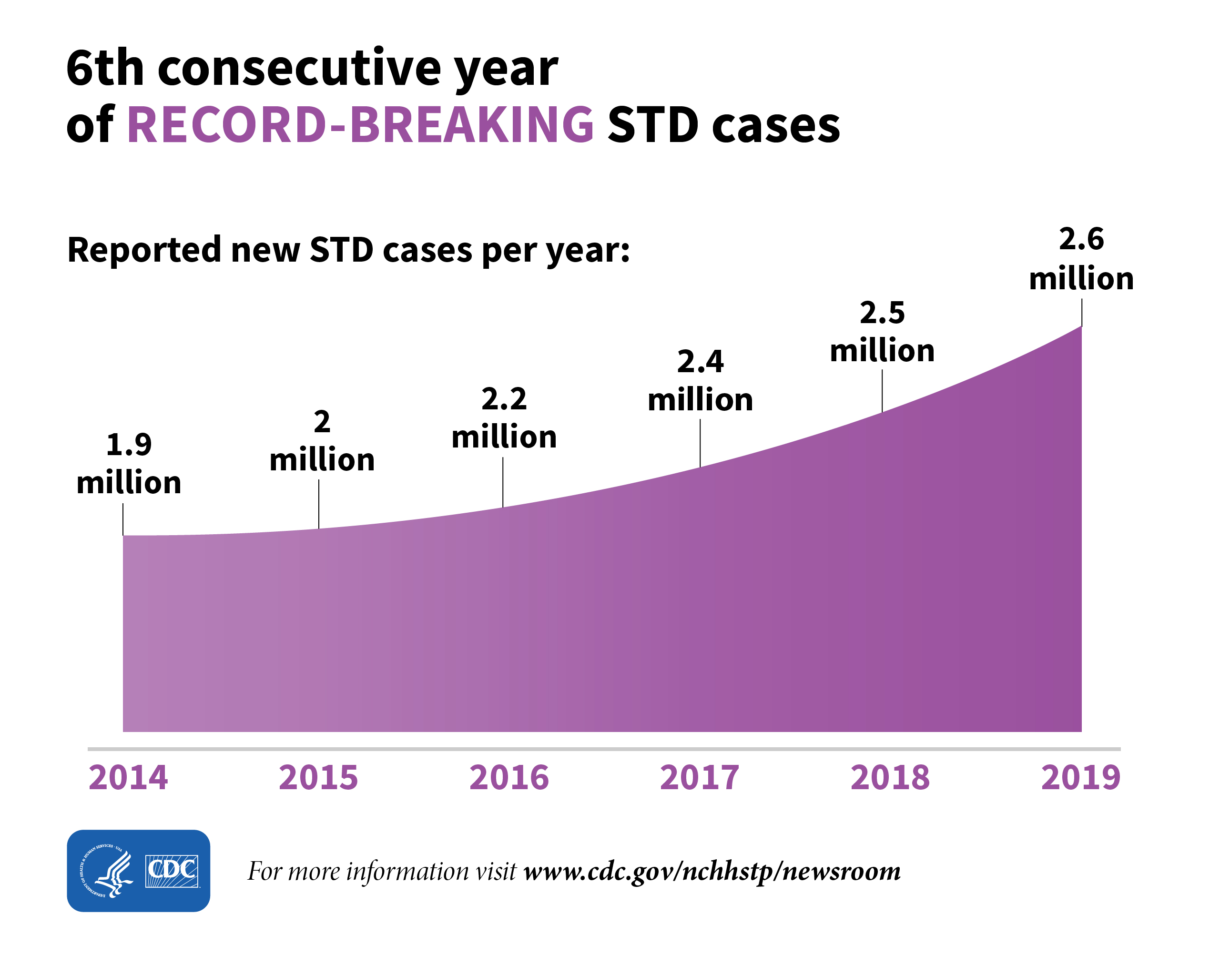
Statistics July 16, 2021 – During the COVID-19 pandemic, reported STDs in the U.S. dropped then resurged
New CDC data show that during March-April 2020, reported STD cases dramatically decreased compared to the same time in 2019.
However, a resurgence in gonorrhea and syphilis cases later in the year suggest overall STDs may have increased during 2020.
As of Dec. 12, the cumulative totals for 2020 STD cases compared to 2019 were:
Chlamydia, 14% lower
Gonorrhea, 7% higher
Primary & secondary (P&S) syphilis, 1% lower
Three factors likely contributed to the initial decrease in reported cases:
Reduced screening – many health care clinics limited in-person visits to symptomatic cases or closed
Limited resources – many state and local health department STD staff were redirected from routine STD responsibilities to COVID-19 activities, which affected STD tracking capacity and reporting
Stay-at-home orders – which were intended to reduce COVID-19 spread may have influenced sexual behaviors and reduced STD transmission

Slide 4
Current Practice on Selected Clinical Services in the United States
Most PCP obtain a sexual hx if it is relevant to the chief complaint but less frequently at an initial or routine annual visit and seldom at acute care, non-STD–related visits
studies have documented that 1/3- 1/2 of PCP routinely screen men or women for STDs (chlamydia, gonorrhea, syphilis, or HIV)
uninsured young adults were 3X to 4Xmore likely to NOT fill a STD Rx
The median time to treatment for patients not treated the same day was 8 days

Slide 5
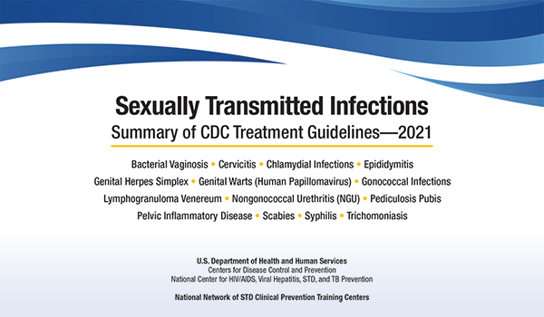

Slide 6
CDC StI Guidelines: 2021 released July 23, 2021
now be known as the STI Treatment Guidelines
U=U or Undetectable equals Untransmittable
Recommendation regarding universal testing for hepatitis C in ALL pregnant women. Population prevalence of greater than 1.1%, every pregnant woman with every pregnancy gets rescreened
In the adolescent section, there is some more permissive language for rectal chlamydia and gonorrhea testing to be considered in females based on reported sexual behaviors
Expanded section on the importance of rectal and pharyngeal testing
HIV testing should be performed on all persons not known to have HIV infection who present with genital anal or perianal ulcers
genital herpes, herpes PCR is the preferred diagnostic test with call for a Biokit or a Western blot as the second test for confirmation.
Separating out HSV1 & HSV2, in terms of different counseling messages
Adult syphilis, there's expansion in the clinical presentation and which patients there's an increased clinical notability of atypical presentations of syphilis, including painful, multiple lesions, especially occurring perennially that can mimic herpes presentation.
FDA cleared test do use the NAATs at the rectal and pharyngeal sites, both for chlamydia and gonorrhea

Slide 7
These guidelines discuss…..
1) updated recommendations for treatment of Neisseria gonorrhoeae, Chlamydia trachomatis, and Trichomonas vaginalis;
2) addition of metronidazole to the recommended treatment regimen for pelvic inflammatory disease;
3) alternative treatment options for bacterial vaginosis;
4) management of Mycoplasma genitalium;
5) human papillomavirus vaccine recommendations and counseling messages;
6) expanded risk factors for syphilis testing among pregnant women;
7) one-time testing for hepatitis C infection;
8) evaluation of men who have sex with men after sexual assault; and
9) two-step testing for serologic diagnosis of genital herpes simplex virus.

Slide 8

STD, STI , Tomato, tomato
The term “sexually transmitted infection” (STI) refers to a pathogen that causes infection through sexual contact,
whereas the term “sexually transmitted disease” (STD) refers to a recognizable disease state that has developed from an infection.
Physicians and other health care providers have a crucial role in preventing and treating STIs

Slide 9
These guidelines are applicable to any patient care setting that serves persons at risk for STI
family planning clinics,
HIV care clinics,
correctional health care settings,
private physicians’ offices,
Federally Qualified Health Centers,
clinics for adolescent care,
and other primary care facilities.

Slide 10
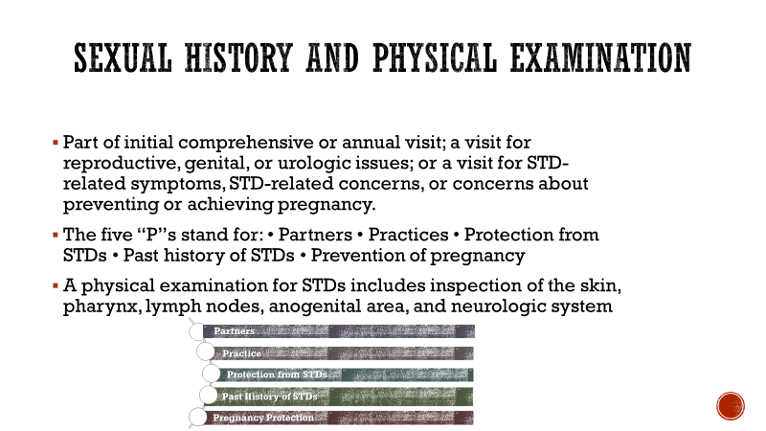

Slide 11
Partner
“Are you currently having sex of any kind?”
“What is the gender(s) of your partner(s)?”

Slide 12
Practice
“To understand any risks for sexually transmitted infections (STIs), I need to ask more specific questions about the kind of sex you have had recently.”
“What kind of sexual contact do you have, or have you had?”
º “Do you have vaginal sex, meaning ‘penis in vagina’ sex?”
º “Do you have anal sex, meaning ‘penis in rectum/anus’ sex?”
º “Do you have oral sex, meaning ‘mouth on penis/vagina’?”

Slide 13
Protection from STI
“Do you and your partner(s) discuss prevention of STIs and human immunodeficiency virus (HIV)?”
“Do you and your partner(s) discuss getting tested?”
For condoms:
º “What protection methods do you use? In what situations do you use condoms?”

Slide 14
Past history of STIs
“Have you ever been tested for STIs and HIV?”
“Have you ever been diagnosed with an STI in the past?”
“Have any of your partners had an STI?”
Additional questions for identifying HIV and viral hepatitis risk:
“Have you or any of your partner(s) ever injected drugs?”
“Is there anything about your sexual health that you have questions about?”

Slide 15
Pregnancy intention
“Do you think you would like to have (more) children in the future?”
“How important is it to you to prevent pregnancy (until then)?”
“Are you or your partner using contraception or practicing any form of birth control?”
“Would you like to talk about ways to prevent pregnancy?”

Slide 16
STI screening Among Special Populations

Slide 17
Pregnant Women Screening Recommendations: Chlamydia/Gonorrhea
All pregnant women aged <25 years as well as older women at increased risk for chlamydia & gonorrhea
aged ≥25 years who have a new sex partner, more than one sex partner, a sex partner with concurrent partners, or a sex partner who has an STI) should be routinely screened for Chlamydia & Gonorrhea at the first prenatal visit
remain at increased risk for chlamydial infection also should be retested during the third trimester to prevent maternal postnatal complications and chlamydial/gonorrheal infection in the neonate
Identified as having chlamydia or gonorrhea should be treated immediately and have a test of cure to document chlamydial eradication by a nucleic acid amplification test (NAAT) 4 weeks after treatment
chlamydial infection should be rescreened 3 months after treatment.

Slide 18
Pregnant Women Screening Recommendations: Syphilis
During 2012–2019, congenital syphilis rates in the United States increased from 8.4 to 48.5 cases per 100,000 births, a 477.4% increase
At least 45 states have a prenatal syphilis testing requirement, with high variability among those requirements
Prenatal screening for syphilis has been reported to be suboptimal in the United States
In the United States, all pregnant women should be screened for syphilis at the first prenatal visit, even if they have been tested previously
Pregnant women should be retested for syphilis at 28 weeks’ gestation and at delivery if the mother lives in a community with high syphilis rates or is at risk for syphilis acquisition during pregnancy (e.g., misuses drugs or has an STI during pregnancy, having multiple sex partners, having a new sex partner, or having a sex partner with an STI)
Partners of pregnant women with syphilis should be evaluated, tested, and treated

Slide 19
Pregnant Women Screening Recommendations: HIV/Hep B&C
HIV: All pregnant women in the United States should be tested for HIV at the first prenatal visit, even if they have been previously tested
Retesting in the third trimester (preferably before 36 weeks’ gestation) is recommended for women at high risk for acquiring HIV infection.
Rapid HIV testing should be performed for any woman in labor who has not been tested for HIV during pregnancy or whose HIV status is unknown, unless she declines
Those who inject drugs, have STIs during pregnancy, have multiple sex partners during pregnancy, have a new sex partner during pregnancy, or have partners with HIV infection; those who are receiving care in health care facilities in settings with HIV incidence ≥1 per 1,000 women per year; those who are incarcerated; those who live in areas with high rates of HIV infection; or those who have signs or symptoms of acute HIV infection (e.g., fever, lymphadenopathy, skin rash, myalgia, arthralgia, headache, oral ulcers, leukopenia, thrombocytopenia, or transaminase elevation)
Hep B:
All pregnant women should be routinely tested for hepatitis B surface antigen (HBsAg) at the first prenatal visit even if they have been previously vaccinated or tested
Pregnant women who are HBsAg positive should be reported to the local or state health department to ensure that they are entered into a case-management system and that timely and age-appropriate prophylaxis is provided to their infants.
Hep C
screening should be performed for all pregnant women during each pregnancy, except in settings where the HCV infection (HCV positivity) rate is <0.1%

Slide 20
Pregnant Women Screening Recommendations: Bacterial Vaginosis, Trichomoniasis, and Genital Herpes
Evidence does not support routine screening for BV among asymptomatic pregnant women at high risk for preterm delivery
Evidence does not support routine screening for Trichomonas vaginalis among asymptomatic pregnant women. Women who report symptoms should be evaluated and treated
evidence does not support routine HSV-2 serologic screening among asymptomatic pregnant women.
Routine serial cultures for HSV are not indicated for women in the third trimester who have a history of recurrent genital herpes.

Slide 21
Patient self collected vaginal swabs for STI
NAAT is the most sensitive test for detection of chlamydia and gonorrhea,
Self-collected vaginal swabs (SCVS) appear to be more sensitive for diagnosing chlamydia and gonorrhea than health-professional–collected endocervical swabs and first-catch urine
self- collection with NAAT will likely save time and be more comfortable for your patients. It will also provide a higher sensitivity in detecting chlamydia infections and equal sensitivity in detecting gonorrhea compared with provider collected samples
Rectal chlamydia testing can be considered for females based on sexual behaviors and exposure.
“Patient collected vaginal swab specimens are equivalent in sensitivity and specificity to those collected by a clinician using NAAT:
For men, urethral infection should be diagnosed by testing first-void urine or a urethral swab
Self-collected rectal swabs are a reasonable alternative to clinician-collected rectal swabs
Page, C., Mounsey, A., & Rowland, K. (2013). PURLs: Is self-swabbing for STIs a good idea?. The Journal of family practice, 62(11), 651–653.
Lucashu, Amanda DO; Killian, Sarah MD Are self-swabs as effective for screening for vaginal STIs as swabs collected during a speculum exam?, Evidence-Based Practice: February 2018 - Volume 21 - Issue 2 - p E4-E5 doi: 10.1097/01.EBP.0000541982.39580.66
Schachter J, Chernesky MA, Willis DE, et al. Vaginal swabs are the specimens of choice when screening for Chlamydia trachomatis and Neisseria gonorrhoeae: results from a multicenter evaluation of the APTIMA assays for both infections. Sexually transmitted diseases 2005;32:725-8.
CDC MMWR (2021). CDC’s Sexually Transmitted Infections (STI) Treatment Guidelines, 2021

Slide 22

Chlamydia
Annual screening of all sexually active women aged <25 years old
Screening of older women at increased risk for infection (e.g., women aged ≥25 years who have a new sex partner, more than one sex partner, a sex partner with concurrent partners, or a sex partner who has an STI)
Female college students the incident chlamydial infection was also associated with BV and high-risk HPV infection
Treatment
Women:
Doxycycline 100 mg po BID x 7 days
Males and pregnancy
Azithromycin 1 g po in a single dose
Alternative Levofloxacin 500 mg orally once daily for 7 days
Men and women who have been treated for chlamydia should be retested approximately 3 months after treatment
CDC's 2021 STI Treatment Guidelines Update Webinar(link is external) https://npin.cdc.gov/sites/default/files/CDC_STI_Transcript_FINAL_0114.pdf

Slide 23

Gonorrhea
CDC’s 2010 STD treatment guidelines recommended dual therapy for gonorrhea with a cephalosporin plus either azithromycin or doxycycline, regardless of C. trachomatis results at the time of treatment to prevent antimicrobial resistance.
urogenital, rectal, or pharyngeal gonorrhea
NAATs that are FDA-cleared for use with vaginal swab specimens can be collected by a provider or self-collected in a clinical setting.
Treatment:
Ceftriaxone 500 mg IM as a single dose for persons weighing <150 kg (300 lb)
For persons weighing ≥150 kg (300 lb), 1 g of IM ceftriaxone should be administered.
If chlamydial infection has not been excluded, providers should treat for chlamydia with
doxycycline 100 mg orally twice daily for 7 days.
During pregnancy: azithromycin 1 g as a single dose is recommended to treat chlamydia.
Partner therapy:
Cefixime 800 mg orally as a single dose (Doxycycline 100mg BID x 7day if chlamydia not excluded).
Resistance is suspected: Dual treatment with single doses of IM gentamicin 240 mg plus oral azithromycin 2 g can be considered
Need a test of cure for pharyngeal infections, only

Slide 24
Recommended Regimen for Genital Herpes
Episodic Therapy (recurrent) Suppressive Therapy (recurrent)
First Clinical Episode_____ ______
Acyclovir† 400 mg po TID x 7–10 days
Famciclovir 250 mg po TID x 7–10 days
Valacyclovir 1 g po BID x 7–10 days
* Treatment can be extended if healing is incomplete after 10 days of therapy.
† Acyclovir 200 mg orally 5 times/day is also effective but is not recommended because of the frequency of dosing
Acyclovir 800 mg po BID x 5 days
Acyclovir 800 mg po TID x 2 days
Famciclovir 1 g po BID x 1 day
Famciclovir 500 mg po x1, the 250 mg 2 BID x 2 days
Famciclovir 125 mg PO BID x 5 days
Valacyclovir 500 mg po BID x 3 days
Valacyclovir 1 g orally PO D xor 5 days
*Acyclovir 400 mg po TID X 5 days is also effective but is not recommended because of frequency of dosing.
Acyclovir 400 mg PO BID
Valacyclovir 500 mg po D
Valacyclovir 1 g PO D
Famciclovir 250 mg PO BID
* Valacyclovir 500 mg once a day might be less effective than other valacyclovir or acyclovir dosing regimens for persons who have frequent recurrences (i.e., ≥10 episodes/year)

Slide 25

Recommended Regimen for Suppression of Recurrent Genital Herpes Among Pregnant Women
* Acyclovir 400 mg po TID
*Valacyclovir 500 mg PO BID
* Treatment recommended starting daily at 36 weeks’ gestation.

Slide 26

Syphilis
divided into stages based on clinical findings:
Primary syphilis classically presents as a single painless ulcer or chancre at the site of infection but can also present with multiple, atypical, or painful lesions
Secondary syphilis manifestations can include skin rash, mucocutaneous lesions, and lymphadenopathy.
Tertiary syphilis can present with cardiac involvement, gummatous lesions, tabes dorsalis, and general paresis. Latent infections (i.e., those lacking clinical manifestations) are detected by serologic testing.
Latent syphilis acquired within the preceding year is referred to as early latent syphilis; all other cases of latent syphilis are classified as late latent syphilis or latent syphilis of unknown duration.
All persons who have tertiary syphilis should receive a CSF examination before therapy is initiated and have an HIV test.
Ocular syphilis can result in permanent vision loss.

Slide 27
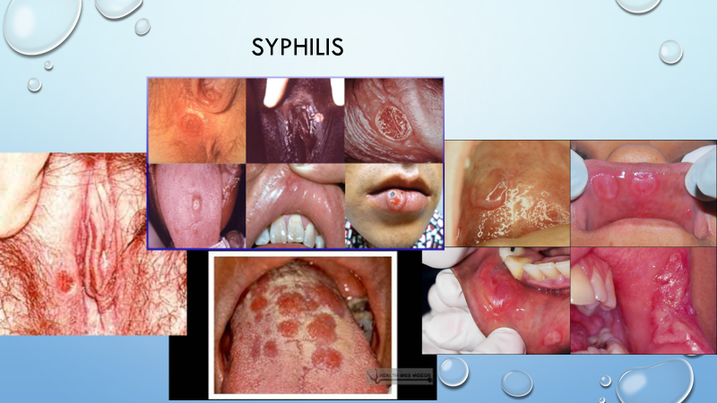

Slide 28
Syphilis: Diagnosis
A presumptive diagnosis of syphilis requires use of two laboratory serologic tests:
a nontreponemal test (i.e., Venereal Disease Research Laboratory [VDRL] or
rapid plasma reagin [RPR] test)
and a treponemal test (i.e., the T. pallidum passive particle agglutination [TP-PA] assay, various EIAs, chemiluminescence immunoassays [CIAs] and immunoblots, or rapid treponemal assays)
False-positive nontreponemal test results can be associated with multiple medical conditions and factors unrelated to syphilis, including other infections (e.g., HIV), autoimmune conditions, vaccinations, injecting drug use, pregnancy, and older age

Slide 29
syphilis
Pregnant women seropositive for syphilis should be considered infected unless an adequate treatment history is clearly documented in the medical records and sequential serologic antibody titers have decreased as recommended for the syphilis stage.
Antepartum screening can be performed by manual nontreponemal antibody testing (e.g., RPR) by using the traditional syphilis screening algorithm or by treponemal antibody testing (e.g., immunoassays) using the reverse sequence algorithm.
When syphilis is diagnosed during the second half of pregnancy, management should include a sonographic fetal evaluation for congenital syphilis.
If syphilis is diagnosed and treated at or before 24 weeks’ gestation, serologic titers should not be repeated before 8 weeks after treatment (e.g., at 32 weeks’ gestation) but should be repeated at delivery.
Titers should be repeated sooner if reinfection or treatment failure is suspected.
For syphilis diagnosed and treated after 24 weeks’ gestation, serologic titers should be repeated at delivery.
Any woman who has a fetal death after 20 weeks’ gestation should be tested for syphilis.
An optimal interval between doses is 7 days for pregnant women. Missed doses >9 days between doses are not acceptable for pregnant women receiving therapy for late latent syphilis.
Pregnant women who miss a dose of therapy should repeat the full course of therapy.

Slide 30
Syphilis: Treatment
Penicillin G administered parenterally, is the preferred drug for treating patients in all stages of syphilis.
Primary and Secondary Syphilis Adolescents and Adults
Benzathine penicillin G 2.4 million units IM in a single dose
Pregnant women should be treated with the recommended penicillin regimen for their stage of infection.
Tertiary Syphilis with normal CSF Examination:
Benzathine penicillin G 7.2 million units total, administered as 3 doses of 2.4 million units IM each at 1-week intervals
Recommended Regimen for Syphilis Among Infants and Children
Benzathine penicillin G 50,000 units/kg body weight IM, up to the adult dose of 2.4 million units in a single dose Syphili

Slide 31

Trichomoniasis
NAAT testing in women with vaginal discharge and HIV+
OB considerations: PROM 1.4, preterm birth1.4, endometritis 2.2, HIV acquisition 1.4
estimated to be the most prevalent nonviral STI worldwide, affecting approximately 3.7 million persons in the United States
Treatment:
Men: Metronidazole 2gm orally once
Women: Metronidazole 500 mg bid x 7
Alternative for men and women: Tinidazole 2gm x once
Test of Cure by NAAT in 3 weeks !
CDC's 2021 STI Treatment Guidelines Update Webinar(link is external) https://npin.cdc.gov/sites/default/files/CDC_STI_Transcript_FINAL_0114.pdf

Slide 32
Vaginitis

Slide 33

Bacterial Vaginosis
BV increases risk of other STIs: HSV, HPV, MG
NAAT for diagnosis
Pregnant women can be treated with any of the recommended regimens for nonpregnant women, in addition to the alternative regimens of oral clindamycin and clindamycin ovules.
Treatment (non pregnant & pregnant)
Metronidazole 500 mg po BID x7
Alternative Regimens
Secnidazole 2 g oral granules in a single dose†
Tinidazole 2 g po x2 days
Clindamycin ovules 100 mg intravaginally HS x3
Tinidazole 1 g po daily x5 days
Clindamycin 300 mg po BID x7 days

Slide 34
Candidiasis
Over-the-Counter Intravaginal Agents
Clotrimazole 1% cream 5 g daily x7–14 days
Clotrimazole 2% cream 5 g daily x3 days
Miconazole 2% cream 5 g daily x7 days
Miconazole 4% cream 5 g daily x3 days
Miconazole 100 mg one suppository daily x7 days
Miconazole 200 mg one suppository x 3 days or
Miconazole 1,200 mg one suppository for 1 day or
Tioconazole 6.5% ointment 5 g intravaginally in a single application
Prescription Intravaginal Agents
Butoconazole 2% cream (single-dose bioadhesive product) 5 g intravaginally in a single application
Terconazole 0.4% cream 5 g intravaginally daily x7 days
Terconazole 0.8% cream 5 g intravaginally daily x3 days
Terconazole 80 mg vaginal suppository one suppository daily x3 days
Oral Agent Fluconazole 150 mg orally in a single dose
Non-Azole Treatment/Glabrata
BREXAFEMME is 300 mg (two tablets of 150 mg) twice a day for one day,
NAAT testing
Culture remains gold standard for susceptibility testing
C. albicans azole resistance is becoming more common
Recurrent VVC (> 3 episodes/year)
Fluconazole (100mg, 150mg 200mg) weekly for 6 months
Only topical azole therapies, applied for 7 days, are recommended for use among pregnant women.
Diflucan is NOT used pregnancy
Increased risk for congenital anomalies,
Spontaneous abortions

Slide 35
Legal issues

Slide 36
Reporting requirements for suspected cases of STD(s), which includes HIV-exposed infants §97.133
A health professional, and any other person mandated to report under Texas Health and Safety Code §81.042; any health professional, including Rns;
Any person in charge of a clinical laboratory, hospital laboratory, blood bank, mobile unit, or other facility (such as a contract research organization laboratory) in which a laboratory examination of a blood specimen, or any specimen derived from a human body, yields microscopic, cultural, serological or any other evidence of a suspected STD;
The medical director or other physician responsible for the medical oversight of a testing program, as defined in Texas Health and Safety Code §85.002.
Failure to report as required under this subchapter is prohibited by law, as described in Texas Health and Safety Code, §81.049. An offense under this section is a Class B misdemeanor)

Slide 37
What about the partner? Expedited Partner Therapy
a harm-reduction strategy and the clinical practice of treating the sex partners of persons with diagnosed chlamydia or gonorrhea, who are unable or unlikely to seek timely treatment, by providing medications or prescriptions to the patient as allowable by law.

Slide 38

“partner services” Expedited Partner Therapy
Patients then provide partners with these therapies without the health care provider having examined the partner.
A continuum of clinical evaluation, counseling, diagnostic testing, and treatment designed to increase the number of infected persons brought to treatment and to reduce transmission among sexual networks.
Clinicians’ efforts to ensure treatment of patients’ sex partners can reduce the risk for reinfection and potentially diminish transmission of STIs
More partners were treated when patients were offered EPT, Studies reported statistically significant decreases in the rate of reinfection. Responsibility for discussing the treatment of partners of persons with STIs rests with the diagnosing provider and the patient.
State laws require a good faith effort by the provider to inform partners, and providers should familiarize themselves with public health laws

Slide 39
Texas and STis
EPT is the Standard of Care for STD Treatment
In 2016, 137,739 cases of Chlamydia and 40,971 cases of Gonorrhea were reported in Texas.
reinfection of persons treated for STDs by their untreated sex partners accounts for 14% to 30% of incident bacterial STDs.
saves money by reducing the costs of treating re-infections, and reduces the number of clinical visits and STD testing in sex partners.
Because untreated STDs can increase the risk of acquiring and transmitting HIV, EPT may also help reduce new HIV infections

Slide 40
How ept works….
should be offered to all heterosexual patients diagnosed with gonorrhea and/or chlamydia.
The medications used for EPT are single-dose oral medications, with low risks of allergic reaction and minimal side effects.
Information related to potential allergic reactions and side effects can be given to the partner at the same time a prescription or medication is provided.
Clinicians may
provide the patient with drugs intended for their partners,
prescribe extra doses of medication in the index patients’ names, or
write prescriptions for patients to deliver to their partners

Slide 41
TMB and EPT
EPT is explicitly permitted, by amendment to Texas Medical Board (TMB) rules that took effect in June, 2009.
TMB amended Chapter 22, Section 190.8 of the Texas Administrative Code
to allow a physician to provide a prescription for an infected patient's partner with whom the physician doesn't have a "proper professional relationship."

Slide 42
Texas Laws
“…establishing a professional relationship is not required for a physician to prescribe medications for sexually transmitted diseases for partners of the physician’s established patient, if the physician determines that the patient may have been infected with a sexually transmitted disease.” 22 Tex. Admin. Code §190.8(1)(L)(iii)
“An advanced practice registered nurse may prescribe medications for sexually transmitted diseases for partners of an established patient, if the advanced practice registered nurse assesses the patient and determines that the patient may have been infected with a sexually transmitted disease. Nothing in this subsection shall be construed to require the advanced practice registered nurse to issue prescriptions for partners of patients.” 22 Tex. Admin. Code § 222.4(d)

Slide 43
Physicians/Nurses worried they could be liable should a patient's partner have an allergic reaction to a medication.
physicians shouldn't fear prescribing medications for a patient's sex partner because the drugs prescribed to treat chlamydia and gonorrhea have few side effects and are effective in treating the diseases. TMB
Tx BON: an unforeseen allergic reaction does not justify licensure action with EPT file:///C:/Users/Owner/Downloads/DSHSltrTBON%20(1).pdf
Is the provider’s on-site presence required for drug administration by a nurse?
No, not if there is a standing order. Administration of medication (oral and injection) is within the scope of practice of a RN and LVN.

Slide 44
Rx, Pharmacist, and EPT
“A pharmacist may not dispense a prescription drug if the pharmacist knows or should have known that the prescription was issued…without a valid patient-practitioner relationship.” Tex. Occ. Code Ann. § 562.056a Or practitioner-patient relationship is not present in an emergency. Tex. Occ. Code Ann. § 562.056(b)
<<<However>>>
“A pharmacist may dispense a prescription when a physician has not established a professional relationship with a patient if the prescription is for medications for sexually transmitted diseases for partners of the physician’s established patient…” 22 Tex. Admin. Code § 291.29(b)(3).

