Slide 1

Bariatric Surgery
Cristy Ainsworth, FNP-C
Wendy Guest, FNP-C
Brooke Himic, FNP-C

Slide 2
Objectives
Review the surgical procedures offered
Review the outcomes/benefits of surgery
Review insurance coverage
Review the pre-operative process and requirements
Review post operative care
Review ASMBS recommendations for labs and supplementation
Review resources we offer

Slide 3
Disclosure
We have no disclosures

Slide 4
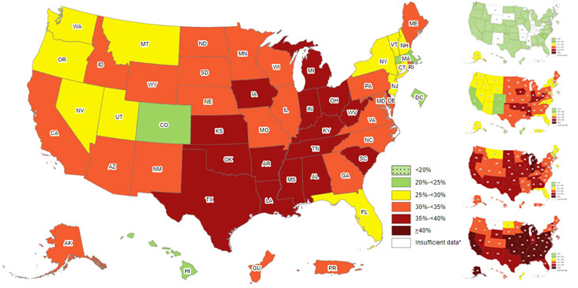
Obesity in America per the CDC
Notes:
https://www.cdc.gov/obesity/data/prevalence-maps.html#overall

Slide 5
Procedures

Slide 6
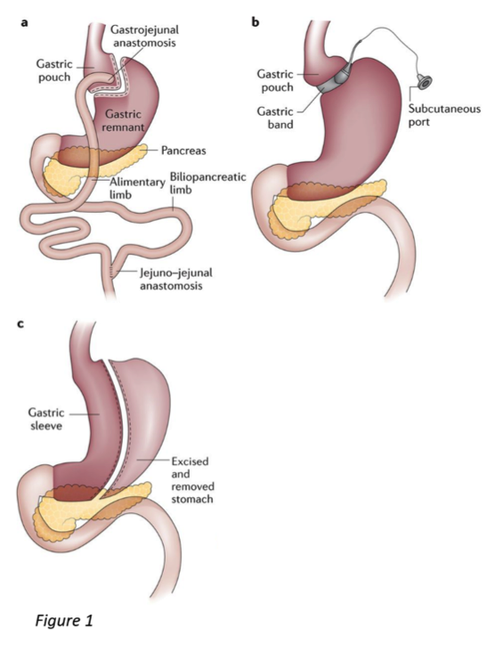
Laparoscopic Gastric Sleeve
Notes:
http://www.epic4healthblog.com/bariatric-surgery-and-nutritional-status/

Slide 7
Laparoscopic Gastric Sleeve
Laparoscopic Gastric Sleeve weight loss surgery, also called Vertical Sleeve Gastrectomy (VSG) or Gastric Sleeve Resection, is currently the most common bariatric surgery procedure performed in the United States. This procedure involves the removal of roughly 80% of the patient’s stomach.
Not only does removing a significant portion of the stomach dramatically limit the amount of food a patient is able to consume, but it also reduces production of the hormone ghrelin. This hormone triggers the appetite, helping patients to feel less hungry.
Notes:
https://panhandleweightlosscenter.com/weight-loss/

Slide 8
Laparoscopic Gastric Sleeve
Life long vitamins and mineral supplementation
Slight risk for worsening acid reflux
Improvement in obesity related conditions
Average of 65% excess body weight loss
Potential for weight regain

Slide 9
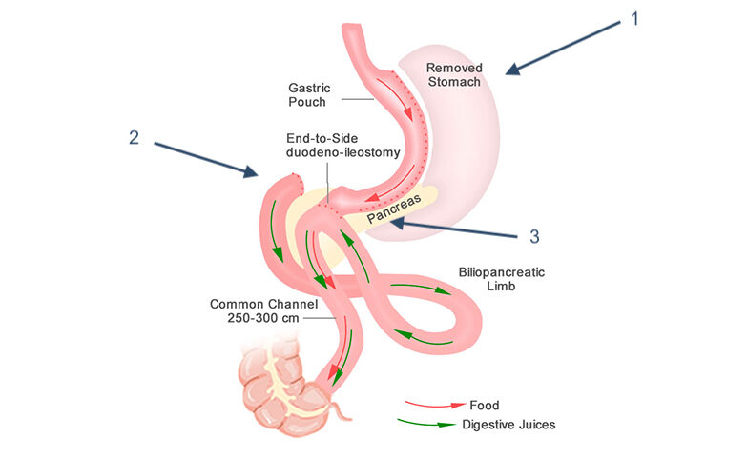
Single Anastomosis Duodeno-Illeal Bypass with Sleeve Gastrectomy (SADI-S)
Notes:
https://asmbs.org/patients/bariatric-surgery-procedures

Slide 10
Single Anastomosis Duodeno-Illeal Bypass with Sleeve Gastrectomy (SADI-S)
This procedure is most commonly performed on patients with BMI >45 and who need to lose 100 pounds or more.
This procedure is most effective in reducing Type II Diabetes Mellitus.
After the surgeon creates the gastric sleeve, a loop of intestine is measured 300 cm from its end and then connected to the stomach. This is the only anastomosis site.

Slide 11
Single Anastomosis Duodeno-Illeal Bypass with Sleeve Gastrectomy (SADI-S)
When the patient eats, food goes through the pouch and directly into the latter portion of the small intestine.
The food then mixes with digestive enzymes from the first part of the small intestine.

Slide 12
Single Anastomosis Duodeno-Illeal Bypass with Sleeve Gastrectomy (SADI-S)
Life long vitamins and mineral supplementation is required
Risk of looser or more frequent bowel movements.
Average of 85% excess body weight loss
Lower risk of weight regain

Slide 13
Benefits of Surgery

Slide 14
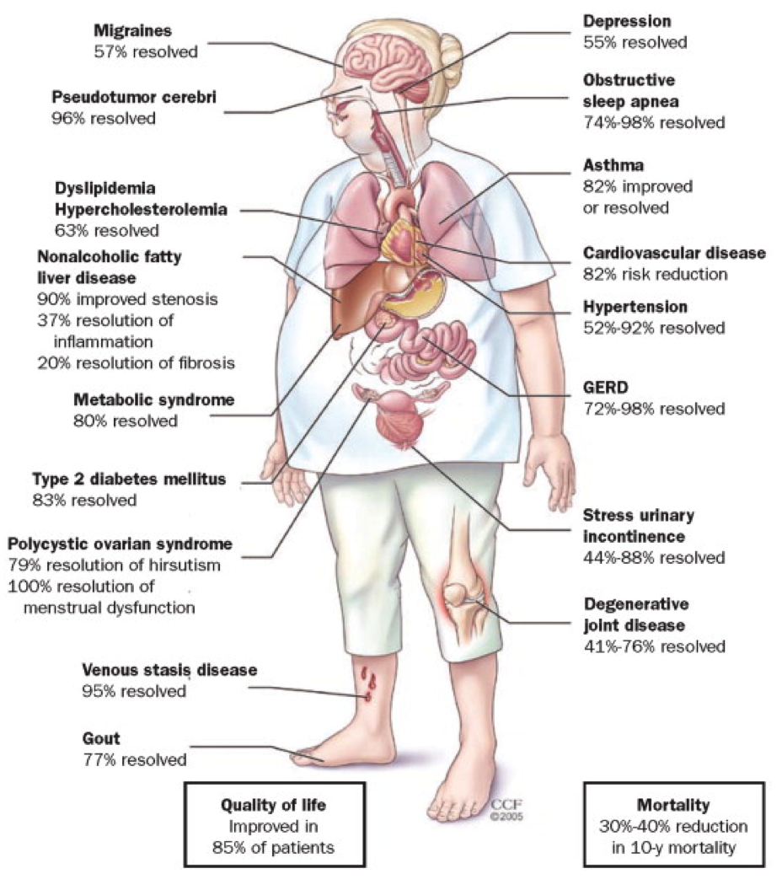
Reduction of comorbidities
Notes:
http://www.epic4healthblog.com/bariatric-surgery-and-nutritional-status

Slide 15
Insurance coverage

Slide 16
What to know about insurance and bariatric surgery
Not all insurances cover bariatric surgery. Bariatric coverage is dependent on the policy holders employer. (Bariatric coverage remains optional for most commercial insurance policies)
If the patient or policy holder has bariatric coverage as an exclusion they must move forward as a cash pay patient. Unfortunately, letters submitted to the insurance company, to make an exception, have proved to be futile.
Medicare does cover bariatric surgery if the patient meets their criteria. (There is no recommended age maximum for bariatric surgery)
For those with bariatric coverage there is typically a specific set of requirements to follow
The basics
BMI >35 with a weight related comorbidity (i.e. OSA, refractory HTN, Type II DM)
BMI >40 without a comorbidity
Prior failed attempts at weight loss
Consider referral of any patient despite them meeting these criteria
We have cash pay and financing options available

Slide 17
Pre-operative Process

Slide 18
Visit Schedule
1st visit- Initial consultations are performed by one of our surgeons.
This is followed by meeting with a bariatric coordinator to review insurance benefits and pre-operative requirements
2nd visit- This visit is scheduled with our NP’s to review medical history and ensure pre-operative requirements are being met.
Meeting with the dietician shortly follows to discuss current nutritional needs and expectations after surgery.
3rd visit- Most patients visit with the NP again to review results of testing or lab results.
Notes:
PWLC Bariatric Patient Manual

Slide 19
Visit Schedule
Checking in with the dietician for an additional 1-2 visits to review vitamins and supplementations postoperatively along with the pre-op diet.
Pre-op visit- meet back with the surgeon to discuss the risks and benefits of surgery along with a detailed explanation of the procedure.
Notes:
PWLC Bariatric Patient Manual

Slide 20
Pre-operative requirements
Cardiac testing
All patients must receive cardiac clearance from their Cardiologist or undergo the cardiac testing we have available in our office
Lab work
Most insurances require basic labs to be performed:
CBC- anemia to be addressed prior to surgery
CMP
Lipid Panel
Hba1c- optimal glycemic control is encouraged
TSH- endocrine disorders must be screened to ensure optimal weight loss postoperatively
Notes:
PWLC Bariatric Patient Manual

Slide 21
Pre-Operative Requirements
Tobacco cessation
Any patient using tobacco in any form must discontinue use 60 days prior to surgery
Psychological Evaluation
Referral is made to local LPC or existing Psychologist or Psychiatrist
Letter of recommendation
Some insurances require a letter of recommendation to be submitted to insurance from a provider not associated with the surgeon.
Pregnancy Counseling
All child bearing age women are instructed to avoid pregnancy for 18-24 months after surgery.
Increased fertility happens postoperatively and appropriate birth control method must be in use
Bariatric surgery can result in a change in absorption of drugs including oral contraceptives. If a non-oral option is available, this is preferred.
Notes:
https://www.ncbi.nlm.nih.gov/pmc/articles/PMC5644910/

Slide 22
Post-Operative Care

Slide 23
Visit Schedule
2 week postop visit
6 week postop visit
8 week body composition testing
12 week postop visit
6 month postop visit
9 month postop visit
12 month postop visit
18 month postop visit
24 month postop visit
Annually for life

Slide 24
Complications
Early complications (immediate postoperative timeframe):
Bleeding
Gastric leak
Pneumonia
PE/DVT
Dehydration
Nausea/vomiting
Notes:
2021 Obesity Algorithm

Slide 25
Complications
Late complications:
Stricture
Hernia
Marginal Ulcer
Vitamin Deficiencies
Osteoporosis
Notes:
2021 Obesity Algorithm

Slide 26
Emergent Presentations
Fever over 100.5
Uncontrolled pain
Uncontrolled nausea and vomiting
Uncontrolled diarrhea
Chest pain
Bright red blood by mouth or rectum
Inability to keep hydration down or no urination
Please have the patient call the clinic right away or send to local ER for evaluation

Slide 27
Post-Op Care At The Primary Care Level
We encourage follow up around 2-4 weeks after surgery to check in with long term medications
We may make suggestions on long term medications in the immediate post op phase but do not manage them
If patients c/o non-surgical issues post operatively we recommend they call their PCP

Slide 28
Most Common Long-Term Complications
Sleeve gastrectomy
Weight regain or lack of long term weight loss
Worsening GERD
Deficiencies:
Iron
B12
Calcium
B1
Vitamin D
Notes:
2021 Obesity Algorithm

Slide 29
Most common long term complications
SADI-S
Weight regain
Protein malnutrition
Deficiencies
Iron
B12
Calcium
B1
Vitamin D
Vitamin A
GERD
Osteoporosis
Notes:
2021 Obesity Algorithm

Slide 30
Post-operative Diet

Slide 31
Post-operative dietary progression
6-8 week dietary progression broken down into 2 week increments
Weeks 1-2- full liquid diet with a focus on hydration and protein intake
Weeks 3-4- soft and moist proteins
Weeks 5-7- soft proteins and low fiber
Week 8 forward- regular diet with a focus on high protein, low carb, healthy fats
Notes:
PWLC Bariatric Patient Manual

Slide 32
Protein Needs
ERAS Society recommends 60-120g/day
ASMBS does not have a definite daily protein recommendation
PWLC recommends 60-80g per day for SG and 80-100g per day for SADI-S
Body composition testing is performed postoperatively to assess muscle mass and calculate protein needs based on lean mass
Formula: 0.8-1.2g protein per pound of lean mass
Notes:
https://asmbs.org/app/uploads/2020/04/Mechanick-2020-AACE-TOS-ASMBS-Guidelines.pdf

Slide 33
Post operative Lab work

Slide 34
Sleeve Gastrectomy
The ASBMS recommends screening patients for deficiencies beginning at 3 months postop
 | 3 months | 6 months | 9 months | 12 months
CBC | x | x | x | x
B1 |  | x
Iron | x | x | x | x
TIBC | x | x | x | x
Ferritin | x | x | x | x
B12 | x | x | x | x
Folate |  | x |  | x- if consiering pregnancy
Vitamin D |  | x
CMP |  | x |  | x
Notes:
https://asmbs.org/app/uploads/2020/04/Mechanick-2020-AACE-TOS-ASMBS-Guidelines.pdf

Slide 35
SADI-S
The ASMBS recommends screening for deficiencies beginning at 3 months postop
 | 3 months | 6 months | 9 months | 12 months
CBC | x | x | x | x
B1 |  | x
Iron | x | x | x | x
TIBC | x | x | x | x
Ferritin | x | x | x | x
B12 | x | x | x | x
Folate |  | x |  | x- if considering pregnancy
Vitamin D |  | x
CMP |  | x |  | x
Vitamin A |  | x
Copper |  |  |  | x
Zinc |  |  |  | x
Vitamin E- screening if symptomatic
Vitamin K- screening if symptomatic
Notes:
https://asmbs.org/app/uploads/2020/04/Mechanick-2020-AACE-TOS-ASMBS-Guidelines.pdf

Slide 36
Vitamins and Supplements

Slide 37
General Information
Lifelong supplementation is required
Guidelines for Supplementation:
Bariatric vitamins are recommended (can be purchased online or through bariatric clinics) over OTC vitamins
Iron and calcium should be taken at least 2 hours apart
Multivitamin/iron supplements should be taken 4 hours apart from thyroid and/or antacid medications
Cost of Supplementation:
Sleeve Gastrectomy: approximately $0.75-$1.25 per day
SADI-S: approximately $1.50-$2.00 per day
Thiamin
Depleted quickly with vomiting/diarrhea/dehydration
Deficiency can cause permanent neurological damage
If deficiency is suspected, recommend IV replenishment WITHOUT dextrose solution
Notes:
Source: 2019 ASMBS Guidelines for VSG
Thiamine is utilized in carbohydrate metabolism, so if patients are being given IV dextrose, their thiamin levels will replete at higher rates

Slide 38
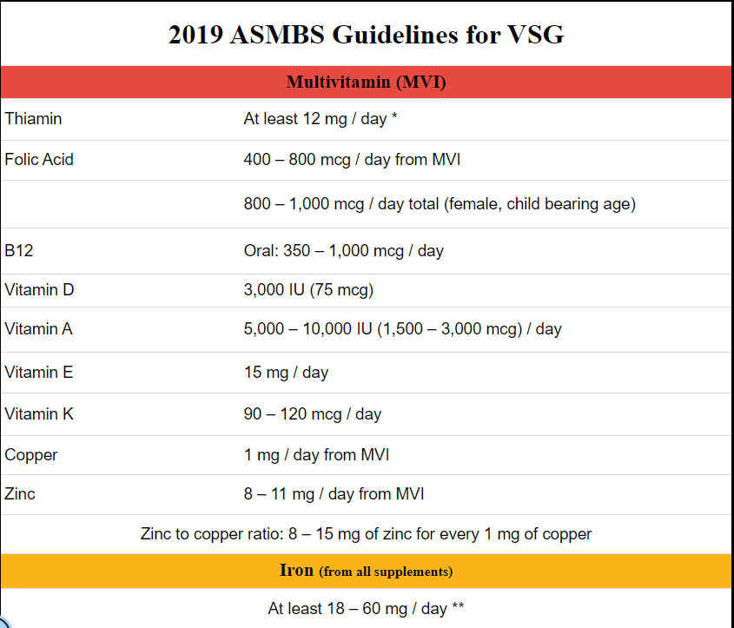
Sleeve Gastrectomy
Daily Needs:
Bariatric MVI with iron
See graphic to the right for recommended intake after sleeve gastrectomy
1000 mg Calcium Citrate
Women are recommended to take an additional iron supplement during menses

Slide 39
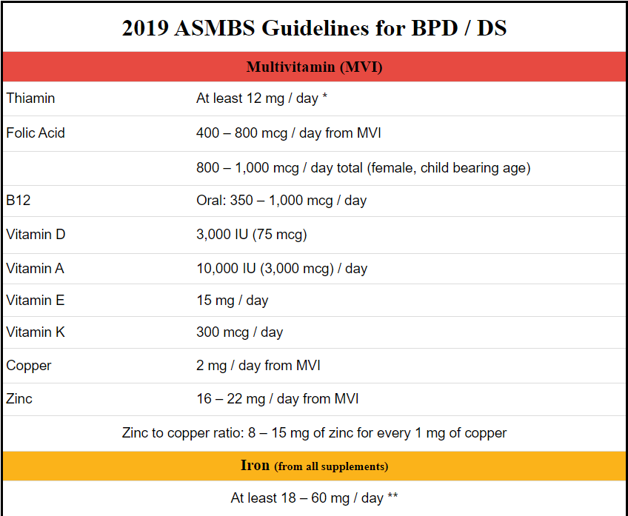
SADI-S
Daily Needs:
Bariatric MVI with iron and additional fat-soluble vitamins (ADEK)
See graphic to the right for recommended intake after SADI-S
1500 mg Calcium Citrate
B-50 Complex
Probiotic (to help reduce gas, bloating, constipation, diarrhea)
Women are recommended to take an additional iron supplement during menses

Slide 40
Additional Resources

Slide 41
Additional Resources from PSG
The bariatric patient manual
This document is free to anyone and located right on our website. We encourage all patients to download this and take notes on it as they move through the pre-op and post-op process. Here is the link: https://panhandleweightlosscenter.com/wp-content/uploads/2020/11/2020-bariatric-manual-revision-B-compressed.pdf
Baritastic App
Use code 77952
This links the patient to our practice and we can review food logs with patients after surgery
Teachable
Our patients are enrolled in an online video course to help navigate them through the pre-operative and post-operative process.

Slide 42
References
https://asmbs.org/app/uploads/2020/04/Mechanick-2020-AACE-TOS-ASMBS-Guidelines.pdf
PWLC Bariatric Patient Manual
2021 Obesity Algorithm
http://www.epic4healthblog.com/bariatric-surgery-and-nutritional-status
https://asmbs.org/patients/bariatric-surgery-procedures
https://panhandleweightlosscenter.com/weight-loss/
https://panhandleweightlosscenter.com/wp-content/uploads/2020/11/2020-bariatric-manual-revision-B-compressed.pdf
https://www.ncbi.nlm.nih.gov/pmc/articles/PMC5644910/
https://www.cdc.gov/obesity/data/prevalence-maps.html#overall

