Slide 1

Texas Nurse Practitioners
Presented by:
Cindy Weston DNP, APRN, CNS-CC, FNP-BC, CHSE
TNP President
Legacy Member

Slide 2

Mission Statement
Empowering nurse practitioners to advance our profession and the health of all Texans through a unified voice.

Slide 3
Goals – V.O.I.C.E.
Voice
Wield influence to preserve and advance the practice of nurse practitioners.
Organization
Sustain the leadership and resources to serve members with excellence.
Impact
Disseminate awareness of nurse practitioners’ scope, practice and achievements through public relations.
Community
Build a vibrant professional community through outreach and engagement of members.
Education
Be the trusted source of information and education to support practice success.

Slide 4








TNP Board Members
Cindy Weston, President
Christy Blanco, Past President
Erin Perez, Vice President
Anna Jessup, Treasurer
Shelagh Larson, Secretary
John Gonzalez, Board Member at Large
Lutricia Harrison, Board Member at Large
Tracy Hicks, Board Member at Large

Slide 5




TNP Staff
Emily Eastin
Chief Executive Officer
Erin Cusack
Government Affairs Director
Connie Rentz
Community Engagement Coordinator
Bella Stewart
Education Manager

Slide 6
TNP Contract Consultants
Accounting: Daphne Weyand, CPA
Communications: Allison Castle, Castle and Associates
CPA: Peter Allman, Peter Allman & Associates
Graphic Design: Sabrina Blackwell
Lobbyist: Allen Blakemore & Casey Haney, Blakemore & Associates and Denise Davis and Lisa Kaufman, Davis Kaufman
Regulatory Attorney: Kevin Stewart

Slide 7
Dues
Legacy Member: $1,200.00
Lifetime membership currently being offered as a trial period for one-year. All graduates from a nurse practitioner program. Regular members shall pay annual dues, may vote, hold elected or appointed office and serve on committees.
Regular Member: $150.00
All graduates from a nurse practitioner program. Regular members shall pay annual dues, may vote, hold elected or appointed office and serve on committees.
New Graduate: $95.00
A recent graduate of an NP program that is entering the NP profession for the first time. DNP graduates are not eligible for this membership. First Year Graduate members shall pay annual dues, may vote, hold elected or appointed office and serve on committees.
Student Member: $60.00
A registered nurse currently enrolled in a NP program. Student members shall pay dues, may have a voice in discussions, and may serve as non-elected committee chairs but may not vote or serve as officers.
Retired Member: $75.00
A nurse practitioner who has retired from active practice. Retired members shall pay annual dues, may vote, hold elected or appointed office and serve on committees.
Associate Member: $110.00
A licensed nurse who is interested in promoting and supporting the purposes and goals of TNP. Associate members shall pay dues, may have a voice in discussions and serve as committee members but may not vote or serve as officers.

Slide 8
What TNP Does For Me
Education Designed to Help You and Your Practice
Spring Conference – April 22-23, 2022 at the Hyatt Hill Country Resort and Spa in San Antonio
Clinical Skills and Workshop Conference – May 27-28, 2022 at the Sheraton in Downtown Dallas
Rural Health Conference – July 16, 2022 (virtual)
Annual Conference – September 23-26, 2022 at the Kalahari Resort in Round Rock
Entry Into Practice Conference – October 21, 2022 (virtual)
Opening the Door for Crucial Conversations on Diversity & Inclusion – November 16, 2022 (virtual)
Online CE Center – Includes all Texas CE requirements
Hot Topic Policy Webinars for Members Only
Annual NP Capitol Days

Slide 9
What TNP Does For Me
Programs Designed to Help You and Your Practice
Practice Resources – Sample PAA, Facility-Based Protocols, Essential Guide to Practice and NP Handbook
Practice Questions – Members may ask a practice question and have access to practice-related FAQ.
Regulatory and Policy monitoring and advocacy.
TNP has retained a Healthcare Attorney to assist with monitoring regulatory changes that have a direct impact on your practice. TNP serves as your advocate to protect your practice.
Preceptor Tool Kit and Preceptor Directory
Rural Health Tool Kit
Entry Into Practice Tool Kit

Slide 10
What TNP Does For Me
Membership Matters
TNP is the boots on the ground in Texas. The work TNP does on behalf of all nurse practitioners in Texas directly impacts your everyday practice - from monitoring regulatory changes to advancing legislative initiatives for nurse practitioners.
The cost of membership is just 41 cents a day. Isn’t the advancement and protection of your profession worth that amount?
Join or renew your membership and help show your support for the important work that TNP does on your behalf everyday!

Slide 11

What TNP Does For Me

Slide 12


Slide 13


Slide 14


Slide 15
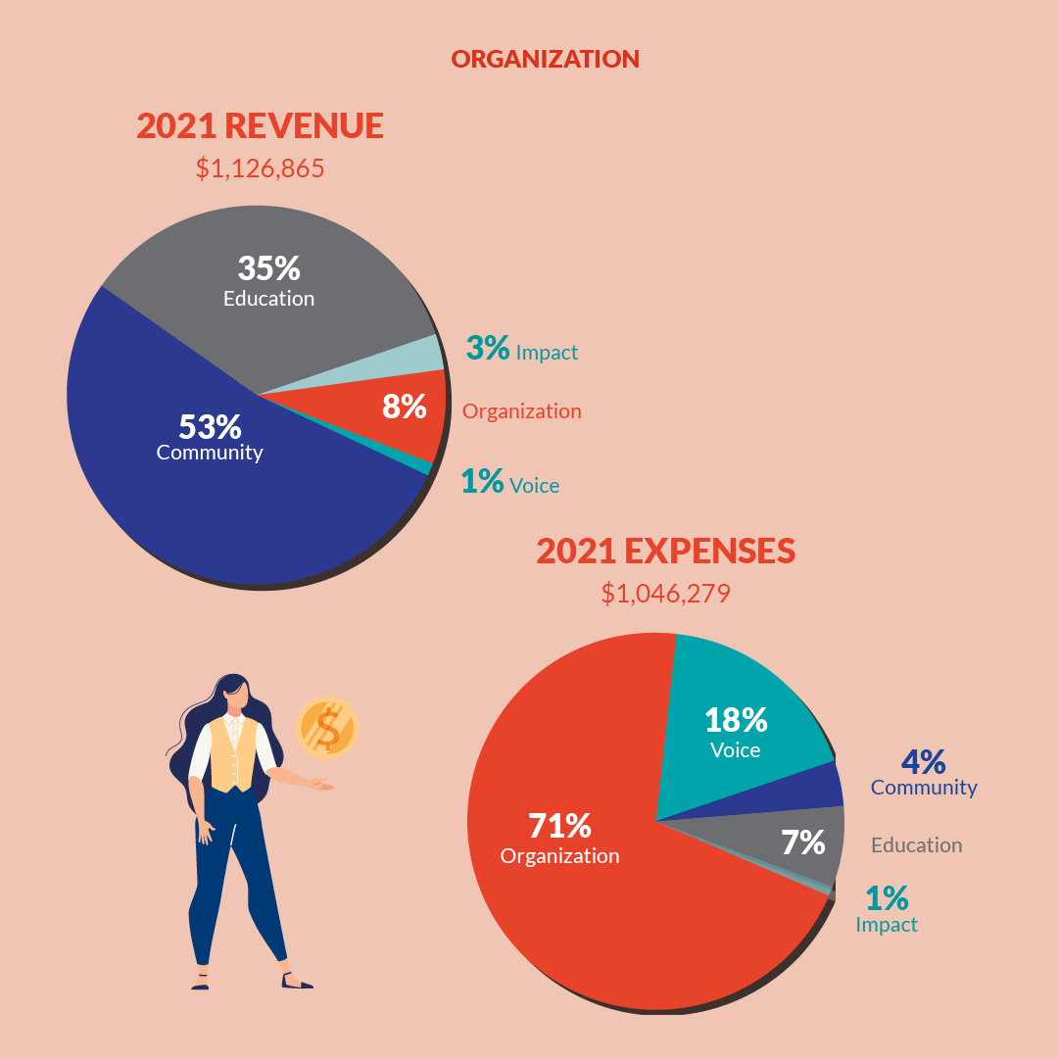

Slide 16
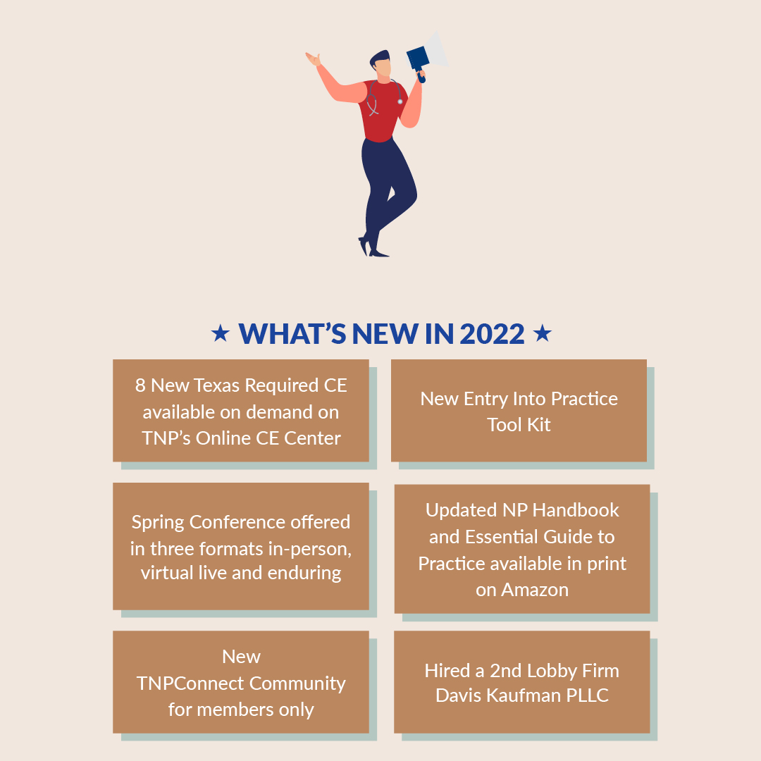

Slide 17

TNP PAC
The mission of the TNP PAC is simple: to make political contributions to elected officials who have supported nurse practitioners in the past, or who will be key gatekeepers to nurse practitioner legislation in the future – regardless of party.

Slide 18

Texas Nurse Practitioner Foundation
Texas Nurse Practitioners Foundation, 501C3, is the charitable organization for NPs in Texas, providing community service grants to NPs as well as scholarships to NP and DNP students.

Slide 19
Ways to Support TNPF
Donate to a TNPF Fund - https://tnp.givingfuel.com/tnpf
General TNPF Fund
Katie Russel Memorial Fund
Kim Oas Memorial Fund
Emergency Fund
Select TNPF on AmazonSmile
Donate a basket or item to the TNPF Silent Auctions during Spring and Fall Conferences

Slide 20

APRN Alliance

Slide 21

AARP
Amazon
Americans for Prosperity - Texas
APRN Alliance
Coalition of Texans with Disabilities
Consortium of Texas Certified Nurse Midwives
Convenient Care Association
Every Texan (formerly Center for Public Policy Priorities)
Leading Age Texas
Methodist Healthcare Ministries of South Texas
National Alliance on Mental Illness
R Street Institute
Texans for Midwifery
Texas Association of Business
Texas Association of Nurse Anesthetists
Texas Association of Health Plans
Texas Clinical Nurse Specialists
Texas Business Leadership Council
Texas Employers for Insurance Reform
Texas Impact
Texas Nurses Association
Texas Nursing Legislative Agenda Coalition
Texas Nurse Practitioners
Texas Organization of Rural and Community Hospitals
Texas Physician Assistant Business Alliance of Texas
Texas Public Policy Foundation
Texas Silver Haired Legislature
The Heartland Institute
The Libre Initiative
University Health Systems San Antonio
Veterans Deserve Care
Young Conservatives of Texas

Slide 22
Communications
TNP Pulse – Quarterly Electronic Magazine
TNP News Flash – Weekly Email Newsletter (Healthcare & TNP News)
Website – www.texasnp.org and https://texasnp.enpnetwork.com/
Facebook – http://www.facebook.com/TexasNP
Instagram – txnursepractitioners
Twitter - @TNPAustin

Slide 23
Become an engaged TNP Member
Texas Nurse Practitioners
4425 S. MoPac Expressway
Building III, Suite 405
Austin, TX 78735
512-291-6224
512-291-6225 (fax)
www.texasnp.org

