Slide 1
COVID-19 in Boone County
By Jessy Sorrick, FNP-DNP

Slide 2
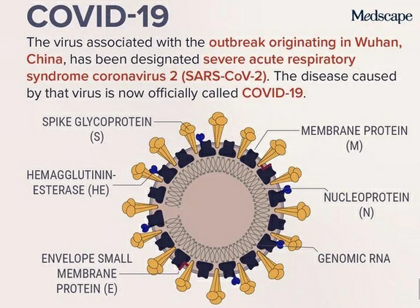
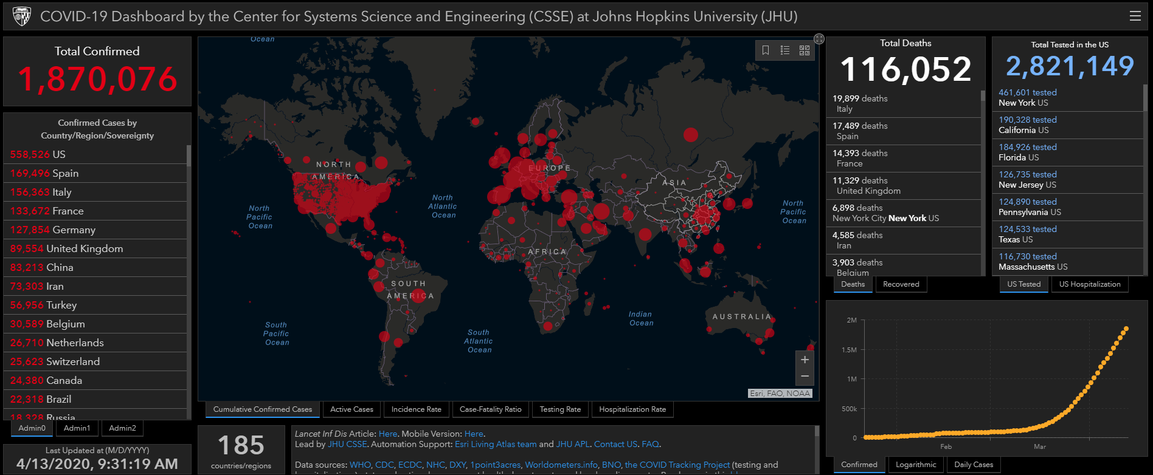
Virus: SARS-CoV-2; Disease: COVID-19
Image 2. Coronavirus COVID-19 Global Cases by the Center for Systems Science and Engineering (CSSE) at Johns Hopkins University (JHU). John Hopkins University of Medicine (2020).
Image 1. Depiction of SARS-CoV-2. Medscape (2020).

Slide 3
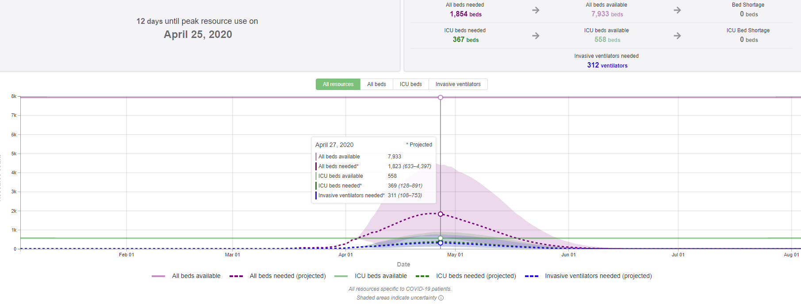
What is Missouri’s outlook with COVID-19?
For the latest update, go to this link: https://covid19.healthdata.org/projections

Slide 4
Columbia’s COVID-19 timeline
March 11-13th, 2020
WHO declared COVID-19 as a pandemic
MU cancelled all in-person classes
March 16-18th, 2020
1st person dx with COVID-19 in Boone County
1st person died from COVID-19 in MO
March 21,24-25th, 2020
Columbia schools cancelled in-person classes
Boone County placed “Stay at Home” order
Trump declared as National Emergency
Columbia declared a State of emergency
Gov. Parson issued orders for social distancing
April 3-6th, 2020
CDC changed their rec. about public wearing masks
April 9th, 2020
Gov. Mike Parson orders all schools to cancel for the rest of the remaining school year
April 20-26th, 2020
Projected COVID-19 peak for Missouri
Gov. Mike Parson places “Stay at Home” order

Slide 5
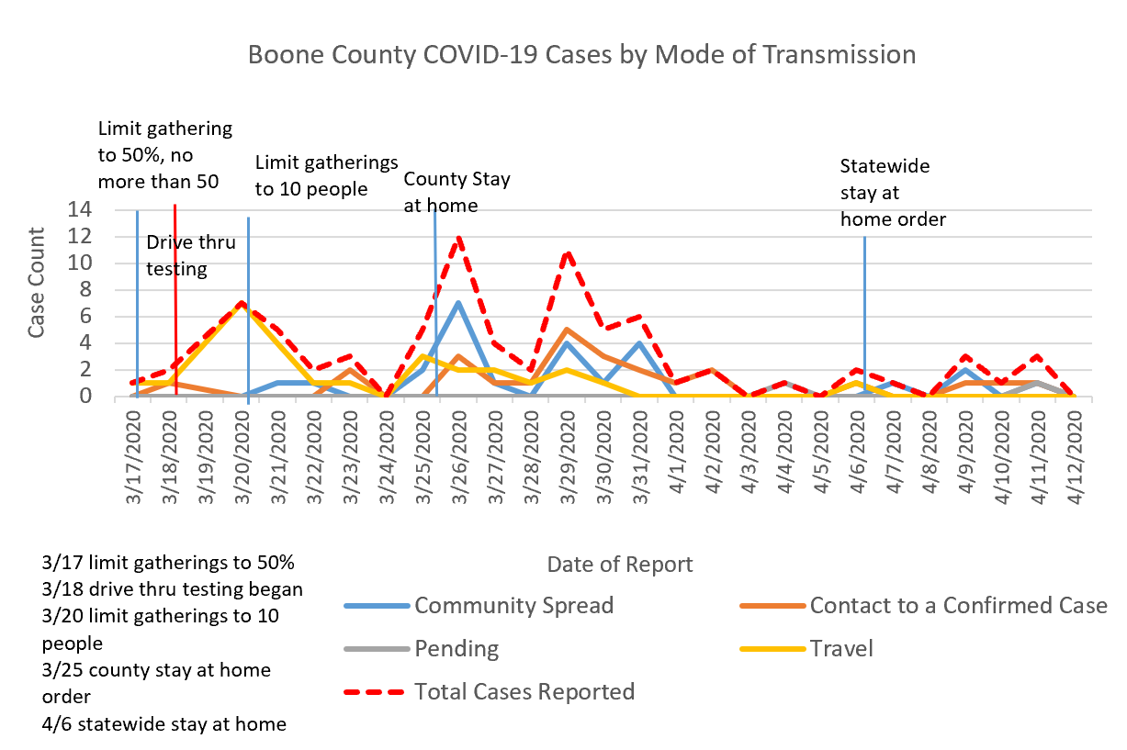
How has Boone County fared?
Image 1. Boone County COVID-19 Cases by Mode of transmission. Retrieved from Columbia/Boone County Department of Public Health and Human Services (Estes, 2020).

Slide 6
Healthcare’s approaches and needs have changed
PPE shortages:
  Rationing masks/gowns
  Reusing masks/gowns
  Highly competitive market
COVID testing:
  Evolution of testing guidelines
  Evolution of testing speed: Abbott and 5 min testing
Cancellation of elective procedures
Completing Zoom/Telephone visits
Rescheduling wellness and non-acute visits

Slide 7
So what are we (in Boone County) doing about this?
MU Healthcare and Boone are currently offering community drive thru testing
  Boone: 7am-7pm M-F, and 8-12pm on weekends
  MU: 7am-7pm M-F, and 8-12pm on weekends
Currently, Gentrait has been the primary lab running the majority of labs for Columbia, MO
  24 hours (or less) turn-around time
  MU estimates about 200-300 tests per day
Boone County Health Department:
  Working with care facilities and healthcare systems
  Collaboration with the State Health Department

Slide 8
What MU is doing about this:
Created ‘Telephone Respiratory Triage’ teams
Checking temperatures and s/s prior to clinic/hospital entry
Have set ‘clean’ and ‘dirty’ areas in UH ER/PCU/ICU and WCH
Enforcing use of negative pressure rooms for any suspected COVID-19 s/s
Provision of masks to staff
  N95 UV disinfection
Provision of scrubs to staff working with COVID-19 patients
Hospitalizing symptomatic suspected patients with high risk factors
  Patients who require admittance are to remain until cleared by testing
Trying to enroll into research trials
Providing frequent COVID education:
  COVID-19 Town halls
  SHOW ME ECHOS
  GRAND ROUNDS (MU Health Care’s COVID-19 Information website, 2020)

Slide 9
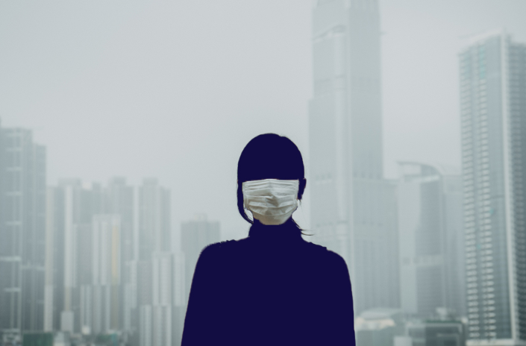
That Discomfort You’re Feeling Is Grief
According to Berinato (2020), we are experiencing different griefs:
    Things will be different after this, such as after 911
    Loss of normalcy
    Fear of economic toll
    Loss of connection
  Anticipatory grief: uncertainty
How to manage:
  Find balance in how you think
  Be in the present
  Let go of what you can’t control
Image 1. Original art image provided with Berinato’s Harvard Business Review article.

Slide 10
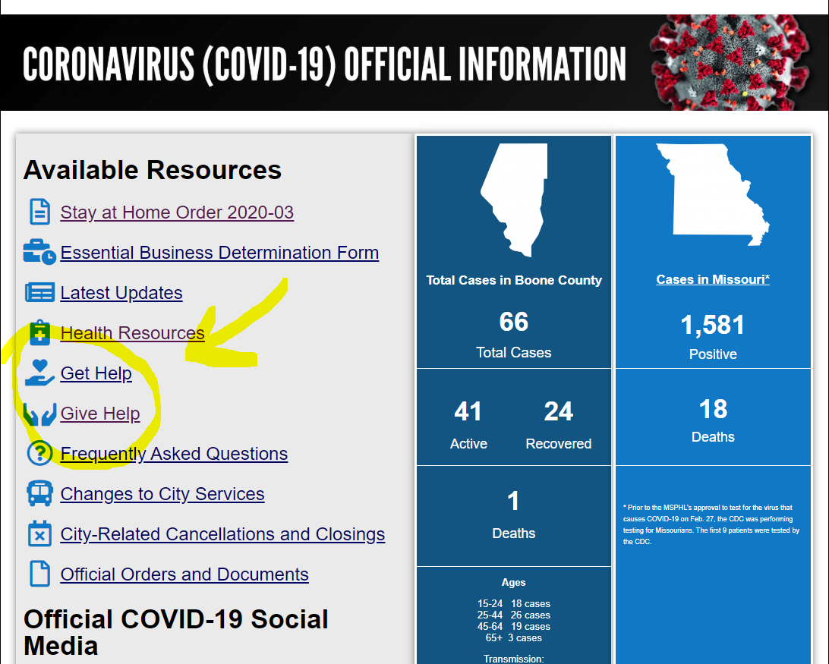
What can YOU do about this?
Volunteer or donate through Columbia (webpage as seen on right):
  https://www.como.gov/coronavirus/
Participate in COVID SHOWME ECHO: Mondays @ 12:00-1300
  https://showmeecho.org/clinics/covid-19/
Participate with State phone calls with Dr. Randall Williams (for providers only)
  Ask your facility about coordinating to receive this info
Donate blood (or serum) with Red Cross:
  Red Cross is starting to collect plasma/serum from post-infx COVID pts
  Go to RedCrossBlood.org/Plasma4COVID to see if you qualify
Attend Grand Rounds (if you are an MU employee)

Slide 11
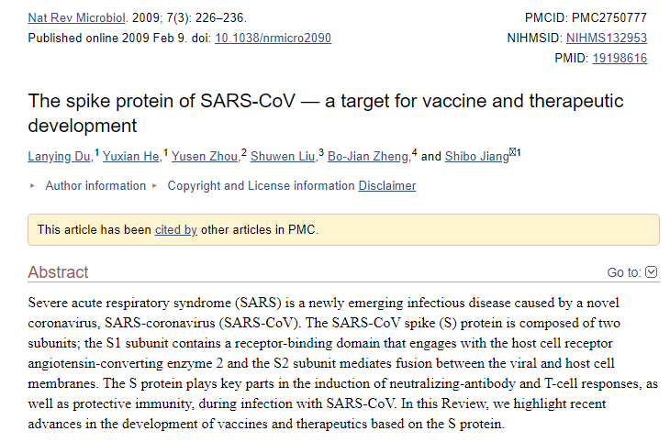
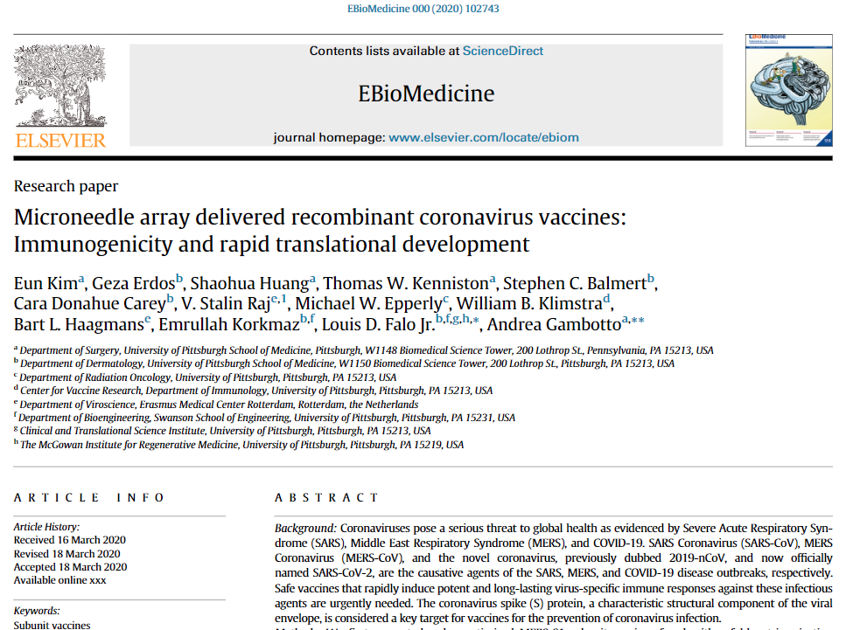
What will the future be with COVID-19?
Several ID professionals predict this will be similar to Influenza
COVID-19 will most likely return this fall
Potential vaccines are already being developed, but will need to be trialed
  Dr. Peter Hotez had developed a SARS-CoV-1 vaccine that can be repurposed for SARS-CoV-2
    SARS-CoV-1 has 80% similarity of genetic code to SARS-CoV-2 (Du et al., 2009)
  UPMC and University of Pittsburgh School of Medicine have also developed a possible vaccine against SARS-CoV2
    new form of delivery: microneedle array (Kim et al., 2020)
Image 1. Research article by Du et al. (2009)
Image 2. Research article by Kim et al. (2020)

Slide 12
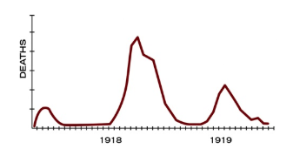
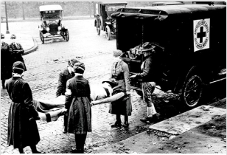
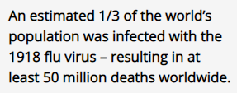
How do we put this in perspective with the past?
1918 H1N1 Flu Pandemic:
  Possibly killed 50 million people worldwide
  Targeted healthy adults: 15-34 years of age
  Lower the average life expectancy by 12 years in the US
  Occurred during a war: WWI
  Unknown virus source
  Very limited news coverage
  No vaccines at the time
  Came in 3 waves (CDC, 2018)
Figure 1. The three different waves of illness during the pandemic, starting in March 1918 and subsiding by summer of 1919. From Centers for Disease Control and Prevention (CDC). (2018).
Image 1. The Motor Corps of St. Louis chapter of the American Red Cross on ambulance duty during the influenza epidemic, October 1918. From CDC. (2018).

Slide 13
References
Berinato, S. (2020). That discomfort you’re feeling is grief. Harvard Business Review. Retrieved April 6, 2020, from https://hbr.org/2020/03/that-discomfort-youre-feeling-is-grief
Centers for Disease Control and Prevention. (2018). 1918 pandemic Influenza: Three waves. Retrieved from https://www.cdc.gov/flu/pandemic-resources/1918-commemoration/three-waves.htm
Du, L., He, Y., Zhou, Y., Liu, S., Zheng, B. J., & Jiang, S. (2009). The spike protein of SARS-CoV--a target for vaccine and therapeutic development. Nature reviews. Microbiology, 7(3), 226–236. https://doi.org/10.1038/nrmicro2090
Estes, R. (2020). Columbia/Boone County Health and Human Services Operational Activity [Word document]. Columbia/Boone County Health and Human Services.
John Hopkins University of Medicine. (2020). Coronavirus COVID-19 Global Cases by the Center for Systems Science and Engineering (CSSE) at Johns Hopkins University (JHU). Retrieved from https://coronavirus.jhu.edu/map.html
Kim, E., Erdos, G., Huang, S., Kenniston, T., Balmert, S., Carey, C., Raj, V. … Gambotto, A. (2020). Microneedle array delivered recombinant coronavirus vaccines: Immunogenicity and rapid translational development, EBioMedicine. Retrieved from https://doi.org/10.1016/j.ebiom.2020.102743
Medscape. (2020). COVID-19 Infographics. Retrieved from https://www.medscape.com/slideshow/covid-19-infographics-6012689
MU Health Care. (2020). COVID-19 Information. Retrieved from https://www.muhealth.org/covid19-information

Slide 14

How has COVID impacted your practice/life?
Doing Telehealth?
Moved to a different clinic?
Still working?
Grocery shopping online?
Avoiding news?
  Or following news more?
Minimizing travel… -you should be!

