Slide 1

Pharmacological Management of Sleep Disorders in the Older Adult
Maureen Smith, DNP, APRN, ANP-BC, GNP-BC

Slide 2
I have no financial disclosures.
Special thanks to my colleague
Melissa Carlucci, DNP, APRN, ACNP-BC

Slide 3
Objectives
The learner will be familiar with current American Academy of Sleep Mediicne guidelines for the treatment of sleep disorders
The learner will be able to identify signs and symptoms of at least two sleep disorders in the older adult
The learner will identify pharmacotherapy recommendations for sleep disorder management in the older adult

Slide 4
Pre- Questions
Which primary sleep disorders increase with age?
What are common side effects of sedative hypnotics used to treat insomnia?
According to Beers Criteria, what classification of medications should be avoided to treat insomnia in the older adult?

Slide 5
Normal Sleep
Cycles of NREM and REM sleep that last approximately 90-120 minutes → 4-5 cycles/night
Non-rapid eye movement (NREM) sleep
Rapid eye movement (REM) sleep
N1 → lightest
N2 → longest
N3 (slow wave sleep) → deepest
Stable respiratory and CV function
Activated EEG similar to wakefulness
Muscle atonia
Rapid eye movements
Changes in respiratory and CV function

Slide 6
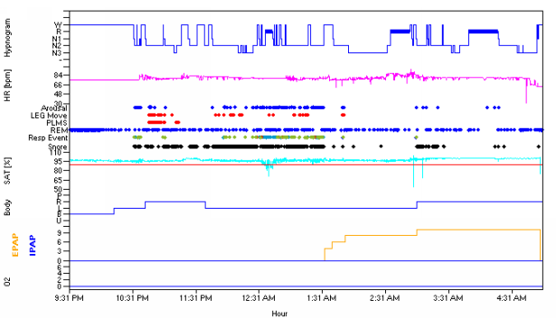
Sleep Architecture

Slide 7
Obstructive Sleep Apnea (OSA)
Most common type of sleep-disordered breathing
Advancing age is a risk factor
Characterized by recurrent collapse of the upper airway during sleep
  Frequent nocturnal arousals → fragmentation of sleep → excessive daytime sleepiness
Negative effects on daily functioning, quality of life, and public safety
Chronic disease that requires long-term management

Slide 8
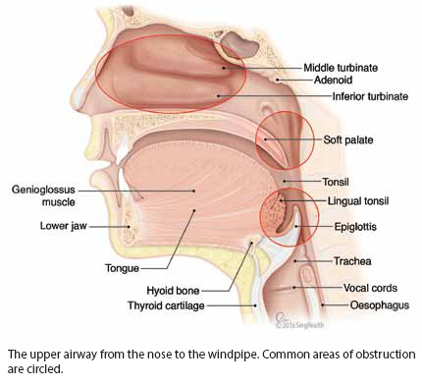
Role of the Upper Airway
Lacks bony support → collapsible
Patency is maintained by upper airway dilating muscles (genioglossus) → respond to ↑ CO₂ and negative intrathoracic pressure

Slide 9
Demographics
Estimates of prevalence vary based on the definition used
  Recent systematic review (Senaratna et al., 2017)
    AHI ≥ 5: 9%-38%
    AHI ≥ 15: 6%-17%
  Current estimates are higher than previous
  Under-diagnosed
More common in men, with increased rates in women after menopause
Prevalence increases with age

Slide 10
History: Risk Factors & Conditions
Clinical Risk Factors
Associated Conditions
Obesity
Age
Gender
Menopause
Family history
Smoking
Craniofacial structural abnormalities
Upper airway soft tissue abnormalities
Hypothyroidism
Depression
Chronic lung disease
ESRD
Pregnancy
Polycystic ovary syndrome
Sexual dysfunction
**Cardiovascular disease
**Diabetes

Slide 11
History: Symptoms
Nighttime Symptoms
Daytime Symptoms
Snoring
Witnessed apneas
Nocturnal choking or gasping
Insomnia
  Difficulty initiating or maintaining sleep
Diaphoresis
Nocturia
Excessive daytime sleepiness (EDS)
Unrefreshing sleep
Morning headaches
Dry mouth
Memory or concentration difficulties
Irritability

Slide 12
Objective Testing: Sleep Study
Should be performed in conjunction with a comprehensive sleep evaluation and adequate follow-up (Kapur et al., 2017)
Two acceptable methods
  Polysomnography (PSG) or Home Sleep Test (HST)
Device | Description | Minimum Channels
Type I (PSG) | Attended, in-laboratory | EEG, EOG, chin EMG, airflow, O2Sat, effort, ECG
Type III (HST) | Testing with portable monitors, unattended or attended | Respiratory effort, airflow, O2Sat, ECG or HR

Slide 13
Severity Classification
Mild: AHI 5-15/hr
Moderate: AHI 15-30/hr
Severe: AHI > 30/hr
Guides treatment options
Correlates poorly with symptomatic sleepiness
Increased mortality in severe OSA (Pan et al., 2016)

Slide 14
Continuous Positive Airway Pressure
Standard of care (Kushida et al., 2006)
  Indicated for moderate-to-severe OSA
  Recommended for mild OSA
  Compliance standard: 4 hours on 70% of nights
  Pneumatic splinting of the upper airway with a fixed pressure
Benefits are well established (Jonas et al., 2017)
  ↓ AHI
  ↓ daytime sleepiness
  ↓ blood pressure
  ↓ driving risk
  Improves quality of life

Slide 15
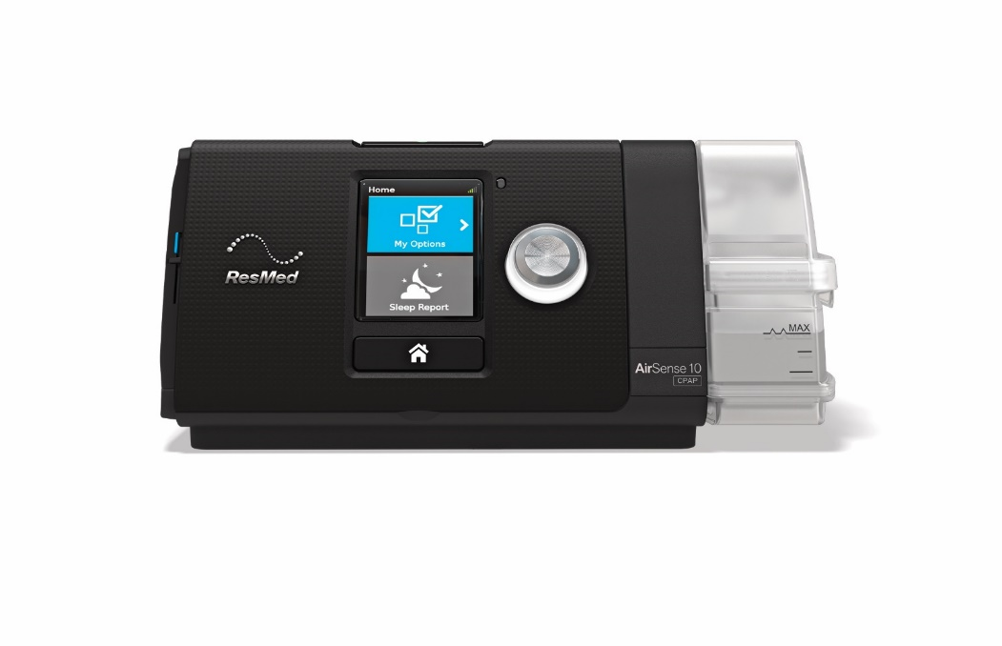
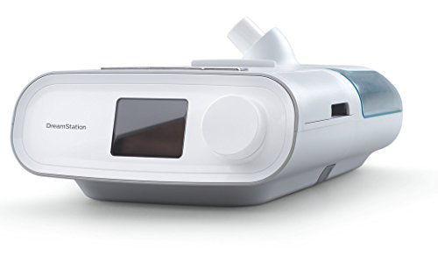
CPAP Devices
©ResMed 2012. Used with Permission.

Slide 16
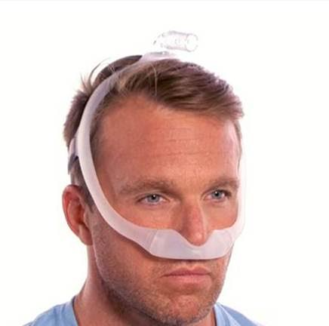
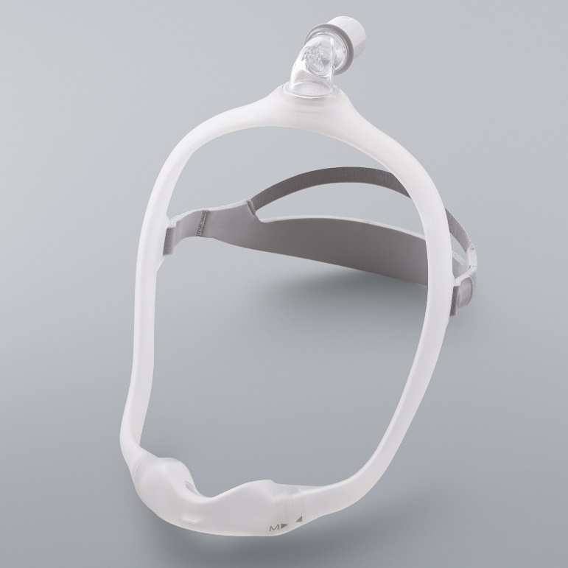
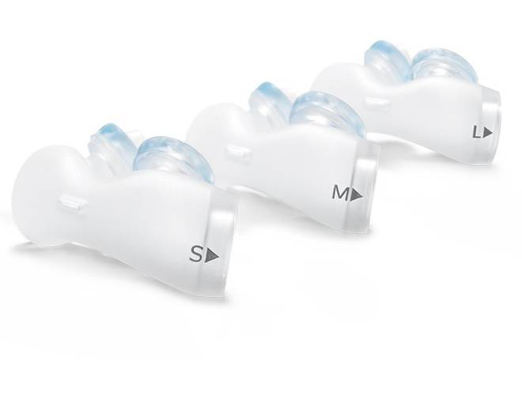
Interfaces: Nasal Pillows

Slide 17
OSA: Alternative treatments
Weight loss-most conservative
  Sometimes curative
Oral Appliance Therapy (dental device)
  Mild to Moderate OSA
  May not be covered under insurance
Upper Airway Surgery
  Rare- for craniofacial abnormalities
Hypoglossal Nerve Stimulator (Inspire)
  Mild stimulation to CN XII to maintain airway patency during sleep
  CN XII controls tongue and airway muscles

Slide 18

Your patient doesn’t have OSA (or maybe they do have OSA and are adherent to CPAP) but is still excessively sleepy during the day. What else could be causing this?

Slide 19
Narcolepsy
Disorder of central hypersomnolence
  “organic” brain sleepiness
Cardinal symptom: EDS
  Inability to stay awake and alert during major waking episodes of the day
  More likely to occur in sedentary situations
  Often the 1st symptom to appear
  Sleep periods are generally refreshing
Onset generally teens or twenties → symptoms develop gradually
AASM, 2014
Notes:
One of the most common causes of disabling daytime sleepiness after OSA
Concern with driving here, similar to OSA.
Sleep episodes refreshing: different from OSA where patients do not wake up in the morning or after a nap refreshed because of the apnea.
Onset in teens/twenties: however, underdiagnosed so patients may not present until later in life

Slide 20
Narcolepsy
Hypocretin deficiency → Type 1
Secondary to a medical condition → CNS disorders, hypothalamic lesions, head trauma
Characterized by impaired sleep-wake regulation → Instability of REM sleep
AASM, 2014
Notes:
Neurotransmitter produced in the hypothalamus that has excitatory effects: Promotes wakefulness and prevents inappropriate transitions into sleep
In these patients, CSF hypocretin levels are either low or undetectable.
What essentially happens is that elements of sleep intrude into wakefulness and elements of wakefulness intrude into sleep. So when they’re awake, they fall asleep inappropriately. And when they are asleep, they exhibit these other symptoms

Slide 21
Narcolepsy: Other Features
Cataplexy → highly specific for narcolepsy
  Sudden, brief loss of muscle tone with retained consciousness
  Triggered by strong emotion (usually positive)
  Typically presents within 1 year of onset
Hypnagogic hallucinations
  Vivid dream-like experiences
  Occur at transition from wake to sleep
Sleep paralysis
  Temporary inability to move voluntary muscles immediately after awakening
AASM, 2014
Notes:
Remember that all patients will have EDS, but these may or may not be present and only about 1/3 of patients will have all of them.
Cataplexy is the only one specific to narcolepsy: HH and SP can occur with other sleep disorders
Cataplexy is hard because it’s based on self report and this is hard to explain to patients, so often there may be a questionable h/o cataplexy. You don’t generally see these episodes occur, although…
The severity, affected part of body, triggers are highly variable.
Brief = less than 2 minutes

Slide 22
Narcolepsy: Diagnosis
Requires clinical evaluation and objective testing
Overnight PSG followed by daytime Multiple Sleep Latency Test (MSLT)
  Standard of care
  PSG to exclude other causes of EDS
  MSLT (nap test) to make the diagnosis of narcolepsy
Measurement of CSF hypocretin levels
  Rarely done clinically-lumbar puncture
AASM, 2014
Notes:
There is a h/o EDS +/- cataplexy, hypnagogic hallucinations, sleep paralysis
Purpose of PSG is to exclude other causes of EDS, the biggest one being OSA. If they are diagnosed with OSA on that PSG, then MSLT is on hold until the OSA is treated.
Hypocretin not widely available, requires an LP, low levels highly specific for narcolepsy type 1

Slide 23
Narcolepsy: Diagnostic Criteria
Narcolepsy Type 1
Narcolepsy Type 2
Daily EDS for ≥ 3 months
One or both:
  Cataplexy AND mean sleep latency ≤ 8 minutes and ≥ 2 SOREMP on MSLT
  Low CSF hypocretin
Daily EDS for ≥ 3 months
Mean sleep latency ≤ 8 minutes and ≥ 2 SOREMP on MSLT
No cataplexy
CSF hypocretin not measured or not low
Not better explained by another cause
American Academy of Sleep Medicine, 2014
Notes:
Alternatively, 1 SOREMP can be on PSG
Doesn’t change management except with type 1 you treat the cataplexy and with type 2 you don’t.

Slide 24
Narcolepsy: Management
No cure → treatment focused on symptom management
Goal: produce fullest possible return of normal function
  Objectives → control sleepiness & control other sleep related symptoms
Treat any coexisting sleep disorders
Pharmacologic and non-pharmacologic management

Slide 25
Non-Pharmacologic Therapy
Take scheduled naps
Maintain a regular and adequate sleep schedule
Avoid drugs that cause sleepiness or insomnia
Morgenthaler et al, 2007
Notes:
Generally not sufficient as primary therapy and almost all patients require medication

Slide 26
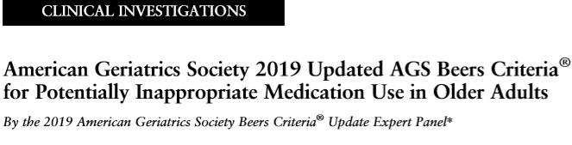
American Geriatrics Society: 2019
DOI: 10.1111/jgs.15767
JAGS 67:674–694, 2019

Slide 27
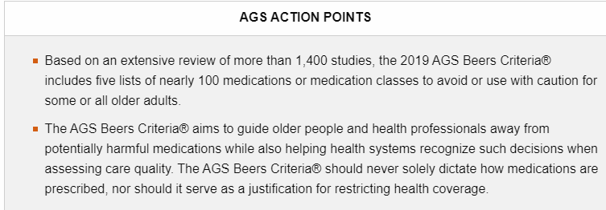
American Geriatrics Society: 2019
Bottom line: most medications used to treat sleep disorders may be used with caution and at lowest effective dose in older adult patients. Beware of drug-drug interactions.

Slide 28
Pharmacologic Therapy: Hypersomnias
Modafinil*
Methylphenidate*
Amphetamines*
Schedule IV
Fewer side effects
Lower abuse potential
Typical dose: 200mg qAM
Schedule II
CNS stimulant
CV and psychiatric side effects
Higher abuse potential
Typical dose: 10 mg BID
Schedule II
CNS stimulant
CV and psychiatric side effects
Higher abuse potential
Typical dose: 10 mg qAM
* Table 8: Medications/Criteria removed since 2015 AGS Beers Criteria; not unique to older adults JAGS, 2019
Morgenthaler et al, 2017
Notes:
Modafinil: MOA believed to be increases dopamine signaling, fewer sympathomimetic effects than the others but may increase BP so need to watch if arrhythmias or heart disease
May need divided dosing if persistent sleepiness in the afternoon
Decreases effectiveness of OCP so women of childbearing age should be cautioned
More expensive

Slide 29
Alerting Agents: Mechanism of Action
Caffeine: adenosine receptor antagonist
Methlyphenidate, amphetamines, sympathomimetic agents: enhance neurotransmission of dopamine, norepinephrine, serotonin
Modafinil/Armodafinil: dopaminergic reuptake inhibitor
SLEEP, June 2019

Slide 30
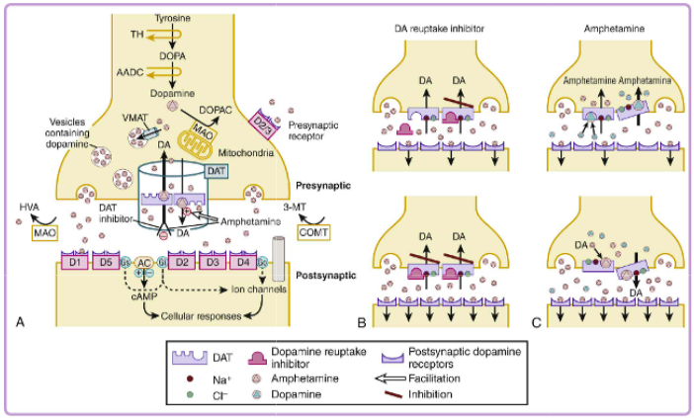
How Amphetamines Work
Nishino, S. & Mignot, E., 2011

Slide 31
Pharmacologic Therapy for Cataplexy
REM-Suppressing Drugs
Sodium Oxybate (Xyrem)
Serotonin and norepinephrine ↓ REM → meds that ↑ serotonin and norepinephrine will ↓ REM → ↓ cataplexy
SSRI*
SNRI*
TCA (less common)*
Schedule III (active ingredient is schedule I)
CNS depressant given* nocturnally
No alcohol or CNS depressants!!
Available only through a restricted distribution program
*Table 5: Avoid total of three or more CNS-active drugs; minimize number of CNS-active drugs JAGS, 2019
Notes:
REM is inhibited by norepinephrine and serotonin, so drugs that increase noradrenergic and serotonergic signaling suppress REM
Remember that cataplexy comes from REM sleep dissociation. Also why we want to stop these meds prior to MSLT to make the diagnosis.
TCAs less common due to anticholinergic side effects
Xyrem: 1st dose at bedtime and 2nd dose 2.5-4 hours later d/t short half life, may need to set an alarm, drink it, salty – sodium salt of GHB, potential for abuse
Dose is up-titrated for effect so may take several weeks to see full response
Rapidly produces deep sedation so many considerations
Xyrem REMS: both prescribers and patients have to register, central pharmacy

Slide 32
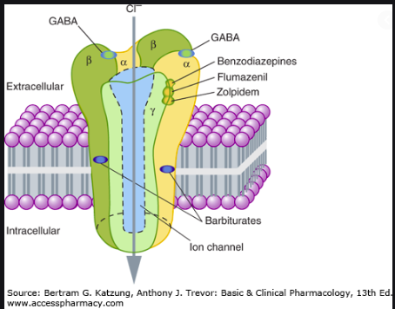
Sodium oxybate (Xyrem): GABAB Binding
New medications for narcolepsy

Slide 33
Your patient has difficulty initiating and/or maintaining sleep. What else (other than primary insomnia and OSA) could be causing this?

Slide 34
Restless Legs Syndrome (RLS)
Sleep-related movement disorder characterized by an urge to move the legs, usually accompanied by uncomfortable sensations in the legs
3 required characteristics:
  Worse at rest
  Better with movement
  Occurs in the evening hours
Pathophysiology → iron deficiency, alternation in dopamine regulation-Fe for dopamine production
American Academy of Sleep Medicine, 2014

Slide 35
Restless Legs Syndrome
Clinical Features
Risk Factors and Precipitating Factors
Sleep disturbance: often most troubling symptom, reason for seeking care
Daytime sleepiness: less severe than OSA
Periodic limb movements in sleep: reported by bed partner or seen on PSG
Female
Family history
Iron deficiency
Pregnancy
Chronic renal failure
Medications
  Sedating antihistamines
  Dopamine antagonists
  Antidepressants
American Academy of Sleep Medicine, 2014

Slide 36
Restless Legs Syndrome
Diagnosed by clinical evaluation
Laboratory → check ferritin in all patients, check renal function if indicated
Polysomnography not routinely indicated
Severity rating scale (IRLSSG, 2019)
  10 questions rated 0-4
  1-10: mild
  11-20: moderate
  21-30: severe
  31-40: very severe

Slide 37
Periodic Limb Movement Disorder (PLMD)
Repetitive, rhythmic extensions of big toe/dorsiflexion of ankle on PSG (requires objective documentation for diagnosis)
Related to RLS; majority of those with RLS with have PLMs (> 80%)
Occur in first part of night
Increase in frequency with age
May be caused low serum ferritin (<75 ng), SSRIs (serotoninergic phenomenon), antiemetics
Pharmacotherapy tx if symptomatic with RLS or disruptive to sleep pattern (> 15 movements/hr)
Barkoukis et al., Therapy in Sleep Medicine, 2012

Slide 38
RLS/PLMD: Management
Iron supplementation if ferritin < 75 ng/mL
  Do not take with dairy, antacids, calcium supplements
  Repeat ferritin in 3 months
Non-pharmacologic therapy
  Treat comorbid OSA if present
  Avoid sleep deprivation
  Avoid aggravating factors (ie…medications)
  Symptomatic relief: exercise, massage, hot baths, compression stockings, stretching, acupuncture
Aurora et al., 2012

Slide 39
RLS/PLMD: Medication Management
Dopamine Agonists
  Example: ropinirole, pramipexole
  Consider if severe RLS symptoms, +PLMD on PSG
Alpha 2 delta ligands*
  Example: gabapentin enacarbil, gabapentin, pregabalin
  Consider if comorbid pain, insomnia, anxiety
First line therapies
Daily dosing, take 2 hours before bedtime
Aurora et al., 2012; Garcia-Borreguero et al.,2013
*Table 6: Drugs to avoid or dosage reduced if CrCl < 60—reduce dose. Potential CNS adverse effects. JAGS, 2019

Slide 40
Insomnia
Persistent difficulty with sleep initiation, duration, consolidation, or quality that occurs despite adequate opportunity and circumstances for sleep, and results in some form of daytime impairment.
3 required components:
  Persistent sleep difficulty
  Adequate sleep opportunity
  Associated daytime dysfunction
American Academy of Sleep Medicine, 2014
Notes:
Different than sleep deprivation because it occurs despite adequate opportunity and circumstances for sleep.
Sleep difficulty: poor sleep quality or insufficient sleep quantity due to difficulty initiating or maintaining sleep or waking up too early.
Daytime functioning issues: fatigue, inattention, poor mood, vocational problems
Fatigue must be differentiated from daytime sleepiness: this is more of a lack of energy and even though they have a desire to sleep during the day they usually cannot. This is different from the daytime sleepiness of OSA where they report subjective sleepiness and often fall asleep unintentionally during the day.

Slide 41
Insomnia
Often co-exists with other medical, psychiatric, or sleep disorders
  Separate diagnosis → separate treatment plan
May also be related to stress, medications/substances, poor sleep hygiene
Chronic Insomnia | Short-Term Insomnia
Symptoms ≥ 3 times per week for ≥ 3 months | Symptoms for ≤ 3 months
Onset may be acute (then persist) or insidious | Occurs in response to an acute, identifiable stressor
Course is variable; Specific complaints may change | Symptoms ↓ over time or in response to withdrawal of the stressor
AASM, 2014
Notes:
Night-to-night variability in insomnia symptoms. Will get occasional good night sleep.
Even if insomnia occurs 2/2 another condition, it often develops an independent course and can remain clinically significant even if the comorbid even if the “primary” condition is adequately treated. If untreated, insomnia can negatively affect the outcome of comorbid conditions. Conversely, treatment of insomnia can improve the outcome of comorbid conditions. So insomnia best viewed as a comorbid disorder with separate treatment attention (no longer considered a secondary condition).

Slide 42
Insomnia
Chronic Insomnia: affects about 10% of population
More common in:
  Women
  Older adults
  Difficulty sleeping during stressful times or habitual light sleepers
  Comorbid medical, psychiatric, substance use disorders
American Academy of Sleep Medicine, 2014
Notes:
Talking about more chronic insomnia rather than short-term insomnia symptoms.
Women: especially peri- and post-menopausal
Older adults: age-related deterioration in sleep continuity and increase in medical comorbidities
Comorbid: This encompasses a lot. But generally speaking, medical conditions that chronic pain, breathing difficulty, immobility. Psychiatric conditions, especially mood disorders (depression/anxiety).

Slide 43
Diagnostic Criteria
Nighttime sleep difficulty
Associated daytime dysfunction
Not explained by inadequate opportunity or circumstances for sleep
Occurs at least 3 times per week
Has been present for at least 3 months
Not better explained by another sleep disorder
American Academy of Sleep Medicine, 2014

Slide 44
Insomnia: Management
General treatment measures
  Treat comorbid medical/psychiatric/other sleep conditions
  Modify medications and substances that interfere with sleep
  Counselling about sleep hygiene and stimulus control
Two primary categories of specific treatment
  Cognitive Behavioral Therapy (CBT-I)
  Medications
Sateia et al., 2017; Schutte-Rodin et al., 2008
Notes:
Treat other conditions that may be precipitating or exacerbating the insomnia.

Slide 45
Cognitive Behavioral Therapy
Multimodal approach to change thoughts and behaviors that impair ability to sleep
  First line therapy for chronic insomnia
CBT-I alone or CBT-I + medication are more effective than medication alone
  Combination therapy is a common approach
Challenges → accessibility, insurance coverage, treatment response not immediate
Sateia et al., 2017; Schutte-Rodin et al., 2008

Slide 46
Components of CBT-I
Stimulus Control
Sleep Hygiene
Go to bed only when sleepy
Use the bed only for sleep and sex
If not asleep in 20 minutes, get out of bed and do something relaxing. Return to bed when sleepy.
Wake up at the same time every morning
Do not nap during the day
Sleep when sleepy, get out of bed when rested
Regular sleep schedule
Avoid meals, alcohol, caffeine close to bedtime
Exercise regularly
Limit screen time before bed
Comfortable sleep environment
Address worry before bed
AASM, 2018

Slide 47
Medication Management
One piece of the overall treatment plan for chronic insomnia
Not intended for long term use
Indications for chronic insomnia → CBT-I not available, symptoms persist despite CBT-I, temporary adjunct to CBT-I
Considerations → treatment goals, comorbidities, prior treatment response, availability, safety, patient preference, cost
Sateia et al., 2017

Slide 48
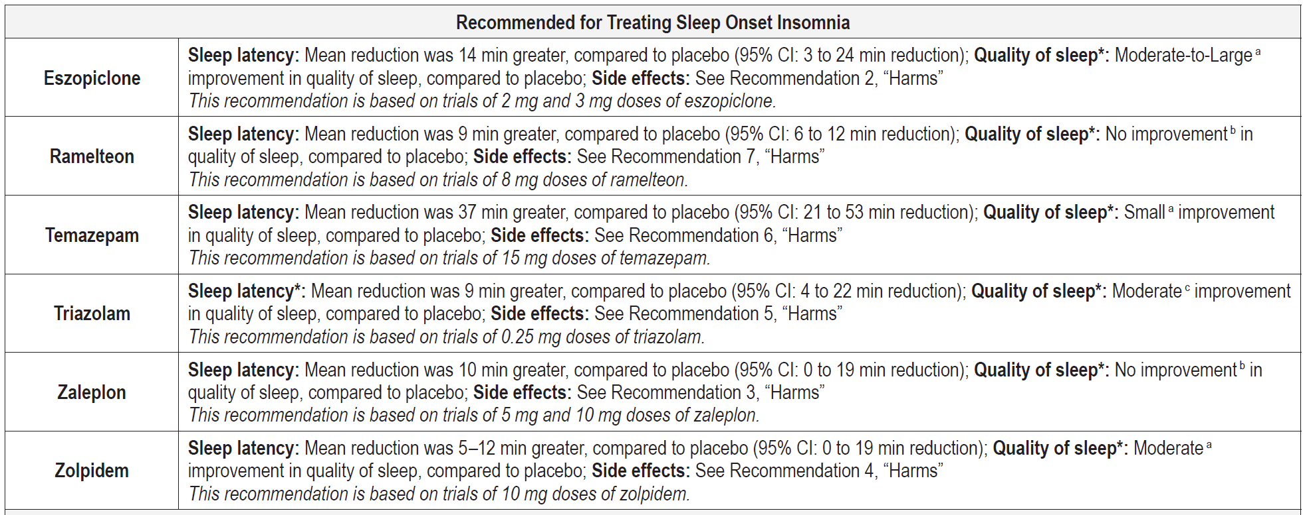
Medication Recommendations
Sateia et al., 2017
Table 5: Avoid total of > 3 CNS-active drugs. Increased risk of falls and of fracture in drug classes benzodiazepines and non- benzodiazepine Z drugs, benzodiazepine receptor agonist hypnotics) JAGS, 2019
Notes:
Te/Tr are benzodiazepines
E/Z/Z are benzo receptor agonists
Ram: melatonin agonist

Slide 49
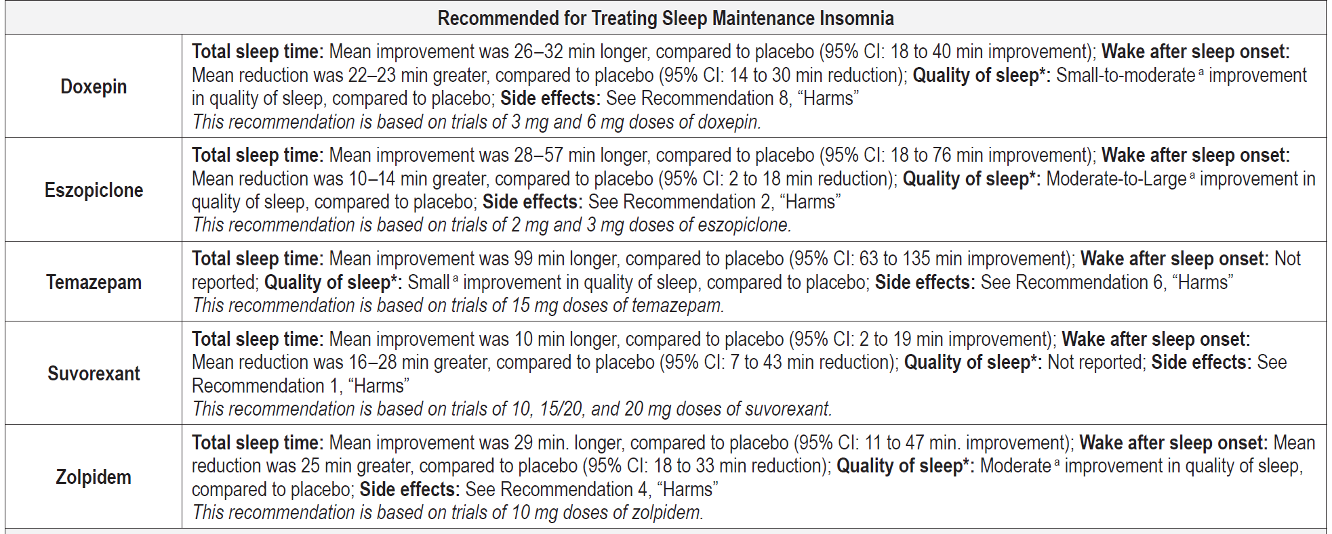
Medication Recommendations
Sateia et al., 2017
Table 5: Avoid total of > 3 CNS-active drugs. Increased risk of falls and of fracture in drug classes benzodiazepines and non- benzodiazepine Z drugs, benzodiazepine receptor agonists

Slide 50
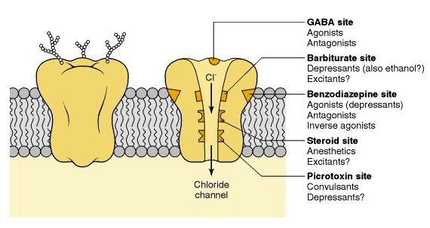
GABAA Benzodiazepine-Chloride Receptor Site
Olsen RW, DeLorey TM., Basic Neurochemistry, Molecular, Cellular and Medical Aspects. 6th ed., 1999

Slide 51
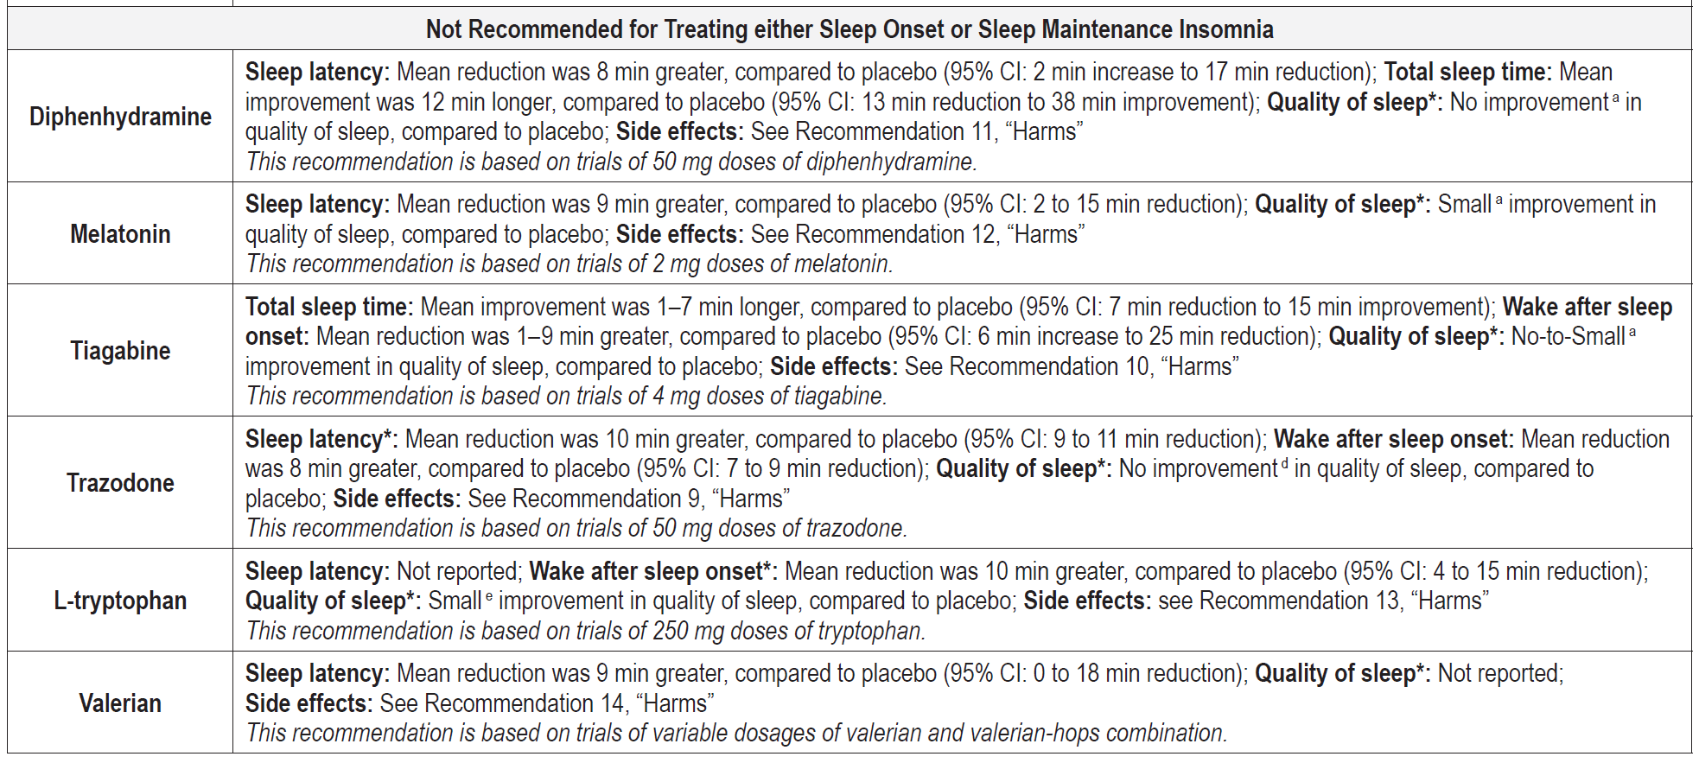
Medication Recommendations
Sateia et al., 2017
Table 5: Anticholinergic- Increased risk of cognitive decline. Avoid/minimize number of anticholinergic drugs. JAGS, 2019

Slide 52
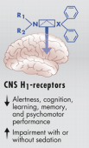
What about antihistamines?
Diphenhydramine (Benadryl)
Hydroxyzine (Atarax, Vistaril)
Potential adverse effects: First (old)–generation H1-antihistamines cross the BBB and occupy CNS H1-receptors, as documented by means of PET. High H1-receptor occupancy correlates directly with impairment of CNS function, with or without accompanying sedation
Avoid strong anticholinergics in the older adult
Simons, ER & Simons, KJ. J Allergy Clin Immunol, Vol 128, No 6, Dec 2011

Slide 53
Circadian Rhythm Sleep Disorders
Body Clock regulated by two processes:
      Homeostatic sleep drive
      Endogenous 24 hour circadian pacemaker
Sleeping at wrong circadian phase
      Self-induced, environmentally induced, intrinsic disorder
Advanced Sleep Phase Disorder: “Larks”
      Seen more often in older adults than younger population
Delayed Sleep Phase Disorder: “Owls”
Jet Lag
Shift Work Sleep Disorder (SWSD)
      Insomnia or excessive sleepiness

Slide 54
Circadian Rhythm Treatment
Timed exposure to bright light (>4000 lux) to move the body clock
  Dosed at sensitive times of the Phase Response Curve
Melatonin taken to entrain sleep schedule
  Not a “sleeping pill”
  Should be taken at the same time every night
  Can have side effects; prescribe at lower doses (5 mg or less)
Other timing cues to enforce rhythm
  Exercise, meals
Wake-promoting agents for alertness
  Provigil (modafinil)-available as generic; Nuvigil (armodafinil)

Slide 55
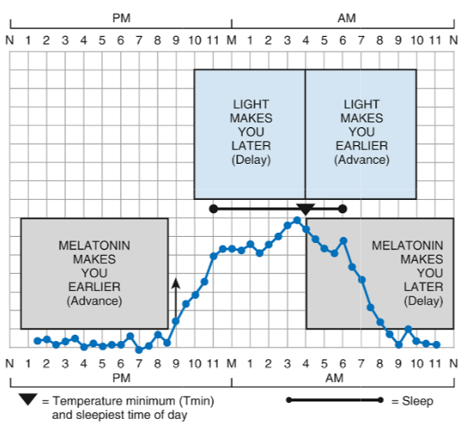
Phase Response Curve (PRC)
The phase-shifting effect of light and melatonin on the human circadian clock
Revell & Eastman, 2014

Slide 56
Post Question # 1
Which primary sleep disorders increase with age?
        A. Obstructive Sleep Apnea (OSA)
        B. Delayed Sleep Phase Syndrome (DSPS)
        C. Narcolepsy
        D. Periodic Limb Movement Disorder (PLMD)

Slide 57
Post Question # 2
Common side effects of sedative hypnotics used to treat insomnia include:
      A. Weight gain
      B. Memory impairment
      C. Increased falls
      D. Increased urination

Slide 58
Post Question # 3
According to current Beers Criteria, what classification of medications should be avoided to treat insomnia in older adults?
      A. Anticholinergics
      B. Melatonin agonists
      C. Benzodiazepines
      D. Antidepressants

Slide 59
References
American Academy of Sleep Medicine. International classification of sleep disorders, 3rd ed. Darien, IL: American Academy of Sleep Medicine, 2014.
American Academy of Sleep Medicine. Cognitive behavioral therapy. 2018; http://sleepeducation.org/treatment-therapy/cognitive-behavioral-therapy
American Geriatrics Society. 2019 Updated AGS Beers criteria for potentially inappropriate medication use in older adults. JAGS. 2019; 67(4),:674-694.
Aurora RN, Kristo DA, Bista SR, et al. The treatment of restless legs syndrome and periodic limb movement disorder in adults – an update for 2012: Practice parameters with an evidence-based systematic review and meta-analyses. SLEEP. 2012;35(8):1039-1062.
Bathgate CJ, Edinger JD, Wyatt JK, et al. Objective but not subjective short sleep duration associated with increased risk for hypertension in individuals with insomnia. SLEEP. 2016;39(5):1037-1045.
Bertisch SM, Pollock BD, Mittleman MA, et al. Insomnia with objective short sleep duration and risk of incident cardiovascular disease and all-cause mortality: Sleep heart health study. SLEEPJ. 2018;41(6):1-9.
DiBonaventura M, Richard L, Kumar M, et al. The association between insomnia and insomnia treatment side effects on health status, work productivity, and healthcare resource use. PLoSOne. 2015. doi: 10.1371/journal.pone.0137117
Epstein LJ, Kristo D, Strollo PJ, Jr., et al. Clinical guideline for the evaluation, management and long-term care of obstructive sleep apnea in adults. J Clin Sleep Med. 2009;5(3):263-276.
Garcia-Borreguero D, Kohnen R, Silber MH, et al. The long-term treatment of restless legs syndrome/Willis-Ekbom disease: evidence based guidelines and clinical consensus best practice guidance: A report from the International Restless Legs Syndrome Study Group. Sleep Med. 2013;14:675-684.

Slide 60
References
Littner MR, Kushida C, Wise M, et al. Practice parameters for clinical use of the multiple sleep latency test and the maintenance of wakefulness test. SLEEP. 2005;28(1):113-121.
Morgenthaler TI, Kapur VK, Brown TM, et al. Practice parameters for the treatment of narcolepsy and other hypersomnias of central origin. SLEEP. 2007;30(12):1705-1711.
Sateia MJ, Buysse DJ, Krystal AD, et al. Clinical practice guideline for the pharmacologic treatment of chronic insomnia in adults: An American Academy of Sleep Medicine clinical practice guideline. J Clin Sleep Med. 2017;13(2):307-349.
Schutte-Rodin S, Broch L, Buysse D, et al. Clinical guideline for the evaluation and management of chronic insomnia in adults. J Clin Sleep Med. 2008;4(5):487-504.
Sharon D, Allen RP, Martinez-Martin P, et al. Validation of the self-administered version of the international restless legs syndrome study group severity rating scale – The sIRLS. Sleep Med. 2019;54:94-100.
Smith MT, McCrea CS, Cheung J, et al. Use of actigraphy for the evaluation of sleep disorders and circadian rhythm sleep-wake disorders: An American Academy of Sleep Medicine clinical practice guideline. J Clin Sleep Med. 2018;14(7): 1231-1237.
Woznica AA, Carney CE, Kuo JR, et al. The insomnia and suicide link: Toward an enhanced understanding of this relationship. Sleep Med Rev. 2015;22:37-46.

