Slide 1

Management of Adolescent
Female Athlete Injuries
Tracye Lawyer, MD, PhD
Orthopedic Sports Medicine Surgeon
October 18, 2019

Slide 2
Disclosures
I, Tracye Lawyer, DO NOT have a financial interest/arrangement or affiliation with one or more organizations that could be perceived as a real or apparent conflict of interest in the context of the subject of this presentation

Slide 3
Learning Objectives
1. To learn how to manage common adolescent female athletic injuries
2. To evaluate, examine and counsel patients with these types of injuries
3. To interpret and order appropriate imaging for diagnostic purposes
4. To understand when to initiate physical therapy and when to send to specialist for operative management

Slide 4
Outline
Joint Hypermobility
Multi-directional Shoulder Instability (MDI)
Osteochondritis Dissecans of the capitellum(OCD)
Anterior Cruciate Ligament (ACL) Injuries
Patellar instability
Stress fractures
Female Athlete Triad

Slide 5
Joint Hypermobility Syndrome (JHS)

Slide 6
Joint Hypermobility Syndrome
Heritable disorder of connective tissue that comprises symptomatic hypermobility predisposing to joint pain, soft tissue injury and joint instability
Generalized hyperlaxity is caused by increased length and elasticity of the normal joint restraints → allows greater degree of translation of the articular surfaces
Instability develops only if the normal joint restraints fail to maintain mechanical stability
Joint hypermobility syndrome can be a part of many different connective tissue disorders
  Ehlers-Danlos syndrome (EDS hypermobile type) ,Marfan syndrome

Slide 7
Joint Hypermobility Syndrome
Adolescents with hypermobility are 2x likely to experience MSK pain vs non-hypermobile peers
Frequently missed during routine clinic visits
High prevalence rates with specific sports (ballet, gymnastics, swimming and musicians
Diagnosis is largely clinical and can be established in the primary care setting
Cause of chronic pain but also patients present with headaches, anxiety, GI and GU complaints

Slide 8
Presentation
Generalized Joint Hypermobility
  Beighton score
Joint dislocations/subluxations
Skin
  Hyperextensible
Hypotonia
Scoliosis
Opthalmologic
  Blue sclera (OI)
Cardiac
  Mitral valve Prolapse, aortic root dilation (Marfan’s)
Family History

Slide 9
Beighton Score
1. Bending small finger back further than 90 degrees (1 point each side)
2. Bending your thumb forward to touch your forearm (1 point each side)
3. Hyper-extending your elbows and knees(1 point each joint, each side)
4. Putting your palms flat on the floor without bending your knees (1 point)

Slide 10
Types of hyperlaxity
Congenital
Acquired
Young females
Diminishes after skeletal maturity
Seen in EDS, Marfan, OI
Suspected collagen abnormality refer for genetic counseling
Repetitive use during training
Stretch of the normal capsulo-ligamentous restraints

Slide 11
Shoulder Multi-Directional Instability (MDI)

Slide 12
Shoulder Multi-Directional Instability
Symptomatic subluxation/dislocation occurring in two or three directions
Repetitive micro-trauma imposed on a congenitally lax and redundant joint capsule
Determine laxity versus instability
Most symptoms are midrange positions of glenohumeral during ADLs
Higher incidence of MDI in overhead athletes, especially swimmers and gymnasts

Slide 13
Anatomy
IGHL functions as a hammock
Patulous inferior recess attached to the diminutive labrum
Glenohumeral ligaments tighten only after significant rotation of the joint or translation of the humeral head

Slide 14
Classification
TUBS
AMBRI
Traumatic
Unidirectional
Bankart
Surgery
Atraumatic
Multidirectional
Bilateral
Rehabilitation Program
Inferior capsule

Slide 15
History
Atraumatic instability may occur during ADLs
  Reaching overhead, sleeping, grooming
Can also occur during sporting activities ( swimming strokes, weight-lifting)
Careful history for recurrent instability in other joints or family history
Do not normally require manual reduction
Numbness in hand carrying heavy objects
  Suggests inferior subluxation
Poorer outcomes with voluntary components, seizures and other psychological conditions

Slide 16
Physical Exam
Always begin with cervical spine and scapular exam
Apprehension test, relocation test, load and shift
Sulcus sign
Gagey Test/Hyperabduction test
  Past 105 degrees – inferior laxity

Slide 17
Load and Shift
Grade 1 translation
  To glenoid rim
Grade 2
  Over the glenoid rim with spontaneous reduction
Grade 3
  Anterior or posterior dislocation without spontaneous reduction

Slide 18
Scapular Winging
Medial Scapular Winging
Lateral Scapular Winging
Dysfunction of the serratus anterior (long thoracic nerve)
Young athletic patient
More common than lateral
Dysfunction of the trapezius (Spinal accessory nerve)
Usually iatrogenic ( history of neck surgery)

Slide 19
Imaging
Plain radiographs:
  AP, Scap Y, axillary view, west point view, velpeau
MRI:
  Patulous capsule
  Increased glenohumeral volume and labral abnormalities
CT scan helpful but MRI can accurately assess glenoid bone loss
**Diagnosis of MDI is based on history and physical exam

Slide 20
Treatment
First line of treatment: Physical therapy
  Good to excellent results for 80% - 90% patients with atraumatic instability
  At least 6 months PT
    Phase 1 - resistance exercises to strengthen the RC and deltoid, then add scapula-stabilizing exercises
    Phase 2 – retrain humeroscapular coordination and awareness
  Goal – regain strength and neuromotor coordination of the stabilizing muscles of the RC, deltoid and scapula
  May not fully restore stability or provide complete pain relief for some patients

Slide 21
Treatment
Operative: traditional treatment of MDI of the shoulder → open capsular shift
  Recurrence rate 26%
  RTS 75%
Arthroscopic
  Thermal capsulorrhaphy (thermal-induced chondrolysis) no longer recommended
  Capsulorraphy, closure rotator interval (controversial), address anterior, inferior and posterior capsule redundancy
  Outcomes after arthroscopic treatment are equivalent to open procedures

Slide 22
Osteochondritis Dissecans (OCD) of the Capitellum

Slide 23
OCD Capitellum
Inflammatory condition of bone and cartilage resulting in localized necrosis and fragmentation of bone and cartilage
Capitellum is the most common area affected
  Can occur in the trochlea and olecranon
Most commonly affects young athletes engaged in sports that repetitively stress the elbow (valgus compressive load)
  Gymnastics, Baseball

Slide 24
Clinical Presentation and History
Primarily disorder of the young athlete
12-14 years old
High prevalence in young female gymnasts and competitive cheerleaders
History of overuse, pain that increases with increased activity, loss of motion, swelling lateral side of the elbow
Popping, clicking, giving away with load bearing

Slide 25
Physical Exam
Pain, tenderness and swelling over the lateral aspect of the elbow
Loss of extension
Catching and locking in later stages
Valgus extension overload test
  Valgus load with full extension

Slide 26
Imaging
Radiographs: ( PA and lateral )
  Radiolucency in the central aspect of the capitellum
MRI:
  Gold standard to evaluate these lesions
  Want to look at: extent of bony involvement, integrity of overlying cartilage cap, loose bodies
***Lesions along the lateral column are much more severe that may require more extensive surgery

Slide 27
Staging
  Grade I
    Cystic shadow lateral or middle of capitellum
  Grade II
    Clear zone between the lesion and the adjacent subchondral bone
  Grade III
    Loose bodies present

Slide 28
Treatment
Non-operative Treatment:
  Rest, cessation of aggravating activities until symptoms resolve, splinting
Restriction is continued until symptoms resolve (up to 12 weeks)
50% of stable OCD lesions will fail to heal with non-operative treatment
Critical determinant: intact cartilage cap
  Operative or consultation with orthopedic surgeon if cartilage cap disrupted

Slide 29
Operative Management
Operative
  OCD lesions that do not respond to conservative management
  Unstable OCD lesion
  Loose bodies
Elbow arthroscopy, debridement of lesion, removal loose bodies, microfracture
  ORIF, OATS, Retrograde drilling

Slide 30
Patellar Instability

Slide 31
Epidemiology
Most common knee problem during growth
Most dislocations are lateral
  Medial dislocations are usually iatrogenic due to extensive lateral retinacular release
Occur more frequently in children with connective soft tissue disorders or hypermobility syndromes
Patients with prior instability episodes are 7 times more likely to have a recurrence

Slide 32
Anatomy (Bony)
At 20 and 30 degrees flexion, patellar articular surfaces is most constrained in the walls of the trochlear groove
Patella Alta
  Abnormal engagement with the trochlear groove during knee flexion
Trochlear dysplasia can predispose to patellar instability
  96% of patients with patellar dislocations had some degree of trochlear dysplasia
Patellar dysplasia is another pathologic factor that may play role in patellar instability

Slide 33
Anatomy (soft tissue)
Patella tendon and quadriceps tendon pulls patella laterally
Lateral retinaculum – 3 layers
  IT band medial fascial extensions
  Lateral patellofemoral band
  Knee capsule
MPFL (medial patellofemoral ligament)
  Counteracts patellar lateralization and instability
MQTFL(medial quadriceps tendon femoral ligament)
  Static constraint

Slide 34
History and Exam
Patellar dislocations usually occur during sporting activities
  Very similar to ACL
Increased lateral translation manually
Gait analysis
  Quadriceps avoiding gait, increased foot plantar-flexion + knee extension
Bassett sign
  TTP over the medial femoral condyle at MPFL attachment
J sign

Slide 35
Imaging
Plain Radiographs
  Standard 4-view + standing alignment
Lateral
  Patellar height
Merchant view
  Patella shape, tilt, sulcus angle

Slide 36
Patellar Height
Insall-Salvati Index
Blackburn-Peel ratio
Caton-Deschamps

Slide 37
Trochlear Dysplasia
Type A
  Shallow sulcus
Type B
  Flat, horizontally trochlear surface
Type C
  Flat, obliquely oriented trochlear surface
Type D
  Same as type C with prominent bone protrusion

Slide 38
Tibial Tubercle to Trochlear Groove (TT-TG)
CT/MRI – defining baseline anatomy, preoperative planning
TT-TG replaced Q angle for assessing lateralization of the TT
20 mm threshold (15-20 normal)
MRI reported to underestimate TT-TG

Slide 39
Treatment
Non-operative
  Gold standard after primary patellar dislocation without osteochondral fragments
First time patellar dislocation
  Conservative management best strategy
  Except with significant mal-tracking factors and/or osteochondral fractures
Bracing, PT
Risk factors
  Positive family hx, CL patella instability, highest risk with trochlea dysplasia
3-4 months PT recommended – resolve pain and swelling, restore motion, muscle strength, prevent further episodes of instability

Slide 40
Operative Treatment
Operative management for failed conservative treatment
Operative consideration: repeated giving away can cause cartilaginous lesions
Goal of surgery: restore patellar tracking consider bony and soft tissue constraints
MPFL reconstruction versus repair +/- other procedures (TTO, trochleoplasty, MQTFL)

Slide 41
Anterior Cruciate Ligament (ACL) Injuries

Slide 42
ACL Injuries
ACL injuries rare in children < 12 years but can happen
  Presumably ligaments are stronger than bones and growth plates
  Skeletally immature children are more likely to sustain a fracture
ACL injury rates for girls peaks during adolescence then declines in early adulthood
Highest number of ACL injuries is female athletes 15-19 years old
Girls HS sports associated with the highest rates of ACL injuries are:
  Soccer > basketball > gymnastics
Female adolescent athletes have the greatest risk of ACL injuries, 4-6x as high as their male counterparts

Slide 43
ACL Injuries
Consequences of an ACL injury
  Short term:
    Pain, disability during the treatment phase (surgery + 6-9 months of rehab)
    Can affect academic performance (36% athletes in 6th-12th grade were noted to fail an exam during the school year)
    Girls were more likely to have surgery and less likely to return to sports after an ACL injury
  Long term:
    Can limit future participation in physical activity
    Athletes with ACL injury are 10-fold higher risk of developing early-onset degenerative knee OA compared to non-injured population (even if ACL is reconstructed)

Slide 44
Risk Factors
ACL injury is more common in females due to
  Landing biomechanics
    Conditioning and strength play the biggest role
    Females land with their knees in more extension and valgus due to hip IR
  Smaller notches
  Smaller ACL size
  Cyclic hormonal levels
    ACL at greater risk for injury during the first half of the menstrual cycle
  Leg alignment
  Genetic predisposition
    Underrepresentation of CC genotype of a COL5A1 gene sequence in female with ACL ruptures

Slide 45
Mechanism
Approximately 80% of ACL tears are non-contact
Dynamic valgus position → Hip IR and adduction, tibial ER and foot eversion
Poor control of the center of mass
Highest strain on the ACL occurs during isolated quadriceps contraction with the knee relatively straight

Slide 46
History
Non-contact injury
Audible pop
Rapid hemarthrosis
Unable to return to play initially
Some continue playing when swelling resolves but complain of instability
Seen in clinic usually with severe pain or locking due to cartilage or meniscal injury

Slide 47
Physical Exam
Always compare to the other side
Palpation
  Patella, joint line, tuberosity
Range of motion
Lachman, Anterior drawer, Pivot shift if patient relaxed
McMurray’s
Varus/valgus stress
Posterior drawer
Dial test

Slide 48
Imaging
Plain radiographs
  Rule out fractures, avulsion type injuries
CT scan
  Define avulsion type injuries
MRI
  Gold standard to diagnose ACL
  Must look at other injuries

Slide 49
Treatment
Non-operative
  Partial ACL tears, < 50% of fibers torn
  PT
  If any instability events → move to operative treatment
Operative
  Complete ACL tear
  Inability to participate in their sport
  Instability that affects daily living
  Associated chondral or meniscal injury

Slide 50
Prevention
Goal of Neuromuscular training programs
  Strengthen hamstrings and core muscles
  Improve balance
  Recognize and avoid dynamic knee valgus
Key components of most effective prevention programs
  Progressive strengthening for the core and LE
  Plyometrics
  Feedback-driven technique modification

Slide 51
Stress Fractures

Slide 52
Stress Fractures
Common overuse injuries in athletes
Typically affects lower extremity (most common in the tibia)
Female athletes sustain stress fractures of the femoral neck, metatarsals and pelvis more frequently than male counterparts
Most commonly seen in runners
  20% incidence in competitive track and field athletes
Tibia, fibula and tarsals
  Runners, soccer players, ballet dancers
Humerus, olecranon
  Throwers

Slide 53
Pathophysiology
Bone is dynamic tissue that responds to external forces with adaptive remodeling
Stress-induced injury to bone occurs when the loads placed on the bone exceeds its capacity for repair
Stress reaction (micro-architectural damage) → Stress Fracture (Cortical disruption)
Pathogenesis likely multifactorial
  Mechanical, hormonal, nutritional and genetic factors
Training errors
  High mileage, high intensity, change in training program

Slide 54
Diagnosis
Should be made in timely fashion to avoid disastrous complications
  Displaced femoral neck, tibia fracture, collapsed navicular
History
  Gradual onset of activity-related pain
  Ache that resolves with rest
  More severe cases → pain with walking or even at rest
What you should ask:
  Athlete’s training pattern
  Previous history of stress fractures
  Nutritional history
  Menstrual history
  Goals and upcoming competitions

Slide 55
Exam
Gait
Focal tenderness, swelling, erythema
Fulcrum test – femoral stress fractures
ROM hip – femoral neck stress fractures
Hop test
Look at limb length, muscle mass, foot alignment, flexibility

Slide 56
Imaging
Plain radiographs
  Periosteal bone reaction, cortical lucency, callus formation, fracture line
  Only 50% of stress fractures will ever be evident on plain radiographs

Slide 57
Imaging
Bone scan (Technetium-99 diphosphonate)
  100% sensitive in diagnosing stress fractures
  Changes present within 48-72 hours after onset of symptoms
  Poor Specificity (improved with 3-phase scan)
    Stress factures positive in all three phases

Slide 58
Imaging
MRI
  Gold standard
  Better specificity vs bone scan
  STIR images positive early, then T2, then T1

Slide 59
Treatment
Non-operative
  Treatment for majority stress fractures
  Avoid aggravating activity
  NSAIDS and ice
  No U/S - can cause pain at the site
  If athletes are symptomatic with walking or at rest → protected weight-bearing
  Most Stress fractures heal in 6-8 weeks
  Can continue activities such as stretching, swimming, cycling
  Resume Sports gradually when pain-free and non-tender
  Radiographs not necessary to establish healing

Slide 60
Treatment
Operative
  Surgical treatment rarely required
  Displacement of fracture indication for surgery

Slide 61
Prevention
Athlete’s footwear, running surface, training programs and overtraining
Encourage cross train and strength training (increased muscle mass decrease risk of stress fractures)
Females:
  Screen for eating disorders
  Menstrual abnormalities
  Calcium 1500 mg, 400-800 IU Vit D
  Oral contraceptive – may decrease stress fractures

Slide 62
Female Athlete Triad

Slide 63
Female athlete triad
1. Amenorrhea
2. Insufficient energy availability
3. Osteoporosis/BMD

Slide 64
Amenorrhea
Resulting in energy imbalance, low body fat, and hypothalamic-pituitary axis changes
Secondary amenorrhea (cessation for 6 months) often caused by hormonal disturbances
  Lose bone mass that may be permanent
Incidence in elite runners is nearly 50%
Leads to bone demineralization and stress fractures

Slide 65
Insufficient energy availability
Insufficient caloric intake
  Most common cause of amenorrhea in female athletes
May or may not be associated with an eating disorder

Slide 66
Osteoporosis
Osteoporosis and decreased BMD have been implicated in the development of stress fractures in female athletes
Obtain DEXA scan in female athletes with history of amenorrhea and stress fractures

Slide 67
Treatment
Multidisciplinary approach
Psychological counseling
  Education and counseling for eating behaviors
Dietary management
  Establish an energy balance
  Increase calcium and vitamin D in diet
  Labs: cbc, chemistry, vit D, TSH, LH, FSH, pregnancy test
Reduced training intensity and cross-training
  Decrease risk of stress fractures
Oral contraceptive pills
  Beneficial in treating amenorrhea

Slide 68
References

Slide 69
References
Schenk et al. Shoulder Multidirectional Instability. JAAOS 1998
Savoie F. Osteochondritis Dissecans of the Elbow, 2006. Oper tech sports medicine
Nelson BJ and Arciero RA. Stress Fractures in the Female Athlete. Sports Medicine and Arthroscopy Review. 10:83-90 2002
Bing Y. Et al. ACL Injuries in Female Athletes: Anatomy, Physiology and Motor Control. Sports Med and Arthroscopy Review
Renstrom P. et al. Non-contact ACL injuries in female athletes. Br J Sports Med. 2008;42(6):394-412
Hewett TE. Et al. The effect of neuromuscular training on the incidence of knee injury in female athletes. A prospective study. Am J Sports Med. 1999;27(6)699-706

Slide 70
References
Hewett TE. ACL injuries in female athletes: part 1, mechanisms and risk factors. AM J Sports Med. 2006;34(2) 299-311
Myer GD et al. The influence of age on the effectiveness of neuromuscular training to reduce ACL injury in female athletes. AM J Sports Med. 2013;41(1)203-215.
Pediatric ACL injuries: A Review of Current Concepts. Open orthopedic Journal 2017. 11: 378-388
Khormaee S. et al. Evaluation and Management of Patellar Instability in Pediatric and Adolescent Athletes. Sports Health 7(2) 2014
Milewski et al. Pediatric and Adolescent Shoulder Instability. Clinics in Sports Medicine. 32: 761-779. 2013

Slide 71
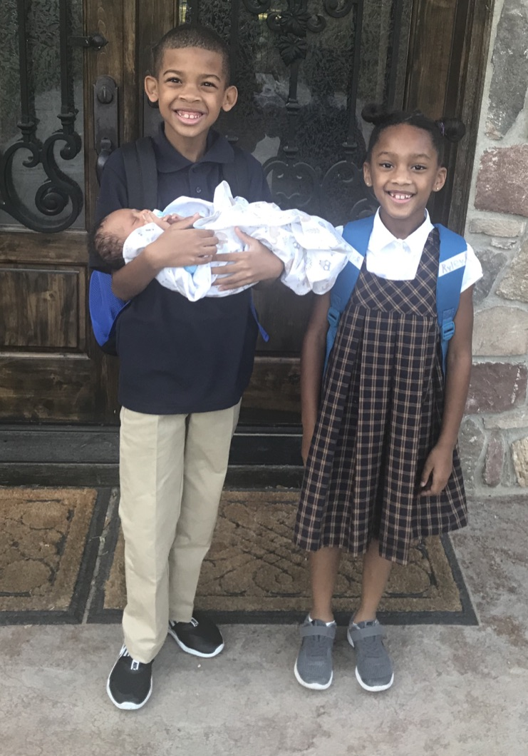
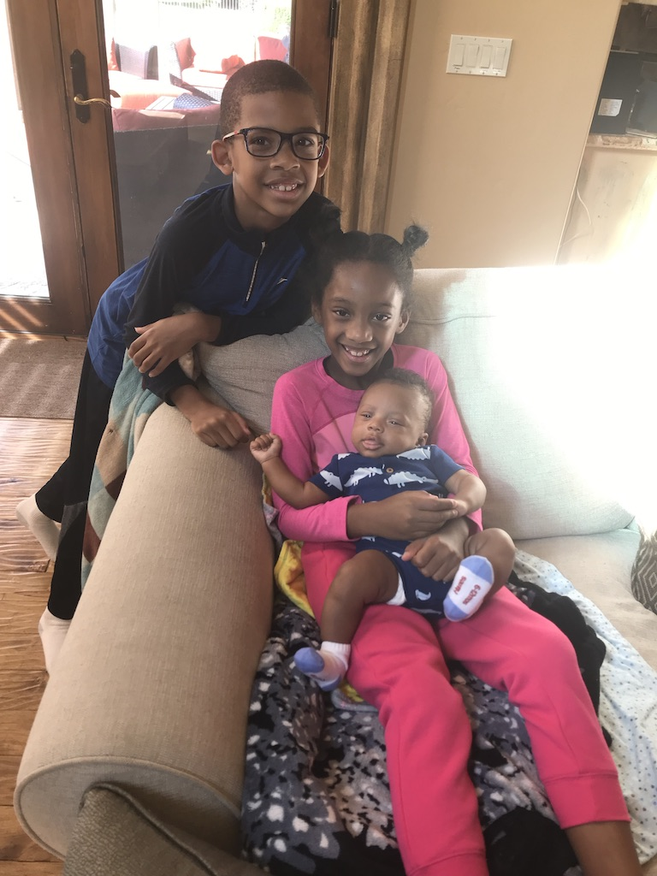
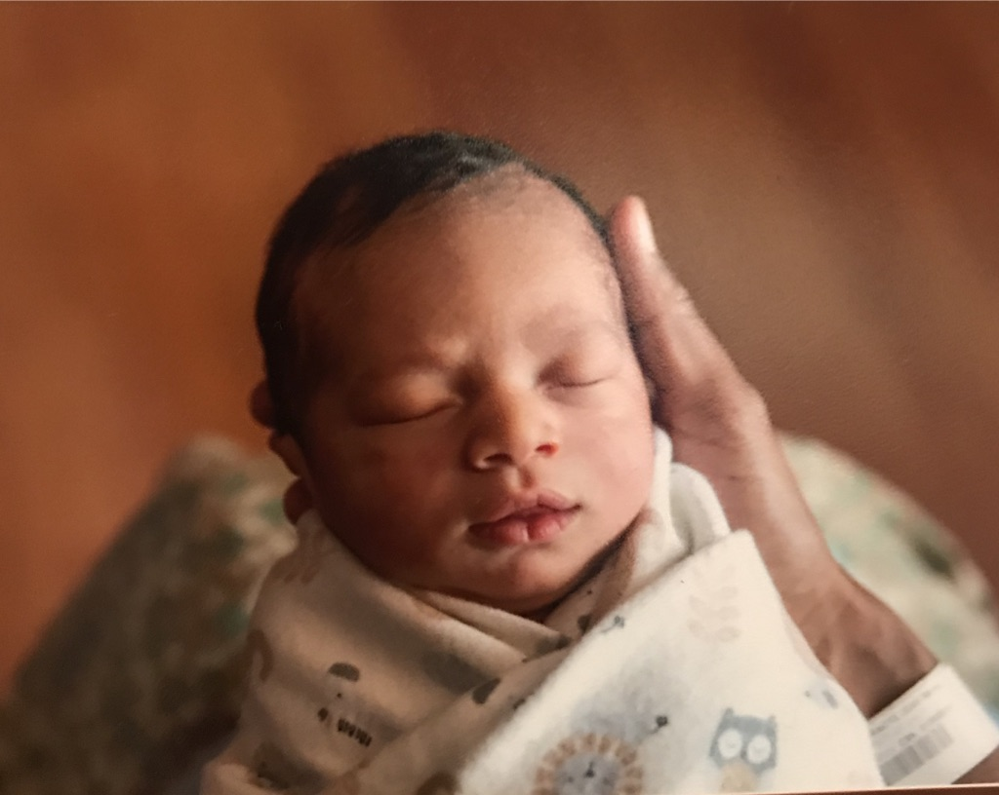
Thank you
Contact: traylaw@gmail.com

