Slide 1
Human Trafficking: Identifying and Supporting Survivors in the Clinical Setting
Stacia M. Hays, DNP, CPNP-PC, CCTC, CNE
Clinical Assistant Professor
NAPNAP Gulf Coast and Florida Chapters 9th Annual Development in Pediatric Health Care
November 3, 2018
Adapted with permission from Dr. Jessica Peck
Notes:
I’ve been working with Natl Assoc Ped NP (NAPNAP, isn’t that a catchy name?). Last year we launched a tax exempt charitable org, NAPNAP Partners for Vulnerable Youth and the first initiative is the Alliance for Care Coordination of Children in Human Trafficking. Our charge is to educate those who come in contact with children in any setting, including clinicians, case manager, teachers, day care workers to identify suspected victims and situations, including fishy stories.
Why should you care? It doesn’t happen in my backyard, in my neighborhood, I live in a great subdivision..
As we get started I want you to think back to a couple of months ago. The situation that was all over the news, FB. About the 5 year old selling water to raise money for a trip….we will come back to that at the end of the talk.

Slide 2
Disclosures
I have no relevant financial disclosures to make.
I have no conflicts of interest to disclose.

Slide 3
Learning Objectives
Identify potential signs of human trafficking in victims who present for care in a clinical setting.
Summarize immediate health care needs of identified victims.
Integrate multi-disciplinary care models to aid in victim recovery.
Discover available resources for victim rescue and after-care.
Recognize the role of healthcare providers in the screening, assessment, and referral for suspected and identified victims.
Notes:
What I am going to do is start with talking about trafficking, what it is, etc. then get into what to look for.
Available resources, including reporting hotlines, how to give victims information for when they are ready for help.

Slide 4
Human Trafficking
Raising Awareness To Identify Victims
In The Clinical Setting
Notes:
If you think HT doesn’t affect your or that you won’t encounter it because of where you live or work, I’m sorry to say that you are mistaken. If you look at the statistics, traffickers live in your neighborhood, and could be the mother of your daughter’s friend. Florida is ranked #3 in HT, behind Calif and Tx. There is a rapid rise in cases of young adults. Every county in the state of Florida has had at least one HT situation, either sex trafficking or labor trafficking. I had thought the same thing, but I was wrong. In my practice as a pediatric nurse practitioner I wasn’t seeing the victims in front of me. Now that I have taken a much deeper dive into this modern day slavery, I see signs everywhere. AND, I thought back to 2 children I saw several years ago, that I now know were likely victims. I never, ever want to miss that again. My spidey sense is now quickly heightened based on signs and the stories I hear.
And, remember this: 84% of victims state they encountered some sort of HC professional within the year prior to rescue. They were not recognized as victims.

Slide 5
Notes:
So first I want to define what IS human trafficking. It is modern day slavery. Uses force Fraud or coercion. These are the most common, labor, sex, child soldiering, but also includes debt bondage where they are sold to pay a families debt

Slide 6
What is Human Trafficking?
Human trafficking is modern-day slavery and involves the use of force, fraud, or coercion to obtain some type of labor or commercial sex act.
Targets vulnerable people
Does not need to be across state or national lines
Not always kidnapping
Notes:
HT is not necessarily transfer of people over state lines. We tend to think of it as we do drug trafficking. HT trafficking involves force, fraud or coercion to lure their victims into labor or commercial sex exploitation. Traffickers look for people who are susceptible to exploitation-for a variety of reasons including psycho or emot vulnerability, such as runawayseconomic hardship, natural disasters, etc.
We like to think human trafficking involves kidnapping or taken by force, the child is stolen or woman taken by gunpoint. But that is the least common scenario. Typically persuasion and kindness are used to gain someone’s trust. Or, in the case of children, it is often someone they know including their parents or neighbors.

Slide 7
What is Human Trafficking?
30 million people in slavery
Illegal in every country
$150 billion annual market (ILO, 2012)
Fastest growing criminal industry
Notes:
HT is Exploitation of humans, which is treating someone unfairly in order to benefit from their work. It is the fastest growing industry in the world, coming in behind drugs and arm sales. 20% of victims are children, ¼ are men. Men are more commonly seen in labor trafficking, which makes sense, than sex trafficking, but sex trafficking of men does occur.
HT is the fasted growing commodity-it’s people and there are always people who are at risk, feel neglected and unloved, This is huge, 30 million people around the world are living in slavery. That is just an estimate, HT has been a hidden issue and is underreported-I’ll explain why in a few minutes.
This is a huge money making industry. Just to give you an idea, Starbucks earned $19 billion last year, HT made at least $32 billion. Victims can be sold over and over, bringing in over $300 thousand per year. Talk about motivation.

Slide 8
Impact of Human Trafficking
http://polarisproject.org/sites/default/files/2017NHTHStats%20%281%29.pdf

Slide 9
Notes:
Trafficking is worldwide, but in the US it most commonly seen in labor and sex trafficking. Labor trafficking occurs in all states. It’s easy to hide, if you think about where the fields are. They are in the middle of nowhere, away from towns, or other people. Sex trafficking is most commonly found in massage parlors, escort services, strip clubs, online ads. There is also sex tourism-this is in large metropolitan cities. It involves children and adults. In prostitution there is a fine line between someone’s choice, and HT. Right? Typically we hear about someone’s “pimp”. If they are forced to make money and then give it to their pimp for protection, food, living, drugs, that is now human trafficking

Slide 10
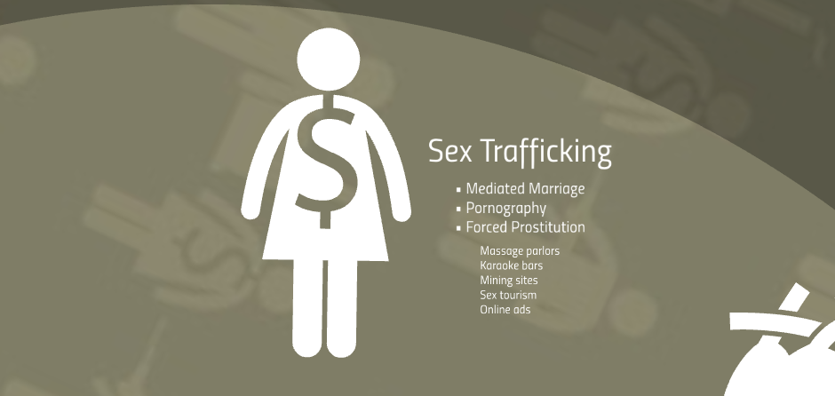
Notes:
Last year in Florida, there were over 1600 calls to the human trafficking hotline and over 600 cases were reported. The top venues for sex trafficking were hotel based and massage or spa businesses. These places have “stables’ where they keep the women. Backpage.com was recently removed but that was another avenue for sex traffickers to advertise their properties. Many of those were underage. October of sex trafficking ring last year in Lake worth-51 suspects arrested. Traffickers Ages ranged from 16-71 years

Slide 11
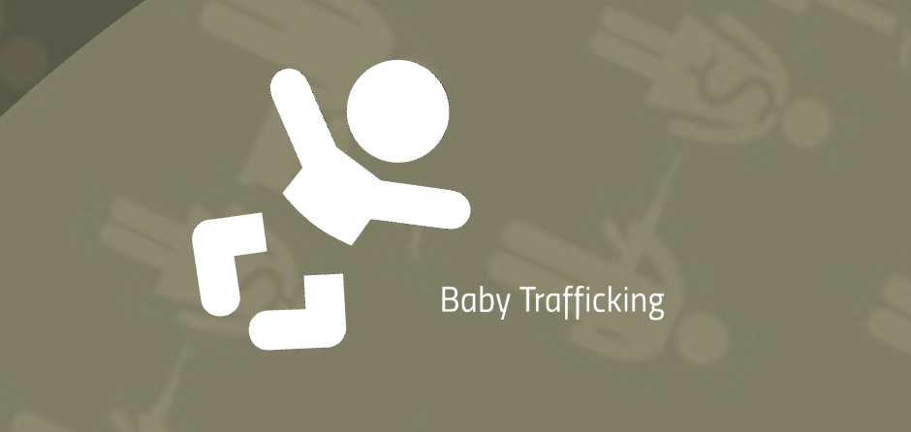
Notes:
In baby trafficking, babies are stolen, or women who are being trafficked for sex are forced to have babies so they can either be sold or used as leverage to keep her in line.

Slide 12
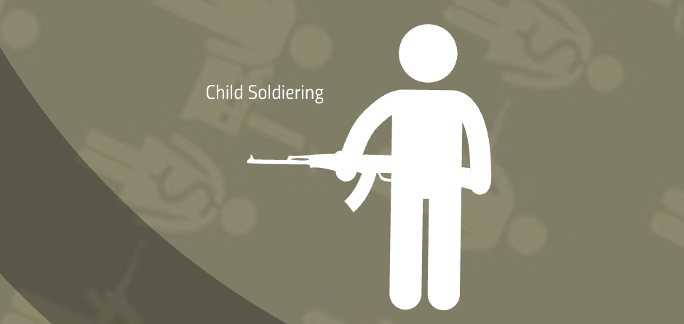
Notes:
We’ve all seen the photos on the news of children in the middle east carrying M-16. Those involved make the claim that the children “chose” to become part of this. It’s impossible, since they are involved in conflict that their brains, and emotionally are not able to understand.But I am certain there is force, fraud or coercion-what are the promising (fraud), what are they threatening (force or coercion) to entice them to join? If they need to fight to get food for them or their families, is that really a choice or is it force or coercion?

Slide 13
Notes:
That goes for organ harvesting. We like to think it is an Urban myth, but when you need to feed your family, you will do anything. And there are those willing to take advantage of a situation.

Slide 14
Notes:
Do not think they have another work option. In the US, most common areas are Work camps, domestic servitude. Measuring the scope of labor trafficking is so difficult. Not only are these victims isolated in the rural areas, but sex trafficking cases get more attention from law enforcement and the media. Believe it or not, most of the victims arrived in the US on legal visas. Visas are either taken away, or have expired. They then become “undocumented’ and so are afraid to report abuse to law enforcement. They are unfamiliar with the culture and that what is happening is illegal.
July of last year, south Fl prosecuted its first labor trafficking case. A father and son were the traffickers were contractors on tomato farms and used physical violence, threats of deportation, and withholding of papers to keep the workers enslaved. In south florida there is a rescue grant program that uses PSAs and other tools to reach the farm communities to inform them o ftheir rights and connect them to local antitrafficking services. One of these tools was a water bottle promoting the Human Trafficking Hotlin that was distributed to the fields. One of the workers called the hotline.

Slide 15
Labor Trafficking Stats
71% entered on lawful visas, paid average $6150 in recruitment fees
31% of undocumented, Spanish speaking migrant workers interviewed in San Diego County experienced labor trafficking
The U.S. Department of Labor has identified 136 goods from 74 countries made by forced and child labor.
Notes:
-Study in 2014

Slide 16
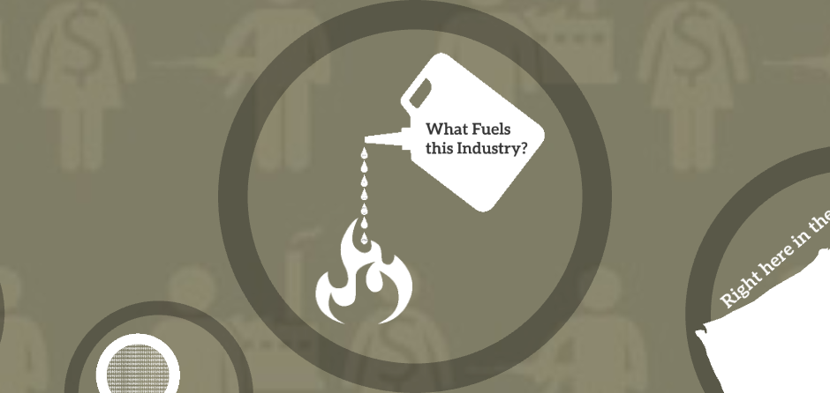
Notes:
What would be your guess as to what fuels the industry. $150 billlion worldwide

Slide 17
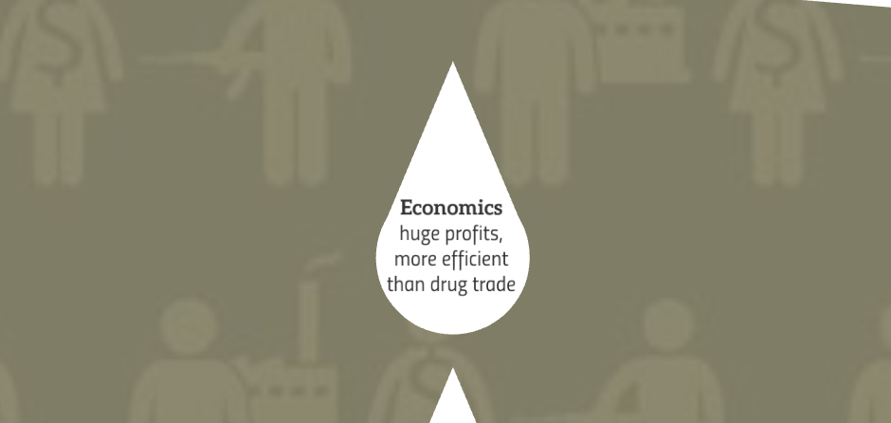
Notes:
Economics, including huge profits. As I said, one victim can earn over 300,000 per year. It is enticing to people who are economically disadvantaged, They enter prostitution to pay their bills, and before they know it, they have been forced or coerced into becoming a pimp’s slave

Slide 18
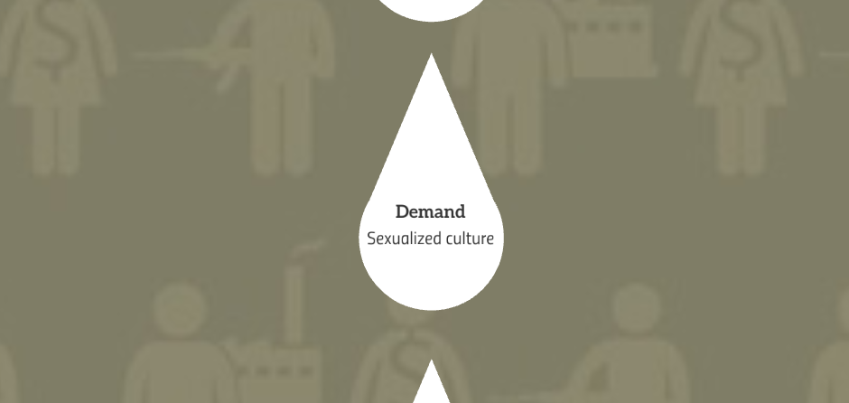
Notes:
Sex sells, sex makes money. Sex can be an addiction, if you think about how much is spent on gambling due to addictions, imagine sex. There is also a culture of tolerance, especially to the sex industry. There is also a bias towards people who may be undocumented or have those jobs that we don’t want to do, such as picking vegetables in a field in the 100% humidity during the florida summers.

Slide 19
Notes:
This Culture of Tolerance fuels the porn industry. 1 in 5 images online is of a minor. Science has demonstrated that porn feeds the region of the brain where addiction is located. What happens is you have to continue to feed it, just like a drug, and you need more stimulation for the same initial response. Eventually, there is “break in the flesh barrier” where just viewing is not enough, one needs to see and do it in person. There are lots of studies detailing how porn affects the brain.

Slide 20
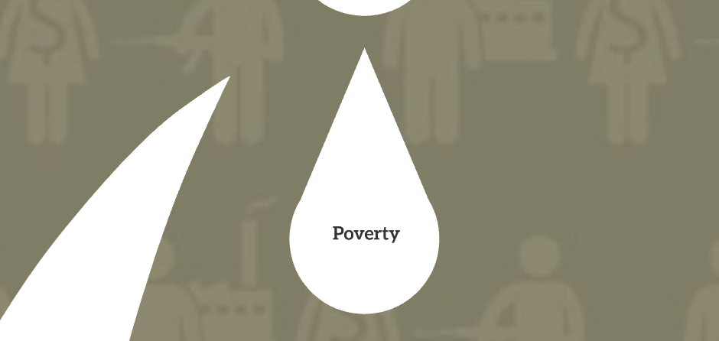
Notes:
Poverty is a major driving factor in both sex and labor trafficking. You need money, you need food, you need shelter, you will do whatever it takes. It may start with good intentions then be manipulated into serving someone else.

Slide 21
Notes:
We would like to think corruption is only in other countries, but in some states corruption of law enforcement occurs and they are paid off to look the other way. Last year, several police officers in DC were arrested for pimping young girls, and one officer has been sentenced to 7 years. One of the officers met a girl at the mall, asked her if she wanted to be a model and took her back to his apartment. There is also fear of deportation, even with legal visas. People who come here often do not know the system or culture and think it is where they came from. So there are afraid

Slide 22
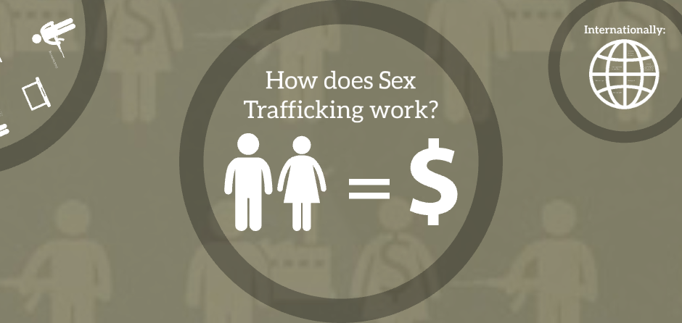

Slide 23
Trafficking Definition
The recruitment, harboring, transportation, provision, or obtaining of a person for labor or services through the use of force, fraud or coercion for the purpose of insubjection to involuntary servitude, peonage, debt bondage or slavery.
Sex trafficking involves commercial sex acts through same means.
Under the age of 18 years, do not need to prove force, fraud or coercion.
Notes:
The US definition of human trafficking. In most states force, fraud and coercion is not required for the def of trafficking of a minor. If someone is making money from sex or labor of a minor, that is trafficking. Children, yes teens too , are not developed emotionally and intellectually enough to make informed decisions. Think about the teenagers you know. What kind of dumb decisions do they make? This is why there is no such thing as a “child prostitute”. A child cannot make the conscious decision to sell their body for money.

Slide 24
Main Players
Trafficker =
a person who exploits another human being for their own financial gain
What is the difference between a pimp and a trafficker?
Notes:
Traffickers can be anyone, anyone. I’ll tell you a story in a minute

Slide 25
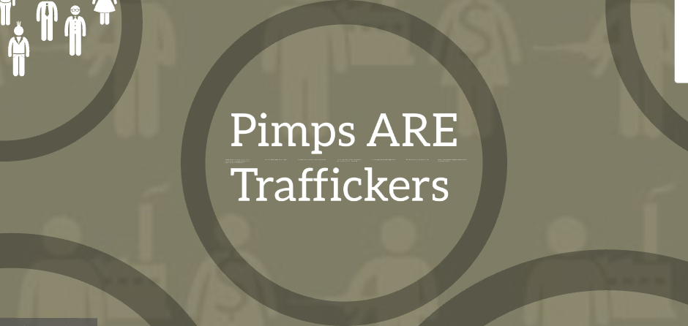

Slide 26
Notes:
In order to combat human trafficking we have to get rid of the glamorization of pimps. We like to think about how Hollywood has made it so appealing: “Pimp my ride”, Pimp my house, etc. We picture someone dressing in style, taking trips, dressed in furs etc. Or the movie Pretty Woman…Julia Roberts character is what they would call an “Out of pocket”-she is not under the control of a pimp but working on a pimp controlled track leaving her vulnerable to threats and violence in order to choose a pimp. The truth is these people are deplorable. The victimize, take advantage of those who need protection the most, and torture them in some way, whether physically, emotionally into working for them against their will. As a reaction, trauma bonds are fo rmed and the victims are often unable to identify as a victim. They see that are secure and have food. Their basic needs are being met, even if in an unsafe way. They also may feel responsible to the others in the stable. They use emotional tactics. One victim explained how she was dropped off at a gas station by her pimp and told to wait until someone came for her. She was there all day, and finally decided to get up and go. At that time, a car pulled up, her pimp got out and beat her. She learned to do what he said. Another common psychological beat down is that they are to ld they can’t look up or into their pimps eyes, or they can’t touch a doorknob. When they disobey they are beaten.

Slide 27
Main Players
Recruiter =
a person who seeks out vulnerabilities and recruits victims for a trafficker
Buyer =
a person who pays for a sex act (prostitution/escort, stripping, pornography)
Notes:
We think about kidnapping as a way into trafficking, but it’s much easier for recruiters to lure someone into what they want them to do. There is the ROMEO pimp or romantic pimp who becomes their friend, talks to them about their problems and develops trust and friendship. These people can identify who are the vulnerable ones. Holly Austin Gibbs, who has written a book about her trafficking experience, explains how she was recruited. She was walking with her friends, and this cute older guy points at her, gives her the come here finger and she walked up to him. She felt special. And explains how as a teen you just want to feel s pecial and noticed. It’s no wonder, young teens, LGBQ, children in foster homes are at high risk

Slide 28
Main Players
Survivor (Victim) = not a criminal
Anyone can be a victim of human trafficking.
Race
Gender
Socioeconomic status
Sexual identity
Age-average age of entry 12-14 years old
Circumstances can lead to being trafficked
Notes:
Anyone. It’s easy to be tricked. Think about the spam phone calls you get about your computer needing a patch. How many people are convinced that it is true? Average age of entry into sex trafficking is 12-14 years old. The life expectancy once trafficked is about 7 years. What are the 2 most common causes of death for victims: HIV and murder

Slide 29
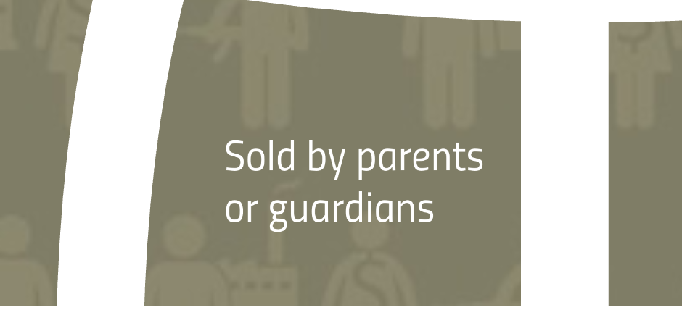
Notes:
The head of florida schools told me about one of her kids in her school. There was a child in the third grade that she hadn’t noticed since the beginning of the school year, since she was responsible for the troubled kids. One day, another 3rd grader came to her office to say she was worried about her friend. She misses a lot of school, and doesn’t want to play with her. She then told her that her mom is making her “do t hings” that she doesn’t want to do. The little girl described what her friend had told her and it was not something 3rd graders should know about. She went to the class to bring the child to her office. She was the most pathetic looking girl-sad, dirty, depressed. She asked her if what her friend said was true, and at first she denied it but admitted to being “abused’. As my friend and the principal were discussing how to report the abuse (not the sex abuse), the child said in a small voice “it’s true” and started to cry. Her mom was selling her to men when she needed rent money

Slide 30
Notes:
In labor trafficking, they are lured by false promises. Once they begin work, pay may be held or they are forced to shop at the community store owned by the company where prices are outrageous and forces them into more debt. There are companies that bring workers from other countries to work in the US. Once in the US, they may tell the worker that they owe more than the original cost of travel due to expenses during the trip. This creates debt bondage and they have to pay off the debt. Now we know t hat is not true or “right’ but as someone who does not speak the language or knows the cultures, it creates the belief that the worker has no other choice but to work for that organization or in that area of labor. Just as in the definition for sex trafficking, children under the age of 18 years do not have to prove force, fraud, or coercion to be identified as a victim of trafficking.

Slide 32
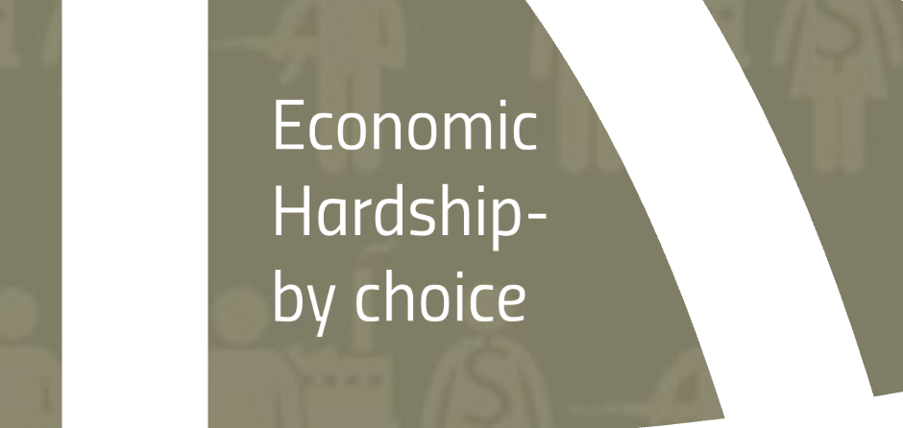
Notes:
Need to have your basic needs met..

Slide 33
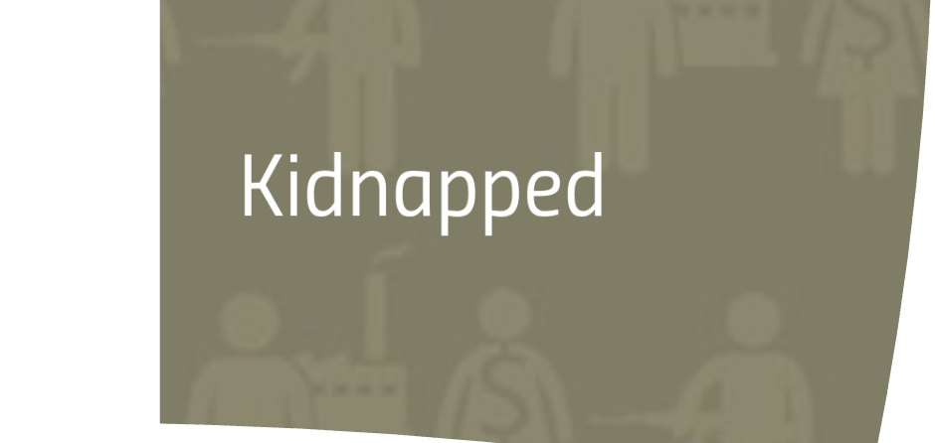
Notes:
Yes this does happen.

Slide 34
Notes:
Victims often feel guilty and are afraid to ask for help. They believe it is there fault there are in the situation and deserve what happens to them..no!

Slide 35
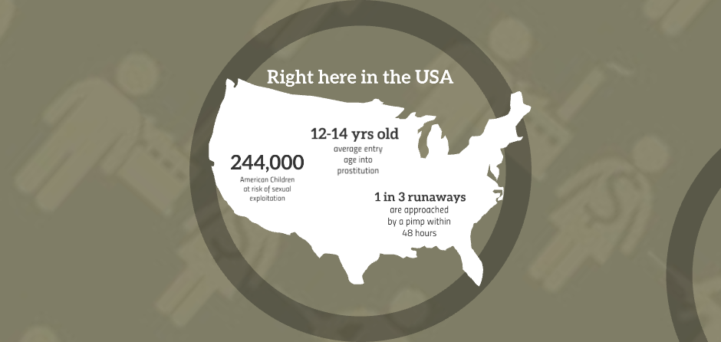

Slide 36
From: Selah Freedom

Slide 37
https://polarisproject.org/2017statistics
Potential Human Trafficking Locations in the US (2017)
Notes:
All labor trafficking

Slide 38
Notes:
Sex and labor trafficking

Slide 39
Definition of Child Labor
Employment below the minimum age as established by legislation
Sale or trafficking of children
Debt bondage
Forced or compulsory labor
Procuring child for illicit activities
Work, that by its nature or circumstance, is likely to harm the health, safety or morals of children
Notes:
The International Labour Organization Conventions (ILO) has identified that a child in at least one of these working situations meets the criteria for child labor and ultimately can be considered child trafficking. A child who is under his or her nation’s legislated age to work, children who have been sold in debt bondage or forced labor; a child who is used for illicit activities (including sex and sex trafficking), or work that is dangerous to be done by a child of that age. In the United States, the definition of Child Labor stated by the ILO also supports the US definition of child trafficking.

Slide 40
Who are Labor Traffickers
Family members
Recruited through family, community ties
May share same ethnic, national, cultural background
Introduce themselves as benevolent employer or smuggler
Use force, fraud, coercion to keep victim working
Notes:
This doesn’t get as much attention as sex trafficking, but children are victims of this, often not noticed.
Who is a “trafficker”? In many venues such as hospitality and agriculture, traffickers are third party employment agencies, using coercive tactics to convince people to work for them. Traffickers can be strangers, but often are people whom the victim trusts such as family, including parents. This is common in the case of debt bondage, where parents sell their child as a servant in order to satisfy a family’s debt. Traffickers recruit though social networks, where people are looking for opportunities for themselves or their families. Traffickers frequently share the same ethnic or cultural background as their victims, allowing the trafficker to gain trust then later exploit the person. Many times a trafficker will introduce him or herself as someone who wants to help a family in dire need to either find them jobs or new places to live. Initially the price quoted is a price that can be paid off, but once in the country, typically increases for expenses supposedly acquired during transportation or in finding a job. This amount often exceeds the average yearly income of a worker in the country from which the person has just left. In all cases, just as in sex trafficking, traffickers use force, fraud, and coercion, including document withholding, extortion, psychological manipulation, violence, torture, attempted murder or threats against victims or their family members.

Slide 41
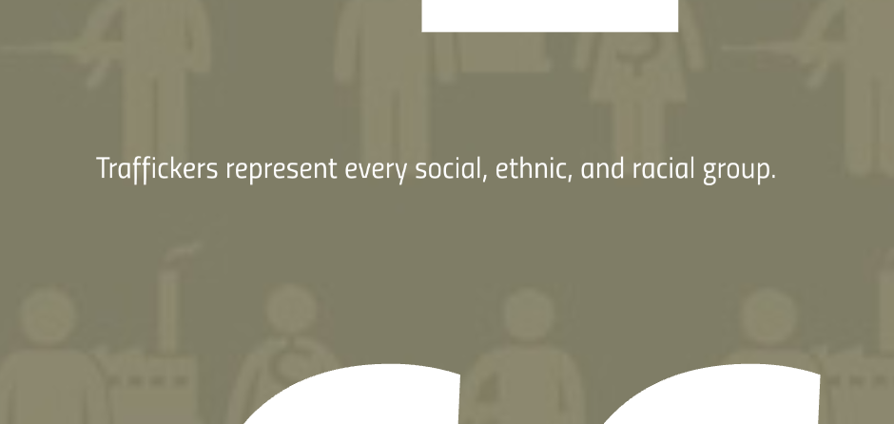
Notes:
In labor trafficking often same culture, nationality or even from same town. They are recommended to the person by family or friends and then are trafficked

Slide 42
Notes:
Very organized system. Labor and sex trafficking. In sex trafficking this is where marking them comes from. There is a definite hierarchy. A female who is appointed to traffick the others is called “bottom”. The “family/folks” is used to describe the other individuals under the control of the same pimp.

Slide 43
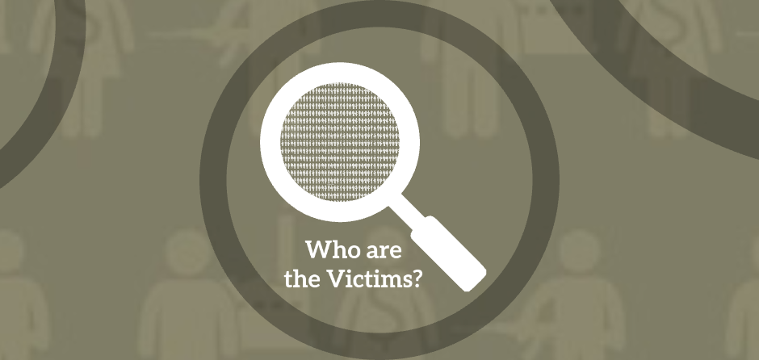
Notes:
Labor and sex trafficking

Slide 44
Victims
Traffickers target vulnerabilities:
Low self esteem
Few or no connections
History of abuse
Economically disadvantaged
Runaway and/or homeless
Foster care system
Adults and children from other countries
Undocumented or lack of connections
Easily found on social media
New term Survivor
Notes:
Traffickers target vulnerabilities. Children in foster care, disabilities, women who live in poverty, etc. They are easy to find, especially with social media. The tech industry is the number one supporter (whether known or unknown) of ht industry. Stats for children under 13 and platforms is staggering. Up to 60% have primary settings on social media. Recuiters are paid to search social media to find those who pose certain types of photos, give info about t hemselvs., etc. People, especially children should use stock photos.
Now that social media so prevalent….can throw this out of the window. Example of 11 year left note on her pillow to help her friend for a few days. Found her in jax with a collar and chain in a hotel room with a 35 year old man.

Slide 45
Notes:
I like you, no one understands you like I do. You should be a model. I’ll take care of you..

Slide 46
Notes:
They may convince them to send nude photo of themselves, then use it as blackmail. I’ll send the photo to everyone at your school….

Slide 47
Notes:
The Romeo pimp. I love you , etc…then as time as goes they pull the love away and leaves the victim doing more and more to reach the original state.
This is opposed to the guerilla pimp who lures them by violence

Slide 48
Notes:
Psychological weapons can be more powerful than physical violence. Traffickers will tell them they will hurt their family, their dog. Or use drugs to keep them in line. Then when they need their next fix, they have to work for it.
Guerilla pimp

Slide 49
Women, young girls and boys, are sold to traffickers, locked up in rooms for weeks, months, and even years
They are drugged, starved, terrorized, and raped repeatedly
Notes:
It’s not only women and young girls. Boys are trafficked for sex. If we even start to guess their lives: lets’ assume they start their “shift” at 5pm. They can have a buyer every 15 minutes. Let’s think about this. Every 15 minutes x 8 hours= 32 times a night they are being raped.

Slide 50
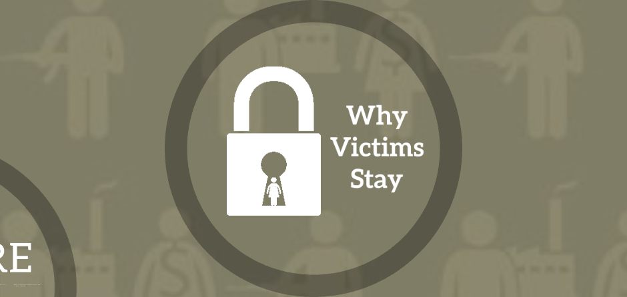

Slide 51
Notes:
Sex and labor trafficking. They have no place to go, no idea. Their whole identity is stripped
Let’s talk about Trauma Bonds: told to stay at gas station until someone came to pick her up. Waited until sun went down, decided to leave. Car pulled, up 2 men got out and beat her.
Often taught to not touch door knobs, look at pimp using violence
Becomes an abusive relationship: you want to get back to the ‘love” and happy times, so do anything. Give just enough to make you crave more attention and think you can get it back.

Slide 52
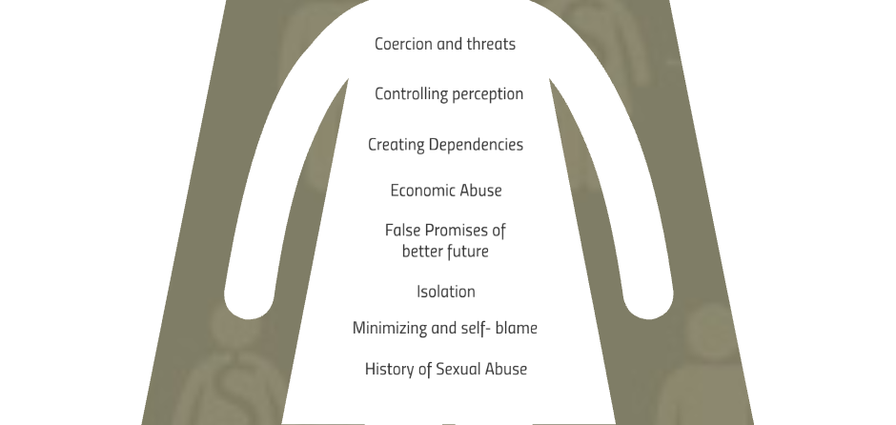
Notes:
Self blame, isolation, don’t feel like a victim. Especially when with others.
Subjected to violence, threat of violence to themselves or loves ones. Have baby to use as collaterol

Slide 53
Notes:
I want to briefly mention this. Patients may come in with “typical symptoms’ of STd ,etc. but you should be suspicious of everyone.

Slide 54
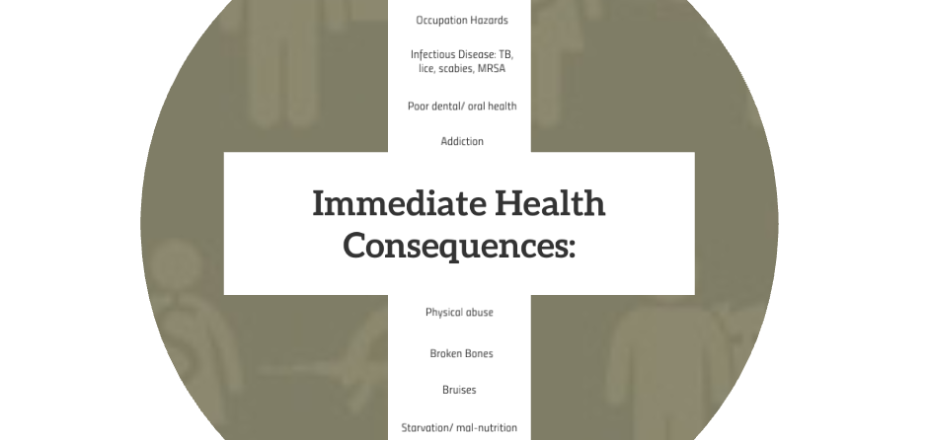
Notes:
Lack of basic preventative care. What you would expect from someone who is not well nourished, has poor living environment. Essentially live in squalor. May have scabies, lice, malnourished, broken teeth, broken bones, bruises. Signs of sexual trauma, Bruises where you wouldn’t think-inner thighs, for sex trafficking. etc. Poorly controlled chronic illnesses-diabetic will not have insulin, can’t check BG. May have partial abortions, may be done by pimps themselves. PID. STI. Be suspicious in someone younger
Occupational hazards of frequent, unprotected sex : STI, HIV, PID, sexual trauma With labor trafficking, exposure, injuries that haven’t been treated, think about occupational hazards.
Sex trafficking common but not only specific to sex trafficking
Often sex and labor trafficking go together. Bring traveling bands of sex trafficking victims to these remote areas where labor trafficking is occurring. Neither knows the situation of the other.

Slide 55
Notes:
Remember what we said are 2 top causes of death in this population? HIV and murder. PID. They will work during their menstrual cycle which places them and the johns more at risk for std, hiv, and other bloodborne infections
Abortions may be done by trafficker

Slide 56
Notes:
Used by abusers to control and create dependency
Increases risk of blood born diseases including HIV and hepatitis
Victims may suffer from acute withdrawal symptoms or overdose
Alcohol, cocaine, heroin, marijuana and methamphetamines
Prescription drugs such as benzodiazepines and hydrocodone

Slide 57
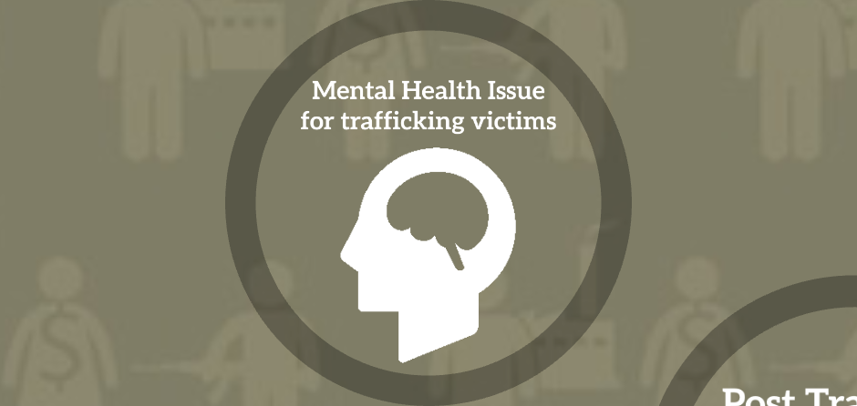
Notes:
Complex , complex trauma bonds, and not identifying as victim so unable to access services
Knowing about ACES, what do you think these futures look like for these victims??

Slide 58
Notes:
They may have somatization-chronic pain symptoms

Slide 60
Notes:
Typical includes medications for depression, OCD, phobias, antipsychotics

Slide 62
Notes:
Your job is not to rescue. Your role is to offer a safe place. They may not accept it the first, or tenth time. But always need to offer. You are the connection to resources, not the resource.

Slide 63
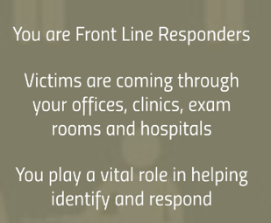
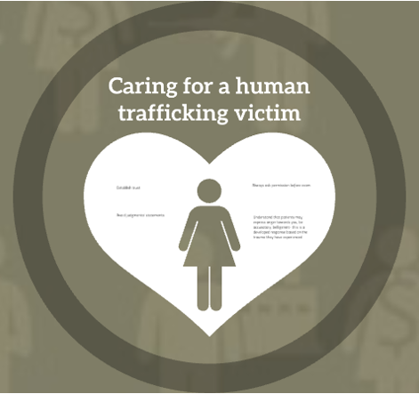
Notes:
Front line, vital role
This is when it gets difficult. You HAVE to ask those questions that are in your mind-your spidey sense. Ask “are you being hit” do you feel safe”
First thing is to separate suspected victim from person with them-trafficker. If you cannot separate, DO NOT ASK.
So, what are you going to do? Your goal is not get them to identify as victim and not to “Save” them, but to identify, offer resources, and safe place. Victims don’t present themselves as victims and are often unwilling to identify this way. Ask permission, trauma informed care. Assume everyone has a traumatic past

Slide 64
Identification of Victims
What to look for:
Chaperone who speaks for patient or seems overly involved
Disorientation or inability to answer simple questions
Little or no money or identification
Drug involvement
STDs, infectious disease
Malnutrition
Signs of physical or sexual abuse
Patient is disoriented, confused
Suspicious tattoos/brands
History
Gut feeling
Source: Polaris Project. Potential Trafficking Indicators for Medical Professionals.
Notes:
Chaperone may be near same age (bottom up), or be same culture. May not know where they live, no address or phone, arrive without ID or money

Slide 65
Identification of Victims: Labor Trafficking
Undocumented immigrants, temporary visas
Language barrier
Homeless, or otherwise economically vulnerable
Untreated injuries, explanations inconsistent
Malnourished
Exposure, burns
Notes:
Similar to sex trafficking. Those most at risk are those…

Slide 66
Physical Factors
Untreated injuries; explanations inconsistent with injury
Multiple STDs, UTIs, abortions
Evidence of sexual abuse, forced/violent sex
Broken teeth
Neck / jaw problems
Bruising, scarring, burns, ligature marks, broken bones
Tattoos of ownership they are reluctant to discuss
Notes:
Injuries from forced or violent sex, ligature marks, bite marks, bruising in unusual places such as upper thighs, breasts. Farm injuries untreated. Tattoos may be regional. Bar codes, daddy, king/queen on hands, tattoos in unusual places such as upper thighs upper lip. Most law enforcement depts. Have catalog of tattoos.

Slide 67
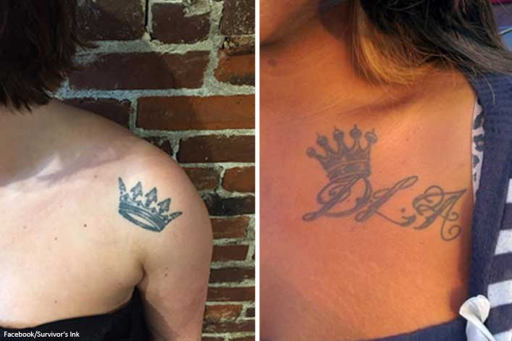
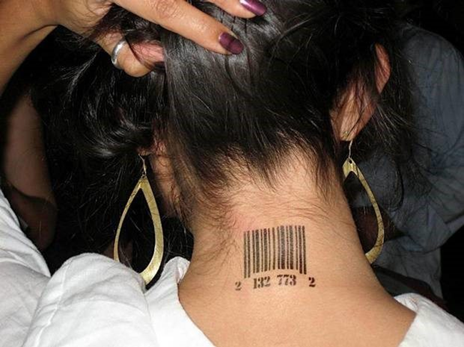
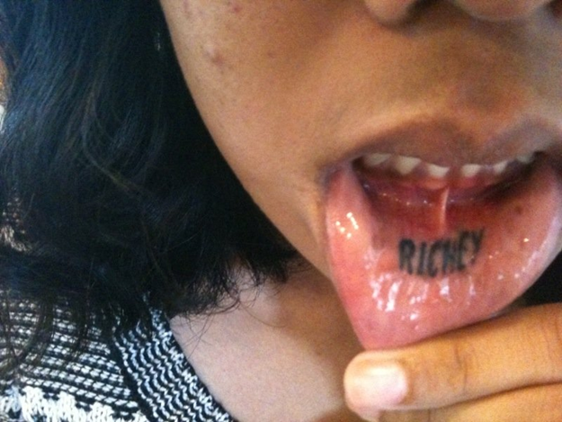
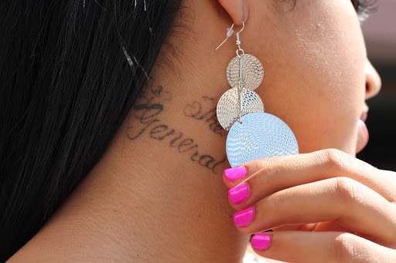
Notes:
Many times the tattoos are not in plain site.

Slide 68
Notes:
Wave of the future in general: RFID Radio frequency implantable device.: mplantable radiofrequency transponder system for patient identification and health information is a device intended to enable access to secure patient identification and corresponding health information. This system may include a passive implanted transponder, inserter, and scanner.
The stranger the story the more you have to listen.

Slide 69
Physical Factors
Delayed medical care – advanced stage disease
Headaches, fatigue
Abdominal pain, back pain
Industrial injuries
Severe or untreated dental issues
Elevated blood pressure, diabetes (undetected)
Malnourishment, stunted growth (in children)

Slide 70
Identification of Victims: What to do
Do not use friend as interpreter
Limit staff involvement
Assess dynamics between patient and guest
Provide reason for separation (tests, xrays,)
Find reason for guest to leave area, such as to complete paperwork in another room
Be open to unfamiliar stories (hostage, device implants, etc)
Notes:
If you cannot get them alone, don’t ask.
Make an excuse to get them alone. Tests, have person with them fill out paperwork.
Years ago patient frequent ER visits. At one point told them she had a tracker in her arm…no one believed her..

Slide 71
If you are unable to separate the person from the friend,
Then DO NOT ASK QUESTIONS
Notes:
Went for surgery, in front of husband asked if I felt safe or victim of violence..dumb…

Slide 72
Identification of Victims: What to do
Ask specific but nonjudgmental questions
Get social work and/or law enforcement involved
Call the human trafficking hotline and discreetly give hotline information to suspected victim
Source: Polaris Project. Potential Trafficking Indicators for Medical Professionals.
Notes:
For example: tell them they have to go to xray or obtain urine specimen and no one allowed in the back
Tell Joyce Knestrick story during gyn exam. Used phone to message patient if in danger.

Slide 73
Identification of victims: What to do
Always use a professional interpreter if language barrier exists (not a friend or associate of patient)
Use the same words the patient is using and do not correct them, especially if it refers to their relationships and situation
Use a trauma-informed, non-judgmental approach
Source: Polaris Project. Potential Trafficking Indicators for Medical Professionals.

Slide 74
Victim-Centered Approach
Goal is not to force the patient to disclose their trafficking situation
Assess safety
Determine if there are services you can offer
Letting patient know you are a safe place to go for help
Notes:
They may not recognize themselves as victims

Slide 75
Identification of Victims: Questions
What type of work do you do?
What are your work hours?
How often do you get to see your family?
Does someone prevent you from contacting them?
Can you get another job if you want?
Come you come and go as you please?
How many people live with you?
Are you being paid?
Do you have a safe place to go
Source: Polaris Project. Potential Trafficking Indicators for Medical Professionals.
Notes:
What are some others: do you owe money to your employer. Do you have control over your money and your ID? Do you feel pressured to do something you don’t want to do? Did someone tell you what to say today?

Slide 76
Identification of Victims: Questions
Do you owe money to your employer?
Do you have control over your money and ID/documents?
Do you ever feel pressure to do something you don’t want to?
Have you been physically hurt?
Did someone tell you what to say today?
Has your family been threatened?
Source: Polaris Project. Potential Trafficking Indicators for Medical Professionals.

Slide 77
Identification of Victims: Questions
Has anyone asked you to have sex with someone else?
Have you ever felt you had to have sex to get what you need, such as food or to stay in where you live?
Has anyone asked you to dance at a gentleman’s club or take your clothes off in front of someone?
Notes:
You can ask these questions to children.

Slide 78
Assess Safety
Are you afraid to go home?
Do you have a safe place to stay?
What would happen if you didn’t go back to your worksite/residence tonight?

Slide 79
Caring for a Victim Using Trauma-Informed Care
Be safe
Establish trust-victim in charge of exam
Always ask permission before exam
Understand patients may express trauma-developed negative behavior
Notes:
Victim centered approach. Victim is in charge of how the visit goes-or doesn’t go. As case managers you may be the first one to have the spidey sense that something is wrong, or They will be referred to you for follow up. Don’t ask about immigration Be straight up, ask Do you owe money to your employer?•Do you have control over your money and your ID / documents?•Do you ever feel pressure to do something you don’t want to do?•Have you been physically hurt?•Did someone tell you what to say today?•Has your family been threatened. Then ask if they are comfortable talking about it.

Slide 80
Messages of Hope
You are safe here
You are not alone and not to blame
You deserve to receive help

Slide 81
If he/she is not ready to accept help…
If the patient is an adult, it is his or her choice to accept help at that time.
Validate and normalize what he or she is feeling.
Discreetly, verbally provide information that he or she may choose to act on in the future.
Notes:
You seem in a hurry to leave. We are here to help, and you need treatment. what is making you feel like you must go

Slide 82
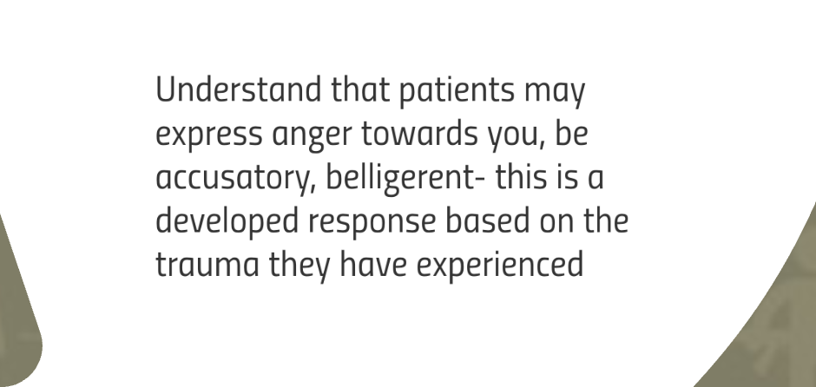

Slide 83
What NOT to do…
Do not “rescue” the patient.
Do not ask about the patient’s immigration status.
Do not make promises you cannot keep.
Do not force, deceive or coerce a patient in an effort to save them.
Do not be discouraged if a patient does not disclose victimization to you.
Do NOT ignore trafficking suspicions. Trust your instincts!

Slide 84
Treatment and Restoration
Treating immediate health concerns
Malnutrition and injury
SANE Exam
STD testing and treatment – use sexual assault protocols
HIV post-exposure prophylaxis and follow-up testing
Full psychological evaluation and treatment plans
Addiction treatment
Dental care
Social and legal aid
Mental health treatment
Life skills training and rehabilitation

Slide 85
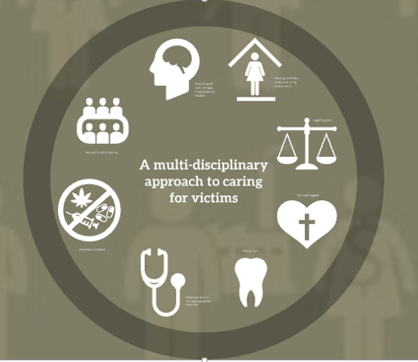
Notes:
Psychological, housing and basic needs, legal care to know rights and offer protection, spiritual care, dental care, medical care, treatment for addiction

Slide 86
Notes:
We forget this piece. Job and life skills, Often they have never handled money, had anything of their own. Don’t know how to grocery shop write check, pay bills, etc

Slide 87
Policy
Runaway and Homeless Youth and Trafficking Prevention Act
The Federal Strategic Action Plan on Services for Victims of Human Trafficking in the United States 2013-2017
Alliance to End Slavery and Trafficking (ATEST)
Office of Child Labor, Forced Labor, and Human Trafficking (OCFT) in the US Department of Labor (USDOL)
Supply Chain Transparency (2015), Trade and Development Act (2000)
McCain Institute
Notes:
1. Continue essential services provided under this act to ensure all youth have access to housing and other critical needs.
2. The U.S. is the largest importer in the world, giving us a unique position to demand that companies effectively root out trafficking in their supply chains and ensure fair, humane conditions for workers. The Business Supply Chain Transparency on Trafficking and Slavery Act of 2015 (H.R. 3226 and S.1968) would require companies to disclose the measures they're taking to address forced labor and human trafficking within their supply chains and empower everyday consumers to make informed decisions about the companies they choose to support
3. collaborative effort to align federal agency efforts to assist all victims of human trafficking. Advocate to strengthen holistic and comprehensive care for victims. Agencies collaborate effectively
4. US based coalition that advocates for solution to prevent and end all forms. Made of 14 human rights orgz, find lasting solutions to prevent, hold perps accountable, ensure justice for victims, empower survivors with tools for recovery.
LABOR: The US is working to end forced labor and sex trafficking and child labor worldwide The Office of Child Labor, Forced Labor, and Human Trafficking (OCFT) in the Bureau of International Labor Affairs (ILAB) within the U.S. Department of Labor (USDOL) works with national and international organizations to identify and address these modern day slavery situations. As a result of the collaborative work between these departments and other countries, there are approximately 80 countries that have developed or strengthened services, monitoring, enforcement of laws, and programs to combat child labor, forced labor, and human trafficking. In 2000, the Trade and Development Act charged the department of labor in consultation with the Departments of State and Homeland Security to maintain and publish a list of products by country of origin which are believed to be produced with the use of forced or child labor. As of 2017, the list had 35 products from 26 countries. You can access the most recent list at the US Department of Labor website, click on Bureau of International Affairs, or cut and paste the link from here.

Slide 88
Notes:
Let’s summarize what to look for and what to do.

Slide 89
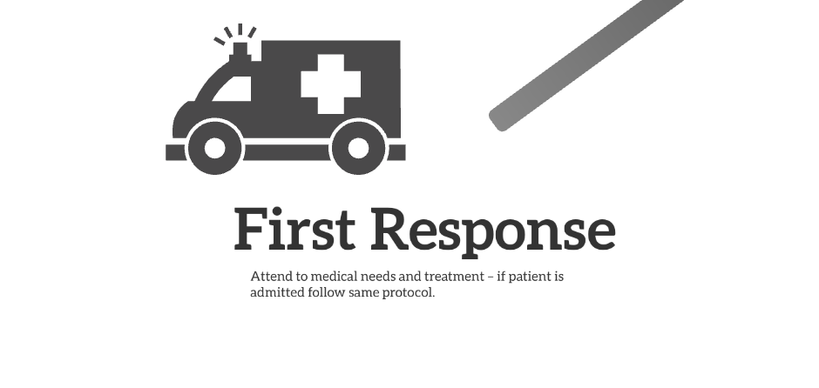

Slide 90
Notes:
Do you owe money to your employer?•Do you have control over your money and your ID / documents?•Do you ever feel pressure to do something you don’t want to do?•Have you been physically hurt?•Did someone tell you what to say today?•Has your family been threatened. Do you feel comfortable telling me about it. CALL THE HOTLINE THEY WILL HELP YOU

Slide 91
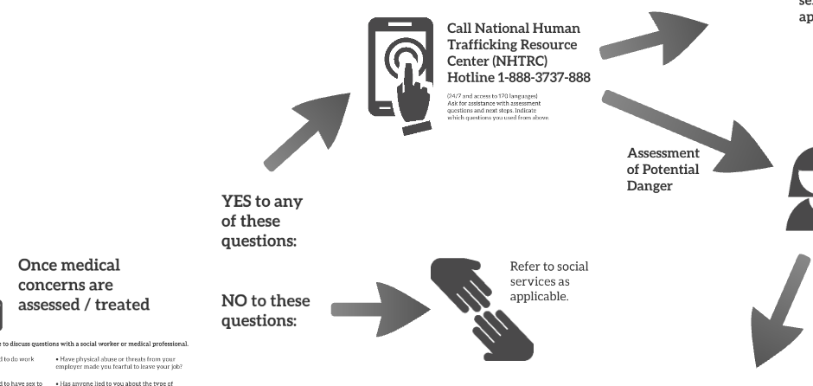

Slide 92
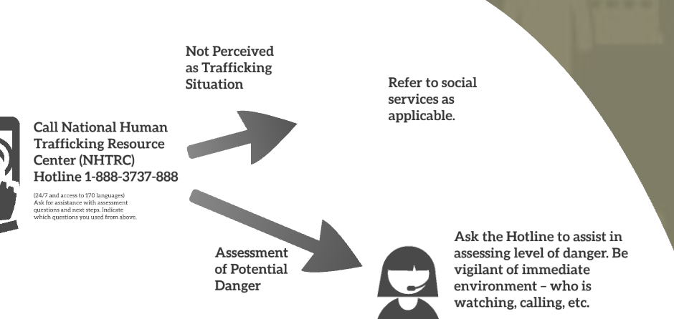

Slide 93
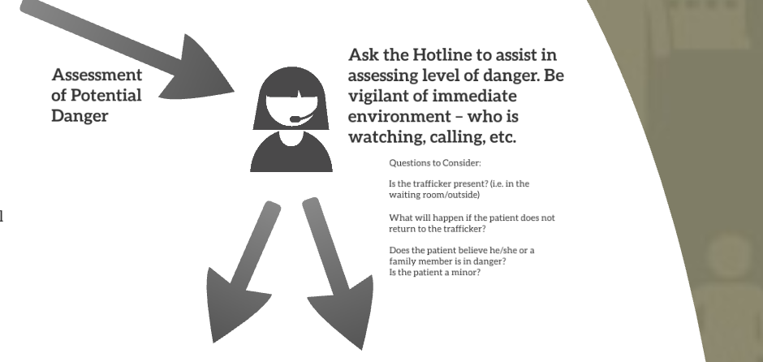

Slide 94
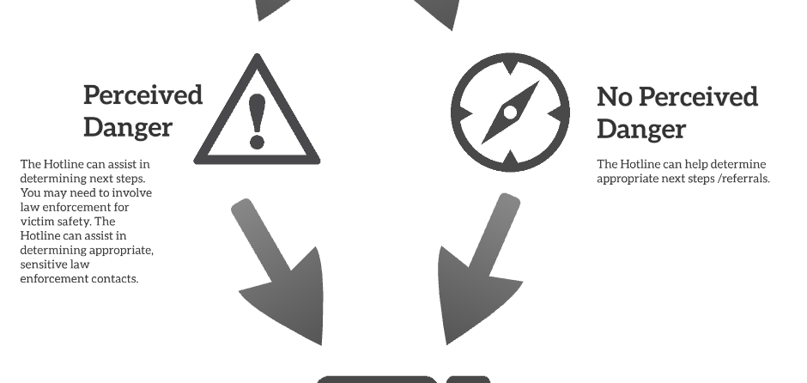

Slide 95
What else can you do?
Share what your know
TraffickCam web app
Post Human Trafficking hotline flyers in your work areas, rest stops, bathrooms
USDOL website lists goods and countries that have made a good faith effort to identify if forced or indentured child labor was used to produce items
https://www.dol.gov/agencies/ilab/our-work/child-forced-labor-trafficking
Notes:
What can a regular person do to help combat HT and help to identify victims? Your hotel room photos can help victims. If you see something, say something,r ight? If your spidey senses tell you something is not right, be brave, and offer a phone number, website or text

Slide 96
Change Our Vocabulary
“Child Prostitute”, “Child Pornography”:
A child cannot consent to something they do not developmentally understand
These are crimes against children and crime scenes.
Updated terms are “Sale and Exploitation of Children”

Slide 97
The Polaris Project
.
National Human
Trafficking Hotline
1-888-373-7888
24/7, Confidential,
Multiple languages
Texting Hotline
Text: HELP
To 233733 (BEFREE)
3pm-11pm

Slide 98
Notes:
These are some of resources in my area. Your go to is the trafficking hotline.
Now, remember that 5 year old girl selling water? Knowing what you know now, how does your spidey sense feel??

Slide 99
Common Trafficking Terms
Automatic: routine when pimp is out of town, jail,e tc.
Bottom: appointed by pimp to enforce rules and supervise; often recruits new victims
Stable: group of victims under one pimp
Caught a case: when a pimp has been arrested
Circuit: a series of cities among which people are moved
Daddy: term pimp will often require victim to call him
Date
Out of pocket: working pimp controlled track leaving her vulnerable to violence to make her “choose
Squaring up: attempting to escape

Slide 100
Selected References
Beck, M.E., Lineer, M.M., Melzer-Lange, M., Simpson, P., Nugent, M., & Rabbitt, A. (2015). Medical Providers’ understanding of sex trafficking and their experience with at-risk patients. Pediatrics, 135(4), e895-e902. doi:10.1542/peds.2014-2814
Children’s Defense. (2014). Preventing sex trafficking and strengthening families act (H.R. 4980). Retrieved from http://www.childrensdefense.org/library/data/fact-sheet-on-hr-4980.pdf
DeChesnay, M. (Ed.). (2013). Sex trafficking: A clinical guide for nurses. New York, New York: Springer.
Gelernter, J. (2015, June). Slavery still exists: We just don't talk about it. National Review. Retrieved fromhttp://www.nationalreview.com/article/436205/slavery-still-exists
Greenbaum, J., & Crawford-Jakubiak. (2015). Child sex trafficking and commerical sexual exploitation: Health care needs of victims.. Pediatrics, 135(3), 566-574. doi:10.1542/pedis.2014-4138
Hom, K.A., & Woods, S.J. (2013). Trauma and its aftermath for commercially sexually exploited women as told by front-line service providers. Issues in Mental Health Nursing, 34, 75-81. doi: 10.3109/01612480.22012.723300
Isacc, R., Solak, J., & Giardino, A. (2011). Health care providers’ training needs relate to human trafficking: Maximizing the opportunity to effectively screen and intervene. Journal of Applied Research on Children: Informing Policy for Children at Risk, 2(1), 61-91.
Jimenez, M., Jackson, A.M., & Deye, K. (2015). Aspects of abuse: Commercial sexual exploitation of children. Current Problems in Pediatric & Adolescent Health Care, 45(3), 80-85. doi: 10.1016/j.cppeds.2015.02.003
Lederer, L., & Wetzel, C. (2014). The health consequences of sex trafficking and their implications for identifying victims in health care facilities. Annals of Health Law, 23(1), 61-91.
Miller, C.L., & Duke, G.. (2016). Child sex trafficking- Recognition, intervention, and referral: An educational framework to guide the development of health provider education. Journal of Human Trafficking, 2(3).
The Polaris Project. (2017). 2016 Hotline Statistics. Retrieved from https://polarisproject.org/resources/2016-hotline-statistics
U.S. Department of Health & Human Services [USDHHS]. (2017). Office on trafficking in persons. Retrieved from https://www.acf.hhs.gov/otip
Wilson, B., & Butler, L.D. (2014). Running a gauntlet: A review of victimization and violence in the pre-entry, post-entry, and peri-/post-exit periods of commercial sexual exploitation. Psychological Trauma: Theory, Research, Practice and Policy 6(5) 494-504.

