Slide 1
Diabetes Mellitus in the Pediatric Population
Corey Fowler, PharmD, BCPPS
November 3, 2018
Notes:
Edit: take away main tittle.

Slide 2
Pictorial
CV
Teaching/Precepting

Slide 3
What setting do you work in?
Primary Care
Hospital
Other
Do you have a specialty?

Slide 4
Objectives
Differentiate between the pediatric presentation of type 1 diabetes mellitus (T1DM) and type 2 diabetes mellitus (T2DM)
Describe monitoring for T1DM and T2DM
Provide tailored therapy for pediatric patients presenting with T1DM and T2DM based on guideline recommendations
2

Slide 5
Background
One of the most common chronic diseases in children
¾ of all cases of T1DM are diagnosed in individuals <18 years
Rapid escalation of T2DM due to obesity pandemic
7th leading cause of death in the US
Total cost to treat DM is $174 billion per year (all ages in the US)
Centers for Disease Control and Prevention. National diabetes fact sheet 2011: national estimates and general information on diabetes and prediabetes in the
United States. Available at: http://www.cdc. gov/diabetes/pubs/factsheet11.htm Accessed September 15, 2017
Gregory JM, Moore D, Simmons J. Type 1 Diabetes Mellitus. Pediatrics in Review. 2013;34(5): 203-215.

Slide 6
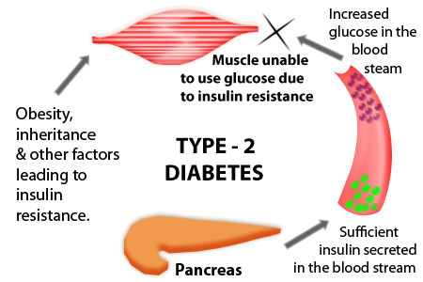
Pathophysiology
T1DM
T2DM
Gregory JM, Moore D, Simmons J. Type 1 Diabetes Mellitus. Pediatrics in Review. 2013;34(5): 203-215. httpvisual.ly/diabetes-type-1-diabetes-vs-type-2-diabetes Accessed: October 1, 2015.

Slide 7
Characteristics of Type 1 and Type 2
 | T1DM | T2DM
Age of presentation | Throughout childhood | Peaks during puberty
Onset | Abrupt | Insidious
Affected relative | 5% | 75 – 90%
Female:Male | 1:1 | 2:1
Ethnicity | All, highest among non-Hispanic white | All, highest among racial/ethnic minorities
Insulin secretion | Decreased/absent | Variable
Insulin sensitivity | Normal when controlled | Decreased
Insulin dependence | Permanent | Episodic
Obesity | < 24% | > 90%
Gregory JM, Moore D, Simmons J. Type 1 Diabetes Mellitus. Pediatrics in Review. 2013;34(5): 203-215. httpvisual.ly/diabetes-type-1-diabetes-vs-type-2-diabetesAccessed: October 1, 2015

Slide 8
Clinical Presentation
Classic triad plus weight disturbance
Polyuria
Polydipsia
Polyphagia
Glycosuria and ketonuria
T1DM
Diabetic Ketoacidosis
T2DM
Candidal vulvovaginitis/UTIs
Acanthosis nigricans
American Diabetes Association. Classification and diagnosis of diabetes. Sec. 2. In Standards of Medical Care in Diabetes 2017. Diabetes Care 2017;40(Suppl. 1):S11–S24

Slide 9
Prediabetes
Term used for those with impaired fasting glucose (IFG) and/or impaired glucose tolerance (IGT)
IFG: 100 - 125 mg/dL
IGT: 140 - 199 mg/dL after oral glucose tolerance test
A1c: 5.7 - 6.4
Recommend testing for diabetes in children who are overweight or obese and have one or more risk factors
Family history
Race/ethnicity
Signs of insulin resistance
Maternal history of diabetes or gestational diabetes
American Diabetes Association. Classification and diagnosis of diabetes. Sec. 2. In Standards of Medical Care in Diabetes 2017. Diabetes Care 2017;40(Suppl. 1):S11–S24
Notes:
-

Slide 10
Diagnosis
Criteria for Diagnosis
Fasting BG ≥ 126 mg/dL
Hemoglobin A1c ≥ 6.5%
2-hour plasma glucose ≥ 200 mg/dL via oral glucose tolerance test
Random plasma glucose ≥ 200 mg/dL with symptoms
A second test is required for confirmation
It is recommended that the same test be repeated or a different test be performed without delay using a new blood sample for confirmation
American Diabetes Association. Classification and diagnosis of diabetes. Sec. 2. In Standards of Medical Care in Diabetes 2017. Diabetes Care 2017;40(Suppl. 1):S11–S24

Slide 11
Therapeutic Goals
T1DM
Plasma Blood Glucose Range (mg/dL) |  | A1c
Before Meals | Bedtime/Overnight
90 - 130 | 90 - 150 | < 7.5%
T2DM - goals are the same as adults
Fasting BG < 126 mg/dL
A1c < 7%
10
Silverstein J, Klingensmith G, Copeland K, Plotnick L, Kaufman F, Laffel L, et al. Care of children and adolescents with type 1diabetes: a statement of the American Diabetes Association. Diabetes Care 2005;28:186-212.

Slide 12
Monitoring Therapeutic Outcomes
A1c
Every 3 months
Self-monitoring blood glucose (SMBG)
T1DM at least 4 times per day
Before breakfast and dinner, before bedtime and nocturnally
T2DM 2-3 times daily
Continuous glucose monitoring should be considered
Benefits of continuous glucose monitoring correlate with adherence
Urine glucose and ketones
T1DM when BG >250 mg/dL or during acute illness
32
Benavides S. Diabetes Mellitus. In: Benavides S, Nahata MC, ed. Pediatric Pharmacotherapy. 1st ed. Lenexa, KS: American
College of Clinical Pharmacy; 2013:346-364.

Slide 13
Acute Complications of Diabetes Mellitus
Hypoglycemia
Diabetic Ketoacidosis (DKA)
Hyperosmolar Hyperglycemic Syndrome (HHS)
33
Gregory JM, Moore D, Simmons J. Type 1 Diabetes Mellitus. Pediatrics in Review. 2013;34(5):203-215.

Slide 14
Chronic Complications of Diabetes Mellitus
Microvascular
Retinopathy
Nephropathy
Neuropathy
Macrovascular
Atherosclerotic disease
Peripheral vascular disease
Cerebrovascular disease
Cardiovascular disease
34
Gregory JM, Moore D, Simmons J. Type 1 Diabetes Mellitus. Pediatrics in Review. 2013;34(5):203-215.

Slide 15
Overall Therapeutic Goals
Maintenance of blood glucose as close to normal physiologic values as possible
Attainment of normal growth and weight
Prevention of acute and chronic complications
Minimization of adverse events secondary to pharmacological management
American Diabetes Association. Type 2 diabetes in children and adolescents. Diabetes Care 2000; 23:381-389 Silverstein J, Klingensmith G, Copeland K, Plotnick L, Kaufman F, Laffel L, et al. Care of children and adolescents with type 1 diabetes: a statement of the American Diabetes Association. Diabetes Care 2005;28:186-212.

Slide 16
2018 ADA Guideline Pediatric Updates
Recommendations were added on the treatment of T1DM regarding intensive insulin regimens, self-monitoring of blood glucose, CGM, and automated insulin delivery systems
Recommended risk-based timing of celiac disease screenings was defined
Estimating glomerular filtration rate was removed because of the poor performance of the estimating equation
T2DM section was substantially expanded, with several new recommendations

Slide 17
Management of Type 1 Diabetes

Slide 18
Guideline Recommendations for Glycemic Control
T1DM should be treated with intensive insulin regimens
Multiple daily injections
Continuous subcutaneous insulin infusion
Automated insulin delivery systems improve glycemic control and reduce hypoglycemia in adolescents

Slide 19
Insulin
Protein composed of 51 amino acids
2 chains (alpha and beta) connected by disulfide bonds
Naturally produced by the pancreas
Recombinant DNA technology
No longer bovine/porcine derived
No studies have reported increased efficacy of one form of insulin over another but pharmacokinetics provide variability
Mainstay of treatment in the pediatric population
Benavides S. Diabetes Mellitus. In: Benavides S, Nahata MC, ed. Pediatric Pharmacotherapy. 1st ed. Lenexa, KS: American College of Clinical Pharmacy; 2013:346-364

Slide 20
Insulin Types and Pharmacokinetics
 |  | Pharmacokinetics
Insulin Type | Brand (Generic) Names | Onset of Action | Peak of Action | Duration of Action (hours)
Rapid-acting | NovoLog (aspart insulin) Humalog (lispro insulin) Apidra (glulisine insulin) | 10 - 15 minutes | 30 - 90 minutes | 3 - 4
Short-acting | Novolin-R (regular insulin) Humulin-R (regular insulin) | 30 - 60 minutes | 2 - 4 hours | 4 - 6
Intermediate-acting | Novolin-N (NPH insulin) Humulin-N (NPH insulin) | 1 - 2 hours | 3 - 10 hours | 8 - 15
Long-acting | Lantus (insulin glargine) Levemir (insulin detemir) | 2 - 4 hours 1 – 2 hours | No peak 6 - 12 hours | 20 - 24 6 - 24
Gregory JM, Moore D, Simmons J. Type 1 Diabetes Mellitus. Pediatrics in Review. 2013;34(5): 203-215. httpvisual.ly/diabetes-type-1-diabetes-vs-type-2-diabetes Accessed: October 1, 2015

Slide 21
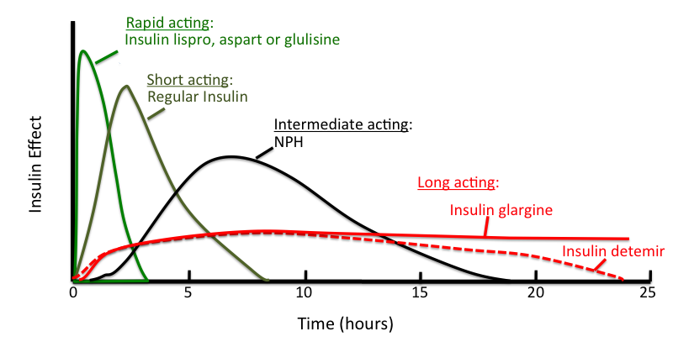
Insulin Types and Pharmacokinetics

Slide 22
Special Considerations
Insulin Type | Advantages | Disadvantages
Rapid-acting | Given with meals or immediately after Fastest resolution of hyperglycemia Can be used in continous subcutaneous infusion | Expensive
Short-acting | Abundance of data Inexpensive | Must administer 30 minutes before meals Hypoglycemia with incomplete meals
Intermediate-acting | Can be mixed with other insulins Fewer daily injections | More strict diet required when part of the ”Split/Mixed” regimen
Long-acting | As compared to intermediate-acting: Less intra-patient variability Fewer hypoglycemic episodes Greater satisfaction in adolescents Less weight gain with insulin detemir Fewer injections | Expensive Glargine may cause a burning sensation (acidic pH)
16
Gregory JM, Moore D, Simmons J. Type 1 Diabetes Mellitus. Pediatrics in Review. 2013;34(5): 203-215. httpvisual.ly/diabetes-type-1-diabetes-vs-type-2-diabetes Accessed: October 1, 2015

Slide 23
Recommended Initial Dosing
Stage of Diabetes Mellitus | Recommended Total Daily Dose
Initial diagnosis | 0.5 - 1 unit/kg/day
Honeymoon phase | < 0.5 unit/kg/day
Prepubertal children (out of honeymoon phase) | 0.5 - 1 unit/kg/day
Pubertal adolescents | May require up to 1.5 units/kg/day
Silverstein J, Klingensmith G, Copeland K, Plotnick L, Kaufman F, Laffel L, et al. Care of children and adolescents with type 1 diabetes: a statement of the American Diabetes Association. Diabetes Care 2005;28:186-212.. Bangstad HJ, Danne T, Deeb L, Jarosz-Chobot P, Urakami T, Hanas R. Insulin treatment in children and adolescents with diabetes. Pediatr Diabetes 2009;10(suppl 12):82-99.

Slide 24
Honeymoon Phase
Following initial onset of T1DM
Pancreas increases insulin production before complete cessation of insulin secretion
Decreased supplemental insulin requirement
Occurs several weeks after diagnosis and may persist for several months to a year
Silverstein J, Klingensmith G, Copeland K, Plotnick L, Kaufman F, Laffel L, et al. Care of children and adolescents with type 1 diabetes: a statement of the American Diabetes Association. Diabetes Care 2005;28:186-212
Bangstad HJ, Danne T, Deeb L, Jarosz-Chobot P, Urakami T, Hanas R. Insulin treatment in children and adolescents with diabetes. Pediatr Diabetes 2009;10(suppl 12):82-99

Slide 25
Split/Mixed Regimen
Standard insulin dosing in 2-3 divided doses
Combination of intermediate/long acting insulin with rapid/short acting insulin
Requires regularly scheduled meals with consistent carbohydrate content
Typically not adequate in most patients to achieve desired A1c
Ideal upon diagnosis of T1DM
Patients transitioned to basal/bolus regimen following the honeymoon phase
Silverstein J, Klingensmith G, Copeland K, Plotnick L, Kaufman F, Laffel L, et al. Care of children and adolescents with type 1 diabetes: a statement of the American Diabetes Association. Diabetes Care 2005;28:186-212.

Slide 26
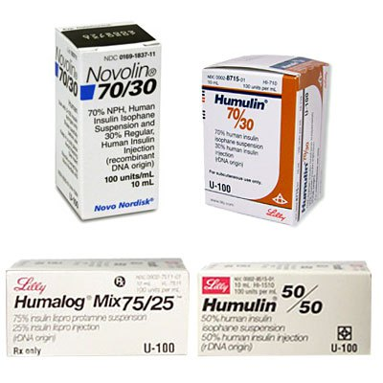
Split/Mixed Regimen (Fixed Regimen)
Calculate the TDD of insulin
Administer 2/3 of the TDD in the morning and 1/3 in the evening
Mixture of each dose (2 options)
Intermediate-acting 2/3 + 1/3 Rapid/short-acting
OR
Long-acting 1/2 + 1/2 Rapid/short-acting
Silverstein J, Klingensmith G, Copeland K, Plotnick L, Kaufman F, Laffel L, et al. Care of children and adolescents with type 1diabetes: a statement of the American Diabetes Association. Diabetes Care 2005;28:186-212.

Slide 27
Basal/Bolus Regimen
Closely matches physiologic release of insulin
Long-acting insulin
Emulates physiologic basal insulin secretion
Pre-prandial insulin
Emulates pancreatic insulin secretion in response to meals
Dose depends on BG before the meal, carbohydrates in the meal, and level of physical activity
Increased number of daily injections
Associated with lower glucose levels and decreased incidence of nocturnal hypoglycemia
Increased complexity
More calculations
Silverstein J, Klingensmith G, Copeland K, Plotnick L, Kaufman F, Laffel L, et al. Care of children and adolescents with type 1diabetes: a statement of the American Diabetes Association. Diabetes Care 2005;28:186-212.

Slide 28
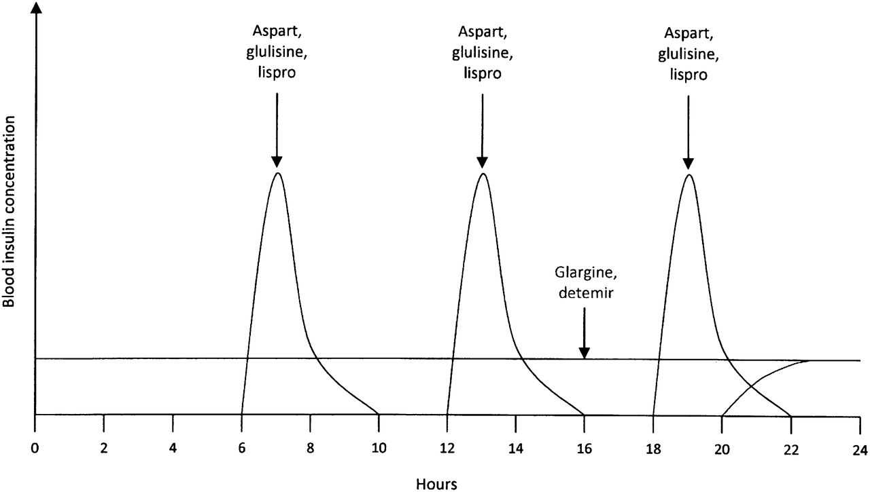
Basal/Bolus Regimen
Gregory JM, Moore D, Simmons J. Type 1 Diabetes Mellitus. Pediatrics in Review. 2013;34(5): 203-215. httpvisual.ly/diabetes-type-1-diabetes-vs-type-2-diabetes Accessed: October 1, 2015

Slide 29
Basal/Bolus Regimen
Basal (insulin glargine)
1/2 total insulin dose daily
If nocturnal hypoglycemia – administer with dinner or breakfast
Bolus (rapid-acting/short-acting)
1/2 total insulin dose
Divided between meals and snacks
+/- Carbohydrate dose & Correction dose
Silverstein J, Klingensmith G, Copeland K, Plotnick L, Kaufman F, Laffel L, et al. Care of children and adolescents with type 1diabetes: a statement of the American Diabetes Association. Diabetes Care 2005;28:186-212.

Slide 30
Bolus Insulin Requirements
“500 Rule”
Estimates number of grams of carbohydrate that will be covered by 1 unit of rapid-acting insulin
500/TDD = # of grams covered
“Correction Factor”
Determines how far the blood glucose drops per unit of rapid acting (“1800 rule”)
1800/TDD = point drop in blood glucose per unit of insulin
22
Silverstein J, Klingensmith G, Copeland K, Plotnick L, Kaufman F, Laffel L, et al. Care of children and adolescents with type 1 diabetes: a statement of the American Diabetes Association. Diabetes Care 2005;28:186-212

Slide 31
Insulin Adjustments
Deviation | Adjustment | Precautions
Elevated fasting BG before breakfast (dawn phenomenon) | Increase the PM basal dose of insulin Administer the PM basal dose of insulin later | Obtain BG at 3 - 4 AM to ensure nocturnal hypoglycemia does not occur
Elevated fasting BG before breakfast (Symogi effect) | Decrease the PM basal dose of insulin
Elevated BG after meal | Increase the bolus does of insulin before meals | Evaluate the carbohydrate content of the meal to ensure it is appropriate
Elevated BG before lunch/dinner | Increase the AM basal dose of insulin Increase the breakfast bolus dose of insulin
23
Benavides S. Diabetes Mellitus. In: Benavides S, Nahata MC, ed. Pediatric Pharmacotherapy. 1st ed. Lenexa, KS: AmericanCollege of Clinical Pharmacy; 2013:346. 364

Slide 32
Continuous Subcutaneous Insulin Infusion
Benefit of basal/bolus regimen without the need for multiple daily injections
Continuous basal infusion with boluses at meals
Patient/caregiver needs to check BG at least 4 times daily and be proficient with carbohydrate counting
Results in lowest A1c levels, fewest emergency department visits, and decreased number of hypoglycemic events
Paris CA, Imperatore G, Klingensmith G, Petitti D, Rodriguez B, Anderson AM, et al. Predictors of insulin regimens and impact on outcomes in youth with type 1 diabetes: the SEARCH for Diabetes in Youth. J Pediatr 2009;155:183-189.e1.
Fuld K, Conrad B, Buckingham B, Wilson DM. Insulin pumps in young children. studyDiabetes Technol Ther 2010;(12 suppl 1):S67-S71.

Slide 33
Continuous Subcutaneous Insulin Infusion
Advantages | Disadvantages
Allows flexible dosing regimens | Larger needles
Decreases the number of daily injections | Difficult pump placement due to size
Small doses of insulin can be administered | Dislodgement and risk of infection
Allows several boluses throughout meals | Costly
Insulin dosage information is downloadable | Cosmetic appeal
Increased patient and family satisfaction
“Smart pumps” can automatically calculate the meal or correction boluses
Bangstad HJ, Danne T, Deeb L, Jarosz-Chobot P, Urakami T, Hanas R. Insulin treatment in children and adolescents with diabetes.
Pediatr Diabetes 2009;10(suppl 12):82-99. Fuld K, Conrad B, Buckingham B, Wilson DM. Insulin pumps in young children. Diabetes Technol Ther 2010;(12 suppl 1):S67-S71.

Slide 34
Adverse Reactions of Insulin
Hypoglycemia
Most common and serious adverse reaction
Nocturnal hypoglycemia
Hypoglycemic unawareness
Hypokalemia
Injection-related reactions
Hypersensitivity reactions, lipoatrophy
Weight gain

Slide 35
Hypoglycemia
Category | Symptoms | Management
Mild | Sweating Pallor Palpitations Tremors | 10-15 g of easily absorbable carbohydrates (juice, soda, etc.)
Moderate | Aggression Drowsiness Confusion | 20-30 g of glucose administered by another person
Severe | Altered mental state Coma seizure | glucose tablets, glucose gel, IV dextrose, glucagon
Administer glucose
Test BG after 15 minutes
If still low re-administer glucose source
27

Slide 36
Management of Type 2 Diabetes

Slide 37
Lifestyle Management
Overweight or obese youth → achieve 7–10% decrease in excess weight
Participate in at least 60 min of moderate to vigorous physical activity per day
Decrease sedentary behavior
Emphasize consumption of nutrient-dense, high-quality foods and decreased consumption of calorie-dense, nutrient-poor foods, particularly sugar-added beverages

Slide 38
Pharmacotherapy in Type 2 DM
In metabolically stable patients (A1C < 8.5% and asymptomatic) → Metformin
Initiate basal insulin when A1c target is no longer met with metformin, or if contraindications or intolerable side effects of metformin develop
Metabolically unstable patients (A1c ≥ 8.5%, random BG ≥ 250, symptomatic) → Basal insulin and metformin
Once stable, basal insulin can be tapered over 2–6 weeks
Patients presenting with ketosis or DKA → insulin
Initiate metformin once ketosis resolves
American Diabetes Association. Children and adolescents. Sec. 12. In Standards of Medical Care in Diabetesd2017. Diabetes Care 2017;40(Suppl. 1):S105–S113
Copeland, K. C., Silverstein, J., Moore, K. R., Prazar, G. E., Raymer, T., Shiffman, R. N., ... & Flinn, S. K. (2013). Management of newly diagnosed type 2 diabetes mellitus (T2DM) in children and adolescents. Pediatrics, 131(2), 364-382.

Slide 39
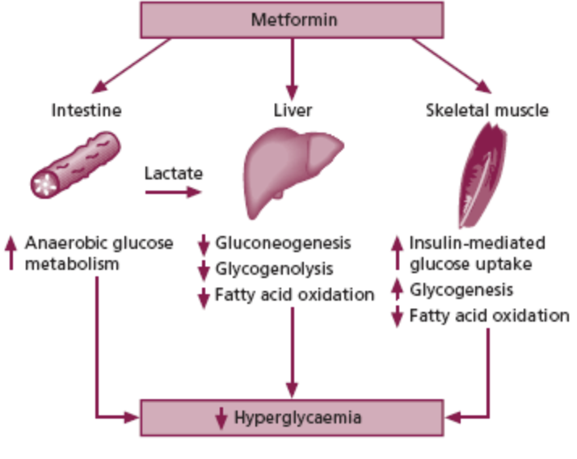
Metformin (Glucophage®)
Dose:
>10 years of age: 500mg BID with meals. Max dose: 2000mg/day
Contraindications:
Renal dysfunction, Acute/chronic metabolic acidosis
Adverse drug Reactions:
GI upset, lactic acidosis
Drug interaction
Iodinated IV contrast
Benavides S. Diabetes Mellitus. In: Benavides S, Nahata MC, ed. Pediatric Pharmacotherapy. 1st ed. Lenexa, KS: American College of Clinical Pharmacy; 2013:346-364.

Slide 40
Recommended Insulin Dosing
Stage/Type of Diabetes Mellitus | Recommended Total Daily Dose
Type 2 Diabetes Mellitus (initial dosing) | 0.15 - 0.2 units/kg/day
Type 2 Diabetes Mellitus | May require up to 2 units/kg/day
Silverstein J, Klingensmith G, Copeland K, Plotnick L, Kaufman F, Laffel L, et al. Care of children and adolescents with type 1 diabetes: a statement of the American Diabetes Association. Diabetes Care 2005;28:186-212.. Bangstad HJ, Danne T, Deeb L, Jarosz-Chobot P, Urakami T, Hanas R. Insulin treatment in children and adolescents with diabetes. Pediatr Diabetes 2009;10(suppl 12):82-99.

Slide 41
Conclusion
Diabetes Mellitus is one of the most common diseases in children
Type 1:
Autoimmune destruction of beta cells
Treatment → Insulin
Generally, basal/bolus > mixed regimen
Type 2:
Insulin Resistance
Treatment → Metformin
Careful monitoring of blood sugar and diet is essential to preventing acute and chronic complications

Slide 42
Diabetes Mellitus in the Pediatric Population
Corey Fowler, PharmD, BCPPS
November 3, 2018
Notes:
Edit: take away main tittle.

