Slide 1
Update on Concussions
Carlos R. Rodriguez, MD, FAAFP
Director, Bayfront Sports Medicine Fellowship
Assistant Medical Director, Johns Hopkins All Childrens Hospital Sports Medicine Program
Assistant Director, Bayfront Family Medicine Residency
Associate Clinical Professor, University of South Florida SOM

Slide 2
Concussion
Definition
    Clinical syndrome characterized by immediate and transient impairment of brain function caused by a traumatic injury that resolves spontaneously
    The injury can be direct or indirect
    Functional/Metabolic disturbance rather than structural injury
    LOC is not necessary
    Majority (80-90%) resolves in a short period (7-10 days), typically following a sequential course
    No abnormality is seen in standard neuroimaging

Slide 3
Concussion: Neurometabolic condition
Immediately after the injury, release of neurotransmitters and ionic shifts occur
Calcium in the brain ⬆ to 5x normal for up to 3 days
Potassium ⬆ by 4x for up to 24 hours
⬆ In K and Ca lead to suppression of neuron activity
Glucose ⬆ by 2x during the first 20 minutes after injury

Slide 4
Concussion: Neurometabolic condition
Blood flow to the brain can ⬇ by 20%
As K increases, Na-K pump starts to restore balance needing ATP (⬆ in energy requirement)
⬆ energy requirement + ⬇ cerebral blood flow = ⬆ lactic acid forms in the brain
Disruptions of autonomic regulation can persist for several weeks, making the brain vulnerable to additional injury

Slide 5
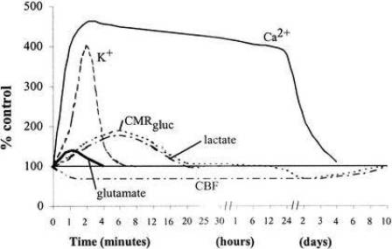
Neurometabolic cascade
-Giza and Hovda, 2001

Slide 6
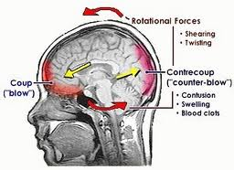
Mechanism of Injury
Linear acceleration
Angular/Rotational acceleration
  Measured by G-Forces (accelerometer/gyroscope)
Forceful blow that results in rapid movement of the head

Slide 7
Epidemiology
1.6-3.8 million sports-related concussion annually in US
90% of head injuries seen in emergency rooms are concussions
Most individuals do not obtain or pursue medical attention
Highest rate in American Football for males and Soccer for females
BMI >27 kg/m² and training <3 hrs/wk increase the risk of concussion (Class I study)
85-90% full clinical recovery in first two weeks

Slide 8
Incidence in Sports
Rate per 1,000 games
Sport | Males | Females
College
Football | 3.02 | -
Ice Hockey | 1.96 | -
Soccer | 1.38 | 1.80
Basketball | 0.45 | 0.85
Baseball/Softball | 0.23 | 0.37
High School
Football | 1.55 | -
Soccer | 0.59 | 0.97
Basketball | 0.11 | 0.60
Baseball/Softball | 0.08 | 0.04

Slide 9
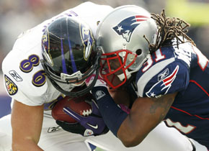
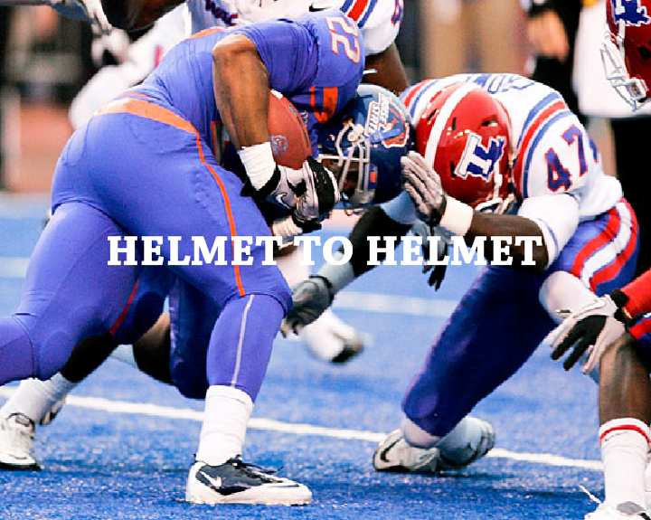
9

Slide 10
Classification systems
Cantu 1986
    Adopted by ACSM
Colorado 1991
    Adopted by NCAA
AAN 1997, new 2013
International Conference for Concussion in Sports (ICCS)
    Vienna 2001, Prague 2004, Zurich 2008 and 2012, Berlin 2016

Slide 11
Colorado system of grading concussions
Grade I (Mild)
    Transient confusion
    No amnesia, no LOC
    Symptoms clear within 20 minutes
Grade II (Moderate)
    Transient confusion
    Amnesia <30 minutes, no LOC
    Symptoms persist greater than 20 minutes
Grade III (Severe)
    Any LOC
OLD SYSTEM DO NOT USE GRADING SYSTEMS ANYMORE!

Slide 12
ICCS Consensus 2008
Abandon grading scales
Simple v. Complex
  Simple: resolves in 7-10 days without complications
  Complex: persistent symptoms with or without exertion, seizures, LOC, amnesia, cognitive impairment, multiple concussions
Concussions can only be evaluated in retrospect after clearing of symptoms
Athletes should be removed from competition after any signs of concussion

Slide 13
ICCS cont. 2008
Amnesia is an important symptom
The presence of LOC does not necessarily make the concussion complex
All concussions should be evaluated by a physician
Return to play must follow a supervised stepwise approach
Sport Concussion Assessment Test (SCAT2)

Slide 14
ICCS 2012
Re-emphasized recommendation of 2008 conference
Duration of LOC is a predictor of outcome but not of injury severity
  LOC > 1 minute may modify management
SCAT 3 developed with a new Child SCAT 3
A cognitive deficit is not necessary for the acute diagnosis of concussion
Return to play guidelines

Slide 15
ICCS 2016
Moving away from complete rest
Brief rest 24-48 hours
Then encourage them to become gradually and progressively more active
Stay below threshold that incites symptoms
Avoid vigorous exertion during recovery
Persistent symptoms
  >10-14 days for adults
  >4 weeks for children

Slide 16
ICCS 2016
Limited evidence for pharmacotherapy
Developed the Concussion Recognition Tool 5 (Pocket CRT5)
  Designed to assist non-medically trained individuals to recognise the signs and symptoms of possible sport-related concussion
  Provides guidance for removing an athlete from play/sport and to seek medical attention
SCAT 5 developed with a new Child SCAT 5

Slide 17
SCAT 5
Declaration that the complete SCAT5 cannot be appropriately completed in less than 10 min
Inclusion of an Immediate/Acute Assessment section, including indications for emergency management and observable signs of possible concussion
Addition of questions that compare the athlete’s post-injury presentation with preinjury behavior
A Rapid Neurological Screen has been included
A section has been added that includes affirmation that the SCAT5 was used or supervised by a healthcare professional and whether a concussion was diagnosed
The Return to Sport progression emphasizes that the initial period of physical and cognitive rest should typically only last 24-48 hours.
A Return to School progression has been added, including possible academic accommodations.
The SCAT5 specifically indicates that written clearance by a healthcare professional is necessary prior to returning to play/sport

Slide 18
AAN Recommendations
School-based professionals should be educated by experienced licensed health care practitioners (LHCP)
LHCP should inform athletes and families of evidence concerning concussion risk factors
Sideline evaluation to be performed by experienced LHCP
Baseline testing should be performed in young athletes, those with prior concussion history or those with pre-existing learning disabilities/ADD/ADHD

Slide 19
AAN Recommendations
Athlete suspected of having concussion should be removed from play immediately
Athlete is not allowed to RTP until evaluation and assessment by LHCP with training in both the diagnosis and management of concussion and in the recognition of more severe TBI is completed
Those with concussions should not RTP until an LHCP has judged that the concussion has resolved
    Athlete should be asymptomatic off medication
    High school and younger athletes should be managed more conservatively

Slide 20
Legal issues
ALL states and D.C. have enacted specific youth concussion legislation since 2009. Last four states passed laws in 2014.
In April of 2012, Florida enacted concussion related legislation regarding concussion.
Rules regarding potential head injuries in athletes in the Florida Law:
      Parental consent and acceptance of concussion risk
      Immediate removal from activity if concussion suspected
      No same day RTP
      Return to play only after written medical clearance by MD/DO

Slide 21
Legal Issues
Zachary Lystedt Law
  Enacted in Washington State in 2009. Has served as the model for most laws enacted in other states.
  Key provisions of the law
    Guidelines/education
    Mandatory consent
    Immediate removal if concussion is suspected
    Written clearance before return to play
    Legal immunity if compliant with the law

Slide 22
Pre-season evaluation
A history of prior concussion increases the risk of future concussions
Identify those athletes with history of concussion
  Number, symptoms, time to resolution
  Type of sporting event
  Protective equipment used
Previous face, head and neck injuries

Slide 23
Concussion evaluation
Symptoms
    Cognitive: Confusion, amnesia, disorientation, inability to focus, slurred speech, LOC
    Affective: Anxiety, depression, emotional lability, irritability, personality changes
    Somatic: Dizziness, visual changes, nausea, unsteady gait, headache, fatigue, tinnitus
    Sleep disturbances: increased, decreased, trouble initiating, drowsiness
Signs
    Loss of coordination
    Pupil changes
    Loss of concentration
    “Deer in the headlights” look

Slide 24
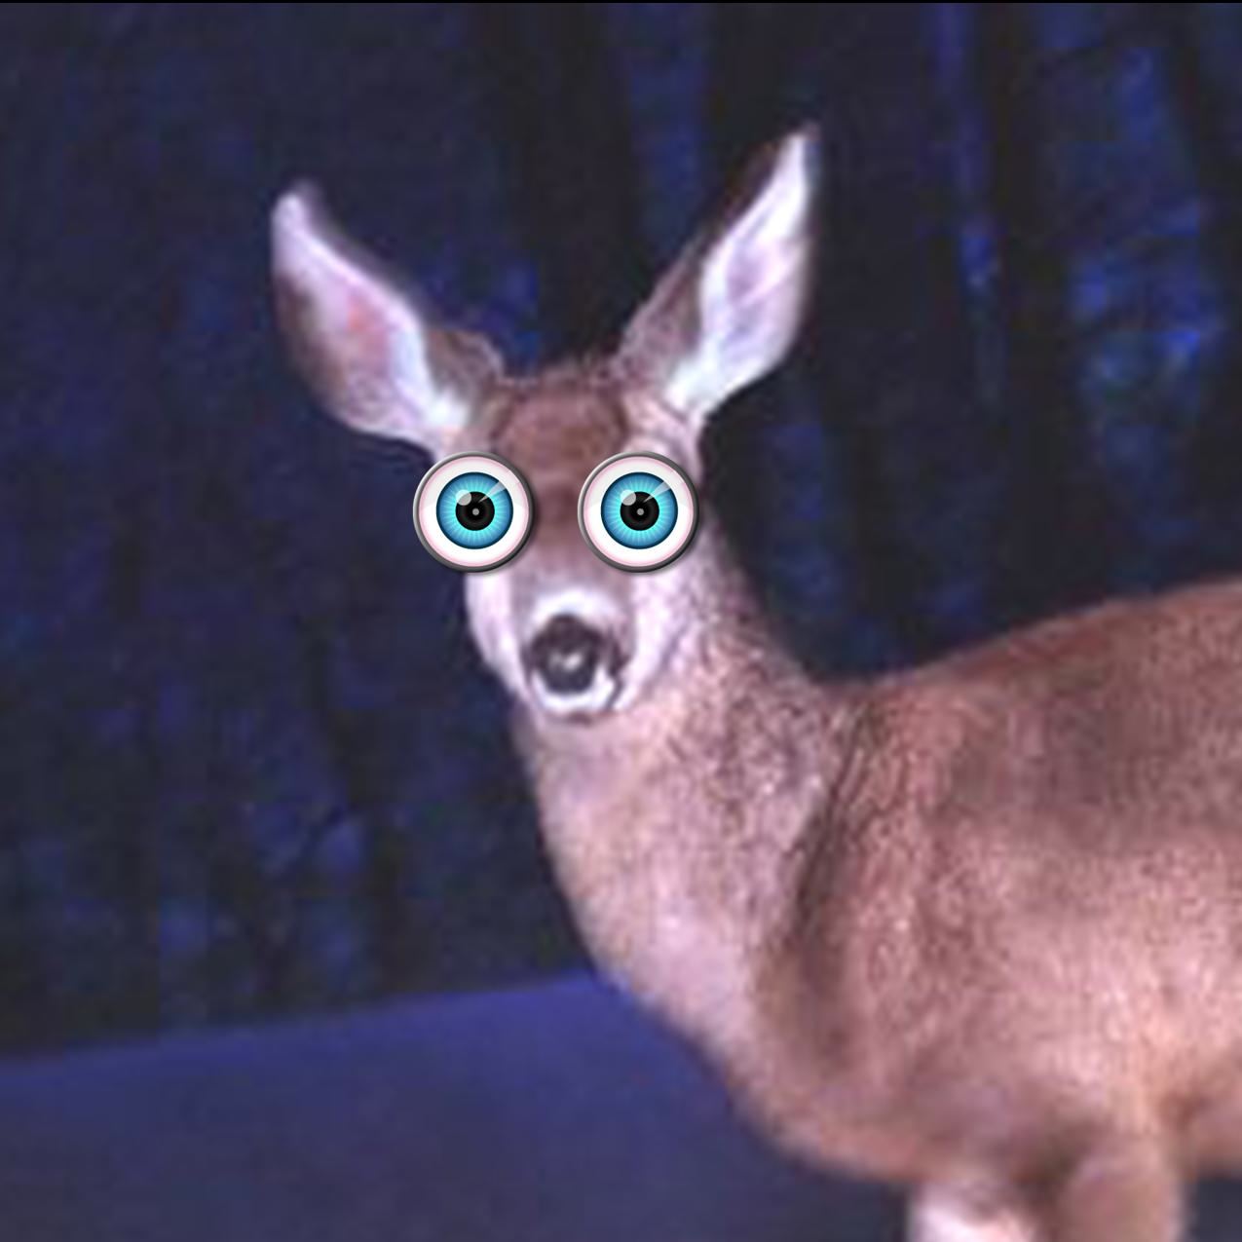
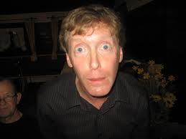
“Deer in the headlights look”

Slide 25
Symptoms
Headache = 71%
Feeling slow = 58%
Difficulty concentrating = 57%
Fatigue = 50%
Blurred or Double vision = 49%
Balance problems = 43%
LOC <10%

Slide 26
Concussion evaluation
Field evaluation
  LOC
  Brief mental status
  Neck pain (rule out C-spine injury)
  Neurological symptoms
Sideline evaluation
  Mental status exam
  Further and thorough neurological evaluation
  BESS, SCAT 3, SAC
  Serial monitoring
      Sit athlete out and re-evaluate in 15 minutes
  Evolving injury, symptoms might be delayed

Slide 27
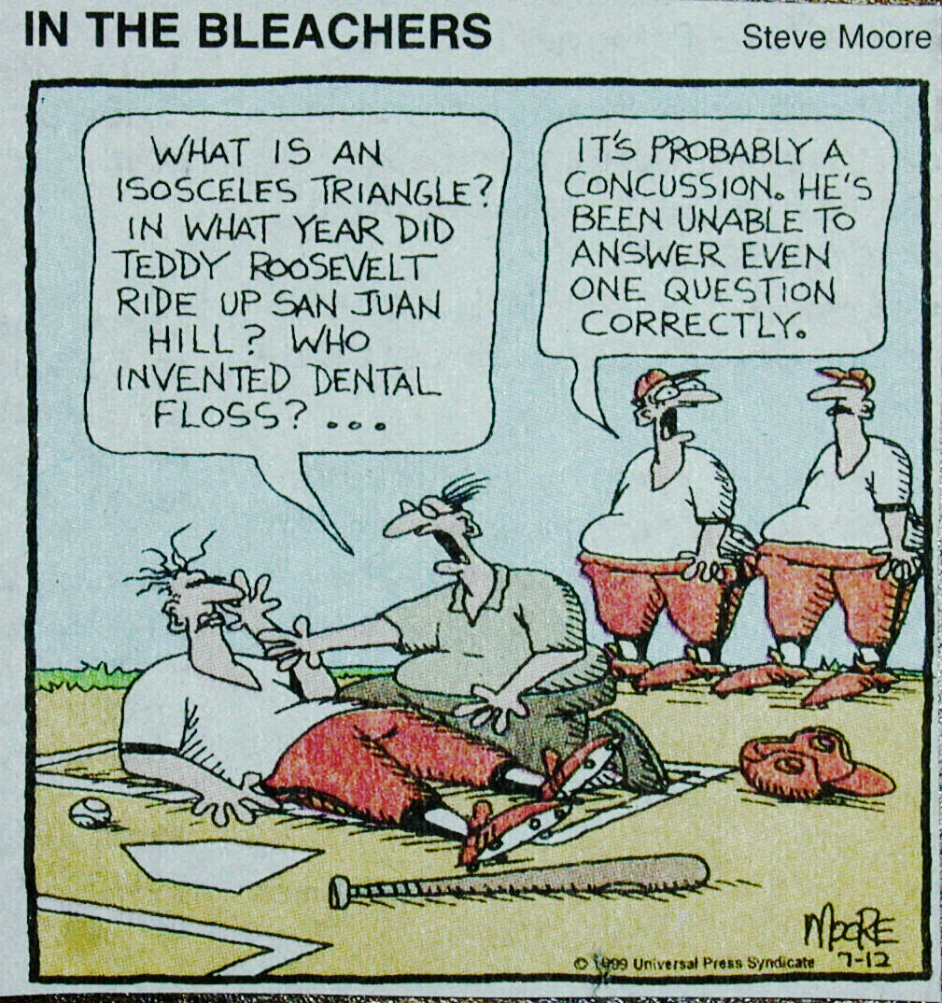
27

Slide 28
Maddocks questions
Which field are we at?
Which team are we playing today?
Who is your opponent at present?
Which half/period is it?
How far into the half is it?
Which side scored the last touchdown/goal/point?
Which team did we play last week?
Did we win last week?

Slide 29
Concussion evaluation
Mental status exam
  Orientation may not be reliable in sports
  Memory function is more reliable
    Events preceding injury
    Current events
    Immediate and delayed recall
    Serial 7’s
    Months of the year in reverse
    Opposing team and score

Slide 30
Balance Error Scoring System (BESS)
Two testing surfaces: Floor/ground and foam pad
Remove shoes and ankle taping
Eyes closed and hands on iliac crests
Twenty second trials of double leg stance, single leg stance and tandem stance in each surface
Record number of errors
    Eyes opening, hands of hips, loss of balance, lifting foot or heel, remaining out of test position for > 5 seconds
http://www.sportsconcussion.com/pdf/management/BESSProtocolNATA09.pdf

Slide 31
Standardized Assessment of Concussion (SAC)
Orientation (month, date, day of week, year, time)
Immediate memory (recall of 5 words in 3 separate trials)
Neurologic:
Loss of consciousness (occurrence, duration)
Amnesia (either retrograde or anterograde) (recollection of events pre- and post-injury)
Sensation
Coordination
Strength
Concentration
Exertional maneuvers (jumping jacks, sit-ups)
Delayed recall (5 words)

Slide 32
SAC test
http://minden.k12.ne.us/modules/groups/homepagefiles/cms/727332/File/SAC%20Concussion%20form%20a%20%20.pdf

Slide 33
Sport concussion Assessment Tool (SCAT)
Replaced the SAC
Added balance testing
Several iterations
  Latest is the SCAT 5 and the addition of the Child SCAT 5

Slide 34
SCAT 5
http://bjsm.bmj.com/content/bjsports/early/2017/04/26/bjsports-2017-097506SCAT5.full.pdf

Slide 35
SCAT 5

Slide 36
Child SCAT 5

Slide 37
Emergent evaluation
Red flags
  Double vision/blurred vision/pupils unequal
  Change in consciousness/unarousable
  Numbness, weakness, unequal/asymmetry one extremity or part of body
  Change in breathing pattern
  Seizures
Make sure athlete is not left alone for 1st 24 hrs.

Slide 38
Concussion: Neurological exam
Eye movements, smooth pursuit, saccades
Pupil response
Neck active ROM
Straight line walk
Romberg sign, tandem stance
Finger to nose, heel to shin
Exert the athlete on sideline to elicit further symptoms

Slide 39
Concussion mantra
When in doubt sit them out

Slide 40
Neuroimaging
Who needs it? Often overused
Guidelines ACEP*:
    LOC or amnesia +one of the following: headache, vomiting >60 years old, intoxication, deficits STM, seizures, trauma above the clavicles, GCS<15, focal neurological deficits, coagulopathy
    No LOC or amnesia + one of the following: focal neurologic deficit, vomiting, severe headache, >65 years old, signs of basilar skull fracture, GCS<15, coagulopathy, significant mechanism of injury (ejection from vehicle, auto v. pedestrian, fall from height>3 ft or five stairs
    *ACEP guidelines apply to >16 years old in ED within 24 hrs of non-penetrating head injury and GCS of 14-15

Slide 41
Neuroimaging
Guidelines AAP and AAFP**:
  LOC > 1 minute, evidence of skull fracture or focal neurologic deficits
  Consider imaging or observation if brief LOC
  Note that nonspecific signs (i.e., vomiting, headache, lethargy, seizures) increase the likelihood of intracranial injury, but have limited predictive value
    **AAP and AAFP guidelines apply to 2-20 year olds presenting to ED within 24 hrs of isolated closed head injury

Slide 42
Office evaluation
Comprehensive history and detailed neurological examination
  Balance testing is very reliable
Assessment of improvement or deterioration of symptoms since injury
  Parents, coaches, teammates, teachers input
Determination of the need for imaging
  Prolonged period of unconsciousness, focal neurological deficits, worsening of symptoms
Neuropsychological testing

Slide 43
Neuropsychological testing
Computerized tests have been described as a cornerstone of concussion management
    Most popular ImPACT
Part of multidisciplinary approach to managing concussions
Insufficient evidence to recommend widespread routine use of baseline testing
      AAN and ICCS
Should be administered in a supervised environment
Limited data in children <12 years old

Slide 44
ImPACT Testing
Neuro-Cognitive computer test
20-25 minutes to complete
Best known concussion testing program available
    Used by NFL, NHL,MLS, MLB, boxing associations, USA Soccer, auto racing, and the NCAA
    Can be used to monitor a patients progression from concussion but the most optimal use is when compared to a players personal baseline

Slide 45
Neuropsychological testing
If baseline testing is available it provides a point of comparison for the test and athlete’s recovery
If baseline testing is not available, repeated tests can help determine recovery progression
Test scores give objective data for Physician and parent discussions
Baseline testing
    NFL 1995
    NHL 1997

Slide 46
Neuropsychological testing
Program should measure:
Attention Span
Working memory
Speed of thinking
Reaction time

Slide 47
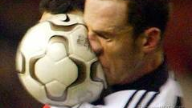
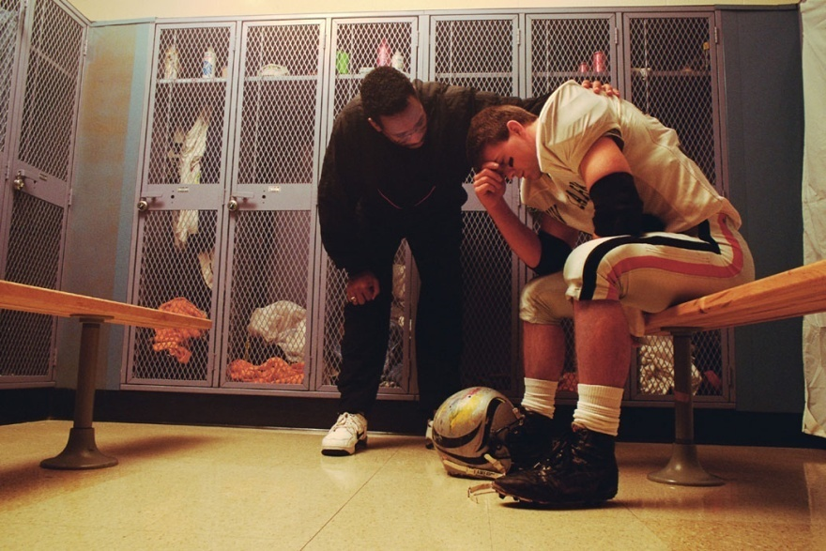
Benefits of Neuropsychologic testing
May assist with returning athletes as quickly and safely as possible
Properly managed-reduce the risk of not only Second Impact Syndrome but other long term neurologic side effects
Provides reproducible objective evidence of players cognitive function

Slide 48
Neuropsychological testing
Neuropsychological testing in general can be part of the concussion evaluation
Any athlete suspected of having a concussion needs to see a healthcare professional trained extensively to deal with brain injury and not just trained to administer a test.
"The confluence of symptom assessment, balance assessment, physical assessment, neurocognitive assessment and clinical interview is the 'best practice' approach,”
      Philip Schatz, professor of psychology at St. Joseph's University.

Slide 49
Concussion management
No same day return to play (RTP)
Physical and cognitive rest until the acute symptoms resolve
Sunglasses, earplugs, medications if needed
Transition back to school
Graduated program of exertion prior to medical clearance and RTP
Individual should be symptom free and not taking any medications that may mask or modify symptoms.

Slide 50
Concussion management
Academics
  Memory, concentration and attention are affected by concussion
  Need to accommodate and restrict academics during period of recovery
  Enroll the participation of teachers and school officials
  Create official return to academics policies with school boards
  Return to full academics needs to be completed prior to any return to sports participation

Slide 51
Return to Academics Strategy
  Daily activities at home that do not give the child symptoms
    Typical activities of the child during the day as long as they do not increase symptoms (reading, texting, screen time)
    Start with 5–15 min at a time and gradually build up
    Gradual return to typical activities
  School activities: Homework, reading or other cognitive activities outside of the classroom
    Increase tolerance to cognitive work
  Return to school part-time: Gradual introduction of schoolwork.
    May need to start with a partial school day or with increased breaks during the day
    Increase academic activities
  Return to school full time
    Gradually progress school activities until a full day can be tolerated
  Return to full academic activities and catch up on missed work

Slide 52
Graduated RTP format
Rehabilitation Stage | Functional exercise at each stage | Objective of the stage
No activity | Symptom limited physical and cognitive rest | Recovery
Light aerobic exercise | Walking, swimming, or stationary cycling keeping intensity <70% of maximal HR No resistance training | Increase HR
Sport specific exercise | Skating drills in hockey, running drills in soccer, etc. No head impact activities | Add movement
Non-contact training drills | Progression to more complex drills May start progressive resistance training | Exercise, coordination, and cognitive load
Full contact practice | Following medical clearance participate in normal training activities | Restore confidence and assess functional skills by coaching staff
Return to play | Normal game play

Slide 53
Concussion management
Evaluate for anxiety and depression
Persistent symptoms >10 days can occur in 10-15% of concussions
If symptoms persist >10 days consider other pathologies
  Manage in a multidisciplinary manner by health care providers with experience in sports-related concussions

Slide 54
Concussion in children
  No RTP for children until they have managed to return to school successfully
      Return to learn before return to sport
Below age 13 children report concussion symptoms differently from adults
  SCAT 5 for children (5-12 years old)
May not comprehend injury significance, may not accept activity restrictions
Evaluation should include input from patient, teacher, coaches and parents
Longer recovery time: 2-4 weeks
More conservative return to play approach is recommended

Slide 55
Concussion: Sub-types
#1. Cognitive/Fatigue
#2. Cervical
#3. Vestibular
#4. Occulomotor
#5. Post-Traumatic Migrane
#6. Mood Disorders
Treatment
  Mental Rest/Meds/Aerobic /Neuropsychologist
  Rehab/Strengthening
  Vestibular Rehab/Aerobic
  Eye evaluation by specialist
  Meds/Neuro
  Neuropsychology/Meds
Sports Traumatol. 2014
Michael W. Collins

Slide 56
Risk Factors for Prolonged
Recovery Following Sports Concussion
Age
  Field, Lovell, Collins et al. J of Pediatrics 2003
  (Pellman, Lovell et al. Neurosurgery 2006
  Guskiewicz. 2011 Pm R
Previous concussion
  Collins, Lovell et al, Neurosurgery 2004
  Iverson, Lovell, Collins, Brit J Sport Med, 2006
  Hollis. 2009 Am J of SM
Migraine History
  Lipton. JAMA 2004
Genetics
  APOE e4: Tierney. Clin J Sport Med 2010
Gender Differences
  Females have higher rate of concussion 1:7:1
  Females more prone to post-concussion symptoms
  Neck strength differences?
  Lovell. Clin Sports Med 28 (2009) 95-11
Mood Disorders
  Kontos. Arch Phys Med Rehab 2012

Slide 57
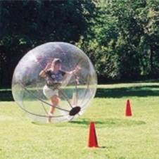
Concussion prevention
Education
  Parents, Coaches, Teachers, Officials
  Physicians, Athletic Trainers, Emergency Medical, Physical Therapists
  Early Recognition/Management
  Appropriate Sports Specific Strengthening (Core & Shoulder Girdle/Neck)

Slide 58
Concussion prevention
Football Rules Changes
  More strict helmet to helmet rules (2010-2013)
  New kickoff rules (2012)
  Targeting with crown of helmet (2013)
  Strike Zone (2013)
  Penalty box?
No body checking in youth hockey until > age 13 does help
Vision training for college football players may be helpful

Slide 59
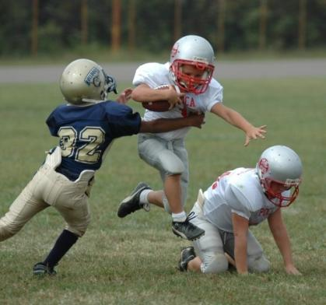
Concussion prevention
Youth Changes: Coaches/Parents role
Be aware of subtle changes in behavior
HELP CHANGE CULTURE
  Can’t tough out head injuries
  Difference between pain & injury
  No dings, bell ringers, seeing stars
NO BLINDSIDE HIT DRILLS
  Learn to take and deliver a blow
  “Heads Up” tackling technique (AAP)
NEW GUIDELINES – Pop Warner rules 2012 (limit number of contact practices)
Can we change the “Culture of Tough” when it comes to head injuries?

Slide 60
Concussion prevention
Current protective gear including helmets and mouthguards have not shown to decrease the incidence of concussions.
  Some protective head gear has shown a reduction of impact forces to the brain (rugby)
  Educate athletes regarding the false perception that equipment protects them from concussions
      May result in more dangerous playing techniques
  Mostly they help protect the skull, face and teeth
Sports specific rule changes may have a larger impact

Slide 61
Second Impact Syndrome
Brain physiology affected by impact
Athlete sustains a second concussion before recovering from the previous one
Glucose use and metabolic rate are increased
Cerebral blood flow decreases and is unable to meet demand
Vascular congestion, brain edema, herniation, coma, death
Usually occurs in athletes <23 years old
About 20 cases reported since 1992

Slide 62
Post Concussion Syndrome
Fatigue, headaches, equilibrium disturbances
Difficulty with concentration
May persist for weeks or months after the injury
Imaging should be obtained if symptoms persist for more than ten days
Neuropsychologic testing
Psychological counseling consisting of education, reassurance and reattribution of symptoms

Slide 63
Long lasting effects of recurrent concussions
Chronic headaches
Cognitive and memory problems
Inability to function and participate in their sport
Depression
Irritability
Permanent brain changes
Increase suicide risk??

Slide 64
Chronic Traumatic Encephalopathy (CTE)
Potential for developing CTE must be considered
Incidence in athletic populations is unknown
A cause and effect relationship has not been documented between CTE and SRC or exposure to contact sports
The relationship between repeated concussion or sub-concussive impacts and CTE is unknown

Slide 65
Retirement from play
AAN recommends that athletes with history of multiple concussions and subjective persistent impairment be counseled about the risks of developing permanent and long lasting cognitive and neurobehavioral problems
Increased length of symptoms, decreased trauma induces concussions, decreased time between concussions
Those who show objective evidence of chronic/persistent neurologic/cognitive deficits should be counseled on retirement from contact sports.

