Slide 1
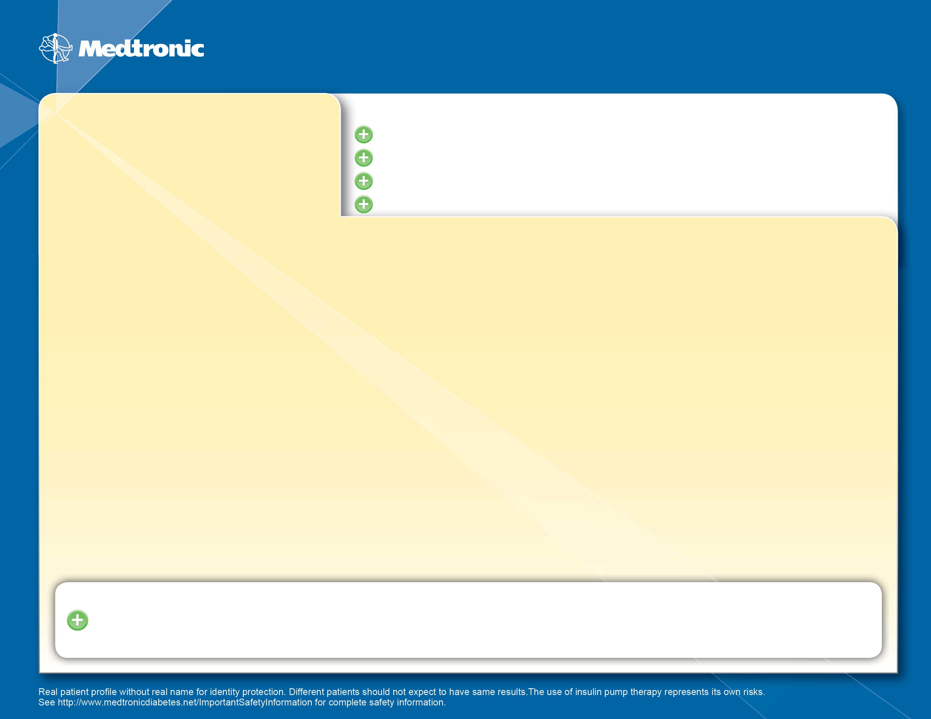
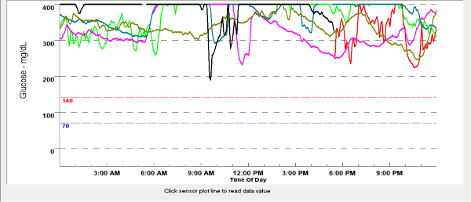
BEFORE using Insulin Pump Therapy...
Richard
Age: 56
Ht/Wt: 6’0”, 360# BMI 48
Occupation: Disabled
A1C: 11.5 %
Medications: Lantus 60 units BID, Novolog 35 units QID, TDD 260 u
Medical History: MS, A Fib, Depression, asthma, GERD
Chief Complaint: Unable to control glucose values, fatigue.
Life With Type 2 Diabetes Before Medtronic Insulin Pump Therapy
No energy, tired of constant high glucose values
No formal carb counting, would guess when dosing for food
Insulin Pump Therapy?

Slide 2
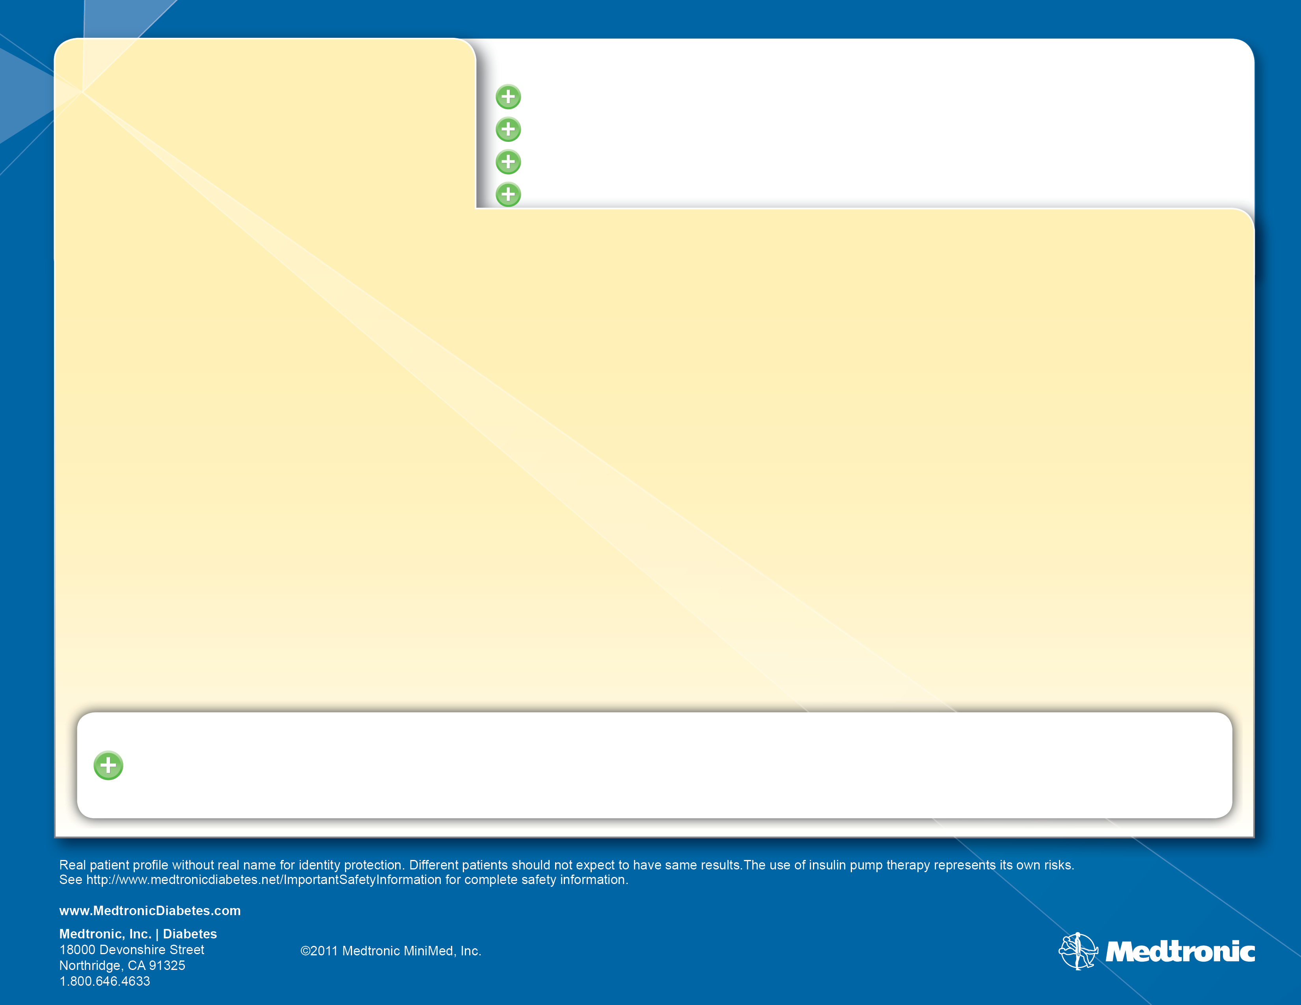
Richard
Age: 56
Ht/Wt: 6’ 0”, 350
AFTER using Insulin Pump Therapy...
A1C: 8.0 %
Medications: Novolog 140 units, 7 weeks post pump
Medical History: More control of glucoses, increased energy
Therapy Benefit: realizing the benefit of carb counting, not as hungry.
Pump Therapy Outcomes
7 weeks after initiating
Avg BG 166
Reduced TTD by 110 units
Continuing to work on wt loss and dose reduction
Pt states: “ I should of done this along time ago! My A1C has never been this low! My disability makes it difficult to exercise, but lowering my insulin will help my wt.
9404493-011 20111028

