Slide 1
Medical education
PRIMARY CARE &
INTENSIVE INSULIN MANAGEMENT
Julie Wood, DNP, CDE, BC-ADM
Diabetes Management Associates, LLC
Mt. Pleasant, TN 38474
950M10067-022 20160623 ©2016 Medtronic MiniMed, Inc. All Rights Reserved.
Notes:
1
Notes
The MiniMed 530G Insulin Pump Practicum
Deck I: “Reviewing Scientific Evidence / Diabetes Technology”
In the next hour or so my plans are to provide a medical review of diabetes technology. I have around 70 slides to cover, so, we are going to move fast, but please stop me if you have questions.
The key idea of this session is to provide you with clinical evidence, studies and information so you can make a more informed decision about the option of using insulin pump therapy as the therapy of choice for insulin requiring patients.
A printout of these slides are provided in your binder– if you would like to follow along and make any notes.

Slide 2
Learning objectives
Perspective on care for T2 diabetes
Standards of medical care
Available treatment options
Potential for significant improvement in patient outcome

Slide 3
TYPE 2 DIABETES – THE CHALLENGES
Notes:
3
What are the challenges of Type 2 diabetes?
Compliance
Cost of meds, insurance approval
Choosing correct medication

Slide 4
incidence of Type 2 diabetes is increasing
Shortage of endocrinologists to meet rising demand
“There are some 4,000 M.D. endocrinologists to care for approximately 25 to 100 million patients who might reasonably wish to be seen by an endocrinologist”
    -Andrew Stewart, M.D., chief of endocrinology division at University of Pittsburgh
Though the incidence of diabetes is on the rise, Endocrinology fellowship programs are declining (140 in 1996 to 122 in 2008)¹
Stewart, A. J Clin Endocrinol Metab. 2008;93(4):1164-1166

Slide 5
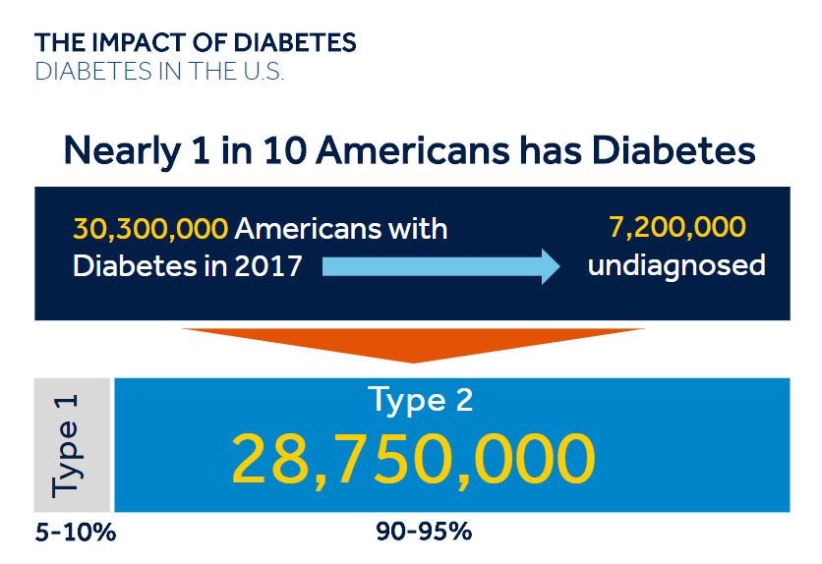
Notes:
Statistics for US.
Quadruple this stat for worldwide.
2040 estimated to be 160 million in US.

Slide 6
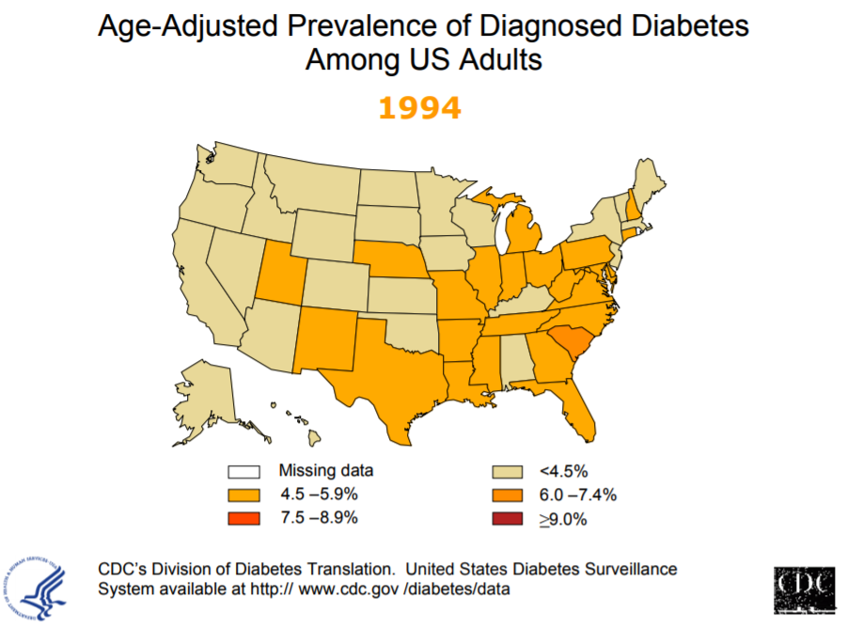
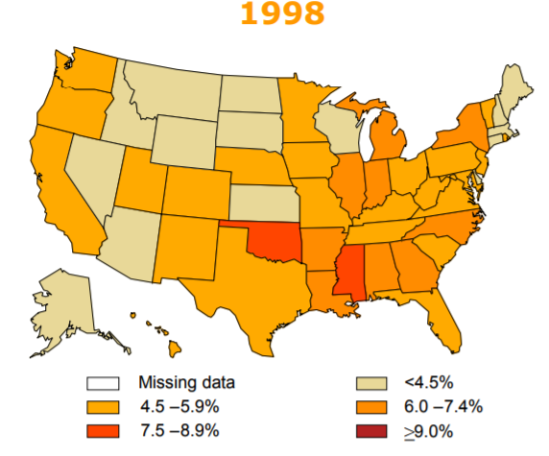
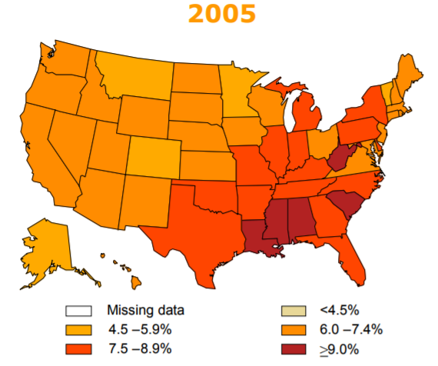
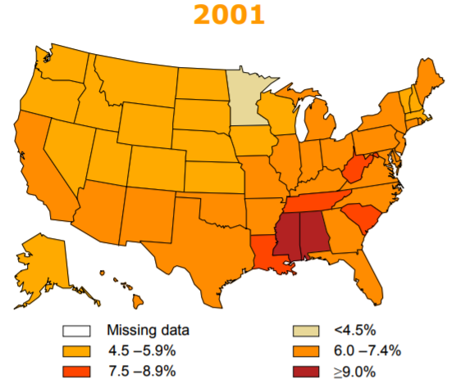
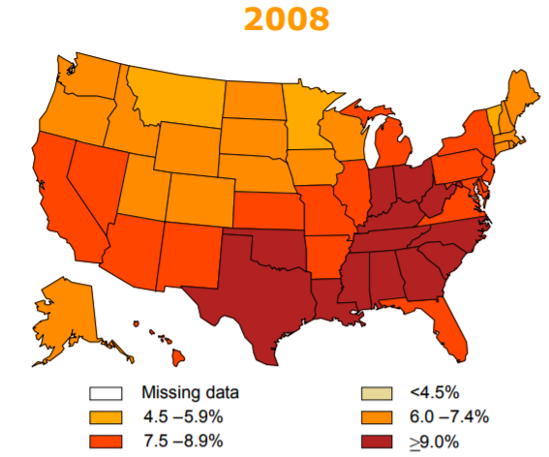
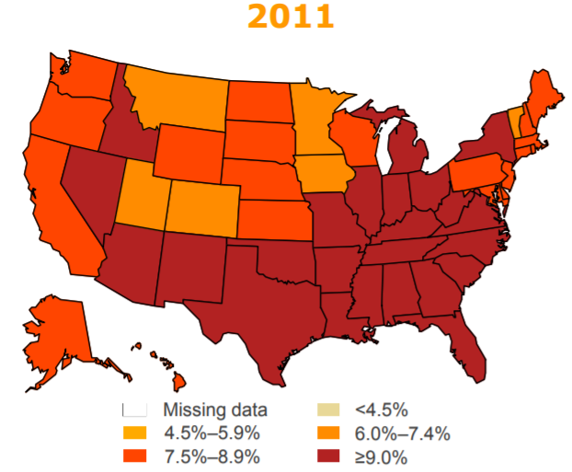
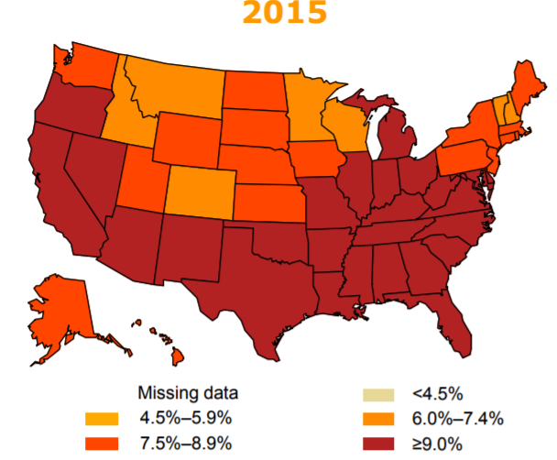
U.s. | Area mapping

Slide 7

TN | Area mapping
10.6%+
Notes:
Madison County is 9.8% according to CDC stats of 2015

Slide 8
Type 2 Diabetes
characterized by insulin resistance & progressive
β-cell failure, resulting in increasing hyperglycemia¹
Treatment Challenges
Patients with advanced type 2 diabetes often require insulin
A1C targets often are not achieved when basal insulin is added ^{2,3}
Multiple Daily Injections (MDI), long-acting + rapid-acting insulin, are typically added when targets are not achieved
30% of type 2 patients on MDI still do not achieve A1C targets
  These patients have increased risk of hypoglycemia and weight gain⁴
Limitations of MDI highlight the need for new treatment strategies in this subgroup of patients
Ferrannini E, et al. J Clin Endocrinol Metab 2005;90:493-500.
Inzucchi SE, et al. Diabetes Care 2012; 35:1364-1379.
Riddle MC, et al. Diabetes Care 2003;26:3080-3086.
Reznik, Y, et al. Lancet 2014;1265-1272.

Slide 9
TYPE 2 DIABETES IS A PROGRESSIVE DISEASE
KNOWN CHALLENGES
1 2
OUT
OF
Patients living with type 2 (T2) diabetes on multiple daily injections (MDI) are not reaching their glycemic targets (a1c > 8%)¹
8
10
OUT
OF
T2 patients report having either major depression or some depressive symptoms ²
1 2
OUT
OF
Patients admitted to often skipping insulin injections they know they should take³
Arcangeli, A, et al. AMD Associazione Medici Diabetologi. 2011: Accessed July 20, 2016.
Gonzalez J, et al. Diabetes Care 2007;30(9): 2222-2227.
Peyrot M, et al. Diabetes Care 2010;33(2):240–245.

Slide 10
Impaired Glucose Tolerance Precedes DX
Schematic of β-cell failure and insulin resistance prior to diagnosis
Pre-diabetes
Diabetes
Insulin Resistance
Endogenous Insulin
Postprandial Blood Glucose
Time of Diagnosis
Fasting >125mg/dL
Postprandial >180mg/dL
Fasting Blood Glucose
4-7 years
β-cell failure
Years
Adapted from Ramlo-Halsted BA, Edelman SV. Prim Care. 1999;26(4):771-789.
Notes:
Notes
“Natural History of Type 2 Diabetes” – Barbara Ramlo-Halsted and Steven Edelman, 2000
The causes of β-cell failure is unknown, however we do know that it begins to occur very early in the pathogenesis of T2 DM.
Drs. Ramlo-Halsted & Edelman have shown, as insulin resistance increases, the production of endogenous insulin begins to decrease.
We can see this initial phase of β-cell failure 4-7 years prior to the diagnosis of T2 DM.
measurable change in β-cell secretion is evident before meeting the diagnostic criteria for type 2 or even impaired glucose tolerance.

Slide 11
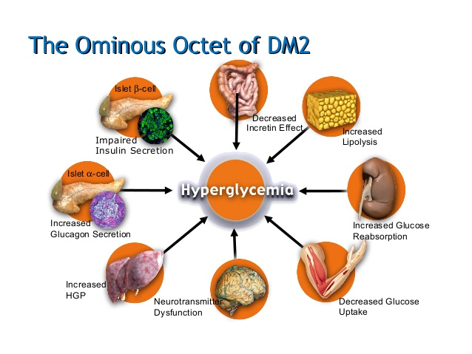
Ominous octet of dm2
Adapted from Defronzo. Diabetes.2009;58:773-795
Notes:
2009. Dr. Ralph DeFronzo elaborates further on natural history of DMT2
Insulin resistant is partly d/t genes inherited from our parents
IR affects liver with overproduction of glucose in basal state and impaired suppression during following a meal
HGP- hepatic glucose production
IR affects Muscle with impaired glucose uptake after meal
IR resistant in muscle, liver and b-cell dysfunction has been called “TRIUMVIRATE”
Fat cells (adipocytes) are resistant to insulins antilipolytic effect and thus more FFA----gluconeogenesis---insulin resistance----impaired insulin secretion
Lowering BGs lowers TGS
Gut- GLP-1 inhibitor of glucose secretion---postmeal rise in plasma glucagon and impaired suppression in HGP.
Alpha cells of pancreas- elevated plasma glucagon---increase basal rate of HGP
Kidneys- filter 160 grams of glucose daily (4x160=640 calories)
90% reabsorbed by SGLT-2 in proximal tubule.
Rest by SGLT-1 in descending proximal tubule
This process is maladaptive in DM
Brain- Impaired appetite regulation by insulin or IR

Slide 12
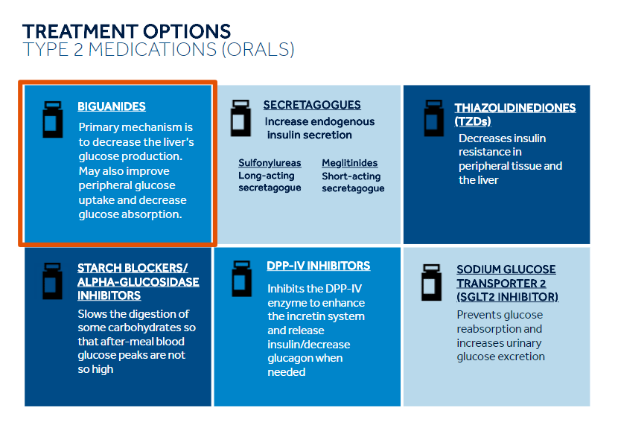

Slide 13
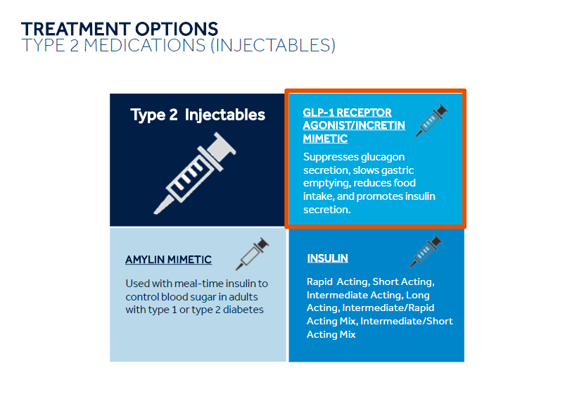

Slide 14
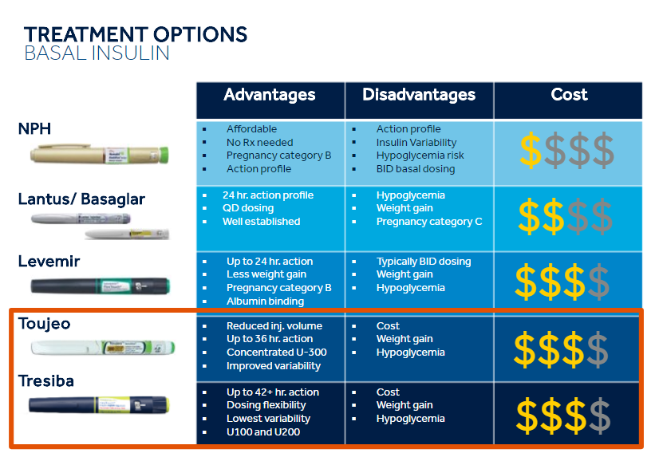
Notes:
Insulin- 24 types
Tresiba U-100 and U-200
Toujeo U-300

Slide 15
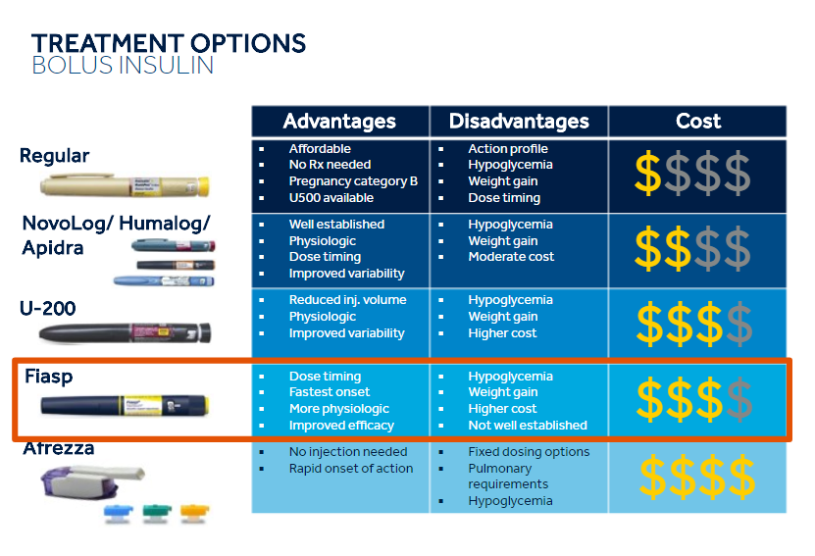
Notes:
U-500
Mixed insulins

Slide 16
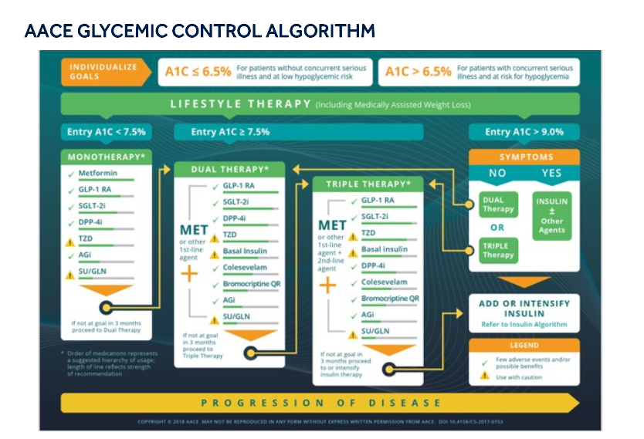

Slide 17
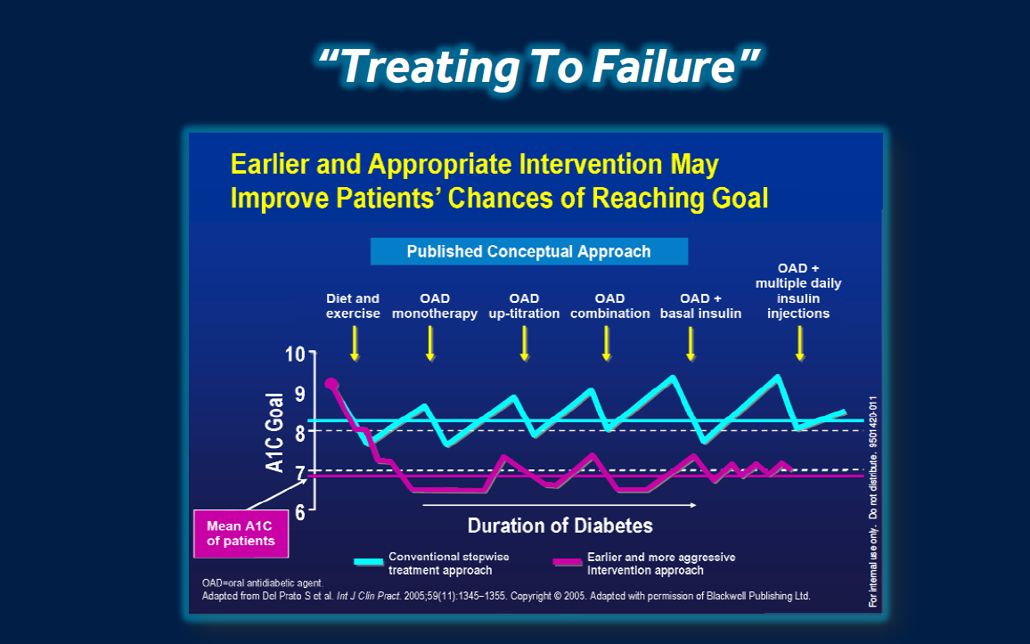

Slide 18
Diabetes Control & Complications Trial (DCCT)
Published 1993
Study Stopped at 7.4 Years (6.5 years average follow-up)
Compassionate need
  Overwhelming evidence needed to be relayed to conventional therapy group
Study Results
Long-term complications significantly reduced in intensive therapy group
  Retinopathy by 63%
  Neuropathy by 60%
  Nephropathy by 54%
Average BG:
  Intensive Therapy: 155 mg/dL (A1C = 7.1%)
  Conventional Therapy: 231 mg/dL (A1C = 9.0%)
Conclusion:
Long-term complications minimized when near normal glucose levels are achieved
DCCT Research Group. N Engl J Med. 1993;329:977-986.
Notes:
Notes
The primary landmark study that showed proof of the benefits of using intensive therapy was a large study
conducted way back in the 1982
published in 1993.
DCCT, or the Diabetes Complications Control Trial study.
1,400 people in the DCCT study
designed to be 10 years in length.
- purpose of the study was to confirm these two questions:
1) Are abnormally high blood glucose levels related to the long term complications so commonly seen in patients with diabetes
2) If so, can these long-term complications be minimized by keeping glucose levels as close to normal as possible.
There were two groups or arms to the study:
Group 1: The “Conventional Therapy” group, stayed on conventional therapy which consisted of two injections per day – a combination of long-acting insulin and regular-acting insulin.
Group 2: The “Intensive Therapy” group was placed on intensive insulin therapy.
That meant taking at least three injections per day or using an insulin pump. It could be either one.

Slide 19
Diabetes Control & Complications Trial (DCCT)
Published 1993
Purpose
Determine if intensive therapy reduces long-term complications associated with diabetes
  Intensive Therapy vs. Conventional Therapy
Design
10 Year Study (n = 1441 patients)
2 Groups:
  Conventional Therapy (1-2 injections/day)
  Intensive Therapy (≥3 injections/day or Pump)
DCCT Research Group. N Engl J Med. 1993;329:977-986.
Notes:
Notes
Even though the study was designed to last ten years, it was stopped early - at 7.4 years.
Now, as we all know, when a study stops early it is either because it is showing either very bad or very good results.
And in the case of the DCCT actually showed both.
It stopped for two reasons:
1) At 7.4 years there was overwhelming evidence that intensive therapy really did minimize the risk for complications
2) there was a concern for those subjects who were in the control group
They did not feel that it was ethically right to keep those people on conventional therapy because they too could be benefiting from using a more intensive insulin regimen.
What the DCCT study clearly showed was that if we could use intensive insulin therapy safely (without increasing hypoglycemia) we could significantly reduce the risk of patients developing long-term complications.

Slide 20
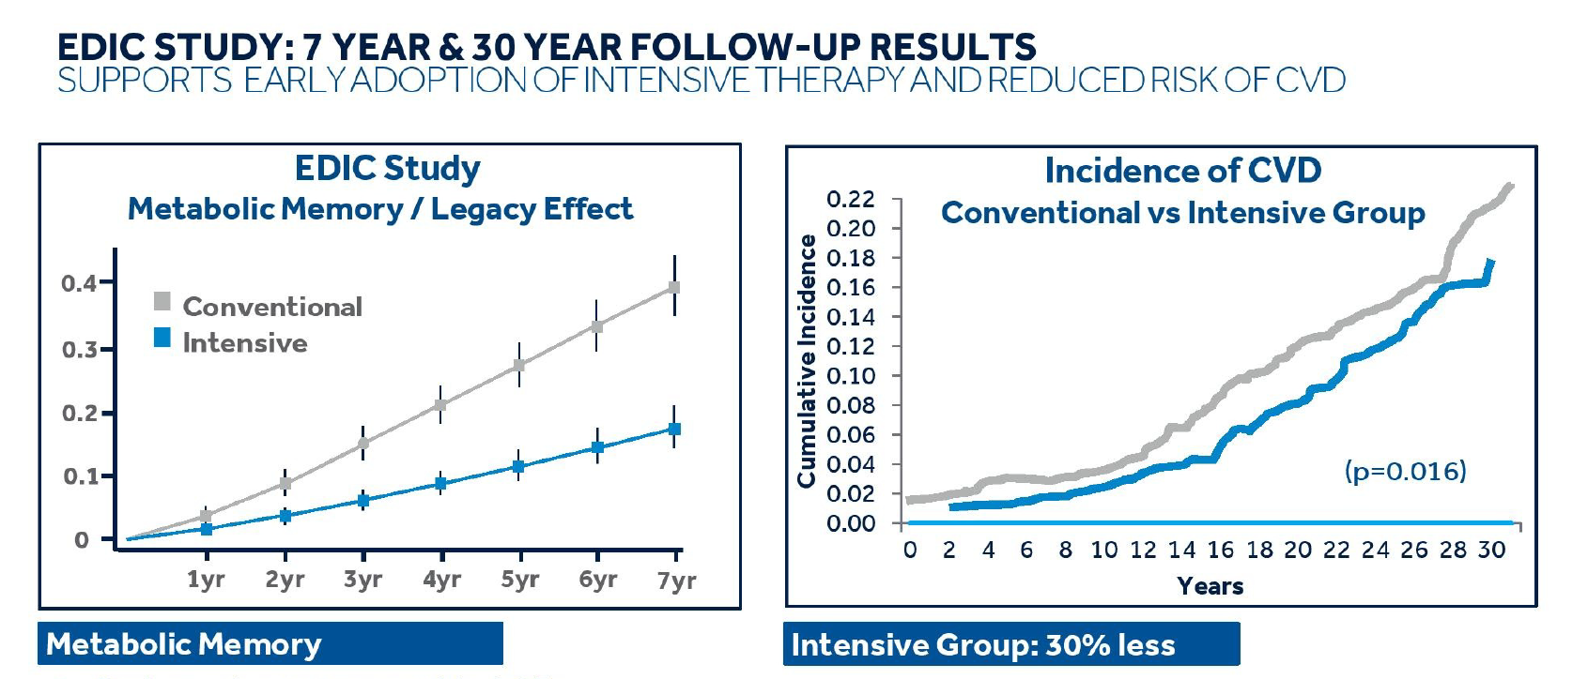
EDIC STUDY: 7 yr & 30 yr follow up results
Supports early adoption of intensive therapy &
Reduced risk of cvd
Notes:
EDIC- Epidemiology of Diabetes Interventions and Complications
Began in 1994
Follow-up for 30 years.

Slide 21
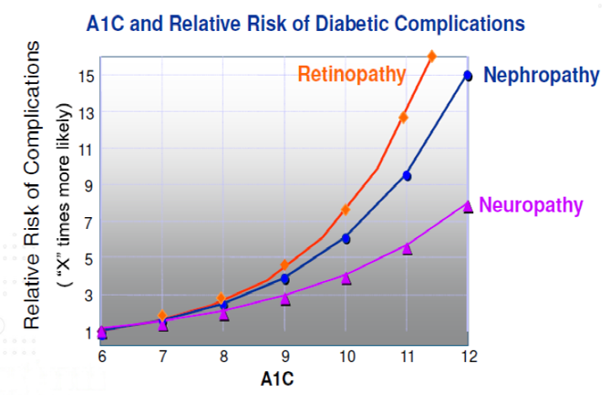
Remember this
8% A1C nearly TRIPLES the risk of retinopathy
10% A1C nearly 7X
11% A1C nearly 12X
Notes:
Early control is important
before complications develop

Slide 22
Legacy Effect: A1C Contribution Over Time
Legacy Effect
3.0
2.5
2.0
Relative risk contribution
1.5
1.0
0.5
0
0
1
2
3
4
5
6
7
8
9
10
Time since A1C value was attained (years)
Lind M, et al. Diabetalogia 2010;53:1093-8.
Notes:
Lowering of relative risks of DM complications by obtaining good control early.
PREVENTION of complications

Slide 23
ANSWERING THE CHALLENGES OF DIABETES management
Insulin pump therapy for patients with type 2 diabetes
1
  Better Glucose Control
  Lowered A1C¹
  Reduction of total daily dose of insulin¹
  Reduced risk of microvascular & macrovascular complications³
2
  Better Quality of Life
  Simplified diabetes management with fewer injections or complicated insulin regiments
  Easy, discrete dosing with or without carb counting
1. Aronson R, et al. Diabetes Obes Metab. 2016. e-pub ahead of print. DOI: 10.1111/dom.12642
2. UK Prospective Diabetes Study (UKPDS) Group. Intensive blood-glucose control with sulphonylureas or insulin competed with conventional treatment and risk of complications in patients with type 2 diabetes (UKPDS 33). Lancet. 1998;352(9131):837-853.

Slide 24
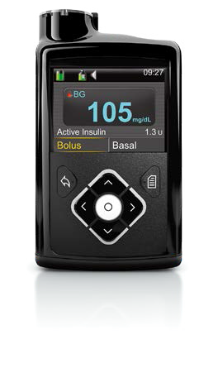
Why Pumps Provide Better Control
Pumps use rapid-acting insulin
  Minimizes insulin variability
  Precise and continuous insulin delivery
  Less insulin utilization
Pumps deliver insulin in two ways:
  Basal
    Replaces long-acting insulin
    Covers hepatic glucose production / maintains glycemic stability in fasting states (between meals & overnight)
    Automatically delivers precise programmed dose
    Adjusted to match diurnal variations
    Can set multiple basal rates, if needed
  Bolus
    Covers food intake and corrects high BG levels
    Manual bolus to calculate meal time dose
Pumps use Bolus WizardTM calculator
  Calculates insulin boluses (food & correction)*
  Tracks “active” insulin
*WARNING: Do not use the Bolus Wizard to calculate a bolus for a period of time after giving a manual injection of insulin by syringe or pen. Manual injections are not accounted for in the active insulin amount. Therefore, the Bolus Wizard could prompt you to deliver more insulin than needed. Too much insulin can cause hypoglycemia. Consult with your healthcare professional for how long you need to wait after a manual injection of insulin before you can rely on the active insulin calculation of your Bolus Wizard."
Notes:
Notes
Insulin pumps come closer than MDI to mimicking the natural insulin delivery of a healthy pancreas

Slide 25
Pumps Deliver Insulin in Two Ways
Pumps Use Basal and Bolus Insulin Delivery
Breakfast
Lunch
Dinner
Snack
Insulin
12am 3am 7am 12pm 6pm 9pm
Time of Day
Insulin delivery more closely mimics insulin secretion of a healthy pancreas
Notes:
Notes
secretion of insulin by a normal functioning pancreas.
small amounts of insulin in fasting states
larger amounts when a person eats.
Pump can come closer to matching this normal secretion than with injections.
pumps deliver insulin in two ways:
Basal insulin (background insulin) and bolus insulin (for meals).
Basal insulin is the insulin that is constantly delivered in tiny increments similar to the way a healthy pancreas secretes insulin.
Bolus is determined by patient based on amounts of food and blood sugars levels.

Slide 26
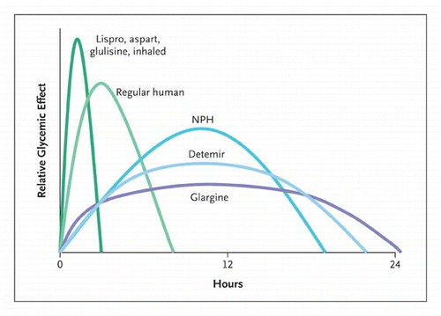
Notes:
Each type of insulin has a unique
action time
peaks
time it remains active
Called pharmacodynamic

Slide 27
Insulin Pumps Use Only Rapid-Acting* Insulin
Rapid-acting insulin minimizes therapy errors due to pharmacodynamic variability in insulin action**
Intermediate-acting
insulin
Long-acting
insulin
46%
Rapid-acting insulin
36%
16%
Rapid-acting insulin
has the lowest
intrapatient variability
*U100 Insulin
**Percentages represent coefficients of variation for insulin action as measured by maximum glucose infusion rate in these euglycemic glucose clamp studies
Heinemann L, et al. Diabetes Care.1998;21:1910–1914;
Heise T, et al. Diabetes. 2004;53:1614-1620.
Notes:
Notes
Pharmacodynamic variability is how consistently expect insulin to act upon the body from one patient to the next
46% variation in the effectiveness of intermediate-acting insulin
36% variability for long-acting insulin
rapid-acting insulin – less than half of the closest – three times much more accurate than intermediate acting insulin
- Ultra rapid- Fiasp
So, even if you are using MDI therapy exactly as directed and you are using an intermediate or a longer-acting insulin such as glargine to cover basal insulin requirements throughout the day, the action is inconsistent enough that every day could be different and it would be hard to know how much is still active and to determine if or how much to give when glucose levels are running high during the day or night.
limitations of longer acting insulin.
Rapid-acting insulin has the lowest intra-patient variability, and it is easier to reproduce similar results day after day.
In today’s market, most pump patients use rapid-acting insulin.

Slide 28

Using An insulin pump - 90% fewer shots
120 injections
per month*
1,440 injections per year
12 infusion site changes per month**
144 site changes
per year
PUMP THERAPY
MULTIPLE DAILY INJECTIONS
*Assumes four injections per day for 30 days.
**Assumes one infusion site change every 2 to 3 days.

Slide 29
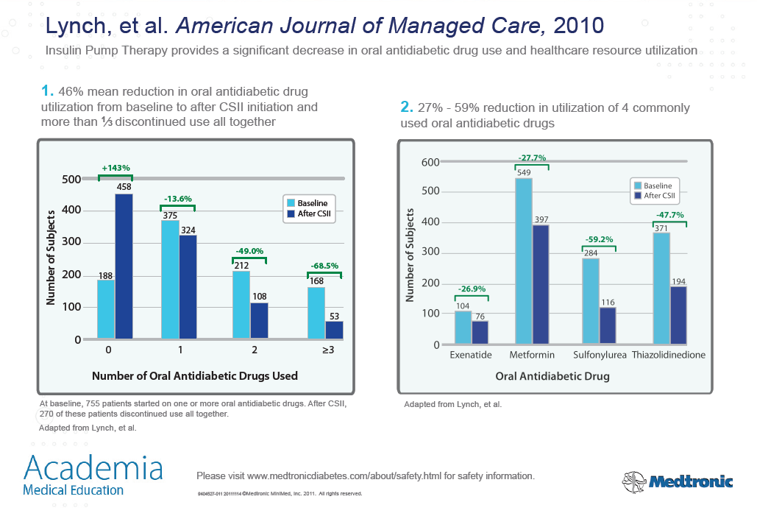
Oral medications can be reduced with pump therapy
46% mean reduction in oral antidiabetic drug utilization from baseline to after insulin pump therapy utilization.
More than 1/3 discontinued use of oral antidiabetic medications altogether.
27-59% reduction in utilization of 4 commonly used oral antidiabetic drugs
Though it is an injectable drug, Exenatide is listed as an oral antidiabetic drug in the source document.
Notes:
OAD reduction d/t
Not effective
Improved glucose control
Cost savings
s/e, adverse reaction

Slide 30
Pumps increase cost savings for some patients
Medical office visits and complications are reduced
“The impact of CSII [insulin pump] treatment for these high insulin-use patients is 2-fold: improved glycemic control and substantially lower cost. The potential for cost savings due to improved glycemic control, which can reduce medical office visits and complications, in the middle insulin user group should also be considered in the determination of approval for insulin pumps.”
$12,274 cost savings over 4 years in high-use insulin category
Notes:
Pumps initial cost is expensive
Less missed work time

Slide 31
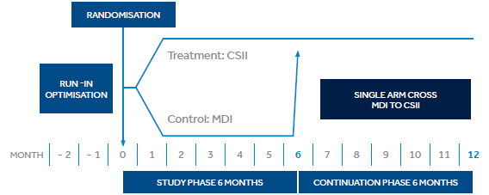
OPT2MISE STUDY DESIGN¹
OBJECTIVE: Compare the efficacy of pump therapy and multiple injection therapy in patients with type 2 diabetes who had failed to respond to a basal-bolus regimen after optimal insulin intensification.
DESIGN:
Randomized controlled trial with single arm cross over
Subjects: 331 adult patients randomized (35-75 years old) in 36 centers across the globe
METHODOLOGY:
Primary endpoint: Between-group difference in mean change in HbA1c from baseline to 6 months
  Δ Pump A1C - Δ MDI A1C
Aronson R, et. al. Diabetes, Obesity and Metabolism. 2016;18:500-507.
Notes:
A total of 36 centers participated in the study: 8 in Canada, 23 in Europe and Israel, 2 in South Africa, 3 in the USA
three phases: an 8-week run-in phase, 6-months study phase and 6-months continuation phase.
RUN-IN Phase (8 weeks)
- Designed so that all patients are optimally treated with an MDI regimen.
- Protocols given to help titrate based on published practiced guidelines
- Three (3) visits for all patients: insulin dose titration, nutritional counselling & diabetes education
- All oral medications were stopped and standardized to metformin alone at the maximally tolerated dose.
- Told to test BG a minimum 2.5 times per day
STUDY Phase (2 weeks)
- Three (3) visits : Patients assigned to pump group underwent pump training whereas the MDI therapy was continued with ongoing titration.
- Pump training with the patient was performed according to site routine practice.
- Bolus design are left to the investigators judgment and ranged from set doses to doses based on ICR/ISF.

Slide 32
OpT2mise Subject Characteristics
  PATIENT POPULATION
    Insulin-taking type 2 on MDI (≥ 3 injections/ day)
    A1C between 8.0% and 12%
    Insulin dose: 0.7 to 1.8 units/kg/day (≤220 units/day)
    Mean number of blood glucose measurements ≥2.5 times/ day
590 patients screened to enter run-in
495 patients in 8-week run-in phase
Randomization
331 randomized in 6-month study phase
6-Month Study Phase (SP)
168 assigned to pump/pump
163 assigned to MDI/pump
No significant differences between groups at baseline except HDL higher in MDI group
152 pump/pump finished SP*
156 MDI/pump finished SP
6-Month
Continuation phase (CP)
MDI
cross over
146 pump/pump finished CP
145 MDI/pump finished CP*
*<10% attrition
291 completed CP
Aronson R, et. al. Diabetes, Obesity and Metabolism. 2016;18:500-507.
Notes:
30–75 years old
at least 3 injections per day of long-acting and rapid-acting insulin analogs, for at least the previous 3 months.
- Patients (n=495) with poor glycemic control despite multiple injections with insulin analogues were enrolled into a 2-month dose-optimization run-in period.
After the run-in phase, patients with A1C ≥ 8·0% and ≤12% (n=331)
to study phase
randomized into two groups
continued on multiple injection therapy (163 assigned to the control group)
initiated insulin pump therapy (168 assigned to the treatment group).
- At the end of the study phase (6 months),
MDI group crosses over to use insulin pump therapy
both groups proceed with pump therapy for the continuation phase.
308 patients completed Run-in and the 6- month study phase.
followed up during the 6-month continuation phase
total study period of 12 months
291 patients completed
Run-in, 6-month study and 6-month continuation phase

Slide 33
OPT2mise Results
Significant a1c reduction
CSII/CSII MDI/CSII
10
BASELINE
9%
Mean A1C and 95% C.I. (%)
9
MDI
8.6%
(-1.2%)
p<0.0001
CSII
(-0.7%)
p<0.0001
CSII
8
_{7.9%} CSII
7.8%
7
Run-in
Study Phase
Continuation Phase
-9
0 3
15
27
39
51
Week
SIGNIFICANT
1.2% A1C drop vs baseline in both groups after 12 months
Over 50% of the patients were able to achieve and maintain A1C<8%
SUSTAINABLE
Reduction in A1C maintained over 12 months
No significant weight gain
REPRODUCIBLE
Similar A1C reduction after 2 or 8 months of optimal insulin intensification
Aronson R, et. al. Diabetes, Obesity and Metabolism. 2016;18:500-507.
Notes:
6-months
MDI achieved 8.6% (0.4% reduction)
vs. 7.9% (1.1% reduction) for pump group
for a 0.7% between group difference.
- After the 6-month continuation phase (12-month total) both groups achieved mean HbA1c of 7.8% for a 1.2% reduction from baseline
significant improvement in A1c of 1.2% form baseline
sustainability of this change as evidenced over 12-months

Slide 34
INSULIN reduction seen with pump therapy
CSII/CSII MDI/CSII
150
Total Daily Dose and 95% C.I. (U/day)
125
MDI
121.7
CSII
112.1
-19%
p<0.0001
-20%
(p<0.001)
106.1
CSII
96.8
98.3
98.6
100
CSII
75
Run-in
Study Phase
Continuation Phase
- 4
0 3
15
27
39
51
Week
SIGNIFICANT
~19% TDD (Total Daily Dose) reduction in both groups
SUSTAINABLE
Reduction in TDD maintained over 12 months
REPRODUCIBLE
Similar reduction in TDD after 2 or 8 months of optimal insulin intensification
Aronson R, et. al. Diabetes, Obesity and Metabolism. 2016;18:500-507.

Slide 35
OpT2mise Results Summary
Pump therapy in sub-optimally controlled type 2 diabetes patients provided improved overall glucose control
Significant A1C reduction of -1.2% in both groups over 1 year
  >50% achieved A1C <8.0%
19% used less insulin on pump therapy
No significant difference in weight gain
Simple bolus approach using pump therapy was effective
Aronson R, et. al. Diabetes, Obesity and Metabolism. 2016;18:500-507.
Notes:
Notes

Slide 36


ADA and AACE support
Advantages of insulin pump therapy & Expanded criteria
Advantages of using an insulin pump¹:
Expanded criteria for using an insulin pump²:
Insulin pumps deliver insulin more accurately than injections
Using an insulin pump usually results in fewer large swings in blood glucose
Using an insulin pump makes delivery of bolus insulin easier
Using an insulin pump reduces severe low glucose episodes
Using an insulin pump eliminates unpredictable effects of intermediate- or long-acting insulin
Patients with type 1 diabetes and intensively managed insulin-dependent patients with type 2 diabetes
Patients who are currently performing multiple daily injections and self-monitoring glucose levels daily
Patients who are motivated to achieve optimal glucose control
[Insulin pump therapy] has been associated with improved A1C, improved patient satisfaction and reduced hypoglycemia frequency… studies have shown CSII to be more effective at lowering A1C than injection therapy
1. http:// www.diabetes.org/living-with-diabetes/treatment-and-care/medication/insulin/advantages-of-using-an-insulin-pump.html. Accessed May 16, 2017
2. Grunberger G. et al. Endocrine Pract. 2014;20(5): 463-489.

Slide 37
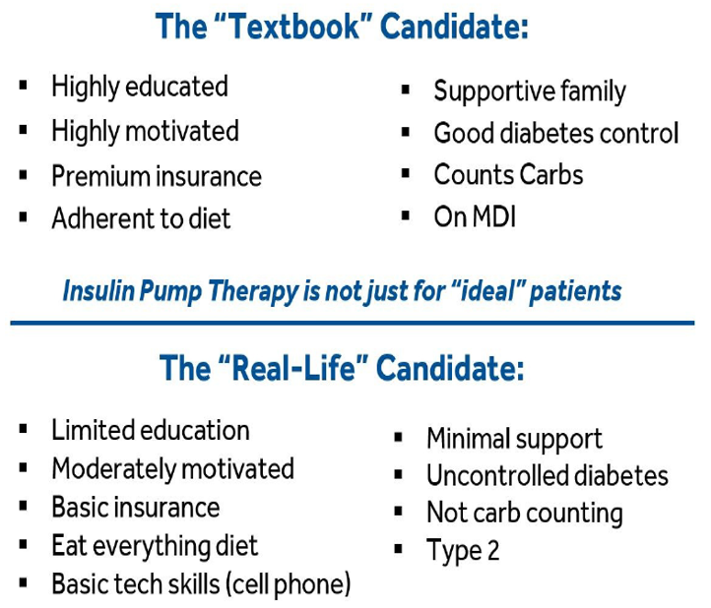
Who can benefit from insulin pump therapy?

Slide 38
Questions?
Thank You!
Notes:
Notes

