Slide 1
Etiology, Pathophysiology, Diagnosis, and Treatment of Heart Failure
ADEY AGBETOYIN,MD FACC.
CARDIOVASCULAR CLINIC OF WEST TENNESSEE,PC.
Notes:
This presentation is provided for educational purposes only and should not be considered the only source for this type of information. At all times, it is the professional decision of the practitioner to exercise independent judgment in a particular situation.

Slide 2
This presentation is provided for educational purposes only and should not be considered the only source for this type of information. At all times, it is the professional decision of the practitioner to exercise independent judgment in a particular situation.
I HAVE NO DISCLOSURES.

Slide 3
Objectives:
Upon completing the session, the participant will be able to:
  Describe the incidence and prevalence of heart failure
  List the common etiologies of heart failure
  Define the compensatory mechanisms that occur due to heart failure
  Identify current assessment and treatment modalities for heart failure patients
  Describe Cardiac Resynchronization Therapy (CRT) and the patient population indicated for CRT devices

Slide 4
Part I:
Etiology and Pathophysiology of Heart Failure
Notes:
Under normal circumstances, the heart accepts blood at low filling pressures during diastole and then propels it forward at higher pressures during systole. A variety of disorders can impair the ability of the heart to meet the metabolic demands of the body. Heart failure (HF) can be defined as a complex clinical syndrome resulting from any structural or functional cardiac disorder that impairs the ability of the ventricle to fill with or eject blood.
Today, substantial healthcare resources are used to treat heart failure patients, yet heart failure patients continue to have a poor quality of life and an unacceptably high mortality rate. According to the American Heart Association, the five-year mortality rate for heart failure patients is about 50%.

Slide 5
Heart Failure (HF) Definition
A complex clinical syndrome in which the heart is incapable of maintaining a cardiac output adequate to accommodate metabolic requirements and the venous return.
Notes:
Heart failure is estimated to afflict more than 22 million people worldwide with an estimated 2 million new cases diagnosed annually.¹
In the United States it is estimated that 5 million people have HF, with 10 out of every 1,000 over the age of 65 being afflicted.²
It is the only major cardiovascular disorder that is increasing in incidence and prevalence.
Other Heart Failure Statistics:
HF patients take an average of six medications³
78% of HF patients have had at least two hospital admissions per year³
Cost of HF in the U.S. is estimated to be between $10 billion and $38 billion annually⁴
5-year survival rate for all NYHA classes estimated at 50%²
1 World Health Statistics, World Health Organization, 1995.
2 American Heart Association, 2002 Heart and Stroke Statistical Update
3 English M and Mastream M. Crit Care Nurse Q 1995;18:1-6.
4 Havranek EP, Abraham WT, The Healthcare Economics of Heart Failure 1998; 14:10-18.

Slide 6
HF Incidence and Prevalence
Prevalence
  Worldwide, 22 million¹
  United States, 6.5 million²
Incidence
  Worldwide, 2 million new cases annually¹
  United States, 500,000 new cases annually²
HF afflicts 10 out of every 1,000 over age 65 in the U.S.²
1 World Health Statistics, World Health Organization, 1995.
2 American Heart Association, 2018 Heart and Stroke Statistical Update.
Notes:
This chart shows that males have a higher incidence of developing HF compared to females until age 65. At that time, females essentially equal males in the incidence of developing HF.

Slide 7
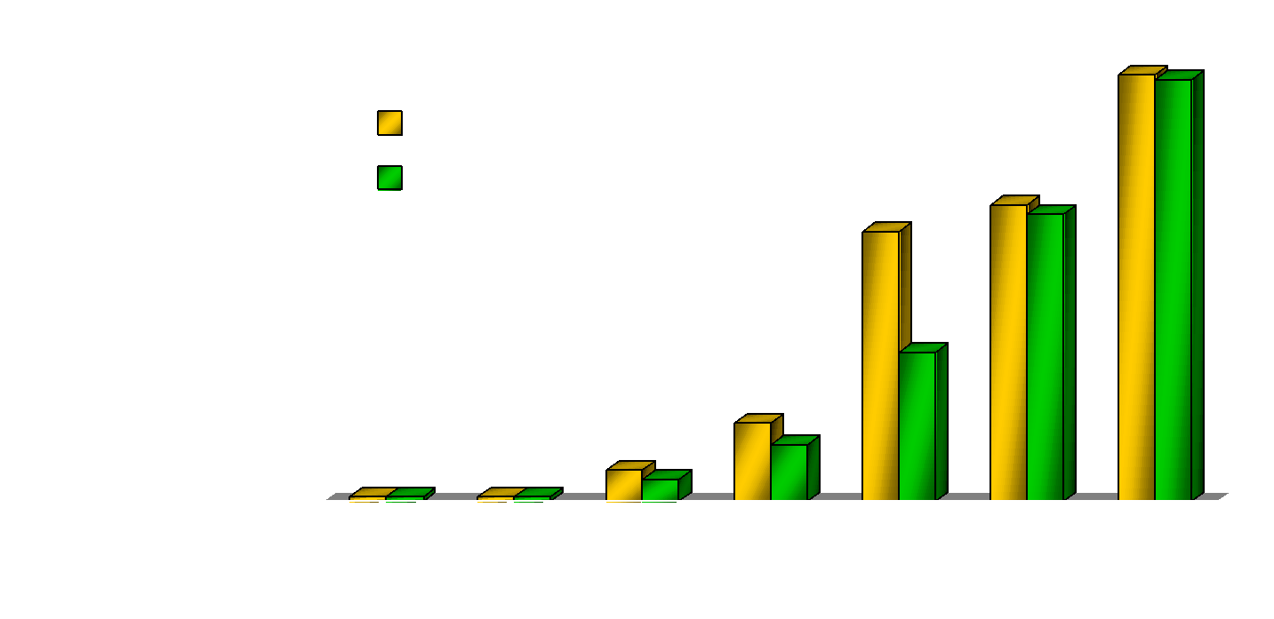
Prevalence of HF by Age and Gender
United States: 1988-94
Source: NHANES III (1988-94), CDC/NCHS and the American Heart Association
Notes:
After completing a thorough history and physical exam, physicians will commonly use the New York Heart Association (NYHA) functional classification to help describe the degree of physical disability a patient has. The NYHA class is also commonly used to determine entry criteria for patients participating in clinical research trials.

Slide 8
New York Heart Association
Functional Classification
Class I: No symptoms with ordinary activity
Class II: Slight limitation of physical activity. Comfortable at rest,
but ordinary physical activity results in fatigue,
palpitation, dyspnea, or angina
Class III: Marked limitation of physical activity. Comfortable at
rest, but less than ordinary physical activity results in
fatigue, palpitation, dyspnea, or anginal pain
Class IV: Unable to carry out any physical activity without
discomfort. Symptoms of cardiac insufficiency may be
present even at rest

Slide 9
HF Classification: Evolution and
Disease Progression
Four Stages of HF (ACC/AHA Guidelines):
  Stage A: Patient at high risk for developing HF with no structural disorder of the heart
  Stage B: Patient with structural disorder without symptoms of HF
  Stage C: Patient with past or current symptoms of HF associated with underlying structural heart disease
  Stage D: Patient with end-stage disease who requires specialized treatment strategies
Hunt, SA, et al ACC/AHA Guidelines for the Evaluation and Management of Chronic Heart Failure in the Adult, 2001
Notes:
Listed above is the etiology of heart failure in order from most to least common causes.

Slide 10
Severity of Heart Failure
Modes of Death
NYHA II
CHF
NYHA III
12%
CHF
Other
26%
Other
24%
Sudden
59%
Death
Sudden
64%
n = 103
15%
Death
n = 103
NYHA IV
CHF
33%
Other
56%
Sudden
Death
11%
n = 27
MERIT-HF Study Group. Effect of Metoprolol CR/XL in chronic heart failure: Metoprolol CR/XL randomized intervention trial in congestive heart failure (MERIT-HF). LANCET. 1999;353:2001-07.
Notes:
Interestingly, most patients who suffer from sudden cardiac death (64%) are the patients who are minimally symptomatic with Class II heart failure. The sickest, most symptomatic patient (Class IV) experience heart failure deaths (56%) from pump failure, rather than sudden cardiac death (33%).
It is important to remember that although it can be said that a heart failure patient in NYHA Class II may have a higher risk of SCD, their relative annual risk of dying is less than the other NYHA classes.
The SCD-HeFT Trial (Sudden Cardiac Death in Heart Failure Trial) which enrolled NYHA Class II and III patients, hopes to answer whether patients in these classes are truly at a higher risk for SCD and need protection.

Slide 11
Etiology of Heart Failure
What causes heart failure?
The loss of a critical quantity of functioning myocardial cells after injury to the heart due to:
  Ischemic Heart Disease
  Hypertension
  Idiopathic Cardiomyopathy
  Infections (e.g., viral myocarditis, Chagas’ disease)
  Toxins (e.g., alcohol or cytotoxic drugs)
  Valvular Disease
  Prolonged Arrhythmias
Notes:
As previously seen, there are many causes of heart failure. Some diseases, however, tend to more adversely affect the heart’s systolic function (ventricular contraction/ejection), while others tend to more adversely affect diastolic function (ventricular filling/relaxation). This provides a useful way of classifying heart failure from a hemodynamic standpoint. Most patients who have systolic dysfunction also have a component of diastolic dysfunction.

Slide 12
Left Ventricular Dysfunction
Systolic: Impaired contractility/ejection
  Approximately two-thirds of heart failure patients have systolic dysfunction¹
Diastolic: Impaired filling/relaxation
30%
(EF > 40 %)
(EF < 40%)
70%
Diastolic Dysfunction
Systolic Dysfunction
1 Lilly, L. Pathophysiology of Heart Disease. Second Edition p 200
Notes:
Stroke volume is affected by preload, afterload, and contractility.
Preload is the amount myocardial stretch at the end of diastole.
Afterload is the resistance that needs to be overcome for the heart to eject the blood. There is an inverse relationship between afterload and ventricular function. As the resistance to contraction increases, the force of contraction decreases which results in a decreased stroke volume. Also, as an increase in resistance occurs, there is an increase in myocardial oxygen demand.
Contractility is the inotropic state of the heart independent of the preload and the afterload.
Synergistic LV contraction, wall integrity, and the competence of the valves also affect cardiac output.

Slide 13
Determinants of Ventricular Function
Contractility
Preload
Afterload
Stroke
Volume
Synergistic LV Contraction
Wall Integrity
Valvular Competence
Heart Rate
Cardiac Output
Notes:
Animated slide (works in slide show):
In this schematic, notice when the LVEDP rises due to an increase in LV end diastolic volume (mouse click to add arrow), and it causes the left atrial pressure to rise (mouse click), which causes elevated pressures in the lungs (mouse click). This elevated pulmonary pressure causes fluid to seep out of the pulmonary capillaries, and causes pulmonary congestion. This pulmonary congestion causes the patient to be short of breath.
Slide courtesy of Dr. Philip B. Adamson, Director, Congestive Heart Failure Treatment Program University of Oklahoma, Oklahoma City, OK

Slide 14
Left Ventricular Dysfunction
Volume
Overload
Pressure
Overload
Loss of
Myocardium
Impaired
Contractility
LV Dysfunction
EF < 40%
↑ End Systolic Volume
↓ Cardiac
Output
↑ End Diastolic Volume
Hypoperfusion
Pulmonary Congestion
Notes:
This slide represents what we have seen on the previous 2 slides: a rise in LVEDP causes a rise in Left Atrial Pressure which causes a rise in pulmonary capillary pressure, and subsequently pulmonary congestion and shortness of breath.

Slide 15
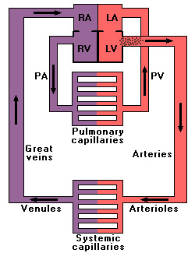
Hemodynamic Basis for
Heart Failure Symptoms
Notes:
It is important to understand that the symptoms of systolic and diastolic heart failure are the same. Whether a patient has systolic or diastolic heart failure depends on the ejection fraction. If the EF is less than 40%, it is labeled systolic heart failure. If it is greater than 40%, it is labeled diastolic heart failure. Remember that almost all systolic heart failure has a component of diastolic failure.
Patient symptoms must correlate to the physical signs in order for them to be diagnostic of heart failure.
The symptoms of left ventricular dysfunction and the physical signs are all resultant of increased left arterial pressure, capillary pressure, and pulmonary congestion.

Slide 16
Hemodynamic Basis for
Heart Failure Symptoms
LVEDP ↑
Left Atrial Pressure ↑
Pulmonary Capillary Pressure ↑
Pulmonary Congestion
Notes:
The most common cause of Right Ventricular Failure is Left Ventricular Failure¹.
The symptoms of right ventricular dysfunction and the physical signs are due to a back flow problem and the build up of pressure in the liver, stomach, and intestines. This increase in pressure most often causes abdominal pain, leg swelling (peripheral edema), and increase in liver size (hepatomegaly).
1 Lilly, L. Pathophysiology of Heart Disease. Second Edition. Lippincott Williams and Wilkins, 1998. P 202.

Slide 17
Left Ventricular Dysfunction
Systolic and Diastolic
Symptoms
  Dyspnea on Exertion
  Paroxysmal Nocturnal Dyspnea
  Tachycardia
  Cough
  Hemoptysis
  FATIGUE
Physical Signs
  Basilar Rales
  Pulmonary Edema
  S3 Gallop
  Pleural Effusion
  Cheyne-Stokes Respiration
Notes:
The mean arterial pressure, or blood pressure, is the result of cardiac output (stroke volume x heart rate) times the peripheral resistance. The amount of arterial constriction determines the mean arterial pressure. When the hemodynamic system is intact, the mean arterial pressure is closely regulated.
A heart failure patient experiences decreased cardiac output which in turn decreases mean arterial pressure. The body tries to compensate and bring it back to normal.

Slide 18
Right Ventricular Failure
Systolic and Diastolic
Symptoms
  Abdominal Pain
  Anorexia
  Nausea
  Bloating
  Swelling
Physical Signs
  Peripheral Edema
  Jugular Venous Distention
  Abdominal-Jugular Reflux
  Hepatomegaly

Slide 19
Compensatory Mechanisms
Frank-Starling Mechanism
Neurohormonal Activation
Ventricular Remodeling
Notes:
Several natural compensatory mechanisms are called into action to help buffer the fall in cardiac output and help maintain sufficient blood pressure in order to perfuse vital organs. These compensatory mechanisms include:
Frank-Starling mechanism
Neurohormonal activation
Ventricular remodeling
Neurohormonal activation is an important compensatory mechanism involved in maintaining the mean arterial pressure.
Hormones and neurohormonal systems play a important role in maintaining normal cardiovascular hemostasis; they also play an important compensatory role in the early stages of heart failure.
First, let’s start by defining what a neurohormone is.
A hormone is simply a biologically active substance that originates in one tissue and is transported through the bloodstream to another part of the body where it acts to either increase the activity of that tissue or stimulate the release of another hormone. Hormones that are formed by neurosecretory cells and are liberated by nerve stimulation are called neurohormones.
In general, activation of the body’s various neurohormonal systems serve to increase systemic vascular resistance, thereby attenuating any fall in blood pressure (recall: Blood Pressure = Cardiac Output x Total Peripheral Vascular Resistance). In addition, many neurohormones encourage salt and water retention, which increases intravascular volume and LV preload so as to maximize stroke volume via the Frank-Starling mechanism.
But as was the case with remodeling, too much of a good thing over the long-term eventually becomes detrimental to the failing heart. Because of the importance of neurohormonal activation in the cascade of events that lead to chronic heart failure, and ultimately death, the following slides will review the various neurohormones and neurohormonal systems in detail, starting with their role in maintaining normal cardiovascular hemostasis, and then later their contribution to the progression of heart failure.
The acute effects of neurohormonal stimulation are beneficial but the long term or chronic activation of these mechanisms is detrimental.
Several natural compensatory mechanisms are called into action to help buffer the fall in cardiac output and help maintain sufficient blood pressure in order to perfuse vital organs. These compensatory mechanisms include:
Frank-Starling mechanism
Neurohormonal activation
Ventricular remodeling

Slide 20
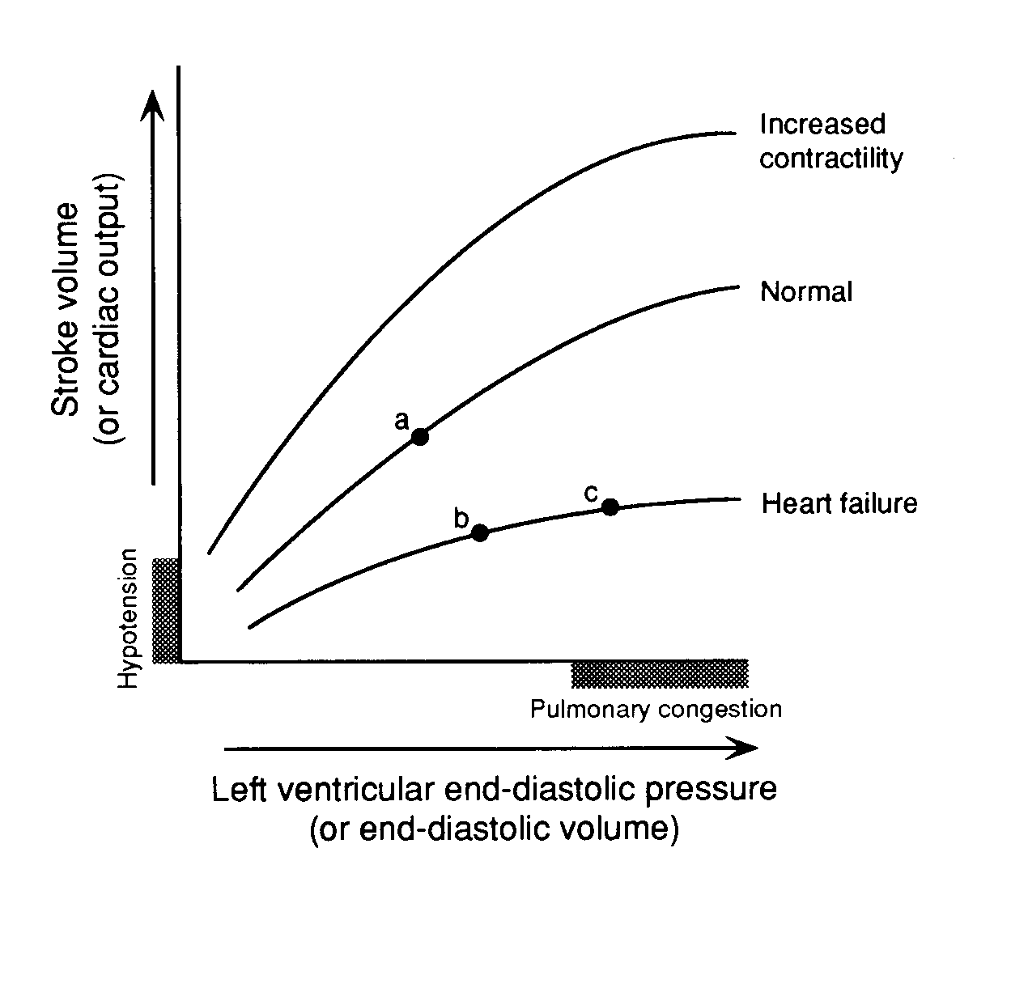
Compensatory Mechanisms
Frank-Starling Mechanism
a. At rest, no HF
b. HF due to LV systolic dysfunction
c. Advanced HF
Notes:
The sympathetic nervous system ( SNS ) is stimulated due to a decrease in mean arterial pressure. Sympathetic outflow is increased to the heart and the peripheral circulation which causes an increase in the patient’s heart rate and an increase in contractility. In addition, vasoconstriction occurs which increases the peripheral vascular resistance. Stroke volume is subsequently increased which in turn increases mean arterial pressure.

Slide 21
Compensatory Mechanisms
Neurohormonal Activation
Many different hormone systems are involved in maintaining normal cardiovascular homeostasis, including:
Sympathetic nervous system (SNS)
Renin-angiotensin-aldosterone system (RAAS)
Vasopressin (a.k.a. antidiuretic hormone, ADH)
Notes:
The sympathetic nervous system’s goal is to increase cardiac sympathetic activity. This response is mediated through three receptors: Beta 1, Beta 2, and Alpha 1. In normal situations the Beta 1 receptor increases cardiac sympathetic activity.
In heart failure patients, the Beta 1 and Beta 2 receptors are activated. Alpha receptors and their role is yet to be fully delineated.
Beta 1, Beta 2, and Alpha 1 receptors lead to myocardial toxicity in the ventricles. Myocardial toxicity leads to decreased ejection fraction, arrhythmias, and tachyarrhythmias caused by sympathetic activation.
Increase in sympathetic activity also affects the kidneys and peripheral vasculature through the Beta 1 and Alpha 1 receptors. This mediates activation of the renin-angiotensin system ( discussed on the next slide ), which causes vasoconstriction, sodium retention, and thirst. All of these responses causes the disease to progress.
Prolonged neurohormone release also has direct adverse effects on the heart tissue itself. Norepinephrine, for example, is known to be directly cardiotoxic. In fact, studies have established that in patients with heart failure, the probability of survival is markedly worse for those whose plasma norepinephrine levels are >400 pg/ml than for those whose levels are <400 pg/ml.

Slide 22
In the absence of or early onset of HF
The normal effects of SNS/RAAS intensify
due to increased cardiac demands
NPS reacts to counter regulate
the activation of SNS/RAAS
As HF progresses
The effects of the overactivation of SNS/RAAS cause further progression
NPS is unable to sufficiently counteract overactivation of SNS/RAAS
SNS
NPS
RAAS
Notes:
Key Takeaways
Short-term effects of the RAAS and the SNS intensify in order to increase cardiac output when blood and oxygen demand is increased; however, long-term activation results in neurohormonal imbalance^{1,2}
Activation of the NPS opposes the overactive RAAS and the SNS¹
However, the counterregulatory effects of the NPS are diminished as heart failure with reduced EF progresses³
References
Mann DL, Zipes DP, Libby P, Bonow RO, Braunwald E. Braunwald's Heart Disease: A Textbook of Cardiovascular Medicine. 10th ed. Philadelphia, PA: Elsevier/Saunders; 2015.
Volpe M, Carnovali M, Mastromarino V. The natriuretic peptides system in the pathophysiology of heart failure: from molecular basis to treatment. Clin Sci. 2016;130(2):57-77.
Hartupee J, Mann DL. Neurohormonal activation in heart failure with reduced ejection fraction. Nat Rev Cardiol. 2017;14(1):30-38.

Slide 23
Compensatory Mechanisms:
Sympathetic Nervous System
Decreased MAP
Sympathetic Nervous System
↑ Contractility
Tachycardia
Vasoconstriction
↑MAP = (↑SV x ↑HR) x ↑TPR
Notes:
The other mechanism in the neurohumoral response to heart failure is the renin-angiotensin-aldosterone system (RAAS). In the RAAS, Renin ( secreted by the kidney ) acts on Angiotensinogen (secreted by the liver) to make Angiotensin I.
The Angiotensin converting enzyme (secreted by the lungs) acts on Angiotensin I to make Angiotensin II. Angiotensin II in turn causes vasoconstriction, an increase in aldosterone, facilitates the release of norepinephrine from the SNS, causes sodium reabsorption, stimulates vasopressin secretion from the brain (discussed later), and increases contractility. Subsequently, remodeling of the heart occurs.
In a heart failure patient, the effects of Angiotensin II are not beneficial. Why not think about using a medication to block the conversion of Angiotensin I to II? Or, an agent that blocks the Angiotensin I receptor? These blocking agents will be discussed later when we talk about the treatment of heart failure.

Slide 24

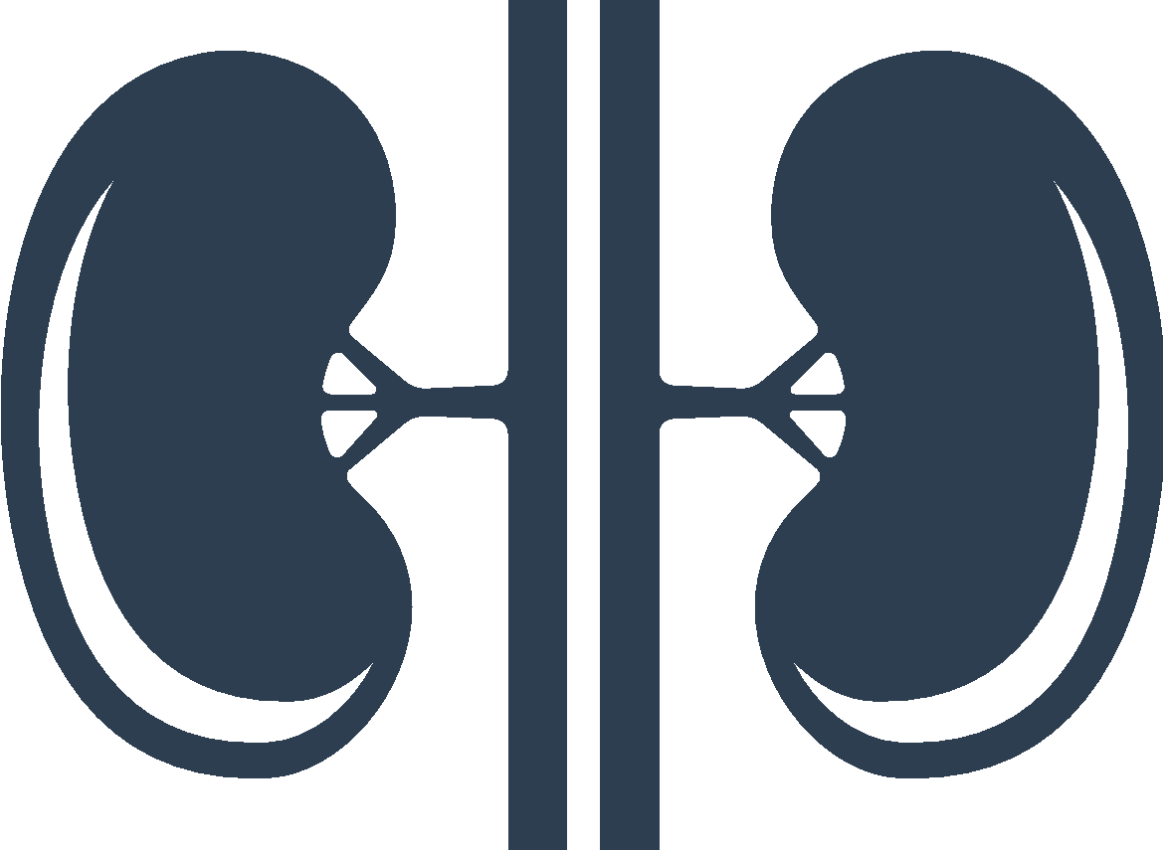

CARDIOVASCULAR
RENAL
VASCULAR
Depleted norepinephrine stores
Myocyte apoptosis, necrosis, hypertrophy, and fibrosis
Impaired systolic function
Increased heart rate and contractility
RAAS stimulation
Increased renin release
Increased sodium reabsorption
Vasoconstriction
Vascular hypertrophy
SNS
RAAS
Sodium and water retention
Fibrosis
Renal perfusion pressure
Renal tubule sodium load
Notes:
Key Takeaway
Short-term effects of the RAAS and the SNS are beneficial; however, long-term activation results in neurohormonal imbalance^{1,2}
Additional Information¹
Chronic activation of the SNS results in
Depleted norepinephrine stores
Myocyte apoptosis, necrosis, hypertrophy, and fibrosis
Impaired systolic function
Increased heart rate and contractility
RAAS stimulation
Increased renin release
Increased sodium reabsorption
Vasoconstriction
Vascular hypertrophy
Chronic activation of the RAAS results in
Sodium and water retention
Fibrosis
Peripheral vasoconstriction
Vascular hypertrophy
SNS hyperactivity is characterized by increased levels of norepinephrine and epinephrine, elevated sympathetic outflow, and heightened norepinephrine spillover
Increased sympathetic tone requires more oxygen in myocardial cells; myocardial ischemia can ensue, resulting in ventricular tachycardia and/or sudden cardiac death
References
Mann DL, Zipes DP, Libby P, Bonow RO, Braunwald E. Braunwald's Heart Disease: A Textbook of Cardiovascular Medicine. 10th ed. Philadelphia, PA: Elsevier/Saunders; 2015.
Volpe M, Carnovali M, Mastromarino V. The natriuretic peptides system in the pathophysiology of heart failure: from molecular basis to treatment. Clin Sci. 2016;130(2):57-77.

Slide 25
CARDIOVASCULAR
RENAL
VASCULAR
Depleted norepinephrine stores
Myocyte apoptosis, necrosis, hypertrophy, and fibrosis
Impaired systolic function
Increased heart rate and contractility
RAAS stimulation
Increased renin release
Increased sodium reabsorption
Vasoconstriction
Vascular hypertrophy
Overactive
SNS¹
Overactive
RAAS¹
Sodium and water retention
Fibrosis
Renal perfusion pressure
Renal tubule sodium load
Myocyte antiproliferation
Attenuation of fibrosis
Sodium and water excretion
Aldosterone inhibition
Renin inhibition
Vasodilation
BP reduction
NPS²
Notes:
Key Takeaways^{1,2}
Short-term effects of the RAAS and the SNS are beneficial; however, long-term activation results in neurohormonal imbalance
Activation of the NPS opposes the overactive RAAS and SNS through
Myocyte antiproliferation
Attenuation of fibrosis
Sodium and water excretion
Aldosterone inhibition
Renin inhibition
Vasodilation
BP reduction
Additional Information
Speaker to read slide for specific cardiovascular, renal, and vascular effects of NPS, SNS, and RAAS
References
Mann DL, Zipes DP, Libby P, Bonow RO, Braunwald E. Braunwald's Heart Disease: A Textbook of Cardiovascular Medicine. 10th ed. Philadelphia, PA: Elsevier/Saunders; 2015.
Volpe M, Carnovali M, Mastromarino V. The natriuretic peptides system in the pathophysiology of heart failure: from molecular basis to treatment. Clin Sci. 2016;130(2):57-77.

Slide 26
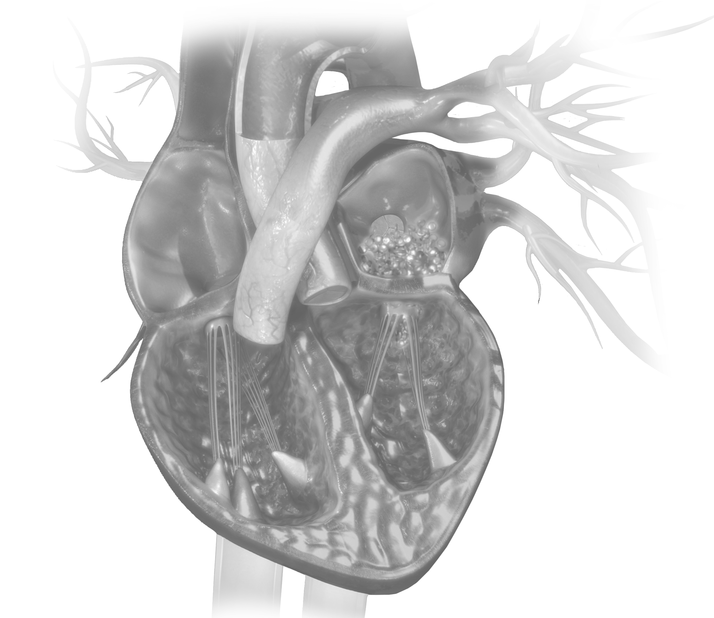
CNP
Vasculature
inflammation^{1,2}
ANP
Atrial myocyte
stretch^{1,2}
BNP
Ventricular
myocyte stretch^{1,2}
Notes:
Key Takeaways
Under normal physiologic circumstances
ANP is stored and secreted from atrial granules and responds to alterations in electrolyte and water balance; ANP decreases blood pressure (BP) by stimulating secretion of renal sodium and water^{1,2}
BNP is found in cardiac ventricles, but is not stored in granules; it is rather transcribed as needed in response to cardiac stress such as volume overload; BNP acts locally to reduce fibrosis^{2,3}
CNP is expressed in endothelial cells and is released in response to vascular inflammation or injury; CNP inhibits vascular smooth muscle proliferation and LDL-induced migration of coronary artery smooth muscle cells and is a vasodilator¹
References
Volpe M, Carnovali M, Mastromarino V. The natriuretic peptides system in the pathophysiology of heart failure: from molecular basis to treatment. Clin Sci. 2016;130(2):57-77.
Potter LR, Yoder AR, Flora DR, Antos LK, Dickey DM. Natriuretic peptides: their structures, receptors, physiologic functions and therapeutic applications. Handb Exp Pharmacol. 2009(191):341-366.
Mann DL, Zipes DP, Libby P, Bonow RO, Braunwald E. Braunwald's Heart Disease: A Textbook of Cardiovascular Medicine. 10th ed. Philadelphia, PA: Elsevier/Saunders; 2015.

Slide 27
As HF progresses, NPS is unable to sufficiently counterbalance the over-activity of SNS and RAAS
In the absence of or early onset of HF, NPS can counterbalance the negative effects of SNS and RAAS
OVERACTIVE SNS
OVERACTIVE RAAS
INEFFICIENT NPS*
NPS
*Mechanisms of reduced NPS effectiveness include reduced/altered production of peptides, reduced receptor expression, and enzymatic peptide degradation⁶
Notes:
Key Takeaways
Chronic SNS activation results in neurohormonal imbalance as heart failure with reduced EF progresses^{1,2}
Click 1
Chronic RAAS activation augments neurohormonal imbalance as heart failure with reduced EF progresses¹
Click 2
Natriuretic peptides (NPs), including BNP, attempt to counterbalance the negative effects of the SNS and the RAAS through mechanisms previously discussed¹
Click 3
However, the counterregulatory effects of the NPS are diminished as heart failure with reduced EF progresses¹
Potential mechanisms mediating reduced peripheral effectiveness of the NPS in heart failure with reduced EF include
Reduced receptor expression³
Reduced/altered production of active peptides⁴
Receptor desensitization⁴
Increased receptor-mediated clearance of peptides⁴
Increased enzymatic degradation⁴
Additional Information
NPs are activated in heart failure with reduced EF; ANP and BNP are released in response to cardiac stretch in the atria and ventricles, respectively, and CNP is released in response to vascular inflammation^{1,3}
Levels of clinically measured BNP are elevated in heart failure with reduced EF⁴
References
Hartupee J, Mann DL. Neurohormonal activation in heart failure with reduced ejection fraction. Nat Rev Cardiol. 2017;14(1):30-38.
Floras JS, Ponikowski P. The sympathetic/parasympathetic imbalance in heart failure with reduced ejection fraction. Eur Heart J. 2015;36(30):1974-1982.
Volpe M, Carnovali M, Mastromarino V. The natriuretic peptides system in the pathophysiology of heart failure: from molecular basis to treatment. Clin Sci. 2016;130(2):57-77.
Diez J. Chronic heart failure as a state of reduced effectiveness of the natriuretic peptide system: implications for therapy. Eur J Heart Fail. 2017;19(2):167-176.

Slide 28





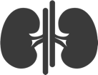
Overactive RAAS/SNS*
Cardiac injury¹
Precipitating
factor(s)
*RAAS, SNS,
and NPS are
initially balanced
NPS
resistance^{1,2}
Worsening heart failure
with reduced EF
(systolic HF) symptoms¹
LV remodeling¹
Hemodynamic alterations¹
Neurohormonal
imbalance¹⁻⁴
Notes:
Key Takeaways
Heart failure with reduced EF is triggered by a precipitating event and the resulting myocardial damage to the left ventricle reduces cardiac output¹
The SNS and the RAAS compensate to restore cardiac output; the NPS offsets the negative effects of the overactive SNS and RAAS to maintain CV homeostasis¹⁻⁴
Autonomic imbalance occurs via loss of parasympathetic tone and pathological augmentation of sympathetic outflow^{1,5}
Peripheral resistance to the NPS occurs via¹
Reduced/altered production of active peptides⁶
Attenuated renal responsiveness to NPs²
Symptoms increase with worsening heart failure with reduced EF, the left ventricle is structurally remodeled, and LV hemodynamic alterations ensue¹
Additional Information
LV remodeling includes alterations in myocyte biology and alterations in LV chamber geometry (ie, increased size, increased sphericity, wall thinning, and mitral valve incompetence)¹
Phenotypic changes in myocyte morphology occur; high systolic wall stress leads to parallel addition of sarcomeres and widening of the cardiomyocytes, resulting in concentric hypertrophy¹
References
Hartupee J, Mann DL. Neurohormonal activation in heart failure with reduced ejection fraction. Nat Rev Cardiol. 2017;14(1):30-38.
Volpe M, Carnovali M, Mastromarino V. The natriuretic peptides system in the pathophysiology of heart failure: from molecular basis to treatment. Clin Sci. 2016;130(2):57-77.
Floras JS, Ponikowski P. The sympathetic/parasympathetic imbalance in heart failure with reduced ejection fraction. Eur Heart J. 2015;36(30):1974-1982.
Mangiafico S, Costello-Boerrigter LC, Andersen IA, Cataliotti A, Burnett JC, Jr. Neutral endopeptidase inhibition and the natriuretic peptide system: an evolving strategy in cardiovascular therapeutics. Eur Heart J. 2013;34(12):886-893c.
Lymperopoulos A, Rengo G, Koch WJ. Adrenergic nervous system in heart failure: pathophysiology and therapy. Circ Res. 2013;113(6):739-753.
Diez J. Chronic heart failure as a state of reduced effectiveness of the natriuretic peptide system: implications for therapy. Eur J Heart Fail. 2017;19(2):167-176.

Slide 29
Sympathetic Activation in Heart Failure
↑ CNS sympathetic outflow
↑ Cardiac sympathetic
activity
↑ Sympathetic
activity to kidneys
+ peripheral vasculature
β₁-
receptors
β₂-
receptors
α₁-
receptors
Activation
of RAS
α₁-
β₁-
Myocardial toxicity
Increased arrhythmias
Vasoconstriction
Sodium retention
Disease progression
Packer. Progr Cardiovasc Dis. 1998;39(suppl I):39-52.
Notes:
So, when there is a decrease in the mean arterial pressure, there is decreased renal perfusion. Hence, the RAAS is stimulated, and the MAP is increased.

Slide 30
Chronic decline
Myocardial Function
Hospitalizations for worsening symptoms
Disease Progression
Adapted from: Gheorghiade M, et al. Am J Cardiol. 2005;96(6):11G-17G.
  Worsening symptoms of HF can damage the heart and other organs, including the kidneys,
  contributing to the inevitable downward spiral of disease progression
Notes:
Key Takeaway¹
Worsening symptoms of HF can damage the heart and other organs, including the kidneys, contributing to the inevitable downward spiral of disease progression
Reference
Gheorghiade M, De Luca L, Fonarow GC, Filippatos G, Metra M, Francis GS. Pathophysiologic targets in the early phase of acute heart failure syndromes. Am J Cardiol. 2005;96(6):11G-17G.

Slide 31
Compensatory Mechanisms:
Neurohormonal Activation – Vasopressin
Decreased systemic blood pressure
Central baroreceptors
-
Increased systemic blood pressure
Stimulation of hypothalamus, which produces
vasopressin for release by pituitary gland
Vasoconstriction
Release of vasopressin by pituitary gland
Notes:
Ventricular Remodeling:
Heart failure is a progressive disease, and the chronic hemodynamic stresses imparted on the failing heart eventually lead to alterations in the heart’s size, shape, structure, and function. This process is known as remodeling.
As the heart remodels, its overall geometry changes; it becomes less elliptical and more spherical. There are also changes in ventricular mass, composition, and volume.
Initially, the changes that occur with remodeling can be considered compensatory. For example, the dysfunctioning heart has a compromised stroke volume; thus, from a remodeling perspective, one adaptive mechanism to maintain stroke volume is to enlarge the ventricular volume (ventricular dilatation) so that a greater stroke volume results from a reduced ejection fraction.
Remodeling also increases myocardial mass, resulting in increased ventricular wall thickness (hypertrophy). This added wall thickness initially helps reduce ventricular wall stress and improve contractility.
It is the progressive nature of remodeling that occurs in the failing heart that eventually becomes detrimental. Continued hypertrophy and dilatation of the ventricle inevitably leads to increasing ventricular wall stress, and ongoing fibrosis of the damaged myocardium increasingly impairs contractility. Thus, the events associated with remodeling eventually become self-propagating and harmful. This remodeling is felt to cause an increase in cell death ( apoptosis).
Text from the article:
Images were generated by tagged magnetic resonance imaging, which offers a unique noninvasive tool for determining and displaying high-resolution 3D wall motion in patients. Two images are displayed in the Figure: on the left, a normal control patient is seen, and to the right, a patient with severe cardiomyopathy and left bundle branch morphology conduction delay is shown (each image is activated by double clicking over it with the mouse). During systolic contraction, the colors change, reflecting the distribution and timing of regional circumferential strains. Red coding corresponds to the diastolic relaxed state; shortening, by a transition from red to blue; and stretch, by red to yellow. In the normal heart, contraction is synchronous within the myocardium, with a normal symmetric distribution of negative strain (≈-20% by end-systole) across the wall. In contrast, the contraction pattern is markedly dyssynchronous in the heart with dilated cardiomyopathy. Myocardium in the septal region (green dot denotes septum) becomes first blue in early systole and then yellow (i.e., stretching) in late systole. Contraction slowly spreads to the lateral wall as the septum develops positive strains. The temporal magnitude of dyssynchrony is substantial. In this and other such patients, ventricular free wall (or biventricular) pacing with pre-excitation enhances the systolic function of the heart.

Slide 32
Compensatory Neurohormonal Stimulation: Summary
Decreased Cardiac Output
↑ Sympathetic
nervous system
↑ Renin-angiotensin
system
↑ Antidiuretic hormone
(vasopressin)
↑ Contractility
↑ Heart
rate
Vasoconstriction
↑ Circulating volume
Anteriolar
Venous
Maintain
blood
pressure
↑ Venous return to heart
(↑ preload)
Cardiac
output
+
-
+
Peripheral edema
and pulmonary
congestion
↑ Stroke
volume

Slide 33
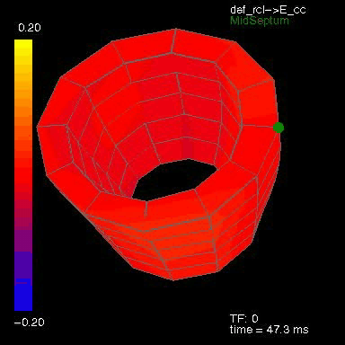
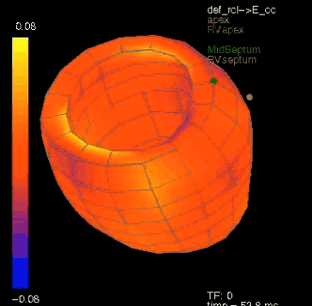
Compensatory Mechanisms
Ventricular Remodeling
Alterations in the heart’s size, shape, structure, and function brought about by the chronic hemodynamic stresses experienced by the failing heart.
Curry CW, et al. Mechanical dyssynchrony in dilated cardiomyopathy with intraventricular conduction delay as depicted by 3D tagged magnetic resonance imaging. Circulation 2000 Jan 4;101(1):E2.
Notes:
Natriuretic Peptides
The third neurohormone system on our list includes the natriuretic peptides. The natriuretic peptides—ANP, BNP, and CNP-- are vasodilating neurohormones. As such, they play an important role in counter-regulating the vasoconstricting effects of other neurohormones.
These peptides are made and stored in specialized cells in the atria and ventricles, and are released when the atria are stretched (e.g., in volume overload, which distends the atria) or when the ventricles are dilated.
The natriuretic peptides act directly on blood vessels to cause vasodilatation. They also have natriuretic (salt excreting) and diuretic (water excreting) effects because of their ability to inhibit the secretion of renin, aldosterone, and vasopressin.

Slide 34
Other Neurohormones
Natriuretic Peptides: Three known types
  Atrial Natriuretic Peptide (ANP)
    Predominantly found in the atria
    Diuretic and vasodilatory properties
  Brain Natriuretic Peptide (hBNP)
    Predominantly found in the cardiac ventricles
    Diuretic and vasodilatory properties
  C-type Natriuretic Peptide (CNP)
    Predominantly found in the central nervous system
    Limited natriuretic and vasodilatory properties
Notes:
Human brain natriuretic peptide (hBNP) is found mainly in the cardiac ventricles which suggests that this particular natriuretic peptide may be more sensitive to ventricular disorders. Its level seems to correlate with the amount of shortness of breath and left ventricular volume and pressure. For this reason, the level of BNP may be the first “white count” for heart failure. For example, a low BNP level may mean that heart failure is unlikely in a patient. It also may be a way of following the progression of disease.
Natriuretic peptide levels, like norepinephrine, are also directly related to mortality.

Slide 35
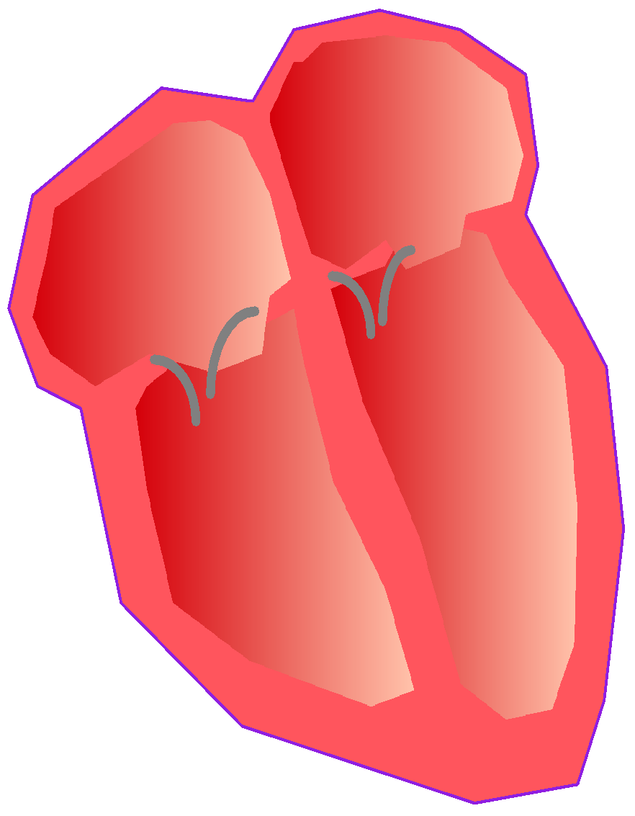
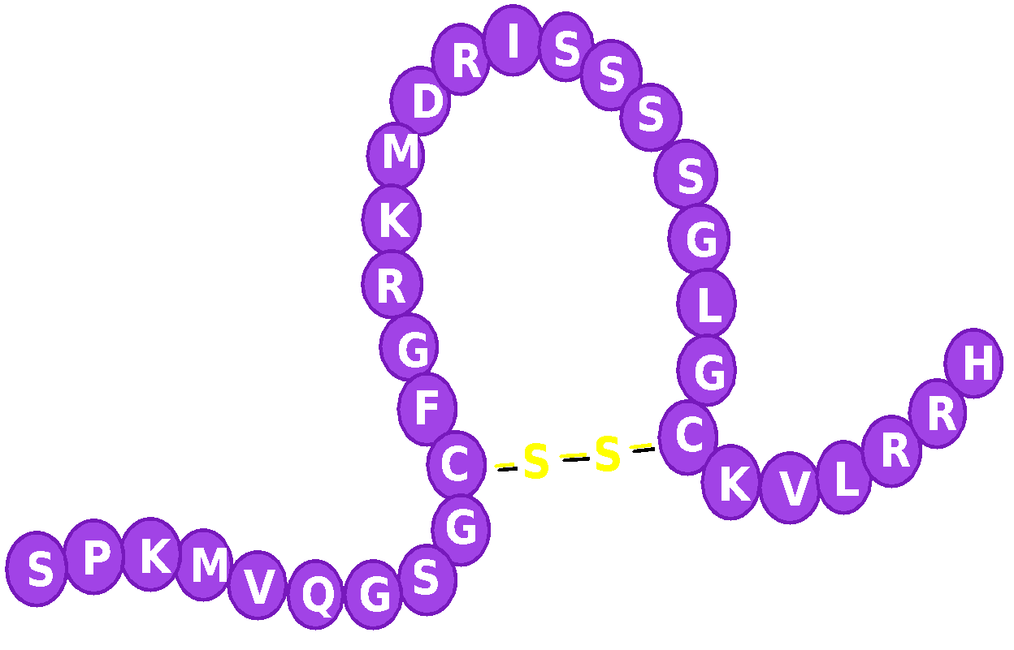
Pharmacological Actions of hBNP
Hemodynamic
(balanced vasodilation)
• veins
• arteries
• coronary arteries
Neurohormonal
aldosterone
norepinephrine
Renal
diuresis & natriuresis
Abraham WT and Schrier RW, 1994
Notes:
Endothelium-Derived Vasoactive Substances
These hormones are produced by a thin lining of cells within the arteries and veins called the endothelium. Most of the effects of these substances are local, meaning that they exert their effects mostly on their local environment (unlike the circulating neurohormones discussed previously that tend to have a more diffuse effect).Their actions are primarily directed at one of three targets: the endothelium itself, the underlying smooth muscle cells of blood vessel walls (which cause the vessel to constrict or dilate), or on other substances circulating nearby in the blood.
Endothelium-derived vasoactive substances that signal the blood vessels to relax (vasodilate) are called endothelium-derived relaxing factors (EDRF). Nitric oxide (NO), bradykinin, and prostacyclin are three such substances. In contrast, vasoactive substances that lead to constriction (vasoconstriction) are called endothelium-derived constricting factors (EDCF). One of the most important EDCFs is Endothelin I, which is one of the most potent vasoconstricting substances known (it also directly decreases cardiac contractility, as does nitric oxide).

Slide 36
Endothelium-Derived Vasoactive Substances
Produced by a thin lining of cells within the arteries and veins called the endothelium
Endothelium-derived relaxing factors (EDRF) – Vasodilators:
    Nitric Oxide (NO)
    Bradykinin
    Prostacyclin
Endothelium-derived constricting factors (EDCF) – Vasoconstrictors:
    Endothelin I
Notes:
Cytokines
The cytokines are small protein molecules that decrease the strength of contraction, and thus are known as negative inotropes. Included in this class are tumor necrosis factor (TNF)-alpha, interleukin 1-alpha, interleukin-2, interleukin-6, and interferon-alpha.
Tumor necrosis factor (TNF)-alpha, a cytokine, is known to have deleterious effects in heart failure. TNF-alpha used to be called cachectin. It is elaborated by cancers and causes the marked cachexia seen in patients with certain forms of cancer, and likely also causes the weight loss in certain patients with heart failure. Like norepinephrine and the natriuretic peptides, increased plasma levels of TNF-alpha are associated with a poor prognosis.

Slide 37
Mediators of Heart Failure
Cytokines
Small protein molecules produced by a variety of tissues and cells
Negative inotropes
Elevated levels associated with worse clinical outcomes
Examples:
  Tumor necrosis factor (TNF)-alpha
  Interleukin 1-alpha
  Interleukin-2
  Interleukin-6
  Interferon-alpha
Notes:
In addition to maintaining normal cardiovascular homeostasis, the hormones and neurohormonal systems described in the last few slides also play an important role in compensating for the diminished cardiac output seen in patients with early heart failure. But it is also known that over time, these same neurohormone systems eventually become detrimental and contribute to the progression of heart failure. Why does this happen?
Physiologists now recognize that the neurohormonal mechanisms activated in heart failure are identical to those normally triggered when cardiac output and blood pressure are threatened (e.g., intense physical exercise, hemorrhage), but with an important difference. Under normal circumstances, the release of neurohormones is generally successful in reversing the hemodynamic abnormalities seen in acute low volume/low output states, and consequently, neurohormonal activity eventually subsides.
In contrast, neurohormonal activation never “turns off” in the setting of heart failure; rather, is always “on” in an attempt to compensate for the failing heart’s chronic inability to maintain normal cardiovascular homeostasis. Furthermore, the chronic presence of circulating neurohormones tends to exacerbate the hemodynamic abnormalities in heart failure, which only encourages further remodeling and neurohormone release and, thus, further hemodynamic deterioration. Thus, a vicious cycle develops whose end result is progressive ventricular dysfunction and death.

Slide 38
Vicious Cycle of Heart Failure
LV Dysfunction
Decreased cardiac output
and
Decreased blood pressure
Increased cardiac workload
(increased preload and afterload)
Increased cardiac output (via increased
contractility and heart rate)
Increased blood pressure (via vasoconstriction
and increased blood volume)
Frank-Starling Mechanism
Remodeling
Neurohormonal activation
Notes:
End-stage Heart Failure
Continued progression of heart failure eventually leads to a critical reduction in blood flow to vital organs. In this final phase, the body maximizes all its vasoconstrictor systems (norepinephrine, vasopressin, endothelin) in an attempt to redirect blood flow to these critical organ systems. But the activation of these systems only add to the hemodynamic burden of the failing heart; thus, ventricular function progressively deteriorates, and terminal heart failure ensues.

Slide 39
Neurohormonal Responses to Impaired
Cardiac Performance
Initially Adaptive, Deleterious if Sustained
Response | Short-Term Effects | Long-Term Effects
Salt and Water Retention | Augments Preload | Pulmonary Congestion, Anasarca
Vasoconstriction | Maintains BP for perfusion of vital organs | Exacerbates pump dysfunction (excessive afterload), increases cardiac energy expenditure
Sympathetic Stimulation | Increases HR and ejection | Increases energy expenditure
Jaski, B, MD: Basics of Heart Failure: A Problem Solving Approach

Slide 40
Part II:
Assessing Heart Failure
Notes:
Evaluating patients with heart failure requires gathering information to document the history of the patient’s heart failure, completing a physical examination, and obtaining laboratory and other diagnostic tests to gauge the severity of the disease. With this information, a prognosis and appropriate treatment plan can be made for the patient.
This section reviews the typical historical and physical findings typically seen in a patient with heart failure. Useful laboratory and diagnostic tests will also be reviewed.

Slide 41
Assessing Heart Failure
Patient History
Physical Examination
Laboratory and Diagnostic Tests
Notes:
All patients presenting with heart failure should undergo diagnostic evaluation that:
Determines the type of cardiac dysfunction (systolic vs. diastolic)
Uncovers the etiology and if it is reversible
Defines the prognosis, and
Guides therapy

Slide 42
Diagnostic Evaluation of
New Onset Heart Failure
Determine the type of cardiac dysfunction (systolic vs. diastolic)
Determine Etiology
Define prognosis
Guide therapy
Notes:
Recent guidelines suggest that initial testing should include an ECG, chest x-ray, blood work, and echocardiography.
ECG:
Hypertrophy, arrhythmias, and conduction disturbances, such as an inter- or intraventricular conduction delay, are all commonly found in patients with heart failure, making the ECG an important diagnostic tool in these patients. In addition, the presence of infarct or ischemia, and the effects of certain cardiac drugs used n the treatment of heart failure can be monitored using the ECG.
Chest X-ray:
The chest x-ray is an important, inexpensive, and extremely useful tool in the evaluation and management of heart failure. Heart size and pulmonary congestion can be readily identified and help determine the severity of the patient’s heart failure.
Blood Work:
Laboratory blood work helps track important physiologic processes affected by heart failure, such as liver and kidney function, electrolyte balance, neurohormone levels, and drug levels, as well as reveal the presence of disorders or conditions that can lead to or exacerbate heart failure.
Echocardiography:
Echocardiography is probably the single most useful diagnostic test in heart failure. It uses ultrahigh frequency sound waves to evaluate the heart’s structure and function.
The basic equipment used to perform echocardiography consists of a transducer, a computer, and a visual display unit. The transducer, which (except for transesophageal echo) is placed on the chest wall and aimed at the heart, emits ultrahigh frequency sound waves through the chest wall. Some of the sound waves bounce back towards the hand-held transducer each time they pass through an object in their path. These “echos” are detected by the transducer, which sends them to the computer for processing. The resulting image, called an echocardiogram, is then displayed on the video screen.
Several types are echocardiography are available, including M-Mode, two-dimensional (with or without Doppler flow studies), and transesophageal echocardiography.

Slide 43
Diagnostic Evaluation of
New Onset Heart Failure
Initial Work-up:
ECG
Chest x-ray
Blood work(anemia,kidney disease,BNP)
Echocardiography (LVef,valve disease,prior MI)
Ischemia work up
Notes:
Of the various types of echocardiography, the most basic is motion, or M-mode echocardiography. M-mode uses a narrow ultrasound beam to depict a one-dimensional slice of the heart. The resulting echocardiogram consists of a series of lines and spaces of various thicknesses, with each representing various cardiac structures. An ECG is usually recorded simultaneously to aid timing of the cardiac events that are also seen on the M-mode tracing. This mode is used to accurately measure cardiac dimensions and to analyze the complex motion of various cardiac structures.
Another mode, called two-dimensional, or 2-D, echocardiography, is one of the most useful modes for evaluating heart failure, especially when it is combined with a Doppler flow study. This study is useful in assessing ejection fraction, ventricular mass, chamber size, and systolic and diastolic function. Two dimensional echocardiography is also well suited for searching for causes that are best treated with specific therapies, such as aortic stenosis or segmental wall motion abnormalities (suggestive of underlying ischemic heart disease).
A more invasive form of echocardiography, called transesophageal echocardiography, or TEE, is used when the results from other forms of echocardiography are not adequate to evaluate the situation. During TEE, the patient is sedated and an ultrasound transducer is positioned down the throat, in the esophagus, just behind the heart. From here, the transducer allows close evaluation of the heart’s structure and function without interference from the ribs or lungs. This is particularly helpful in viewing otherwise obscured parts of the heart.
It is worth noting that three terms are commonly used when describing the wall motion abnormalities that are sometimes seen on echo. These terms are hypokinesis, dyskinesis, and akinesis.
Hypokinesis refers to an area of decreased myocardial contractility. Hypokinesis can be regional (e.g., septal, left ventricular) or global (i.e., affecting all four chambers of the heart). Dyskinesis refers to abnormal ventricular wall motion. Oftentimes, dyskinetic wall motion is just the opposite the normal contraction pattern. It is commonly seen with ventricular wall aneurysms that develop after an MI. Finally, there is akinesis. Akinesis refers to area of the myocardium where there is no wall motion. It commonly occurs in the region of the myocardium affected by an infarction.

Slide 44
ACCF/AHA Stages of HF¹ |  | NYHA Functional Classes¹ |  | Symptom Terminology²
A | At high risk for HF but without structural heart disease or symptoms of HF | None
B | Structural heart disease but without signs or symptoms of HF | I | No limitation of physical activity; ordinary physical activity does not cause symptoms of HF | Asymptomatic
C | Structural heart disease with prior or current symptoms of HF | I | No limitation of physical activity; ordinary physical activity does not cause symptoms of HF | Asymptomatic
 |  | II | Slight limitation of physical activity; comfortable at rest, but ordinary physical activity results in symptoms of HF | Mild
 |  | III | Marked limitation of physical activity; comfortable at rest, but less-than-ordinary activity causes symptoms of HF | Moderate
 |  | IV | Unable to carry on any physical activity without symptoms of HF, or symptoms of HF at rest | Severe
D | Refractory HF requiring specialized interventions | IV | Unable to carry on any physical activity without symptoms of HF, or symptoms of HF at rest | Severe
Notes:
Key Takeaways
The ACCF/AHA stages focus on the development and progression of HF, and can be used to describe both individuals and population¹
The NYHA classes focus on exercise capacity and symptomatic status of the disease based on the specific class¹
Additional Information
Because NYHA classes focus on symptoms and functional status of patients, an individual could improve from NYHA class III to class II but still have a progressing disease^{1,2}
References
Yancy CW, Jessup M, Bozkurt B, et al. 2013 ACCF/AHA guideline for the management of heart failure: a report of the American College of Cardiology Foundation/American Heart Association Task Force on practice guidelines. Circulation. 2013;128(16):e240-e327.
Mosterd A, Hoes AW. Clinical epidemiology of heart failure. Heart. 2007;93(9):1137-1146.

Slide 45
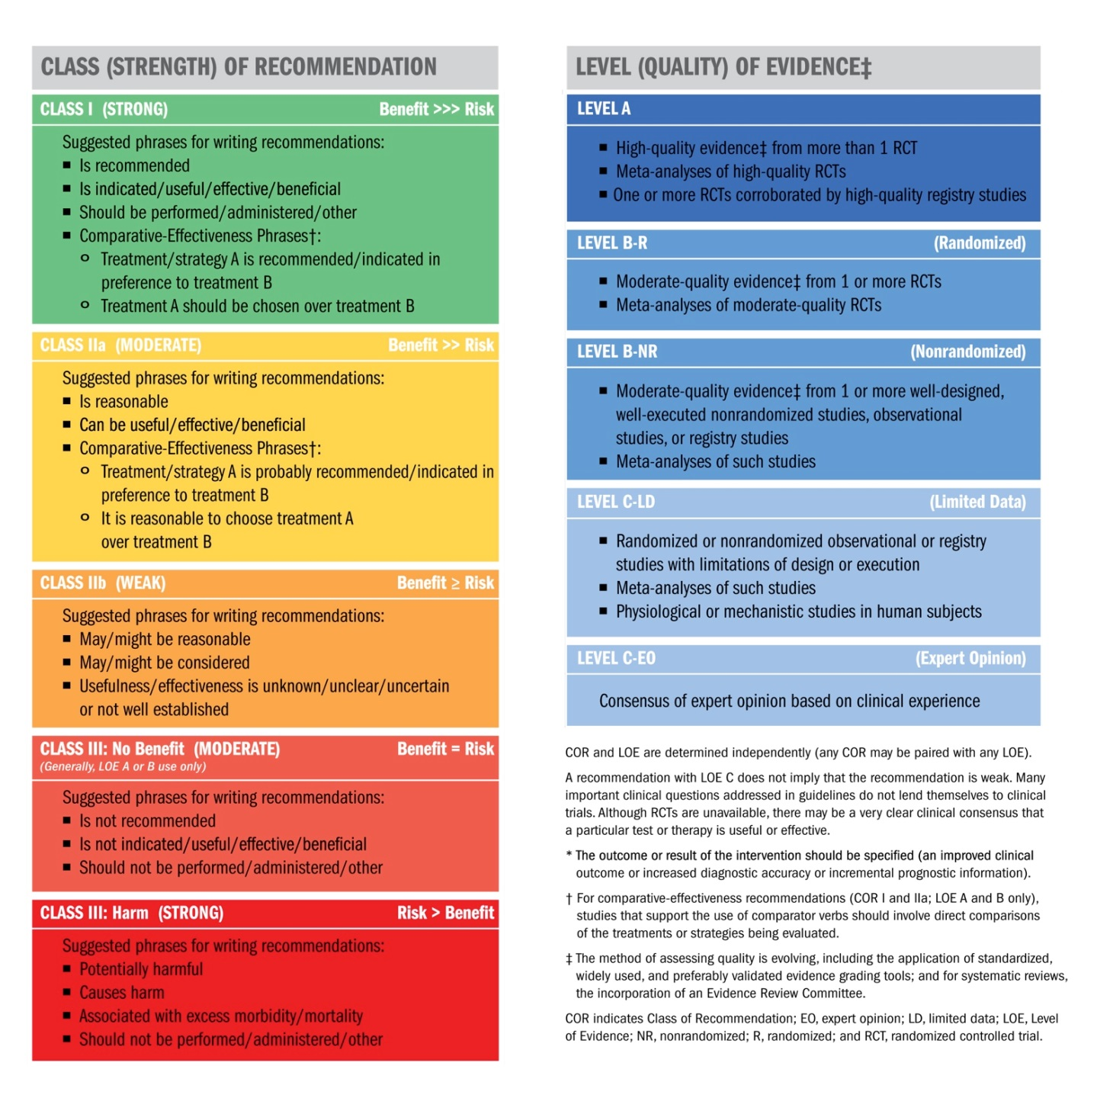
Classification of Recommendations and Levels of Evidence

Slide 46
Recommendations for Noninvasive Imaging
Recommendation | COR | LOE
Patients with suspected, acute, or new-onset HF should undergo a chest x-ray | I | C
A 2-dimensional echocardiogram with Doppler should be performed for initial evaluation of HF | I | C
Repeat measurement of EF is useful in patients with HF who have had a significant change in clinical status or received treatment that might affect cardiac function, or for consideration of device therapy | I | C
Noninvasive imaging to detect myocardial ischemia and viability is reasonable in HF and CAD | IIa | C
Viability assessment is reasonable before revascularization in HF patients with CAD | IIa | B
Radionuclide ventriculography or MRI can be useful to assess LVEF and volume | IIa | C
MRI is reasonable when assessing myocardial infiltration or scar | IIa | B
Routine repeat measurement of LV function assessment should not be performed | III: No Benefit | B

Slide 47
Recommendations for Invasive Evaluation
Recommendation | COR | LOE
Monitoring with a pulmonary artery catheter should be performed in patients with respiratory distress or impaired systemic perfusion when clinical assessment is inadequate | I | C
Invasive hemodynamic monitoring can be useful for carefully selected patients with acute HF with persistent symptoms and/or when hemodynamics are uncertain | IIa | C
When coronary ischemia may be contributing to HF, coronary arteriography is reasonable | IIa | C
Endomyocardial biopsy can be useful in patients with HF when a specific diagnosis is suspected that would influence therapy | IIa | C
Routine use of invasive hemodynamic monitoring is not recommended in normotensive patients with acute HF | III: No Benefit | B
Endomyocardial biopsy should not be performed in the routine evaluation of HF | III: Harm | C

Slide 48
Recommendations for Biomarkers in HF
Biomarker, Application | Setting | COR | LOE
Natriuretic peptides
Diagnosis or exclusion of HF | Ambulatory, Acute | I | A
Prognosis of HF | Ambulatory, Acute | I | A
Achieve GDMT | Ambulatory | IIa | B
Guidance of acutely decompensated HF therapy | Acute | IIb | C
Biomarkers of myocardial injury
Additive risk stratification | Acute, Ambulatory | I | A
Biomarkers of myocardial fibrosis
Additive risk stratification | Ambulatory | IIb | B
 | Acute | IIb | A

Slide 49
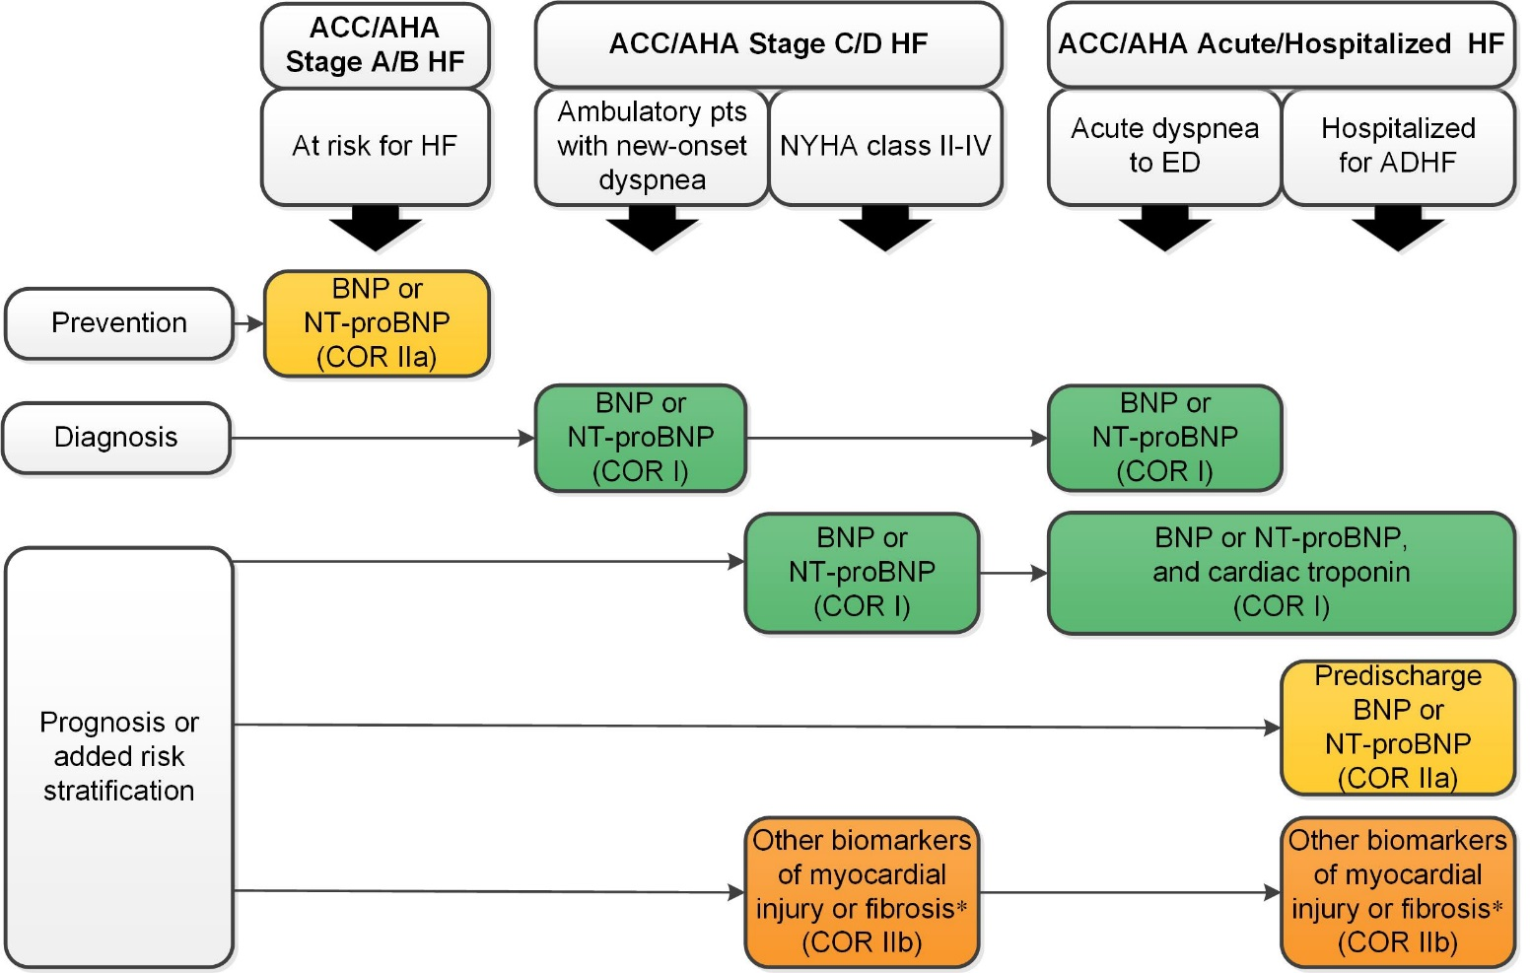
Biomarkers Indications for Use
*Other biomarkers of injury or fibrosis include soluble ST2 receptor, galectin-3, and high-sensitivity troponin.
ACC indicates American College of Cardiology; AHA, American Heart Association; ADHF, acute decompensated heart failure; BNP, B-type natriuretic peptide; COR, Class of Recommendation; ED, emergency department; HF, heart failure; NT-proBNP, N-terminal pro-B-type natriuretic peptide; NYHA, New York Heart Association; and pts, patients.

Slide 50
Part III:
Current Treatment of Heart Failure
Notes:
As you can see from this diagram, heart failure is difficult to manage chronically. When a heart failure patient moves from a compensated state to a decompensated state, their symptoms increase. Subsequently, their medications are adjusted, and often hospitalization is required. After diuresis, the patient typically moves back to a compensated state until something occurs, such as eating too much salt, etc., which pushes them back to a decompensated state.

Slide 51
2017 ACC/AHA/HFSA Focused Update of the 2013 ACCF/AHA Guideline for the Management of Heart Failure
08/18/18
ADEY AGBETOYIN,MD FACC.
Developed in Collaboration With the American Academy of Family Physicians, American College of Chest Physicians, and International Society for Heart and Lung Transplantation

Slide 52
The Vicious Cycle of
Heart Failure Management
Chronic HF
SOB
↑ Weight
Diurese & Home
Hospitalization
MD’s Office
IV Lasix or Admit
PO Lasix
Emergency Room
Notes:
The treatment of heart failure has changed considerably over the past decade, primarily because we now understand the importance of neurohormonal activation in the progression of this disease. In this section we will learn about the treatment of heart failure; however, the focus will be on the ever-expanding armamentarium the pharmacologic agents used to treat this disease.
[Note: The material discussed in this section is based on the ACC/AHA Practice Guidelines 2001, Circulation December 2001.]
General Measures:
An important part of heart failure management is identifying and treating factors that are known to encourage heart failure and its progression. This often requires encouraging patients to adopt lifestyle changes to address these factors.
Lifestyle Modifications:
Weight Reduction—Obese patients should lose weight
Smoking—Smokers should stop smoking
Alcohol—Excessive alcohol use, and the use of other cardiotoxic substances, should be avoided
Exercise—Improve physical conditioning where appropriate

Slide 53
Stage A
I
IIa
IIb
III
Hypertension and lipid disorders should be controlled in accordance with contemporary guidelines to lower the risk of HF.
Other conditions that may lead to or contribute to HF, such as obesity, diabetes mellitus, tobacco use, and known cardiotoxic agents, should be controlled or avoided.
A
I
IIa
IIb
III

Slide 54
Recommendations for Treatment of Stage B HF
Recommendations | COR | LOE
In patients with a history of MI and reduced EF, ACE inhibitors or ARBs should be used to prevent HF | I | A
In patients with MI and reduced EF, evidence-based beta blockers should be used to prevent HF | I | B
In patients with MI, statins should be used to prevent HF | I | A
Blood pressure should be controlled to prevent symptomatic HF | I | A
ACE inhibitors should be used in all patients with a reduced EF to prevent HF | I | A
Beta blockers should be used in all patients with a reduced EF to prevent HF | I | C
An ICD is reasonable in patients with asymptomatic ischemic cardiomyopathy who are at least 40 d post-MI, have an LVEF ≤30%, and on GDMT | IIa | B
Nondihydropyridine calcium channel blockers may be harmful in patients with low LVEF | III: Harm | C

Slide 55
Renin-Angiotensin System Inhibition With ACE-Inhibitor or ARB or ARNI
Pharmacological Treatment for Stage C HF With Reduced EF
COR | LOE | Recommendations | Comment/ Rationale
I | ACE-I: A | The clinical strategy of inhibition of the renin-angiotensin system with ACE inhibitors (Level of Evidence: A), OR ARBs (Level of Evidence: A), OR ARNI (Level of Evidence: B-R) in conjunction with evidence-based beta blockers, and aldosterone antagonists in selected patients, is recommended for patients with chronic HFrEF to reduce morbidity and mortality. | NEW: New clinical trial data prompted clarification and important updates.
 | ARB: A
 | ARNI: B-R

Slide 56
Renin-Angiotensin System Inhibition With ACE-Inhibitor or ARB or ARNI
Pharmacological Treatment for Stage C HF With Reduced EF
COR | LOE | Recommendations | Comment/ Rationale
I | ARNI: B-R | In patients with chronic symptomatic HFrEF NYHA class II or III who tolerate an ACE inhibitor or ARB, replacement by an ARNI is recommended to further reduce morbidity and mortality. | NEW: New clinical trial data necessitated this recommendation.

Slide 57
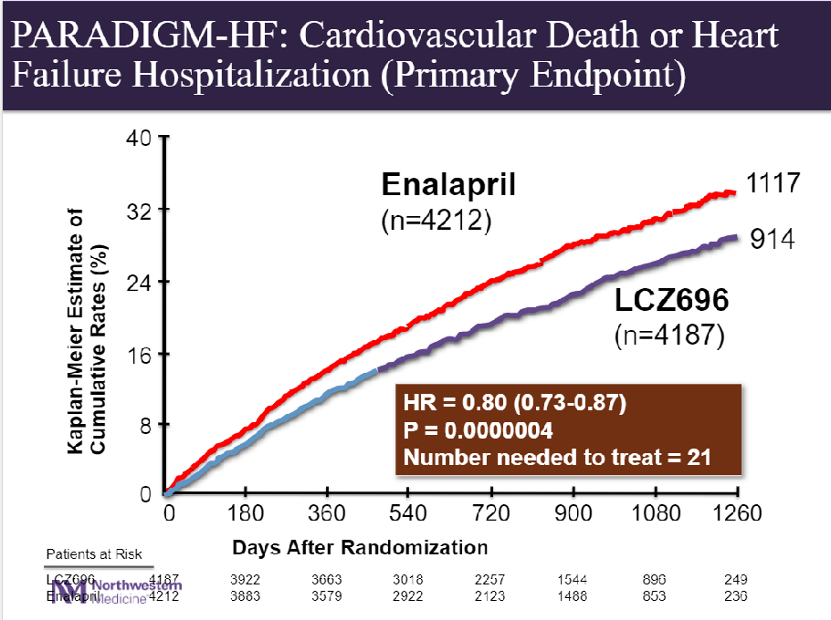
SACUBITRIL-VALSARTAN MORTALITY BENEFIT

Slide 58
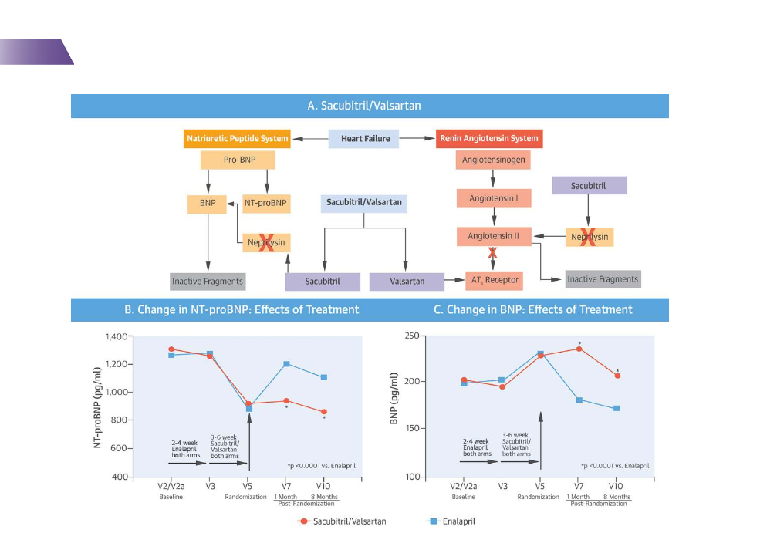
Sacubtril/valsartan treatment effects.

Slide 59
Renin-Angiotensin System Inhibition With ACE-Inhibitor or ARB or ARNI
Pharmacological Treatment for Stage C HF With Reduced EF
COR | LOE | Recommendations | Comment/ Rationale
III: Harm | B-R | ARNI should not be administered concomitantly with ACE inhibitors or within 36 hours of the last dose of an ACE inhibitor. | NEW: Available evidence demonstrates a potential signal of harm for a concomitant use of ACE inhibitors and ARNI.
III: Harm | C-EO | ARNI should not be administered to patients with a history of angioedema. | NEW: New clinical trial data.

Slide 60
Ivabradine
Pharmacological Treatment for Stage C HF With Reduced EF
COR | LOE | Recommendations | Comment/ Rationale
IIa | B-R | Ivabradine can be beneficial to reduce HF hospitalization for patients with symptomatic (NYHA class II-III) stable chronic HFrEF (LVEF ≤35%) who are receiving GDEM*, including a beta blocker at maximum tolerated dose, and who are in sinus rhythm with a heart rate of 70 bpm or greater at rest. | NEW: New clinical trial data.
*In other parts of the document, the term “GDMT” has been used to denote guideline-directed management and therapy. In this recommendation, however, the term “GDEM” has been used to denote this same concept in order to reflect the original wording of the recommendation that initially appeared in the “2016 ACC/AHA/HFSA Focused Update on New Pharmacological Therapy for Heart Failure: An Update of the 2013 ACCF/AHA Guideline for the Management of Heart Failure”.

Slide 61
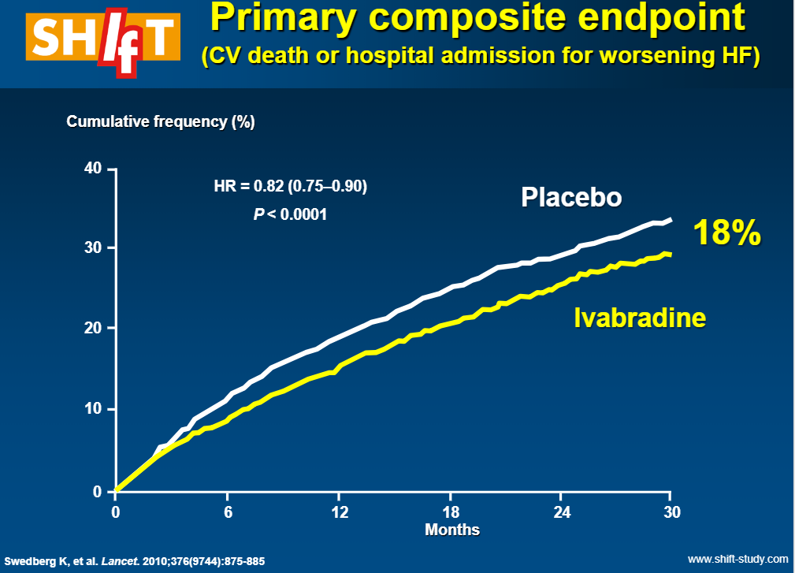
Ivradibine(corlanor).

Slide 62
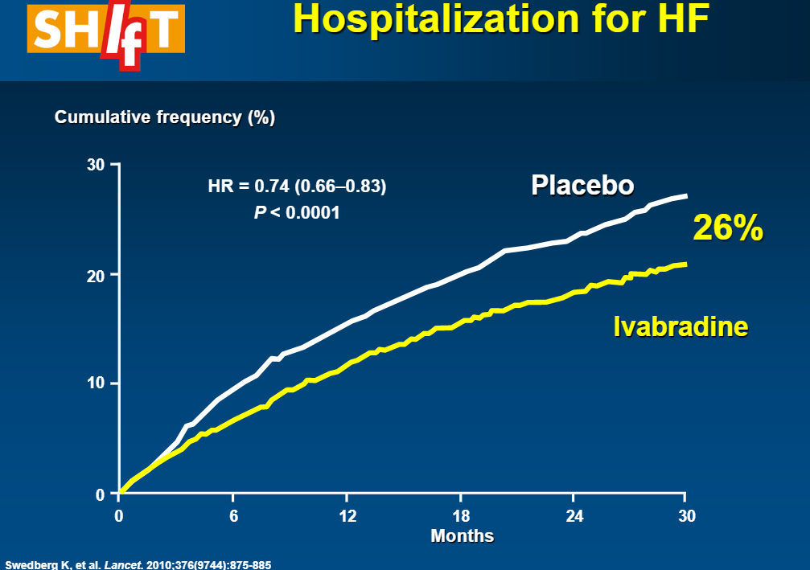
Reduction in CHF Hospitalization with ivradibine.

Slide 63
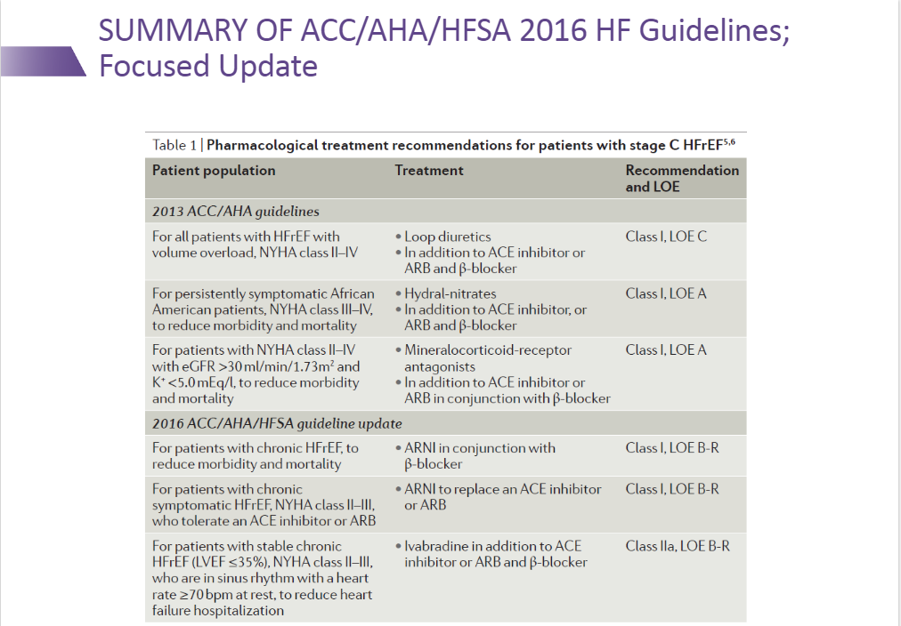

Slide 64
Pharmacological Therapy for Management of Stage C HFrEF
Recommendations | COR | LOE
Beta Blockers
Use of 1 of the 3 beta blockers proven to reduce mortality is recommended for all stable patients | I | A
Aldosterone Antagonists
Aldosterone receptor antagonists are recommended in patients with NYHA class II-IV HF who have LVEF ≤35% | I | A
Aldosterone receptor antagonists are recommended in patients following an acute MI who have LVEF ≤40% with symptoms of HF or DM | I | B
Inappropriate use of aldosterone receptor antagonists may be harmful | III: Harm | B
Hydralazine and Isosorbide Dinitrate
The combination of hydralazine and isosorbide dinitrate is recommended for African-Americans, with NYHA class III–IV HFrEF on GDMT | I | A
A combination of hydralazine and isosorbide dinitrate can be useful in patients with HFrEF who cannot be given ACE inhibitors or ARBs | IIa | B
Notes:
380624 slide 37

Slide 65
Pharmacologic Therapy for Management of Stage C HFrEF
Recommendations | COR | LOE
Digoxin
Digoxin can be beneficial in patients with HFrEF | IIa | B
Anticoagulation
Patients with chronic HF with permanent/persistent/paroxysmal AF and an additional risk factor for cardioembolic stroke should receive chronic anticoagulant therapy* | I | A
The selection of an anticoagulant agent should be individualized | I | C
Chronic anticoagulation is reasonable for patients with chronic HF who have permanent/persistent/paroxysmal AF but without an additional risk factor for cardioembolic stroke* | IIa | B
Anticoagulation is not recommended in patients with chronic HFrEF without AF, prior thromboembolic event, or a cardioembolic source | III: No Benefit | B
Statins
Statins are not beneficial as adjunctive therapy when prescribed solely for HF | III: No Benefit | A
Omega-3 Fatty Acids
Omega-3 PUFA supplementation is reasonable to use as adjunctive therapy in HFrEF or HFpEF patients | IIa | B
Notes:
380624 slide 37

Slide 66
Pharmacological Treatment - Diuretic Therapy
Diuretics are recommended in patients with HFrEF who have evidence of fluid retention, unless contraindicated, to improve symptoms
I
IIa
IIb
III

Slide 67
Pharmacological Therapy for Management of Stage C HFrEF
Recommendations | COR | LOE
Other Drugs
Nutritional supplements as treatment for HF are not recommended in HFrEF | III: No Benefit | B
Hormonal therapies other than to replete deficiencies are not recommended in HFrEF | III: No Benefit | C
Drugs known to adversely affect the clinical status of patients with HFrEF are potentially harmful and should be avoided or withdrawn | III: Harm | B
Long-term use of an infusion of a positive inotropic drug is not recommended and may be harmful except as palliation | III: Harm | C
Calcium Channel Blockers
Calcium channel blocking drugs are not recommended as routine in HFrEF | III: No Benefit | A
Notes:
380624 slide 37

Slide 68
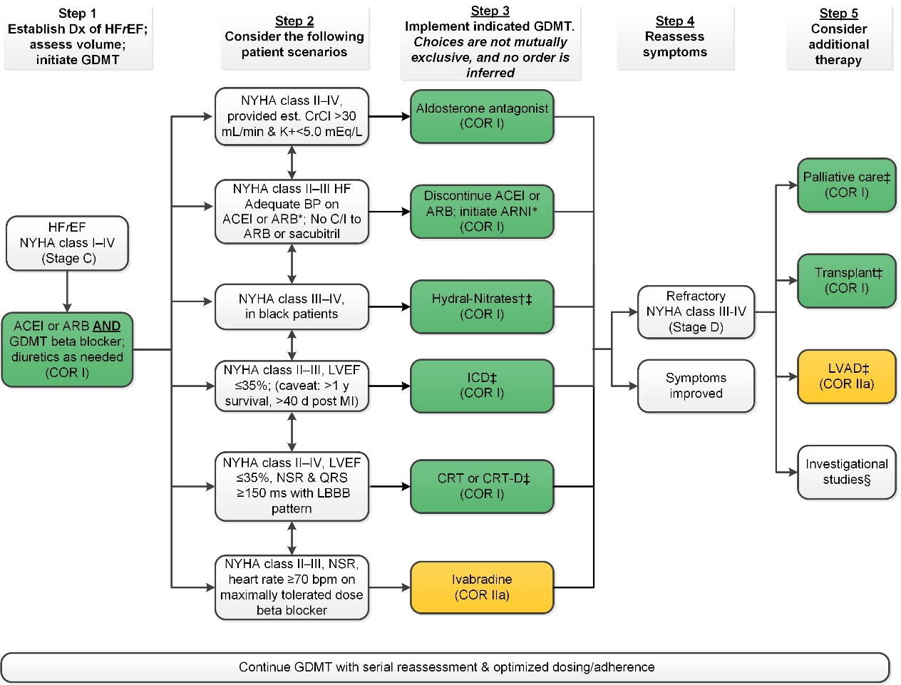
Treatment of HFrEF Stage C and D
†Hydral-Nitrates green box: The combination of ISDN/HYD with ARNI has not been robustly tested. BP response should be carefully monitored.
‡See 2013 HF guideline.
§Participation in investigational studies is also appropriate for stage C, NYHA class II and III HF.
ACEI indicates angiotensin-converting enzyme inhibitor; ARB, angiotensin receptor-blocker; ARNI, angiotensin receptor-neprilysin inhibitor; BP, blood pressure; bpm, beats per minute; C/I, contraindication; COR, Class of Recommendation; CrCl, creatinine clearance; CRT-D, cardiac resynchronization therapy–device; Dx, diagnosis; GDMT, guideline-directed management and therapy; HF, heart failure; HFrEF, heart failure with reduced ejection fraction; ICD, implantable cardioverter-defibrillator; ISDN/HYD, isosorbide dinitrate hydral-nitrates; K+, potassium; LBBB, left bundle-branch block; LVAD, left ventricular assist device; LVEF, left ventricular ejection fraction; MI, myocardial infarction; NSR, normal sinus rhythm; and NYHA, New York Heart Association.

Slide 69
Pharmacological Treatment for Stage C HF With Preserved EF
COR | LOE | Recommendations | Comment/ Rationale
IIb | B-R | In appropriately selected patients with HFpEF (with EF ≥45%, elevated BNP levels or HF admission within 1 year, estimated glomerular filtration rate >30 mL/min, creatinine <2.5 mg/dL, potassium <5.0 mEq/L), aldosterone receptor antagonists might be considered to decrease hospitalizations. | NEW: Current recommendation reflects new RCT data.
IIb | B | The use of ARBs might be considered to decrease hospitalizations for patients with HFpEF. | 2013 recommendation remains current.

Slide 70
Pharmacological Treatment for Stage C HF With Preserved EF
COR | LOE | Recommendations | Comment/ Rationale
I | B | Systolic and diastolic blood pressure should be controlled in patients with HFpEF in accordance with published clinical practice guidelines to prevent morbidity | 2013 recommendation remains current.
I | C | Diuretics should be used for relief of symptoms due to volume overload in patients with HFpEF. | 2013 recommendation remains current.

Slide 71
Pharmacological Treatment for Stage C HF With Preserved EF
COR | LOE | Recommendations | Comment/ Rationale
IIb | B-R | In appropriately selected patients with HFpEF (with EF ≥45%, elevated BNP levels or HF admission within 1 year, estimated glomerular filtration rate >30 mL/min, creatinine <2.5 mg/dL, potassium <5.0 mEq/L), aldosterone receptor antagonists might be considered to decrease hospitalizations. | NEW: Current recommendation reflects new RCT data.
IIb | B | The use of ARBs might be considered to decrease hospitalizations for patients with HFpEF. | 2013 recommendation remains current.

Slide 72
Pharmacological Treatment for Stage C HF With Preserved EF
COR | LOE | Recommendations | Comment/ Rationale
III: No Benefit | B-R | Routine use of nitrates or phosphodiesterase-5 inhibitors to increase activity or QoL in patients with HFpEF is ineffective. | NEW: Current recommendation reflects new data from RCTs.
III: No Benefit | C | Routine use of nutritional supplements is not recommended for patients with HFpEF. | 2013 recommendation remains current.

Slide 73
Pharmacological Treatment for Stage C HF With Preserved EF
COR | LOE | Recommendations | Comment/ Rationale
IIa | C | Coronary revascularization is reasonable in patients with CAD in whom symptoms (angina) or demonstrable myocardial ischemia is judged to be having an adverse effect on symptomatic HFpEF despite GDMT. | 2013 recommendation remains current.
IIa | C | Management of AF according to published clinical practice guidelines in patients with HFpEF is reasonable to improve symptomatic HF. | 2013 recommendation remains current.
IIa | C | The use of beta-blocking agents, ACE inhibitors, and ARBs in patients with hypertension is reasonable to control blood pressure in patients with HFpEF. | 2013 recommendation remains current.

Slide 74
Important Comorbidities in HF

Slide 75
Anemia
COR | LOE | Recommendations | Comment/ Rationale
IIb | B-R | In patients with NYHA class II and III HF and iron deficiency (ferritin <100 ng/mL or 100 to 300 ng/mL if transferrin saturation is <20%), intravenous iron replacement might be reasonable to improve functional status and QoL. | NEW: New evidence consistent with therapeutic benefit.
III: No Benefit | B-R | In patients with HF and anemia, erythropoietin-stimulating agents should not be used to improve morbidity and mortality. | NEW: Current recommendation reflects new evidence demonstrating absence of therapeutic benefit.

Slide 76
Treating Hypertension to Reduce the Incidence of HF
Hypertension
COR | LOE | Recommendations | Comment/ Rationale
I | B-R | In patients at increased risk, stage A HF, the optimal blood pressure in those with hypertension should be less than 130/80 mm Hg. | NEW: Recommendation reflects new RCT data.

Slide 77
Treating Hypertension in Stage C HFrEF
Hypertension
COR | LOE | Recommendations | Comment/ Rationale
I | C-EO | Patients with HFrEF and hypertension should be prescribed GDMT titrated to attain systolic blood pressure less than 130 mm Hg. | NEW: Recommendation has been adapted from recent clinical trial data but not specifically tested per se in a randomized trial of patients with HF.

Slide 78
Treating Hypertension in Stage C HFpEF
Hypertension
COR | LOE | Recommendations | Comment/ Rationale
I | C-LD | Patients with HFpEF and persistent hypertension after management of volume overload should be prescribed GDMT titrated to attain systolic blood pressure less than 130 mm Hg. | NEW: New target goal blood pressure based on updated interpretation of recent clinical trial data.

Slide 79
Sleep Disorders
COR | LOE | Recommendations | Comment/ Rationale
IIa | C-LD | In patients with NYHA class II–IV HF and suspicion of sleep disordered breathing or excessive daytime sleepiness, a formal sleep assessment is reasonable. | NEW: Recommendation reflects clinical necessity to distinguish obstructive versus central sleep apnea.
IIb | B-R | In patients with cardiovascular disease and obstructive sleep apnea, CPAP may be reasonable to improve sleep quality and daytime sleepiness. | NEW: New data demonstrate the limited scope of benefit expected from CPAP for obstructive sleep apnea.
III: Harm | B-R | In patients with NYHA class II–IV HFrEF and central sleep apnea, adaptive servo-ventilation causes harm. | NEW: New data demonstrate a signal of harm when adaptive servo-ventilation is used for central sleep apnea.

Slide 80
Pharmacologic Management
Diuretics
Used to relieve fluid retention
Improve exercise tolerance
Facilitate the use of other drugs indicated for heart failure
Patients can be taught to adjust their diuretic dose based on changes in body weight
Electrolyte depletion a frequent complication
Should never be used alone to treat heart failure
Higher doses of diuretics are associated with increased mortality
Notes:
Angiotensin Converting Enzyme (ACE) inhibitors are recommended for all heart failure patients, whether they are symptomatic or not. Use of ACE inhibitors relieves symptoms and improves exercise tolerance in patients with chronic heart failure. Data from placebo-controlled trials show that ACE inhibitors can also reduce the risk of death and disease progression in heart failure patients.
The benefits of ACE inhibitor therapy may not become apparent for 1-2 months after initiation of treatment. But even in the absence of symptomatic improvement, continued long-term ACE inhibitor therapy is recommended to reduce the risk of death or hospitalization.
Most patients with heart failure tolerate long-term ACE inhibitor therapy. Potential side effects include a decrease in blood pressure, transient worsening of kidney function, hyperkalemia, and chronic cough. Angioedema, a disorder characterized by the development of large, edematous areas of the skin, mucous membranes, and organs, is an infrequent, but life-threatening complication of ACE inhibition, and obviously, ACE inhibitors should not be used in patients with a history of this condition.
Enalapril (Vasotec) and Captopril (Capoten), have been shown to decrease mortality in large heart failure clinical trials. For this reason, these two are typically the drugs of choice.

Slide 81
Pharmacologic Management
Aldosterone Antagonists
Generally well-tolerated
Shown to reduce heart failure-related morbidity and mortality
Generally reserved for patients with NYHA Class III-IV HF
Side effects include hyperkalemia and gynecomastia. Potassium and creatinine levels should be closely monitored
Notes:
Angiotensin Receptor Blockers
Angiotensin receptor blockers, or “ARBs,” are the newest class of drugs to be promoted as a potential treatment for patients with heart failure. ARBs are most often given when a patient cannot tolerate an ACEI. To understand how these unique drugs work, we must first take a closer look at angiotensin II and and the receptors that bind it.
Angiotensin II, as we learned previously in this program, is produced from angiotensin I by the action of angiotensin converting enzyme (ACE). As we now know, angiotensin II has a number of potentially adverse effects that contribute to the development and progression of HF, including vasoconstriction, salt and water retention, and activation of the SNS. In addition, angiotensin II is associated with collagen deposition, fibrosis, and myocardial and vascular hypertrophy, which contribute to cardiac remodeling.
The effects of angiotensin II throughout the body are mediated via two receptor subtypes, designated AT₁ and AT_{2,} which bind angiotensin II. The AT₁ receptor has been extensively studied, and has been shown to be widely distributed in the vasculature, heart, kidneys, adrenal glands, and brain. The AT₁ receptor subtype is responsible for most of the physiologic effects of angiotensin II on blood pressure, salt and water balance, and cell growth, and therefore plays a central role in the pathogenesis of heart failure.

Slide 82
Pharmacologic Management
Angiotensin Receptor Blockers (ARBs)
Block AT₁ receptors, which bind circulating angiotensin II
Examples: valsartan, candesartan, losartan
In clinical practice, ARBs should be used to treat patients who are ACE intolerant due to intractable cough or who develop angioedema
Notes:
These drugs for HF are still under clinical investigation and have not been proven better than or equal to ACE inhibitors. Angiotensin receptor blockers bind to AT1. These receptors are widely distributed in the heart and appear responsible for the mediation of all the classical effects of Angiotensin II.¹
1 McMurray, J and Cleland, J. Heart Failure in Clinical Practice. Second Edition. Martin Dunitz Ltd. p 199.

Slide 83
Part IV:
Assessment and Treatment of the Heart Failure Patient

Slide 84
Treatment Approach for the Patient with Heart Failure WITH REDUCED E.F.
Stage A
At high risk, no structural disease
Stage B
Structural heart disease, asymptomatic
Stage C
Structural heart disease with prior/current symptoms of HF
Stage D
Refractory HF requiring specialized interventions
Therapy
Treat Hypertension
Treat lipid disorders
Encourage regular exercise
Discourage alcohol intake
ACE inhibition
Therapy
All measures under stage A
ACE inhibitors in appropriate patients
Beta-blockers in appropriate patients
Dietary salt restriction
Therapy
All measures under stage A
Diuretics
TRANSITION from ACE inhibitors to sacubitril/valsartan
Beta-blockers
Digitalis
Aldactone
Therapy
All measures under stages A,B, and C
Mechanical assist devices(LVAD).
Heart transplantation
IV inotropic infusions for palliation
Hospice care
H

Slide 85
Cardiac Resynchronization Therapy
Patient Indications
CRT device:
  Moderate to severe HF (NYHA Class III/IV) patients
  Symptomatic despite optimal, medical therapy
  QRS ≥ 130 msec
  LVEF ≤ 35%
CRT plus ICD:
  Same as above with ICD indication

Slide 86
Cardiac Resynchronization Therapy
Follow-up Care
Standard medical management of HF by primary physician as defined by practice guidelines
Device follow-up may be performed by physician specializing in implantable devices

Slide 87
Cardiac Resynchronization Therapy: Creating Realistic Patient Expectations
Approximately two-third of patients should experience improvement (responders vs. non-responders)¹
  Some patients may not experience immediate improvement
Note: CRT is adjunctive and is not intended to replace medical therapy. Patients will continue to be followed by HF Specialist and Physician managing implantable devices.
1 Abraham, WT, et. Al. Cardiac Resynchronization in Chronic Heart Failure. N Engl J Med 2002;346:1845-53

Slide 88
Cardiac Resynchronization Therapy: Creating Realistic Patient Expectations
Have patients set their own goals of what they would like to do following CRT:
  Grocery shopping
  Decreasing Lasix dose
  Walking to the mailbox without stopping
  Lying flat to sleep
Encourage them to be part of the group that responds to their therapy

Slide 89
First Medical Follow-up Visit
7-10 Days Post-implant*
Follow daily weights closely
Check wound site
Physical Exam
  Assess volume status
    Patients typically over-diurese following CRT
Ascertain quality of life
  Subtle improvements?
Check electrolytes including BUN/Cr
Give patients encouragement!
* This is not a complete list for many practitioners and is presented here only as a guideline.

Slide 90
Summary
Heart failure is a chronic, progressive disease that is generally not curable, but treatable
Most recent guidelines promote lifestyle modifications and medical management with ACE inhibitors, beta blockers, digoxin, and diuretics
It is estimated 15% of all heart failure patients may be candidates for cardiac resynchronization therapy (see later section for details)
Close follow-up of the heart failure patient is essential, with necessary adjustments in medical management

Slide 91
General Measures
Lifestyle Modifications:
Weight reduction
Discontinue smoking
Avoid alcohol and other cardiotoxic substances
Exercise
Medical Considerations:
Treat HTN, hyperlipidemia, diabetes, arrhythmias
Coronary revascularization
Anticoagulation
Immunization
Sodium restriction
Daily weights
Close outpatient monitoring
Notes:
Digoxin
Digoxin has been used in the management of heart failure for more than 200 years, yet it wasn’t formally approved by the FDA for this indication until 1997.
Digoxin enhances inotropy (contractility) of cardiac muscle and, at the same time, reduces activation of the SNS and RAAS. These neurohormonal effects are sustained during prolonged treatment with digoxin.
Randomized, double-blind, placebo-controlled trials such as PROVED (Prospective Randomized Study of Ventricular Failure and the Efficacy of Digoxin) and RADIANCE (Randomized Assessment of Digoxin and Inhibitors of Angiotensin-Converting Enzyme) have shown that long-term therapy with digoxin reduces symptoms and increases exercise tolerance¹. These two trials demonstrated that “patients with mild to moderate chronic heart failure due to left ventricular systolic dysfunction, who are clinically stable on either maintenance therapy of Digoxin and diuretics (PROVED), or with additional background therapy with ACE Inhibitors (RADIANCE), are at considerable risk for clinical deterioration if Digoxin is withdrawn.”² Unfortunately, the Digoxin Investigation Group (DIG) Trial demonstrated that digoxin had no effect on mortality; however, digoxin did reduce the hospitalization rate for decompensated heart failure³ .
The ACC/AHA Guidelines support the use of digoxin in conjunction with diuretics, an ACE inhibitor, and a beta-blocker in patients with LV systolic dysfunction who remain symptomatic despite treatment with an ACE inhibitor and a beta-blocker, and in those in whom heart failure is accompanied by rapid atrial fibrillation.The usual digoxin dose is 0.125-0.25 mg per day, and should be adjusted for age, renal function, and body mass. The Guidelines note that although the adverse effects of digoxin, such as cardiac arrhythmias and gastrointestinal and neurologic complaints, occur primarily at high doses, these higher doses are usually not necessary to achieve clinical benefits in patients with heart failure.
1 Young, J. Clinical Management of Heart Failure. Professional Communications, Inc. 2001. p 97.
2 McMurray, J and Cleland, J. Heart Failure in Clinical Practice. Second Edition. Martin Dunitz Ltd. p 232.
3 Young, J., p. 111

Slide 92
Pharmacologic Management
Digoxin
Enhances inotropy of cardiac muscle
Reduces activation of SNS and RAAS
Controlled trials have shown long-term digoxin therapy:
  Reduces symptoms
  Increases exercise tolerance
  Improves hemodynamics
  Decreases risk of HF progression
  Reduces hospitalization rates for decompensated HF
  Does not improve survival

Slide 93
Pharmacologic Management
ACE Inhibitors /Angiotensin receptor Blockers
Blocks the conversion of angiotensin I to angiotensin II; prevents functional deterioration
Recommended for all HFrEF heart failure patients
Relieves symptoms and improves exercise tolerance
Reduces risk of death(important!) and decreases disease progression
Benefits may not be apparent for 1-2 months after initiation

Slide 94
Pharmacologic Management
Beta-Blockers
Cardioprotective effects due to blockade of excessive SNS stimulation
In the short-term, beta blocker decreases myocardial contractility; increase in EF after 1-3 months of use
Long-term, placebo-controlled trials have shown symptomatic improvement in patients treated with certain beta-blockers(Carvedilol,Toprol XL)¹
When combined with conventional HF therapy, beta-blockers reduce the combined risk of morbidity and mortality, or disease progression¹
1 Hunt, SA, et al ACC/AHA Guidelines for the Evaluation and Management of Chronic Heart Failure in the Adult, 2001 p. 20.

