Slide 1
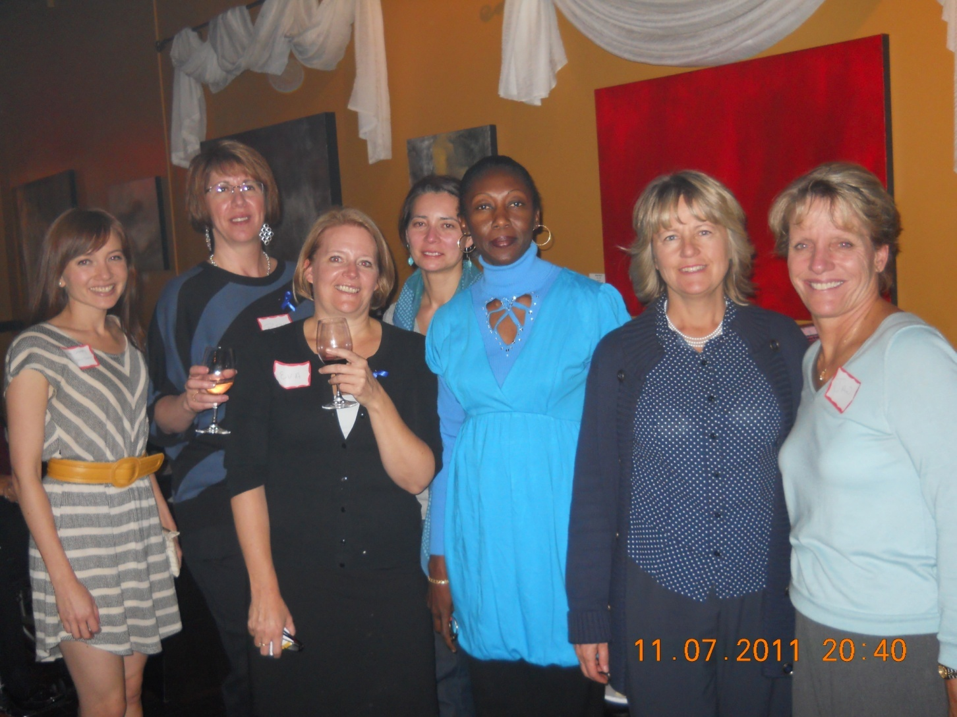
Board of Directors
2011

