Slide 1


OVERVIEW
Results driven business leader, 20 + years of human resources experience.
Experience in global and US organizations (Matrix environments).
Proven HR executive partner in senior leadership teams.
Strong background in mergers, acquisitions and consolidations.
Solid HR leader in building and developing high performance HR organizations and function as cohesive team.
The champion for recruiting, selection, rewarding, developing and retaining top talent.

Slide 2




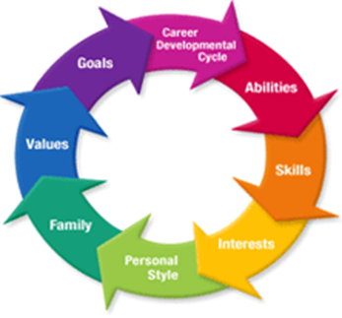









Career Experiences
Internationally Based Organizations
Amazon, Tata Technologies, Benteler Automotive, Valeo, QinetiQ Group, VT Group
Professional Services - Government Contracting – Aerospace & Defense
QinetiQ North America
VT Services
Tata
Automotive Manufacturing & Supply Chain
Supplier for Tier 1, Tier 2, Aftermarket
Tata, Benteler Automotive, Valeo, Dana Automotive, Echlin , FormTech
Consumer Products
Amazon
Sara Lee
Ralston Purina
Louis Zahn Drug Company
Computer / Technology Based Industry
Amazon
Tata
QinetiQ
Wang Laboratories
U.S. Naval Reserve – Retired Intelligence Officer

Slide 3


STRATEGY
Dana, VT Group, QinetiQ - Mergers / Acquisitions / Consolidations.
Amazon – Span of Control implementation
Benteler - Executive strategy sessions & teamwork.
Several Firms – Designed and built effective HR teams.
Benteler – Established benefits strategy to control costs, improve service and retain employees. $1,000,000 annual savings.
Benteler – 2 year Restructuring (3 plants closed).
FormTech – Improved financial performance with $20,000,000 in savings in EDBITDA.
Tata, QinetiQ, Benteler, FormTech, Valeo – Performance management and recruiting.
Valeo, Dana – Succession Planning and Competency Models.
National and International company conferences.
Dana, Echlin, QinetiQ and VT Services – Served as HR executive for acquisitions and new start up contracts.

Slide 4


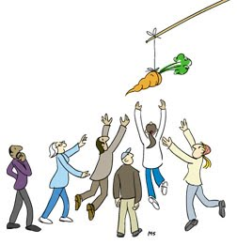

COMPENSATION
Dana Automotive – Lead the consolidation of Dana and Echlin HR benefits programs in $3,000,000,000 organization acquisition of 20,000+ employees.
Benteler Automotive – Installed new standardized compensation structures for 2,000 employees (titles, grades, ranges.).
QinetiQ North America – Established new standardized compensation program (job slotting, titles and established salary grades) of 5,000 employees.
QinetiQ – Streamlined and managed all of the management and executive STI & LTI bonus programs affecting several hundred participants.
VT Services – Established new standardized compensation system (job titles, grades, ranges and merit program)
VT Services – Established new STI & LTI compensation programs.
Amazon – Managed the division quarterly review cycle.

Slide 5



BENEFITS
Dana Automotive – Lead the consolidation of Dana and Echlin HR benefits programs in multi-billon $ organization acquisition.
Tata – Redesigned and implemented new employee benefits programs to be competitive.
Tata – Automated the Open Enrollment process.
Benteler – Streamlined US benefits with $1,000,000 annual savings.
Benteler – Greatly enhanced the 401k plan to be competitive.
VT Services – Modified all employee benefits plans and implemented an executive nonqualified retirement plan.
Dana, Benteler – Managed the company vehicle program.

Slide 6



HUMAN RESOURCES TECHNOLOGY
Greater than 20 years experience with HR systems.
QinetiQ – Served as the corporate VP HR Technology & Compensation Systems, to leverage HRIS capabilities.
QinetiQ – Managed the search, selection and successful implementation of a new Human Capital Management (HCM) system (Workday). Resulted in a streamlined HR system that is the industry leader. Cloud based tool with mobile features.
Benteler – Implemented a new on-line immigration and visa tracking tool providing up to date information.
Benteler – Served as the project lead for U.S. North America to convert from local HR system to SAP.
Benteler, QinetiQ – Implemented an online drug testing and background checks
QinetiQ – Implemented a user friendly organization chart system with daily updates.
QinetiQ – Featured by Workday on new customer systems implementation.

Slide 7


HUMAN RESOURCES ORGANIZATIONAL DESIGN & STAFFING
Tata - Realigned and hired new HR team.
Benteler – All new HR department built and staffed.
VT Services – All new department (Privately held to international division). Built new HR team.
Dana Automotive – Lead the consolidation of Dana and Echlin HR structures and programs in multi-billon $ organization acquisition for 20,000 members.
FormTech – All new department (Sold to private equity).
All assignments including managing corporate staffs and working closely with the field HR operations staff (some internationally based).
All assignments have included traveling a great deal to the field locations and plants to assure the bond with HR teams, to know what is occurring and what is needed.

Slide 8


TRAINING & DEVELOPMENT
Amazon – New management assimilation program “Life of an Order”
Benteler – New Plant Manager training program.
Benteler – Implemented Assessment Centers.
Benteler – 360 Degree management development coaching program.
Benteler – Executive coaching for key staff.
Tata, Benteler – Immigration Compliance.
Several Firms – Supervisors training: DOL Compliance, Affirmative Action, Compensation, training software, HR systems, benefits, union avoidance.
Tata, Benteler, QinetiQ, FormTech, Valeo – Performance management and recruiting.
Benteler, Valeo, FormTech, Dana - Lean Manufacturing.
Benteler, Valeo, Dana – Succession Planning and Competency Models.
Benteler – Focus on Quality program in Mexico.
National and International company leadership & HR conferences (India, Germany, Czech Republic, Mexico, Canada, London, Paris, UK).
Amazon - Led the division program for quarterly Performance Leadership Reviews

Slide 9
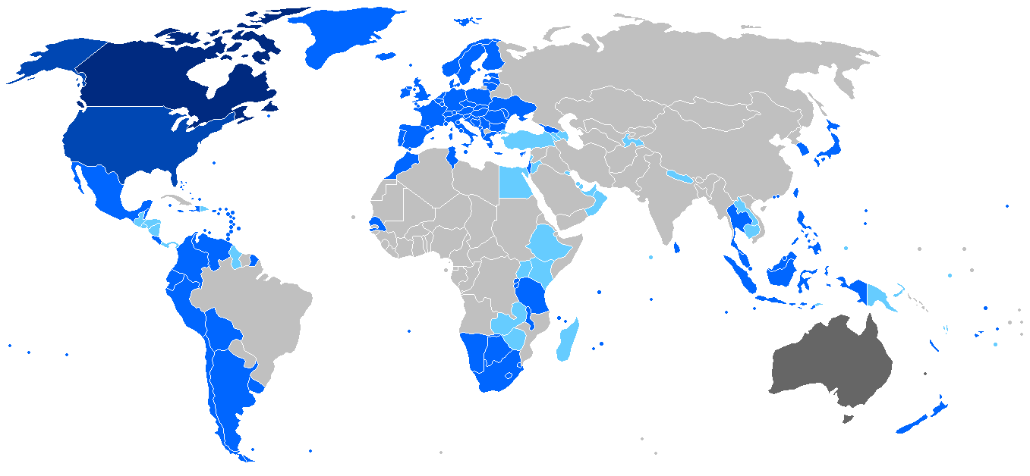


IMMIGRATION & INTERNATIONAL MOBILITY
Tata, Benteler - Streamlined immigration and DOL work visa legal compliance programs.
Benteler – Automated the processes with efficiencies and on-line access.
Tata, Benteler – Trained HR on current Immigration and DOL compliance responsibilities.
Benteler, Valeo – Completed full audit of all expatriates and work visas.
Tata, Benteler – Communicated compliance requirements to line management.
Tata – Managed all Immigration matters for 150 members.
Benteler – Managed compliance for approximately 45 expatriates (Germany, France, Spain, Mexico, Brazil, Canada, Japan, China, India, US, Italy, and the Czech Republic).
Valeo – Managed approximately 140 expatriates for all immigration and work visas (France, US, Spain, Portugal, Mexico, Japan, China, US, Germany, and the UK).
Amazon – Supported a high work visa ratio corporate team.

Slide 10



COMMUNICATIONS
Global Organizations – Benteler. QinetiQ, Valeo, VT Services, Dana, Echlin – Communications were core functions.
Travel to the sites and developed relations with HR members and local leadership.
Monthly Staff calls with the HR teams.
Morning “5 Minute” HR meetings.
On-going communications cadence with the plants and field employees.
HR has been a core competency to be business partners at all levels.
Communication on DOL and immigration rules.
Global distance is always a challenge.
Corporate support required to assist the field teams.
Technical tools and systems must be linked.
On-going reporting requirements have to be harmonized.

Slide 11


LABOR & EMPLOYEE RELATIONS
Greater than 15 years with Labor Relations responsibilities for plants, distribution centers, and field services.
Provided HR leadership on employee relations on resolution of Conflict Management issues.
Served as the HR executive on all third party legal labor / ER issues.
Provided direction on goals for negotiations results.
Valeo - Served on the HR leadership team to successfully emerge from Chapter 11 due to a unions contract.
Benteler – All Mexican operations are unionized for 2,500 members. Helped to establish the cost objectives for 2015 negotiations, with positive results.
Successfully defended all organized labor organization attempts.
Executive HR leadership as an expert to assist the management organization.
Several Firms – Managed the Labor Relations functions with LR staff management members and LR law firms.
Several Firms – Employee Relations programs including handbooks, communications, employee surveys, problem resolution, performance management, Skip Level meetings, employee roundtables, suggestion boxes, on-line questions, benefits programs, compensation strategy, job postings, promotion from within commitments.
Benteler – New 401(k) plan to be market competitive (turnover).
Managed employee opinion survey processes.

Slide 12



TALENT ACQUISTION & STAFFING
Led the Talent Acquisition processes for companies and recruited key top talent into senior management leadership positions.
Tata, Benteler – Built new staffing capabilities, introduced LinkedIn.
QinetiQ – Staffed new department with low average time to fill of 20 days.
Benteler – Led the Assessment Centers for the selection of senior staff.
Valeo – Managed the High Potential / Promotables for key assignments.
Valeo – Managed all international assignments for the Division.
Expatriate Management – HR leadership for Tata, Benteler and Valeo.
Dana Automotive – Lead the consolidation of Dana and Echlin HR structures and programs in multi-billon $ organization acquisition. This included the internal selection of senior staff to fill critical needs.
Relocation – Developed programs at Tata, Benteler, QinetiQ, FormTech, and VT Services.
Tata, Benteler, QinetiQ – Enhanced the drug testing and background checks with cost savings and expedited hiring process.
Benteler – Established new college relations program and enhanced employee referrals.
Amazon – Served on leadership selection panels.

Slide 13


Education & Development
BSBA – Bachelor of Science in Business Administration – University of Missouri – St. Louis. Graduated Cum Laude.
Graduate work in MBA program - University of Missouri – St. Louis.
INSEAD - EUROPEAN CENTRE FOR CONTINUING EDUCATION - Fontainenbleau, France. Executive Management Development – 2003.
Certified Coach – 360 degree Management Development program – 2015.
Technology & HR Programs – Presenter at IHRIM conference and attended national technology events to streamline the HR systems.

Slide 14

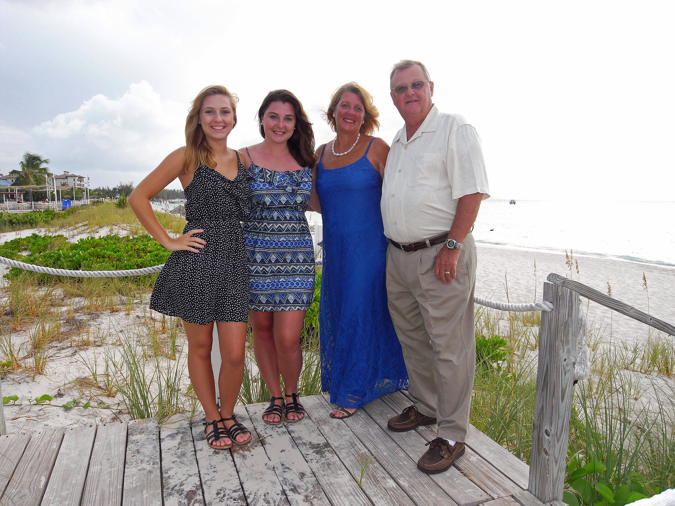

Selected Top Accomplishments
Professional
Dana Automotive – Consolidation of the Dana Automotive Aftermarket HR programs for 20,000 employee SBU.
Built winning high performance HR teams – Tata, Benteler, QinetiQ, VT Services, FormTech.
QinetiQ – Implemented new Human Capital Management system – Workday, resulting in streamlined processes, timely and accurate data for 5,000 employees.
Benteler – Saved $1,000,000 in healthcare costs for US employees.
Implemented new compensation programs at Dana, QinetiQ, VT Services and Benteler.
Successfully defended 10 + union organization attempts
Valeo – Key member of the HR leadership team during Chapter 11 and helped to win the negotiations to reduce the costs of the union contact.
Served as the 1st professional HR executive – QinetiQ, FormTech, VT Services.
Personal
A family to be proud of: a wife, two (2) daughters in university studies.
U.S. Naval Reserve – Promoted from the junior enlisted ranks to that of a Commander in Intelligence, and served as a Commanding Officer of an Intelligence Command.

Slide 15
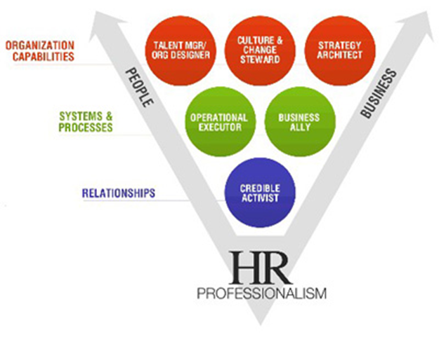
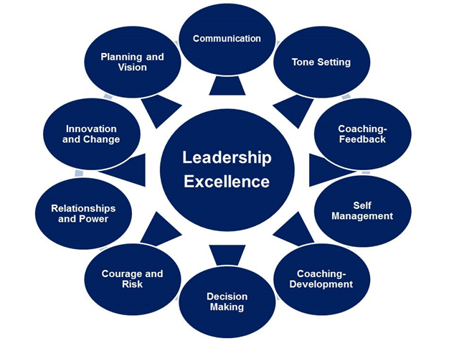







In Summary:
A proven track record of success, from a solid human resources foundation in different environments, organizations, and industries.
Strong HR background in complex and large businesses in international arenas.
Business partner with the senior leadership, peers, the customers and team members.
Professional HR Executive leadership style as a model profile.
A high integrity and professional executive who enjoys developing others.
Proven human resources leader who has designed, built, and developed HR departments.
Broad human resources experience and background in sophisticated companies and international cultures.
Moves an organization forward with positive energy.
United States
Mexico
Canada
UK
Germany
France
India
Germany

