Slide 1



Data Literacy Framework
for Thailand Government Officers
Chaiwat Jirakitpaibool, Sotarat Thammaboosadee, Monsak Socharoentum
IT Management Division,
Faculty of Engineering, Mahidol University
The 20th International Joint Conference on Computer Science and Software Engineering
28th June - 1st July 2023
Naresuan University Phitsanulok, THAILAND
Notes:
Hello, I'm Chaiwat Jirakitpaibol. Master's students of the IT Management Division, Faculty of Engineering, Mahidol University
Today, I will present my work on the topic of Data Literacy Framework for Thailand Government Officers
And have an co-authors as follows
Asst. Prof. Sotarat Thammaboosadee from IT Management Division, Faculty of Engineering, Mahidol University
and dr. Monsak Socharoentum from Digital Government Development Agency (Public Organization) (DGA)

Slide 2
Outline
Introduction and Review
  Background and Statement of Problems
  Definition of Data Literacy and Goal
  Digital Literacy Abilities in Thailand
  The Digital Competence Framework
  APS Data Capability
  Data Literacy Body of Knowledge (DLBOK)
Methodology
The OCSC Position Level and Courses
Conclusion
Notes:
Today, there will be on 4 main topics.
Introduction and Review
Methodology
The OCSC Position Level and Courses
Conclusion

Slide 3
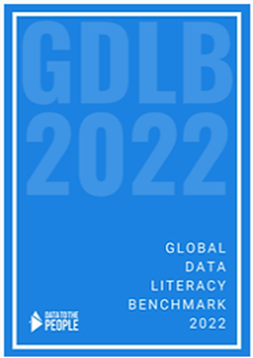
Background and Statement of Problems
Notes:
I'll start with the question: Have you ever had a problem working with information?
Digital literacy skills are now included in the curriculum, but data literacy related to government jobs is not yet complete for government officials.
MIT and Emerson College define Data Literacy as the ability to read, work with, analyze and argue with data.
Jordan Morrow, author of Be Data Literate, uses this definition as the ability to read, work with, analyze and communicate with data.
Aryng, a data science consulting firm, defines data knowledge as: ability to read Understand and use data to drive decision-making. to cover these meanings
However, organizations or workplaces in the Global Data Literacy Benchmark 2022 report that surveyed data literacy skills indicated that they struggled to work with data. of over 5,000 employees around the world, divided into 3 groups: 1. People who can be coaches (Coach), 2. People who are confident in working with information (Confident), and 3. People who are still afraid (Curious).

Slide 4
Background and Statement of Problems
Notes:
from the previous report The results show that in every country only 8-19% of people are confident that they can become a coach.
And some people are still dissatisfied with working with data. It also estimates that organizations lose 43 hours per employee due to delays and stress from working with information and technology,
costing $109.4 billion in the US, $13.17 billion in the UK, and $9.4 billion in Australia.
Therefore mentioned data knowledge framework has been implemented.
And broken down by industry details as follows: It was found that among government agencies,
the number of people from the sample country, 49%, are more confident in working with data.
Because each country has its own data knowledge framework.

Slide 5
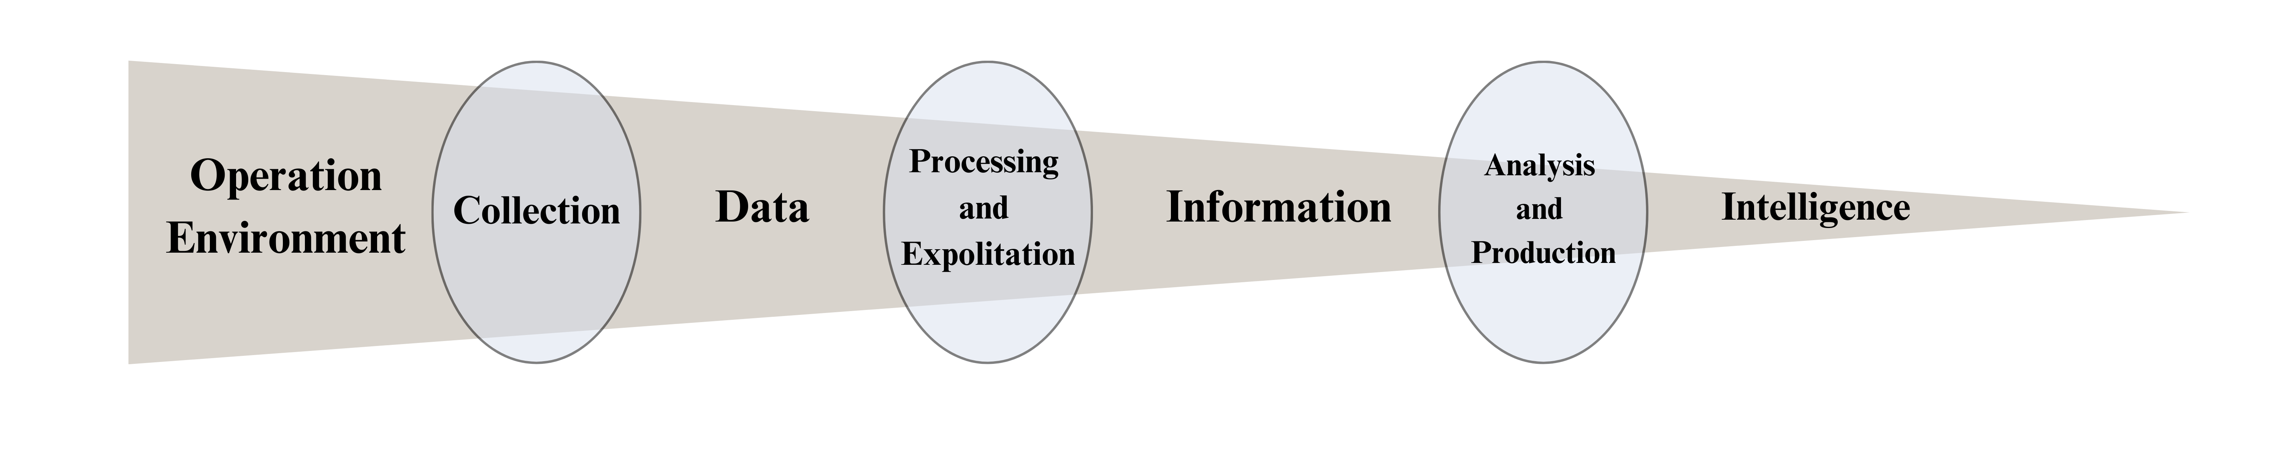
Definition of Data Literacy and Goal
Notes:
From the picture, we can see that Creating an environment that can enhance data collection
It can lead to confidence in the work of information.
Including the creation of a framework framework will help to have confidence in working towards confidence. and intelligent use of information

Slide 6
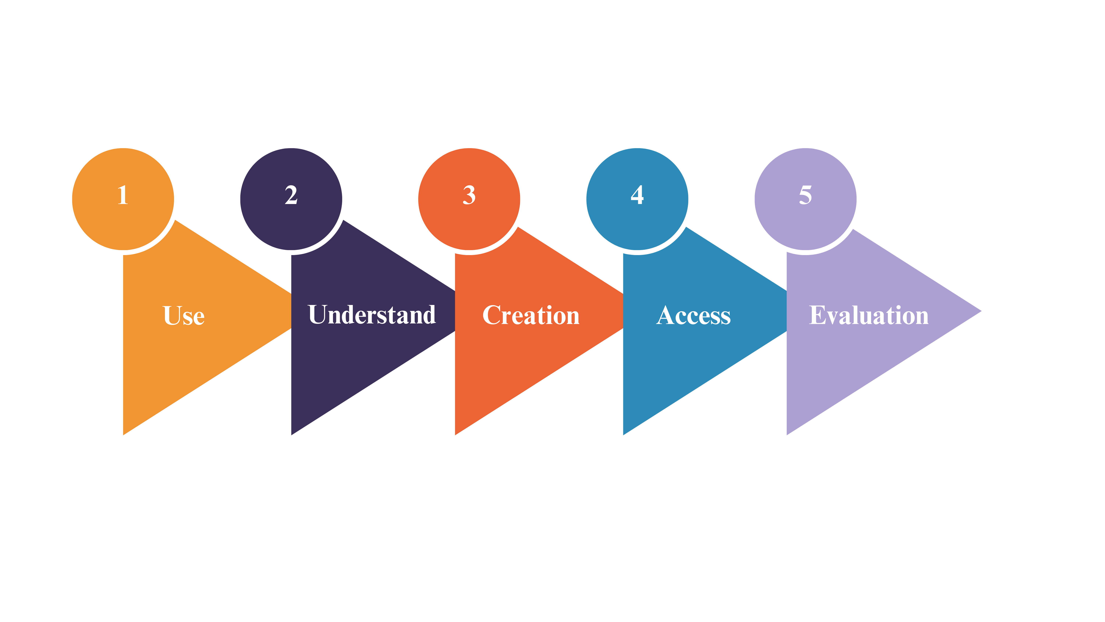
Digital Literacy Abilities in Thailand
Notes:
The Office of the Civil Service Commission (OCSC) in Thailand defines Data Literacy as the effective use of tools, equipment, and digital technologies for communication, collaboration, and work processes. It involves abilities such as using, understanding, creating, accessing, and evaluating digital technologies. While these abilities are important for efficient work systems, they do not encompass all data-related skills.
Thailand aims to transform into a digital government through digital skills, as depicted in the "Digital Literacy Abilities in Thailand" figure. This transformation involves an open and connected government, a smart government for citizens, and a government with a digital culture.
Competency in the government sector refers to the behaviors that personnel should exhibit to fulfill their expected roles. The Cabinet Resolution of September 26, 2017, provides guidelines for the development of digital skills among government officials and personnel. These abilities are categorized into seven groups: Digital Literacy, Digital Governance, Standards and Compliance, Digital Technology, Digital Process and Service Design, Strategic and Project Management, Digital Leadership, and Digital Transformation.
While the establishment of these seven abilities does not fully address the information skills required in the digital era, access to information technology is crucial for creating and utilizing data. Activities involving information technology generate data, such as creating digital media, posting pictures on social media, and publishing online content. Hence, data activities are closely intertwined with digital activities, and it is challenging to separate the two.
The OCSC Digital Literacy framework provides guidance for developing digital competencies among government employees in Thailand. However, a gap analysis reveals the need for a stronger focus on data literacy skills related to analysis, interpretation, and visualization. To enhance the framework, opportunities include expanding the coverage of data literacy skills and providing practical training to enable employees to apply their digital competencies in real-world scenarios.

Slide 7
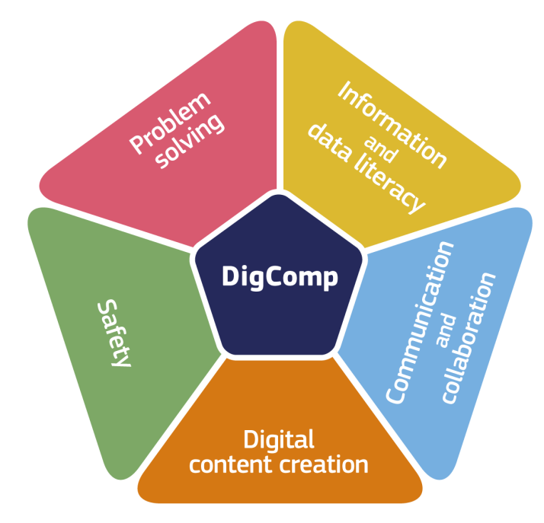
The Digital Competence Framework
Notes:
The Digital Competence Framework, developed by the European Commission, is a comprehensive guide for assessing and improving the digital capabilities of individuals, educators, and organizations.
It consists of 21 capabilities organized into five areas: data literacy, communication and collaboration, digital content creation, security, and problem-solving.
This framework is crucial in today's digital age as it provides a standardized guide for developing the necessary skills to effectively engage with digital technologies. In the field of education,
it ensures that students are prepared for the digital world by developing their digital competence.
The framework presents five digital competencies and 21 detailed competencies, each categorized into three levels. The five areas of digital competency include:
Information: The ability to identify, search, retrieve, store, organize, analyze, and determine the relevance and purpose of digital data.
Communication: The ability to communicate, share resources, connect with others, collaborate through digital tools, and demonstrate cross-cultural awareness in a digital environment.
Content Creation: The ability to create and edit various types of content such as text, images, and videos, integrate and explain new knowledge, produce creative expressions, and manage intellectual property rights and licenses.
Security: The ability to protect personal data, digital identities, and practice safe and sustainable use of digital technology.
Problem Solving: The ability to identify digital needs and resources, make informed decisions about the most suitable digital tools, solve conceptual and technical problems using digital methods, and enhance one's own and others' digital skills.
While the Digital Competence Framework provides detailed guidance, it lacks a specific focus on data literacy skills, despite covering content creation and knowledge production. This gap in addressing data analysis skills is increasingly important in the digital age. To ensure citizens have the necessary skills to fully participate in the digital era, it is essential to integrate data literacy skills into the framework. This will enable individuals to confidently, critically, and securely engage with digital technologies in a data-driven world.

Slide 8
APS Data Capability
Capabilities/Categories | Plan | Describe | Collect | Store | Prepare | Analyse
Value organisational data as assets | ✓ | ✓ | ✓ | ✓ | ✓ | ✓
Data communication | ✓ | ✓ | ✓ | ✓ | ✓ | ✓
Improvement and innovation (for data) | ✓ | ✓ | ✓ | ✓ | ✓ | ✓
Data governance | ✓ | ✓ | ✓ | ✓
Identifying data availability | ✓ |  | ✓
Enabling data access | ✓ |  | ✓
Sourcing and use of administrative data | ✓ | ✓ | ✓ |  |  | ✓
Data collection | ✓ |  | ✓ |  |  | ✓
Subject matter expertise | ✓ | ✓ | ✓ |  | ✓ | ✓
Identify research questions | ✓ |  | ✓ |  |  | ✓
Data outputs, products, or services | ✓ |  |  |  |  | ✓
Data collection methodology |  |  | ✓ |  |  | ✓
Data quality |  | ✓ | ✓ | ✓ | ✓ | ✓
Statistical concepts and methodologies – data analysis |  | ✓ | ✓ | ✓ | ✓ | ✓
Data and information management |  | ✓ | ✓ | ✓ | ✓ | ✓
Data classification |  | ✓ |  | ✓ | ✓ | ✓
Integrate data |  | ✓ |  | ✓ | ✓ | ✓
Data editing |  | ✓ |  | ✓ | ✓ | ✓
Metadata - Describe and summarise data |  | ✓ |  | ✓ | ✓ | ✓
Enabling data use and re-use |  | ✓ |  | ✓ |  | ✓
Data processing methodology |  |  |  |  | ✓ | ✓
Exploratory data analysis |  |  |  |  | ✓ | ✓
Visualise data |  |  |  |  | ✓ | ✓
Statistical data analysis |  |  |  |  |  | ✓
Specialist data analysis |  |  |  |  |  | ✓
Business intelligence data analysis |  |  |  |  |  | ✓
Notes:
The APS Data Capability Framework is a guide that helps Australian Public Service (APS)
employees enhance their data capabilities.
It defines data-specific knowledge, skills, and behaviors across three proficiency levels: foundation, intermediate, and advanced. The framework consists of seven categories:
Plan: Mapping out processes and resources for the data lifecycle, setting project goals, and creating a comprehensive data management plan.
Description: Accurately describing data using appropriate metadata standards.
Collect/Generate Data: Collecting or generating data for individual or organizational use.
Store: Securely and efficiently storing data in a digital repository for reusability.
Preparation: Getting data ready for analysis and use.
Analyze/Use: Analyzing and using data for its intended purpose and extracting additional value from it.
Preserve: Taking actions to ensure long-term viability and availability of data or appropriate data destruction if retention is not necessary.
While the APS Data Capability Framework provides a solid foundation, it has some areas that require further development. Firstly, it emphasizes data governance but lacks guidance on implementing policies and procedures effectively. Secondly, it recognizes the importance of data visualization but doesn't provide adequate guidance on creating effective and accessible visualizations for diverse audiences. Additionally, the framework doesn't sufficiently address emerging technologies like artificial intelligence (AI) and machine learning (ML) that are essential for data analysis. It should incorporate these technologies and the necessary skills and knowledge to work with them effectively.
In summary, the APS Data Capability Framework is a valuable resource for developing data capabilities in the APS. However, it needs further refinement in areas such as data governance, data visualization, and addressing emerging technologies like AI and ML.

Slide 9
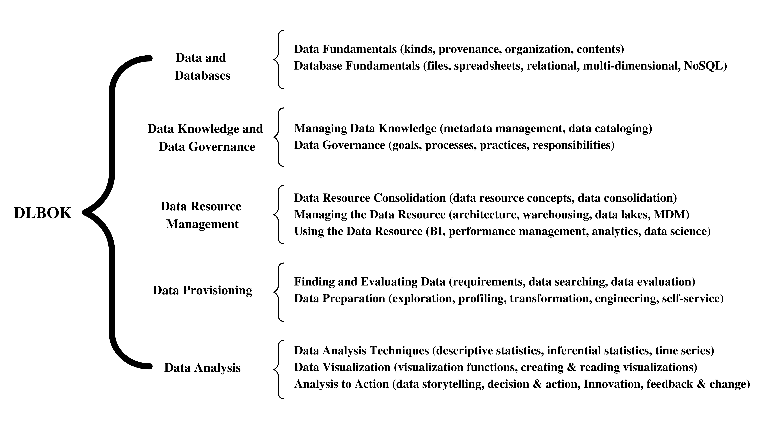
Data Literacy Body of Knowledge (DLBOK)
Notes:
The Data Literacy Body of Knowledge (DLBOK) is a comprehensive list of topics that define the professional domain of data literacy.
The DLBOK includes a Data Literacy Certification Program that provides online learning materials covering all topics in the library, helping individuals build the necessary skills.
The DLBOK defines five skill sets within data literacy:
Data and Databases: Understanding the fundamentals of data and databases, including types of databases and their electronic storage, access, and processing.
Data Knowledge and Data Governance: Having knowledge of data content, meaning, location, structure, quality, privacy, and security requirements. It also involves actively managing data assets through policies, processes, and practices.
Data Resource Management: Managing collections of shared and reused data across organizations, involving processes to develop architectures, execute processing, and define the data management lifecycle.
Data Provisioning: Gathering, refining, and structuring raw data into a suitable format for analysis, reporting, or more advanced data science applications.
Data Analysis: Organizing data for exploration, using statistical methods to identify patterns, visualizing patterns to comprehend and convey insights, and interpreting patterns and visualizations to explain meanings.
While the DLBOK provides a strong foundation, there are areas that require further development.
Notably, integrating ethical and legal considerations into data literacy training is a primary gap.
Additionally, specific guidelines and resources need to be developed in areas such as data ethics, legalities, data-driven decision making, and data visualization.
In summary, the DLBOK offers a solid foundation for developing data literacy skills.
However, there is a need for further development in areas such as ethical considerations, legal aspects, data-driven decision making, and data visualization. Enhancing these aspects will enable individuals and organizations to effectively utilize data in decision making and problem-solving, maximizing the potential of data in the digital age.

Slide 10
Methodology
Notes:
The research methodology involves 4 main steps. The first step is to conduct a comprehensive study of the relevant job characteristics and explore the skill framework that is pertinent to the work.
This will entail reviewing and synthesizing the definitions, meanings, and processes from various sources for comparison purposes.
The second step is to evaluate the gap between the identified frameworks by comparing the patterns of skills and competencies present or absent within each framework. This analysis will provide insight into the strengths and weaknesses of each framework, thereby enabling the researchers to generate analytical results,
And the final step entails creating definitions, competencies, and a recommended course by comparing each framework.
The goal is to develop further skills that will address the gaps identified in the previous step. This step is crucial in ensuring that the final product is tailored to meet the specific needs of the job in question.
1. Framework and Related Research Selection
2. Gap Analysis
3. Data Literacy Framework V.1
4. Definition and course

Slide 11
Data Skill Comparison on Frameworks
Component /Framework | APS Data Capability Framework | The Data Literacy Body of Knowledge (DLBOK) | EU DigComp | Thailand the Office of the Civil Service Commission (OCSC)
Data Gathering | ✓ | ✓ | ✓ | ✓
Data Management | ✓ | ✓ | ✓ | ×
Data Governance | ✓ | ✓ | × | ✓
Data Assessment | ✓ | ✓ | ✓ | ✓
Data Utilizations | ✓ | ✓ | ✓ | ×
Notes:
From this picture, we will evaluate the framework we see. we will see the difference and the completeness that differs in the order of the data.
The researcher has divided the framework into 5 forms from the evaluation
Data Gathering
Data Management
Data Governance
Data Assessment
Data Utilizations
Completeness will be different. And having assessed the gaps, as shown in the picture,
we can see that the Thailand Office of the Civil Service Commission (OCSC) framework is still lacking in terms of Data Management and Data Utilizations.

Slide 12
The OCSC position level and Course
Components | Competencies | Definitions | Officers Level
Data Gathering | Data Collections | An ability to find and follow on the data ethics. | M, A, S, T
 | Evaluating and Ensuring Quality of Data and Sources | An ability to Ensuring Quality of Data and Sources | M, A, S, T, O
Data Management | Data Organization | The act of sorting and categorizing unprocessed data into distinct groups or classes, with the goal of making it more manageable and easier to analyze. | A, S, T, O
 | Meta Data Creation and Use | A process to Creation and Use meta data | A, S, T, O
 | Data Curation, Security and Reuse | An ability to setting lifecycle for reuse organization and integration of data collected from various sources and keep it on security | S, T, O
Data Governance | Data Governance Activities | Understand activities on data governance to support process. | M, A, S, T, O
 | Data Governance Framework | Understand and can be follow the process Data Governance to relate on data governance framework | E, M, A, S, T, O
Notes:
The researchers have also defined the definitions of Data Literacy Framework v.1 and the level of officer’s skill development within the organization,
at the initial 6 level Executives (E), Managements (M), Academics (A), Services (S), Technologists (T) and Others (O) (the level reference from the declaration Thailand the Office of the Civil Service Commission (OCSC)
Digital Literacy Framework for developing the digital government),
government agencies for further evaluation as the shown in Table
for example
the Data Gathering component have Data Collections is An ability to find and follow on the data ethics. related on M, A, S, T officers level and Data governance component have Data Governance Framework is an abilities to Understand and can be follow the process Data Governance to relate on data governance framework related on E, M, A, S, T, O officers level

Slide 13
The OCSC position level and Course
Components | Competencies | Definitions | Officers Level
Data Assessment | Data Tools | The skill of utilizing software that has various capabilities such as setting up and executing data pipelines, gathering configuration data, and performing other related tasks. | A, S, T, O
 | Identifying Problems using Data | Can be explain problems while working with data | A, S, T, O
 | Data Visualizations | The act of converting data or information into a visual form, such as a chart, graph, or map for better understanding and communication. | A, S, T, O
 | Data Driven Decision Making | Can using data for decide on a job or situations | E, M
Data Utilizations | Critical Thinking | The process of examining available facts, evidence, observations, and arguments to work with data and form conclusions based on the analysis. | A, S, T, O
 | Data Ethics | Ability to collecting, generating, analyzing, and disseminating data on a right way such as follow by law. | A, S, T, O
 | Evaluating Decision Bases on Data | A methodical, numerical, and visual approach to addressing and evaluating significant decisions through the use of data. | E, M, A, S, T, O
Notes:
and Data Assessment component have Data Driven Decision Making competencies and the definitions is Can using data for decide on a job or situations related on E, M Level and so on.

Slide 14
The OCSC position level and Course
Notes:
By definition, the researcher has summarized the data. from document review have summarized the course list Definitions that each job position level must know are as follows:

Slide 15
Conclusion
The objective of this research was aims to identify disparities between compliance, data, and other relevant aspects in Thailand and the International Digital Skills Framework, by analyzing performance gaps within the Office of the Civil Service Commission's framework, strengths, weaknesses, and identifying essential competencies, as well as areas in which Thailand lags international standards.
In the future, this research should prioritize gathering feedback and assessing performance needs within government agencies to develop data skills that align with the demands of working with data.
This approach ensures that data skill development is tailored to meet the unique challenges of different roles within government agencies. job skills should be developed in government agencies, dividing them by position or creating a sustainable and appropriate development hierarchy. Due to the diverse range of government personnel and job positions, some roles may require a comprehensive understanding of information skills, while others may only require basic knowledge to make informed decisions.
Notes:
This research aimed to identify disparities between compliance, data, and other relevant aspects in Thailand and the International Digital Skills Framework.
The researchers analyzed performance gaps within the Office of the Civil Service Commission's framework, identified strengths and weaknesses, and essential competencies.
They also provided definitions based on international standards to set performance expectations for employees at different levels.
In the future, it is recommended to prioritize gathering feedback and assessing performance needs within government agencies to develop data skills that align with the demands of working with data.
This approach ensures that data skill development is tailored to meet the unique challenges of different roles within government agencies.
Job skills should be developed in a sustainable and appropriate hierarchy, taking into account the diverse range of government personnel and job positions.
Some roles may require a comprehensive understanding of information skills, while others may only require basic knowledge for informed decision-making.

Slide 16
THANK YOU

