Slide 1


Maximizing Efficiency in Marketing Planning: Artificial Neural Network Regression and Data Imputation for Improving Business Forecasting
Panyanat Aonpong, Ratchai Thipbumrung, Weenawadee Muangon, Opas Wongtaweesap
Silpakorn University, Thailand

Slide 2
Outline
Introduction
Method
  Group dataset and Sorting
  Generate Simulated DayKey
  Merging simulated DayKey with the real DayKey
  CumSales Imputation
  Neural Network Regression
Experiment
Conclusion

Slide 3

Introduction
Marketing planning plays an important role in the success of any business. At present has tools and a library for the prediction.
Datasets may not be good enough for accuracy.
We have to choose methods for managing data such as duplication data, missing, outliers, and too less.
These problems may affect your work.
1
2
2
2
5
6
8
9
999

Slide 4
Introduction
Problems in our work are missing value which is related to time, and we have to use appropriate methods for data preprocessing.
In the step of data preprocessing we use our proposed method for imputation data and prediction.
Raw data
Data preprocessing
Trained model

Slide 5








Introduction
traditional linear regression
linear regression with imputation data
proposed method
In this work, Our experiment will focus on Data imputation and Neural Network Regression. We compare the proposed method with the classical linear regression method.
Traditional linear regression
Linear regression with imputation data
Our proposed method

Slide 6
Method
Overview: These are all processes in our work
Input Data
Process data
Sort and group
Merge simulated data with real data
Result
Imputation
Neural Network Regression
simulated DayKey
Generate artificial cumsales
DayKey

Slide 7
Group dataset and Sorting
DayKey
20XX-01-01
20XX-01-02
20XX-01-03
20XX-01-04
20XX-01-05
20XX-01-06
20XX-01-07
20XX-01-08
DayKey | Product Group | Area | Channel | Sales | CumSales
20XX-01-02 | G1 | A1 | C1 | 10794 | 10794.0
20XX-01-04 | G1 | A1 | C1 | 5397 | 16191.0
20XX-01-05 | G1 | A1 | C1 | 2878 | 19069.0
20XX-01-06 | G1 | A1 | C1 | 1439 | 20508.0
20XX-01-08 | G1 | A1 | C1 | 6476 | 26984.0
Table 1
Table 2
In datasets, We use only ProductGroup, Area, and Channel after that We will use value in those columns for categorical, and then we sort by Daykey. It is like Table 1.
We can see someday It is the lack in the table. It should be January 1st, 3rd, and 7th of the same month in Table 2

Slide 8

Generate Simulated DayKey
we build simulated time data that is standardized by It starts from the first day of the month until the last day of the data, based on the actual number of days in that month.
Real data(Daykey)
Simulated DayKey
Note* X is loss and Green box is filled

Slide 9
Merging simulated DayKey with the real DayKey
Real data |  | Artificial Time |  | Merged
DayKey | CumSales | DayKey (Generated) | CumSales | DayKey (Generated) | CumSales (Merged)
- | - | 20XX-01-01 | - | 20XX-01-01 | -
20XX-01-02 | 20 | 20XX-01-02 | - | 20XX-01-02 | 20
- | - | 20XX-01-03 | - | 20XX-01-03 | -
20XX-01-04 | 40 | 20XX-01-04 | - | 20XX-01-04 | 40
20XX-01-05 | 50 | 20XX-01-05 | - | 20XX-01-05 | 50
- | - | 20XX-01-06 | - | 20XX-01-06 | -
- | - | 20XX-01-07 | - | 20XX-01-07 | -
Real data is from a dataset
The real data, generated artificial time, and merged artificial time and real data

Slide 10
Merging simulated DayKey with the real DayKey
Real data |  | Artificial Time |  | Merged
DayKey | CumSales | DayKey (Generated) | CumSales | DayKey (Generated) | CumSales (Merged)
- | - | 20XX-01-01 | - | 20XX-01-01 | -
20XX-01-02 | 20 | 20XX-01-02 | - | 20XX-01-02 | 20
- | - | 20XX-01-03 | - | 20XX-01-03 | -
20XX-01-04 | 40 | 20XX-01-04 | - | 20XX-01-04 | 40
20XX-01-05 | 50 | 20XX-01-05 | - | 20XX-01-05 | 50
- | - | 20XX-01-06 | - | 20XX-01-06 | -
- | - | 20XX-01-07 | - | 20XX-01-07 | -
Real data is from a dataset
Artificial Time is made by referring to real data in column DayKey.
The real data, generated artificial time, and merged artificial time and real data

Slide 11
Merging simulated DayKey with the real DayKey
Real data |  | Artificial Time |  | Merged
DayKey | CumSales | DayKey (Generated) | CumSales | DayKey (Generated) | CumSales (Merged)
- | - | 20XX-01-01 | - | 20XX-01-01 | -
20XX-01-02 | 20 | 20XX-01-02 | - | 20XX-01-02 | 20
- | - | 20XX-01-03 | - | 20XX-01-03 | -
20XX-01-04 | 40 | 20XX-01-04 | - | 20XX-01-04 | 40
20XX-01-05 | 50 | 20XX-01-05 | - | 20XX-01-05 | 50
- | - | 20XX-01-06 | - | 20XX-01-06 | -
- | - | 20XX-01-07 | - | 20XX-01-07 | -
Real data is from a dataset
Artificial Time is made by referring to real data in column DayKey.
We Merge Real data and artificial time into the Merged table.
We will bring it to data imputation
The real data, generated artificial time, and merged artificial time and real data

Slide 12
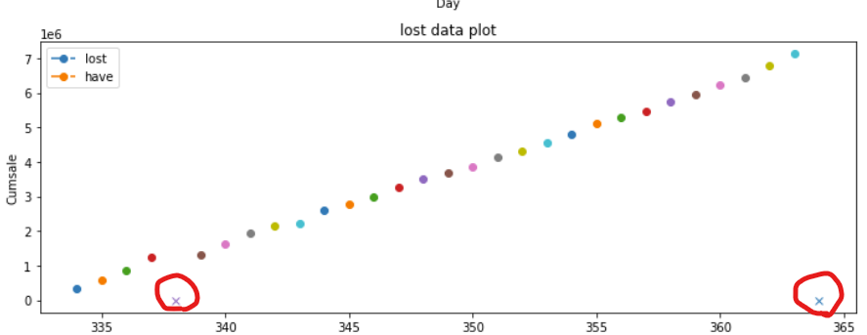
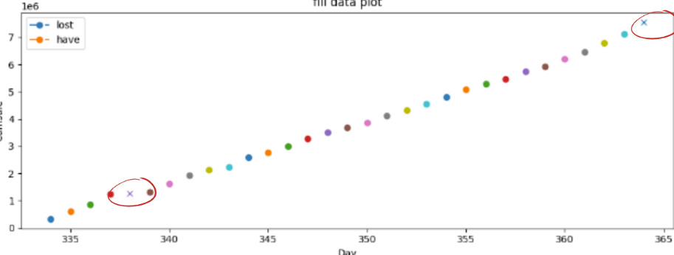
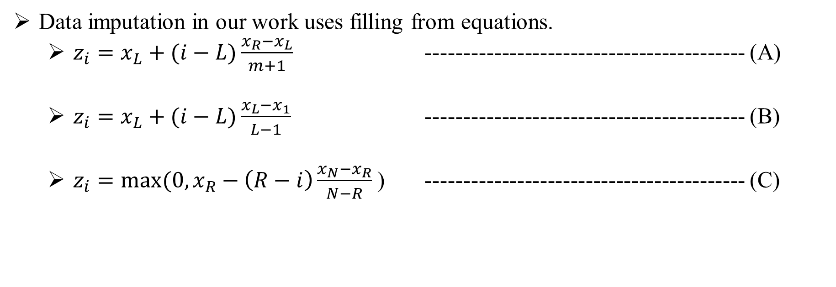
CumSales Imputation
Generate artificial cumsales
Generate artificial cumsales pass through data imputation
Data imputation in our work uses filling from equations.
  $z_{i}=x_{L}+(i−L)\frac{x_{R}−x_{L}}{m+1}$ ------------------------------------------ (A)
  $z_{i}=x_{L}+(i−L)\frac{x_{L}−x_{1}}{L−1}$ ------------------------------------------ (B)
  $z_{i}=max⁡(0, x_{R}−\left(R−i\right)\frac{x_{N}−x_{R}}{N−R}$ ) ------------------------------------------ (C)

Slide 13
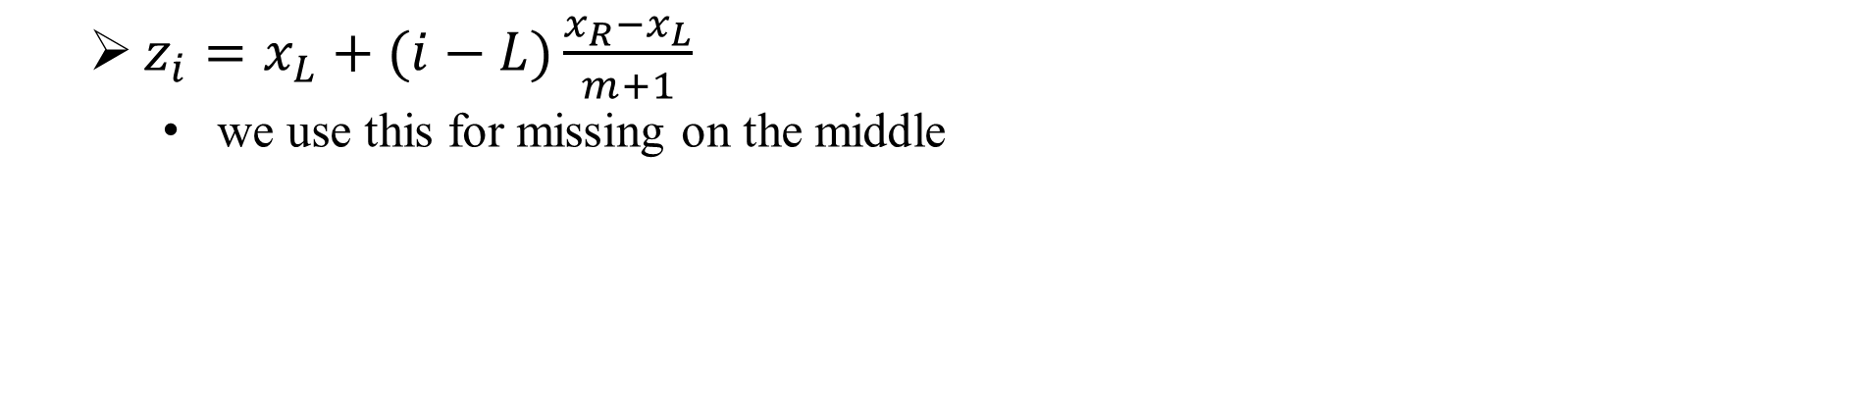
CumSales Imputation (A)
Y
Y
X
X
Generate artificial cumsales
Generate artificial cumsales pass through imputation data
  $z_{i}=x_{L}+(i−L)\frac{x_{R}−x_{L}}{m+1}$
    we use this for missing on the middle

Slide 14
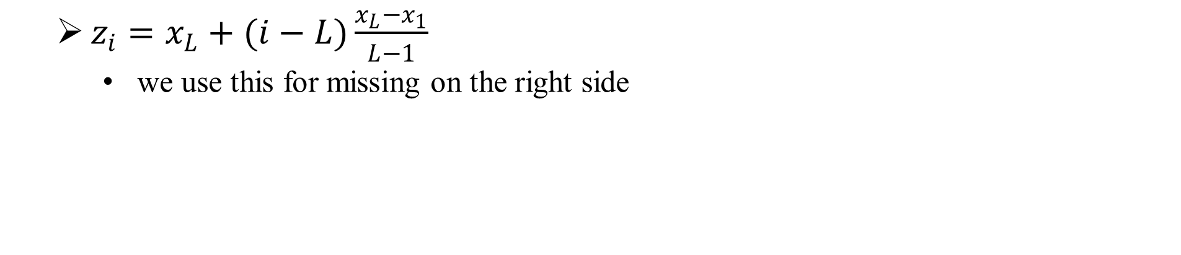
CumSales Imputation (B)
Y
Y
X
X
Generate artificial cumsales
Generate artificial cumsales pass through imputation data
  $z_{i}=x_{L}+(i−L)\frac{x_{L}−x_{1}}{L−1}$
    we use this for missing on the right side

Slide 15
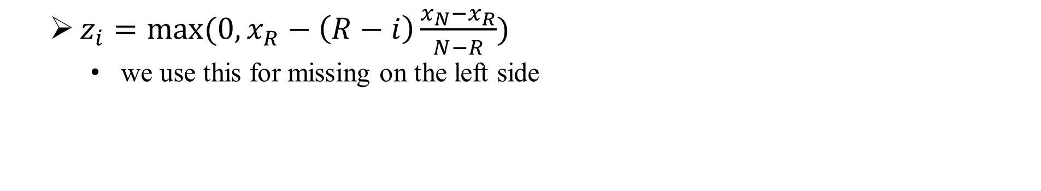
CumSales Imputation (C)
Y
Y
X
X
Generate artificial cumsales
Generate artificial cumsales pass through imputation data
  $z_{i}=max⁡(0, x_{R}−\left(R−i\right)\frac{x_{N}−x_{R}}{N−R})$
    we use this for missing on the left side

Slide 16
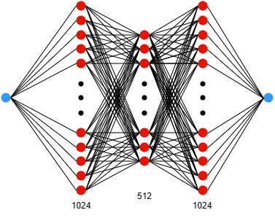
Neural Network Regression
the data will be in the form of 2 dimensions Daykey and Cumsales (Ground truth)
We will define the first layer with only one input or 1 node.
Hidden layers, we will set the depth to 3 layers. Within each layer, there will be a number of nodes, which are 1024, 512, and 1024 nodes.
All activation layers are linear
lastly, the Output layer will have only one node
Our proposed Artificial Neural Network Regression model

Slide 17
Outline
Introduction
Method
  Group dataset and Sorting
  Generate Simulated DayKey
  Merging simulated DayKey with the real DayKey
  Data Imputation
  Neural Network Regression
Experiment
Conclusion

Slide 18
Experiment
We train for 3 Days and 7 Days for different results.
Our proposal tends to decrease loss than traditional and higher performance.
Method | MAE | MSE | R-2
Linear Regression | 2.55E+06 | 1.44E+13 | 83.33
Linear Regression with imputation data | 1.48E+06 | 5.24E+12 | 98.26
Our proposed method | 1.35E+06 | 2.49E+12 | 79.36
Method | MAE | MSE | R-2
Linear Regression | 2.03E+06 | 1.05E+13 | 79.10
Linear Regression with imputation data | 9.08E+05 | 4.26E+12 | 98.82
Our proposed method | 4.53E+05 | 2.78E+11 | 98.51
3 DAYS' DATA OF THE MONTH WITH DIFFERENT MODELS.
7 DAYS' DATA OF THE MONTH WITH DIFFERENT MODELS.

Slide 19
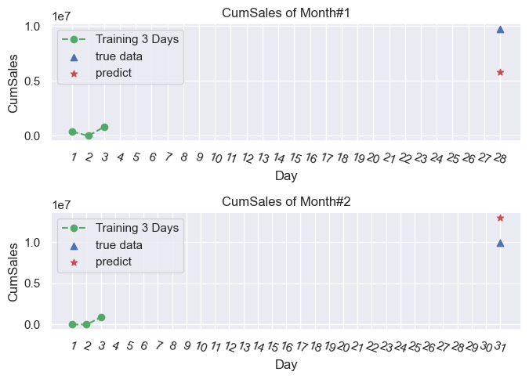
Experiment (1)
This is an experiment of training 3 Days in different methods, and predict the last day of the month
Green dot is trained, Blue triangle is real data, Red star is predicted
Traditional linear regression can predict but It is low accuracy.
traditional linear regression.

Slide 20
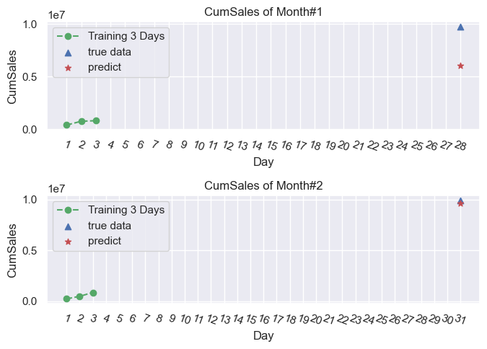
Experiment (2)
linear regression with data imputation can predict some month nearby Ground truth.
linear regression with data imputation

Slide 21
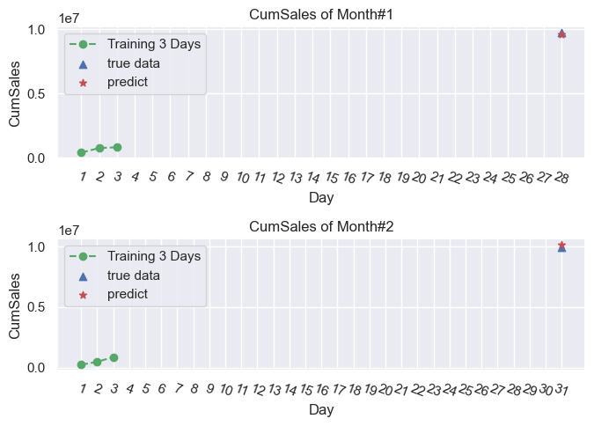
Experiment (3)
Our proposal for some months can get close to Ground Truth.
our proposed method

Slide 22
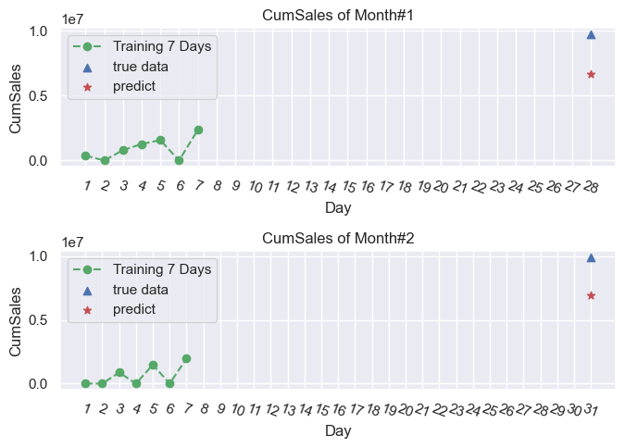
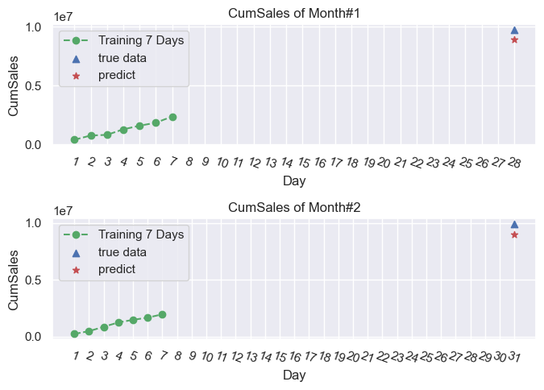
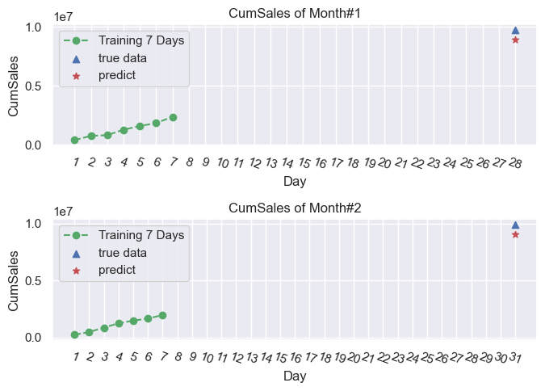
Experiment (4)
And last experiment of training 7 Days
traditional linear regression.
linear regression with data imputation .
our proposed method

Slide 23
Conclusion
Marketing planning can improve the accuracy of decision-making
This research proposes an artificial neural network regression model with artificial data imputation.
Data imputation in our proposed method tend to enhance higher performance for predicting.

Slide 24


Thank you for your attention

