Slide 1



6/18/2023
Development of Control-Plane Switch Migration Testbed Using Mininet-WiFi for Software-Defined Vehicular Network
Muhammad Zain Ul Abideen
Wireless Network and Future Internet Research Unit,
Department of Electrical Engineering,
Chulalongkorn University
Bangkok, Thailand
6470067121@student.chula.ac.th
Aung Myo Htut
Wireless Network and Future Internet Research Unit,
Department of Electrical Engineering,
Chulalongkorn University
Bangkok, Thailand
6271037321@student.chula.ac.th
Chaodit Aswakul
Wireless Network and Future Internet Research Unit,
Department of Electrical Engineering,
Chulalongkorn University
Bangkok, Thailand
chaodit.a@chula.ac.th
The 20th International Joint Conference on Computer Science and Software Engineering
28th June-1st July 2023
Naresuan University Phitsanulok, THAILAND

Slide 2
Presentation Layout
Introduction:
  Traffic Management System
  Issues Faced in Traffic Management System
  Software-Defined Vehicular Network (SDVN)
Proposed Control-plane Switch Migration Testbed Using Mininet-WiFi for Software-Defined Vehicular Network
  System Architecture
  Testbed Design Before Switch Migration
  Timing Diagram of Control-Plane Switch Migration
  Testbed Design After Switch Migration
  Results of Control-Plane Switch Migration Protocol on Mininet-WiFi
  Impact of Control-Plane Switch Migration Protocol on Data-Plane Performance
  Discussion
Conclusion

Slide 3
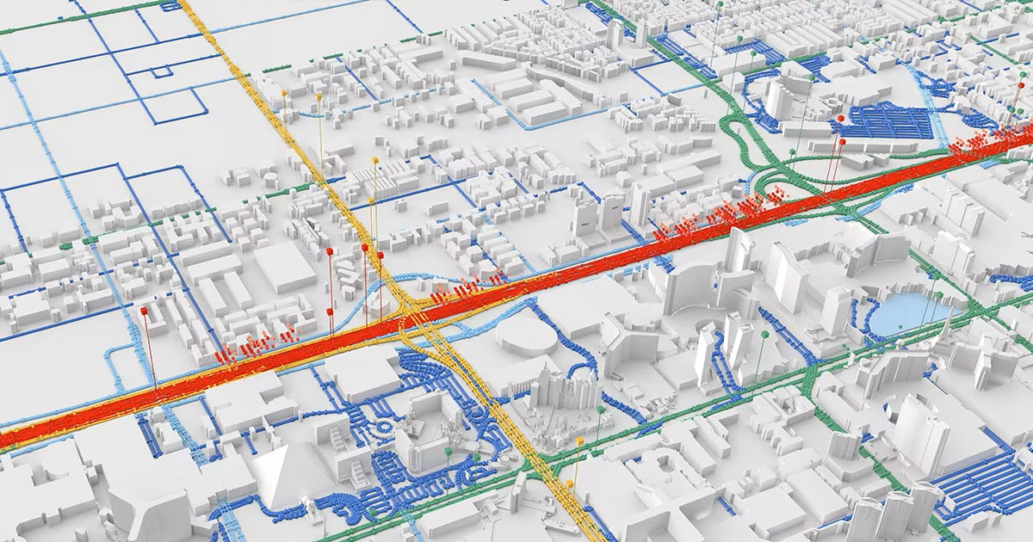
6/18/2023
Traffic Management System:
Vehicular network play key role in traffic management system.
Trips are planned on the basis of:
  Road safety
  Traffic awareness scenarios

Slide 4


6/18/2023
Issues Faced in Traffic Management System:
Congestion in big cities due to heavy traffic.
  Common example: Bangkok
Intelligent traffic management system is required.
  Topology discovery
  Load balancing
  Operational cost optimization
Limitation of static network structure.

Slide 5

6/18/2023
Software-Defined Vehicular Network (SDVN):
Dynamics of vehicular network:
  Diverse and dynamic design of SDN
  Mobility and wireless key aspects are involved.
Type of mobility and traffic addressed is of road vehicles.

Slide 6
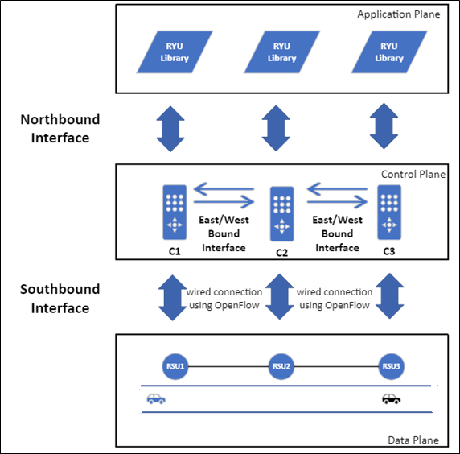
6/18/2023
System Architecture:
Figure 1: SDVN system architecture.

Slide 7
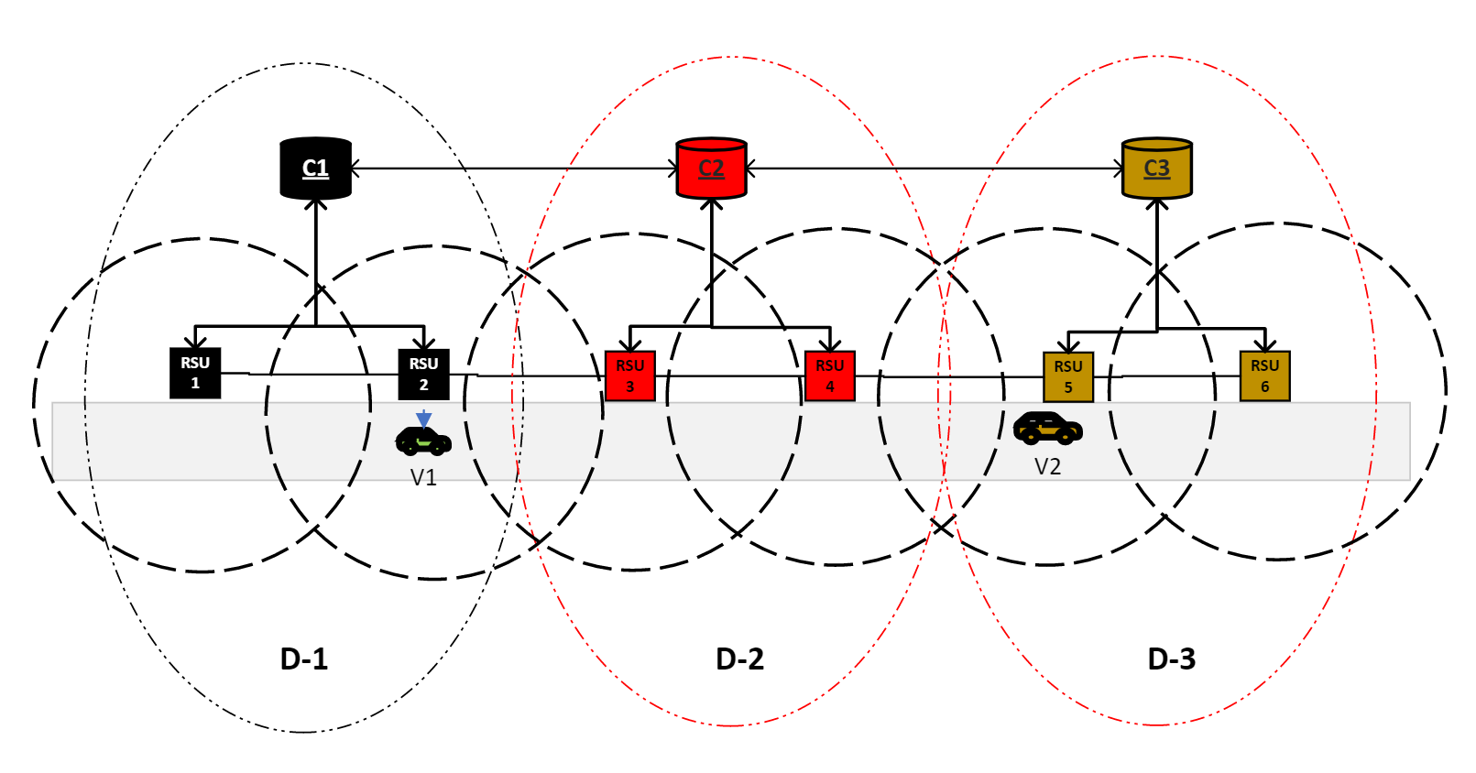
Testbed Design Before Switch Migration:
6/18/2023
Figure 2: Topology design before switch migration.

Slide 8
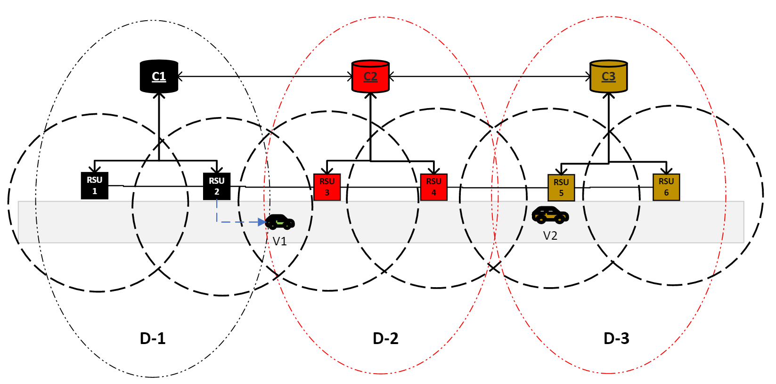
Timing Diagram of Control-Plane Switch Migration:
6/18/2023
V1
When V1 is initially connected with RSU2.
RSU2
C1
C2
RSU3
As V1 is in overlapping region, it is also accessed by neighboring RSU3 also.
Info about neighboring
switch i.e., RSU3 is
sent to RSU2.
RSU2 inform C1 about the
neighboring RSU3 and
also the threshold of RSSI
w.r.t V1.
Continuous Monitoring Event
C1 communicates with
C2 for the
target RSU3.
C2 then notifies RSU3
about breaking the
connection.
RSU3 sends an OVS request to C1.
V1 connected to RSU3.
In return C1 will assign flowrule to RSU3.
Figure 3: Timing diagram of control-plane switch migration.

Slide 9
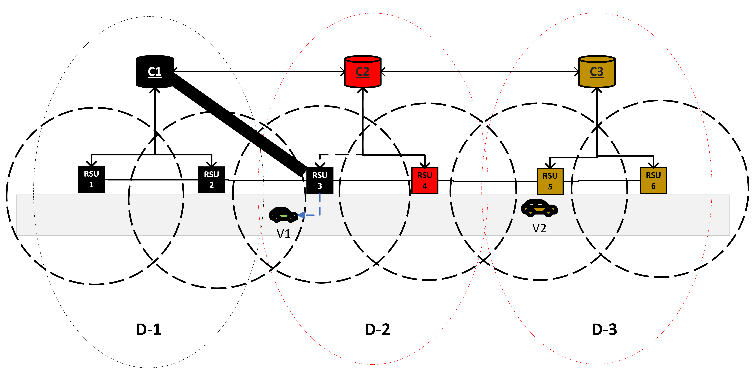
Testbed Design After Switch Migration
6/18/2023
Figure 4: Topology design after switch migration.
9

Slide 10
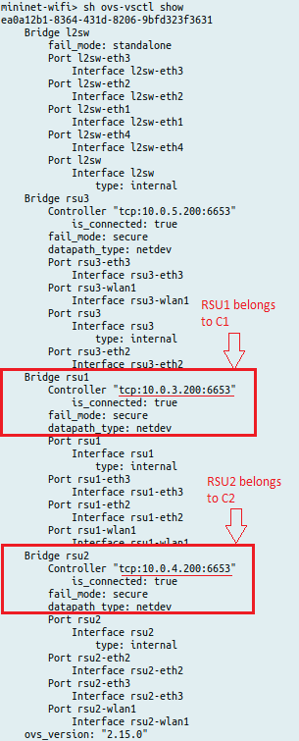
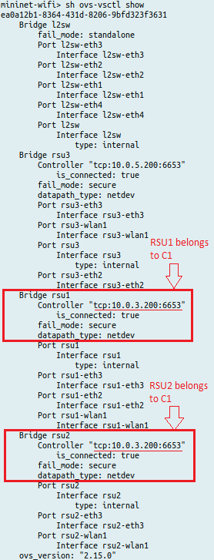
Results of Control-Plane Switch Migration Protocol on Mininet-WiFi:
6/18/2023
Figure 5: RSU2 status before switch migration. Figure 6: RSU2 status after switch migration.

Slide 11
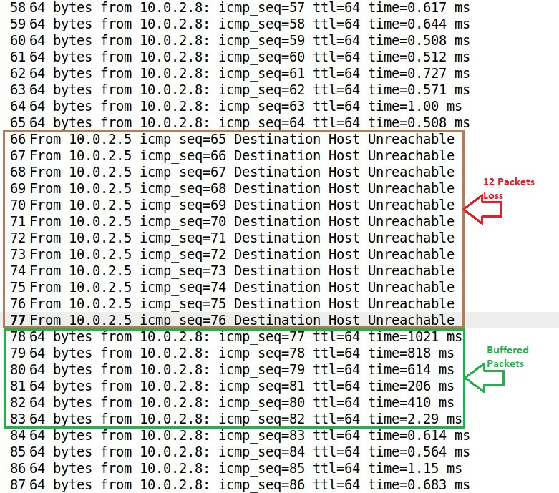
Impact of Control-Plane Switch Migration Protocol on Data-Plane Performance:
6/18/2023
Figure 7: Ping Result when vehicle V1 pings vehicle V2 (packet interval = 0.2 s and packet size = 64 bytes).
11

Slide 12
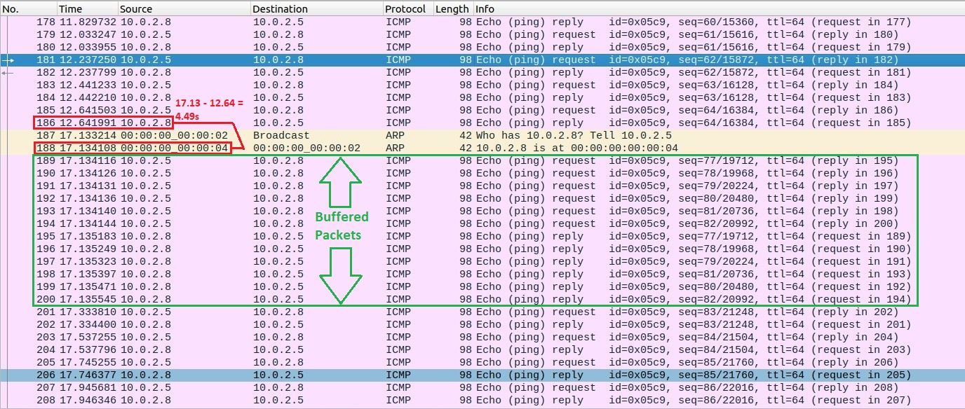
Impact of Control-Plane Switch Migration Protocol on Data-Plane Performance:
6/18/2023
Figure 8: Wireshark result when vehicle V1 pings vehicle V2.

Slide 13
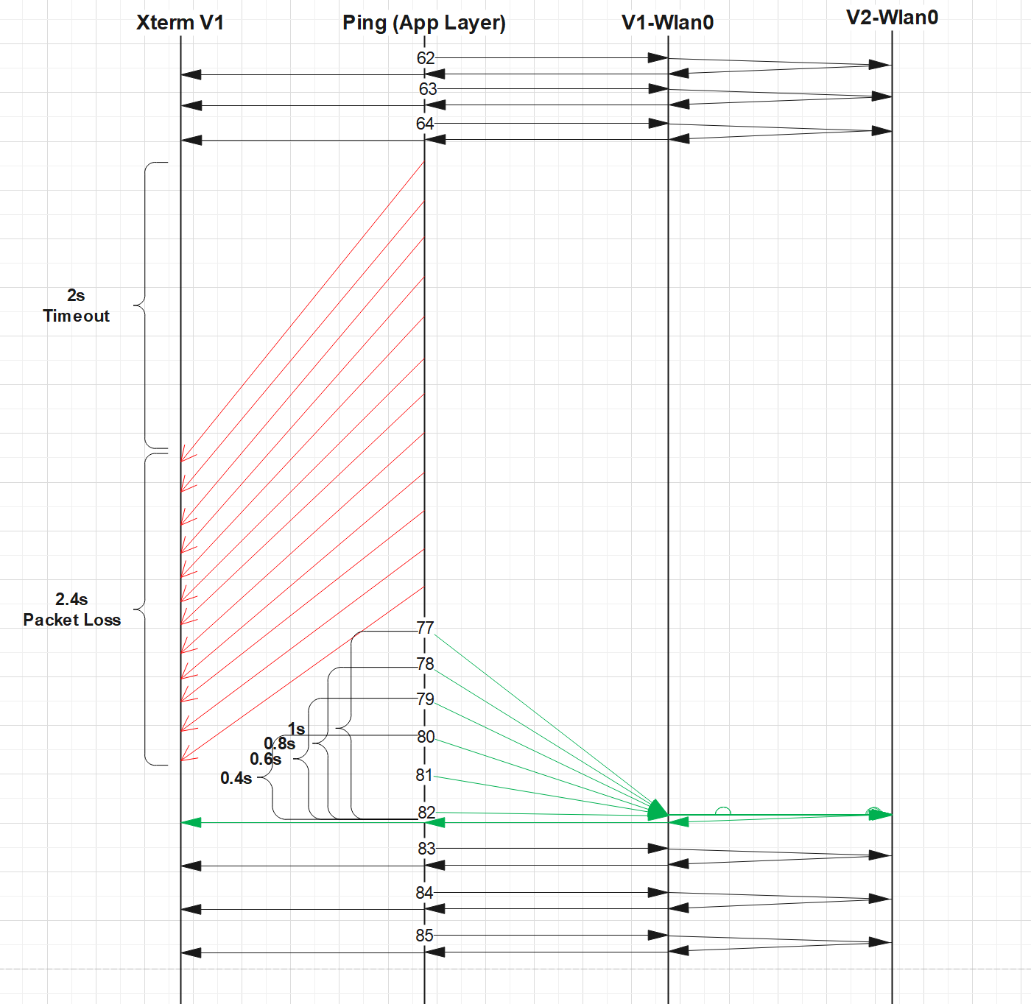
Impact of Control-Plane Switch Migration Protocol on Data-Plane Performance:
6/18/2023
During handover process:
  The packets wait for 2s and after this timeout the loss packets occur for about 2.4s.
  So, in total 4.4s downtime is observed.
When the connection gets re-established:
  There are some buffered packets that occur at the V1-wlan0 interface.
Figure 9: Sequence timing diagram at data-plane (packet interval = 0.2 s and packet size = 64 bytes).

Slide 14
6/18/2023
Conclusion:
Development of a testbed on Mininet-Wifi using control-plane switch migration algorithm and then functionality of the algorithm is verified.
Preliminary investigation conducted to investigate the impact of the protocol on the data-plane performance.
The first investigation reveals about a certain handover time when the vehicle changes the domain.
The second investigation reveals that when vehicle enters in the new domain, initially the RSU takes a certain time to accept responses from the vehicle.
The implemented control-plane switch migration testbed on Mininet-WiFi emulation platform is ready for further investigations on data-plane performance using various performance parameters.

Slide 15
THANK YOU
QUESTION & ANSWER

