Slide 1



Classification of Water Quality Index
in Laguna de Bay using XGBoost
ANGELITO L. CATAJAN JR.
Technological Institute of the Philippines Manila
Philippines
The 20th International Joint Conference on Computer Science and Software Engineering
28th June-1st July 2023
Naresuan University Phitsanulok, THAILAND

Slide 2
Contents
Introduction
Objectives
Design Process
Results
Conclusions
Recommendations

Slide 3
Introduction
Laguna de Bay is the largest lake in the Philippines and second largest in Southeast Asia
Laguna Lake Development Authority (LLDA) and Department of Environment and Natural Resources (DENR)
According to study [3], local ecological knowledge must be conserved. Water crisis in Laguna Lake is the result of industrialization and urbanization
Weighted Average Water Quality Index (WAWQI)
Machine Learning algorithms in water quality analysis [10,11]
Thus it is critical to predict and analyze monitored water quality in order for the decision-makers to make sound decision.
XGBoost was used as primary model for water quality classification

Slide 4
Objectives
The following objectives were pursued in this study:
Classify the water quality index using Weighted Average Water Quality Index (WAWQI).
Applying different machine learning techniques such as XGBoost, Decision Tree, and Random Forest.
Evaluate the classification model using Accuracy, Precision, Recall, and F1-score.

Slide 5
Design Process
Data Preprocessing
Methodology
Evaluation
Data exploration
Outliers detection
Data Cleaning
WQI computation
Data Split
Min-Max Normalization
Classification Models
XGBoost
Decision Tree
RandomForest
Accuracy
Precision
Recall
F1-score
Figure 1. Design Process of the classification model

Slide 6
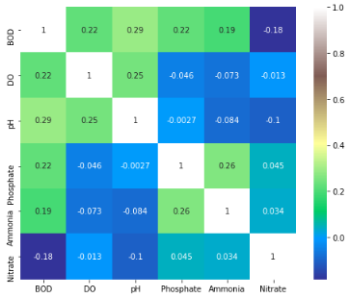
Results
Figure 2. Correlation heatmap of all water parameters used in classification model

Slide 7
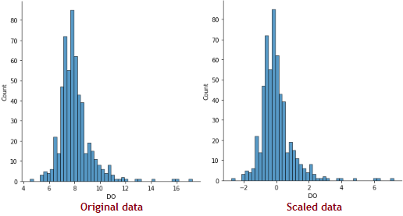
Results
Figure 3. Dissolve Oxygen before and after z-score normalization

Slide 8
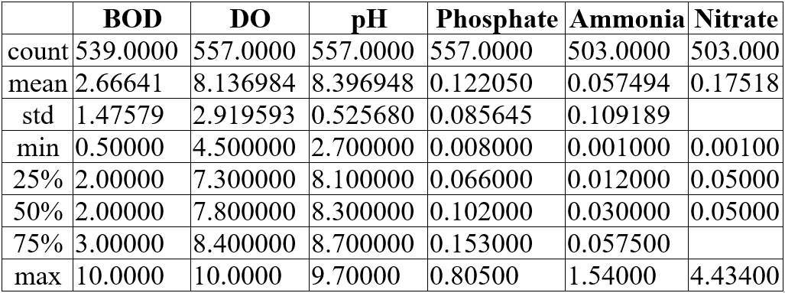
Results
Figure 4. Descriptive statistics of the water parameters used in the study

Slide 9
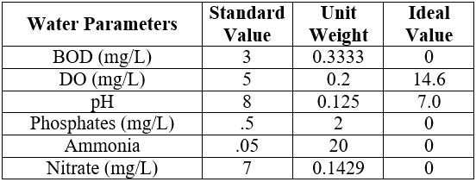
Results
Figure 5. Standard value, unit weight, and ideal value that will be used for WQI computation using WAWQI method.

Slide 10
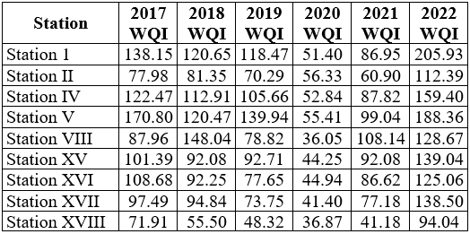
Results
Figure 6. Computed water quality index per year in every station

Slide 11
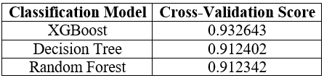
Results
Figure 7. Cross-validation score achieved

Slide 12

Results
Figure 8. Classification report of 3 models used

Slide 13
Conclusions
This study used WAWQI method for WQI computation.
This study utilized several Machine Learning algorithms for water quality index classification.
In 2022, all stations remarked as ‘UNSUITABLE’ except station XVIII which is ‘VERY POOR’.
XGBoost with 5-fold cross-validation and a learning rate of .10, had the most efficient classification, with accuracy of 96.72%. This was significantly higher than the accuracy achieved by Decision Tree (93.45%) and Random Forest (93.35%).
These findings highlight the importance of utilizing advanced Machine Learning techniques in water quality management for efficient WQI classification The study's contribution to water quality management lies in the identification of the most effective Machine Learning algorithm for WQI classification in Laguna de Bay. The use of XGBoost can aid in decision-making processes towards ensuring the sustainability of Laguna de Bay and the health of its aquatic ecosystem.

Slide 14
Recommendations
While the study met its aims, there are some recommendations that will be added in the future:
Based on the results of the study, it is recommended to use the XGBoost algorithm for classifying water quality index in Laguna de Bay, Philippines
The study highlights the importance of regularly monitoring water physicochemical parameters in Laguna de Bay to ensure its sustainability and the health of its aquatic ecosystem.
Adding water quality parameters must be included
Future researches should consider the use of IOT for real-time monitoring of water quality assessment.

Slide 15
THANK YOU
QUESTION & ANSWER

