Slide 1


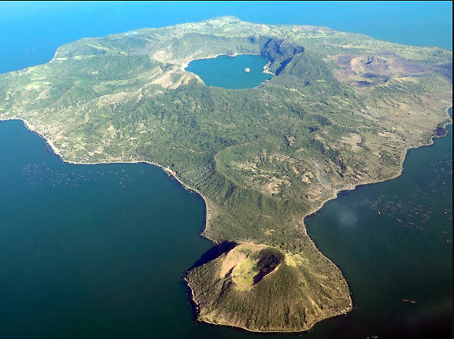

Michelle C. Tanega¹, Arnel C. Fajardo², and Jomel S. Limbago³
Technological Institute of the Philippines Manila
Philippines
The 20th International Joint Conference on Computer Science and Software Engineering
28th June-1st July 2023
Naresuan University Phitsanulok, THAILAND

Slide 2
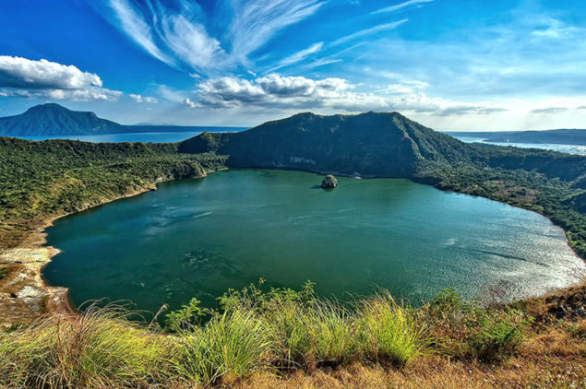
Contents
Introduction
Objectives
Methods
Results
Conclusions
Recommendations

Slide 3
Introduction
The rapid population growth in the Philippines has increased the demand for food and aquatic commodities, making fishing a crucial source of income for coastal households [1].
Ensuring the water quality of Philippine lakes is essential to maintaining the environment's integrity and protecting communities that rely on aquatic resources.
Taal Lake is one of the most substantial bodies of water located in the southern part of the island of Luzon in the Philippines and provide livelihood to around 2,761 fisherfolk.
It is the 3rd largest lake in the country with an area of 24,356.4 ha and bounded by nine towns and two cities. It used for recreation, tourism, navigation, water source for Tagaytay and for agricultural fields, and source of feeds for ducks. [2].
Notes:
Analyzing the water quality are needed for a well-planned monitoring programmed and

Slide 4
Introduction
Water quality monitoring helps researchers predict and understand natural environmental processes and human ecosystem influences.
Machine learning techniques resolve issues and provide valuable or essential data in almost every field. It is necessary for data analysis, categorization, and prediction as aquatic environment data proliferates. [3].
Water quality analysis is an important area of research, and machine learning has emerged as a powerful tool for analyzing data on water quality [4-10].
The manual calculation of WQI for water quality can be time-consuming and labor-intensive, requiring trained personnel and specialized equipment. This can limit the scalability and accessibility of WQI assessment, particularly in resource-limited settings[11-13].
Efforts should be made to develop more automated and efficient methods for WQI calculation [12].
Notes:
Analyzing the water quality are needed for a well-planned monitoring programmed and

Slide 5
Introduction
Water Quality
Water Pollution
Water safety and Human Health
Eutrophication
Traditional method
Food security
Information Utilization
Water Quality Analysis Problem
Notes:
Analyzing the water quality are needed for a well-planned monitoring programmed and

Slide 6
Introduction
Machine Learning
Data Management
Automation
Wide Application
Identify trends and patterns
Data Analysis & Prediction
Importance of Machine Learning Classification Algorithm for Water Quality
Notes:
Analyzing the water quality are needed for a well-planned monitoring programmed and

Slide 7
Objectives
The following objectives were pursued in this study:
Determine the water quality of Taal Lake using machine learning classification algorithm.
Identify the Water Quality Classification (WQA) of Taal Lake using Water Quality Index (WQI).
Examine the use of machine learning techniques in the development of multiclass classification models to determine the water quality of Taal Lake.

Slide 8
Methods
The Experimental design of a multiclass classification model

Slide 9
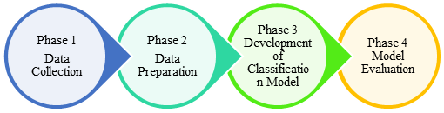
Methods
The four phases of the proposed methodology for Water Quality Analysis of Taal Lake Using Machine Learning Classification Algorithm.

Slide 10
Methods
Phase 1 Data Collection
Collected Dataset from year 2012-2022 of Taal lake from BFAR4 A- BIFTOS (Batangas Inland Fisheries Technology Outreach Station )
Dataset | Attribute | Description
Water quality data | Station | Fishing Site Location Talisay, Laurel, Agoncillo, Mataas na Kahoy, and Tanauan
 | Month | Month
 | Year | Year
 | pH | Potential of Hydrogen
 | DO | Dissolved Oxygen
 | NO₃ | Nitrate
 | Phospate | Phospate

Slide 11
Methods
Phase 2 Data Preparation
Data Collection
Data Preprocessing
Data Transformation
Articulating the problem
Defining data required
Gathering and combining data from different sources
Formatting
Cleaning
Sampling
Scaling/Normalization
Decomposition
Aggregation

Slide 12
Methods
Phase 3 Development of Classification Model
The Experimental design of a multiclass classification model

Slide 13
Methods
Phase 4 Model Evaluation
The effectiveness of the classification algorithm was evaluated by comparing its accuracy, precision, recall, and f1-score results with other algorithms.

Slide 14
Methods
Performance Evaluation Result
Model | Accuracy | Precision | Recall | F1- Score
RF | 95% | 67% | 99% | 75%
DT | 95% | 63% | 99% | 70%
SVM | 93.33% | 95% | 98% | 97%

Slide 15
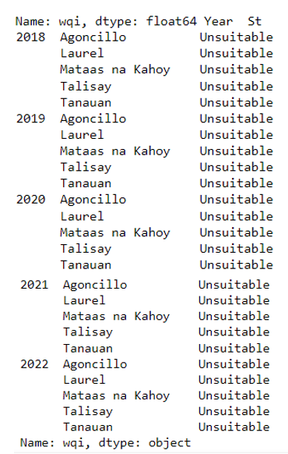
Results
Summary of Taal Lake Water Quality Classification for year 2018-2022

Slide 16
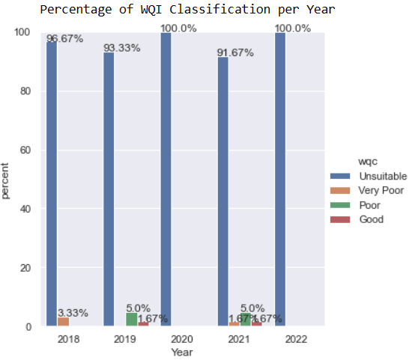
Results
Percentage of WQI classification per year.

Slide 17
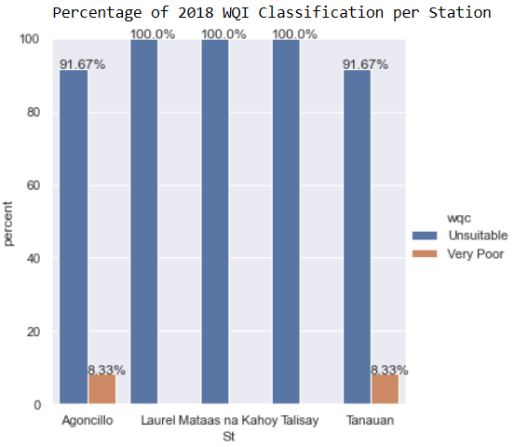
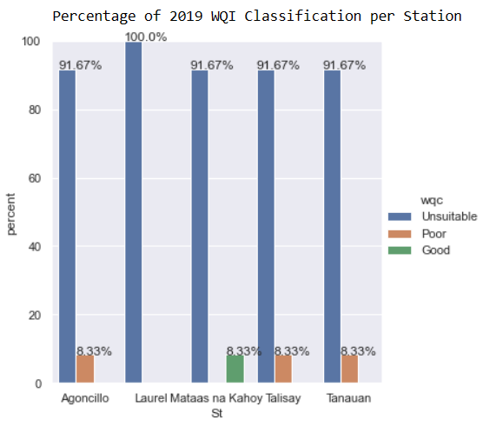
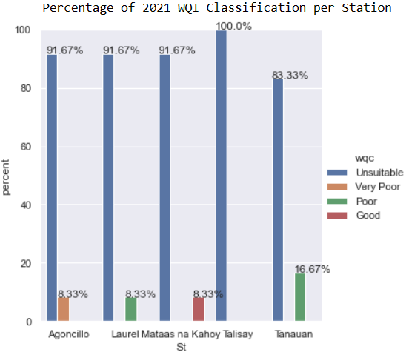
Results
Percentage of WQI classification per year.

Slide 18
Conclusions
Based on the results of this study, it can be concluded that:
Machine learning classification algorithms, precisely the Random Forest algorithm, can accurately predict Taal Lake's water quality with Accuracy rate or 95%. The results of the study can aid in identifying areas requiring attention to enhance water quality and maintain the lake ecosystem's health.

Slide 19
Conclusions
The outcomes of this study imply that the five water quality parameters used in the models are crucial in predicting water quality. Furthermore, the WQI and WQC were used to classify Taal Lake's water quality, and the results confirmed that the lake's water classification was unsuitable for five selected stations between 2018 and 2022 based on WAWQI method .

Slide 20
Recommendations
While the study met its aims, there are some recommendations that will be added in the future:
Further studies are needed to improve the selection and configuration of these algorithms for WQI analysis and established standardized protocols for WQI calculation using high-quality data.
Additionally, it is suggested that the local government agencies create strategies for environmental management, safety, and security to preserve and safeguard the water quality of Taal Lake.

Slide 21
References
[1]PSA, “FisheryResources3”, [Online], 2016. Available: https://psa.gov.ph/content/fishery-resources3
[2]M. Muyot, R. Balunan and T. Mutia, "Supply and value chain analysis of freshwater sardine, sardinella tawilis (Herre 1927)," Taal Lake, Batangas, Philippines. The Philippine Journal of Fisheries, vol. 28, no. 1, pp. 60-76, 2021.
[3]M. Zhu, J. Wang, X. Yang, Y. Zhang, L. Zhang, H. Ren, B. Wu and L. Ye, "A review of the application of machine learning in water quality evaluation," Eco-Environment & Health, vol. 1, no. 1, pp. 107-116, 2022.
[4]J. Wikstrom, “Evaluating supervised machine learning algorithms to predict recreational fishing success : A multiple species, multiple algorithms approach,” Computer Science, Environmental Science, 2015, https://www.semanticscholar.org/paper/Evaluating-supervised-machine-learning-algorithms-%3A-Wikstr%C3%B6m/f36b2492fcb91100fbae8bb2364c2302d28b840f
[5]R. Raman, A. Das, R. Manna, S. Sahuand and B. Das, Physicochemical habitat traits preferred by small indigenous fish (Chanda Nama ) in Indian River discerning through machine learning. To be published. Accessed: February 2023. [Online]. Available: https://doi.org /10.21203/rs.3.rs-591781/v1.
[6]S. Smoliński and K. Radtke, "Spatial prediction of demersal fish diversity in the Baltic Sea: comparison of machine learning and regression-based techniques," ICES Journal of Marine Science, vol. 74, no. 1, pp. 102-111, 2017.
[7]A. Abraham, D. Livingston, I. Guerra and J. Yang, "Exploring the application of machine learning algorithms to water quality analysis," 2022 IEEE/ACIS 7th International Conference on Big Data, Cloud Computing, and Data Science (BCD), Danang, Vietnam, pp. 142-148, 2022 doi: 10.1109/BCD54882.2022.9900636.
[8]T. Mutia, M. Merilles, M. Muyot, and B. Tordecilla, Abundance and distribution of sardinella tawilis (Herre, 1927) larvae in Lake Taal, Philippines. The Philippine Journal of Fisheries, vol. 25, pp. 16-26, 2018.
[9]I. Shamsuddin, I. Suhana, O. Zalinda, and S. Samsiah, "Water quality index classification based on machine learning: a case from the langat river basin model, " Water 14, no. 19, pp. 29-39, 2022, https://doi.org/10.3390/w14192939X. Jia , "Detecting Water quality using knn, bayesian and decision tree," 2022 Asia Conference on Algorithms, Computing and Machine Learning (CACML), Hangzhou, China, 2022, pp. 323-327, doi: 10.1109/CACML55074.2022.00061.
[10]X. Jia , "Detecting Water quality using knn, bayesian and decision tree," in 2022 Asia Conference on Algorithms, Computing and Machine Learning (CACML), Hangzhou, China, 2022, pp. 323-327, doi: 10.1109/CACML55074.2022.00061.
[11] T. Jin, J. Liu, D. Jiang, S. Cai, “A data-driven model for real-time water quality prediction and early warning by an integration method,” Environmental Science and Pollution Research, vol. 26, pp. 3-4, 2019, doi: 10.1007/s11356-019-06049-2.
[12] G. Darvishi, F.G. Kootenaei, M. Ramezani, E. Lotfi, H. Asghamia, “Comparative investigation of river water quality by owqi, nsfwqi, and wilcox indexes (case study: the talar river – iran),” Archives of Environmental Protection, vol. 42 no. 1 pp. 41–48, 2016, doi: 10.1515/aep-2016-0005.
[13] J. Bega, L. Albertin, J, Oliveira, “Development of water quality index as a tool for urban water resources management,” Environmental Science and Pollution Research, vol. 30, pp. 18588–18600, 2023, doi: 10.1007/s11356-022-23513-8

Slide 22
THANK YOU
QUESTION & ANSWER

