Slide 1



An Enhanced Sampling-based Method with Modified Next-Best View Strategy for 2D Autonomous Exploration
Dong Huu Quoc Tran*, Hoang-Anh Phan*, Hieu Dang Van*, Tan Van Duong*, Tung Thanh Bui*, and Van Nguyen Thi Thanh*
* Faculty of Electronics and Telecommunications
VNU University of Engineering and Technology, Hanoi, Vietnam
The 20th International Joint Conference on Computer Science and Software Engineering
28th June-1st July 2023
Naresuan University Phitsanulok, THAILAND
Notes:
Thank you for coming here today. It is my appreciated to attend and present my paper at this conference. My paper named “An Enhanced Sampling-based Method with Modified Next-Best View Strategy for 2D Autonomous Exploration
“, and I am Hieu Dang Van, one of six authors that contributed to this research, from the Faculty of Electronics and Telecommunications, VNU University of Engineering and Technology, Hanoi, Vietnam.

Slide 2
Outline
Introduction
Proposed Method
Experiment Result
Conclusion
Notes:
My presentation has four parts...

Slide 3
Introduction
Methodology Methods of Exploration:
  Based on Frontier
    Find Frontiers on Boundaries between two Voronoi Regions by Clustering, Sampling,...
    Decide the Best Frontier to head by Utility Function
  Based on Next-Best View (NBV)
    Find the Next-Best Goal on Sensors View by Sampling, Filtering,...
    Decide the Best NBV to head by Utility Function
  Hybrid
Notes:
First of all, I'd like to tell you about our study. It is about a problem in the field of robots that has to research, it is exploration, also called "autonomous exploration," is a new technology that has been widely used in practical robotics because of its ability to find its own location, scan maps, and move through any terrain without human control.
In research on robotics, an autonomous robot must build a model of its surroundings by combining localization, mapping, and safe navigation. For simultaneous localization and mapping to work as it should, we all have to handle it by hand. But there are more competent things a self-driving robot can do than drive a manual. So there's a problem. Robots need to explore by navigation.
The benefit of this combination is that it can find and make maps in the best way possible by using specialty planners, such as goal planners, path planners, or motion planners, which perform adaptive movement and make decisions in real-time for map exploration or planned movement. Planners that cover the map on their own tend to be in an “exploration“ group. The next step in research methods is to devise a list of possible actions the robot could take, like setting goals.
So, how do you set goals? We can divide goals into Frontiers and Next-Best Views by looking at how research has been done up until now.
Frontiers are places where the covered and open areas meet. So all the planner has to do is figure out where the best area is for the robot to go.
Same thing with Next-Best View. The area next to the robot is an example of the sensor view. Obviously, this area is close enough for the robot to work well if it is going to a place in this area. Robots can choose the best point by using the utility function, which I call the gain function.
Some study groups combine two different theories by having planners make decisions based on both frontiers and NBVs. When we make our planned method, we want to pay attention to this way.

Slide 4
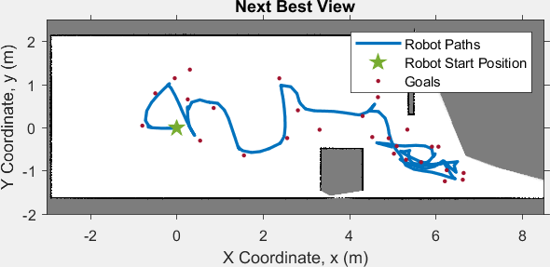
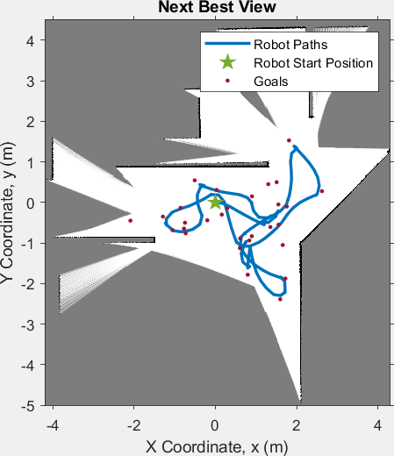
Introduction
Problems of Related Works:
  Uncertain measurement data
  Uncertain information gain
  High Computation Cost
Problems of Sampling-based Methods:
  Nonoptimal Goals
  The Uncertainty
  Stuck in Local Minima
Aim: Modified NBV Sampling -> Modified Information Gain Equation, find Frontiers first
Notes:
But most of the related works have some limitations, like:...
In a 2D environment, the Frontier-based method sometimes gets the robot stuck in bad situations because it doesn't know enough about the environment. For example, it might encounter unknown obstacles and need help moving toward its goals. With the sampling-based NBV planner, on the other hand, the robot can only go into newly found areas if it can get around the local minimum.
Furthermore, Sampling-based planners don't work well in large settings or where there are only small openings or bottlenecks. This makes it harder for the robot to figure out the best way to reach its goal because it has to go back over parts it has already been through or move in a way that could be smoother. As a result, it takes the robot longer and more distance to cover the map.
So, our aim is...

Slide 5
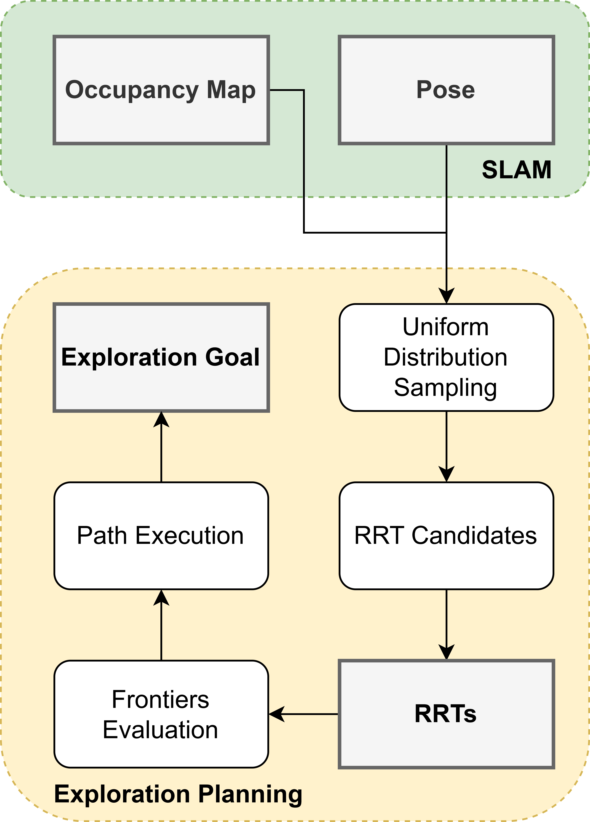
Proposed Method
Input:
Initial:
Sampling:
(3.1)
Building RRTs:
(3.1)
(3.2)
(3.3)
(3.7)
(3.2-3)
Frontiers Evaluation:
(3.4)
(3.4-5-6)
(3.5)
Path Execution:
(3.6)
(3.7)
Notes:
This method used a laser sensor to make an occupancy grid map of the surroundings, and the NBV strategies were used to figure out the robot's movement path. Assume we have ‘M’ as the presented map got from the sensor and SLAM, ‘x_r’ is robot state, and U is a random function, in this case, is uniform random distribution. With initial variables like..., robots first built the samples ‘x_rand’, find ‘x_near’, and steer to get ‘x_new’. We need to evaluate all of ‘x_new’ got from the sampling task by using a gain function defined by equations (3.4), (3.5), and (3.6). Finally, we got the branch with the best frontier as the final node. This branch is our decided path. By executing it and choosing the first node of the path, robots can drive continuously. The controller is like a receding horizon controller, robots finish when planner meets the terminate condition, no ‘x_new’ has gain.
As you can see, this method focused on exploration similarly to frontier-based methods. It needed fewer possible sites for random trees and pushed them to grow in places where the robot hadn't been yet. It helped robots escape local minimums and cut costs for processing compared to RH-NBV sampling-based methods.

Slide 6
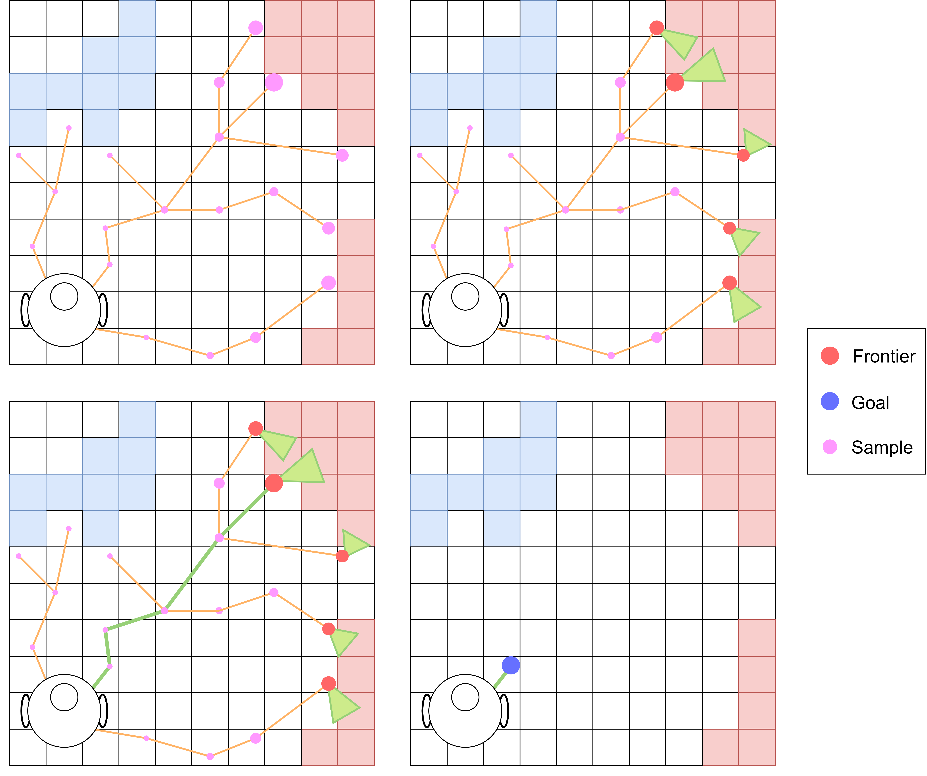
Proposed Method
Notes:
As you can see in this illustration, our suggested method used the RRT algorithm theory to look for possible paths of exploration and chose the first destination as the NBV point. Unless the number of rounds exceeded what was set up initially, these branches stopped at unknown and known map borders. Then, our reward equation was applied to RRT points, which cut down on computing costs and ensured the goals were best met. Conditions for evaluating a frontier are the distance between two nodes, the information gain, the uncertainty, and the field of view of the information area.

Slide 7
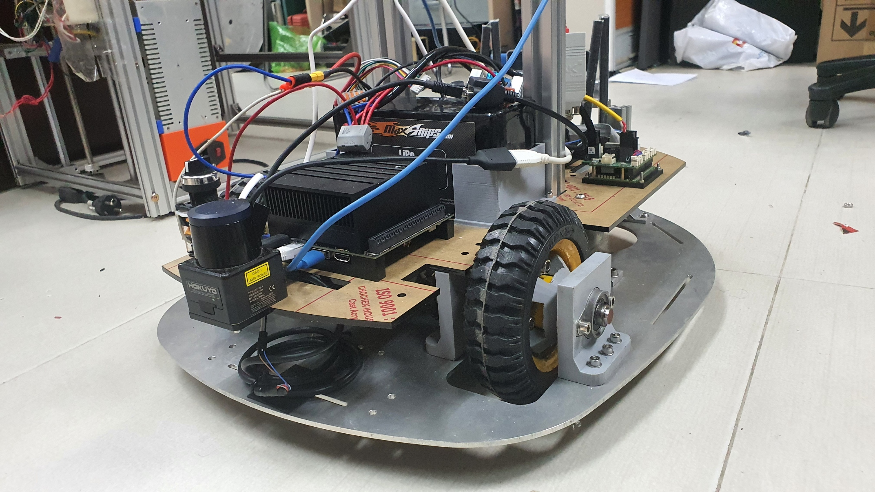
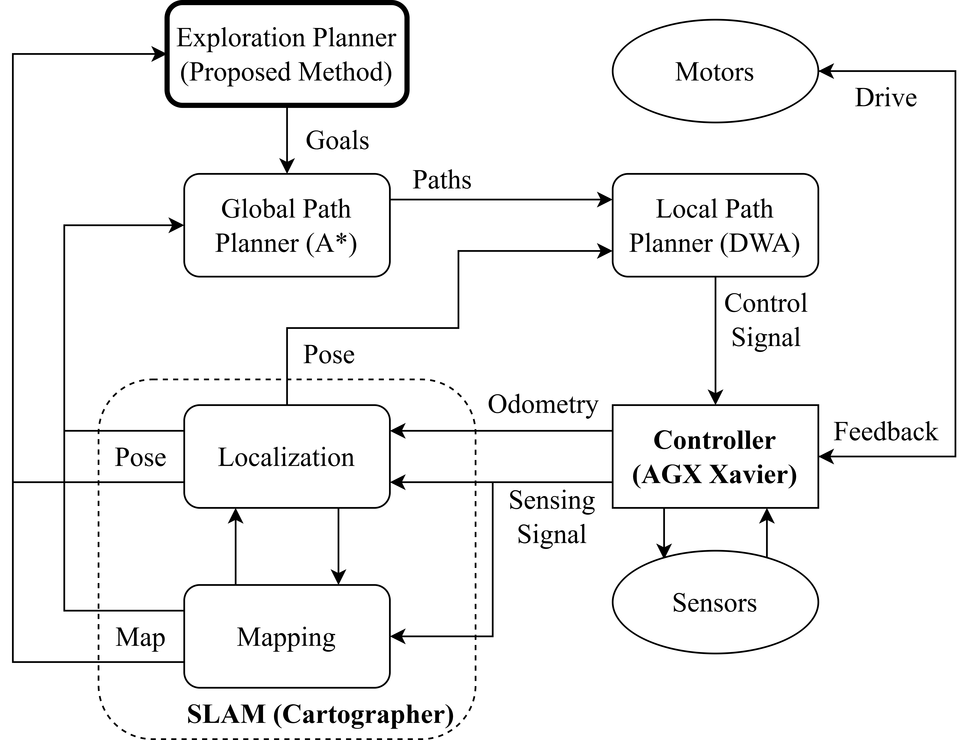
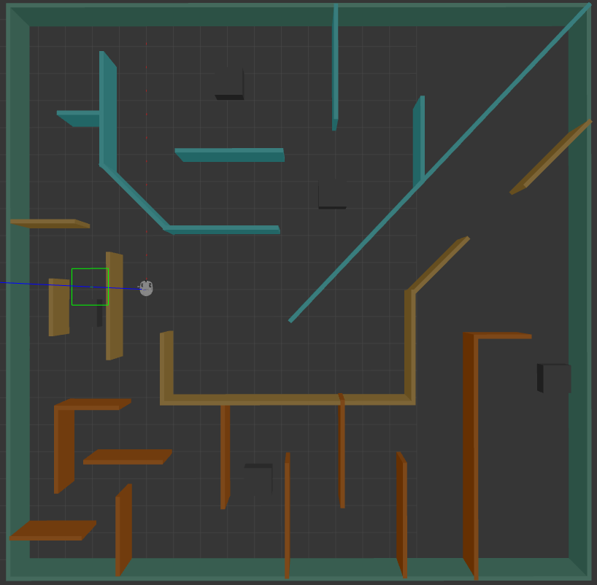
Experiment Result
Overall schematic diagram of the experiment system
Robot and Simulated Environment
Notes:
The image of the robot system I developed is depicted on the right, with the control system diagram on the left. In the right corner is our simulated environment, designed and used in Gazebo for the experiment.
In this exploration system, the method I propose will send the destinations to a global path planner and the robot will travel on an incomplete map. This map is constantly updated using SLAM run in the background.
The robot platform includes an Nvidia AGX Xavier embedded computer and a Hokuyo UST-05LX laser sensor. The laser scanner is mounted to scan the environment around the robot, covering a 240-degree front view with 720 sampling points and a maximum range of 8m. The experimental system is implemented as a Robot Operating System package and tested in our customized environments, comprising four components: Cartographer SLAM, A* Global Planning, DWA Local Planning, and our proposed approach.

Slide 8
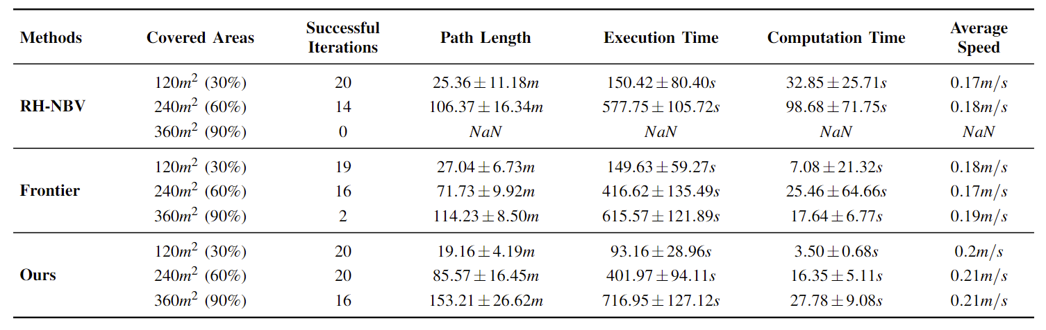
Experiment Result
Notes:
Simulations were conducted in the 400m^2 maze environment. We develop an evaluation of the RH-NBV, Frontier, and our proposed methods by recording the essentials to cover specific average explored spaces after 20 iterations executing in 900 seconds. The primary evaluation criteria include the mean and standard deviation of distance, execution time, computation time, and average speed. Additionally, we analyze the success iterations, representing the number of times the robot covered 120 m^2, 240 m^2, and 360 m^2 of the map.
The table shows that our proposed method consistently outperforms the other methods regarding distance traveled, execution time, computation time, and average speed across all coverage levels. Especially at 360 m^2, the RH-NBV method did not achieve any successful iterations, while our approach achieved most times. This demonstrates that the customized NBV is more effective in covering larger map areas.
Point to some value in table!!!

Slide 9
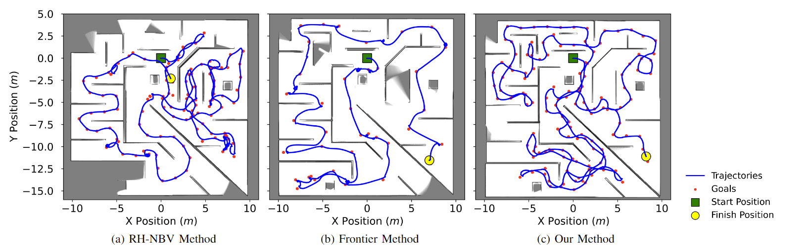
Experiment Result
Notes:
This figure shows pictures of the highest covered areas after the 900s from a top-down view. Our method solved the case, and the environment's areas were fully explored. But with the frontiers sampling method, the goal was too far away for the robots to see, so it kept the robot in a dangerous stage.
In this case, the obstacles were too close, so it couldn't move in a new direction. With RH-NBV, the problem is getting worse because the robot is stuck and doesn't know what its goals are. This makes the robot stuck in small, confined spaces. Still, it needs to get out of this stage. The robot is able to avoid local minima better with the modified NBV method than with the RH-NBV method. It is more aware of its surroundings with the modified NBV method than the Frontier method. This reduces localization mistakes.

Slide 10
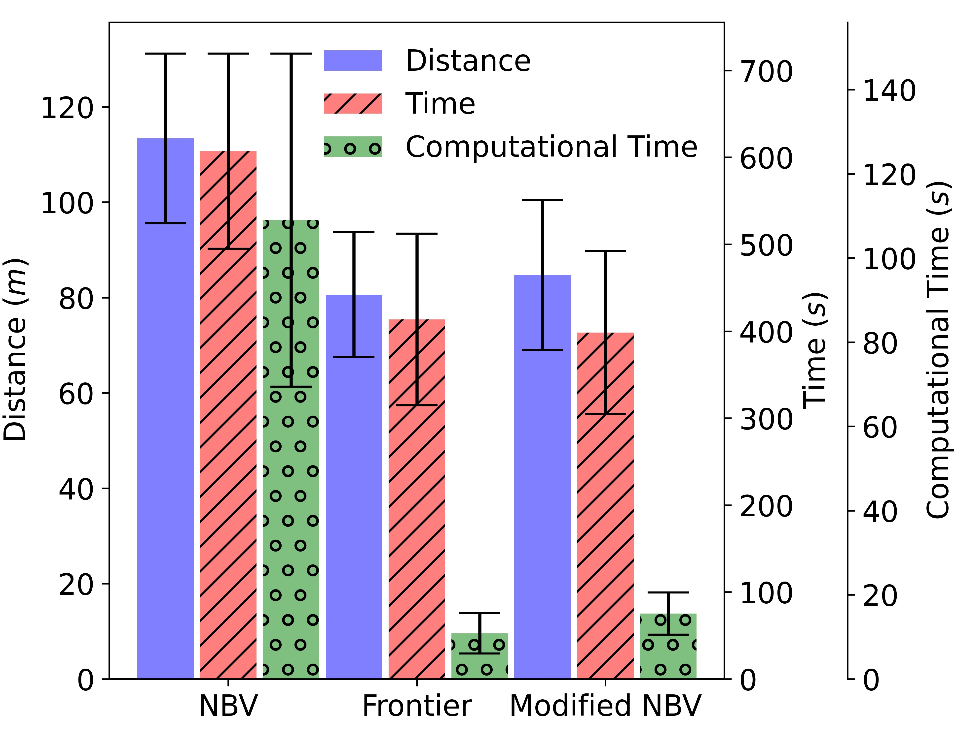
Experiment Result
Notes:
Regarding distance cost, time traveled, and computation time, the modified NBV method takes less time and space to run than the RH-NBV method. This means the modified NBV method is better for efficient exploration and accurate map.
Point to some value in graph!!!

Slide 11
Conclusion
Our Contributions:
  Integrating the modified utility metric and boundaries-aware conditions.
  Maintains an uncertain awareness of the map by using additional gain summed from occupancy probability.
  Sampling random map cells for computing gain instead of making clustering or counting unmapped voxels.
  -> Our modified NBV method consistently outperforms the Receding Horizon NBV (RH-NBV) and Frontier methods regarding the explored area, time efficiency, and exploration consistency.
Notes:
...

Slide 12
Conclusion
Future Works:
  Evaluations of the proposed approach using a self-developed mobile robot in an actual environment.
  Construct a comprehensive strategy that can be used in 2D and 3D situations.
  Consider the scalability of our modified NBV approach to multi-robot systems.
Notes:
...

Slide 13
THANK YOU
QUESTION & ANSWER

