Slide 1



BLUR & TRACK: Real-time Face Detection with Immediate Blurring and Efficient Tracking
Tanakrit Jaichuen, Nanthaphop Ren,
Pichai Wongapinya, Somchart Fugkeaw
School of ICT, Sirindhorn International Institute of Technology
Thammasat University, Pathum Thani, Thailand
The 20th International Joint Conference on Computer Science and Software Engineering
28th June-1st July 2023
Naresuan University Phitsanulok, THAILAND

Slide 2
Motivation
The Personal Data Protection Act, or PDPA, which mandates that all enterprises safeguard individuals' privacy, inspired our effort. Name, address, phone number, bank account information, fingerprint, photographs of people, videos of people, and many more things are protected.
Our main goal is to automatically censor or blur human faces in the CCTV video to disguise their identity.
Only the authorized person can view the uncensored version of the video, while the other user can only view the censored version.

Slide 3
BLUR & TRACK
Blur & Track is a CCTV file access control system with the capacity to compose a censored version to comply with the Thailand Personal Data Protection Act (PDPA).
Each user can only access (view) only the video file that user has the permission to.
There are 3 types of user group account: admin, normal user, and outsider.
  The admin has the highest authorization which can register a new user, assign video access permission, and approve or reject the permission request from the normal user.
  The normal user can access the censored version of the video by default and can request the permission to access each uncensored version to the admin.
  The outsider can only access the video that is assigned by the admin.

Slide 4
Research Challenge
Optimizing face detection algorithms to achieve the highest possible recall and precision on CCTV video files.
Optimizing face detection and video composing to achieve the fastest possible execution time.
Handling video file storage and data retrieval to achieve the fastest possible retrieval time.

Slide 5
Function List
1. Video Importing and Blurring
2. Video Access Permission Management
3. Video and Data Retrieval

Slide 6
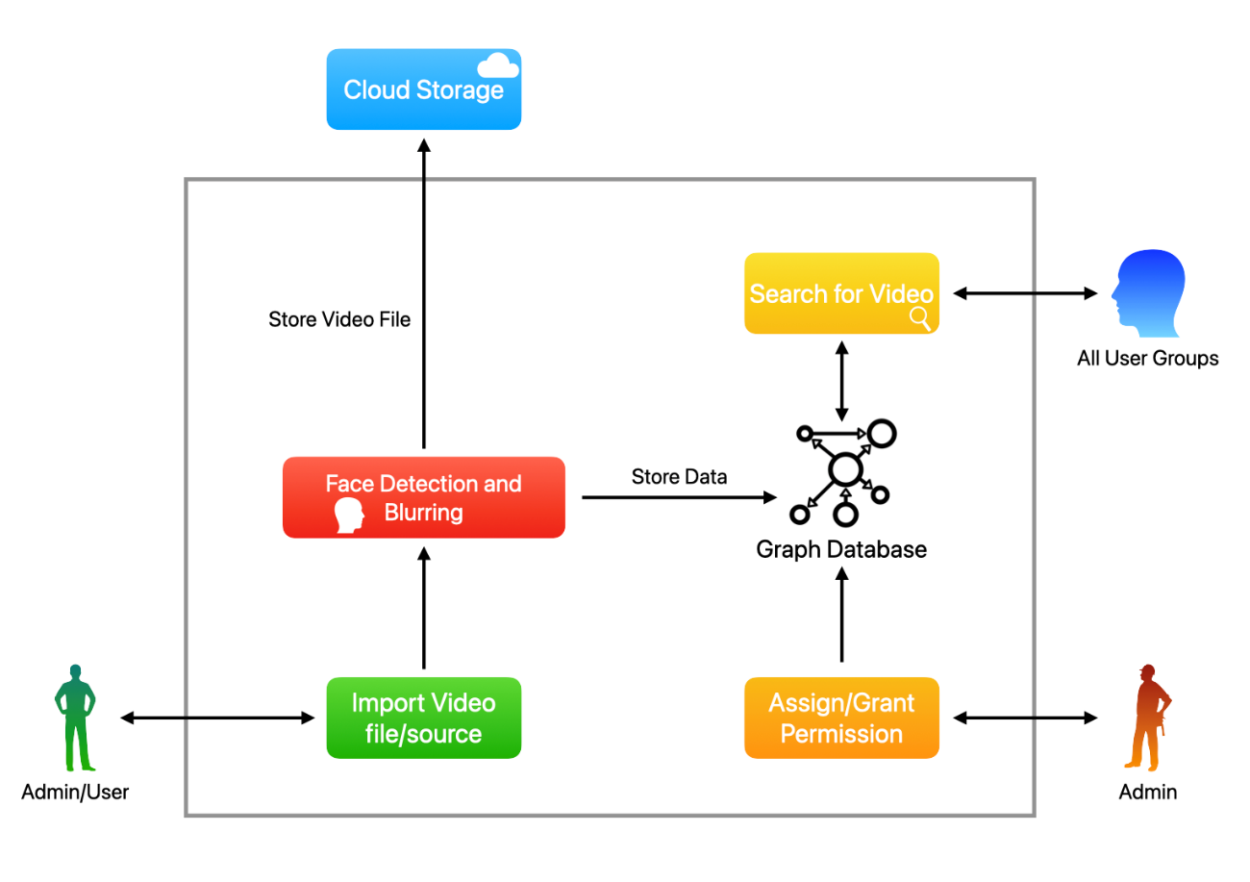
System Model

Slide 7
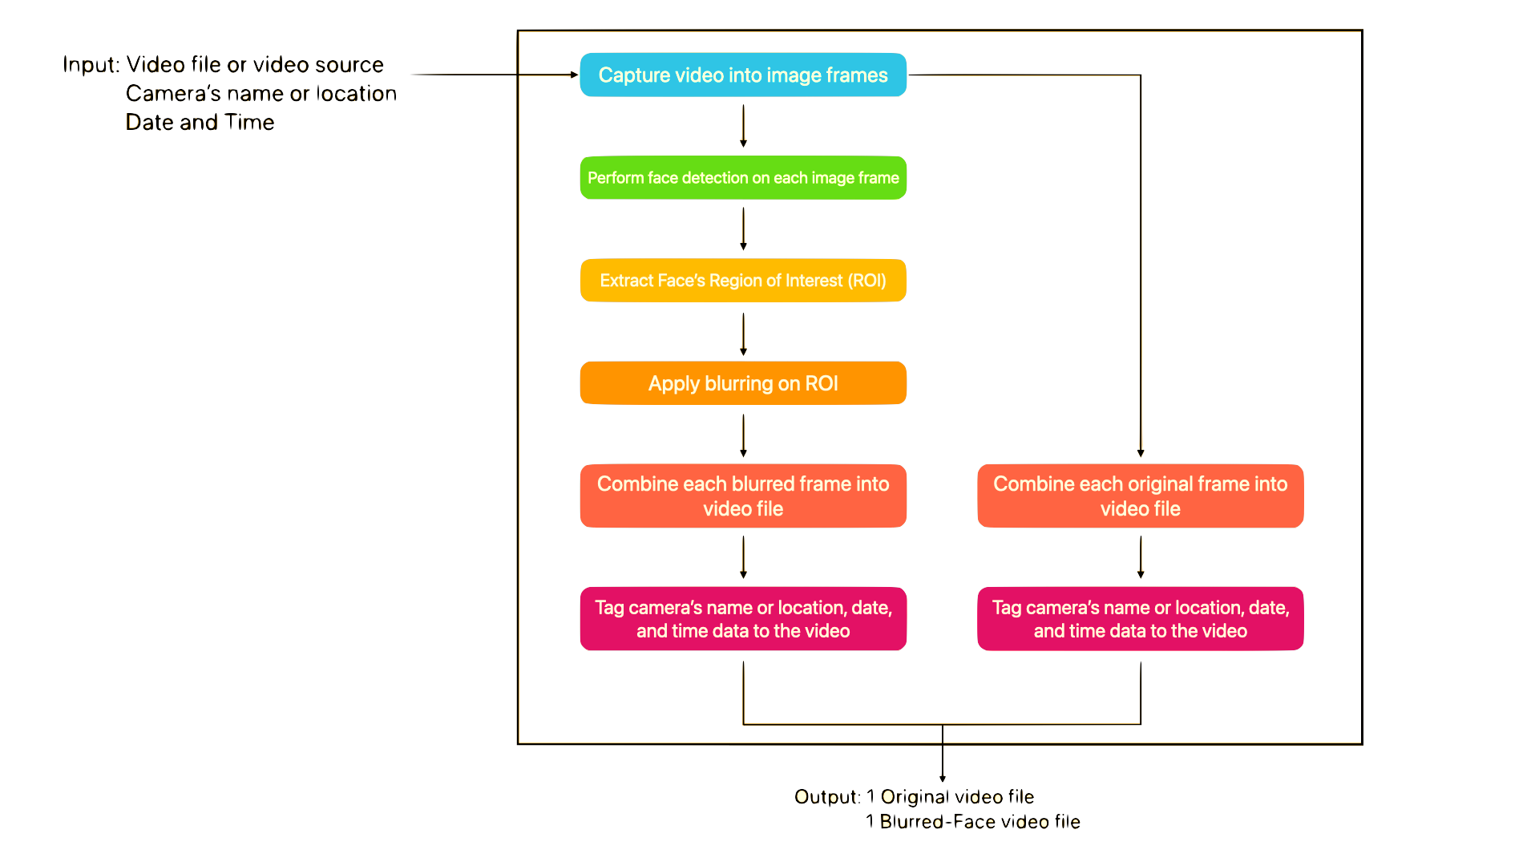
Video Import and Blur Function
Blur Function:

Slide 8
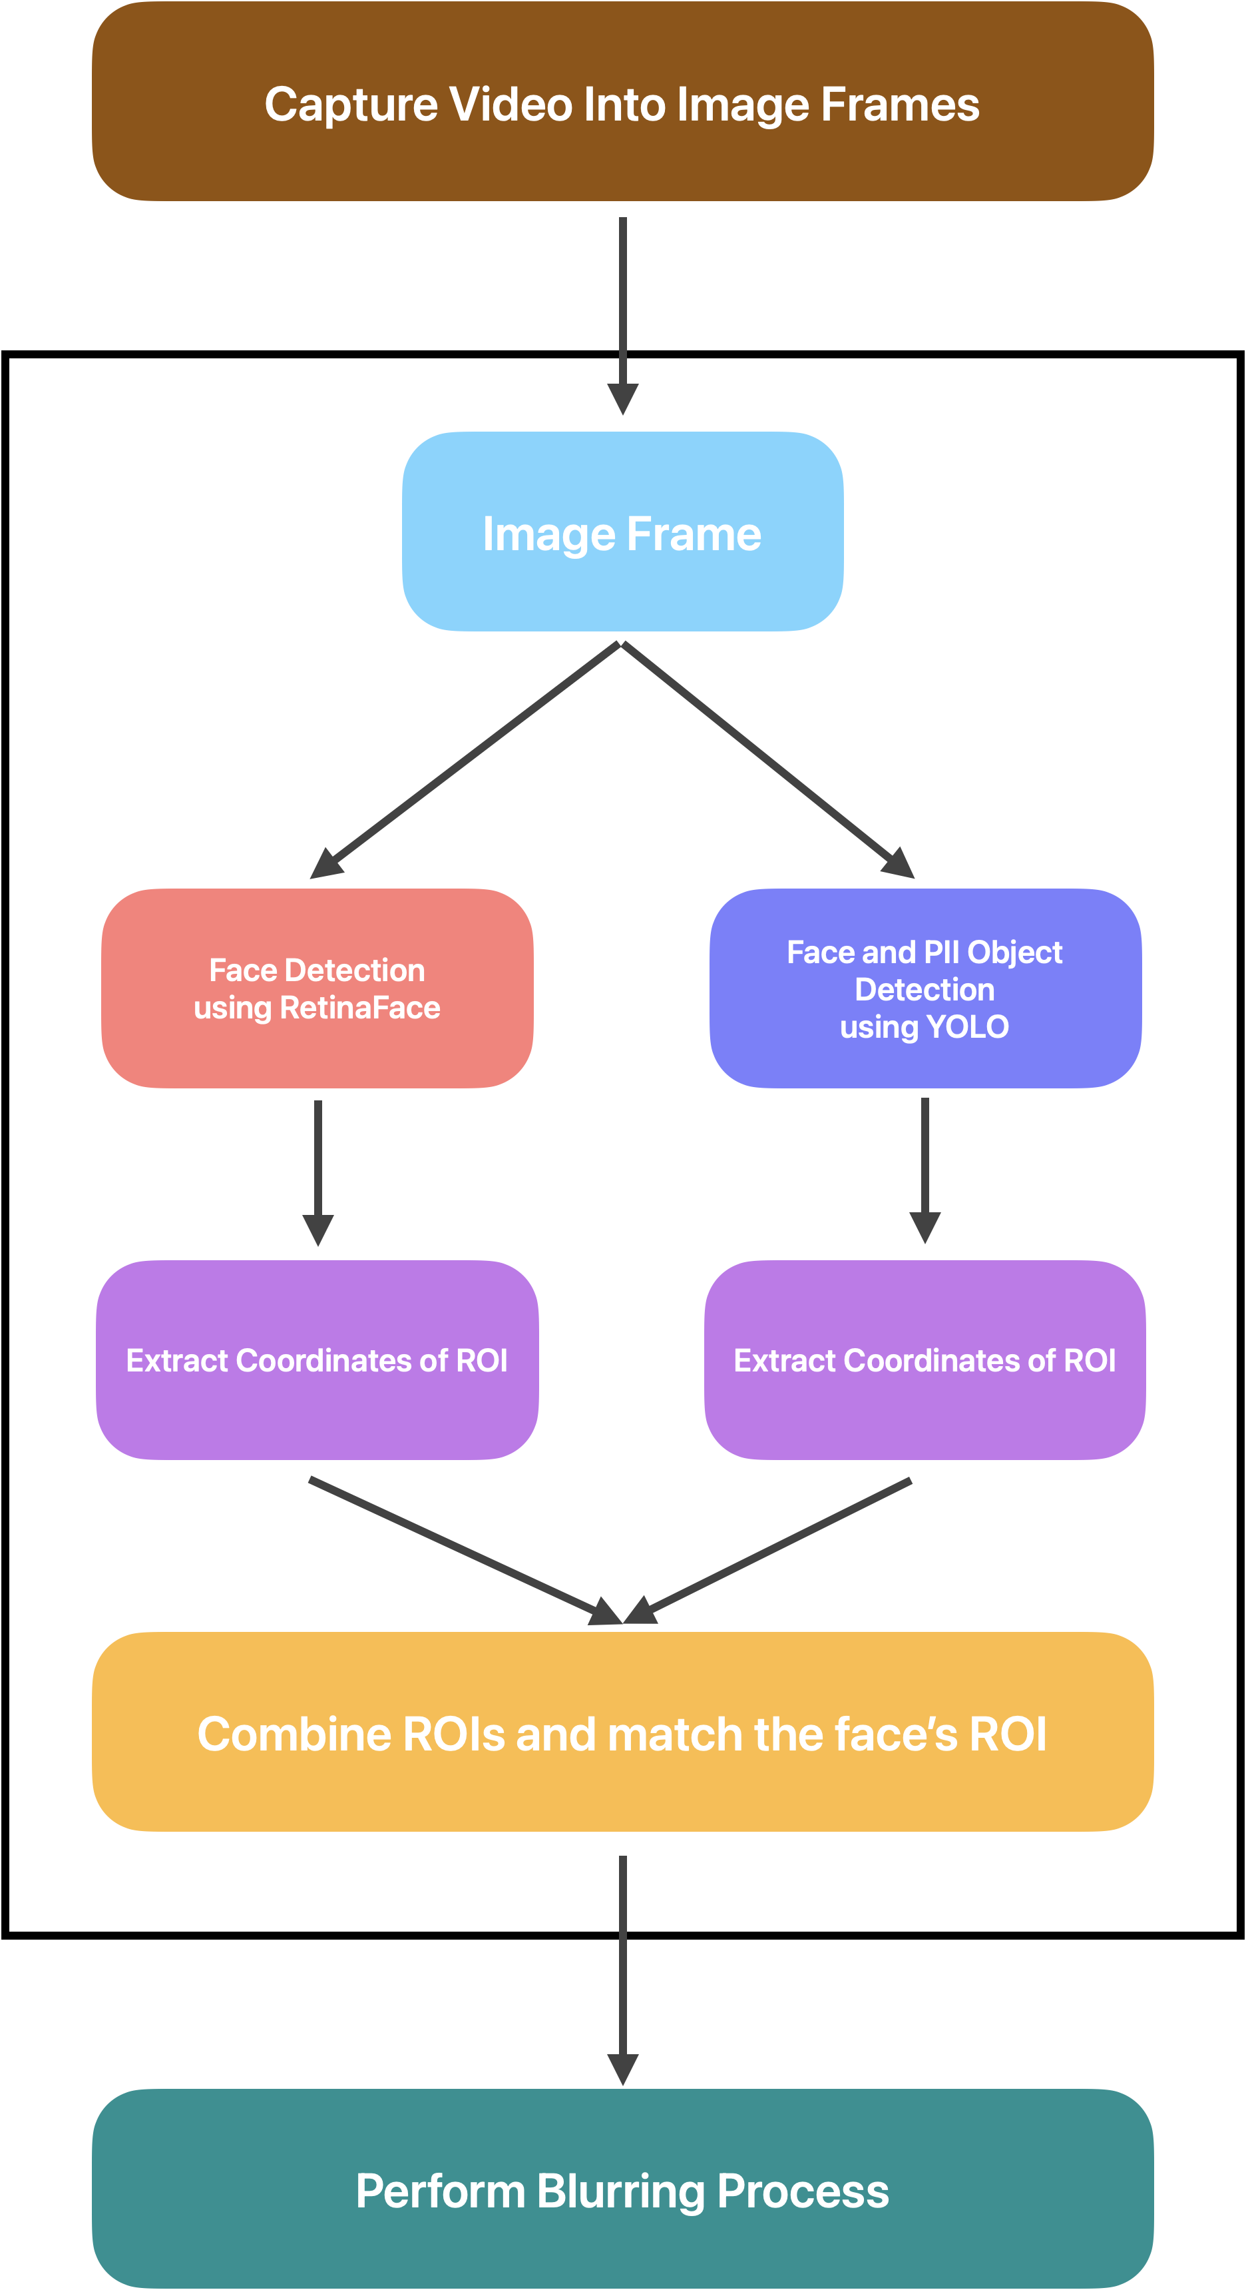
Process of Face and
Object Detection

Slide 9
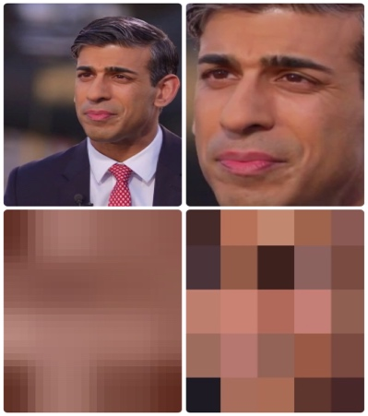

Process of Pixel Blurring

Slide 10
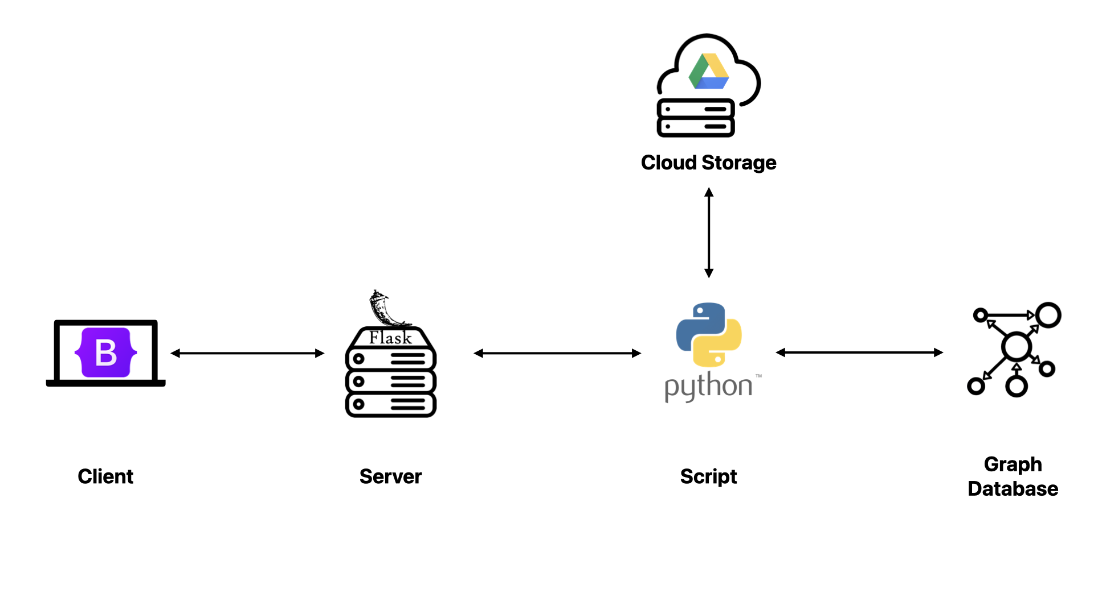
Implementing Architecture

Slide 11
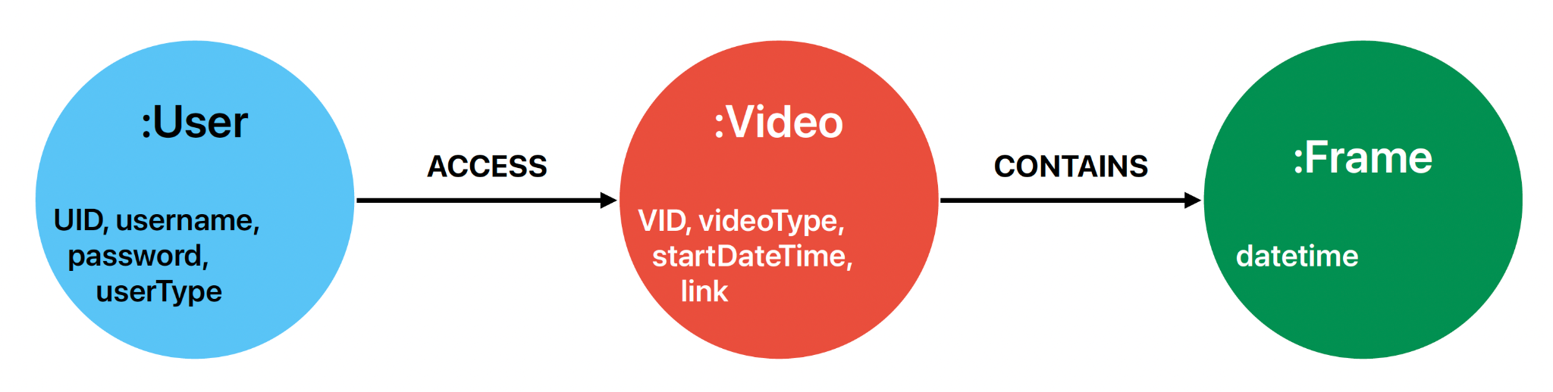
Graph Database Model
The user node represents the user account in the system: user's information, user's type (admin user, normal user, or outsider user) Only the user node who has permission to that video node can access or be linked to it.
The video node represents the CCTV video in the system, providing information about the video, such as start date and time, type (original or censored). The video node is only connected to user nodes that have permission to access it and is also linked to its image frame nodes. As for the access control of our system, the access control list (ACL) containing the list of users and their privilege is used to enforce the authorization.
The frame nodes represent the image frames of each video file, allowing the system to rapidly locate the frame corresponding to the user's input when querying for that video with the specified time.

Slide 12
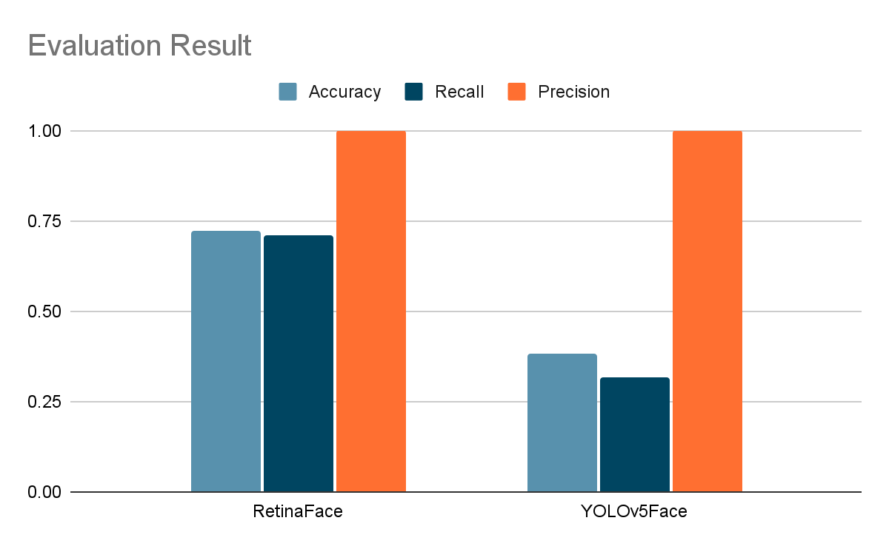
Experiment and Results
Accuracy, Precision, and Recall of 2 Models on NTU CCTV-Fights Dataset
 | Accuracy | Recall | Precision
RetinaFace | 0.725 | 0.712 | 1.000
YOLOv5Face | 0.381 | 0.318 | 1.000

Slide 13
Experiment and Results (Cont.)
 | Total Execution Time (seconds) | Number of Frames | Execution Time per Frame (seconds/frame)
RetinaFace | 583.499 | 285 | 2.047
YOLOv5Face | 62.088 | 285 | 0.218
Execution Time of Both Models

Slide 14
Conclusion
Blur & Track is a CCTV file access control system with the capacity to compose a censored version to comply with the Thailand Personal Data Protection Act (PDPA).
The proposed system uses RetinalFace and YOLOv5Face to detect faces and the pixelate or pixel blurring technique to do censorship on each ROI.
The experiment outcome suggests that our proposed blurring method is well applicable to work with RetinaFace which gives high precision and recall for CCTV video files, even though it has a higher execution time than YOLOv5Face.

Slide 15
Future Work
Extend the experiments using large data set of video files to test the performance of both blurring process, detection, and video frame retrieval.
Enhanced the performance of YOLOv5Face by adding more images from CCTV video footage to the data training process.
Investigate the technique that can detect the personally identifiable information (PII) object in the CCTV.

Slide 16
References
[1] S. V. Tathe, A. S. Narote and S. P. Narote, "Human face detection and recognition in videos," In 2016 International Conference on Advances in Computing, Communications and Informatics (ICACCI), Jaipur, India, 2016, pp. 2200-2205, doi: 10.1109/ICACCI.2016.7732378.
[2] X. Zhang, C. Liu and Z. Su, "Face detection system based on video stream," In 2017 International Conference on Computer Systems, Electronics and Control (ICCSEC), Dalian, China, 2017, pp. 1130-1133, doi: 10.1109/ICCSEC.2017.8446978.
[3] Q. Guo, Z. Wang, C. Wang and D. Cui, "Multi-face detection algorithm suitable for video surveillance," In 2020 International Conference on Computer Vision, Image and Deep Learning (CVIDL), Chongqing, China, 2020, pp. 27-33, doi: 10.1109/CVIDL51233.2020.00013.
[4] V. Mathew, T. Toby, A. Chacko and A. Udhayakumar, "Person re-identification through face detection from videos using Deep Learning," In 2019 IEEE International Conference on Advanced Networks and Telecommunications Systems (ANTS), Goa, India, 2019, pp. 1-5, doi: 10.1109/ANTS47819.2019.9117938.
[5] Q. Zhai, "Integrated access control monitoring system based on face video detection," In 2022 2nd International Conference on Consumer Electronics and Computer Engineering (ICCECE), Guangzhou, China, 2022, pp. 580-585, doi: 10.1109/ICCECE54139.2022.9712709.
[6] M. U. Yaseen, A. Anjum, O. Rana, and N. Antonopoulos, "Deep learning hyper-parameter optimization for video analytics in clouds," IEEE Transactions on Systems, Man, and Cybernetics: Systems, vol. 49, no. 1, pp. 253-264, January 2019.
[7] Z. -Q. Zhao, P. Zheng, S. -T. Xu and X. Wu, "Object detection with deep learning: A review," IEEE Transactions on Neural Networks and Learning Systems, vol. 30, no. 11, pp. 3212-3232, 2019, doi: 10.1109/TNNLS.2018.2876865.
[8] D. Xu, R. Wang and Y. Q. Shi, "Data hiding in encrypted H.264/AVC video streams by codeword substitution," IEEE Transactions on Information Forensics and Security, vol. 9, no. 4, pp. 596-606, Apr. 2014, doi: 10.1109/TIFS.2014.2302899.
[9] H. Tian et al., "A modeling method for face image deblurring," In 2021 International Conference on High Performance Big Data and Intelligent Systems (HPBD&IS), Macau, China, 2021, pp. 37-41, doi: 10.1109/HPBDIS53214.2021.9658445.
[10] K. M. Roozbahani and H. S. Zadeh, "Face detection from blurred images based on convolutional neural networks," In 2022 International Conference on Machine Vision and Image Processing (MVIP), Ahvaz, Iran, Islamic Republic of, 2022, pp. 1-10, doi: 10.1109/MVIP53647.2022.9738783.
[11] T. Wiegand, G. J. Sullivan, G. Bjontegaard and A. Luthra, “Overview of the H.264/AVC video coding standard,” IEEE Transactions on Circuits and Systems for Video Technology, vol. 13, no. 7, pp. 560–576, Jul. 2003.
[12] M. Li, Z. Zhang, J. Yu and C. W. Chen, “Learning face image super- resolution through facial semantic attribute transformation and self- attentive structure enhancement,” IEEE Transactions on Multimedia, vol. 23, pp. 468–483, 2021.
[13] D. Rai and S. S. Rajput, "Robust face hallucination algorithm using motion blur embedded nearest proximate patch representation," IEEE Transactions on Instrumentation and Measurement, vol. 72, pp. 1-10, 2023, Art no. 5002510, doi: 10.1109/TIM.2022.3223141.
[14] D. Qi, W. Tan, Q. Yao and J. Liu, “YOLO5Face: Why reinventing a face detector,” In Computer Vision – ECCV 2022 Workshops: Tel Aviv, Israel, 23–27 Oct. 2022, Proceedings, Part V, Springer, Cham, 2023, pp. 228–244.
[15] Ultralytics. (2018). YOLOv5 [Online]. Available: https://github.com/ultralytics/yolov5.
[16] J. Deng, J. Guo, Y. Zhou, J. Yu, I. Kotsia and S. Zafeiriou, “Retinaface: Single-shot multi-level face localisation in the wild,” In Proceedings of the IEEE/CVF Conference on Computer Vision and Pattern Recognition, Seattle, WA, USA, 2020, pp. 5203-5212.
[17] M. Perez, A. C. Kot and A. Rocha, “Detection of real-world fights in surveillance videos”, In ICASSP 2019–2019 IEEE International Conference on Acoustics, Speech, and Signal Processing (ICASSP), Brighton, UK, 2019, pp. 2662–2666.

Slide 17
THANK YOU
QUESTION & ANSWER

