Slide 1



0.01 Cent per Second:
Developing a Cloud-based Cost-effective Audio Transcription System for an Online Video Learning Platform
Nut Pinyo§, Panya Lokaphadhana§, Pipat Saengow§, Saenyakorn Siangsanoh§, Thanapoom Wonnaparhown§,
Ekapol Chuangsuwanich, Proadpran Punyabukkana, and Atiwong Suchato
§Equal Contribution
Department of Computer Engineering
Chulalongkorn University
The 20th International Joint Conference on Computer Science and Software Engineering
28th June-1st July 2023
Naresuan University Phitsanulok, THAILAND

Slide 2

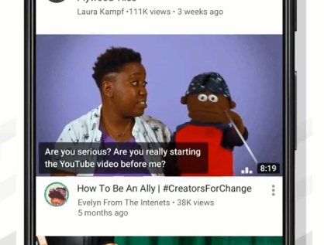
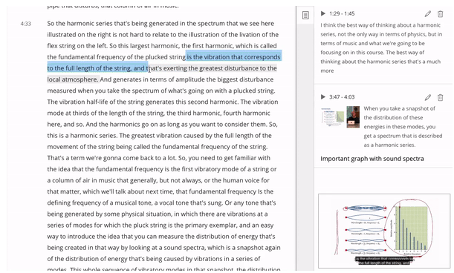
Audio Transcript is Useful
For hard-of-hearing
Watching Video Muted
Learning Aid
Image:
Manual on Uniform Traffic Control Devices
YouTube's Twitter: Autoplay on Home!
Coursera: Presenting a unified note-taking experience

Slide 3
Transcribing Audio can be Costly
Service | Cost per Hour of Audio
Human | 14 USD
AWS Transcribe | 0.47 - 1.44 USD
Adds up if you have a lot of videos!

Slide 4
Objective: Cheap Audio Transcription
Develop a low-cost system for serving audio transcription.
  Can transcribe large number of videos on-demand
  Low cost per videos

Slide 5
Non-Objective: Make it Accurate
Already more accurate. A property of the Engine
  See: gowajee.ai [B. Naowarat 2021]
  Not the focus of this work.
This work focus on making it cheap
[B. Naowarat 2021]: B. Naowarat, T. Kongthaworn, K. Karunratanakul, S. H. Wu and E. Chuangsuwanich, "Reducing spelling inconsistencies in code-switching ASR using contextualized CTC loss,"

Slide 6
Previous Works
Cloud for cost-effective ML serving in general
  Cost reduction with serverless, preemptible, batching (C. Zhang et al. 2019, A. Ali et al. 2020)
Scalable audio transcription
  Scalable worker instances, VAD parallelization (S. Chunwijitra et al. 2016, O. Klejch et al. 2015, Fernández et al. 2020)
Our work: Adapt them (w.r.t. Cost & Workload) and apply to our use-case, then measure.

Slide 7


Proposed Method (1): Basic Operation
Audio
Transcription
Model
Videos
CPU & Mem
Audio Transcript

Slide 8

Proposed Method (2): EC2 Baseline
Cost: 64 USD/mo. Capacity: 7k hours (full utilization) Per-hour: 0.0094 USD
Audio
Transcription
Model
Videos
Audio Transcript

Slide 9

Proposed Method (3):
On-demand with Serverless
Cost: 11 USD/mo. (-80%) + 0.019 USD/hour Capacity: Unlimited Per-hour: 0.019 USD (+100%)
Audio
Transcription
Model
Videos
Controller
Audio Transcript

Slide 10


Proposed Method (4):
Cheap Compute with Preemptible
Cost: 11 USD/mo. + 0.006 USD/hour Per-hour: 0.006 USD (-69%)
Audio
Transcription
Model
Videos
Controller
Queue
Audio Transcript

Slide 11
Proposed Method (5):
Less start-up overhead with Batching
Cost: 11 USD/mo. + (0.004 USD/hour + 0.002 USD/Batch)
Audio
Transcription
Model
Videos
Controller
Queue
Audio Transcript

Slide 12
Recap: Cheap compute obtained
Many videos ✅
On-demand ✅
Low-cost ✅
Shall we go further?

Slide 13
Proposed Method (6):
Closer look at Transcriber
Audio
Transcription
Model
Videos
Controller
Queue
Audio Transcript

Slide 14

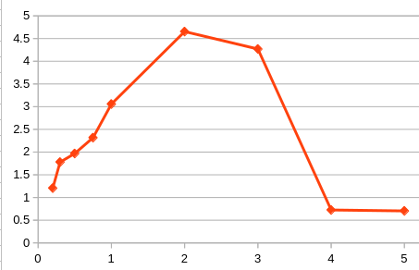
Optimizing Audio Transcription
Memory requirement must be bounded
  Long audio requires large machine. Provision big machine?
Silence should not be transcribed
  Wasteful transcription
Each engine have "optimal length"
Speed
Efficient
Audio Duration (s)

Slide 15
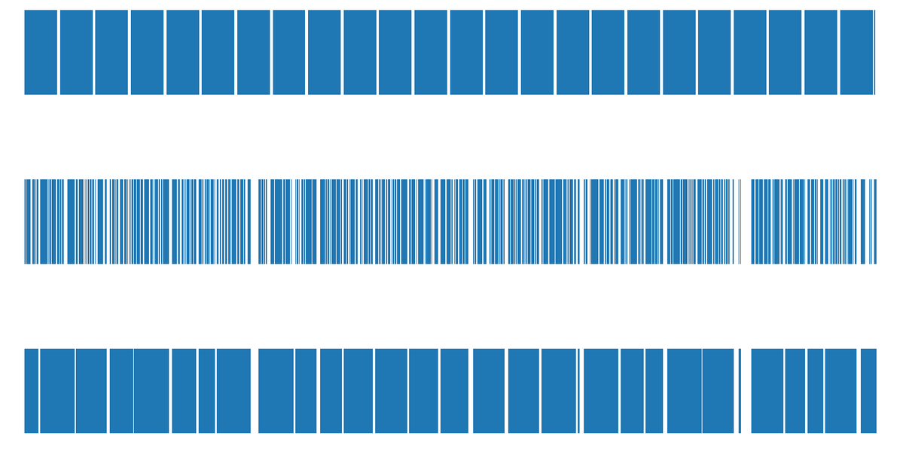
Optimizing Audio Transcription (2):
Chunk the audio equally?
✅ Memory requirement must be bounded
  Long audio requires large machine. Provision big machine?
Silence should not be transcribed
  Wasteful transcription
✅ Each engine have "optimal length"
❌ Accuracy Decreased
Speed
Efficient
Audio Duration (s)

Slide 16

Optimizing Audio Transcription (3):
Chunk by Silence. Optimize Cost
Audio
Detect speech part with VAD
❌
❌
Performance Profile
Audio
Transcription
Model
Parallel

Slide 17
Optimizing Audio Transcription (4):
Chunk by Silence. Optimize Cost
Audio
Detect speech part with VAD
Merge s.t. Total cost is minimized
Solvable via Dynamic Programming
Performance Profile
Audio
Transcription
Model x N
Parallel

Slide 18
Proposed Method (7):
Final System
Audio Preprocessor
Audio
Transcription
Model
Videos
Controller
Queue
Audio Transcript

Slide 19
Results

Slide 20
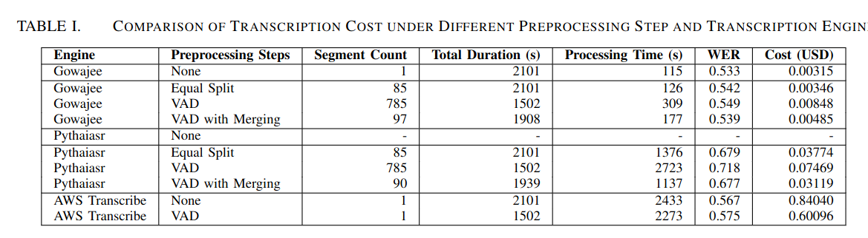
Preprocessing improves accuracy
Better accuracy across the two tested engine
May increase cost in fast engine.
Memory requirement is now bounded

Slide 21
Preprocessing improves accuracy
Engine | Preprocessing | WER | Cost (USD)
Gowajee | Equal Split | 0.542 | 0.00346
 | VAD with Merging | 0.539 | 0.00485
Pythaiasr | Equal Split | 0.679 | 0.03774
 | VAD with Merging | 0.677 | 0.03119

Slide 22
Preprocessing improves accuracy
Engine | Preprocessing | WER | Cost (USD)
Gowajee | Equal Split | 0.542 | 0.00346
 | VAD with Merging | 0.539 | 0.00485
Pythaiasr | Equal Split | 0.679 | 0.03774
 | VAD with Merging | 0.677 | 0.03119

Slide 23
Preprocessing improves accuracy
Engine | Preprocessing | WER | Cost (USD)
Gowajee | Equal Split | 0.542 | 0.00346
 | VAD with Merging | 0.539 | 0.00485
Pythaiasr | Equal Split | 0.679 | 0.03774
 | VAD with Merging | 0.677 | 0.03119

Slide 24
Preprocessing improves accuracy
Engine | Preprocessing | WER | Cost (USD)
Gowajee | Equal Split | 0.542 | 0.00346
 | VAD with Merging | 0.539 | 0.00485
Pythaiasr | Equal Split | 0.679 | 0.03774
 | VAD with Merging | 0.677 | 0.03119

Slide 25
The system can scale and handle large number of videos
Achieved by using Serverless Worker

Slide 26
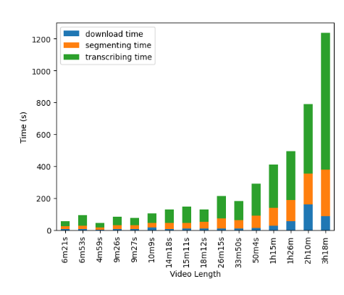
The system can process in a timely manner
~9x Real-time Speed

Slide 27
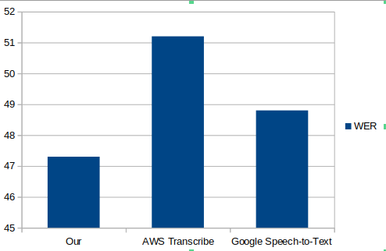
The system remains accurate
The lower, the better.

Slide 28
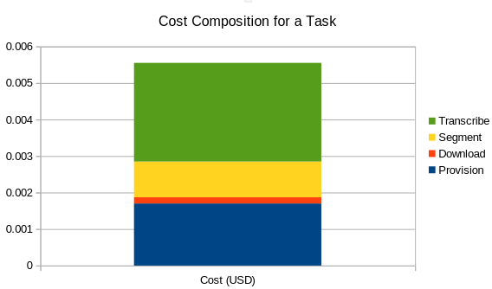
The system can transcribe for cheap
That's 0.0057 USD per hour of audio
With 13.54 USD/month fixed cost.

Slide 29
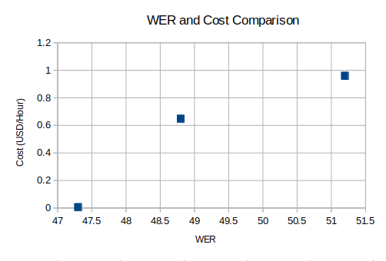
Comparison with commercial API
AWS Transcribe
System | WER | Cost (USD/Hour)
Our Work | 47.3 | 0.0057
AWS Transcribe | 51.2 | 0.9600
Google Speech-to-Text | 48.8 | 0.6480
Google
Speech-to-Text
Better
Ours
****Excl. R&D, Licensing, Operational Cost

Slide 30
Conclusion
A system for cheap audio transcription serving is proposed:
  Exploit cloud pay-as-you-go and preemptible for low compute cost
  Preprocessing step to better match transcriber's profile
The entire system is implemented and measured to be competitive in term of accuracy and processing cost.
Possible future explorations on Engine/VAD possible

Slide 31

THANK YOU
In-Production UI
QUESTION & ANSWER

Slide 32
Extra Slides

Slide 33
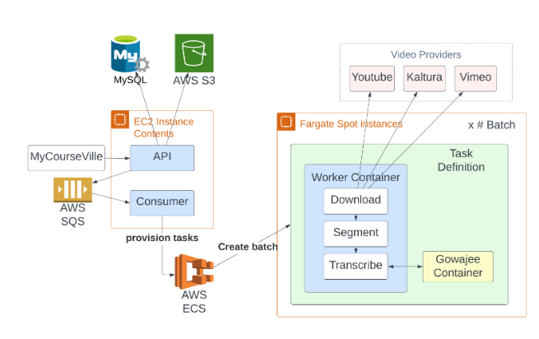
Fig. 1. The system architecture of the Autosub service.

Slide 34
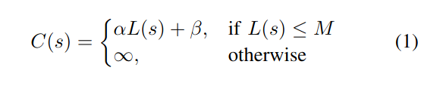
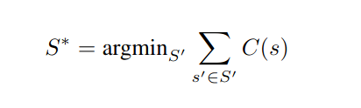
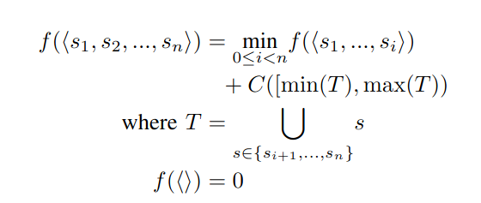
Eq. (DP sol.)

Slide 35
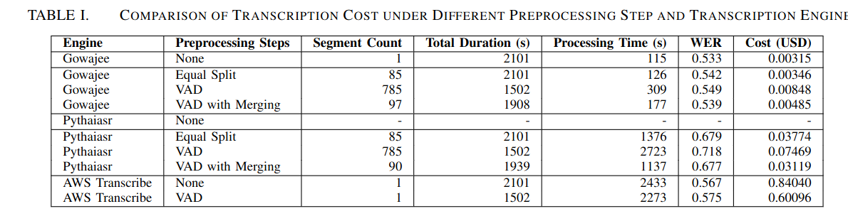
Table I

Slide 36
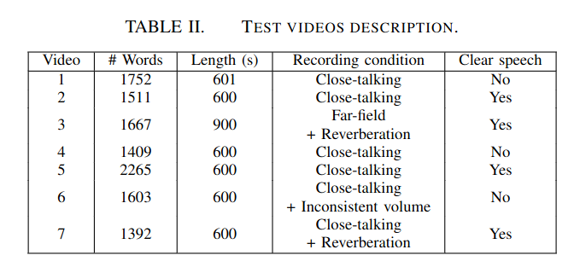
Table II

Slide 37
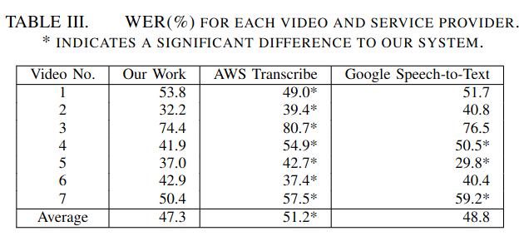
Table III

Slide 38
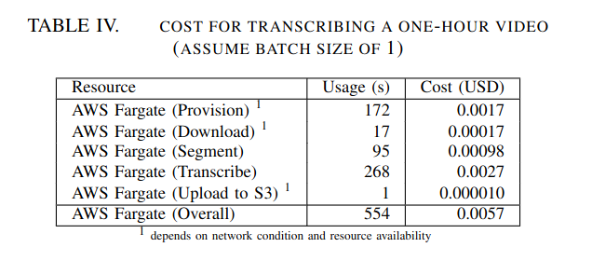
Table IV

Slide 39
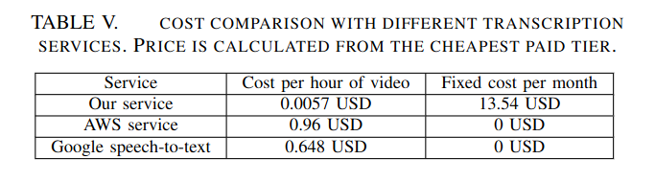
Table V

Slide 40
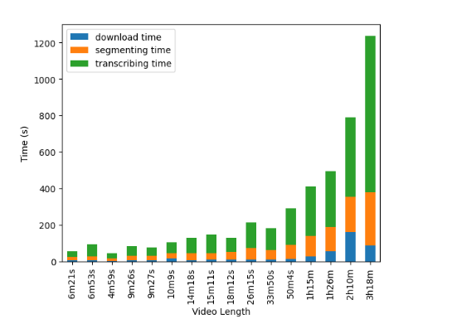
Fig 2

Slide 41
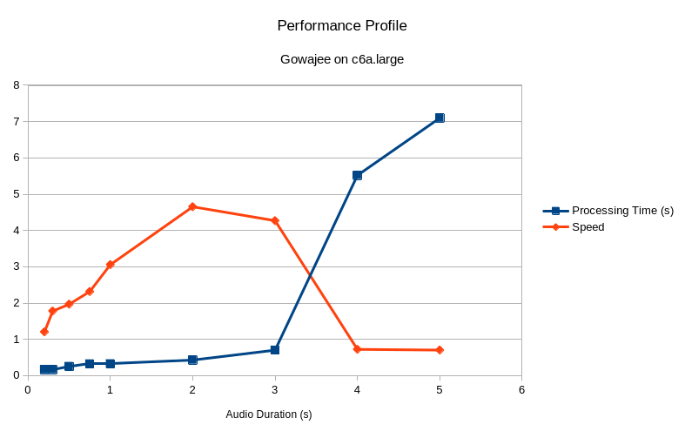
c5a.large-gowajee-profile

Slide 42
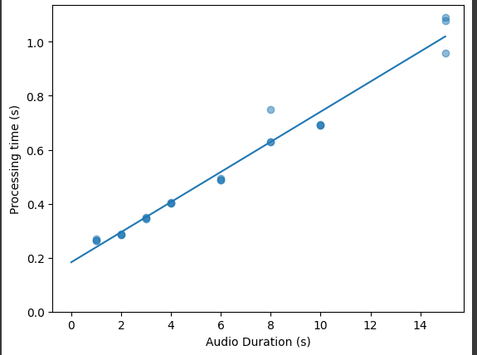
TimeOnly.ipynb (Gowajee, 8GB)

Slide 43
Top-Right Calculation from Table IV
Model Assumption
  Processing Time: 25.259 + 0.0914 * LEN_S (LINREG video_time_dataframe.csv EMPIRICAL) x Good Approx with Table IV (354s)
  Table IV give processing time at 382s/hour. Total time @ 554s
EC2
  c5a.large ($64.240/mo.; $53.071/mo SPOT SGP)
  Assume one hour video we got per video processing time = 382s => Max Cap = 6785 Videos. => 0.00946747 USD/hour vid (Full Utilization)
With serverless
  T2.micro ($10.658, but paper use $13.54) + Fargate ($0.05056 x 2 + $0.00553 x 4 = $0.12324 per hour)
  This give 13.54 USD per month fixed cost + 0.01897 USD/vid hour
With spot
  Fargate Spot (.01542906 x 2 + .00168755 x 4 = .03760832)
  This give 13.54 USD per month fixed cost + 0.0057875 USD/vid hour
With batching
  This give 13.54 USD per month fixed cost + (0.0039907 x num_vid + 0.00179684 x num_batch)
    = (0.0039907 + 0.00179684/batch_size)
  num_batch >= num_vid/batch_size

Slide 44
Paper Title
Author name
dept. name of organization (of Affiliation)
The 20th International Joint Conference on Computer Science and Software Engineering
28th June-1st July 2023
Naresuan University Phitsanulok, THAILAND

Slide 46
THANK YOU
QUESTION & ANSWER

