Slide 1



A Sensor Fusion Approach for Improving Implementation Speed and Accuracy of RTAB-Map Algorithm Based Indoor 3D Mapping
Hoang-Anh Phan∗, Phuc Vinh Nguyen∗, Thu Hang Thi Khuat∗, Hieu Dang Van∗ , Dong Huu Quoc Tran∗, Bao Lam Dang†, Tung Thanh Bui∗, Van Nguyen Thi Thanh∗, Trinh Chu Duc∗
∗Faculty of Electronics and Telecommunications,
VNU University of Engineering and Technology, Hanoi, Vietnam
† Hanoi University of Science and Technology, Hanoi, Vietnam
The 20th International Joint Conference on Computer Science and Software Engineering
28th June-1st July 2023
Naresuan University Phitsanulok, THAILAND
Notes:
Hello everyone attending today's conference. Im Hieu Dang Van - co-author of a paper called "A Sensor Fusion Approach for Improving Implementation Speed and Accuracy of RTAB-Map Algorithm Based Indoor 3D Mapping“. The paper was written by members of the faculty of electronics and telecommunications, VNU University of Engineering and Technology and Hanoi University of Science and Technology

Slide 2
01.
Introduction
02.
Proposed model
03.
Experimental results
04.
Conclusion
Notes:
My presentation consists of 4 parts. first is introduction, second is Proposed model, third is Experimental results and last is C

Slide 3
01.
Introduction

Slide 4
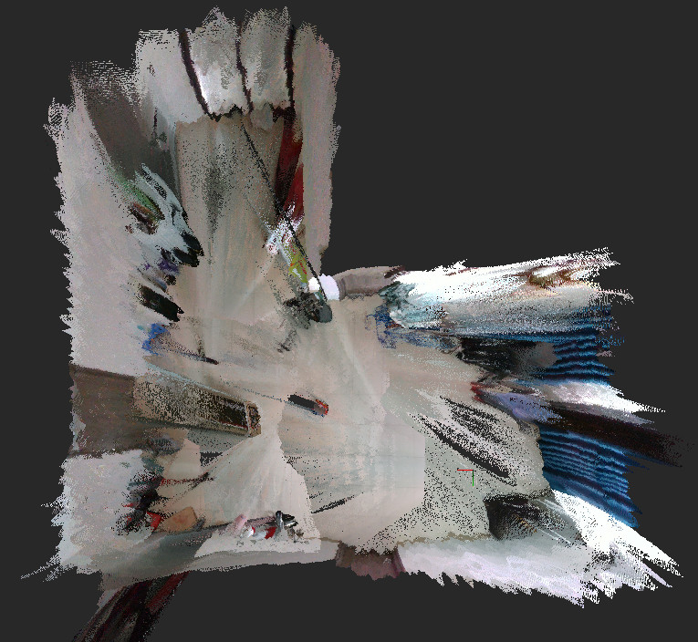
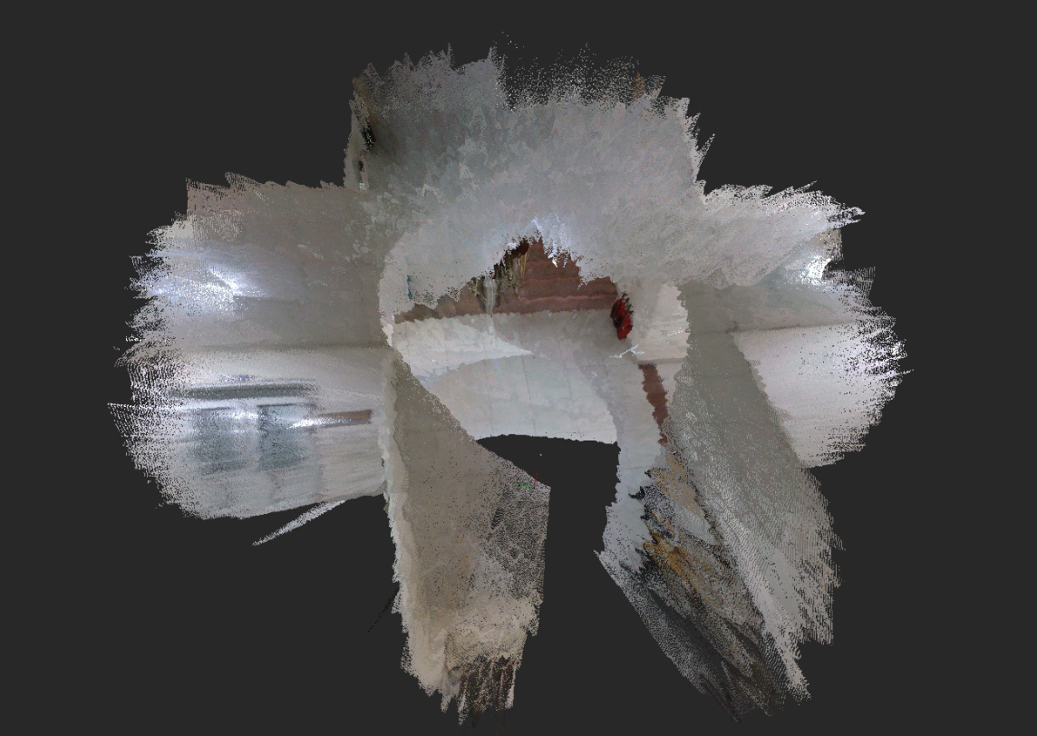
1.1. INTRODUCTION
Notes:
In recent years, 3D mapping for indoor environments has undergone considerable research and improvement because of its effective applications in various fields, including robotics, autonomous navigation, and virtual reality.
Building an accurate 3D map for indoor environment is challenging due to the complex nature of the indoor space, the problem of realtime embedding and positioning errors of the robot system.
One of the methods to build 3D maps is Visual SLAM, which refers to SLAM systems that use the camera as the primary input sensor to receive visual information only

Slide 5
1.2 BASE MODEL
The study was carried out on the basis of the following "Base Model":
Base Model
  Differential 2-wheel robot system
  RGB-D camera D435i
  RTAB-Map
Notes:
The study was carried out on the basis of the following "Base Model" include Differential 2-wheel robot system, RGB-D camera D435i, and RTAB-Map. RTAB-Map is a 3D SLAM system using visual odometry also known as VO.

Slide 6
1.3 INTRODUCTION
The objectives of this study include:
Accuracy
Speed
3D map build time
Quality of 3D map
Notes:
The objectives of this study include improving the accuracy, speed, 3D map build time, and quality of 3D indoor mapping

Slide 7
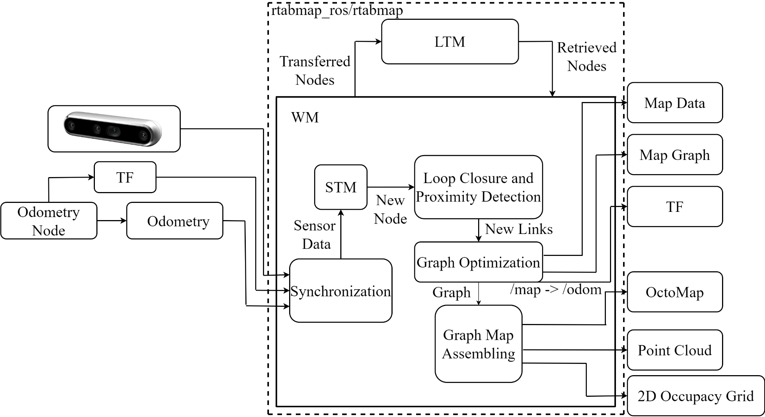
1.4 RTAB-MAP ALGORITHM IN THE BASE MODEL
RTAB-Map algorithm in the base model
Notes:
About the RTAB-Map algorithm in base model.
After synchronizing the sensor data, the STM short-term memory block will create a node to remember the odometry data, the information will be sent as a new node to the next block.
Loop closure and Proximity Detection links are added in the STM between consecutive nodes. All links will be used as constraints to "Graph Optimization". When a new "loop closure and Proximity Detection" link detection is added to the graph, the "graph optimization" block will perform the task of reducing odometry drift. Do the assembling with each optimized graph to get the output

Slide 8
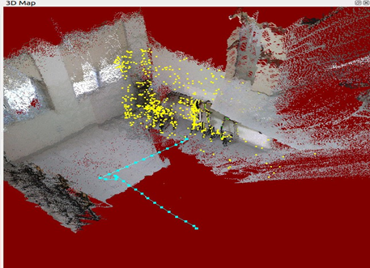
1.5 EXPERIMENT WITH THE BASE MODEL
Some difficulties of VSLAM with the indoor environment:
Light.
Floor.
Drift estimates camera pose.
Conduct experiments to verify:
Stumbling wheels, and rotating the robot at high speed causes noise and loss of Odometry.
=> The accuracy of the 3D map is reduced.
Time-consuming to adjust the position of the robot.
=> The time required to build the map is increased.
Loss of Odometry when experimenting
Notes:
In addition, VSLAM still has some difficulties with the indoor environment like: Light which directly affects the quality of the camera. Floor, which directly affects the accuracy of the robot. And the biggest challenge is Drift estimating the camera pose.
Since then, we conducted experiments to verify and encountered the following problems: Stumbling wheels, and rotating the robot at high speed causes noise and loss of Odometry as you can see in the picture on the right. This results in reduced accuracy of the 3D map.
However, RTABMAP allows access to the position before the loss of odometry thanks to a Loop Closure, so 3D mapping can be continued. And so we have to spend time adjusting the position of the robot. This results in the time required to build the map being increased

Slide 9
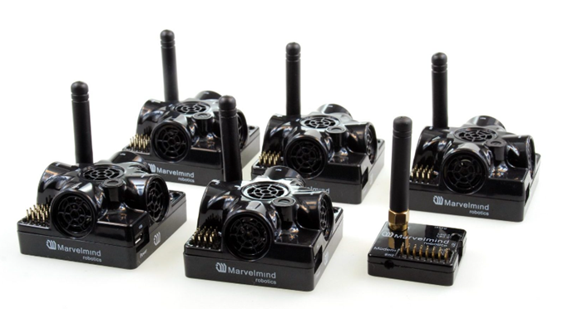
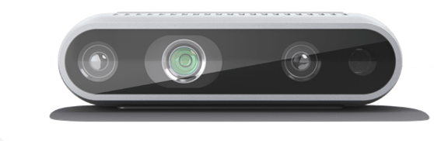
1.6 PROPOSED MODEL
Sensors in the proposed model: Indoor Position System (IPS), inertial measurement system (IMU) obtained from RGB-D camera D435i and Wheel encoders.
RGB-D camera D453i
IPS (Indoor Positioning System)
Notes:
From the difficulties encountered when experimenting in the base model, the study proposes a method to use the fusion data obtained from sensors to serve as an alternative Odometry for VO of RTAB-Map in the base model. Sensors in the proposed model include Indoor Position System (IPS), IMU obtained from RGB-D camera D435i and Wheel encoders.

Slide 10
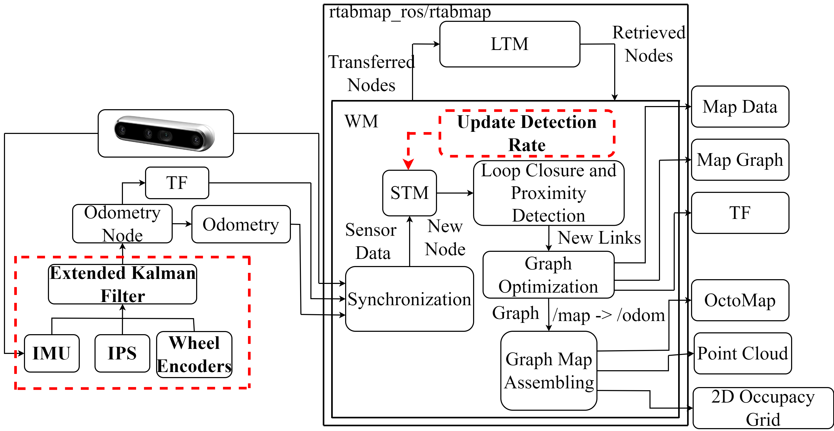
1.7 RTAB-MAP ALGORITHM IN THE PROPOSED MODEL
The “Odometry Node” block input is changed.
=> Provides an alternative source of visual odometry.
The “Update Detection Rate” block is
added.
Change the algorithm's update
frequency.
RTAB-Map algorithm in the proposed model
Notes:
next, i will present the rtab-map algorithm in the proposed model.
We change the input of the “Odometry Node” block to provide a more accurate and reliable alternative odometry than the VO in the base model.
Besides, the “Update Detection Rate” block is added to change the algorithm's update frequency

Slide 11
02.
Proposed model

Slide 12
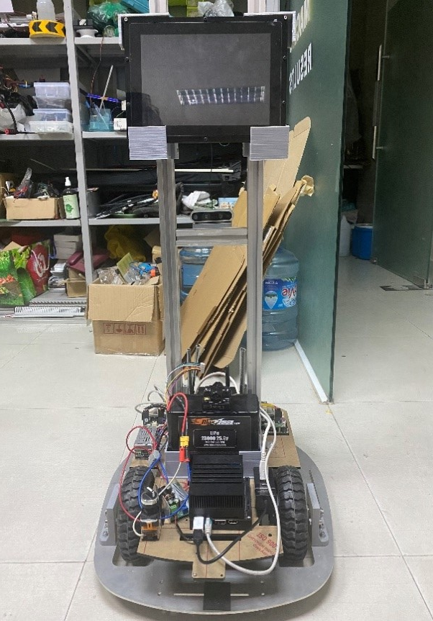
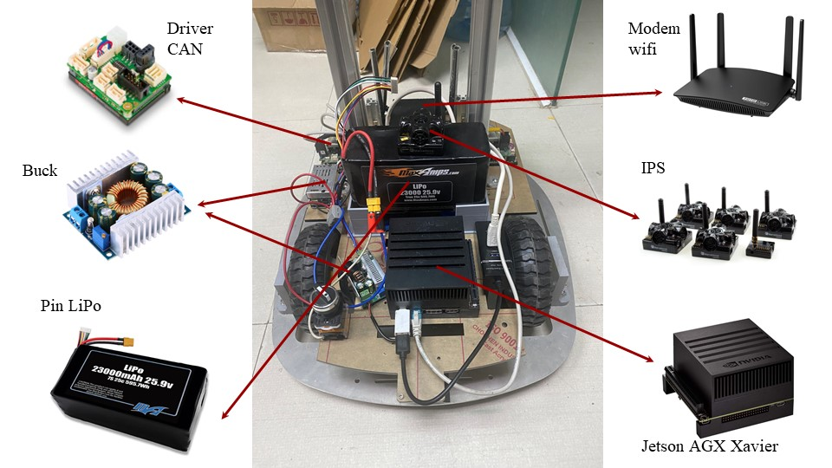
02. PROPOSED MODEL
Components used
Realistic robot model
Notes:
First, I would like to introduce the actual robot model that we use for Visual SLAM. The components at the base of the robot used include Driver CAN, buck converter, lipo battery, wifi modem, IPS and Jetson AGX xavier.

Slide 13
02. PROPOSED MODEL
Use the ROS sensor fusion package.
Prepare input data:
  Coordinates (x, y) from “IPS”.
  Velocity (vx, vy) from “Wheel Encoders”.
  Direction (yaw), angular velocity (vyaw) and acceleration (ax, ay) from IMU.
The filtered data is sent to the main RTAB-Map algorithm module.
RTAB-Map algorithm in the proposed model
Notes:
Next, I will represent about changing the input of the “Odometry Node”. We use the ROS package to fusion sensors through the extended Kalman filter. To do that, we need to prepare the input data include: Coordinates (x, y) from “IPS”, Velocity (vx, vy) from “Wheel Encoders”, Direction (yaw), angular velocity (vyaw) and acceleration (ax, ay) from IMU.
Then the filtered data is sent to the main RTAB-Map algorithm module.

Slide 14
02. PROPOSED MODEL
Increasing the update frequency of the Odometry node that has passed the filter in sync with the IPS.
Synchronizing the values of the parameters that affect the RTAB-Map's map update frequency with the frequency of the alternate Odometry source.
RTAB-Map algorithm in the proposed model
Notes:
About changing the algorithm's update frequency. We increase the update frequency of the Odometry node that has passed the filter in sync with the IPS and synchronize the values of the parameters that affect the RTAB-Map's map update frequency with the frequency of the alternate Odometry source.

Slide 15
03.
Experimental results

Slide 16
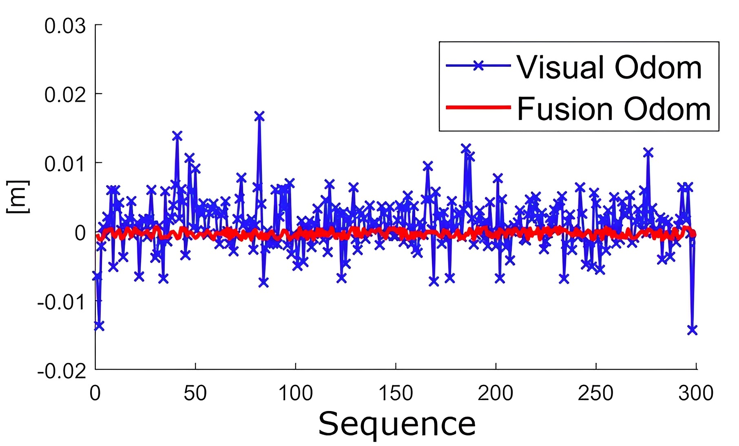
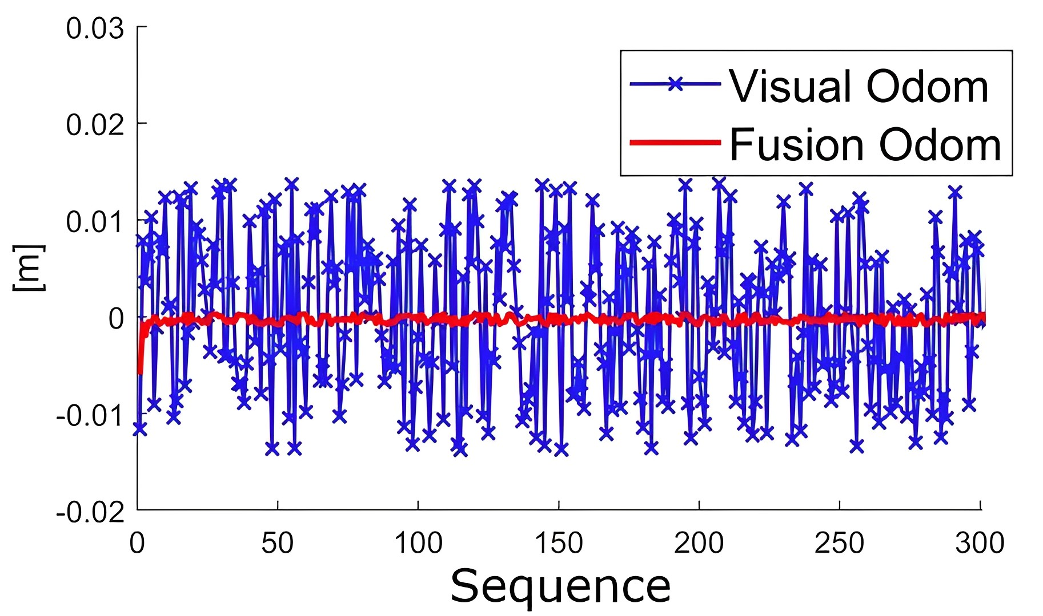
03. Experimental results
a) Pose error X-axis
b) Pose error Y-axis
Estimated position error
Notes:
The presentation will go to the experimental and results section to demonstrate the proposed method's effectiveness.
We will experiment based on 3 criteria: Estimated Position Error, Estimated Trajectory Error and 3D map quality and processing time
We have experimented with the proposed method using fusion Odom and compared it with the standard method using Visual Odom when building 3D maps for robots.
Firstly, the comparison was performed on the position error of the robot while stationary for 60 seconds (5Hz sampling rate) between “Visual Odom” (Blue line) - representing the base method, and “Fusion Odom” (Red line) - illustrating the proposed method, as shown in Fig. a and Fig. b, respectively.
The comparison in the selected 60-second interval can show the” Visual Odom” drift. It could be observed from the line graph that the position estimate in the base method exhibits continuous jumps overtime during the 3D map construction process. However, after sensor fusion, the position estimate becomes more accurate and stable during a specific time period

Slide 17
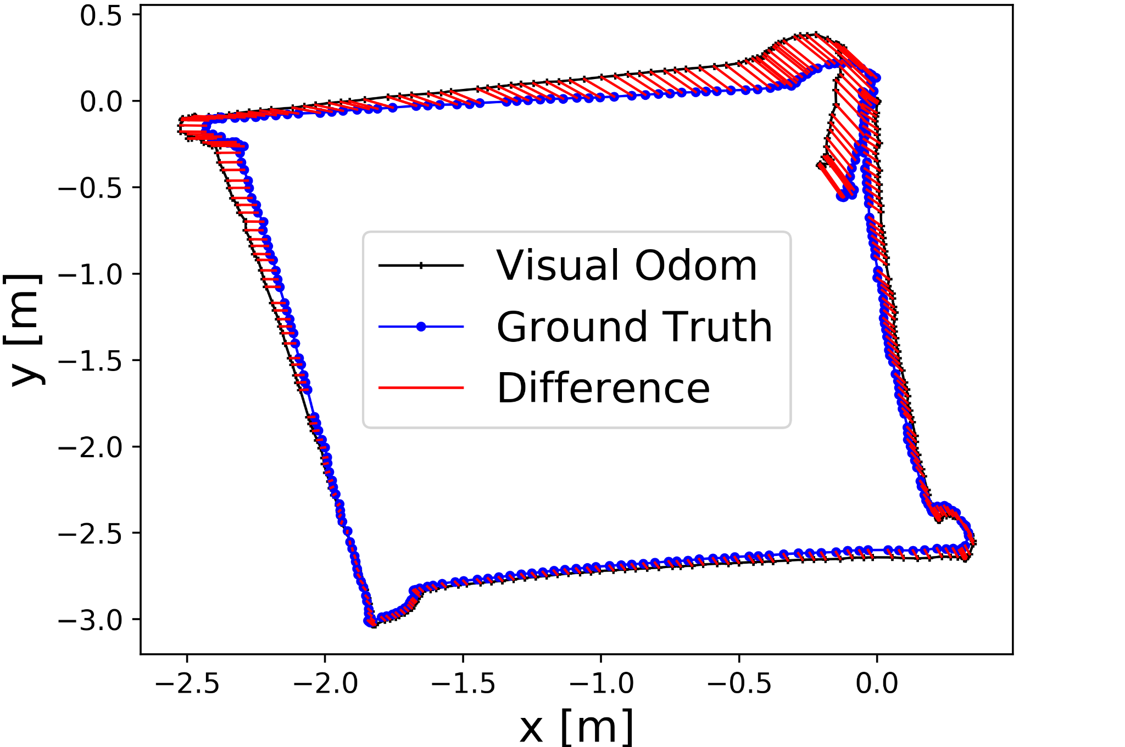
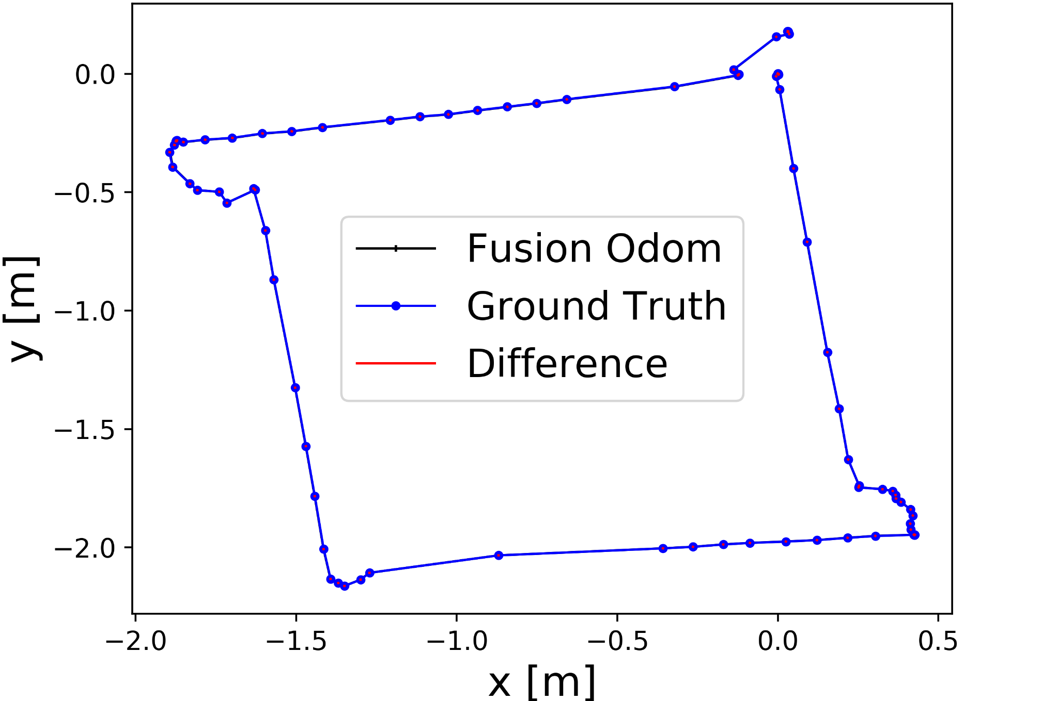
03. Experimental results
Pose error X-axis
Pose error Y-axis
a) Base model
b) Proposed model
Estimated trajectory error in v = 0.3m/s, w = 0.78rad/s
Notes:
The next, comparative analysis of the trajectories obtained from both methods was conducted, and the results were highly favorable.
The mapping process was carried out at different speeds of the robot with a linear velocity of v = 0.15m/s, 0.3m/s and rotational velocity of ω = 0.39rad/s, 0.78rad/s.
The trajectory error was estimated with the ground truth taken from the 3D map after the mapping process was completed.
In this figure are the results of the v = 0.3m/s and ω = 0.78rad/s experiments. It was observed that there were significant differences between the trajectory of “Visual Odom” and the ground truth (Fig. a), which was caused by pose drift when the robot turned. However, “Fusion Odom” performed outstandingly (Fig. b) in reducing the trajectory error.

Slide 18
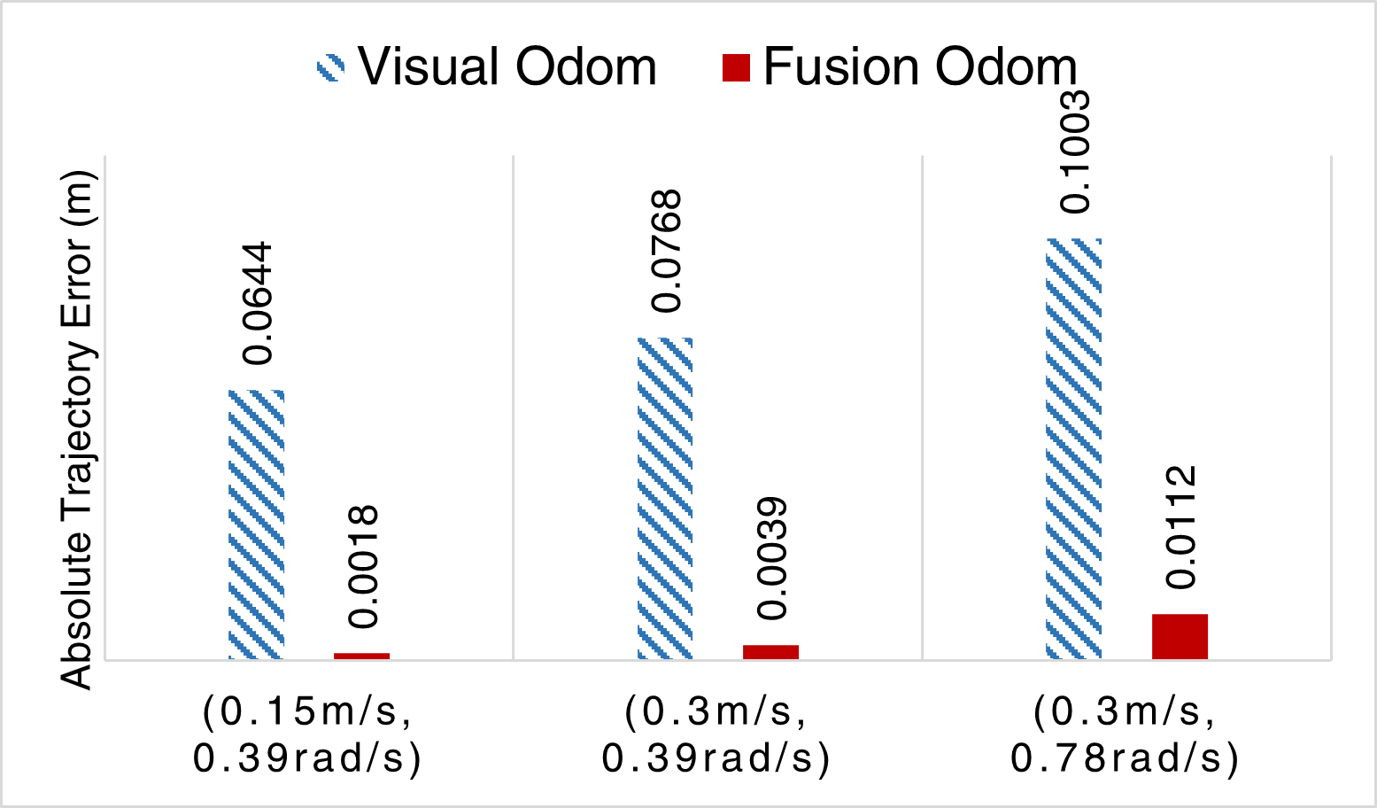
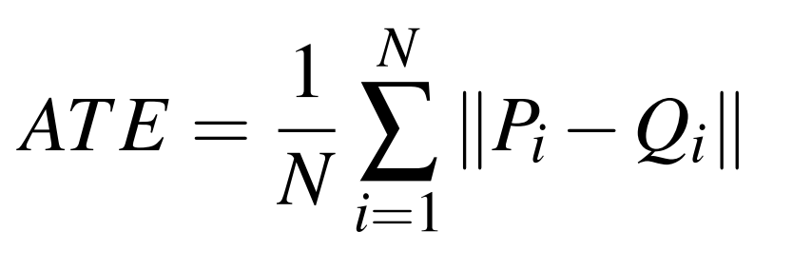
03. Experimental results
Estimated absolute trajectory error
Notes:
In order to evaluate the accuracy of the proposed method, the Absolute Trajectory Error (ATE) was used in these 3 cases which were mentioned.
The ATE was calculated as the average of the Euclidean distance difference between the ground truth and the supplied odometry input over the total number of time steps.
Where N is the total number of time steps, ∥Pi −Qi∥ is the error of the Euclidean distance of the two methods.
The ATE coefficient of the proposed method was significantly lower than that of the base method, ranging from 9-36 times lower.
These findings suggested that the absolute orbital error of the proposed method had been greatly reduced compared to the base method.
Additionally, as the linear and angular velocities increased, the orbital error increased significantly.
At case 3, the error of the base method was approximately 0.1m, whereas the error of the proposed method was only approximately 0.01m.
These results demonstrate the efficacy of the proposed method in reducing errors and improving accuracy.

Slide 19
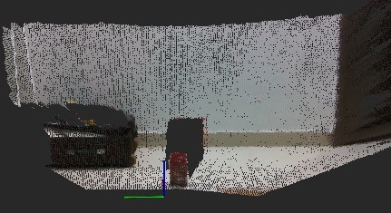
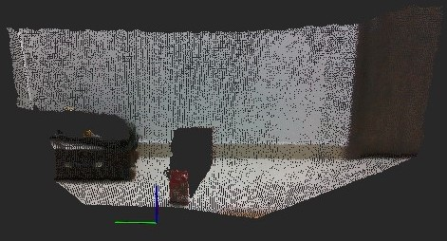
03. Experimental results
a) Base model scans 83902 point clouds
b) Proposed model scans 188190 point clouds
Notes:
A comparative study was conducted to investigate the effectiveness of synchronizing the frequency of updating the map processing of the RTAB-Map method with location updates from the IPS.
The experiment involved scanning an area of the environment with a robot over a fixed time interval (δt = 2s) and a fixed angular velocity (ω = 0.2rad/s). The number of point clouds on the 3D map generated using the base method and the proposed method was compared.
The results showed that the proposed method generated a higher number of point clouds (188190 points) in Fig. b compared to the base method (83902 points) in Fig. a, indicating an improvement in the quality of the 3D map.
The findings demonstrated the clear benefits of increasing the frequency of updating the map processing of RTAB-Map to be synchronized with the frequency of location updates from the “Fusion Odom”.

Slide 20
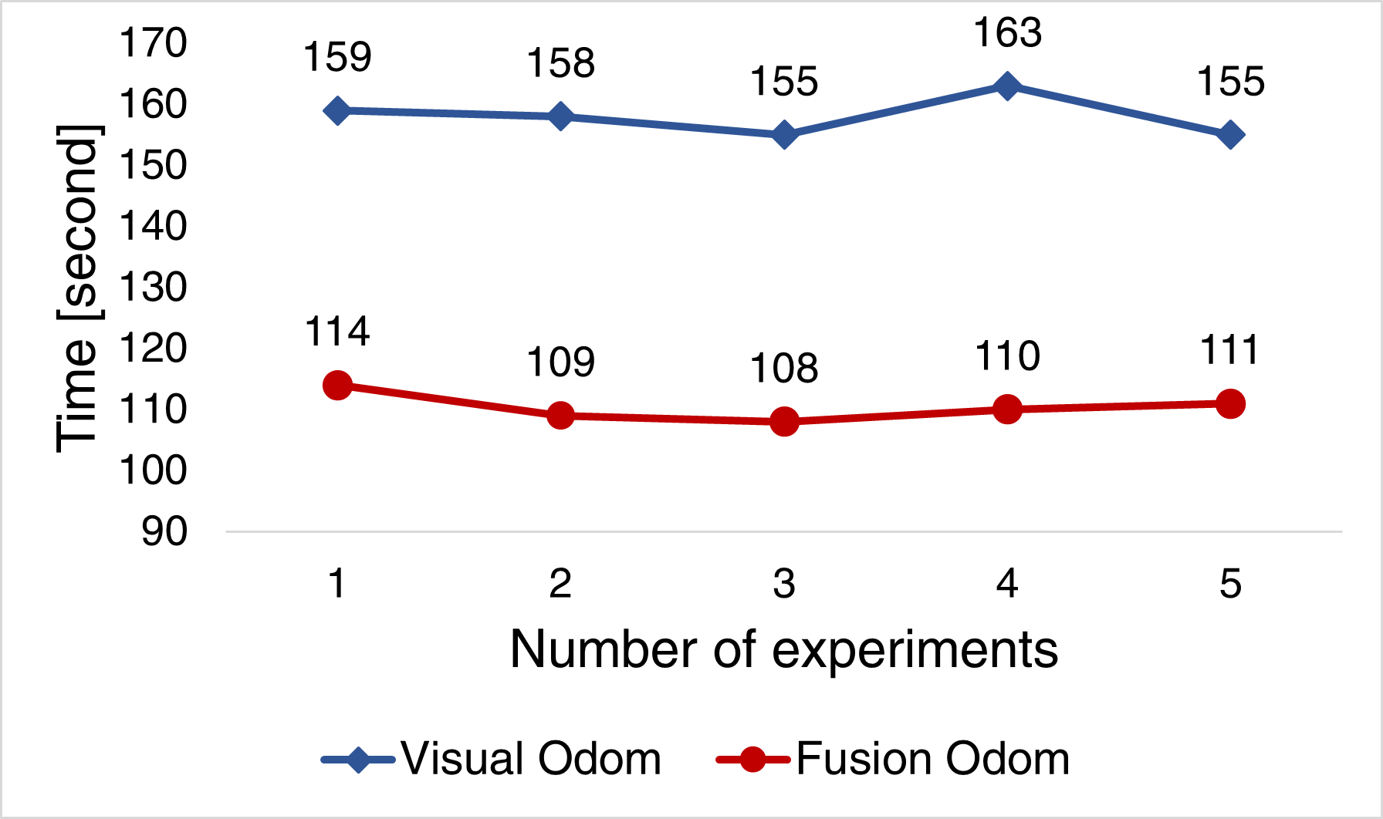
03. Experimental results
Time of 3D map building
Notes:
The last, testing for the robot’s construction of 3D maps using two different methods on the same trajectory with identical linear and angular velocities, the interference and
loss of odometry in the control process led to the repositioning of the robot by the operator and adjustment of the map construction trajectory by the RTAB-Map system.
This interference significantly affected the time required to build the map. A test was conducted to assess the time taken by the robot to build a 3D map with the trajectory obtained after 5 test runs, presented in this figure.
The results indicated that the proposed method had an average mapping time of 110.4 seconds, while the base method took an average of 158 seconds to execute

Slide 21
04.
Conclusion

Slide 22
04. Conclusion
Enhance the accuracy, speed, and quality of indoor 3D mapping by integrating data from IPS, IMU from a D435i camera, and wheel encoders. The integration is achieved using the extended Kalman filter in RTAB-Map base method.
The proposed method reduces errors in position and trajectory estimation while mapping at high speeds, leading to improved map accuracy, optimizes the time required to build the 3D map, increases the map update frequency.

Slide 23
THANK YOU
QUESTION & ANSWER

