Slide 1



Acoustic Monitoring System
with AI Threat Detection System
for Forest Protection
Bhattarapong Somwong, Kritsana Khumpet, and Wansuree Massagram
Department of Computer Science and Information Technology
Naresuan University
The 20th International Joint Conference on Computer Science and Software Engineering
28th June-1st July 2023
Phitsanulok, THAILAND

Slide 2
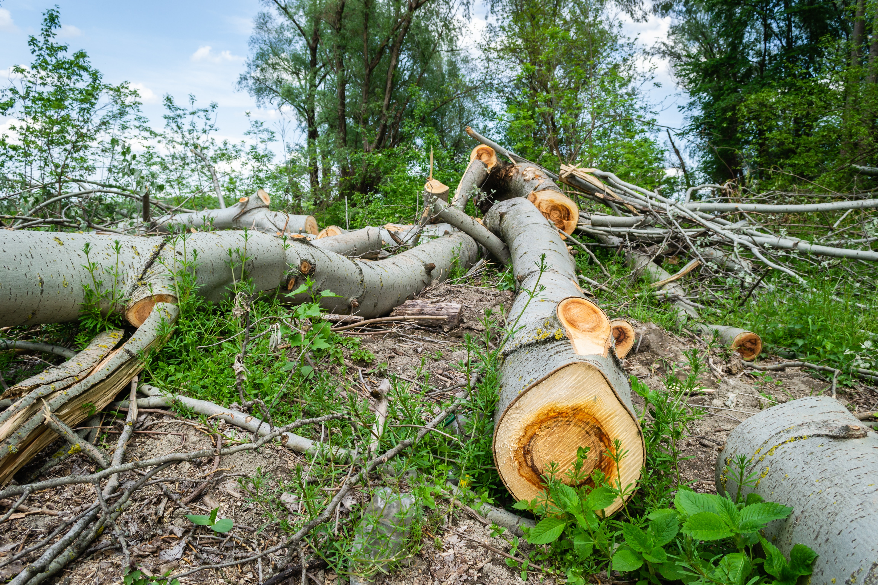
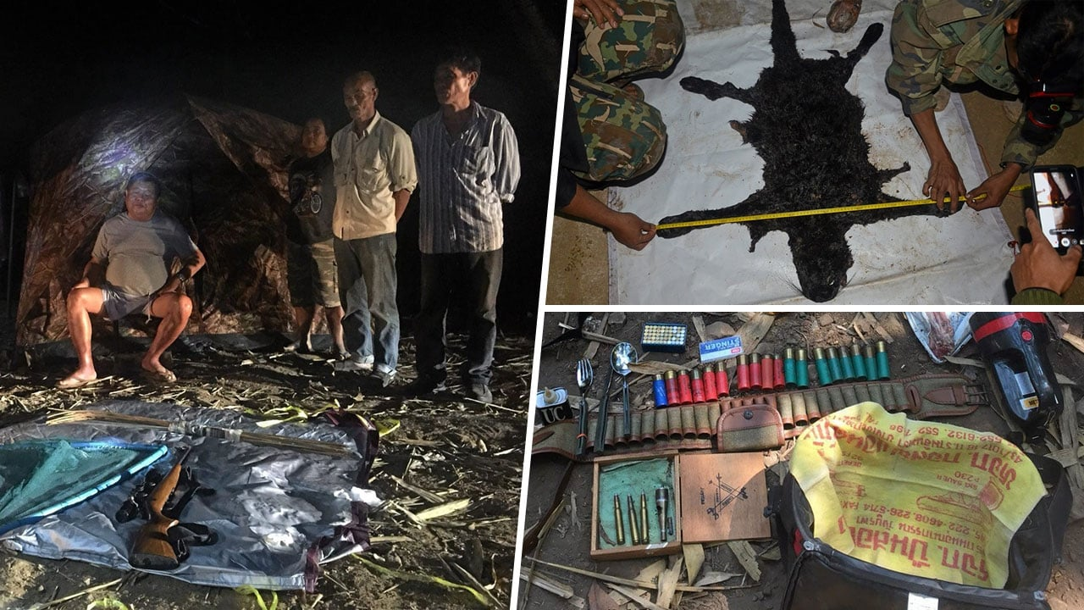
Forest/Wildlife Threats
Illegal Logging
Illegal Poaching

Slide 3



Proposed Solution
A machine box consists of High-Performance Boards (Portenta H7) to record sounds.
Uploads detected data through Swarm to Swarm’s server.
Park rangers, scientists can make use of the data for further analysis.

Slide 4
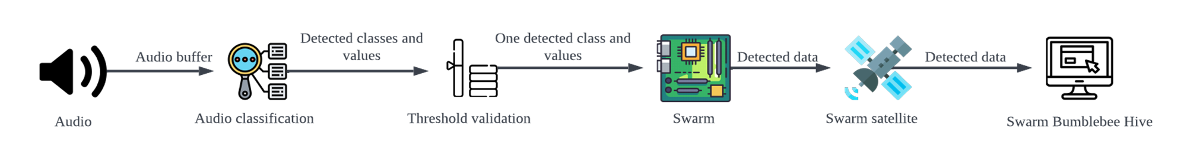
System Overview

Slide 5
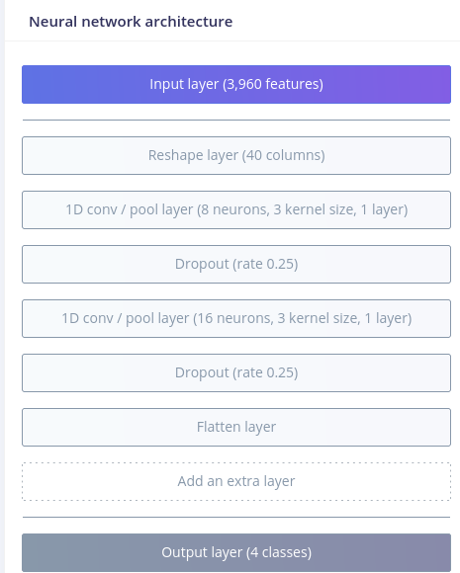
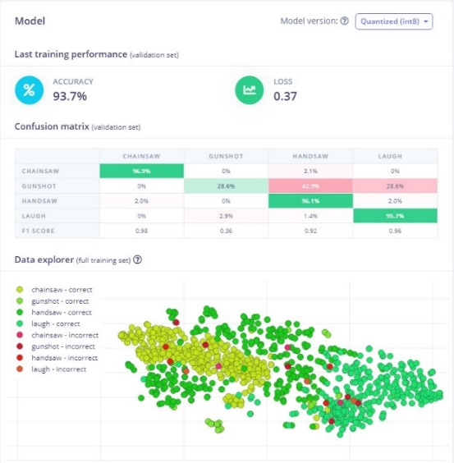
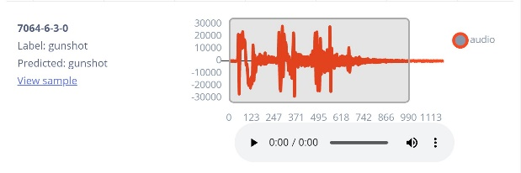
Design and Implementation

Slide 6
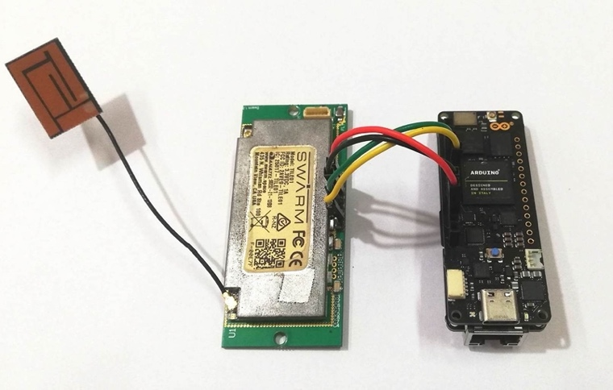
Design and Implementation

Slide 7
Test Results
 | Chainsaw | Handsaw | Gunshot | Laugh | Nd*
Chainsaw | 80% | 2% | 4% | 6% | 10%
Handsaw | 0% | 0% | 25% | 50% | 25%
Gunshot | 0% | 0% | 100% | 0% | 0%
Laugh | 0% | 0% | 2.56% | 84.62% | 12.82%
Precision | 1.00 | 0 | 0.25 | 0.87
Recall | 0.87 | 0 | 1.00 | 0.85
F1 | 0.89 | Undefined | 0.40 | 0.86
*Not detected

Slide 8
Future Work
Utilizing the Portenta Vision Shield’s on-board camera
Optimizing data transfer between Portenta H7 and Swarm
Multithreading for TensorFlow Lite multi-model function

Slide 9
THANK YOU
The authors would like to thank the Rainforest Connection’s Chief Technology Officer, Dr. Antony Harfield for his supports.

Slide 10
Q&A

