Slide 1



Text Classification Using Improving Term Frequency with Gaussian and Multilayer Perceptron Techniques
Vuttichai Vichianchai¹ & Sumonta Kasemvilas²
¹Department of Information Technology, Faculty of Informatics, Mahasarakham University
The 20th International Joint Conference on Computer Science and Software Engineering
29th June 2023
Naresuan University Phitsanulok, THAILAND

Slide 2
Issue
Introduction
Objective
Methodology
Results and Discussions

Slide 3
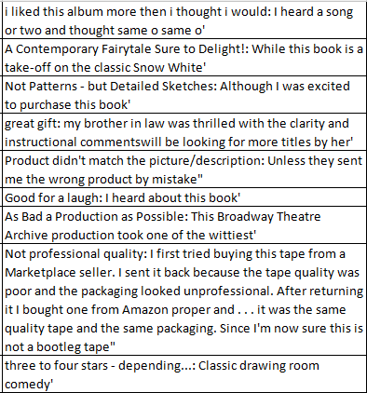
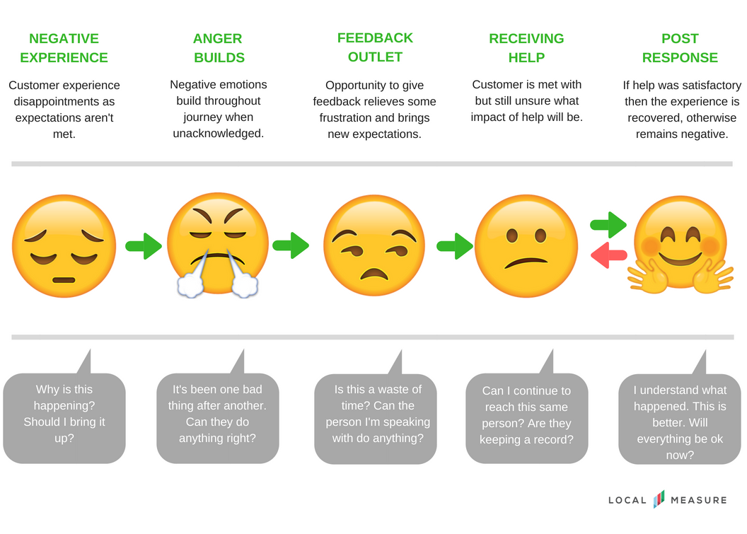
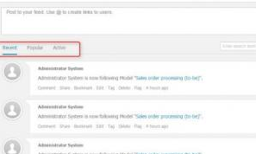
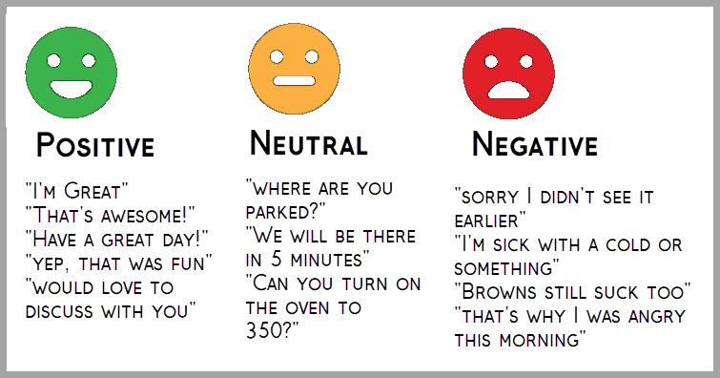
Introduction
The Problem
More interactions and feedback on web pages.

Slide 4
Introduction
The Importance of Text Sentiment Analysis
1. Social Media Analysis
2. Customer Feedback Analysis
3. Risk Management

Slide 5
Introduction
Solving text analytics problems
Natural Language Processing (NLP)
BoW
TF
TF-IDF
TF-ICF
TF-IGM
TF-G
Text
Tokenization/
Word segmentation
Term weighing
k-NN
SVM
RF
MLP
Text classification/
Text analysis using MLs

Slide 6
Introduction
Solving text analytics problems
Sate-of-the-art for NLP
Term frequency inverse gravity moment
(TF-IGM)+MLs
Term frequency with Gaussian
(TF-G) + MLs
BERT

Slide 7
Introduction
The TF-G with ML techniques for text classification and sentiment analysis
(Vuttichai and Sumonta, 2021)
MLs | Precision | Recall | F-measure
DT | 80.99 | 81.75 | 79.93
NB | 81.79 | 82.60 | 82.13
SVM | 99.84 | 99.73 | 99.78
RF | 88.35 | 93.12 | 90.67
MLP | 81.58 | 75.79 | 79.08

Slide 8
Introduction
The TF-G with MLP technique for text classification and sentiment analysis
(Vuttichai and Sumonta, 2021) ใช้นามสกุล ไม่ใช่ใช้ชื่อจริง
TF-G
MLP
Term weighting
TW of index term1
TW of index term2
TW of index term3
TW of index term4
…
TW of index term(n-1)
TW of index term(n)
Input
Hidden1
Hidden2
Output
W1
O1
W1
O2
…
…
…
W1
O3

Slide 9
Objective
To find the term weighting using improving the TF-G technique with the multilayer perceptron technique for text sentiment analysis

Slide 10
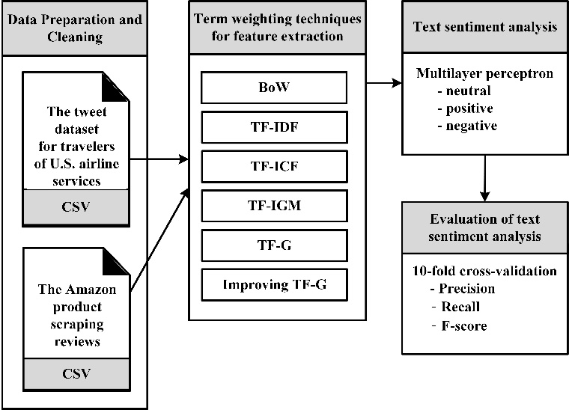
Methodology
14,640 tweets
3,090 neutral
2,363 positive
9,187 negative
17,340 reviews
6,303 neutral
9,503 positive
1,534 negative

Slide 11
Methodology
1. Data preparation and cleaning
"very comfot".
"very comfort".

Slide 12
Methodology
2. indexing
Term index
Review 1: "love it".
Review 2: "very ergonomic".
Review 3: "horrible just horrible".
Review 4: "excellent for price".
Review 5: "very comfort".
Review 6: "very nice".
Review 7: "horrible".
love
it
very
ergonomic
horrible
just
excellent
for
comfort
price
nice

Slide 13
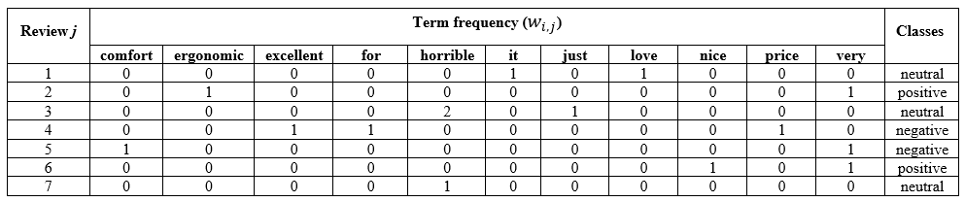
Methodology
Term weighting using TF-G technique
Review 1: "love it".
Review 2: "very ergonomic".
Review 3: "horrible just horrible".
Review 4: "excellent for price".
Review 5: "very comfort".
Review 6: "very nice".
Review 7: "horrible".

Slide 14
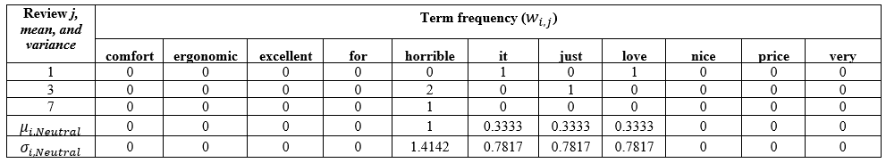
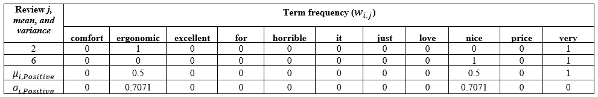

Methodology
Term weighting using TF-G technique (cont.)

Slide 15
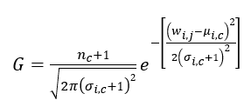

Methodology
Term weighting using TF-G technique (cont.)

Slide 16
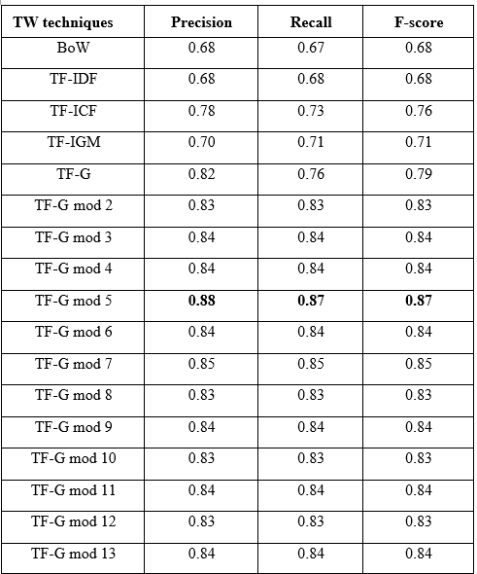
Results
The results of sentiment analysis from the tweet dataset for travelers U.S. airline services

Slide 17
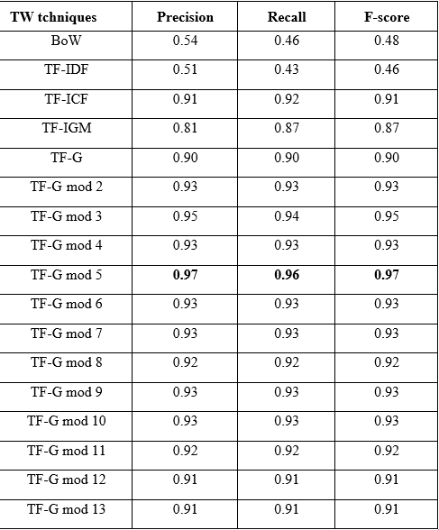
Results
The results of sentiment analysis from the scraped reviews of Amazon products

Slide 18
Results and Discussion
1. The improvement of technique TF-G by modulation with 5 and MLP technique is the most accurate in text sentiment analysis
2. Using appropriate term weights for learning on the dataset, the MLP technique can provide high accuracy in text sentiment analysis
3. Modulation is a technique used to reduce the weight within the range of modulation numbers.
4. Mathematical modulation with appropriate numbers can adjust the weights of terms in the dataset and improve text sentiment analysis accuracy (M. Sammons and el, 2016, M. Mohamed and el, 2022).

Slide 19
Results and Discussion
5. Why does TF-G technique better than other techniques?
TWs | Difference
BoW | considers the number of words in the document
TF | considers the number of words in the document
TF-IDF | considers the number of words in the document with the number of documents in which the word appears
TF-ICF | considers the number of words occurring in a document versus the number of sentiments
TF-IGM | considers the number of words occurring in a document versus the number of documents containing words in each sentiment group
TF-G | determines by calculating the Gaussian distribution or the normal distribution of the terms in each sentiment

Slide 20
THANK YOU
QUESTION & ANSWER

