Slide 1



Automated API Testing With Karate Framework:
A Case Study of an Online Assessment Web Application
Supagid Gidvarowart
Faculty of Engineering
Chulalongkorn University
Bangkok, Thailand
6470285621@student.chula.ac.th
Atiwong Suchato
Faculty of Engineering
Chulalongkorn University
Bangkok, Thailand
atiwong.s@chula.ac.th
Dittaya Wanvarie
Faculty of Science
Chulalongkorn University
Bangkok, Thailand
dittaya.w@chula.ac.th
Naruemon Pratanwanich
Faculty of Science
Chulalongkorn University
Bangkok, Thailand
naruemon.p@chula.ac.th
Nuengwong Tuaycharoen
Faculty of Engineering
Chulalongkorn University
Bangkok, Thailand
nuengwong.t@chula.ac.th
The 20th International Joint Conference on Computer Science and Software Engineering
28th June-1st July 2023
Naresuan University Phitsanulok, THAILAND
Notes:
Hello and good afternoon everyone
Thank you all for joining this session
My name is Supagid Gidvarowart
I am studying for a master's degree Faculty of Computer Engineering at Chulalongkorn University
The topic of this session is …

Slide 2
Automated API Testing With Karate Framework:
A Case Study of an Online Assessment Web Application
Presented by
Supagid Gidvarowart
Department of Computer Engineering
Faculty of Engineering
Chulalongkorn University
Bangkok, Thailand
6470285621@student.chula.ac.th
The 20th International Joint Conference on Computer Science and Software Engineering
28th June-1st July 2023
Naresuan University Phitsanulok, THAILAND

Slide 3
Manual Testing
3 hours > Testing time
A lot of human resource
Automated Testing
Testing time < 30 mins
Less human resource
Notes:
The traditional testing method that involves humans conducting tests using API, and humans checking for accuracy is time-consuming and resource-intensive. Therefore, software or frameworks have been developed in various forms to be used for the automated testing of API, which helps to reduce both the time and resources required for testing.

Slide 4


Introduction
Online learning and teaching are widely used, leading to the development of an Online Assessment Web Application to evaluate the knowledge and abilities of students within Chulalongkorn University, i.e. formal examinations and quizzes. The system is continuously enhanced with new functions to support various types of student assessments based on their learning styles and to provide diverse results that keep pace with changing technologies and potential outbreaks of diseases.
Notes:
At present, online learning and teaching are widely used, leading to the development of an Online Assessment Web Application to evaluate the knowledge and abilities of students within Chulalongkorn University, i.e. formal examinations and quizzes. The system is continuously enhanced with new functions to support various types of student assessments based on their learning styles and to provide diverse results that keep pace with changing technologies and potential outbreaks of diseases.

Slide 5

Karate Framework
The Karate Framework is an open-source tool that integrates automated API testing, mocking, performance testing, and even UI automation testing into a single framework [4]. It is based on the Java programming language and provides the unique ability to perform parallel testing. It supports the Gherkin syntax, specifically the Given-When-Then format, which is commonly used in Cucumber. This syntax serves as a simple, common language for non-programmers. The framework also supports HTML reporting.
Notes:
OK let’s talk about karate framework that is the main testing tool of this case study

Slide 6

Robot Framework
The Robot Framework is an open-source tool that integrates automated API testing and Website automation testing into a single framework [10]. It is based on the Python programming language and not provides the ability to perform parallel testing by itself, but can install a library that can help Robot Framework to run in parallel threads with fixed at 2 threads. It supports the Gherkin syntax, specifically the Given-When-Then format, but Robot Framework has strict rules for spacing between words that cannot be ignored. This can cause the automated testing program to fail if the spacing between words is incorrect, and the framework also supports HTML reporting.
Notes:
And robot framework is and opensource same as a karate framework but use python as based language and not provide parallel testing by itself but can install a library that can help to run in parallel threads

Slide 7
Online Assessment Web Application
MyCourseVille Assessment Platform (MAP) is a web application designed for online assessment of student's knowledge and abilities within the university i.e., quizzes, midterm, and final examinations. The application can be used by both teachers and students. Teachers can create exam rooms, set access codes, times, and dates for the exam, and create different types of exams. Once the exam is over, teachers can choose to automatically or manually grade the exam through the web application or upload the scores in CSV format. Students can access the exam room when it is time for the exam, and the exam can be in various formats such as Essay, True/False, Multiple Choice, and Upload File. As it is a large system that continuously develops, it is necessary to have automated API testing in the continuous development process.

Slide 8
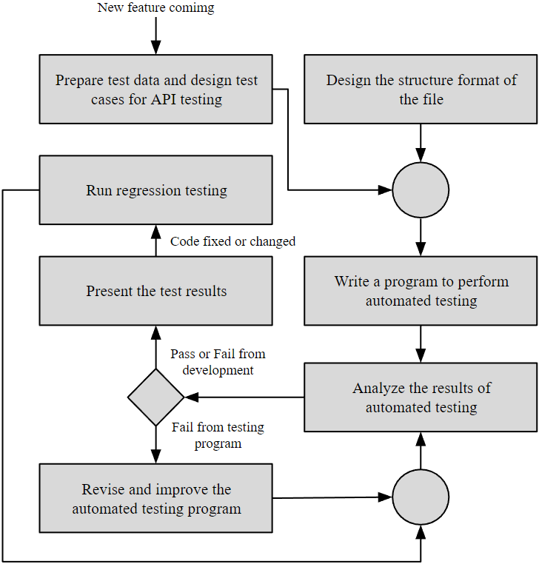
Fig. 2. Steps of the Automated Testing Process
Notes:
The process of initiating the development of an automated testing program using the Karate Framework for API testing in the Online Assessment Web Application was divided into seven steps, as shown in Fig 2. The case study process focuses exclusively on the Online Assessment Web Application. The Karate Framework was chosen because it utilizes JavaScript and Gherkin Syntax, making coding easier in a natural language. JavaScript is used to create additional functions for testing. The framework also provides a parallel testing feature that allows adjusting thread parameters, enabling efficient test execution without requiring additional libraries. This feature facilitates easier testing.

Slide 9
Design the structure format of the file
Structure Format File
- testcases - {test suite name} - .feature files | - resources - common_configs - .json files - testdata - {env} - {test suite name} - .json files | - hooks - .feature files
TABLE I. STRUCTURE FORMAT FILE OF KARATE FRAMEWORK
Notes:
The design of the file structure for testing is aimed at making it easy to manage and modify, and easy to understand the structure. When delivered to others for maintenance and management, they can immediately continue to write programs, as shown in Table I.

Slide 10
Prepare test data and design test cases for API testing
Define the format of test case id to enable the tracking of test cases in automated testing program and utilize them to specify test cases in the test result report.
Test Case ID | First | Middle | Last
TC_BE_XXXXX | Test Cases | Backend | Running number of test cases
TABLE II. FORMAT OF TEST CASES ID

Slide 11
Prepare test data and design test cases for API testing
Define the format of test case documents columns to ensure that the information provided is appropriate, complete, and easily understandable for reading.
Columns Name
Feature | Test Step (Gherkin)
Sub Feature | Expected Result
Test Case No. | Priority
Test Case Name | Test Type
Test Objective | Automation Status
Test Data | Result
TABLE III. FORMAT OF TEST CASES DOCUMENTS COLUMNS
Notes:
After defining the test case format, test case design can begin by selecting features with documentation that can be used to design test cases. Gherkin syntax is used in the Test Step, making it easy to understand and can be immediately used for programming. Also, prepare the test data for each test case.

Slide 12
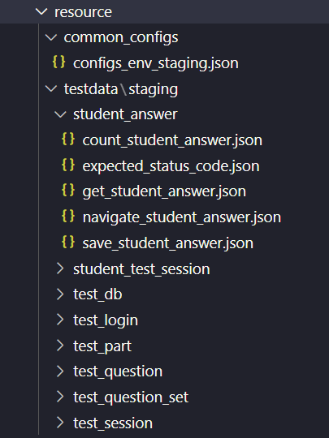
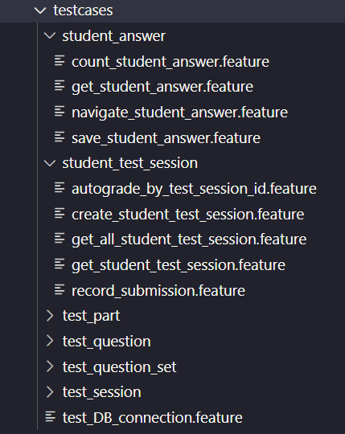
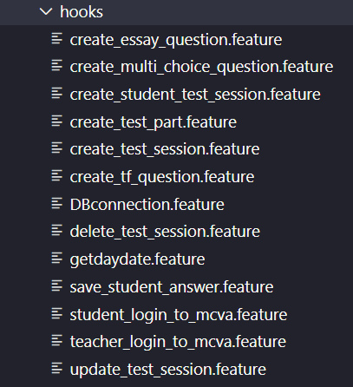
Write a program to perform automated testing
Start by writing programs by first storing the test data for each test case in the "resources" folder and writing the program for each test case using Gherkin syntax in the "testcases" folder. The "hooks" and "keywords" will be used to store the main centralized programs for the operation
Notes:
The next step is

Slide 13
Analyze the results of automated testing
Analyzing test results if it fails and investigating for errors. The details of the errors can be seen in the HTML file format of the test result report. Evaluate the time taken for testing to determine if it is appropriate or not, and it should not exceed thirty minutes per test operation.
Notes:
after that The next step is

Slide 14
Revise and improve the automated testing program
If a problem is caused by errors in the automated testing program, then we revise and improve the point of failure of the automated testing program from the test report. We verify with the document specification to make sure that it is not an error from the development feature and start testing again.

Slide 15
Present the test results
After the test results pass every test case, the framework displays the test results as a quality assurance report to the owner of the Online Assessment Web Application as a guarantee of the accuracy of the results. With Cucumber report, the quality assurance report format depends on the tester to design the report to ensure quality. Alternatively, a test result report in HTML format can be used.

Slide 16
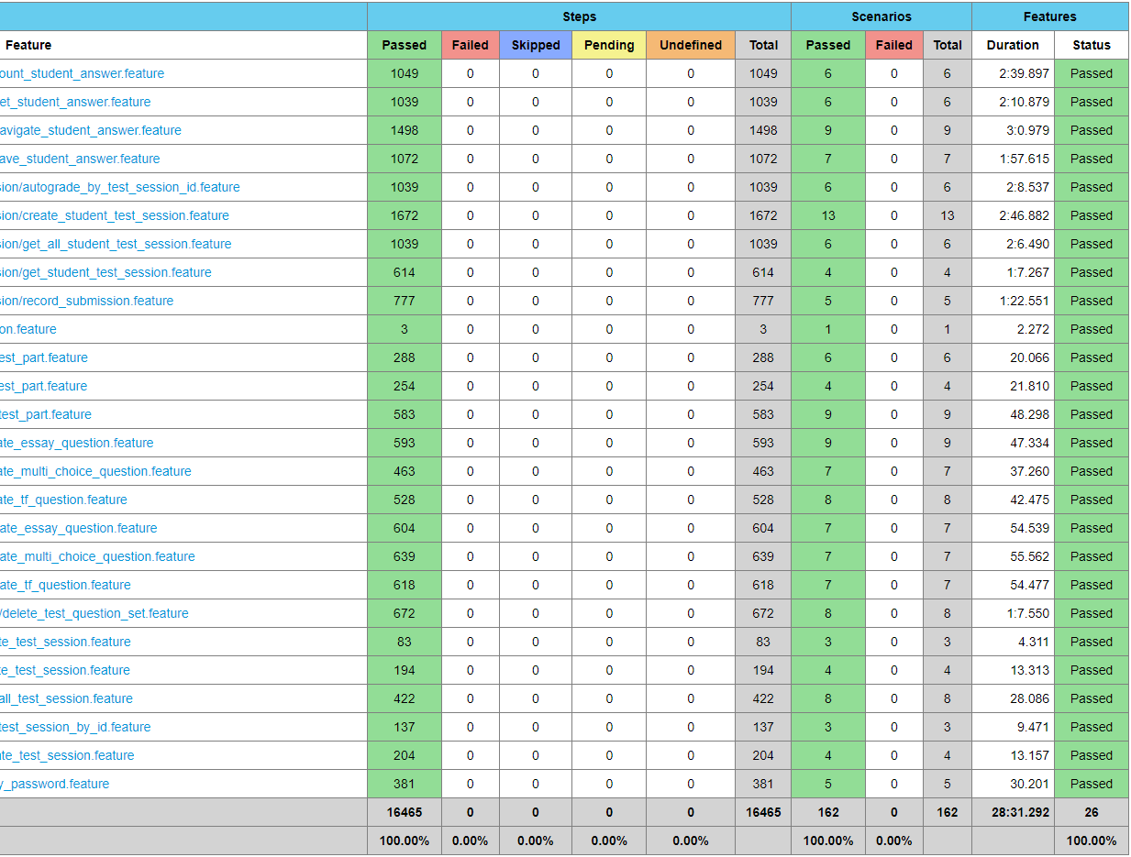
Fig. 4. Cucumber test result report in HTML format

Slide 17
Run regression test
When an error is fixed, or the code is changed, we must run a regression test to test features with automated testing again. The tester can choose to test all features or only specific features that are fixed or changed to ensure the API is working correctly.
Retest
All
Regression Test
Selection
Prioritization
of Test Cases

Slide 18
Results and Discussion
Notes:
Let’s talk about results and discussion of this case study

Slide 19
Test cases of API testing
Test case documents that contain complete information can be easily traced back during testing when using the formats specified in Table II and III. This results in comprehensive test cases that can be grouped based on their priorities and tagged in the automated testing program and can be separated into test suites by selecting with main feature of the Online Assessment Web Application.

Slide 20
Test cases of API testing
Test suite name | Number of teat cases
Exam Session | 27
Exam Question | 53
Exam Part | 19
Student Exam Session | 34
Student Answer | 28
All test cases | 161
TABLE IV. TEST SUITES

Slide 21
Automated testing program
162
Test Cases
161 + 1
161 case is ( Test feature case )
1 case is ( Test database connection case )
Notes:
This case study uses the Karate Framework as a tool for automated testing of the Online Assessment Web Application's API in the development process, with a total of 162 test cases, consisting of 161 feature cases and 1 database connection case

Slide 22
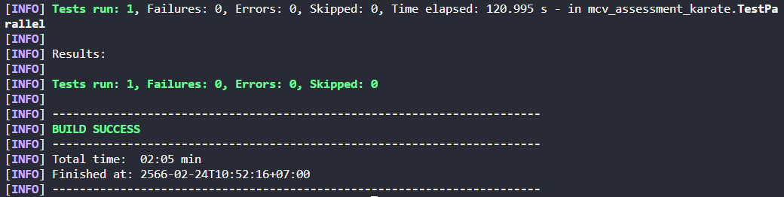
Fig. 5. Console log after running test
Notes:
The result of the console log after running the test in parallel 5 threads and have testing time around 2 minute

Slide 23
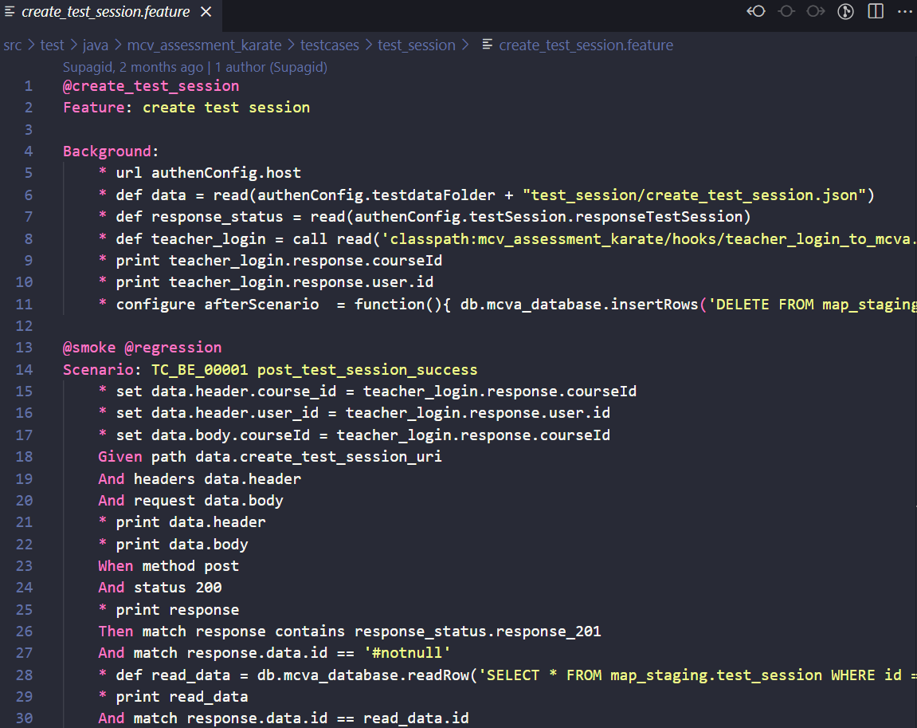
Fig. 6. Feature file of test cases for create test session
Notes:
the feature file of testcases is show in Fig 6 Online Assessment Web Application’s API was tested by an automated testing program for every change of API in the development process and before deploying a project to production to guarantee quality.

Slide 24
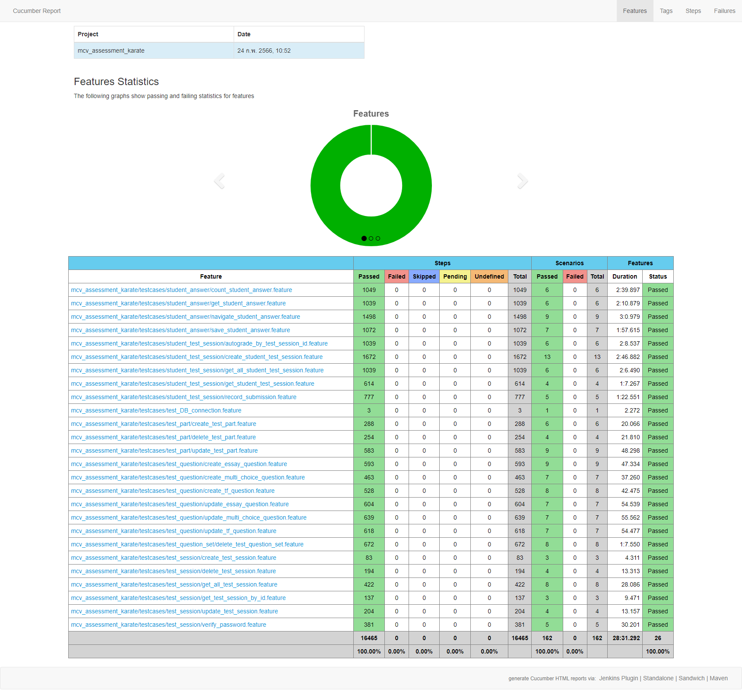
Notes:
After running test this is a result report of automated testing program from cucumber. Can use as report to guarantee quality of an online assessment web application

Slide 26
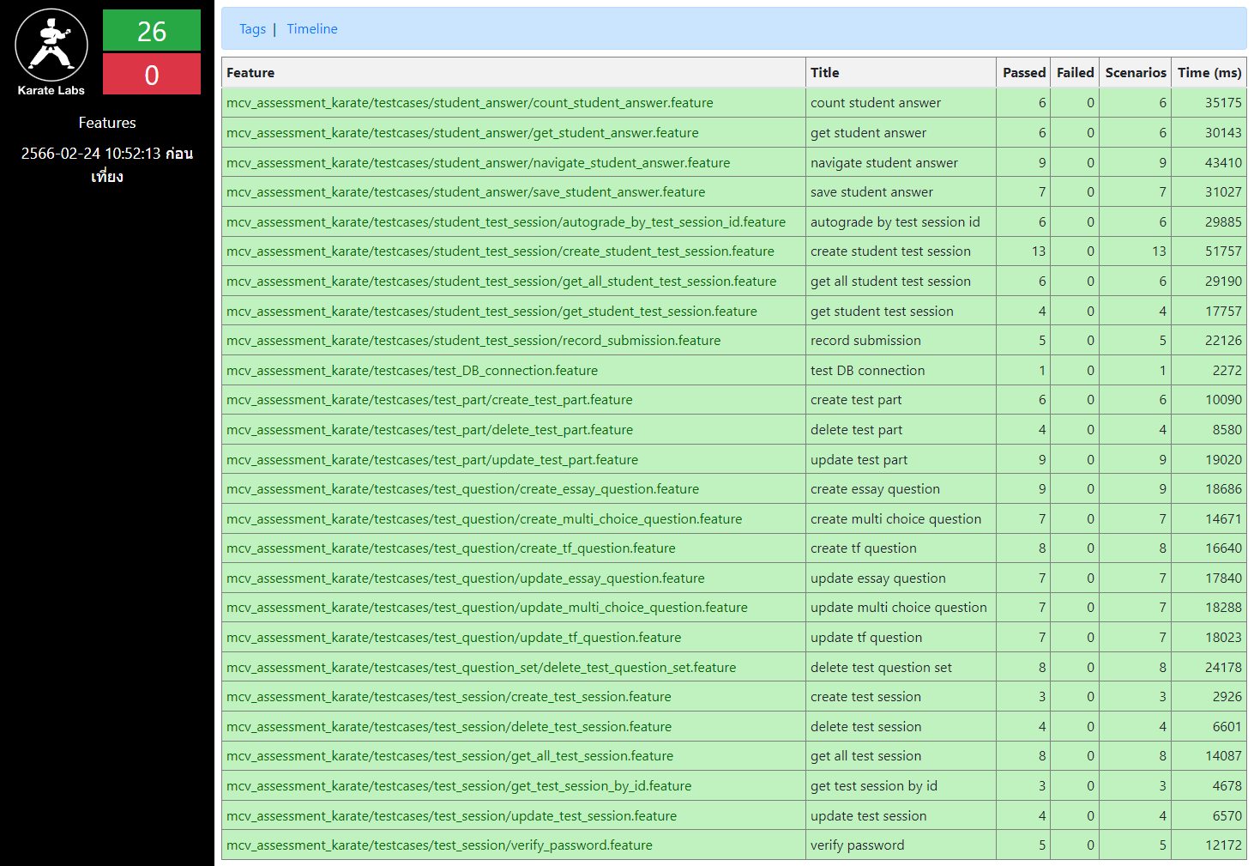
Notes:
this is a result ordinary report of automated testing program from karate framework.

Slide 28
Test result report and quality assurance report
Parallel thread | Duration result
1 | 529.138 s
2 | 270.033 s
3 | 198.173 s
4 | 152.649 s
5 | 120.995 s
TABLE V. TEST DURATION RESULT WITH PARALLEL THREAD
Notes:
The duration of the test results shows that if using more parallel threads, testing time can be reduced further.

Slide 29
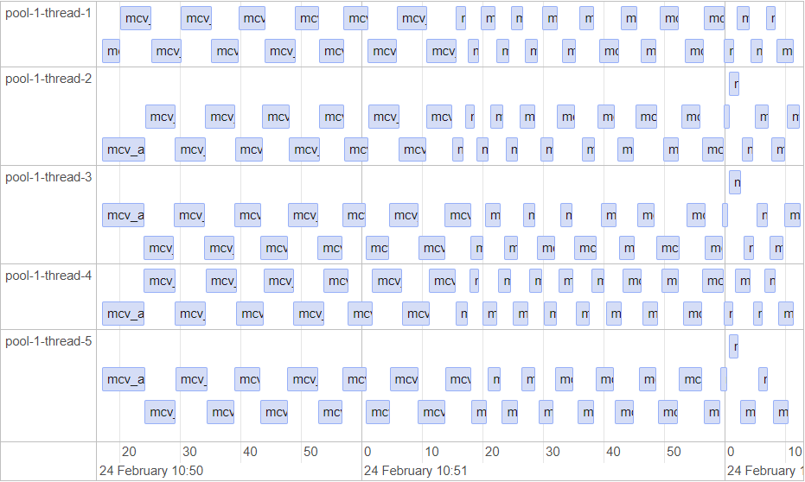
Fig. 7. Parallel threads in the ordinary report of Karate Framework
Notes:
The result ordinary report from karate framework can displays timeline of the test execution with 5 parallel threads

Slide 30
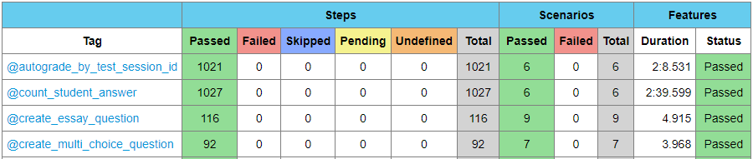
Test result report and quality assurance report
Fig. 8. Tag of specific for each test case from cucumber report
Notes:
We use the Cucumber test result report in HTML format as a quality assurance report to present to the owner of the online assessment web application. The cucumber report is complete with information about test feature file tested and the count of test steps in every tag that we group test case by tag.

Slide 31
Repeatability
Automated testing programs can repeatedly test each test case with the same expectations, and the test results will not change from the previous test unless the API's programming has been altered by the developer. The effectiveness of automated testing depends on the test data and testing environment, and it is important for the tester to prepare the necessary resources before testing. Resources are a crucial factor that testers need to focus on when performing parallel thread testing. Another crucial factor is the testing strategy. It is important for testers to plan their test steps for each test case in a way that ensures complete separation from other tests. This is especially critical when running testing with more than 2 parallel threads. After running a test, all data in the system must be cleared to ensure readiness for the next round of testing.
Notes:
Automated testing programs can repeatedly test each test case with the same expectations, and the test results will not change from the previous test unless the API's programming has been altered by the developer. The effectiveness of automated testing depends on the test data and testing environment, and it is important for the tester to prepare the necessary resources before testing. Resources are a crucial factor that testers need to focus on when performing parallel thread testing. Another crucial factor is the testing strategy. It is important for testers to plan their test steps for each test case in a way that ensures complete separation from other tests. This is especially critical when running testing with more than 2 parallel threads. After running a test, all data in the system must be cleared to ensure readiness for the next round of testing.

Slide 32
Comparison with other framework
The Karate Framework was used to conduct testing with parallel threads. To compare its duration results, the Robot Framework, ordinary supporting only a single thread and very popular for creating the automated testing program was chosen, and 22 test cases were randomly selected for comparison.
Notes:
We random 22 test case for comparison between karate framework and robot framework

Slide 33
Comparison with other framework
Testing tools | Running type | Duration result
Karate Framework | 5 parallel threads (ordinary) | 17 s
Robot Framework | 2 parallel threads (added library) | 35 s
Robot Framework | single thread (ordinary) | 59 s
TABLE VI. COMPARISON OF PARALLEL AND SINGLE THREAD
Notes:
the results of the comparison clearly show that Karate’s 5 parallel threads are faster than a Robot’s single thread. However, Robot Framework can install a library that can help Robot Framework to run in 2 parallel threads. The tester selects an option with the language base of the Framework or abilities to adjust the Framework. Using parallel threads for testing requires more programming constraints to ensure that each test case runs separately and consistently.

Slide 34
Conclusions

Slide 35
CONCLUSIONS
This case study utilizes the Karate Framework as an automated testing tool for the Online Assessment Web Application's API in the development process. By conducting 162 test cases with 5 parallel threads, the testing duration resulted in 120.995 seconds (approximately 2 minutes)
It reduces the testing time per iteration as compared to manual testing, which can save several hours per test. This can facilitate faster development processes, to ensure the quality of the API in every single change and the quality assurance report can be used to ensure the quality of the online assessment system and determine whether it is ready for use.

Slide 36
CONCLUSIONS
Due to the Online Assessment Web Application's API which operates in a highly sequential, conducting parallel testing requires significant preparation and separation of test data to avoid excessive interrelatedness between test cases. This is necessary to prevent errors from occurring during parallel testing. Therefore, the programmer of the automated testing program must have a deep understanding of the system's operation principles and programming constraints to avoid overlapping test cases during testing.

Slide 37
REFERENCES
[1] Amazon Web Services, Inc. (2023). What is RESTful API? [Online]. Available: https://aws.amazon.com/th/what-is/restful-api
[2] MDN. (2023, April. 11). An overview of HTTP [Online]. Available: https://developer.mozilla.org/en-US/docs/Web/HTTP/Over
view
[3] MDN. (2023, April. 11). HTTP request methods [Online]. Available: https://developer.mozilla.org/en-US/docs/Web/HTTP/M
ethods
[4] Karate Labs Inc. (2022). Karate framework product open-source [Online]. Available: https://www.karatelabs.io/open-source
[5] SmartBear Software. (2019). Gherkin reference [Online]. Available: https://cucumber.io/docs/gherkin/reference
[6] M. H. Alkawaz and A. Silvarajoo, "A survey on test case prioritization and optimization techniques in software regression testing," in 2019 IEEE 7th Conference on Systems, Process and Control, IEEE, Melake, Malaysia, 2019,
[7] Y. Wang, “Test automation maturity assessment,” in 2018 IEEE 11th International Conference on Software Testing, Verification and Validation, Sweden, 2018,
[8] K. R. Halani, Kavita and R. Saxena, “Critical analysis of manual Versus automation testing,” in 2021 International Conference on Computational Performance Evaluation, Shillong, India, 2021,
[9] Isha, A. Sharma and M. Revathi, “Automated API testing,” in 2018 3rd International Conference on Inventive Computation Technologies, Coimbatore, India, 2018,
[10] Robot Framework Foundation. (2023). Robot framework [Online]. Available: https://robotframework.org
[11] N. Govil and A. Sharma, “A game plan to build optimized regression testing in agile methodologies using test prioritization,” in 2021 5th International Conference on Information Systems and Computer Networks, Mathura, India, 2021,
[12] F. A. K. P. G. Sutapa, S. Kusumawardani and A. E. Permanasari, “Automated test suite for regression testing based on serenity framework: a case study,” in 2019 International Conference of Artificial Intelligence and Information Technology, Yogyakarta, Indonesia, 2019,
[13] X. Liu and P. Wei, “Test cases selection method of rapid regression testing,” in 2022 IEEE 10th Joint International Information Technology and Artificial Intelligence Conference, Chongqing, China, 2022,
[14] S. Pillai, K. Iijima, M. O'Neill, J. Santoro, P. Dumas and A. Jain. (2022, Nov. 14). Magic quadrant for full life cycle API management [Online]. Available: https://www.gartner.com/doc/reprints?id=1-2BPRE624&ct=221115&st=sb&fbclid=IwAR2
MsjWIG3TCFtvUoP4dC6bhyFMAjJJFyW5w_7BnRDZDEioek-t3d_bAKZo

Slide 38
THANK YOU
QUESTION & ANSWER

