Slide 1






Enhanced Bluetooth with
Low-Density Parity-Check Codes
Pawarit Manakul
Usana Tuntoolavest
La-or Kovavisaruch
Kazuhiko Fukawa
Department of Electrical Engineering
Kasetsart University
The 20th International Joint Conference on Computer Science and Software Engineering
28th June-1st July 2023
Naresuan University Phitsanulok, THAILAND

Slide 2
Outline
Background
  Bluetooth low energy specification
  Low-density parity-check (LDPC) code
  Gaussian frequency-shift keying (GFSK) signal model
  Viterbi demodulator
Proposed method
  Modified Soft-Viterbi demodulator
  Bluetooth LDPC
Simulation setup
Results
Discussions
Conclusions

Slide 3
Background
Bluetooth low energy (BLE) coded PHY
  Use forward error correction in BLE
  Provide more reliable communication
  Adding redundancy bits
LDPC code
  Widely used in Wi-Fi, WiMAX and 3GPP
  Near Shannon limit
Proposed method: Bluetooth LDPC
  Provide better performance
  Lower redundancy bits
  Shorter decoding time

Slide 4
Bluetooth Low Energy
BLE
  Lower energy consumption
  Error detection: Cyclic redundancy check (CRC)
    Access address is incorrect
    There are some errors in the payload
    Good transmission requirement: bit error rate is equal to 0.1% or lower
PHY mode: physical layer configurations
  BLE 2M PHY: 2 mega-symbols per second
    Increase data rate
  BLE coded PHY: concatenated coding
    Extend the communication range (more reliable communication)
    Without increasing transmission power
    Packet is dropped

Slide 5
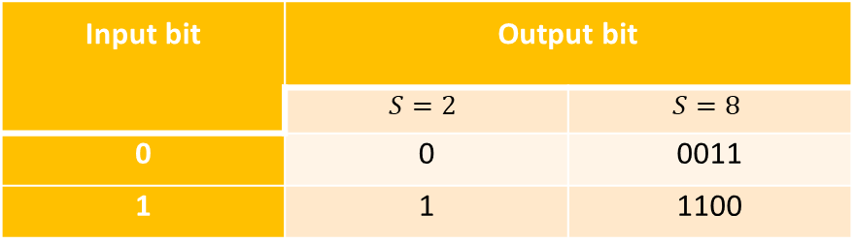
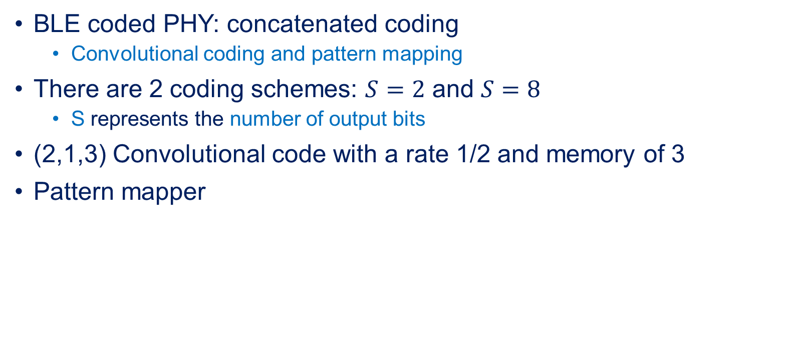
BLE coded PHY
BLE coded PHY: concatenated coding
  Convolutional coding and pattern mapping
There are 2 coding schemes: $S=2$ and $S=8$
  S represents the number of output bits
(2,1,3) Convolutional code with a rate 1/2 and memory of 3
Pattern mapper
Input bit | Output bit
 | $$S=2$$ | $$S=8$$
0 | 0 | 0011
1 | 1 | 1100

Slide 6
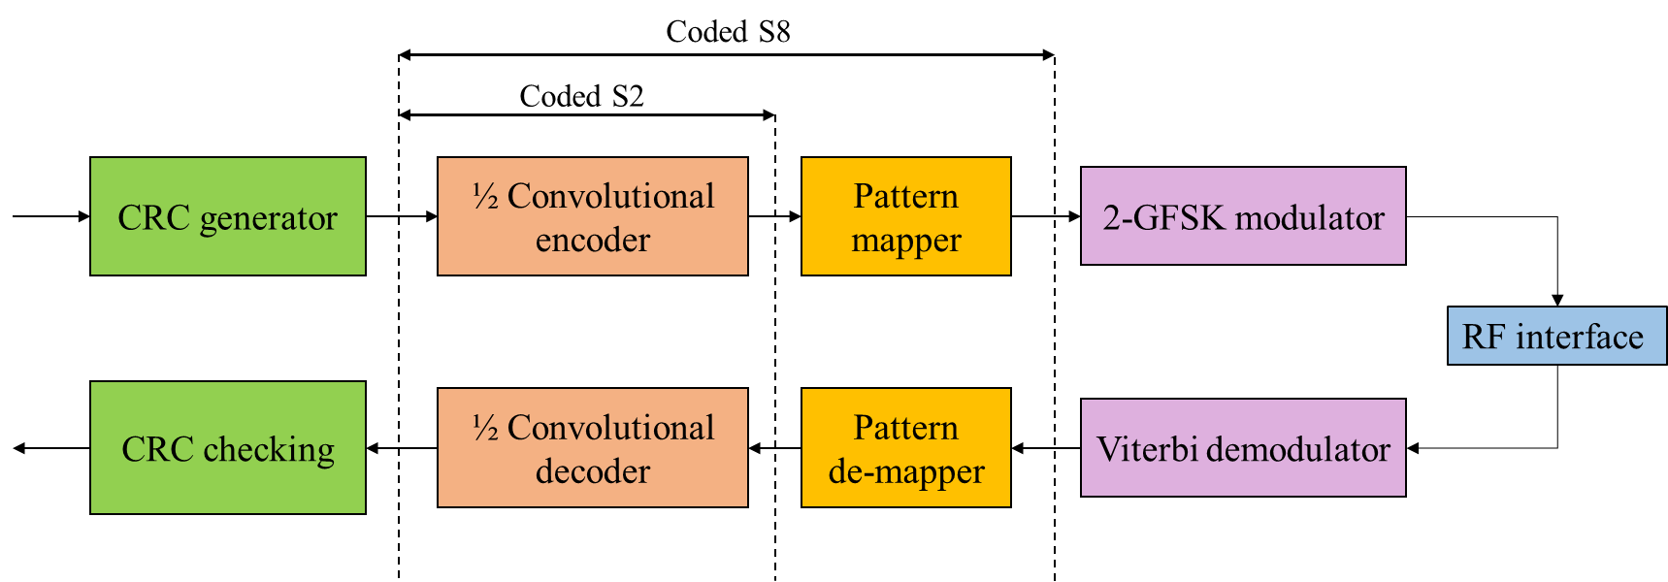
BLE coded PHY Block diagram
Error detection part
Forward error correction part
Modulation part

Slide 7
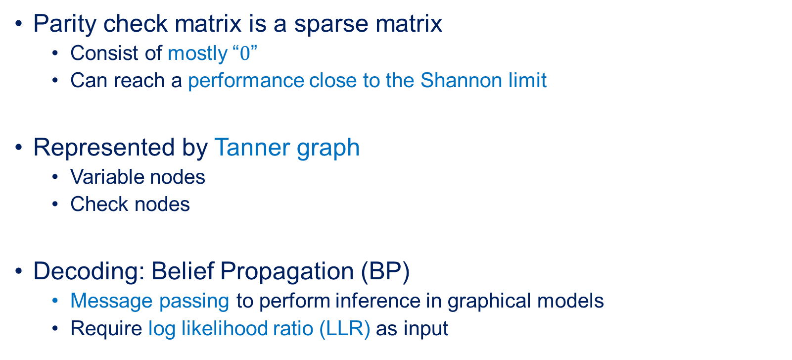
LDPC code
Parity check matrix is a sparse matrix
  Consist of mostly “$0$”
  Can reach a performance close to the Shannon limit
Represented by Tanner graph
  Variable nodes
  Check nodes
Decoding: Belief Propagation (BP)
  Message passing to perform inference in graphical models
  Require log likelihood ratio (LLR) as input

Slide 8
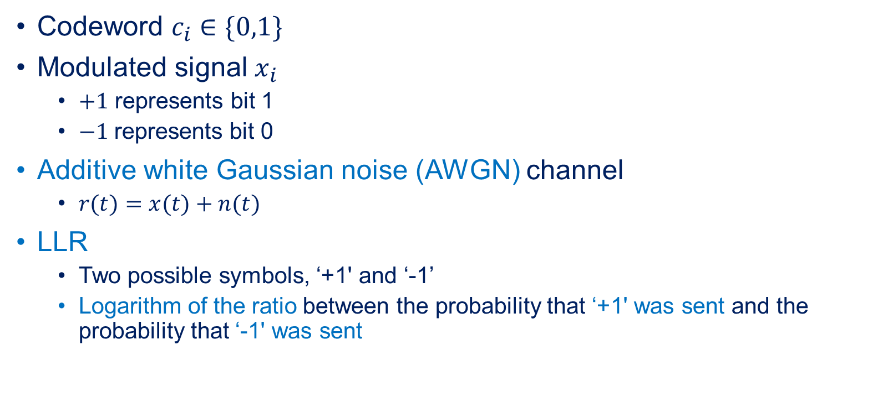
LLR
Codeword $c_{i}∈\{0,1\}$
Modulated signal $x_{i}$
  $+1$ represents bit 1
  $−1$represents bit 0
Additive white Gaussian noise (AWGN) channel
  $r(t)=x(t)+n(t)$
LLR
  Two possible symbols, ‘+1' and ‘-1’
  Logarithm of the ratio between the probability that ‘+1' was sent and the probability that ‘-1' was sent

Slide 9
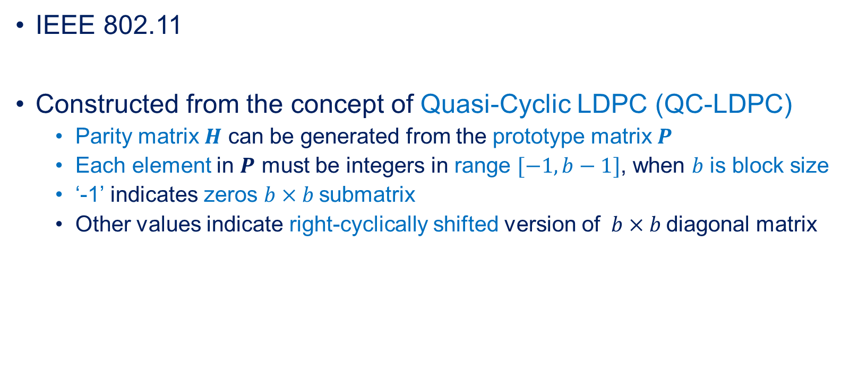
High Throughput LDPC code
IEEE 802.11
Constructed from the concept of Quasi-Cyclic LDPC (QC-LDPC)
  Parity matrix $H$ can be generated from the prototype matrix $P$
  Each element in $P$ must be integers in range $[−1,b−1]$, when $b$ is block size
  ‘-1’ indicates zeros $b×b$submatrix
  Other values indicate right-cyclically shifted version of $b×b$diagonal matrix

Slide 10
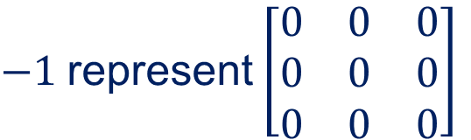

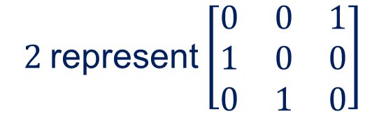
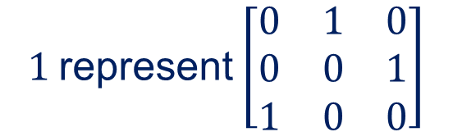
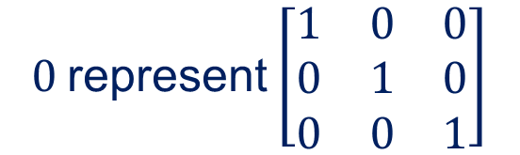
Example: QC-LDPC code
If block size $b=3$
Element in $P$ must be integers in range $[−1, 2]$ to represent $3×3$ submatrices
$−1$ represent $\left[\begin{matrix}0 & 0 & 0 \\ 0 & 0 & 0 \\ 0 & 0 & 0\end{matrix}\right]$
$0$ represent $\left[\begin{matrix}1 & 0 & 0 \\ 0 & 1 & 0 \\ 0 & 0 & 1\end{matrix}\right]$
$1$ represent $\left[\begin{matrix}0 & 1 & 0 \\ 0 & 0 & 1 \\ 1 & 0 & 0\end{matrix}\right]$
$2$ represent $\left[\begin{matrix}0 & 0 & 1 \\ 1 & 0 & 0 \\ 0 & 1 & 0\end{matrix}\right]$

Slide 11
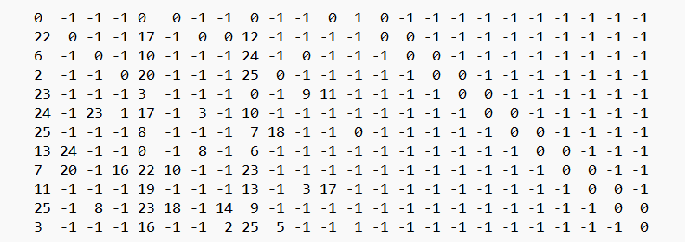
High throughput LDPC code
Prototype matrix of High throughput LDPC code with rate $\frac{1}{2}$

Slide 12
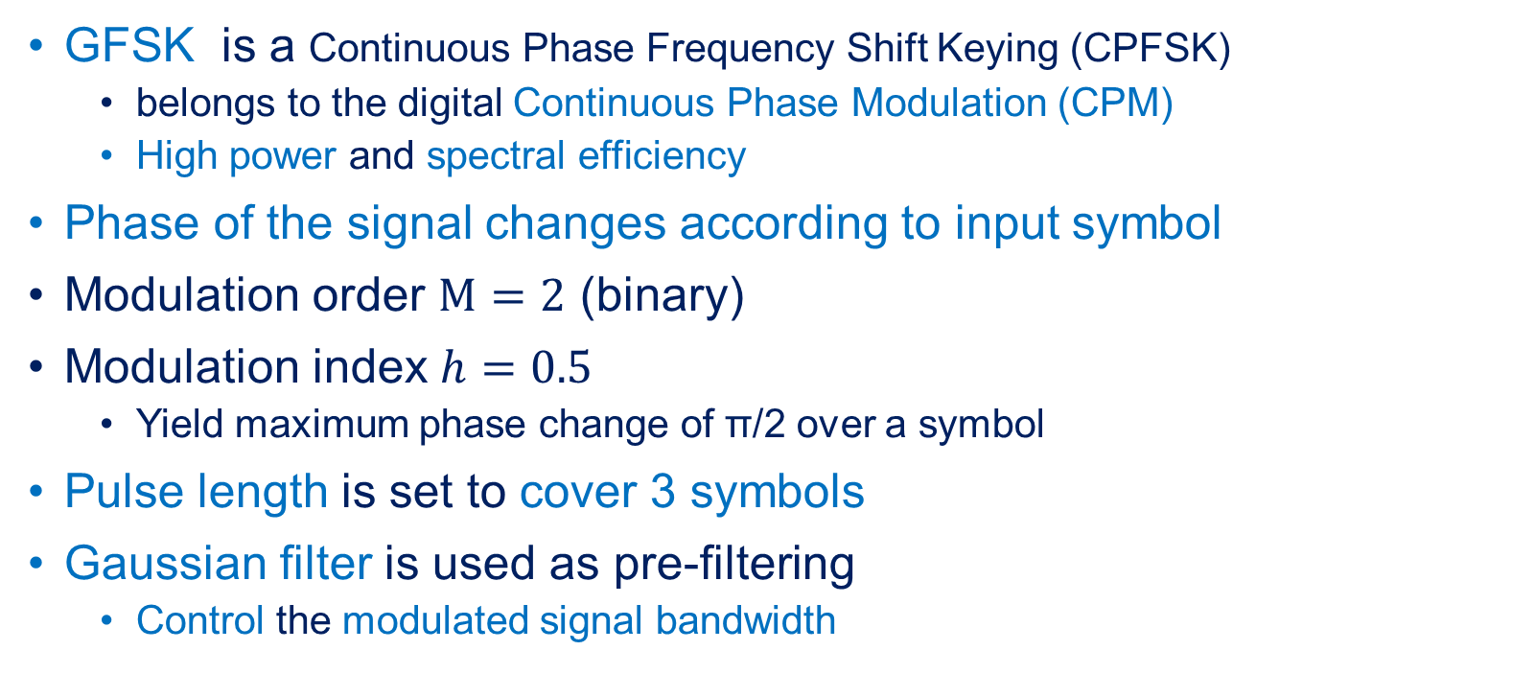
GFSK signal model
GFSK is a Continuous Phase Frequency Shift Keying (CPFSK)
  belongs to the digital Continuous Phase Modulation (CPM)
  High power and spectral efficiency
Phase of the signal changes according to input symbol
Modulation order $M=2$ (binary)
Modulation index $h=0.5$
  Yield maximum phase change of π/2 over a symbol
Pulse length is set to cover 3 symbols
Gaussian filter is used as pre-filtering
  Control the modulated signal bandwidth

Slide 13
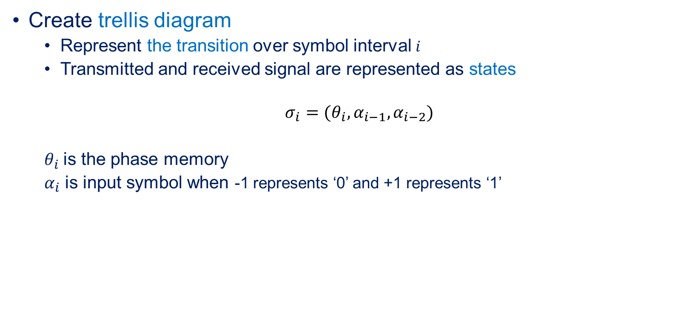
GFSK signal model
Create trellis diagram
  Represent the transition over symbol interval $i$
  Transmitted and received signal are represented as states
  $σ_{i}=(θ_{i}, α_{i−1}, α_{i−2})$
  $θ_{i}$ is the phase memory
  $α_{i}$ is input symbol when -1 represents ‘0’ and +1 represents ‘1’

Slide 14
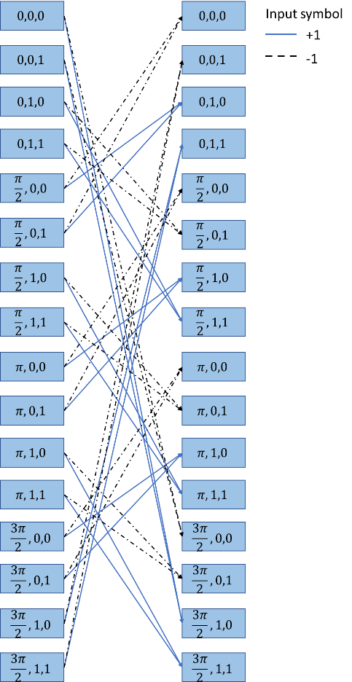
2-GFSK trellis diagram

Slide 15
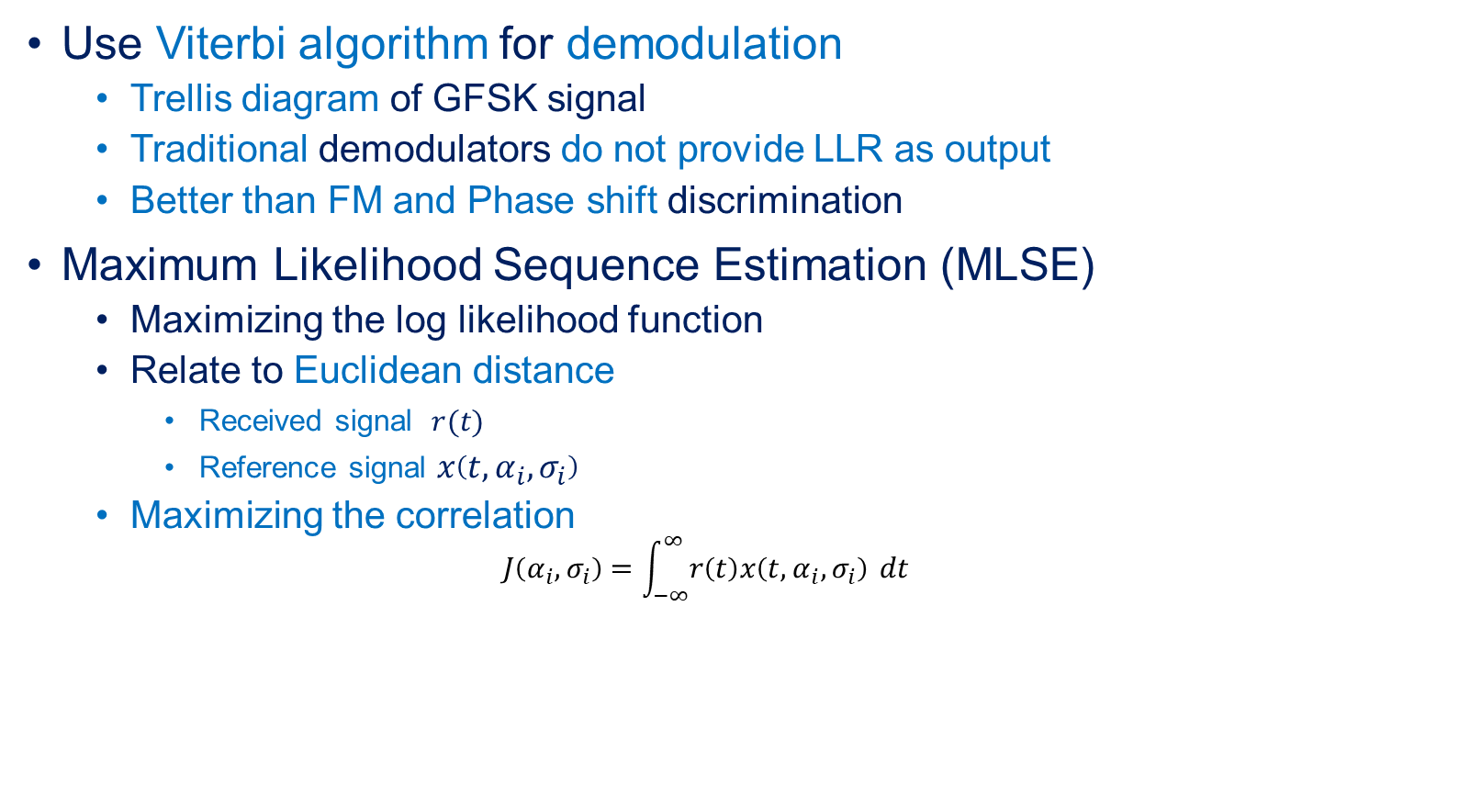
Viterbi demodulator
Use Viterbi algorithm for demodulation
  Trellis diagram of GFSK signal
  Traditional demodulators do not provide LLR as output
  Better than FM and Phase shift discrimination
Maximum Likelihood Sequence Estimation (MLSE)
  Maximizing the log likelihood function
  Relate to Euclidean distance
    Received signal $r(t)$
    Reference signal $x\left(t,α_{i}, σ_{i}\right)$
  Maximizing the correlation
  $$J\left(α_{i}, σ_{i}\right)=\int_{−∞}^{∞}{r\left(t\right)x\left(t,α_{i}, σ_{i}\right)} dt$$

Slide 16

Modified Soft-Viterbi demodulator
LLRs can be obtained during Viterbi demodulation using
  Estimated input symbols from transition input matrix
  Correlations from survival and non-survival matrix
  $$J\left(α_{i}, σ_{i}\right)=\int_{−∞}^{∞}{r\left(t\right)x\left(t,α_{i}, σ_{i}\right)} dt$$

Slide 17
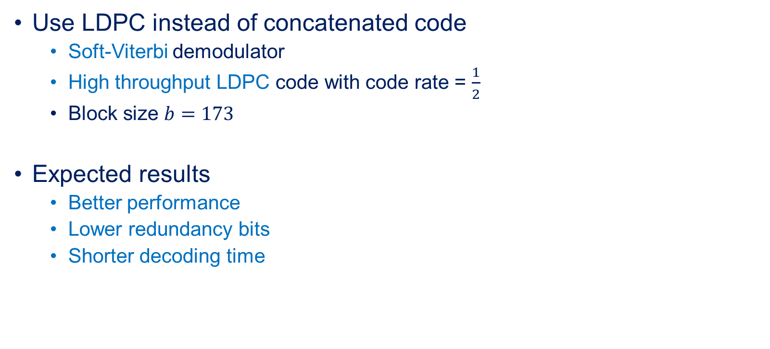
Proposed method: Bluetooth LDPC
Use LDPC instead of concatenated code
  Soft-Viterbi demodulator
  High throughput LDPC code with code rate = $\frac{1}{2}$
  Block size $b=173$
Expected results
  Better performance
  Lower redundancy bits
  Shorter decoding time

Slide 18
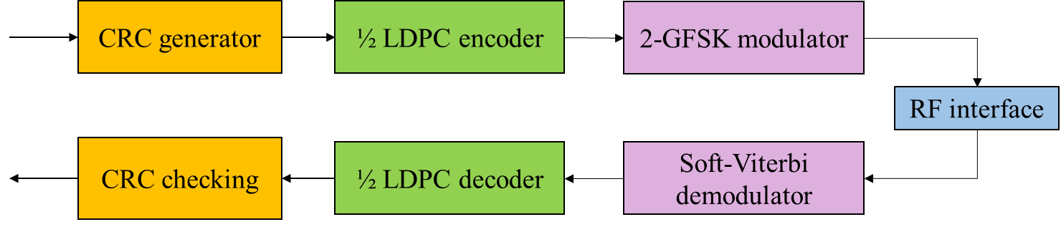
Bluetooth LDPC Block diagram
Forward error correction part

Slide 19
Simulation setup
Simulation is done using MATLAB R2022b
Compare performance of various coding schemes
  Packet error rate (PER)
  Bit error rate (BER)
  Average number of iterations
  Average decoding time
AWGN channel
Message sequence
  Probability of each bit is equally likely

Slide 20
Simulation parameters
Parameter | Values
Modulation type | GFSK
Modulation order | 2
Modulation index | 0.5
SNR range | [1:12]
Channel model | AWGN
Message length (bits) | 2052
Pulse shaping length (symbols) | 3
Traceback depth | 16
Maximum number of iterations | 200

Slide 21
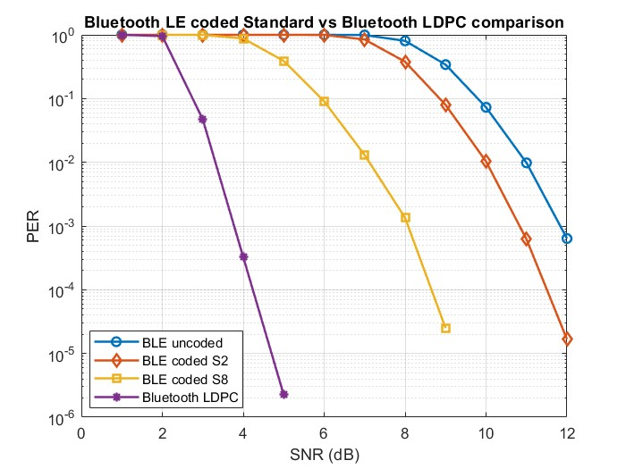

Results
PER of Bluetooth LDPC = 0.047
PER of BLE coded S8 = 0.9995
PER of Bluetooth LDPC $= 3.25×{10}^{−4}$
PER of BLE coded S8 $= 0.877$
2nd best
Best case
Worst case
PER Comparison of Bluetooth LDPC and BLE coded standard

Slide 22
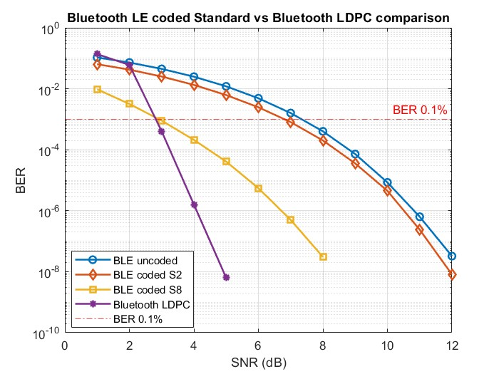
Results
Best case
Worst case
2nd best
BER Comparison of Bluetooth LDPC and BLE coded standard

Slide 23
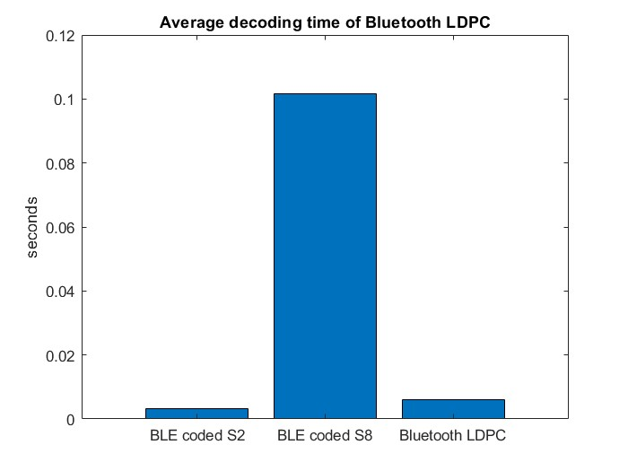
Results
0.102 seconds
17 times faster
0.003 seconds
0.006 seconds
Average decoding time of each coding scheme

Slide 24
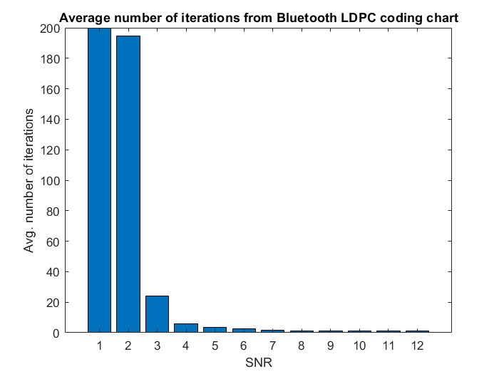
Results
Bluetooth LDPC average number of iterations

Slide 25
Discussions
Performance
  Bluetooth LDPC is better than both BLE coded schemes when SNR ≥ 3 dB
Good transmission
  Bluetooth LDPC: at SNR ≥ 3 dB
  BLE uncoded: at SNR ≥ 8 dB (channel coding is unnecessary)
Average decoding time
  Bluetooth LDPC is 16.954 times faster than BLE coded S8

Slide 26
Discussions
Redundancy bits
  Bluetooth LDPC is equal to 2,100 bits
  6.9314 times lower than 14,556 bits that BLE coded S8 required
Average number of iterations
  SNR increases
  The complexity of Bluetooth LDPC decoding rapidly decreases
Maximum number of iterations can be set
  Suit the channel’s SNR
  Reduce the time consumption and the number of unnecessary iterations

Slide 27
Conclusion
The proposed Bluetooth LDPC
  Better performance than other BLE coded schemes
  at SNR equal to 3 dB or higher
  Lower complexity
  Fewer redundancy bits compared to BLE coded S8
Bluetooth LDPC can be a good alternative for future Bluetooth
  fast and reliable transmission of long packets

Slide 28
THANK YOU
QUESTION & ANSWER

Slide 29
Bluetooth specification
2.4 GHz Industrial-Scientific-Medical (ISM) band
  Bluetooth
  Wi-Fi
  Cordless telephones
Frequency hopping spread spectrum (FHSS)
  Mitigate interferences
Transmission rate = 1 Mbps
Modulation
  Binary Gaussian frequency-shift keying(mandatory mode)
  π/4-Differential Quadrature phase-shift keying (enhanced data rate mode)

Slide 30

Example of Viterbi demodulation in MATLAB
Tempsum = $r∙state ref$
0.05
0.03
0.01
-1e7
-1e7
-1e7
0
-1e7
-1e7
-1e7
-1e7
-1e7
-1e7
-1e7
-1e7
-1e7
-1e7
-1e7
-1e7
-1e7
-1e7
-1e7
-1e7
-1e7
-1e7
-1e7
-1e7
-1e7
-1e7
-1e7
-1e7
-1e7
-1e7
-1e7
-1e7
-1e7
-1e7
-1e7
-1e7
-1e7
-1e7
-1e7
-1e7
-1e7
-1e7
-1e7
-1e7
-1e7
-1e7
-1e7
-1e7
+1
-1
0.01
Survival matrix will record
  the current state that
  gives the highest value
0
0.05
0.01
0
Transition input matrix will record
  The estimated input symbol
0.01
0.03
0
0.05
-0.02
0.03
0
0.05
Normalize
  Minus all value with
  max value
  If the result < -1e7
  set it to -1e7
0.03
-0.02

