Slide 1



CannabisO: The Ontology-Based Knowledge Model
for Safe Cannabis Consumption in Thailand
Pranpreya Samasutthi
Asian Institute of Technology, Thailand
The 20th International Joint Conference on Computer Science and Software Engineering
28th June-1st July 2023
Naresuan University Phitsanulok, THAILAND

Slide 2
TABLE OF CONTENTS
Introduction, Statement of problems, and Objectives
Related works
Methodology
Development (Class hierarchy, Properties, Individual)
Validation
Limitation & Future work
Conclusion

Slide 3
Introduction
In 2022, the Ministry of Public Health of Thailand has announced that, cannabis is no longer considered a narcotic.
This announcement permits Thai citizen to use cannabis in healthcare, medical, research and commercial.
However, entertainment usage is still and importing and exporting cannabis are also still controlled.

Slide 4
Statement of problems
Citizens do not know how to consume it safely without overdoses usage, side effects, the symptoms that cannabis can relive, and precautions.
Knowledge of cannabis are being widely presented on the Internet, the redundancy, inconsistency, and unreliability of the knowledge sources are major concerns.
The content is usually provided in text form on the websites or in PDF format, it is difficult to searching for specific information.

Slide 5
Objectives
Gathering knowledge about cannabis from various official and reliable sources
CannabisO ontology was designed and developed for questioning and answering
  Action of cannabis to human body
  Alleviation of symptoms
  Proper cannabis consumption
  Precautions and side effects of cannabis consumption.

Slide 6
Related work
Related Work | Summary
Drug Abuse Ontology (DAO) | DAO was developed because no existing ontology addressed these particular aspects of drug used DAO analyzed web-based and social media data in order to improve public health and drug use Focused on drug usage, slang words, drug prevention, and withdrawal symptoms.
e-cigarette ontology (E-CigO) | The number of lung problems among young people was rising Lack of a standardized to describe e-cigarettes and their components and compounds Focused on devices, components, substances, and side effect
CANNUSE | Existing database of Cannabis about medical uses, alimentary uses, fibre uses, psychoactive uses, etc. The data that provide are about taxonomy, species origin, morphological, genetic and chemical variability, and also ethnobotany, i.e. its traditional names and uses. Target groups are scientists and general public interested in different aspects of Cannabis uses

Slide 7
Methodology
Defining competency questions (CQs)
Gathering knowledge about cannabis
Developing CannabisO system

Slide 8
Competency Questions (CQs)
Purpose of CQs | List of CQs
Action & Alleviated symptoms | CQ1: What are important compounds of cannabis, which parts can be found and what do they help? CQ2: If I cannot sleep well, which cannabis menu can I take to alleviate this and is it exceeding the safe amount per day? CQ3: If I experience a loss of appetite, which cannabis menu can I have and what are the side effects that I should concern?
Consumption | CQ4: If I eat stir-fried sweet basil with cannabis as an ingredient, what are possible symptoms it can relieve, and what kind of side effects that can occur after consuming? CQ5: What is the maximum amount of cannabis that I can have per day?
Precautions & Side effects | CQ6: Who should avoid taking any food having cannabis as an ingredient? If necessary, what are the precautions I should concern? CQ7: What medical conditions prohibit the use of cannabis? CQ8: What are possible side effects that can happen when consuming cannabis?

Slide 9
Gathering knowledge about cannabis
01
Website of Thai government
Legal announcement
Regulated rules
Precautionary information
02
News websites, hospital websites, or blogs
Safe cannabis consumption
Food menus that contain cannabis as an ingredient
Information about appropriate amounts of cannabis
03
Book
Cannabis compounds
Activation in the human body
04
Published studies & research
Criteria to making decision for develop ontology
Existing ontology is concluded to study about ontology design and developing process
05
Existing published database
Parts of cannabis
Alleviation symptoms

Slide 10
Developing CannabisO system
Identifying the ontology’s domain, problem, objective,and CQs
Knowledge gathering
Defining classes, properties, and individuals
Validating the query result with CQs

Slide 11
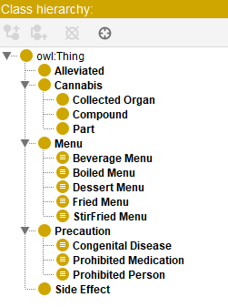
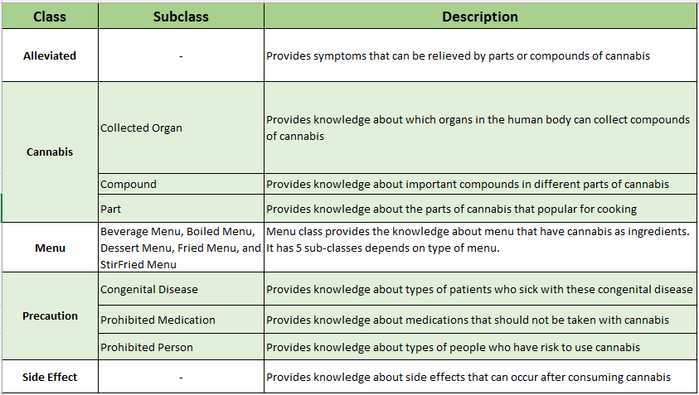
Class hierarchy

Slide 12
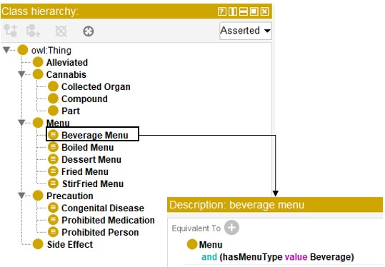
Class hierarchy - Equivalent class

Slide 13
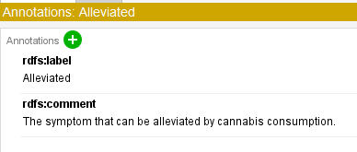
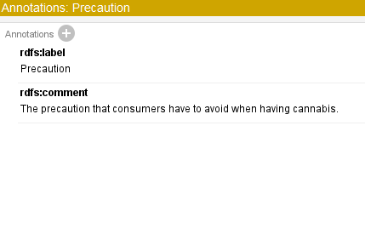
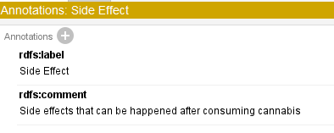
Class hierarchy - Annotations

Slide 14
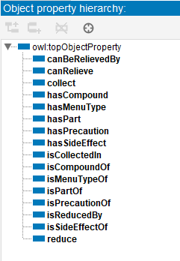
Object Property
Object Property | Domain | Range | Example
canRelieve | Compound | Alleviated | DriedLeaves canRelieve Cough
collect | Collected Organ | Compound | Blood collect THC
hasCompound | Part | Compound | DriedLeaves hasCompound THC
hasMenuType | Menu | Menu | CannabisJuice hasMenuType Beverage
hasPart | Menu | Part | PhatKaprao hasPart FreshLeaves
hasPrecaution | Precaution | Precaution | Student hasPrecaution ProhibitedPerson
hasSideEffect | Compound | Side Effect | CBD hasSideEffect SkinIrritation
reduce | Compound | Alleviated | THC reduce MusclePain

Slide 15
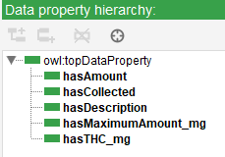
Data Property
Data Property | Description
hasAmount | Defines the relationship between each menu and the recommended amount of cannabis part for cooking.
hasCollected | Defines the relationship between each organ and the period in which the cannabis compound will be collected in the body.
hasDescription | Used to provide additional description for each individual in the ontology.
hasMaximumAmount_mg | Defines the maximum amount of compound that can be consumed per day.
hasTHC_mg | Defines the amount of THC in the menu that contains THC.

Slide 16
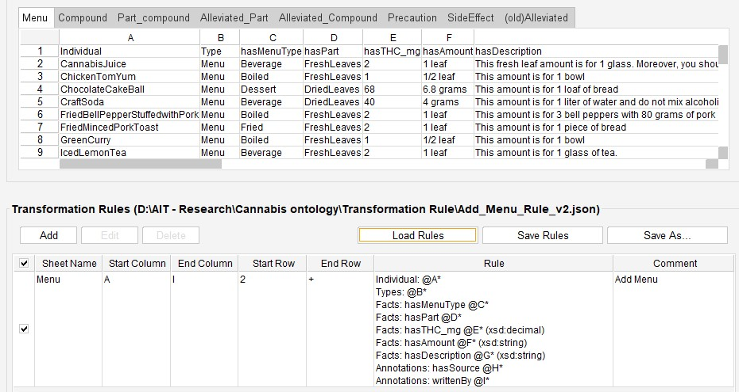
Data Property - Transformation Rule

Slide 17
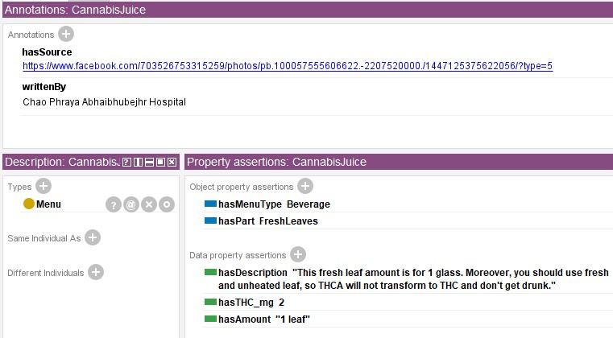
Data Property

Slide 18
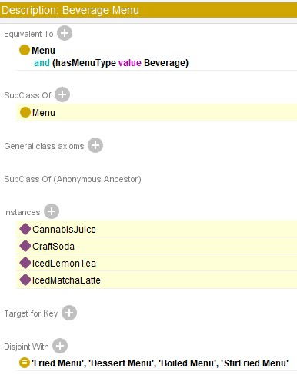
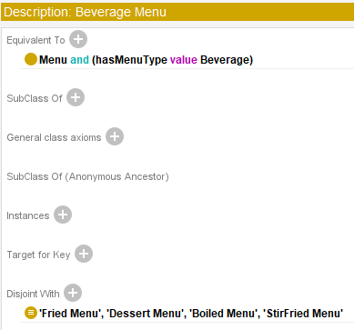
Evaluation
Reasoner

Slide 19
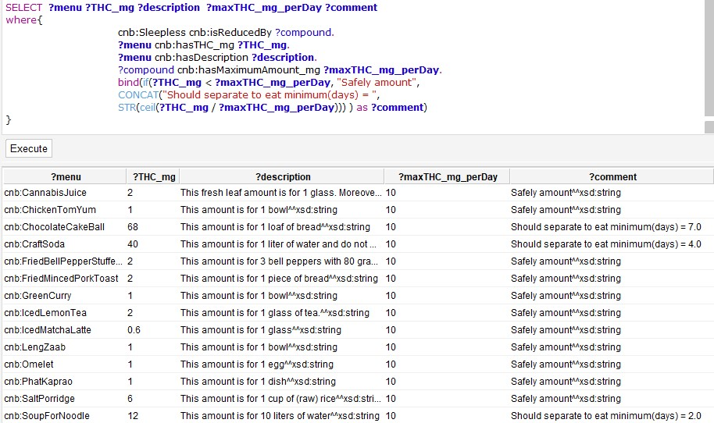
Validation
CQ2: If I cannot sleepwell, which cannabis menu can I take to alleviate this and is it exceeding the safe amount per day?

Slide 20
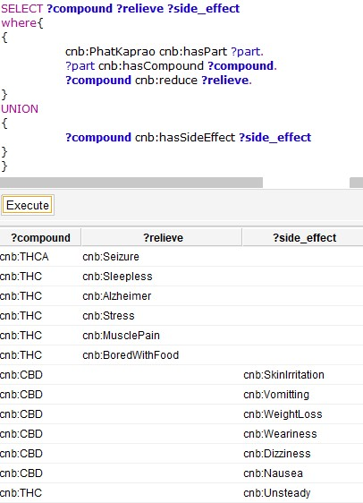
Validation
CQ4: If I eat stir-fried sweet basil with cannabis as an ingredient, what are the possible symptoms that it can relieve, and what kind of side effects can occur after consuming?

Slide 21
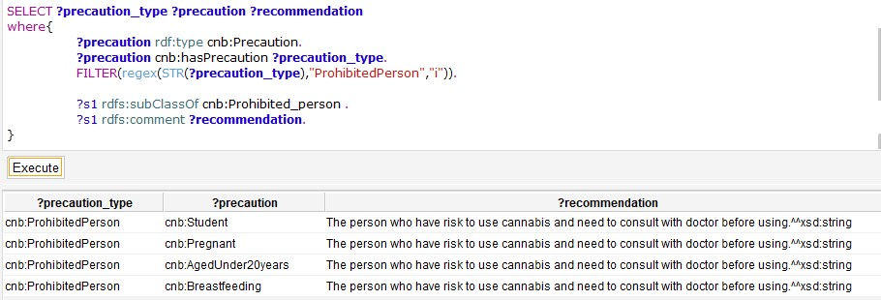
Validation
CQ6: Who should avoid taking any food having cannabis as an ingredient? If necessary, what are the precautions about which I should be concerned?

Slide 22
Limitation & Future work
Limitation | Future Work
CannabisO is focused on providing information for safe cannabis consumption for general people, it may not address the special needs of medical cannabis users. | CannabisO system could be expanded to include more specific data for medical cannabis users and professionals. This may involve the creation of more specialized ontology that accommodate the specific requirements of these user groups.
CannabisO is new designed and developed ontology without expand the existing systems. | Try to import and reuse the existing system with CannabisO to expand the knowledge-based.
Due to the limited time, the system is validated by using SPARQL only and is not reviewed by cannabis experts. Therefore, some imported data may be inaccurate. | Review the ontology by experts in the field such as doctor, pharmacist, expert in the use of cannabis.

Slide 23
CONCLUSION
CannabisO system has been developed as an ontology-based knowledge model that provides support general users to ask questions about safe cannabis consumption.
CannabisO system supports the vulnerability of the existing ontology system such as menus that use cannabis as an ingredient, the amount of cannabis used in each menu, and precautions about using cannabis
Data gathered from 5 main sources including website of government, websites or sources of hospital, book, published studies, and existing cannabis database.
Class hierarchy, object property, data property, and individuals were developed respectively.
Reasoning is conducted for inference knowledge of ontology for checking consistency
Validate each CQ by using SPARQL to query data

Slide 24
THANK YOU
QUESTION & ANSWER

