Slide 1



Studying Cardiac Electrophysiology via EPSSIM
Sujitra Katekarn¹
Noppadon Sisuk², Teonchit Nuamchit¹, Kanjana Jittiporn¹, Janjira Payakpate³
Department of Cardio-thoracic Technology, Faculty of Allied Health Sciences, Naresuan University
Program in Computer Engineering, Faculty of Industrial Technology, Phibunsongkhram Rajabhat University
Department of Computer Science and Information Technology, Faculty of Sciences, Naresuan University
The 20th International Joint Conference on Computer Science and Software Engineering
28th June-1st July 2023
Naresuan University Phitsanulok, THAILAND
Notes:
Good afternoon, ladies and gentlemen. My name is Sujitra Katekarn, and I am a master's student of Cardio-thoracic Technology at Naresuan University. Today, I am excited to present our project titled "Studying Cardiac Electrophysiology via EPSSIM."
Our study focuses on e-learning, specifically utilizing an electronic platform to enhance the understanding of cardiac electrophysiology.

Slide 2



Outline
Introduction
Overview
Methodology
Analyses and discussion
Arrhythmias
Electrocardiogram
Electrophysiology study
Fourier series
Design
Tool
Program construction
Evaluated by Experts
Testing
Notes:
The presentation was divided into four parts. The first part is the Introduction
Following that is the Overview section, we provide background information on arrhythmias, ECG, EP study, and Fourier series.
The third part is Methodology of the study.
Lastly, we have the Analysis and Discussion section

Slide 3
Introduction

Slide 4
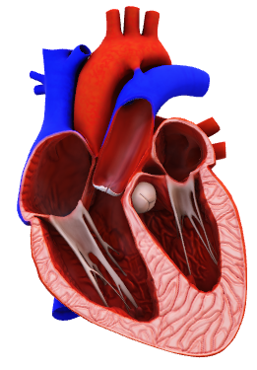
Cardio-thoracic technology
Heart diseases
Electrocardiogram (ECG)
Treatment techniques
Cardiac electrophysiology study (EP study)
Heart-related problems
Echocardiography
Procedure
Heart- lung machine control
Notes:
Cardio-thoracic technology is a specialized course that focuses on the study of heart diseases, diagnosis, and treatment techniques.
The curriculum covers areas such as ECG (Electrocardiogram), EP (Electrophysiology) study, echocardiography, and the operation of heart-lung machines.
Basically, Students in this course gain in-depth knowledge and skills related to heart health and cardiac care.

Slide 5

Cardio-thoracic technology
Electrocardiogram (ECG)
Cardio-thoracic technician
Heart diseases
Treatment techniques
Cardiac electrophysiology study (EP study)
Heart-related problems
Echocardiogram
Procedure
Heart- lung machine control
Notes:
Having completed the course, student have many job opportunities open for them to get in such as Cardio-thoracic technician or specialist.

Slide 6

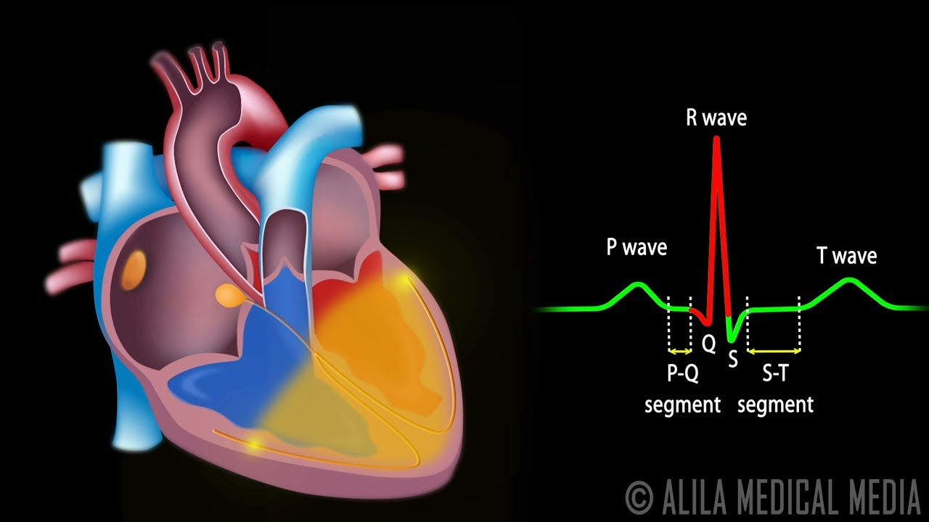
The ECG and EP study courses
Electrocardiogram (ECG)
Cardiac electrophysiology study (EP study)
Lectures
Case studies
Notes:
In this study,We focus on the problem statement related to learning ECG and EP study
This courses currently rely on a combination of lectures and case studies to teach students.

Slide 7
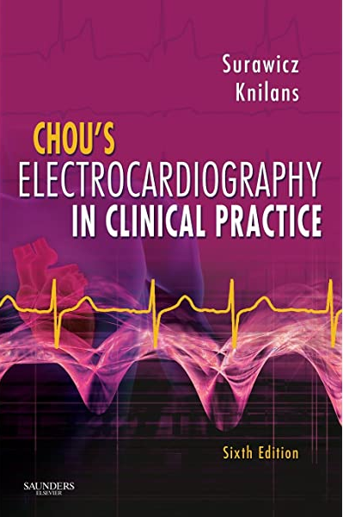
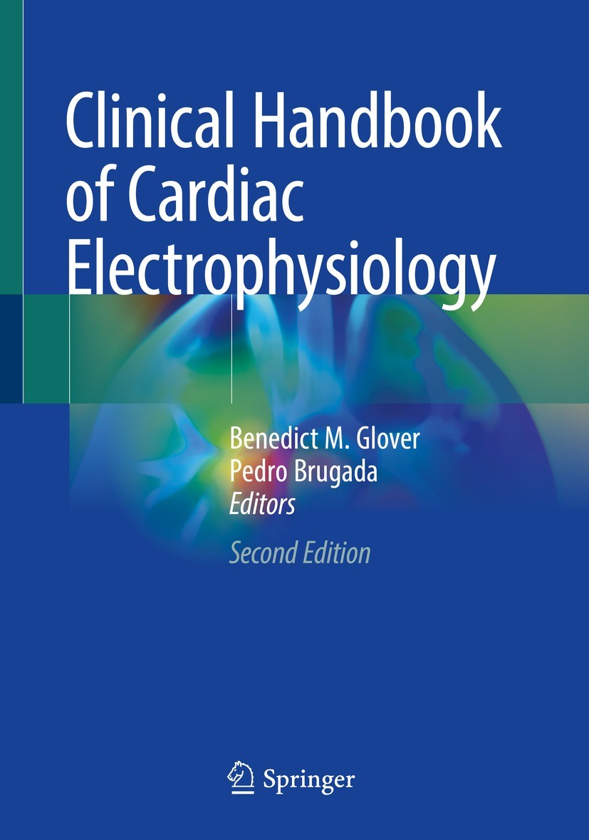

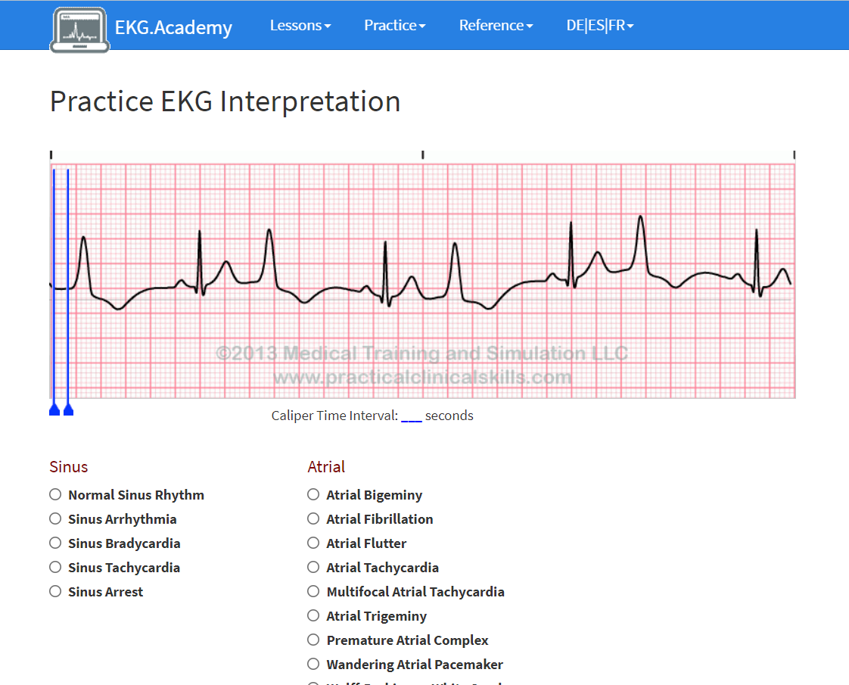
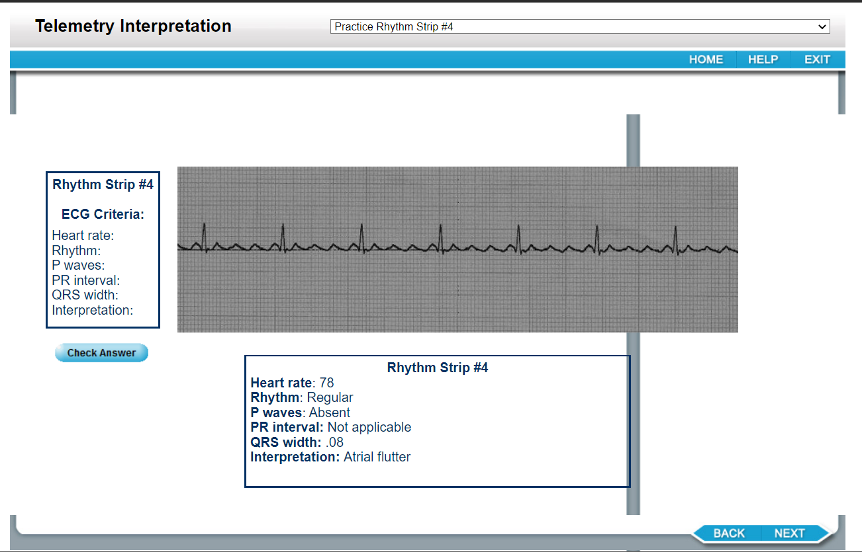
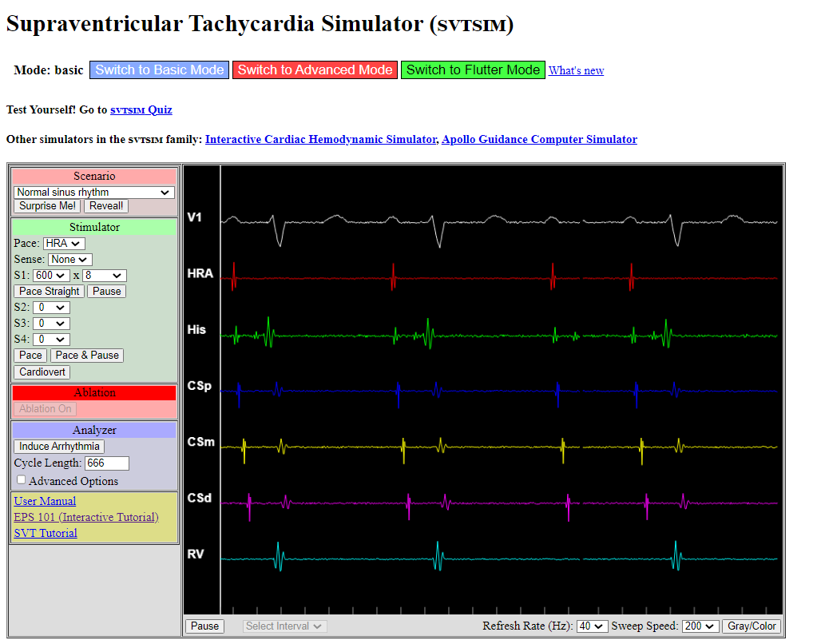
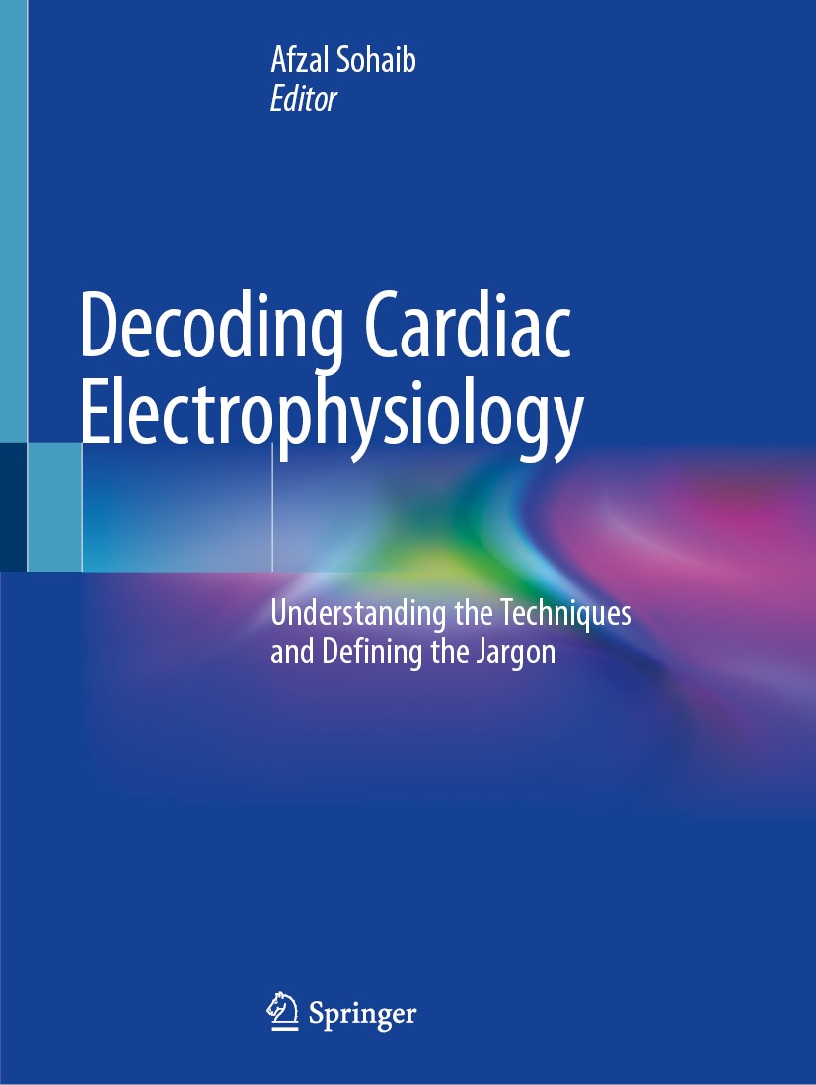
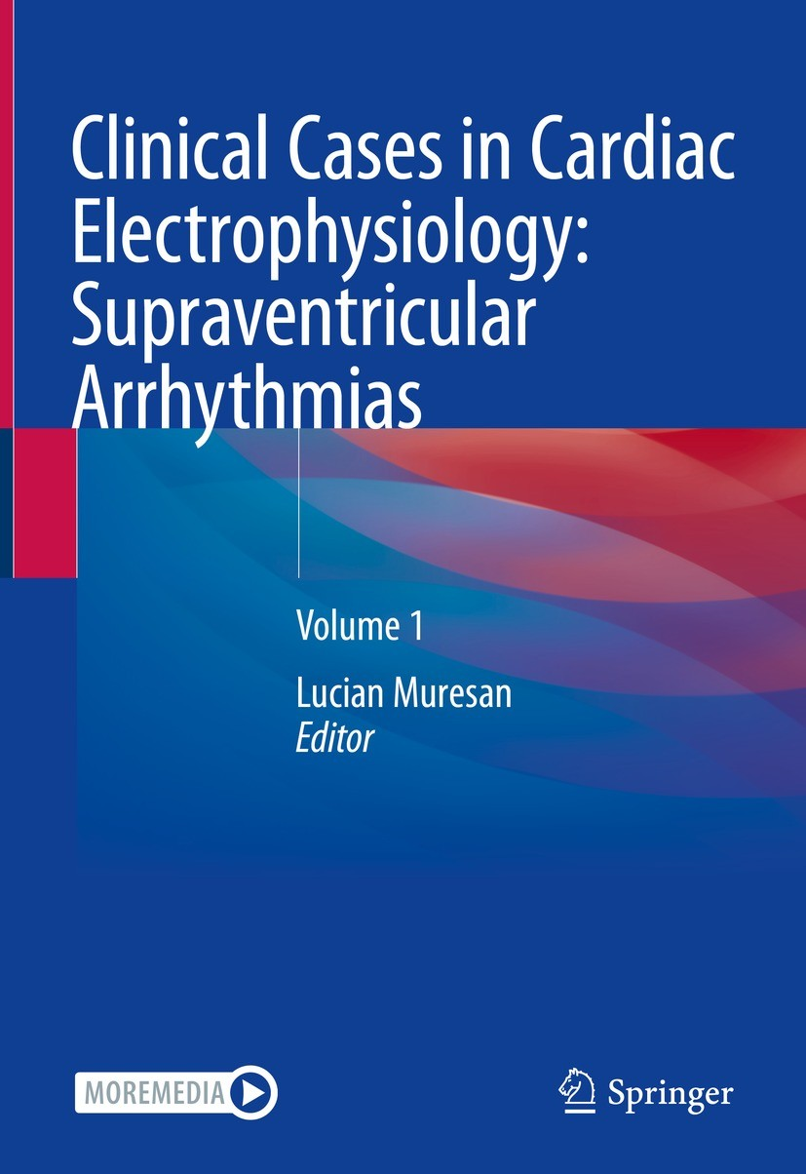

Textbooks
Journal
E-learning
Notes:
The learning resources usually available to expand their knowledge base and review lessons include textbooks, journals, online databases, and e-learning platforms.

Slide 8
Problem statement
1
2
3
The knowledge on arrhythmia due to the complexity of ECG interpretation and EP study, which may be difficult to understand and visualize.
The lack of opportunities for students to participate in clinical practice or internships in the field limits their exposure to the EP Study procedure
There are no e-learning applications that have been developed that combine pathological ECG, EP study, cardiac ablation, ECG and intracardiac electrophysiology simulation for clinical practice.
Notes:
However, we found problems and challenges.
First, The knowledge ECG interpretation and EP study is complexity, which may be difficult to understand and visualize.

Slide 9

Aim of the study
Creation the electrophysiology study simulator program (EPSSIM), which serves as an e-learning platform for EP studies and ECG.
Notes:
Therefore, the purpose of this study was to create the electrophysiology study simulator program (EPSSIM), which serves as an e-learning platform for EP studies and ECG.

Slide 10
Overview
Arrhythmias
Electrocardiogram
(ECG)
Electrophysiology study
(EP study)
Fourier series
Notes:
Before delving into the methodologies, let me provide a brief overview of arrhythmias, ECG (Electrocardiogram), EP (Electrophysiology) study, and Fourier series.
Understanding these will provide a foundation for discussing the methodologies related to arrhythmias, ECG, EP study, and Fourier series for program creation.

Slide 11

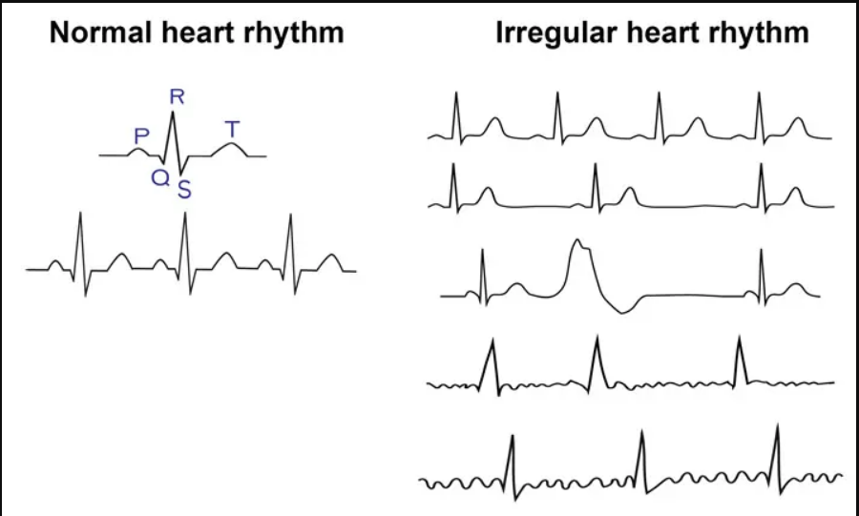
Arrhythmia
Notes:
This is a Normal heart rhythm ECG.
Arrhythmias refer to abnormal heart rhythms, where the heart beats too fast, too slow, or irregularly. They can have various causes and can impact the overall functioning of the heart

Slide 12
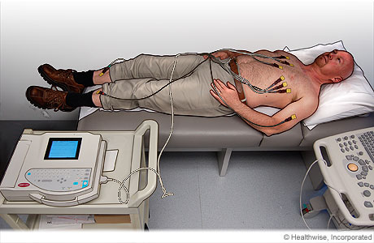
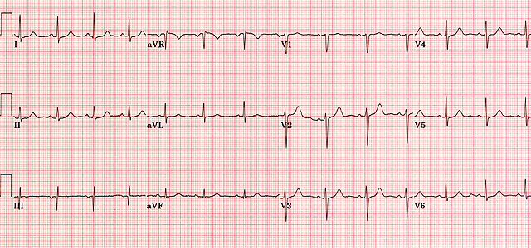
Electrocardiogram (ECG)
An ECG can help detect:
ECG
Enlargement of the heart muscle
Abnormal heart electrical signals
Heart vessel thrombosis
https://elentra.healthsci.queensu.ca/assets/modules/ECG/normal_ecg.html
Notes:
ECG, or Electrocardiogram, is a diagnostic test that records the electrical activity of the heart. It involves placing electrodes on the chest, arms, and legs to measure the electrical signals generated by the heart's contractions. ECGs are commonly used to diagnose and monitor heart conditions.

Slide 13

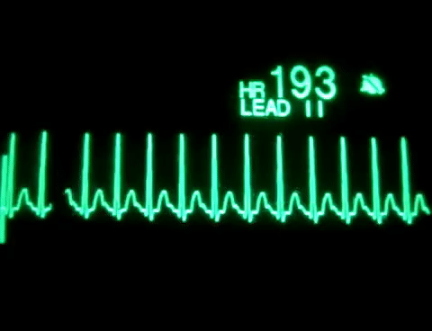
Electrocardiogram (ECG)
https://elentra.healthsci.queensu.ca/assets/modules/ECG/normal_ecg.html
Notes:
Arrhythmia can be detected by ECG interpretation.

Slide 14

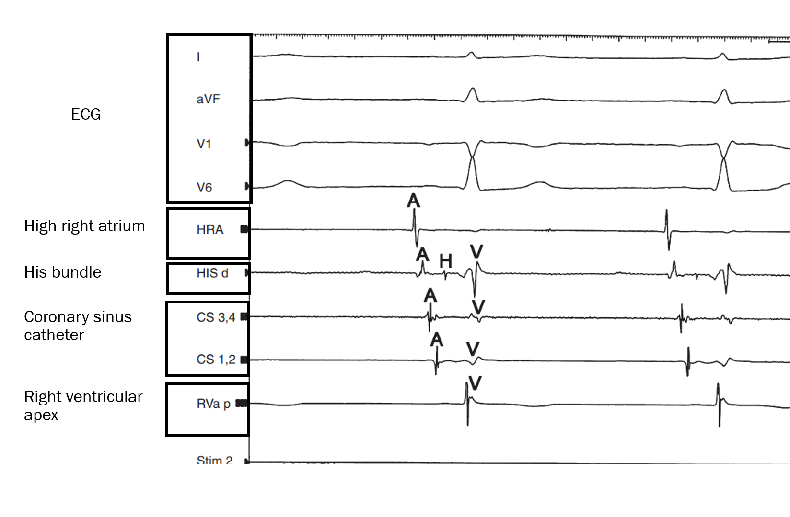
Electrophysiology study (EP study)
Intracardiac electrogram
https://www.choc.org/heart/cardiac-catheterization-program/electrophysiology-program/
Notes:
EP, or Electrophysiology, study. This is EP study procedure that involves the insertion of catheters into the heart to evaluate its electrical activity or intracardiac electrogram.

Slide 15
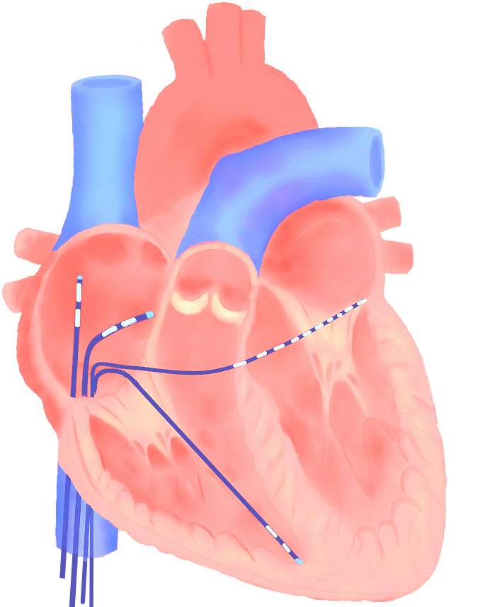
Electrophysiology study (EP study)
Diagnose the mechanism responsible for a documented or suspected arrhythmia to enable treatment
Intracardiac electrogram
Notes:
EP, or Electrophysiology, study. This is EP study procedure that involves the insertion of catheters into the heart to evaluate its electrical activity or intracardiac electrogram.
It helps identify the source of arrhythmia and planning treatment strategies.

Slide 16
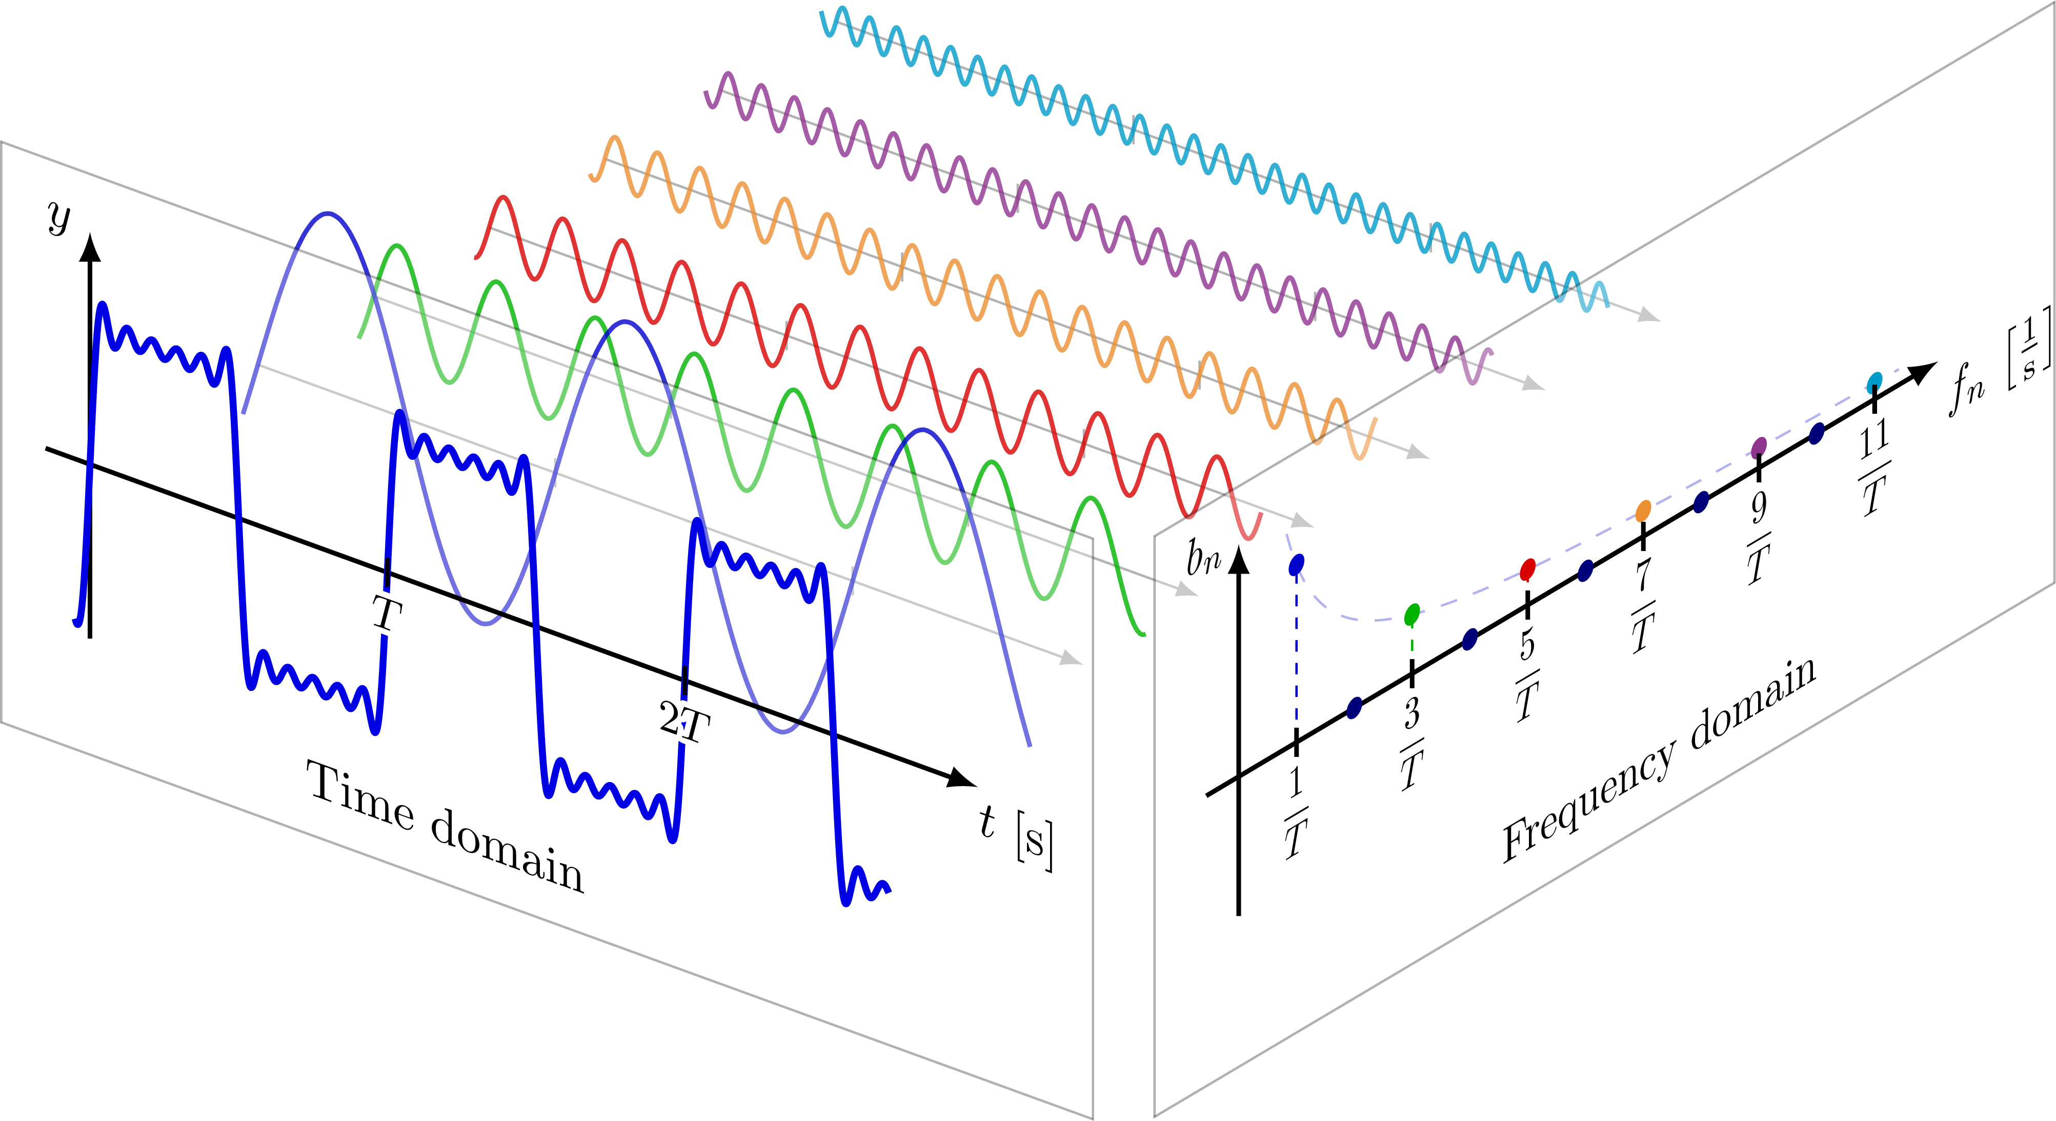
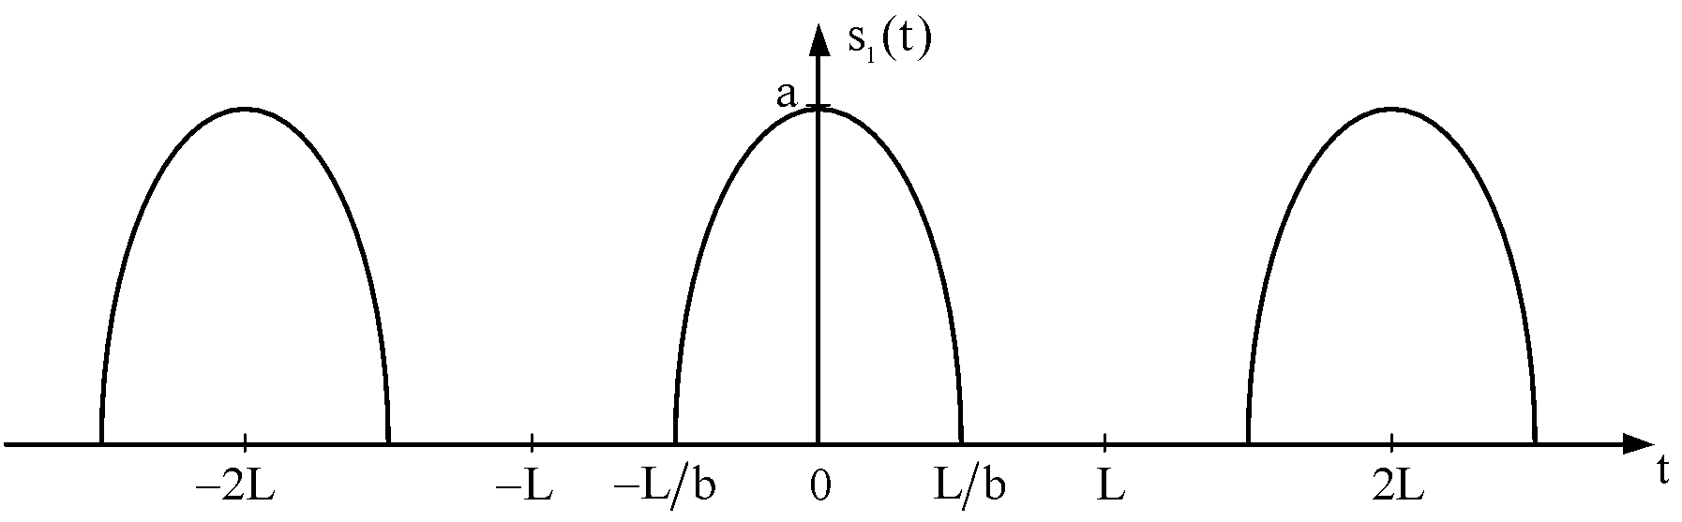
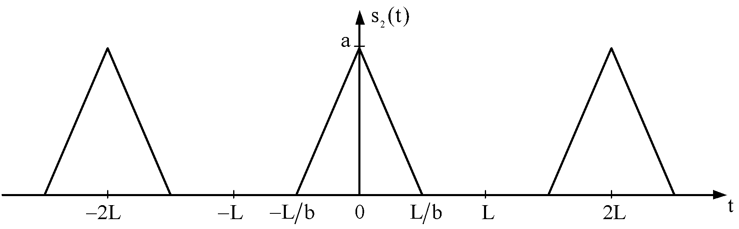
Fourier series
The Fourier series is a mathematical representation of a periodic function that is expressed as an infinite sum of sines and cosines.
Time is represented on the horizontal axis in milliseconds (ms), while amplitude or voltage is represented on the vertical axis in millivolts (mV).
https://tikz.net/fourier_series/
Notes:
Fourier series is a mathematical tool used to analyze periodic functions or signals. It breaks down a complex waveform into a sum of simpler sine and cosine functions

Slide 17
Fourier series
The Fourier series is a mathematical representation of a periodic function that is expressed as an infinite sum of sines and cosines.
Time is typically represented on the horizontal axis in milliseconds (ms), while amplitude or voltage is represented on the vertical axis in millivolts (mV).
Notes:
ECG and intracardiac electrograms share similarities in terms of periodic signals.
These are formed by the combination of two waveforms, a half wave and a triangle wave.

Slide 18
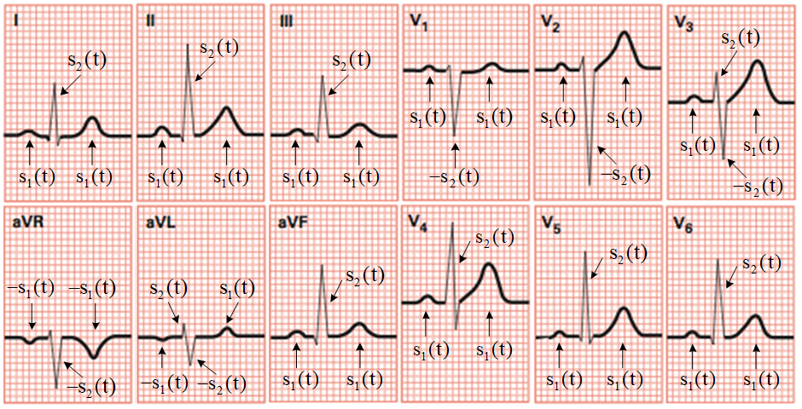
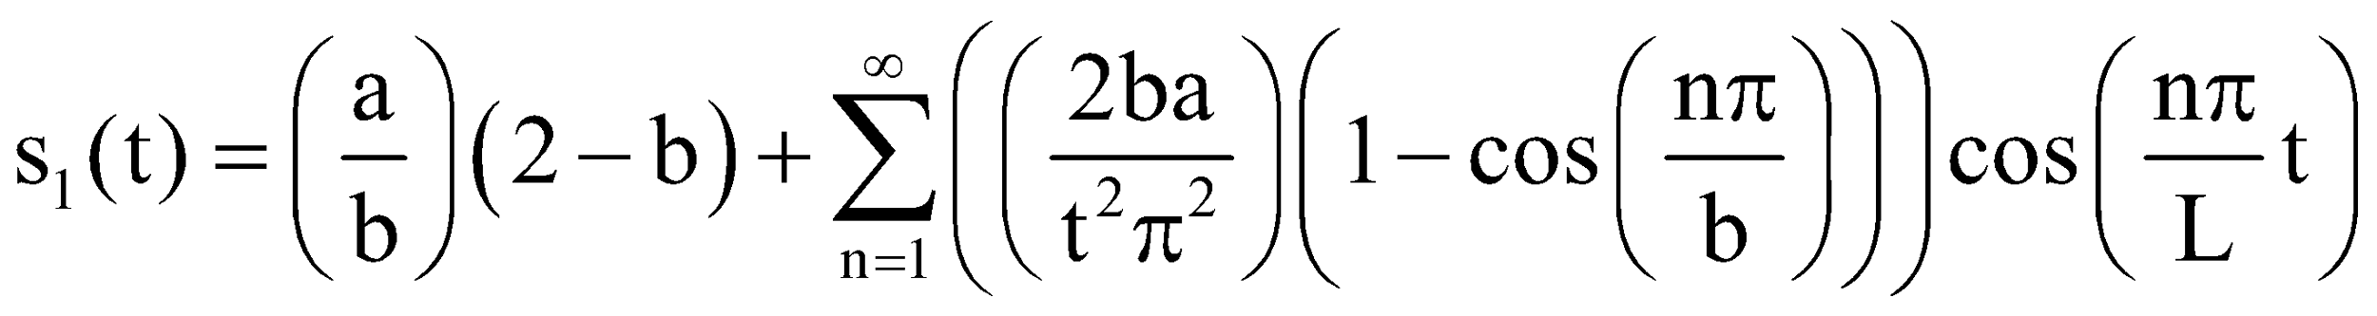
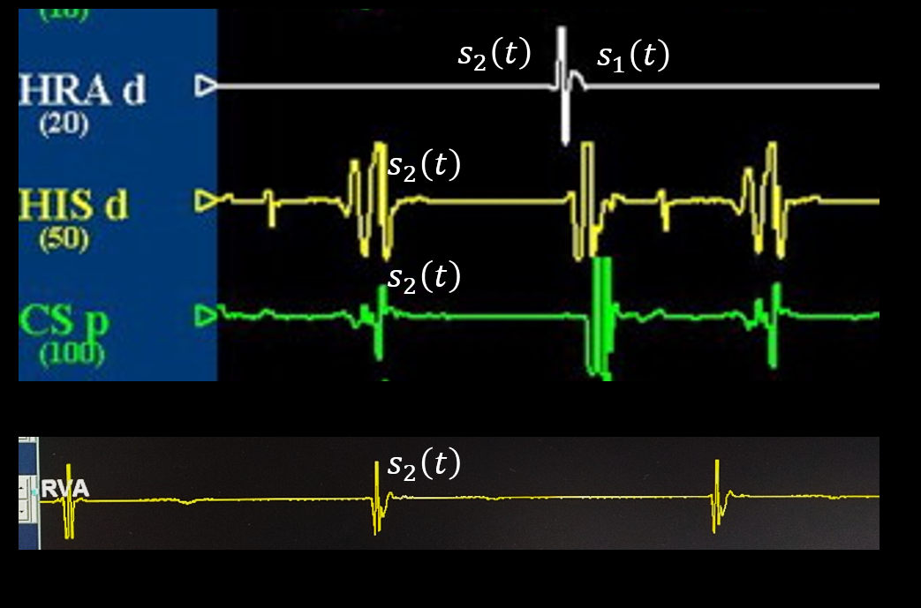
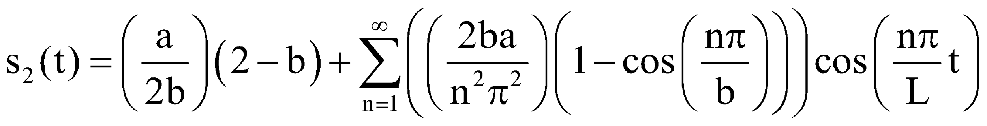
Parabola
Triangular waveforms
Notes:
In the process for signal generation, we utilized the same methods as our previous study to generate synthetic heart signals.
These patterns are generated from the morphology by merging a half- wave and a triangle wave
These synthetic signal are important for EPSSIM program.

Slide 19
Methodology
Notes:
Now, we are moving to the new topic.

Slide 20




Electrophysiology study simulator program (EPSSIM)
Design
Tools
Construction
Evaluated by Experts
Notes:
The methodology in this study was divided into 4 part. Design, Tool, Construction, and Evaluated by expert.

Slide 21

Design
ECG
EP study
simulator
EPSSIM
Notes:
The design concept of the program was integrated of content on ECGs, EP studies and simulator for beginners.

Slide 22
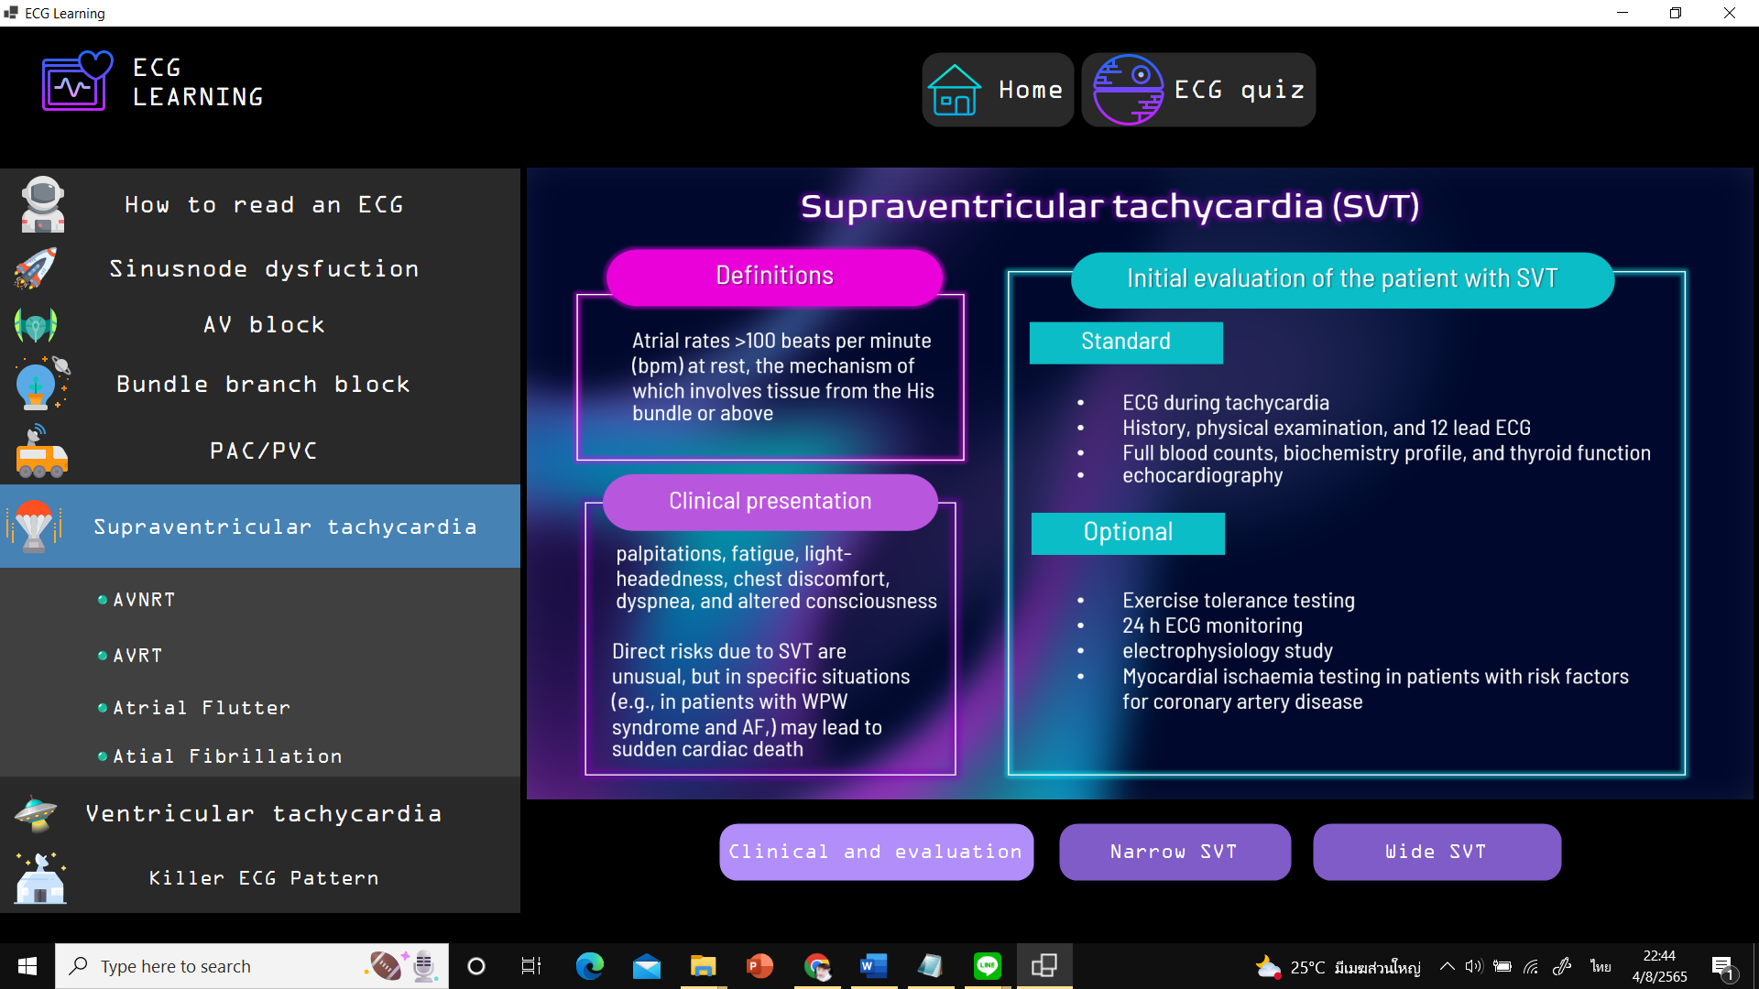
Design
Topic
content
Focus on load reduction instruction
Content Summary
black color screen
Space theme
published textbooks and journals
Notes:
We summarized Information in published textbooks and journals for the content .
The program was designed with a black color screen to enhance the visibility of letters and heart signals.

Slide 23






Tools
Signals Construction and generation
Content
Program construction
Testing
Data collection form
Adobe photoshop
Microsoft Visual studio
Expert evaluation form
MATLAB
Medi Bang pro paint
Pre- and Post-tests
Satisfaction form
Microsoft PowerPoint
Notes:
This slide provides an overview of the tools used in each step.
In the process of Signals Construction and generation.
We used the data collection form for patients recording .
MATLAB for Construction .
Next, we proceeded to create the content using a combination of software such as Photoshop, MediBang Pro Paint, and PowerPoint.
Then, we created the program using Microsoft Visual studio.
After completion of the program , the EPSSIM was tested and evaluated by expert
Pre-test and post-test:
Satisfaction form:

Slide 24
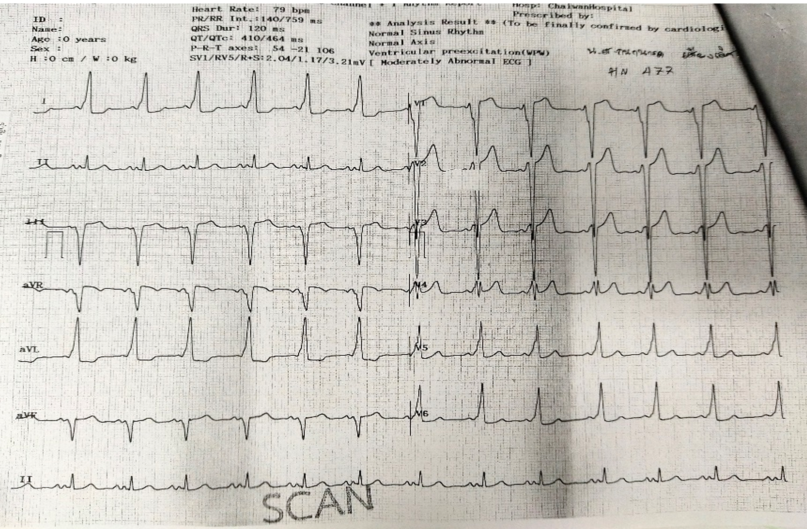
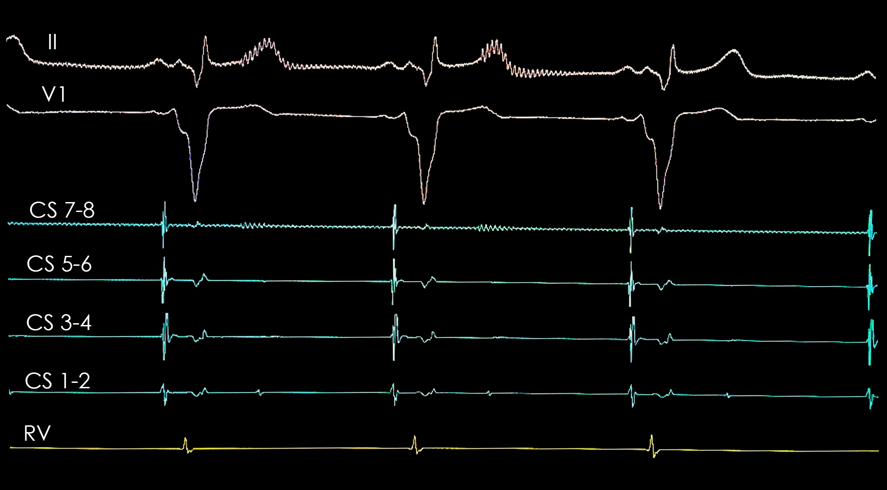
Data collection
Typical atrioventricular nodal reentry tachycardia (AVNRT)
Chief complaint
Sign and symptom
Medication / EP procedure
ECG and intracardiac electrogram data
Wolff-Parkinson-white (WPW) pattern (right side bypass tract) caused Antidromic AVRT
WPW pattern (left side bypass tract) caused Orthodromic AVRT
This study was reviewed and approved by the Institutional Review Board of the Ethics Committee of Sakon-Nakhon Hospital (002/2564).
Notes:
We started with gathering information from the medical records of patients at Sakon-Nakhon Hospital.
These medical records consisted of the Chief complaint, medical history, medication, procedures, ECG and intracardiac electrogram recordings, which had been interpreted by a cardiologist.

Slide 25
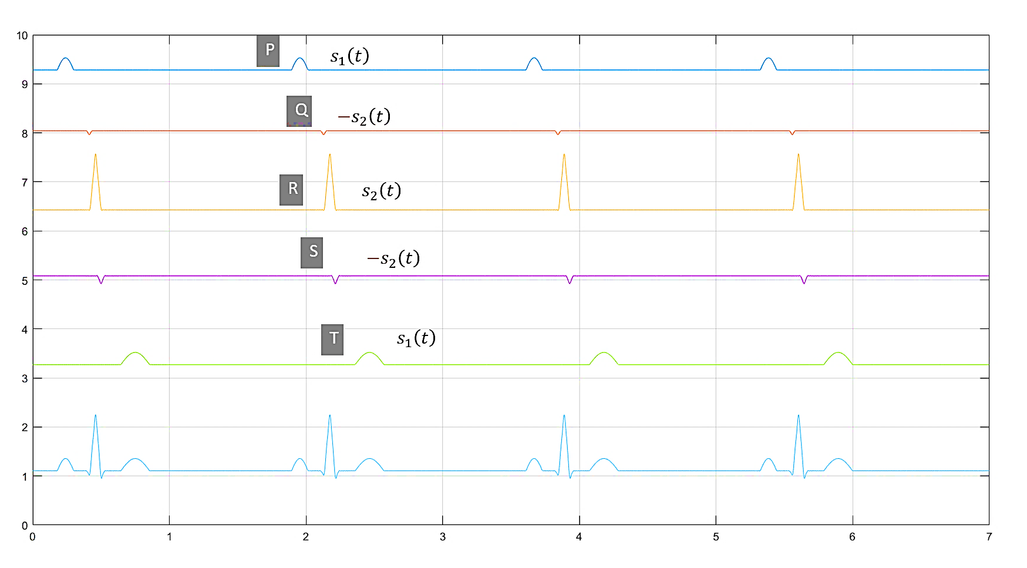
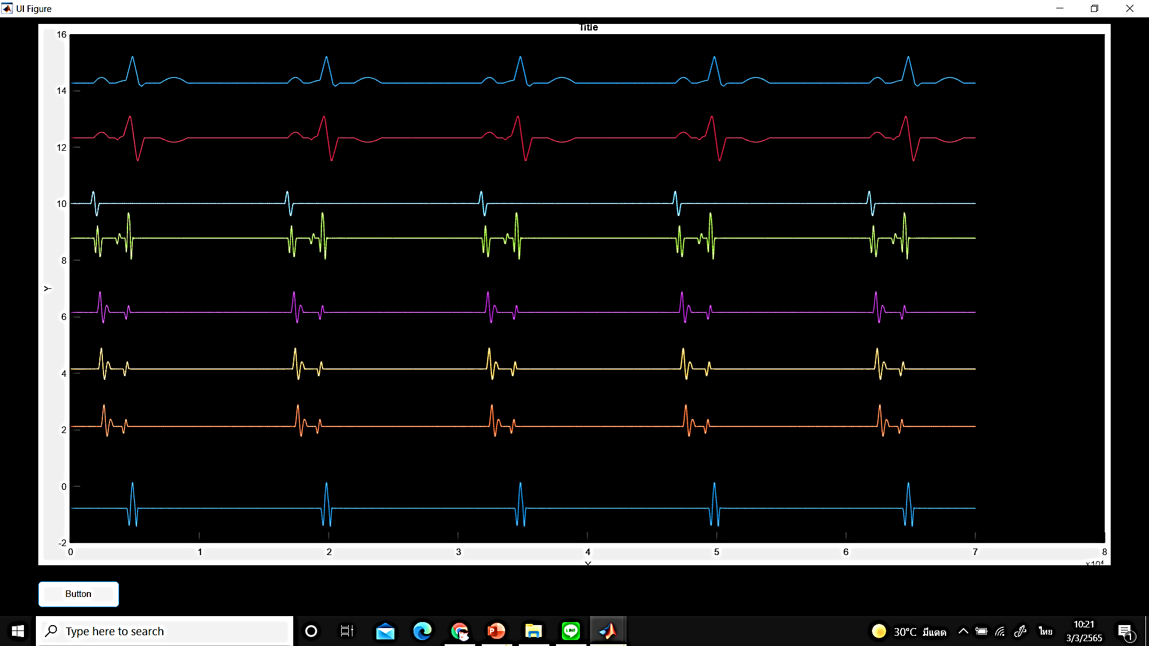
Signals Construction and generation
Fourier series
ECG and intracardiac electrogram data
Amplitude (mV)
Interval (sec)
MATLAB
Synthetic signal
Notes:
The patterns, amplitude and duration from the patient were used to create synthetic heart signals. Particularly, the synthetic ECG and intracardiac electrogram were constructed by applying the Fourier series on MATLAB.

Slide 26
Construction
Signals
Content
Pictures
Program construction
Notes:
In the construction process, we utilize Visual Studio to incorporate signals from MATLAB, content, and pictures.

Slide 27
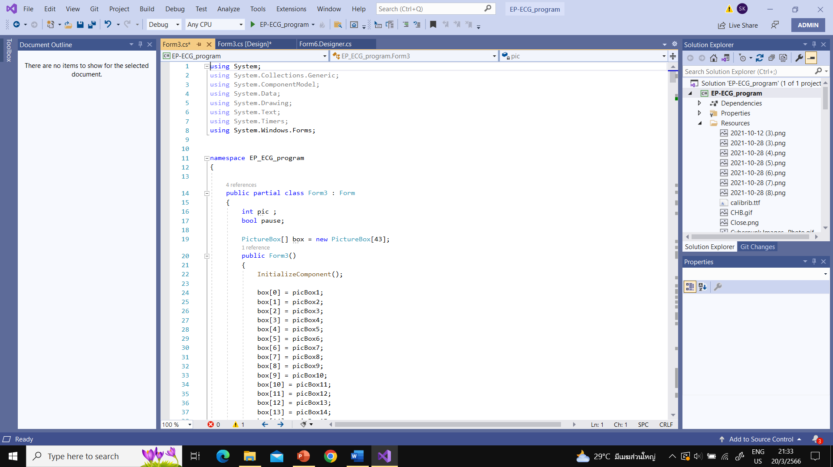
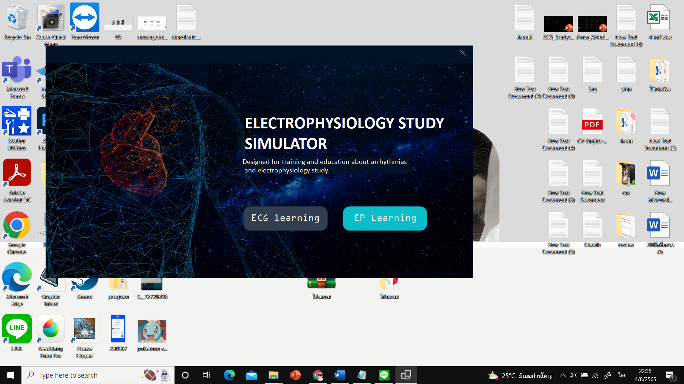
Program construction
C# languages in Visual studio
Program.exe
Notes:
The implementation of the EPSSIM program was carried out using the C# programming language within the Microsoft Visual Studio development environment.
The EPSSIM program was developed as an executable file.

Slide 28


Evaluated by Experts
Electrophysiologist
EP technician
Programmer
Notes:
After the completion of EPSSIM, the program underwent an evaluation of its learning efficiency and validity by experts in the field.

Slide 29
Programmer
Electrophysiologist
EP specialist
Heart signal patterns
Signal characteristics
Accuracy of lessons and learning efficiency
UX/UI
Bugs
Fix, Modified and redesigned
Notes:
electrophysiologists and an EP specialist evaluated about heart signal, the accuracy of the instructional lessons, and the overall learning efficiency of the program.
programmer evaluated the UX / UI and checked for any errors in the program.
The program was continuously Fix, Modified redesigned based on the feedback provided by experts.

Slide 30
Notes:
this is the first page of EPSSIM.
The program contains two parts that ECG learning and EP learning.

Slide 31
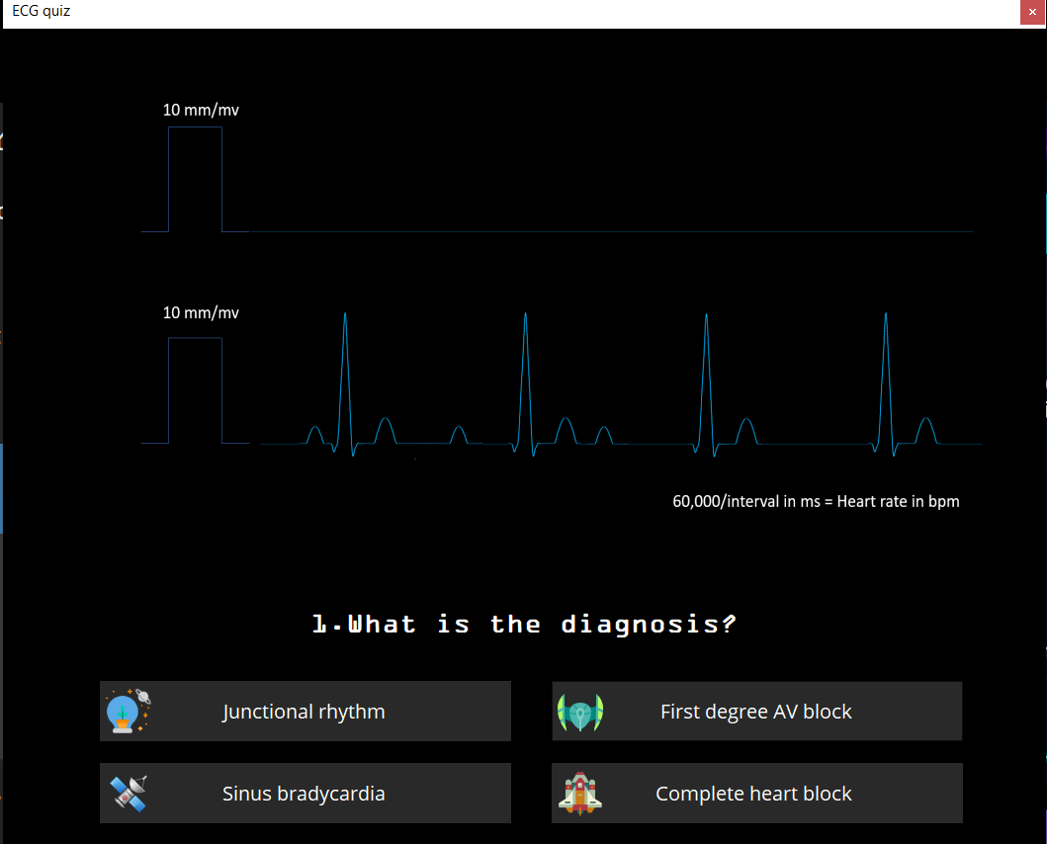
Notes:
The EPSSIM program was designed with two layouts on the screen to organize the information. The left layout represents the different topics, while the right layout represents the content within each topic.
In the EPSSIM have a quiz about ECG interpretation.

Slide 32
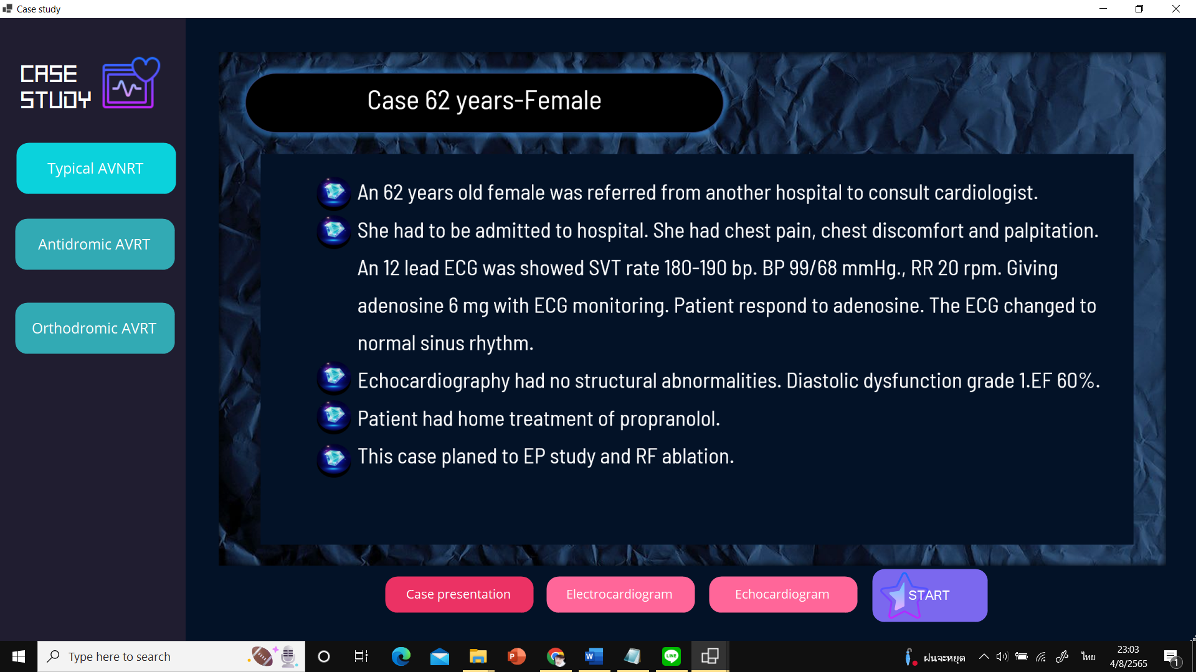
Notes:
In the simulator mode,
EPSSIM allows three case studies to be selected. All the patient history and details of the case are shown, From this screen, the user can proceed to the Simulator.
When click the START button.

Slide 33
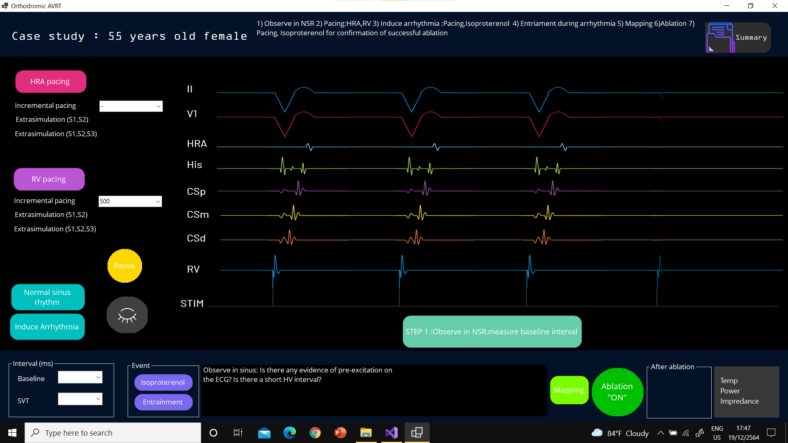
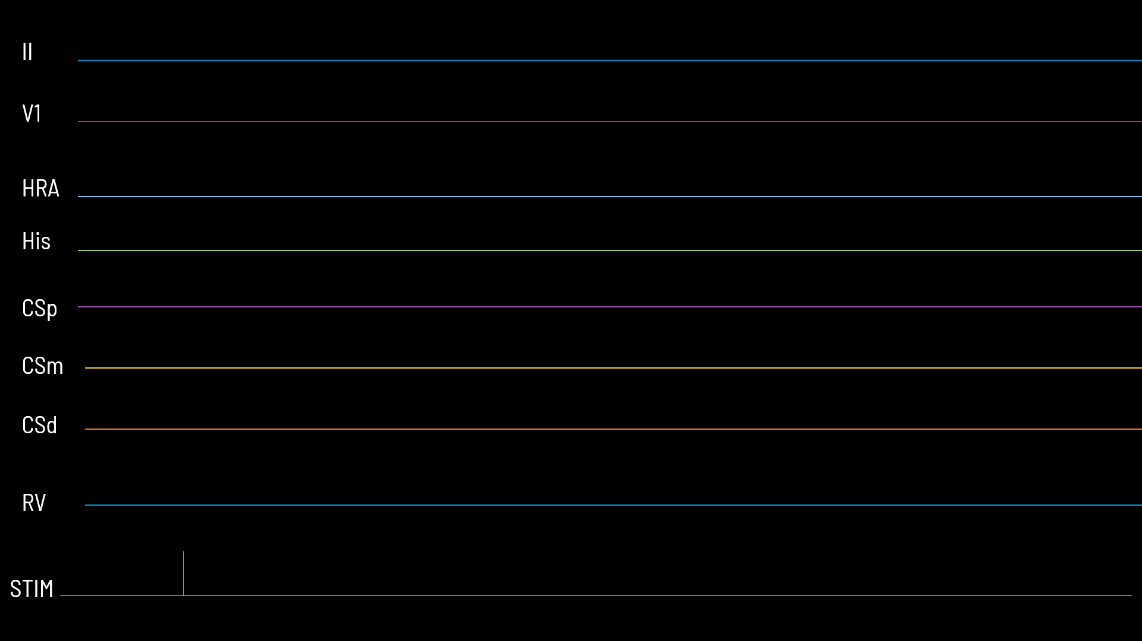
Notes:
This slide shows the Simulator mode that allows the user to perform various diagnostic maneuvers by pacing the simulated heart in real time.
The ECG and intracardiac electrogram are designed to mimic the same signals that from a real patient during an EP study procedure.
The user can stop the signals by pressing the “Pause” button .

Slide 34
Notes:
The user can stop the signals by pressing the “Pause” button .

Slide 35

Testing
Post- test
Satisfaction
Pre- test
Participants
47 participants
30-minute pre-test
For 7days
This study was reviewed and approved by the Institutional Review Board of the Ethics Committee of Naresuan University, Thailand (P10155/63)
Notes:
In the process.
This slide show the overview of the testing.
The participants were completed the pre-test within a 30-minute. Subsequently, we shared the program through Google Drive. On Day 7, the participants were required to complete the post-test and provide feedback on their satisfaction.

Slide 36
Participants
Fourth-year students (bachelor's degree in cardio-thoracic technology during the academic year 2022)
Inclusion
N=47
Exclusion
N=10
Complete both a pre-test and a post-test
Did not complete both the pre-test and post-test
N=57
This study was reviewed and approved by the Institutional Review Board of the Ethics Committee of Naresuan University (P10155/63).
Notes:
The participant inclusion criteria that all participants were fourth-year students pursuing a bachelor's degree in cardio-thoracic technology during the academic year 2022 at NU.
All 57 participants provided informed consent. As part of the study protocol, the participants were required to complete both a pre-test and a post-test. Any individual who did not complete both the pre-test and post-test was excluded from the study.

Slide 37

The educational effectiveness of the EPSSIM program
Pre- and Post- tests
Multiple-choice tests consisted of 20 questions
ECG interpretation, the indications for an EP study, diagnosis, standard EP studies for tachycardia, and cardiac ablation.
Notes:
The educational effectiveness of the EPSSIM program was evaluated by comparing the pre-test and post-test scores of the participants. These multiple-choice tests consisted of 20 questions 20 score covering the fundamental knowledge.

Slide 38
The satisfaction of the EPSSIM program
Strongly Disagree
Undecided
Strongly Agree
1
2
3
4
5
    The EPSSIM Program helped you to improve your knowledge and understanding of ECG.
    The EPSSIM Program helped you to improve your knowledge and understanding of EP study.
    The EPSSIM program has demonstrated the potential to enhance practitioners' confidence and knowledge in the field of EP study.
    The ECG part of the EPSSIM program has been designed with ease of use in mind.
    The EP study part/EP simulator of the EPSSIM program has been designed with ease of use in mind.
    The EPSSIM program was stable and free from errors.
    The EPSSIM program was accessible, allowing students to access the material from any location and at any time.
    The EPSSM program provides adequate and beneficial guidance such as usage methods and suggestions.
    The EPSSIM program provides satisfactory control of commands and buttons.
    You will recommend the EPSSIM program to others
Notes:
The participants were asked to indicate their level of satisfaction with the program.
A 10-question form, with each question rated as a Likert-type scale. (1 = Strongly Disagree, 2 = Disagree, 3 = Undecided, 4 = Agree, 5 = Strongly Agree).

Slide 39
Data analysis
The average pre-test and post-test score were mean±SD
The paired samples t-test analyzes the difference in scores between the pre-test and post-test.
The statistical significance was set at p < 0.05 with a CI of 95 %.
Notes:
We used the SPSS for data analysis. The average pre-test and post test score were mean±SD. The paired samples t-test analyzes the difference in scores between the pre-test and post-test. The statistical significance was set at p < 0.05 with a confidence interval of 95 percentage.

Slide 40
Analyses and discussion

Slide 41
Analyze and discussion
The effectiveness of the EPSSIM program
The satisfaction of the EPSSIM program
Notes:
This section was divided 2 part. The effectiveness and the satisfaction of the program.

Slide 42
The effectiveness of the EPSSIM program
Table 1
Pre and post test score
 | n | min | max | mean ± SD | t | p-value
Pre-test | 47 | 3 | 14 | 8.38±2.73 | -4.882 | 0.000
Post-test | 47 | 6 | 15 | 10.77±1.93
The statistical significance was set at p < 0.05 with a CI of 95 %.
Notes:
The effectiveness of the EPSSIM program was evaluated by analyzing the changes in the pre-post-test scores of the 47 participants. The test consisted of 20 questions.
The pre-test scores, a minimum was3 and a maximum was 14.
The average pre-test score was mean plus or minus SD, 8.38±2.73
and the average post-test score was mean±SD 10.77±1.93.
This result showed a statistically significant increased score resulting from using the program.

Slide 43

3/20
Pre-test
Post-test
9/20
Notes:
While the minimum scores on the post-test were still low. However, it is worth that there was a significant improvement for individual. Such as
one participant who had a minimum score of 3 out of 20 on the pre-test but was able to increase post-test score to 9 , which suggests individual improvement after using EPSSIM for 7 days.

Slide 44
Factors that could impact the post-test scores
1
The short training period
2
The test
3
Motivation, attention span, and learning style
Notes:
Based on an assessment of the participants’s test responses, we identified the issues and limitations of this study.
Several factors could impact the post-test scores.

Slide 45

Factors that could impact the post-test scores
1
The short training period
7 Days
14 Days
2
The test
3
Motivation, attention span, and learning style
Notes:
Firstly, the short training period may affect their post-test scores and 14 days training period may allow participants to acquire more knowledge and skills, leading to higher post-test scores.

Slide 46

Factors that could impact the post-test scores
1
The short training period
2
ECG interpretation, the indications for an EP study, diagnosis, standard EP studies for tachycardia, and cardiac ablation
The test
3
Motivation, attention span, and learning style
Notes:
Secondly, We developed the test to evaluate the fundamental knowledge required for career. However, we acknowledge that it may challenge or difficult for beginners who have no experience in this field.
Secondly, the complexity of some of the questions may have posed a challenge to participants with little to no experience in ECG interpretation and EP study procedures.

Slide 47


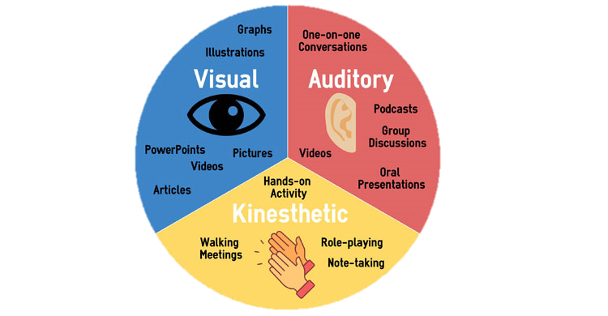

Factors that could impact the post-test scores
1
The short training period
2
The test
3
Motivation, attention span, and learning style
Notes:
Finally, individual factors such as motivation, attention span, and learning style could impact learning achievement.

Slide 48
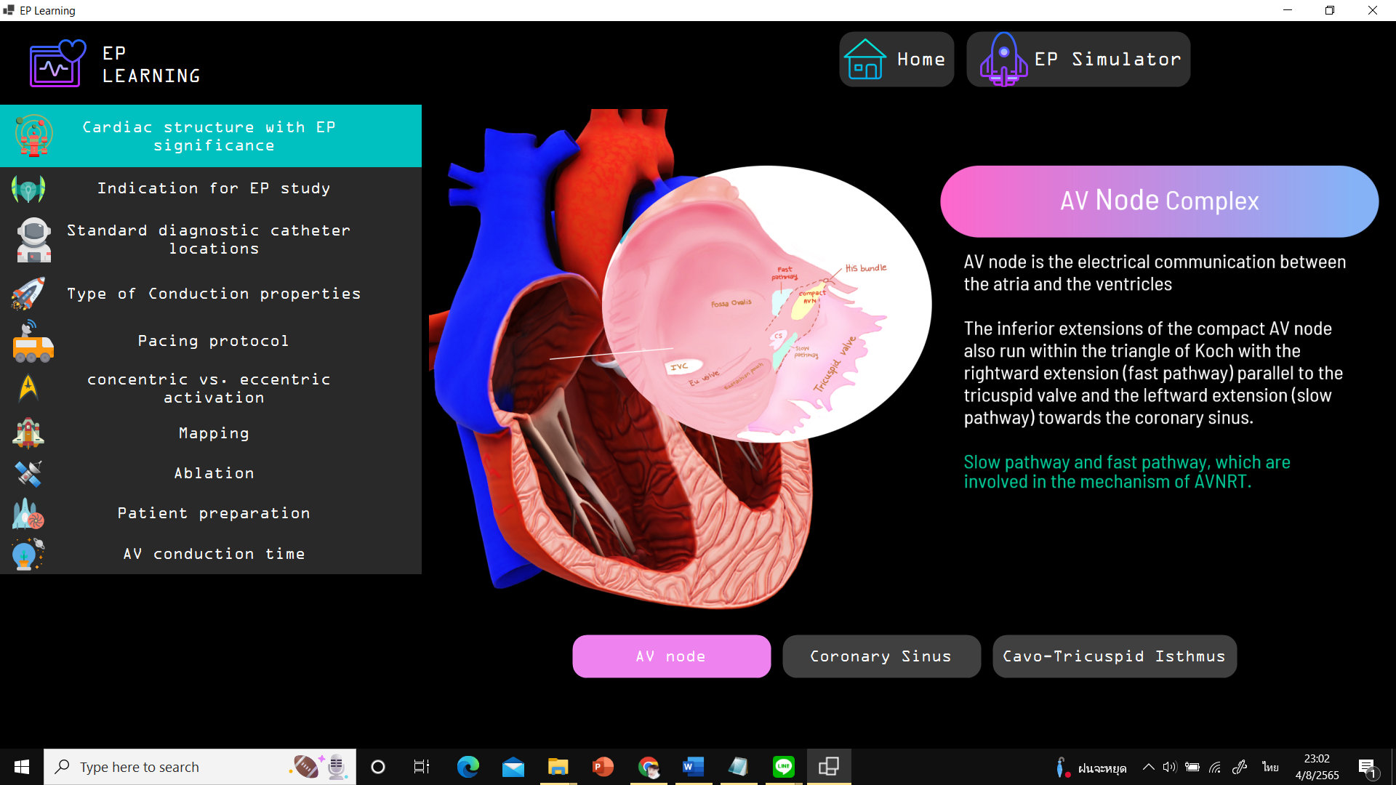
The satisfaction of the EPSSIM program :UX,UI
The ECG part of the EPSSIM program has been designed with ease of use in mind
The EP study part/EP simulator of the EPSSIM program has been designed with ease of use in mind
Notes:
The satisfaction of the program was represented in a pie chart.
over 80% of the participants expressed a high level of agreement that the program had clear and easy-to-understand instructions,
And also, most of the participants agreed that the EPSSIM has an attractive design with high visibility of letters and clear heart signals.

Slide 49
The satisfaction of the EPSSIM program :UX,UI
The EPSSM program provides adequate and beneficial guidance such as usage methods and suggestions
The EPSSIM program provides satisfactory control of commands and buttons
15
13
28
36
57
51
Notes:
over 80% of the participants expressed a high level of agreement that the program provides adequate and beneficial guidance such as usage methods, suggestions and control of commands and buttons.

Slide 50
The satisfaction of the EPSSIM program :improve in knowledge
The EPSSIM Program helped you to improve in knowledge and understanding of ECG
The EPSSIM Program helped you to improve in knowledge and understanding of EP study
33
62
62
Notes:
Most of participants agreed that EPSSIM helped solve problems previously encountered in learning ECG and EP study

Slide 51

The satisfaction of the EPSSIM program :improve in knowledge
The EPSSIM program has demonstrated the potential to enhance practitioners' confidence and knowledge in the field of EP study
36
54
Notes:
Participants gained increased confidence in their knowledge.

Slide 52
The satisfaction of the EPSSIM program
The EPSSIM program was stable and free from errors
The EPSSIM program was accessible, allowing students access the material from any location and at any time
59
51
Notes:
Most of the participants expressed agreement with the statement that the EPSSIM was stable and free from errors.
Furthermore, participants also agreed that the EPSSIM program was accessible, allowing students access the material from any location and at any time.

Slide 53

The satisfaction of the EPSSIM program
You will recommend the EPSSIM program to others
8
44
49
Notes:
Over 90% of participants will recommend the EPSSIM program to others.

Slide 54
Limitation
The program's language is in English, that is a challenge to non-native speakers, necessitating a bilingual interface, especially for novice users
The program is a standalone application
The program only build for computer
Notes:
Let’s talk about The limitation of the EPSSIM program. As the program is a stand-alone application, users must download and install it on their personal computers, which may be inconvenient for some individuals. And also The program's language is English, which is a challenge to non-native speakers, necessitating a bilingual interface.
It make the program more learner-friendly for user who require the Thai language and easy word, leading to enhanced comprehension and a more effective learning experience.

Slide 55
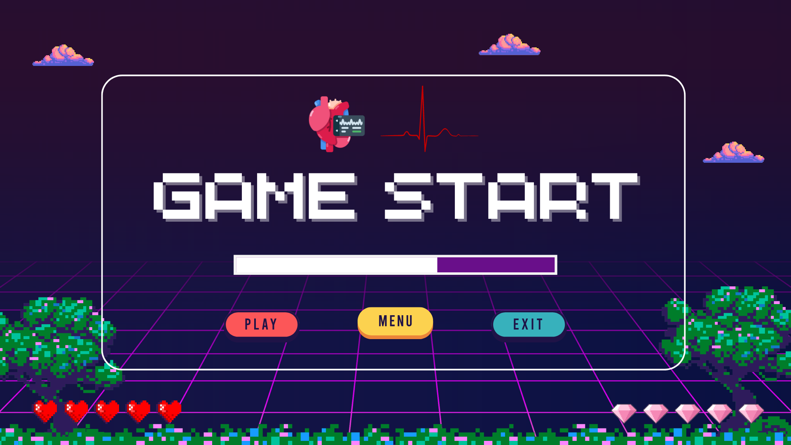
Further work
Notes:
Furthermore, if the program added game-like features, knowledge creation and interactive elements, it would make it more interesting and educational.
We decide to develop the EPSSIM as a website or a mobile application.

Slide 56
Pre-test and Post-test
With EPSSIM
Without EPSSIM
Notes:
The study should test two groups where first group uses pre-test and post-test with EPSSIM while the second group uses pre- test and without EPSSIM.
Such limitations need to be considered in the context of program implementation and future development.

Slide 57
Notes:
Our recommendation is to integrate the EPSSIM program with lecture-based instruction to maximize the learning experience.

Slide 58


Students
Cardio-thoracic technician
Notes:
We hope that the EPSSIM program will effectively learning and review of ECG and electrophysiology lessons, which are considered foundational knowledge for individuals pursuing careers as good cardio-thoracic technicians and EP specialists.

Slide 59
THANK YOU
QUESTION & ANSWER

