Slide 1



Design and Implementation of Data Governance Framework and Platform: A Case Study of National Research Organization of Thailand
Krich Nasingkun
Leveraging Technology Solutions Section
National Electronics and Computer Technology Center
The 20th International Joint Conference on Computer Science and Software Engineering
28th June-1st July 2023
Naresuan University Phitsanulok, THAILAND

Slide 2
Outline
Background
Framework and Implementation
Activities
Result
Future work

Slide 3
Government/MHESI
BIOTEC
National Science and Technology Development Agency (NSTDA)
MTEC
NECTEC
NANOTEC
ENTEC

Slide 4
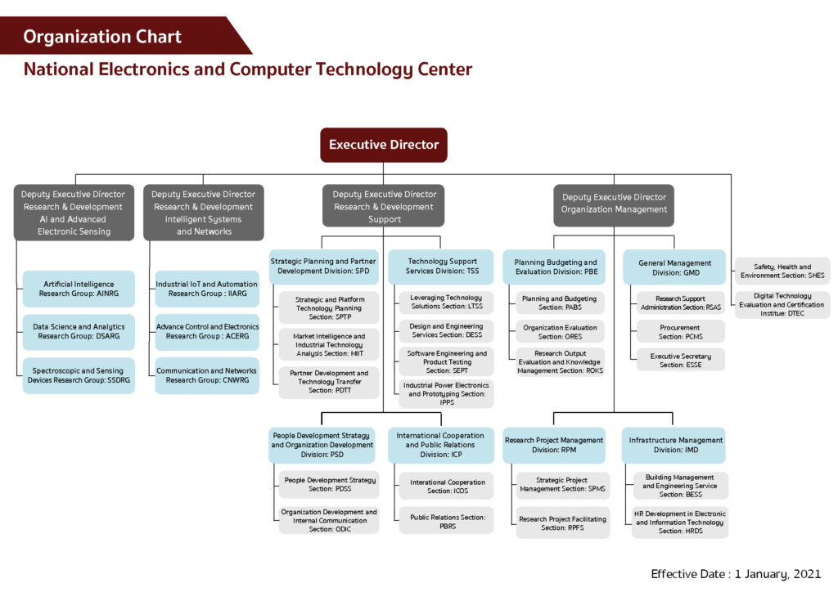

Slide 5
Data in research institute.
Type of data
  Scientific research data
  Marketing research data
  Management data
Format of data
  Structrued data
  Unstructured data
  Real time data
Data Ownership
  Full ownership (NECTEC’s data)
  Co-ownership (joint research data)
  Outside agency (Contact research)
  Public

Slide 6
Data related Laws and Regulations
  Official Information Act B.E. 2540 (1997)
  Personal Data Protection Act B.E. 2562 (2019)
  Royal decree prescribing agencies and businesses whose personal data controllers are not under the protection of the law. 2019 and 2020
  Announcement of the Ministry of Digital Economy and Society on Standards for Security and Security of Personal Data B.E. 2565
  Government Confidentiality Regulations B.E. 2544 and Government Confidentiality Regulations (No. 2) B.E. 2561
  Act on the Promotion of Science, Research and Innovation B.E. 2562 (2019)
  Cyber Security Act B.E. 2562
  Government Administration and Services Act through Digital Systems B.E. 2562 (2019)
  Announcement of the Digital Government Development Committee on Good Governance, Government Information
  Announcement of the Digital Government Development Committee on Standards and Criteria for Public Sector Data Disclosure in the form of Digital Data

Slide 7
Design Framework

Slide 8
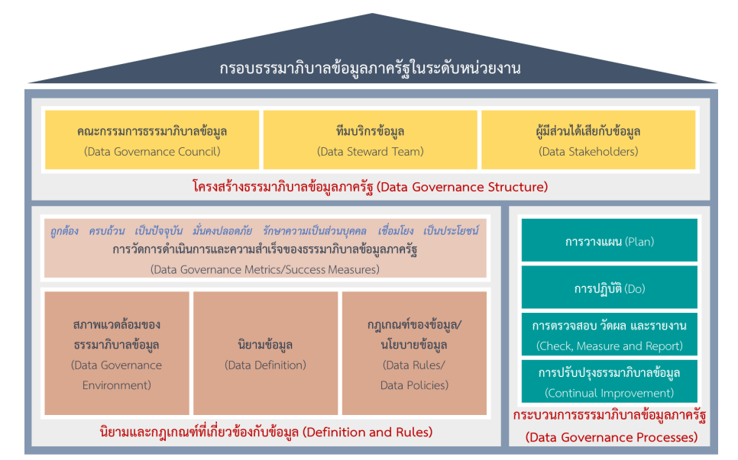
Digital Government Development Agency (DGA) Framework
https://www.dga.or.th/policy-standard/standard/dga-005/dga-006/

Slide 9
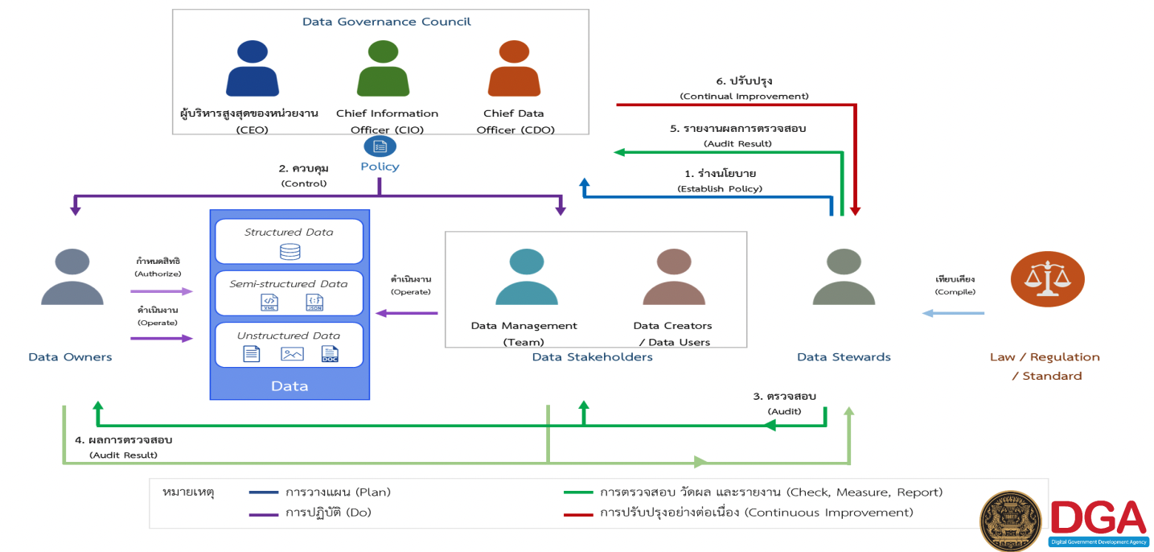
https://www.dga.or.th/policy-standard/standard/dga-005/dga-006/

Slide 10
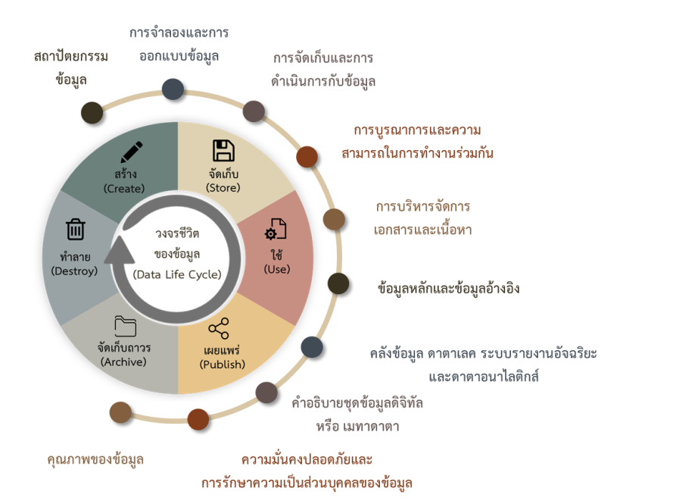
Data life cycle
https://www.dga.or.th/policy-standard/standard/dga-005/dga-006/

Slide 11

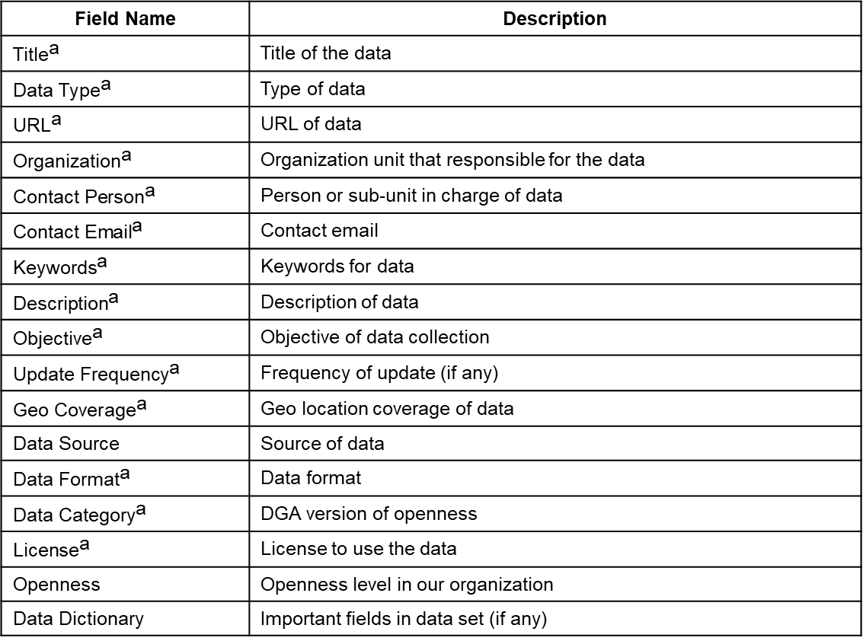
Data Governance Metadata
(mandatory fields)
Field Name | Description
$${\text{Title}}^{\text{a}}$$ | Title of the data
$${\text{Data} \text{Type}}^{\text{a}}$$ | Type of data
$${\text{URL}}^{\text{a}}$$ | URL of data
$${\text{Organization}}^{\text{a}}$$ | Organization unit that responsible for the data
$${\text{Contact} \text{Person}}^{\text{a}}$$ | Person or sub-unit in charge of data
$${\text{Contact} \text{Email}}^{\text{a}}$$ | Contact email
$${\text{Keywords}}^{\text{a}}$$ | Keywords for data
$${\text{Description}}^{\text{a}}$$ | Description of data
$${\text{Objective}}^{\text{a}}$$ | Objective of data collection
$${\text{Update} \text{Frequency}}^{\text{a}}$$ | $\text{Frequency}$ of update (if any)
$${\text{Geo} \text{Coverage}}^{\text{a}}$$ | Geo location coverage of data
Data Source | Source of data
$${\text{Data} \text{Format}}^{\text{a}}$$ | Data format
$${\text{Data} \text{Category}}^{\text{a}}$$ | DGA version of openness
$${\text{License}}^{\text{a}}$$ | License to use the data
Openness | Openness level in our organization
Data Dictionary | Important fields in data set (if any)
DGA compliance fields
Extended fields
$${\text{a}.}_{\text{DGA} \text{Compliance}}$$

Slide 12
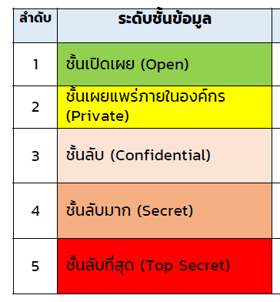
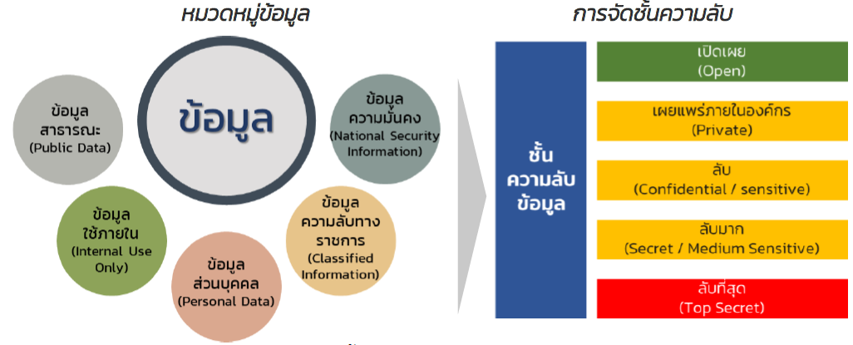
DGA Data categories
(Level)
(Category)
(No.)

Slide 13
Openness
Level | Description | Visibility | Decision for sharing
I | Open to the public | Public | No need
II | Open within organization | Employee | No need
III | Authorization required | Employee | Data Council
IV | Authorization required and permission of third-party owner | Employee | Data Council and Data owner
V | Conceal | Executives, Data Governance staff | Not allow

Slide 14
Impletmentation

Slide 15
NSTDA Data Governance
Set policies & Mananage data
  Data Security
  Data Privacy
  Data Quality
    Accuracy
    Completeness
    Timeliness
    Relevancy
    Availability
Delegate responsibility to staff
  Appoint NSTDA Data Council

Slide 16
NECTEC Data Governance
Compile NSTDA Data Governance Policy
Appoint NECTEC Data Governance working body (Council and Data Stewards)
Announcement on information disclosure policy and user agreement
Establish Key Performance Indicator (KPIs)
Develop planform for sharing data (NECTEC Data Catalog)
Promote and Training

Slide 17
NECTEC Data Council
Member
  Executives
  Directors
Role
  Set up polices and regulations
  Delegate authorize to Data Stewards

Slide 18
NECTEC Data Stewards
Member
  Vice Directos
  Representative
    Reserarch units
    Research infrastructure units
    Non-research units
Role
  Execute authrize from Council
    Manage data
    Regulate and enforce policies
    Create and operate Data Catalog Platform

Slide 19
NECTEC Information Openness Policy
NECTEC’s version of DGA’s Disclousure level
Classify the level of Openness of the data
Define the right for each level
  Right to access metadata
  Right to request data
* At the moment of the announcement, the government disclose level was still in development

Slide 20
NECTEC Data Catalog Platform
Based on C-KAN
Metadata is an extended version of GD-Catalog’ metadata
Implementation of Data Governance for data sharing
Implement with NSTDA Single Sign on (SSO) and organization structure
Support Data registration and Data request workflow
Not yet covered Data council process (still need offline process)
Not support central storage for store real data
Avaiable at https://opend-portal.nectec.or.th

Slide 21
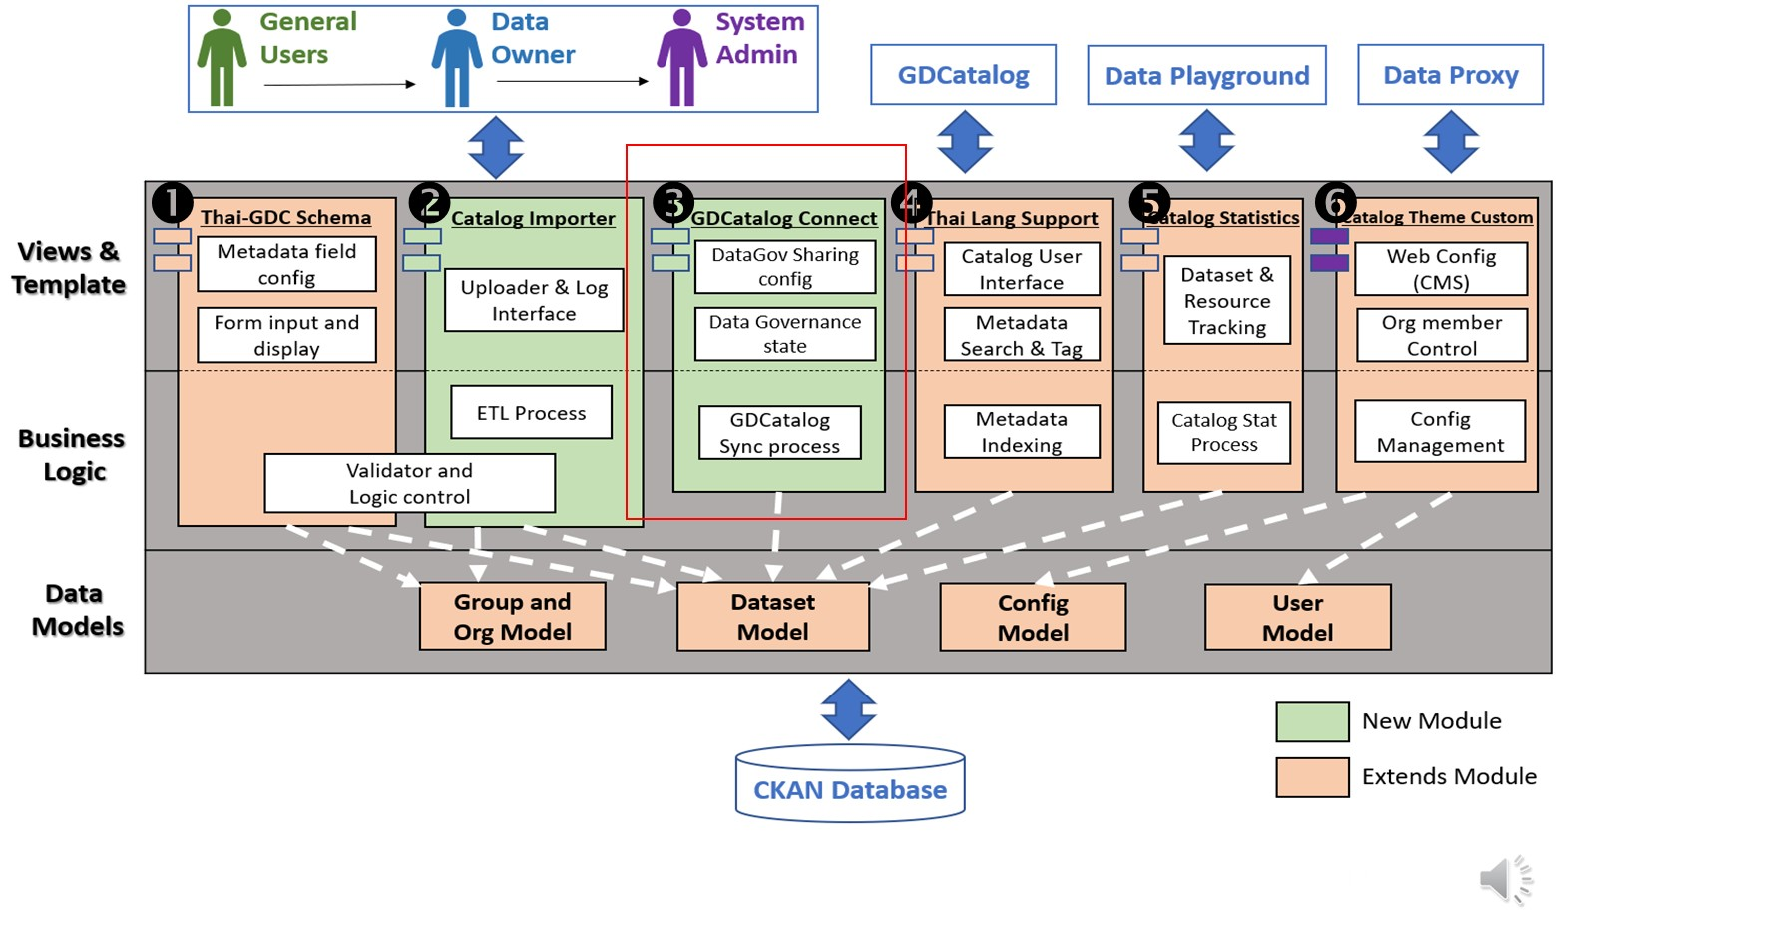

Slide 22
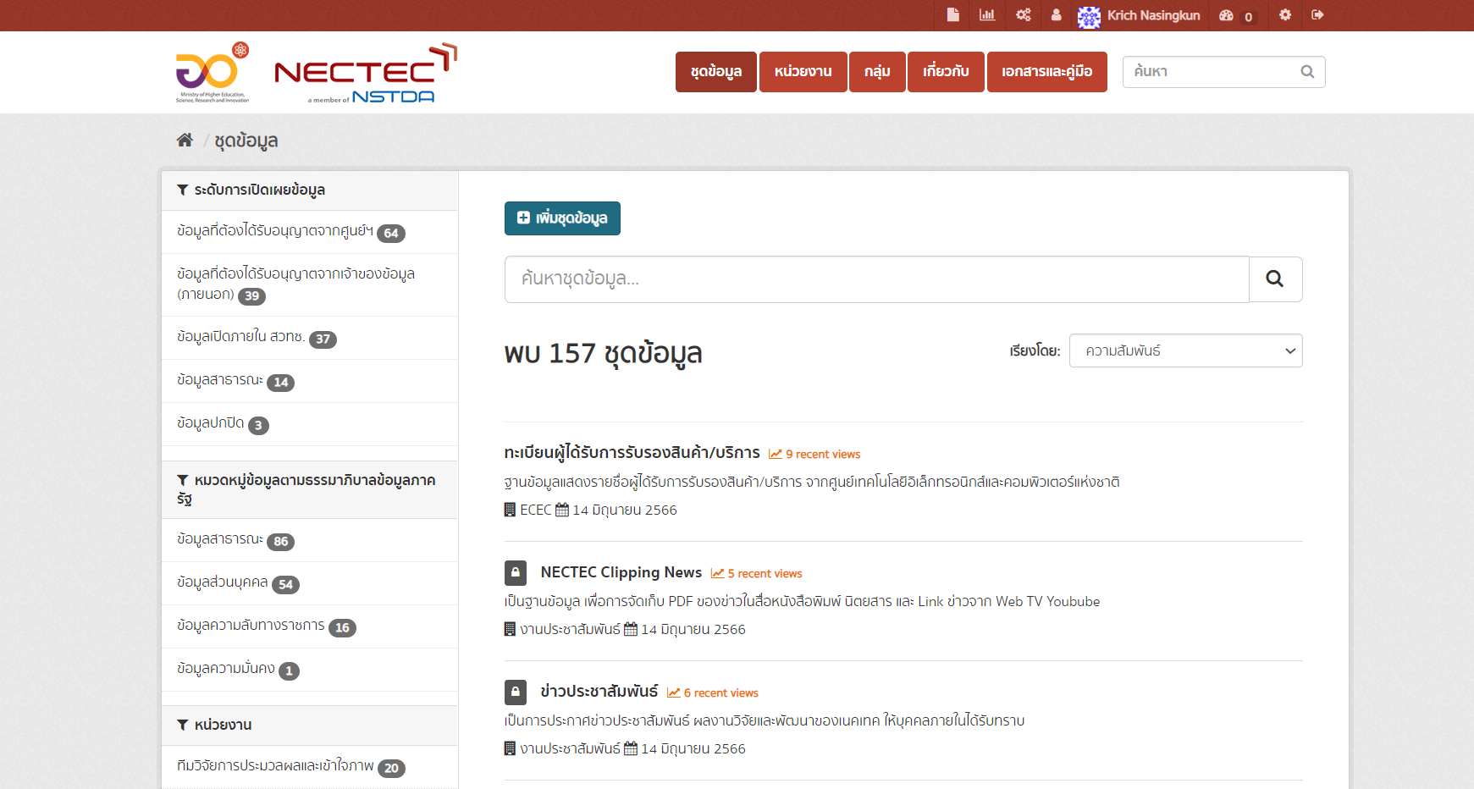
Data catalog

Slide 23
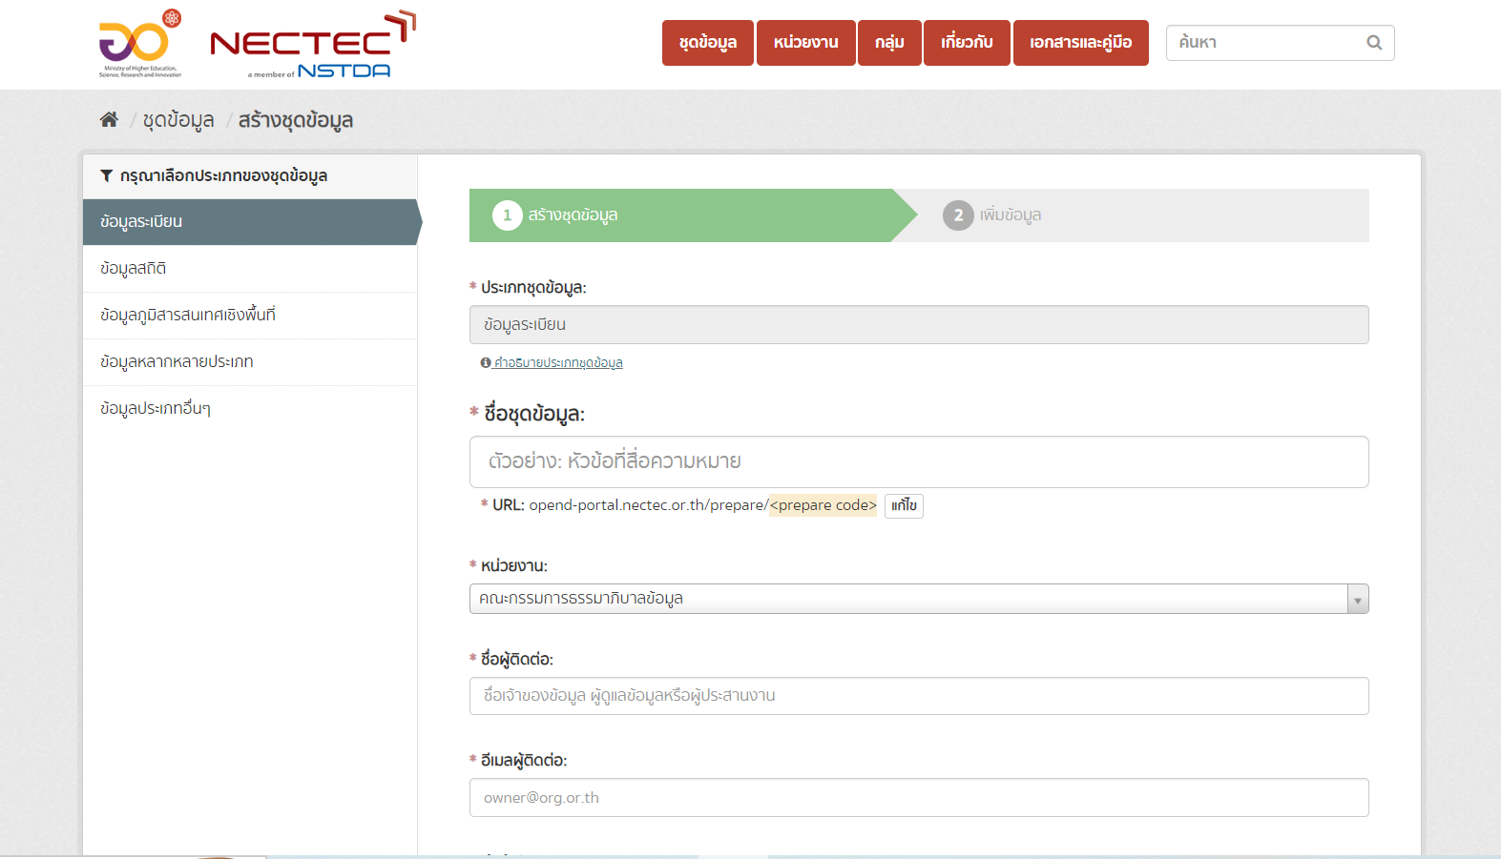
Data register form

Slide 24
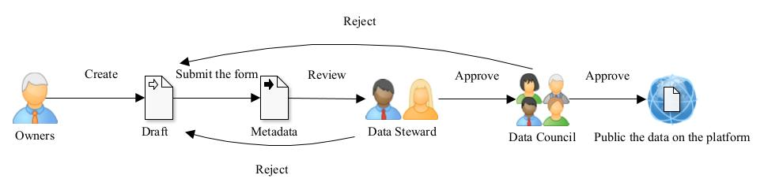
Data Input Flow
Online
Offline

Slide 25

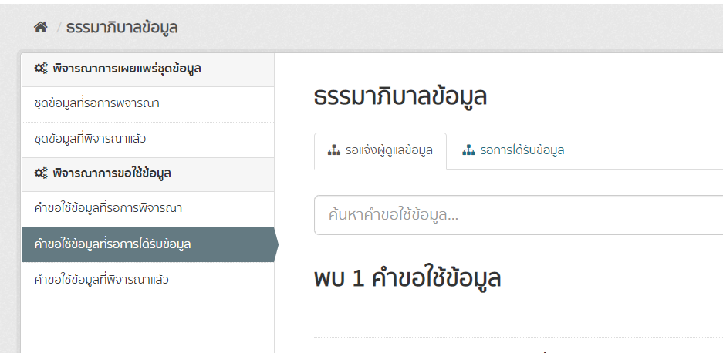
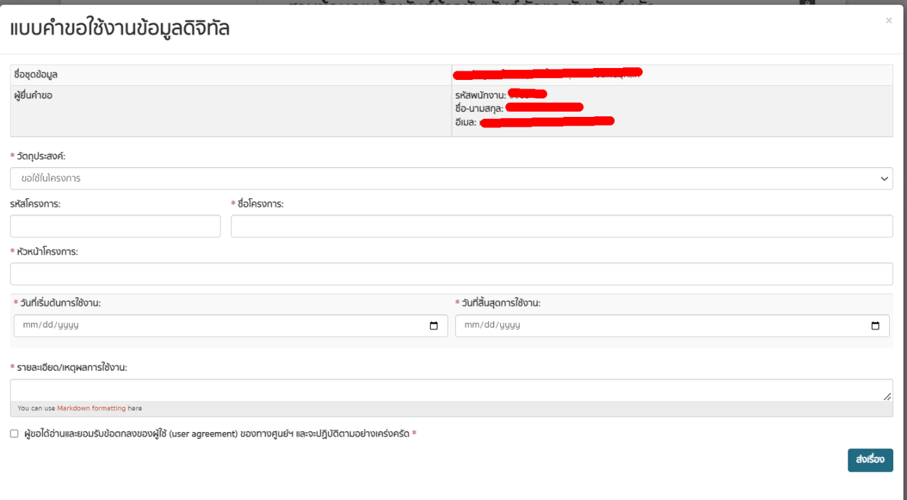
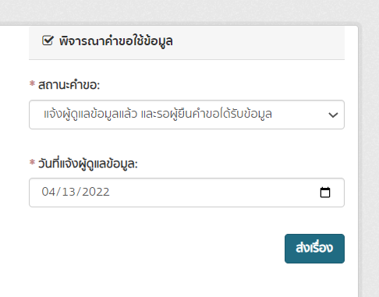
Data Request form

Slide 26
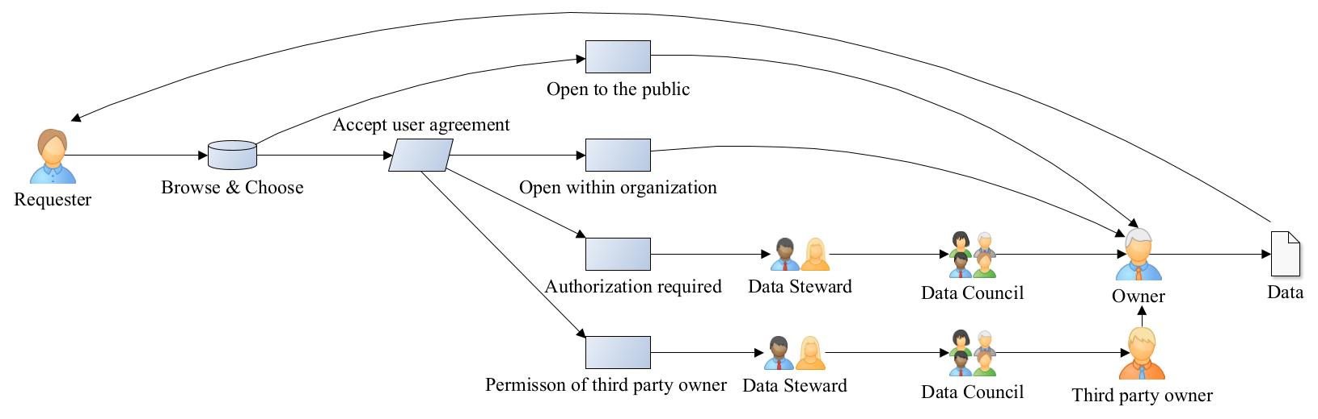
Data Request Flow
Online
Offline

Slide 27
KPI setting (1st and 2nd year goals)
Quatitative goals
  Oraganizae monthly Data Governance team meeting
  Develop Data Catalog Platform
  Set Key Performance Indicators (KPIs)
    1 registred data from each unit
Qualitiative goals
  Increase awareness for all stakeholders

Slide 28
Activities
Top-down communication to deploy KPI
Promote data governance awareness
Conduct monthly meeting for data steward
Report progress for data council every quarter
Conduct training/workshop for all team

Slide 29
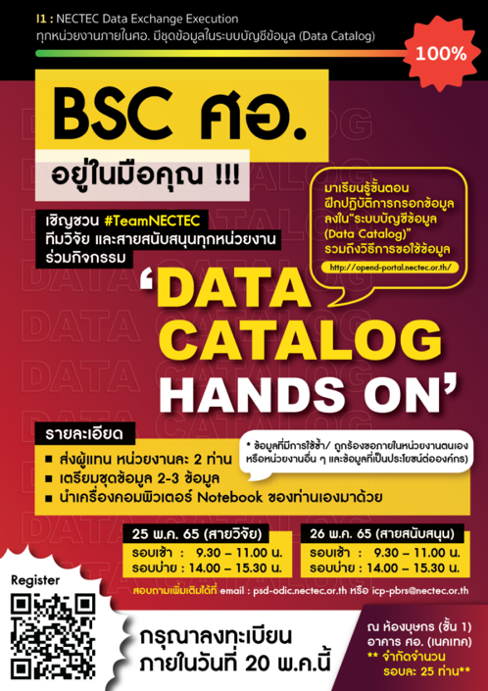
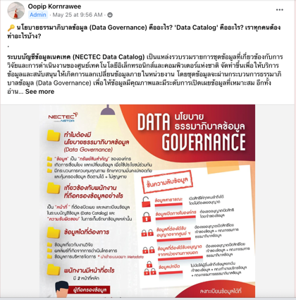
Public relation (PR)

Slide 30
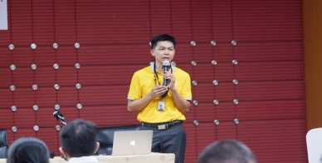
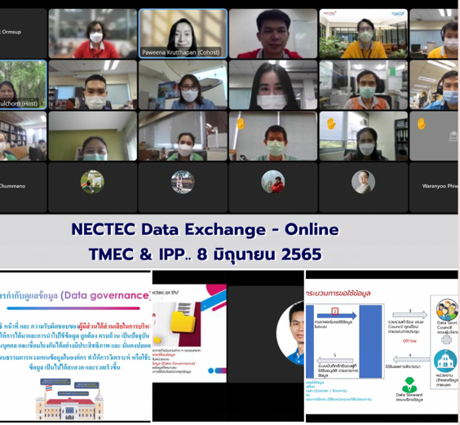
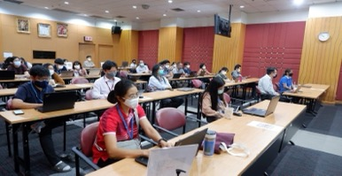
Conduct Workshop

Slide 31
Results
  Develop Data Catalog Platform
  Oraganized monthly Data Governance team meeting
  Get contribution from all team, at least 1 data set be resisted
  Increased data governance awareness of all stakeholders
  Extend usage of platform to another national research center within NSTDA

Slide 32
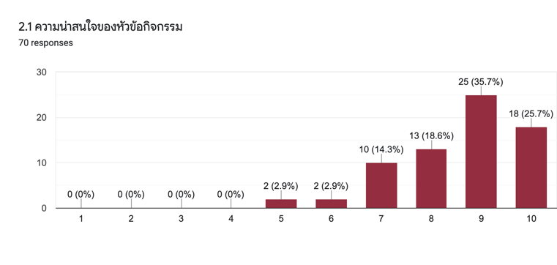
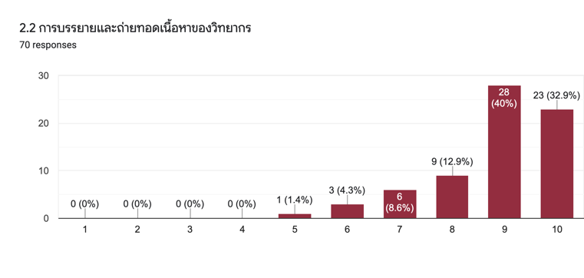
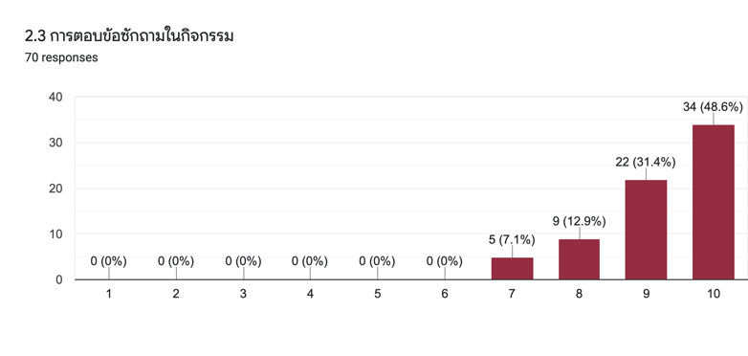
Questionnaries (n=70)
Question on training and presentation
Is the topic interesting = 87 %
Satisfaction with the presentation = 88.4 %
Satisfaction with the Q/A Session = 89.1 %

Slide 33
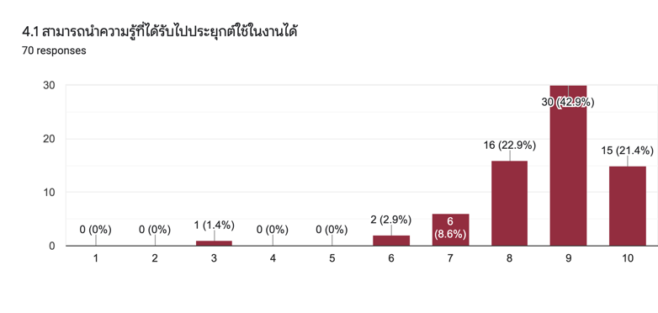
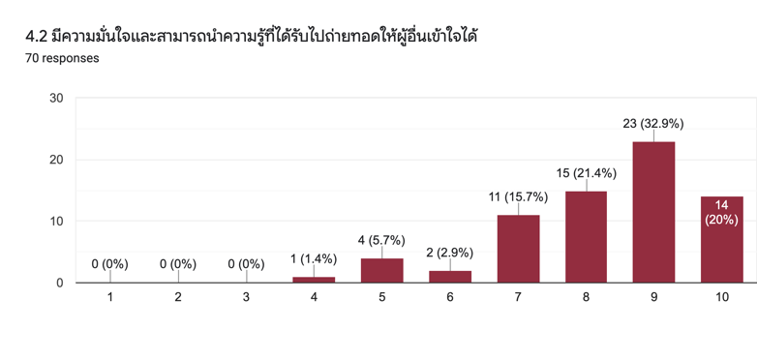
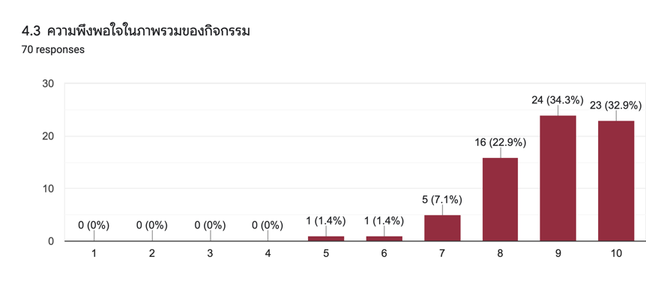
Questionnaries (n=70)
Question on applying training knowledge
Knowledge Application = 89.4%
Confidence in Knowledge Transfer = 84.4 %
Overall Training Satisfaction = 89.6 %

Slide 34
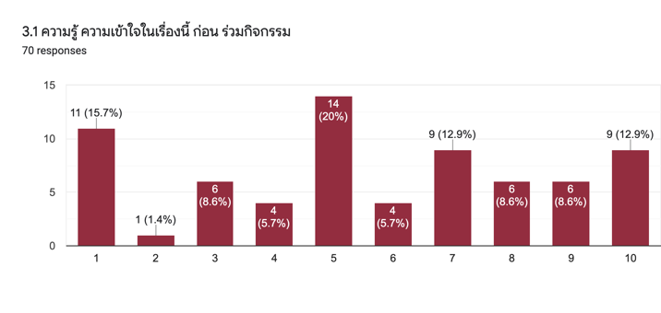
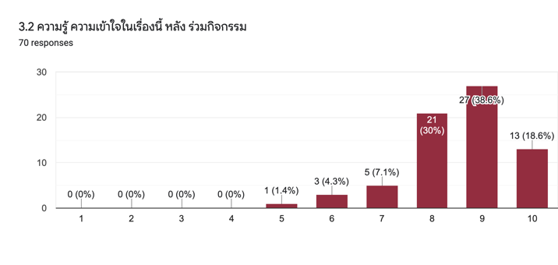
Questionnaries (n=70)
Question on Understanding of Data Governance and Data Catalog
Before Training | After Training
56.6% | 84.5%

Slide 35
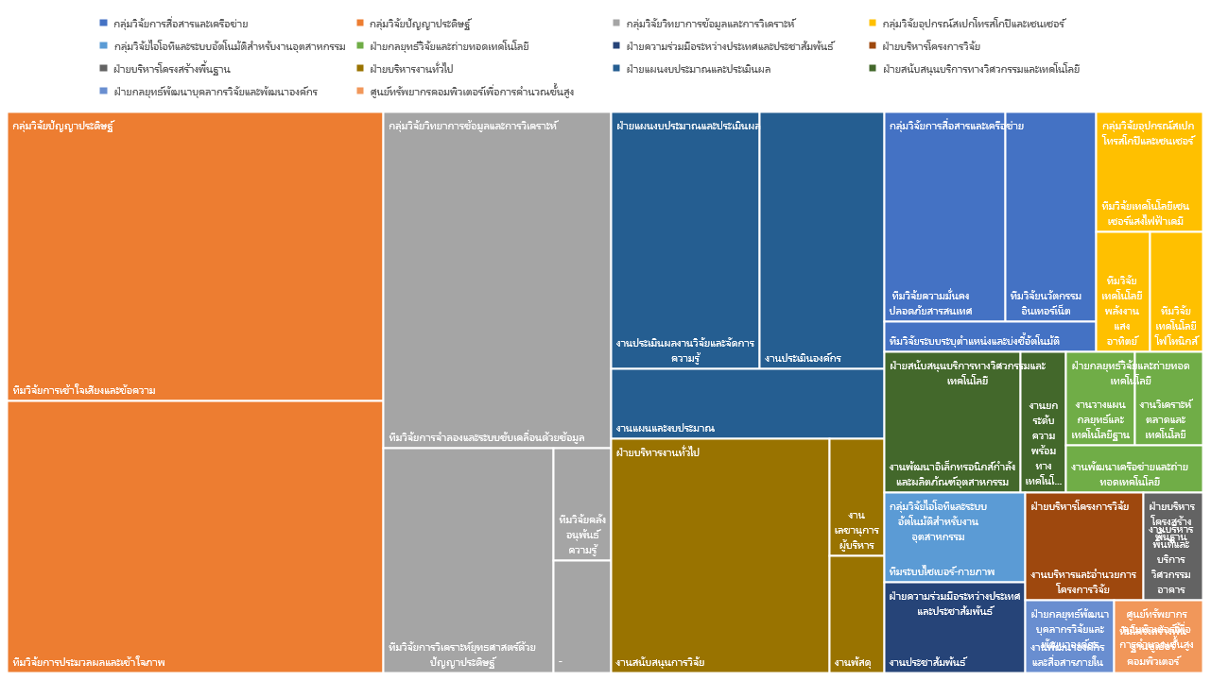
Diversity of registered data based on department

Slide 36
Registerred Data by Openess Level (Nov 22)
Disclosure Level
Open to public | 20
Open within organization | 31
Authorization required | 64
Authorization & permission of owner required | 39
Conceal | 3
Total | 157

Slide 37
Requested Data by Openess Level (Nov 22)
Disclosure Level
Open to public | 0
Open within organization | 2
Authorization required | 10
Authorization & permission of owner required | 3
Conceal | 0
Total | 15

Slide 38
Future Works
Policies
  Improve workflows
  Setup security policies
Data Catalog platform
  Management Dashboard for Stewards
  Console for Data Council
  100% online operation
  Flexible configuration
Promote for public use

Slide 39
THANK YOU
QUESTION & ANSWER

