Slide 1
QUALYST: Data Quality Assessment System for Thailand’s Open Government Data
Tanapat Samakit Dr. Chutiporn Anutariya Dr. Marut Buranarach
The 20th International Joint Conference on Computer Science and Software Engineering
28th June-1st July 2023
Naresuan University Phitsanulok, THAILAND
Notes:
Hello, my name is Tanapat Samakit. Today I’m presenting research proposal namely “Data Quality Assessment System for Thailand Open Government Data”

Slide 2




Table of Contents
Introduction
Background
Statement of Problem
Objectives
Limitations and Scope
Methodology
Data Quality Dimension Selection
System Design
System Implementation
Result
Test Datasets
Quality Assessment Result
Visualization Result
Discussion and Conclusion
Notes:
Here is the table of content; there are introduction Literature, Methodology, Result, and Discussions and Conclusion.
Let’s start with the first one, Introduction, which consists of Background, Statement of Problem, Objectives, and Limitations and Scope

Slide 3
Background of the Study
Open Government Data (OGD) refers to the provision of data produced by the government to the general public, in a format that is readily readable and can be used by machines with ease. It can also promote transparency, improve decision-making, enhance accountability, create economic opportunities, and encourage civic engagement.
However, each published dataset has no indication of its quality assessment at all; thus, making it difficult for citizens to assess the reliability of the data from the OGD.
Therefore, a data quality assessment for OGD should be developed. This will help create effective datasets which in turn help users understand the data.
Notes:
Open Government Data (OGD) refers to the provision of data produced by the government to the general public, in a format that is readily readable and can be used by machines with ease. It can also promote transparency, improve decision-making, enhance accountability, create economic opportunities, and encourage civic engagement.
However, each published dataset has no indication of its quality assessment at all; thus, making it difficult for citizens to assess the reliability of the data from the OGD.
Therefore, a data quality assessment for OGD should be developed. This will help create effective datasets which in turn help users understand the data.

Slide 4
Statement of the Problem
The Government did not provide the data quality of the published data.
No standard framework for data quality evaluation or the dimension of the assessment system to be used for general evaluation.
Notes:
The Government did not provide the data quality of the published data.
No standard framework for data quality evaluation or the dimension of the assessment system to be used for general evaluation

Slide 5
Research Questions
What are the most used data quality dimensions of Open Government Data and how they are measured?
Could a Data Quality Assessment System assess many datasets of the same type using a general pattern of assessment?
After conducting an assessment, what are the challenges of Thailand OGD datasets and what recommendations can be made to overcome them?
Notes:
What are the most used data quality dimensions of Open Government Data and how they are measured?
Could a Data Quality Assessment System assess many datasets of the same type using a general pattern of assessment?
After conducting an assessment, what are the challenges of Thailand OGD datasets and what recommendations can be made to overcome them?

Slide 6
Objective of the Study
To design a framework to evaluate data quality of datasets used for analytics purpose
To design a system of data quality assessment of datasets initially used for analytics purpose
To evaluate data quality of datasets used for analytic purposes of Thailand OGD using the proposed system
Notes:
To design a framework to evaluate data quality of datasets used for analytics purpose
To design a system of data quality assessment of datasets initially used for analytics purpose
To evaluate data quality of datasets used for analytic purposes of Thailand OGD using the proposed system

Slide 7
Limitations and Scope
Structured data for Thailand Open Government (https://data.go.th/)
Datasets for analytical purposes
Notes:
Structured data for Thailand Open Government (https://data.go.th/) which provided for analytical purposes

Slide 8
Contributions
Research Contributions: The data quality assessment methods can clarify the data quality of the Open Government Data.
Practical contribution: The prototype of the Data Quality Assessment System can be implemented to the Open Government Data System to facilitate users in the data quality of a dataset section.
Notes:
Research Contributions: The data quality assessment methods can clarify the data quality of the Open Government Data.
Practical contribution: The prototype of the Data Quality Assessment System can be implemented to the Open Government Data System to facilitate users in the data quality of a dataset section.

Slide 9
Table of Contents
Methodology
Data Quality Dimension Selection
System Design
System Implementation
Notes:
Here is the table of content; there are introduction Literature Review and Methodology.
Let’s start with the first one, Introduction, which consist of Background, Statement of Problem, Objectives, and Limitations and Scope.

Slide 10
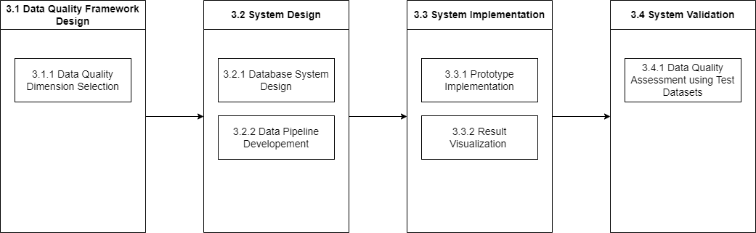
Methodology
The Research Framework
Notes:
The ultimate goal of the proposed system is to develop a prototype of a Data Quality Assessment System (DQAS), in the part of the calculation, storing, and output. Firstly, the data quality dimensions for Open Government Data are chosen for the prototype of assessment. Then, each dimension of the assessment and their calculation methods would be defined in specific conditions and criteria for the scope of datasets, which are for analysis. After that, the database system, and stored procedures for calculation and storing of the DQAS are designed and developed. Finally, the stored result of the DQAS is visualized on a visualization tool.

Slide 11
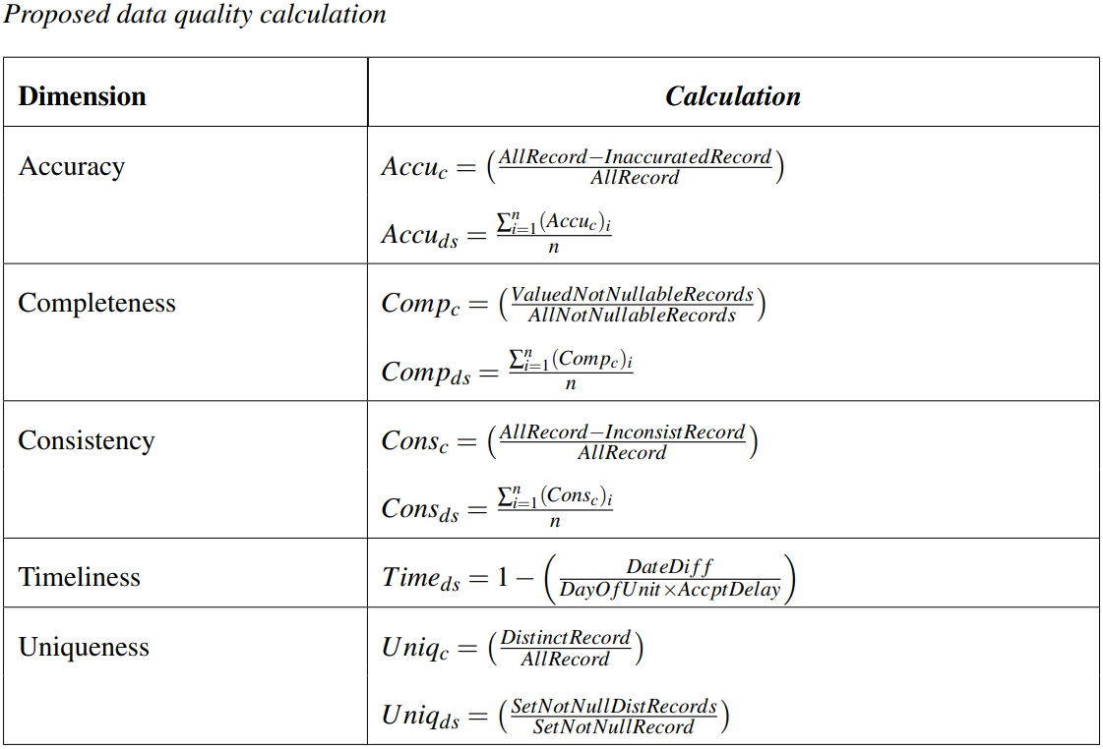
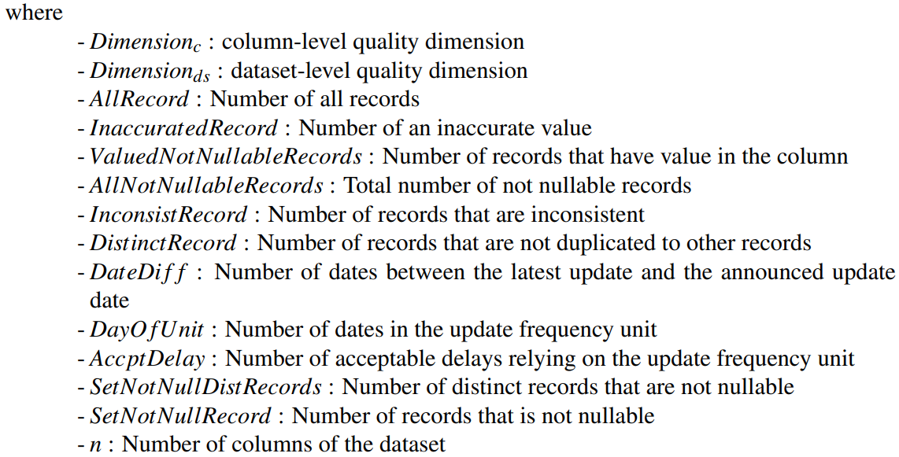
Data Quality Dimension Selection
Notes:
The chosen dimensions for this research are accuracy, completeness, consistency, timeliness, and uniqueness. These dimensions are the most mentioned in many frameworks.
Accuracy: This dimension requires reference data to determine if the data is accurate and usable in the real world. For column level, this dimension should be calculated using the ratio of accurate records. In addition, at the dataset level, it uses the average accuracy score for each column of a dataset as a result.
Completeness: Compare non-NULL mandatory values to total records for column level. The average score of completeness in each column for the dataset level is computed.
Consistency: a format of data in a column that will be compared to another dataset in the same data type. This dimension uses rule-based analysis. Thus, the data type pattern is needed to measure the dimension to the public. The calculation of the dataset level is similar to the previous dimensions as it is calculated through averaging the consistency score of the dataset.
Timeliness: It is calculated based on local suitability, expert consultation, and assessment purposes. It is calculated at the dataset level by subtracting the latest update date from the current date and dividing by an acceptable number of dates for that unit e.g. the acceptable delay of annually should not be more than 2 years, then it should be 365 (number of days in a year) multiply by 2 (acceptable delay).
Uniqueness: This dimension calculates the score by dividing the number of distinct records set and the collection of not nullable columns by the total records set. Additionally, it can be calculated column by column using distinct records of individual columns divided by all records of the column at the column level.

Slide 12
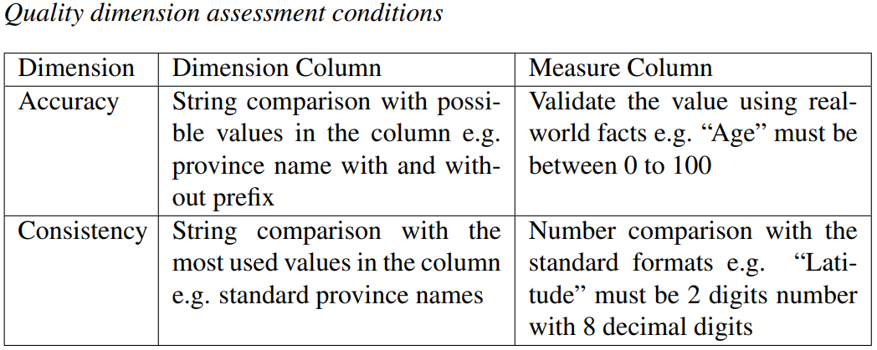
Data Quality Dimension Selection
(Validity)
Notes:
Moreover, there are some dimensions that have their own condition for specific data type, which are accuracy and consistency

Slide 13

System Design
System Pipeline
Database Schema Design
Notes:
There are two primary components that must be developed in order to create the DQAS prototype. To begin, there is the Database System. The purpose of this component is to cache an input dataset for the calculation and to store the assessment result of datasets so that they can be visualized on a dashboard for the purposes of analysis and publication. Furthermore, it will be also intended to be a framework of the Data Quality Assessment System. And, it has Stored Procedures for the calculation of each data quality dimension. Another one to be designed is Data Pipeline for the system, the processes of assessment of each dataset need to be stored in the database system for the result evaluation and visualization. Then, the process of Extract, Transform, and Load (ETL) is needed to be designed to handle the flow of the system.

Slide 14
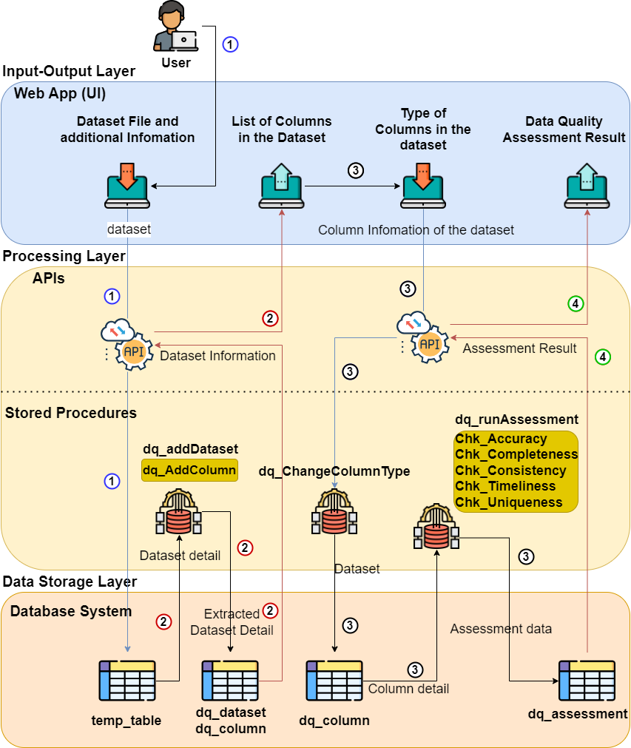
System Pipeline

Slide 15
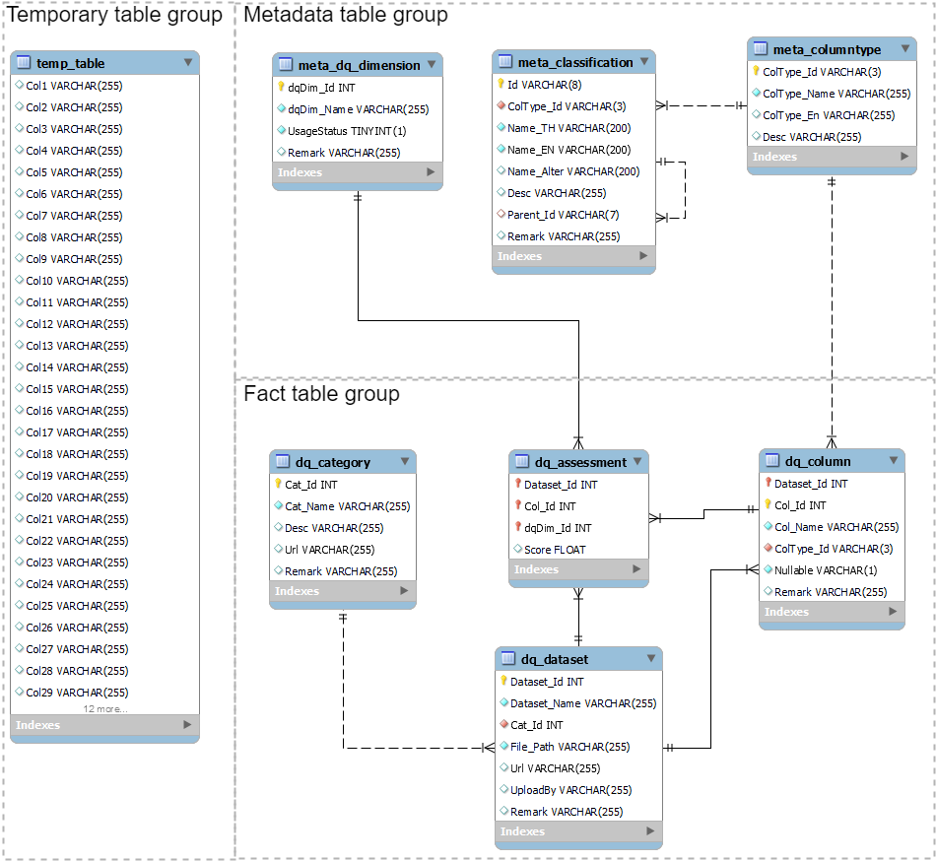
Database
Design
Notes:
It comprises a total of 8 tables, grouped into 3 types of tables:
temp_table: This table is defined as a temporary table, used for holding a forty-column dataset for assessment. After each round of assessment, the table is truncated to accept new input.
Metadata
meta_classification: The purpose of this table is to collect metadata to compare the value of metadata that should be the standard value to a dataset for the assessment.
meta_columntype: This table stores the datatype of a dataset's column and defines the type of a value in the classification.
meta_dq_dimension: This table collects data quality dimensions with usage status for each dimension.
Fact Table
dq_dataset: It collects general dataset information to refer to other tables that will refer to the dataset source.
dq_column: It collects the dataset column name and data type that connects to the \texttt{dq\_dataset} using the column Dataset_Id.
dq_category: It organizes datasets by data catalog to make assessment results easier to access and evaluate.
dq_assessment: It shows the assessment of each dataset by referring to the three related tables: dq_dataset, dq_column, and meta_dq_dimension.

Slide 16
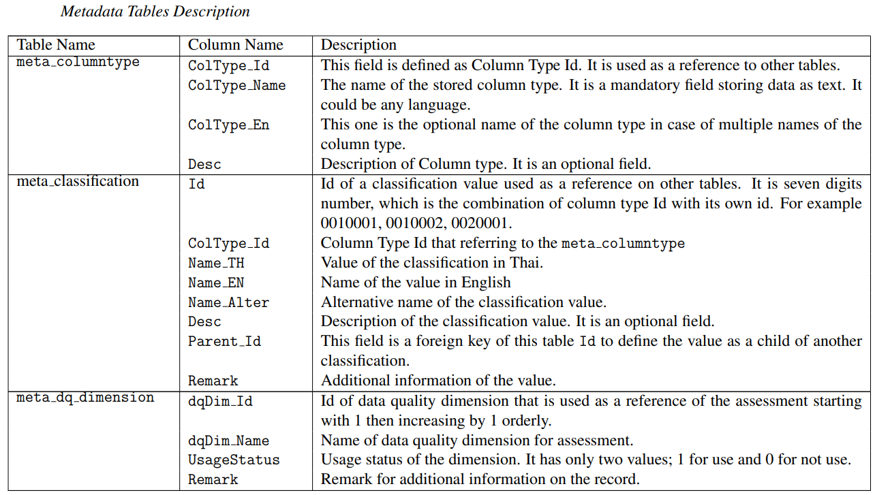
Metadata

Slide 17
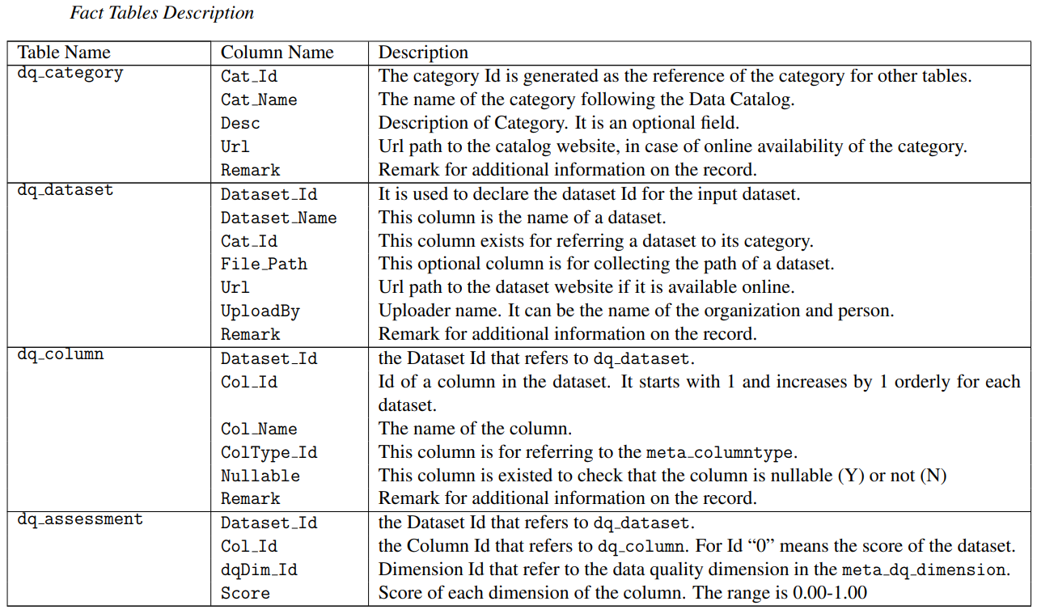
Fact tables

Slide 18
Data Pipeline Development
The data pipeline is used for the flow of the data quality assessment, which targets making the whole process can be worked on demand for the evaluation. The ETL process using stored procedures will be focused to calculate the score of the assessment.
Extract. The raw data from different sources will be extracted into a table for calculation.
Transform. The extracted data will be calculated depending on data quality dimensions, and selected attributes will be obtained and transformed into a consistent format. The data aggregation is also performed mainly for fact tables.
Load. The data that has been calculated will be loaded into the database using the schema that has been designed.
Notes:
The system mainly has five procedures following the number of data quality dimensions. each of them gets input from a dataset which is the column name for assessment, the type of a dataset (such as geo-location, analytic purpose, statistic, and so on), and specific input for the requirement of each dimension. After that, it calculates the score depending on the criteria of each dimension, then stores the dataset id, column id, data quality id, and score of its into the fact table named ``dq\_assessment".
Extract.} The raw data from different sources will be extracted into a table for calculation.
{Transform.} The extracted data will be calculated depending on data quality dimensions, and selected attributes will be obtained and transformed into a consistent format. The data aggregation is also performed mainly for fact tables.
{Load.} The data that has been calculated will be loaded into the database using the schema that has been designed.
\end{itemize}

Slide 19
System Implementation
Prototype Implementation
The implementation includes the data pipeline development to handle the flow of the assessment from the temporary table and the stored procedure input to the database system.
Result Visualization
The outcome of the evaluation conducted for this study is initially visualized using visualization tools.
Notes:
\subsection{ Prototype Implementation }
The components from the previous steps, which are the output of the assessment from the ETL process and the developed database system, will be integrated as a single system in this section. The implementation includes the data pipeline development to handle the flow of the assessment from the temporary table and the stored procedure input to the database system.
\subsection{ Result Visualization }
The outcome of the evaluation conducted for this study is initially visualized using visualization tools such as Tableau, Power BI, or Google Data Studio. This is done to enable users to view both the dataset perspective and the category perspective in order to make decisions on either the user's side or the administrator's side of the system.

Slide 20
System Evaluation
Prototype Evaluation
An evaluation of the prototype system will be carried out to ensure that each component is functioning appropriately. The ETL process will be reviewed by the execution of an input dataset within the system. This will examine the outcome of the process as well as determine whether or not it was carried out in the correct manner.
Visualization Evaluation
The effectiveness and usability of the assessment visualization will be evaluated with examples of the visualization that explain the result of the assessment.
Notes:
{ Prototype Evaluation }
By utilizing the ETL system setting, an evaluation of the prototype system will be carried out to ensure that each component is functioning appropriately. The ETL process will be reviewed by the execution of an input dataset within the system. This will examine the outcome of the process as well as determine whether or not it was carried out in the correct manner.
{ Visualization Evaluation }
The effectiveness and usability of the assessment visualization will be evaluated with the use of a score based on the system's usability (SUS).

Slide 21
Table of Contents
Result
Test Datasets
Quality Assessment Result
Visualization Result
Notes:
Here is the table of content; there are introduction Literature Review and Methodology.
Let’s start with the first one, Introduction, which consist of Background, Statement of Problem, Objectives, and Limitations and Scope.

Slide 22
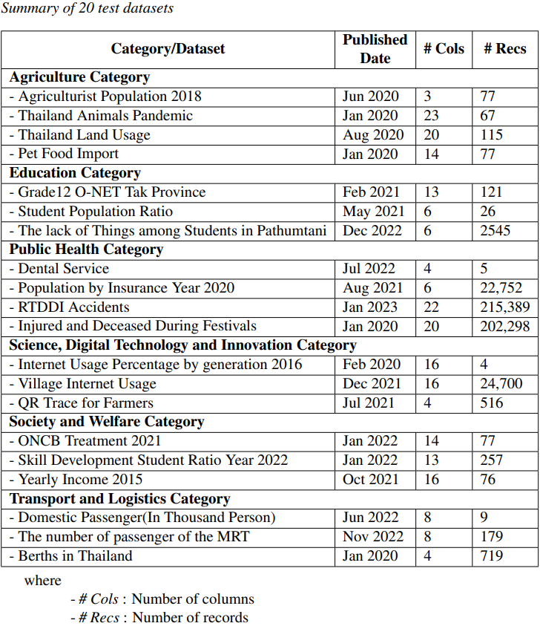
Test Datasets
Notes:
The Thailand OGD datasets are used for the prototype assessment. The use of these datasets in the prototype assessment highlighted the importance of open data and its potential to drive innovation and provide solutions to various societal challenges. There are 2,983 datasets, separated into 15 categories, published on the portal.
For demonstration purposes of the study, 20 datasets from 6 OGD categories were sampled. In selecting those datasets, certain criteria were taken into consideration. First, the provided dataset's file format had to be either a CSV file or XLSX. This was to ensure ease of access and usability for potential users of the datasets. Additionally, the datasets chosen were required to contain in-detail data as much as possible, with a focus on analytics purposes. This means that the datasets needed to provide insights that could be used for analytical purposes. Finally, the datasets chosen were also expected to be high-valued, meaning they could potentially have a significant impact on decision-making processes or provide valuable insights into various fields.

Slide 23
Quality Assessment
Result
Notes:
Fig.~\ref{DQASFlow} depicts the data quality assessment of a particular dataset.

Slide 24
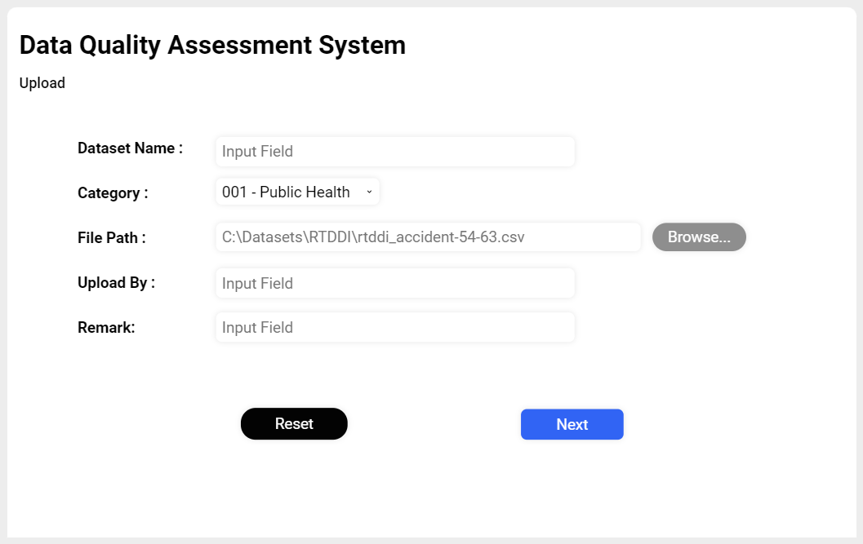
Quality Assessment Result
Notes:
As the first step (1), a user starts QUALYST semi-automatic pipeline by providing a dataset file and its information. Then, the uploaded file is sent to the temp_table. This temp_table is normally truncated every time the new dataset is uploaded to prevent data from mixing up.

Slide 25
Quality Assessment
Result
Notes:
Then, the uploaded file is sent to the temp_table. This temp_table is normally truncated every time the new dataset is uploaded to prevent data from mixing up.
In the next step (2), a QUALYST API triggers the stored procedure dq_addDataset to insert the dataset information into the table dq_dataset and then automatically extracts the columns of the dataset using the procedure dq_AddColumn

Slide 26
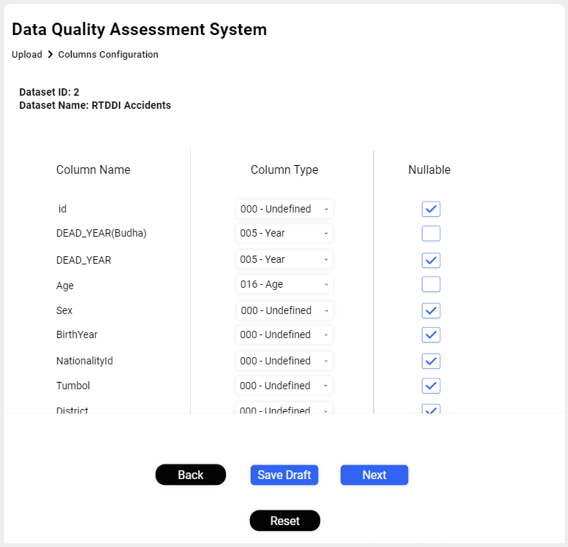
Quality Assessment Result
Notes:
Then, the step (3), each column's data type is configured with a nullable flag for the assessment to verify each data type and nullability of each column for the assessment (cf. Fig.~\ref{SecUI}). After every column is configured, another API sends each column's information to the main stored procedure dq_runAssessment with the input of \texttt{Dataset Id}, \texttt{Update Frequency Unit}, \texttt{Declared Update Date} and \texttt{Latest Update Date}. To perform quality dimension assessment, the store procedures \texttt{Chk\_Accuracy}, \texttt{Chk\_Completeness}, \texttt{Chk\_Consistency}, \texttt{Chk\_Timeliness}, and \texttt{Chk\_Uniqueness} are triggered to assess the quality of each column and of the dataset.

Slide 27
Quality Assessment
Result
Notes:
After every column is configured, another API sends each column's information to the main stored procedure dq_runAssessment with the input of Dataset Id, Update Frequency Unit, Declared Update Date and Latest Update Date. To perform quality dimension assessment, the store procedures Chk_Accuracy, Chk_Completeness, Chk_Consistency, Chk_Timeliness, and Chk_Uniqueness are triggered to assess the quality of each column and of the dataset.

Slide 28
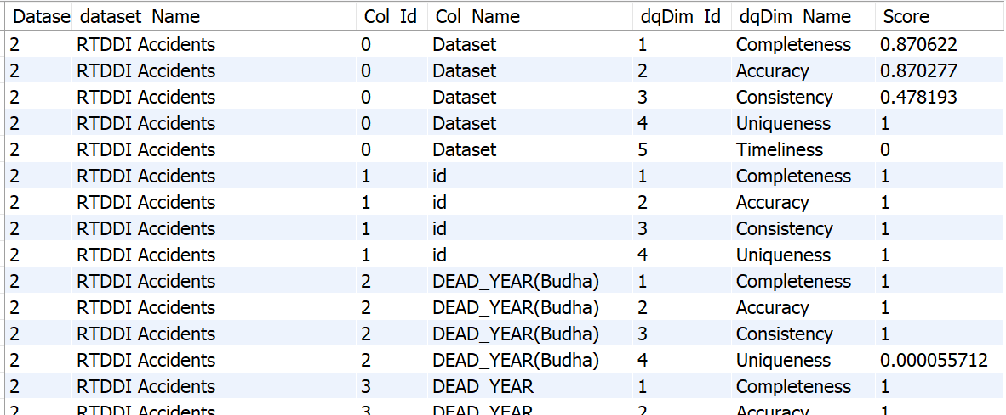
Quality Assessment Result
Notes:
Then, all of the results are stored in the table dq_assessment as shown in Fig.~\ref{SQLResult}.

Slide 29
Quality Assessment
Result
Notes:
For the last step (4), the assessment results and visualization is present to the user, which means it has already assessed and stored the data in the system.

Slide 30
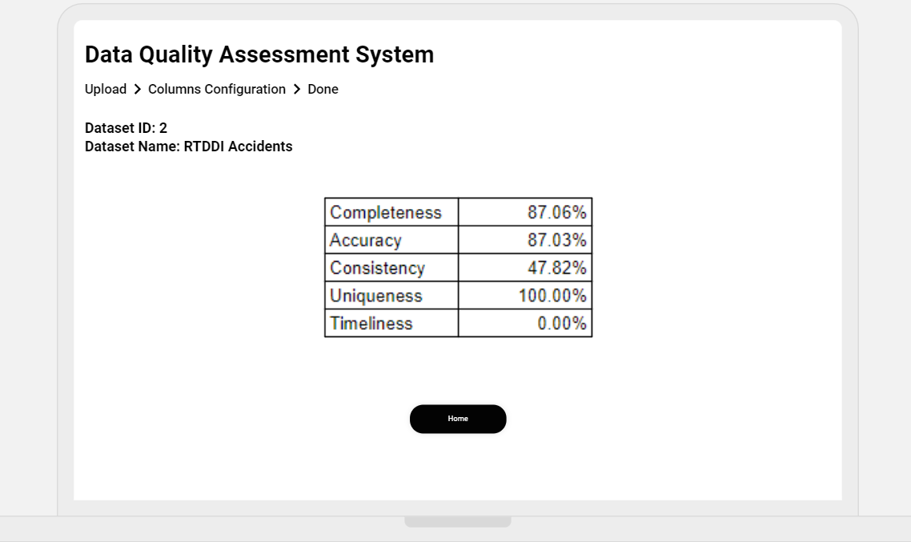
Quality Assessment Result
Notes:
Here is an example of final interface of the assessment system

Slide 31
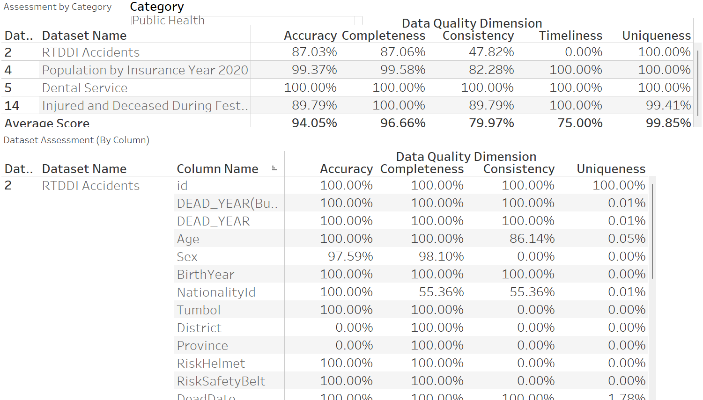
Visualization Result
Notes:
QUALYST provides an interactive dashboard to visualize the quality of OGD datasets in various dimensions. A user can filter, display and compare the quality in different levels, including the column level, dataset level as well as OGD category level. Several types of visualizations are designed to suit different visualization purposes. For example, Figure~\ref{fig:VizDetail} shows the assessment results of the datasets in the selected category, in this case, Public Health. Consider the first table at the top, the designed tabular view depicts the calculated quality scores of the five proposed dimensions: accuracy, completeness, consistency, timeliness, and uniqueness. The scores are presented at both dataset level and category level. The bottom table of Figure~\ref{fig:VizDetail} then elaborates the quality scores at the column level.

Slide 32
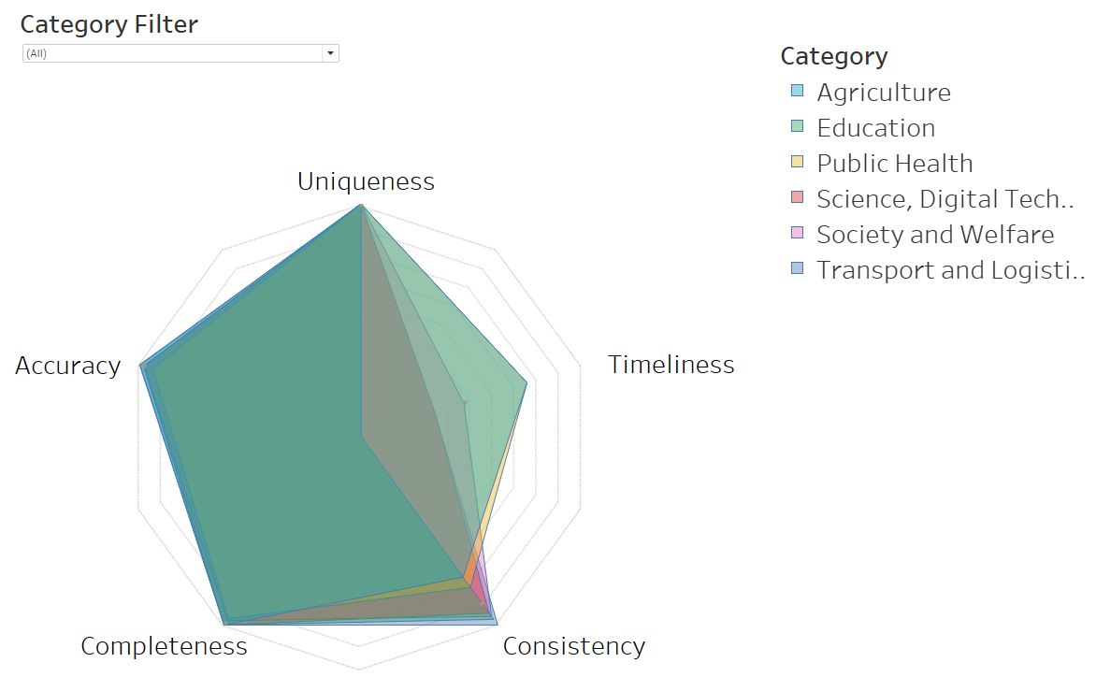
Visualization Result
Notes:
For the purpose of making quality score comparisons across OGD categories, Figure~\ref{fig:VizRadar} presents, in the form of a radar chart, all five quality dimensions for each of the categories that were chosen.

Slide 33
Table of Contents
Discussion and Conclusion
Notes:
Here is the table of content; there are introduction Literature Review and Methodology.
Let’s start with the first one, Introduction, which consist of Background, Statement of Problem, Objectives, and Limitations and Scope.

Slide 34
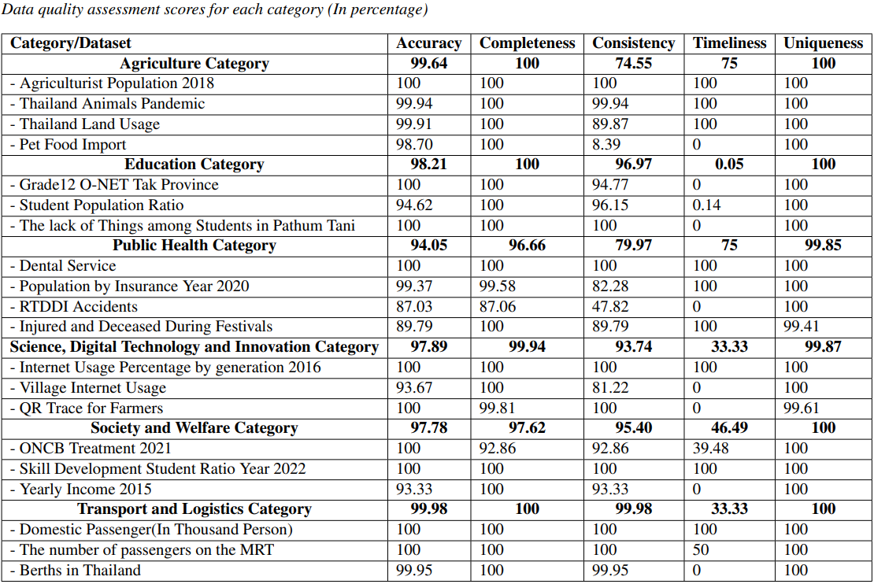
Discussion
Notes:
For analysis of the results at the category level, datasets from 6 categories are assessed: Agriculture, Education, ……
To discuss each dimension for assessment, the first one is accuracy, in part of validity, every category got a high score of accuracy because the semi-automatic system prototype is capable of conducting only the fundamental accuracy evaluation. The system can perform basic accuracy evaluations, which contribute to the high score across all categories.
To make it more accurate, it still needs manual assessment. There are multiple perspectives to consider, necessitating the user to define the evaluation method. Each use case requires a specific evaluation method, which needs to be defined by the user. Additionally, a large amount of metadata is required to assess all values within a dataset. Unfortunately, there is a scarcity of official published metadata to assess, requiring a manual review.
As the table is shown, datasets categorized under Public Health contain numerous columns. Although many of these columns are general and can be assessed using existing metadata, numerous others comprise specific value types lacking official metadata for assessment. This makes it difficult to evaluate certain types of data, especially those that are specific or unique. Consequently, experts are needed to validate or establish standard metadata for these specific columns.
In addition, many datasets in the portal are summarized datasets, these are also the cause of the high accuracy of the datasets.
The next dimension is completeness. The current prototype assesses this dimension automatically depending on mandatory columns. There are no issues with the assessment whenever data profiling is not needed for this dimension.
Regarding the consistency dimension, some categories have a relatively low score because many datasets within those categories use different values with the same meaning. This inconsistency may lead to confusion and may increase the time required for people to understand and use multiple datasets within those categories simultaneously.
Regarding the timeliness dimension, the latest dataset update gets too much delay from the expected update frequency for many datasets, and as a result, the quality of the information would be diminished for usage.
In addition, it appears that several records in the datasets are duplicated. such redundancies in the data can lead to confusion and errors in data analysis. Hence, to improve the data quality of Thailand's OGD for citizens, based on the sampled, selected datasets and OGD categories, the consistency and timeliness dimensions should be of central concern.

Slide 35
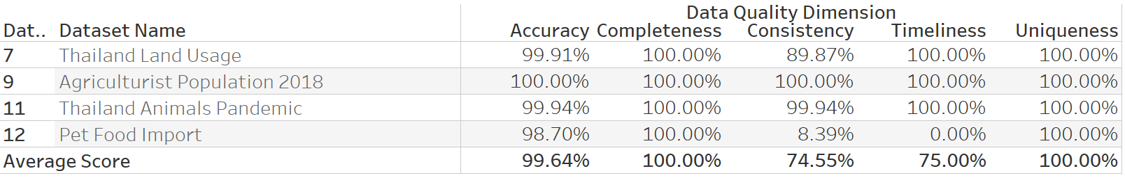
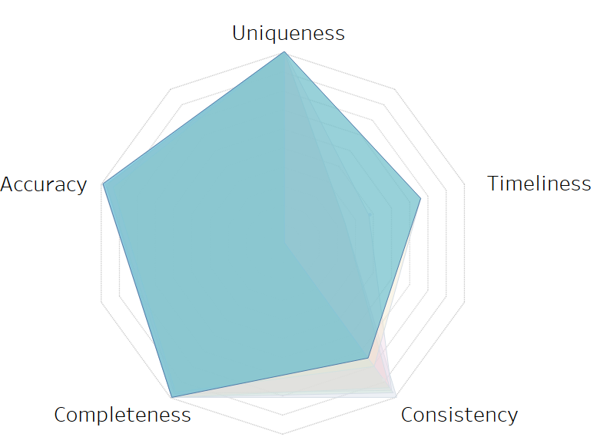
Discussion
Agriculture Category
Notes:
The first one is Agriculture Category. The accuracy score of this category is high because most of the columns are numeric. For completeness, there are no issues for this category due to all mandatory columns of each data fulfill the criteria of completeness. The next one is consistency, the ``Pet Food Import'' dataset got a very low score (8.39\%) since almost all numeric data type columns consist of the text ``-" instead of 0 or \textit{null}. About timeliness, 3 first datasets obviously declared that they are not updated, though the last one is declared as unknown, so it got 0 while the others got 100\%.

Slide 36
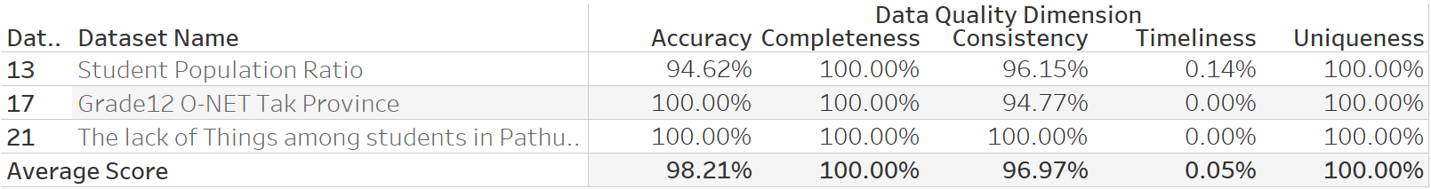
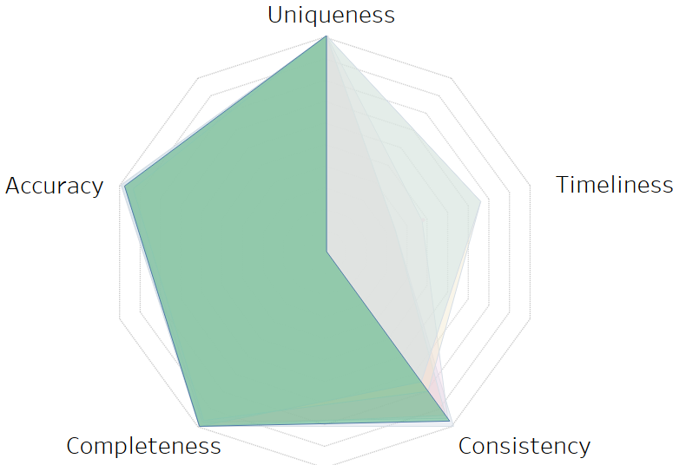
Discussion
Education Category
Notes:
For the second is, Education Category. The accuracy of the ``Student Population Ratio'' is reduced, because one of the columns in the dataset represents the ratio of students to population and is measured in percentage (Ratio). However, certain values in this column exceed 100\%, which is not feasible in real-world scenarios. Next, there is no issue in the completeness dimension. Regarding consistency, both datasets got high scores, there are certain values within the datasets that exhibit inconsistencies. The next is timeliness, the ``Student Population Ratio'' dataset acquired 0.14\% since it declared its annual update, but the last update for this dataset was in 2020, which is around 2 years ago. Another dataset acquired 0\% because the is no information on update frequency in the portal. Lastly, there are no duplicate records in any dataset.

Slide 37
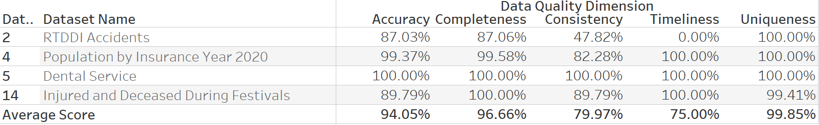
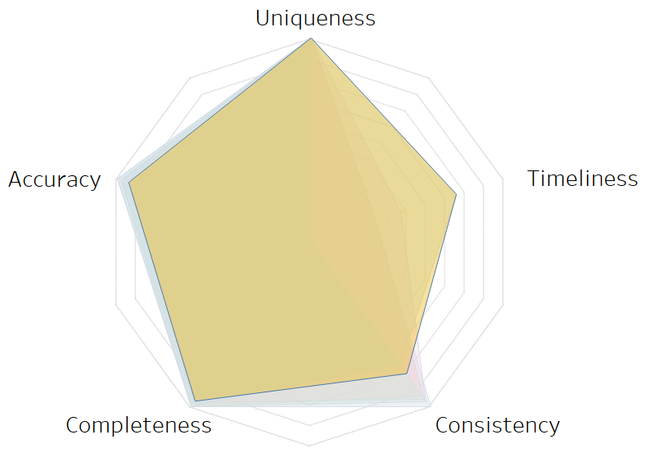
Discussion
Public Health Category
Notes:
The next is Public Health Category. As mentioned in the individual dataset section, most of them contain practical values and contain a similar pattern to other datasets, by the way, a few of them are misspelled. For consistency, several columns deviated from the expected pattern or were dissimilar to column types in other datasets. Moreover, most of the datasets in this category clearly declared frequency update units on both the dataset files and portals hence, the timeliness of this category is high. For uniqueness, the ``Injured and Deceased During Festivals'' dataset could not achieve 100\% as it contains masked data. Therefore, there is a possibility of certain records being identified due to the absence of identity values.

Slide 38
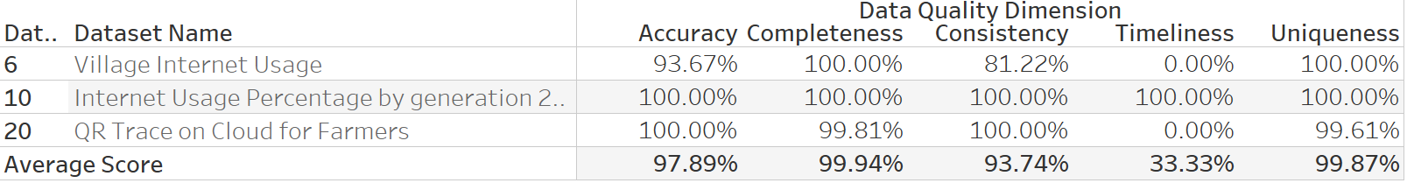
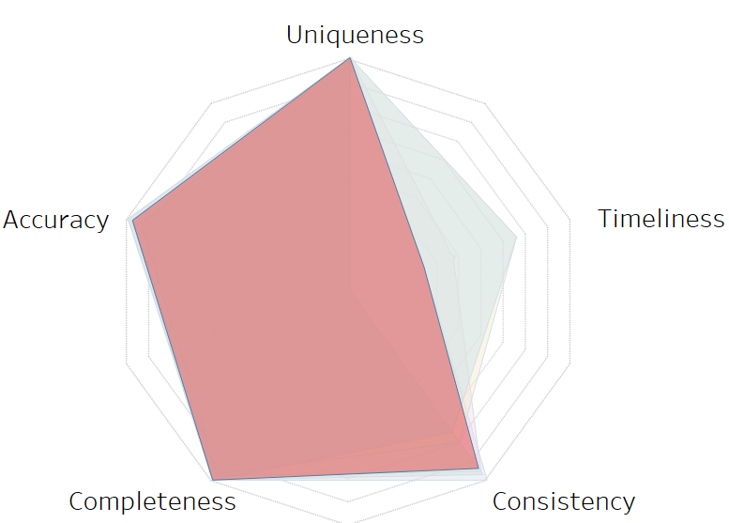
Discussion
Science, Digital Technology and Innovation Category
Notes:
In the Science, Digital Technology, and Innovation category, there are several datasets with potential issues related to accuracy, consistency, and timeliness. One such dataset is ``Village and Internet Usage", which is considered a high-value dataset. However, it contains misspelled place names that may not exist, which could affect the accuracy of the data. Additionally, the dataset has a column with the data type ``Region", but the values do not conform to the expected pattern, leading to inconsistencies in the data. Furthermore, although ``Village and Internet Usage" is supposed to be updated monthly as declared in the portal, the dataset has not been updated in over a year, raising concerns about the timeliness of the information.

Slide 39

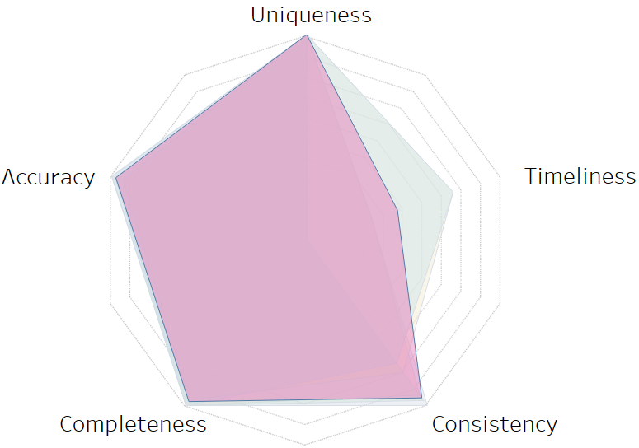
Discussion
Society and Welfare Category
Notes:
Moving on to the Society and Welfare Category and the Transport and Logistics Category, both of these categories have high overall scores due to the majority of columns in their datasets being numeric and practical in nature. However, there is a specific issue related to accuracy that has been identified in these categories, namely, the ``Yearly income 2015'' dataset. In this dataset, all columns have a space before the value, which might be a minor issue that can be easily fixed using the trim function during the assessment. Nonetheless, this problem could potentially cause trouble when working with multiple datasets simultaneously and should be corrected to ensure accurate and reliable data.

Slide 40
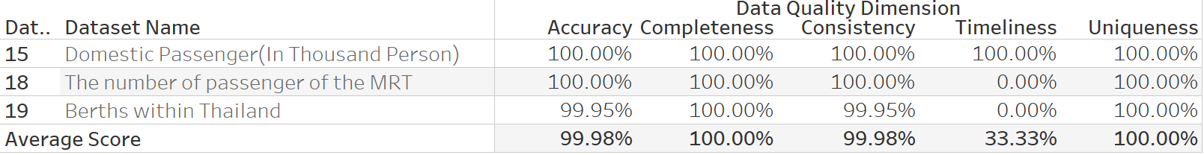
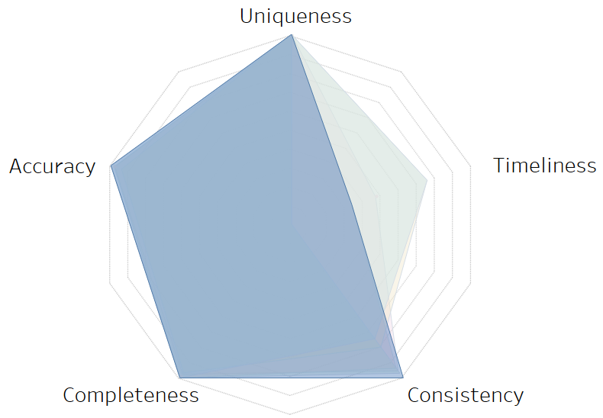
Discussion
Transport and Logistics Category
Notes:
And here is the score of the last category.
To discuss each dimension for assessment, the first one is accuracy, every category got a high score of accuracy because the semi-automatic system prototype is capable of conducting only the fundamental accuracy evaluation. The system can perform basic accuracy evaluations, which contribute to the high score across all categories. To make it more accurate, it still needs manual assessment. There are multiple perspectives to consider, necessitating the user to define the evaluation method. Each use case requires a specific evaluation method, which needs to be defined by the user. Additionally, a large amount of metadata is required to assess all values within a dataset. Unfortunately, there is a scarcity of official published metadata to assess, requiring a manual review. As an illustration, datasets categorized under Public Health contain numerous columns (refer to Table~\ref{DatasetSum}). Although many of these columns are general and can be assessed using existing metadata, numerous others comprise specific value types lacking official metadata for assessment. This makes it difficult to evaluate certain types of data, especially those that are specific or unique. Consequently, experts are needed to validate or establish standard metadata for these specific columns. In addition, many datasets in the portal are summarized datasets, these are also the cause of the high accuracy of the datasets. The next dimension is completeness. The current prototype assesses this dimension automatically depending on mandatory columns. There are no issues with the assessment whenever data profiling is not needed for this dimension. Regarding the consistency dimension, some categories have a relatively low score because many datasets within those categories use different values with the same meaning. This inconsistency may lead to confusion and may increase the time required for people to understand and use multiple datasets within those categories simultaneously. Regarding the timeliness dimension, the latest dataset update gets too much delay from the expected update frequency for many datasets, and as a result, the quality of the information would be diminished for usage. It appears that several records in the datasets are duplicated. such redundancies in the data can lead to confusion and errors in data analysis. Hence, to improve the data quality of Thailand's OGD for citizens, based on the sampled, selected datasets and OGD categories, the consistency and timeliness dimensions should be of central concern.

Slide 41
Conclusion
QUALYST, the data quality assessment system, which is capable of analyzing, maintaining, and visualizing the quality of Thailand OGD datasets in a variety of important dimensions, as well as in a variety of granular levels, such as column, dataset, and OGD category.
To demonstrate the capabilities of the framework, sample datasets provided by the Thailand OGD were evaluated.
The results that have been provided have demonstrated that QUALYST is capable of calculating the data quality of the entirety of the datasets across all dimensions and storing them in their entirety in the database.
Notes:
This study proposes and develops QUALYST, the data quality assessment system, which is capable of analyzing, maintaining, and visualizing the quality of Thailand OGD datasets in a variety of important dimensions, such as accuracy, completeness, consistency, timeliness, and uniqueness, as well as in a variety of granular levels, such as column, dataset, and OGD category.
In order to demonstrate the capabilities of the framework, sample datasets provided by the Thailand OGD were evaluated. The results that have been provided have demonstrated that QUALYST is capable of calculating the data quality of the entirety of the datasets across all dimensions and storing them in their entirety in the database. In addition, the analysis of the assessment results is discussed.

Slide 42
Conclusion
The following user roles will benefit from the proposed system:
OGD providers and administrators, who are required to verify data quality prior to the publication of datasets
OGD consumers, who will be able to determine the initial dataset quality prior to downloading and using it
OGD directors and/or policymakers, who promote OGD provision and consumption, as well as specifically direct OGD strategies.
Notes:
For practical usage of QUALYST, the following user roles will benefit from the proposed system: (i) OGD providers and administrators, who are required to verify data quality prior to the publication of datasets; (ii) OGD consumers, who will be able to determine the initial dataset quality prior to downloading and using it; and (iii) OGD directors and/or policymakers, who promote OGD provision and consumption, as well as specifically direct OGD strategies.
Then, the development of the QUALYST system represents a significant contribution to the field of OGD and data quality assessment. By providing a comprehensive framework for assessing and improving the quality of Thailand OGD datasets, QUALYST has the potential to promote transparency, accountability, and innovation in the public sector. It enables OGD providers and administrators to ensure that datasets are of high quality before publication, which in turn helps to build trust in the data and increase its usefulness for data consumers. QUALYST also benefits data consumers by enabling them to make informed decisions about the suitability of datasets for their specific needs.

Slide 43
Conclusion
Limitation and Recommendations:
The system is currently limited to analyzing CSV file formats
The system's data quality dimensions are based on established literature and may not fully capture the unique aspects of Thailand's OGD.
The system may encounter challenges with dynamic datasets that involve crossed columns validation.
Notes:
The QUALYST system has some limitations that should be addressed to improve its utility and effectiveness. Firstly, the system is currently limited to analyzing CSV file formats, which may exclude other important data formats used in Thailand's OGD. Secondly, the system's data quality dimensions are based on established literature and may not fully capture the unique aspects of Thailand's OGD. Another one, it may encounter challenges with dynamic datasets that involve crossed columns validation. Additionally, the sample datasets used to evaluate the system may not represent the range and diversity of OGD available in Thailand.
To overcome these limitations and improve the QUALYST system, several recommendations can be made. Firstly, the system can be expanded to include an analysis of other data formats commonly used in Thailand's OGD. This will increase the range of datasets that can be evaluated and improve the system's overall usefulness. Secondly, further research can be conducted to identify additional data quality dimensions that are particularly relevant to Thailand's OGD and other purposes. This will help ensure that the system's dimensions are more comprehensive and better aligned with the specific needs of Thailand's OGD. Lastly, it is recommended to involve more people in the development and testing of the QUALYST system. This will help make sure that the system is relevant to Thailand's OGD and caters to the needs of different users.

Slide 44
Conclusion
Future Work:
Conducting a comprehensive analysis of the system's performance and usability to assess its efficiency and effectiveness in providing quality assessment and improvement recommendations for datasets.
Creating new data quality dimensions to expand the scope of the QUALYST system to cover additional aspects of data quality.
Integrating QUALYST with the CKAN platform.
Notes:
Conducting a comprehensive analysis of the system's performance and usability to assess its efficiency and effectiveness in providing quality assessment and improvement recommendations for datasets.
Creating new data quality dimensions to expand the scope of the QUALYST system to cover additional aspects of data quality.
the integration of QUALYST with the CKAN platform. Integrating QUALYST with the CKAN platform will enable users to access quality assessment and improvement recommendations directly within the Thailand OGD portal
To carry out these tasks, close cooperation with experts from Thailand's OGD and government offices responsible for them will be essential. This will ensure that the improvements made are relevant to the needs of users and aligned with the overall goals of the OGD initiative. Ultimately, these efforts will help promote the use of high-quality OGD in Thailand and contribute to the country's digital transformation and development.

Slide 45
Visualization Result
Notes:
Refer to the assessment results presented in the previous section. For a particular dataset,
The assessment of the RTDDI Accidents dataset has high accuracy (87.03%) and completeness (87.06%), indicating that most of its columns have realistic practical values and there exists no missing value in the mandatory columns. Its consistency (47.82%), however, is low because its data values do not rely on patterns. For timeliness, its assessment score is 0 since the dataset itself was declared to be quarterly updated (as of January 2023), but its latest published data was on June 2021.
As for the “Population by Insurance Year 2020” dataset, its overall score is significantly high because the columns are straightforward, most of the values rely on metadata and the defined criteria, and the latest dataset update follows the announcement.
The “Dental Service” dataset has all quality scores at 100%. This dataset is a summary of dental services provided by the dental institute categorized by time period. Since it comprises only numeric data, thus making its accuracy and consistency scores are full. In addition, the dataset is very small and was cleansed by the source, thereby making its completeness and uniqueness to be 100%. For timeliness, the latest update of the dataset is acceptable when compared with the declared update frequency
Regarding the “ONCB Treatments” dataset, all columns in this dataset are high (more than 90%) except for timeliness (39.48%). This is due to the data being out-of-date. The publisher of the dataset has intended to update the data annually yet the dataset available was published too long. However, it is still in the acceptable range which is why the timeliness score did not reduce to zero. Another interesting dataset is “Injured and Deceased During Festivals”. The overall score seems very high (89.79% accuracy, 100% completeness, 89.79% consistency, 100% timeliness, and 99.41% uniqueness), but there are some issues behind this assessment. For accuracy, it is high because there are some minor fields that are misspelled, and not enough official published metadata for assessment causes some columns to have to be defined as text, which is a low-level assessment. Moving to the consistency of this dataset, many fields are specific for only this dataset is the reason to make this dataset got a high score in this dimension.

Slide 46



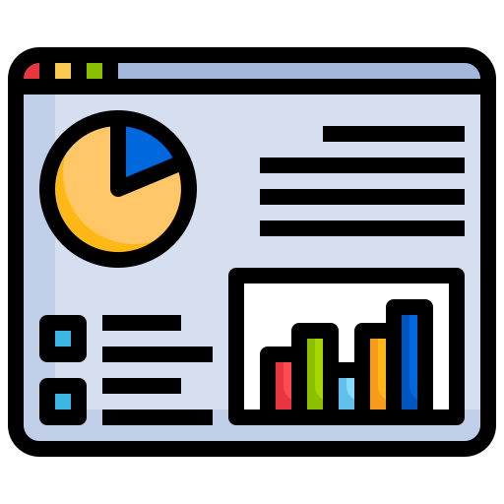
Literature Review
Open Government Data
Data Quality
Dimensional Modeling
Data Visualization
Notes:
For the literature review, there are 4 section for this research. Open Government Data, Data Quality, Data Visualization, and Dimensional Modeling.

Slide 47
Open Government Data
The open Government Data (OGD) initiative is for making data can be accessed, used, and redistributed by anyone freely.
To consider government data be opened, there are eight principles defined for government consideration during an Open Government Working Group as below (Ubaldi, 2013):
Complete
Primary
Timely
Accessible
Machine processable
Non-discriminatory
Non-proprietary
License-free
Notes:
The open Government Data (OGD) initiative is for making data can be accessed, used, and redistributed by anyone freely. It is seen as a key to Open Government, which is a movement that targets to be a more transparent and democratic government that enables cooperation among public administration, politicians, and representatives of industry and the general public.
To consider government data be opened, there are eight principles defined for government consideration during an Open Government Working Group as below (Ubaldi, 2013):
Complete: all public data should be available that have no valid privacy, security, or limitation.
Primary: Data is collected at the source, it must not be in aggregate or modified forms.
Timely: Data have to be available as quickly as necessary to maintain the worth of data
Accessible: The widest range of users can access data for the greatest number of uses.
Machine processable: Data is appropriately arranged to enable automated processing.
Non-discriminatory: Data is available to anyone, without the requirement of registration.
Non-proprietary: Data are available in a format over which no entity has exclusive control.
License-free: Data is not protected by copyright, patent, trademark, or trade secret laws. Reasonable constraints on privacy, security, and privilege may be permitted.

Slide 48
Open Government Data Catalog
The Open Government Data catalog must facilitate providing clarity to those who use this service.
In Thailand, a review of the Open Government Data Catalog was conducted by studying the successful Open Government Data of other countries. The purposes of the Open Government Data Catalog are:
To create clarity for those who come to use the service, both the organization, the data owner and those who use the information to have the same understanding.
To help users to find and access information more easily.
To ensure the catalog of Open Government datasets is consistent with other countries.
Notes:
Data Categorization is important because the published data is like an essential resource that would serve as the basis for continued development of the value with a variety of formats according to the user's purposes. Moreover, The OGD catalog must facilitate providing clarity to those who use this service.
In Thailand, a review of the Open Government Data Catalog was conducted by studying the successful Open Government Data of other countries. The purposes of the Open Government Data Catalog are:
To create clarity for those who come to use the service, both the organization, the data owner and those who use the information to have the same understanding.
To help users to find and access information more easily.
To ensure the catalog of Open Government datasets is consistent with other countries.

Slide 49
Open Government Data Catalog
The government studied the successful data catalog from these countries; the United Kingdom, Canada, and Taiwan in order to be used as a basis for pushing for the disclosure of government information in Thailand.
Country | Categories
United Kingdom | Business and economy Crime and justice Defence Education Environment Government Government Spending Mapping Society
Towns and cities
Transport
( 11 Categories)
Notes:
The government studied the successful data catalog from these countries; the United Kingdom, Canada, and Taiwan in order to be used as a basis for pushing for the disclosure of government information in Thailand.

Slide 50
Open Government Data Catalog
Country | Categories
Canada | Agriculture Art and Music and Literature Economics and Industry Education and Training Government and Policies Health and Safety History and Archaeology Information and Communications Labor Language and Linguistics Law Military
Nature and Environment
Persons
Processes
Science and Technology
Society and Culture
Transport
( 18 Categories)
Notes:
Agriculture, Art and Music and Literature, Economics and Industry, Education and Training, Government and Policies, Health and Safety, History and Archaeology, Information and Communications, Labor, Language and Linguistics, Law, Military, Nature and Environment, Persons, Processes, Science and Technology, Society and Culture, and Transport

Slide 51
Open Government Data Catalog
Country | Categories
Thailand | Agriculture Cities and Regions Economy, Finance and Industry Education Energy Natural Resources and Environment Government Budget and Spending Healthcare Law, Crime and Justice Politics and Government Religion, Art, and Culture Research, Science, Digital, and Innovation
Society and Welfare
Statistics
Tourism and sport
Transport and Logistics
( 15 Categories)
Notes:
Agriculture, Art and Music and Literature, Economics and Industry, Education and Training, Government and Policies, Health and Safety, History and Archaeology, Information and Communications, Labor, Language and Linguistics, Law, Military, Nature and Environment, Persons, Processes, Science and Technology, Society and Culture, and Transport

Slide 52
Data Quality
It is important to attain and perpetuate a high quality of data. The reason is most of the decisions making activities are based on data and information obtained from data analysis.
To describe in detail the data quality measurement, there are two general types of strategies called Data-driven and Process-driven.
Data-driven | Process-driven
Focus on the improvement of the data quality by modifying the value of data to make the focused data be corrected | To redesign the processes of creation or modification of data to improve the quality of data
Notes:
Currently, it is important to attain and perpetuate a high quality of data. The reason is most of the decisions making activities are based on data and information obtained from data analysis. It is commonly viewed the data as a priceless asset that its quality is critical to analyze related issues. In addition, high-quality data could increase the rate of achievement of decision-making and data analysis within the organization. About the level of quality of data measurement, the data quality measures are normally developed to solve particular issues.
To describe in detail the data quality measurement, there are two general types of strategies called data-driven and process-driven.
Data Driven; Focus on the improvement of the data quality by modifying the value of data to make the focused data be corrected
Process Driven; To redesign the processes of creation or modification of data to improve the quality of data
In comparison of both strategies, process-driven techniques turned out to surpass data-driven techniques in the long term, since they got rid of the root cause of the quality problems. In another way, data-driven techniques are reported to be efficient for the short term because they are suitable for one-time applications that are recommended for static data.

Slide 53
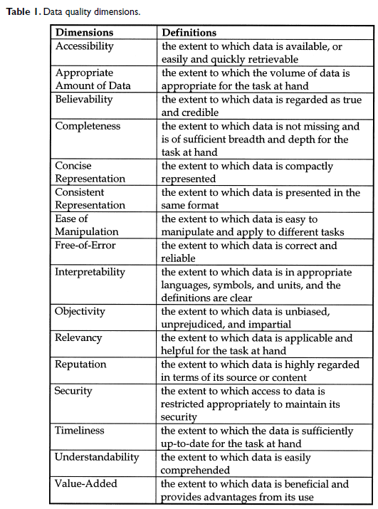
Data Quality
There are several methods that have been used to develop the application frameworks for a specific purpose. So, the data quality attributes or dimensions, which are chosen to be related to the chosen context, have noteworthy impacts on the whole methodology of the data quality domains.
Notes:
Then, there are several methods that have been used to develop the application frameworks for a specific purpose. So, the data quality attributes or dimensions, which are chosen to be related to the chosen context, have noteworthy impacts on the whole methodology of the data quality domains.
And this table is definitions of the data quality dimensions that roughly have 16 dimensions for now.

Slide 54
Data Quality
By the way, The most mentioned and important dimensions of data quality that many researchers commonly use and be defined as a basic set of data quality dimensions are:
Completeness
Accuracy
Consistency
Timeliness
Notes:
By the way, The most mentioned and important dimensions of data quality that many researchers commonly use and be defined as a basic set of data quality dimensions are:
Completeness, it determines data not to be missing and is sufficient for the required task. This dimension can be calculated for many levels, such as schema, property, population,
Accuracy, it is the degree of the data measurement that represents the real-world facts in the sense of correction, reliability, and certification. In addition, an authoritative source of reference is needed to identify this dimension of the data set.
Consistency, it represents the data in the same format and is compatible with the previous datasets which are defined over a set of data items as semantic rules.
Timeliness, it refers to the delay between a change in the real world and the result of data in the information system

Slide 55
Data Quality Framework
There are many data quality frameworks published that are generally applicable regarding the context of data, information system, and business type. Moreover, each framework has its own definition of the dimensions of measurement, and the methodology of assessment depends on its purpose.
Notes:
As the previous topic mentioned, there are many Data Quality Frameworks published that are generally applicable regarding the context of data, information system, and business type. Moreover, each framework has its own definition of the dimensions of measurement, and the methodology of assessment depends on its purpose.

Slide 56
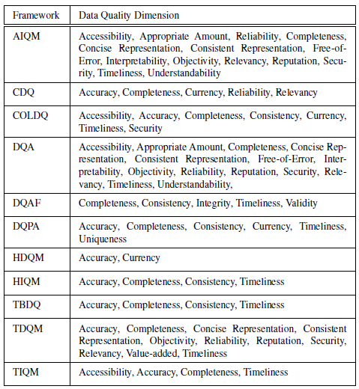
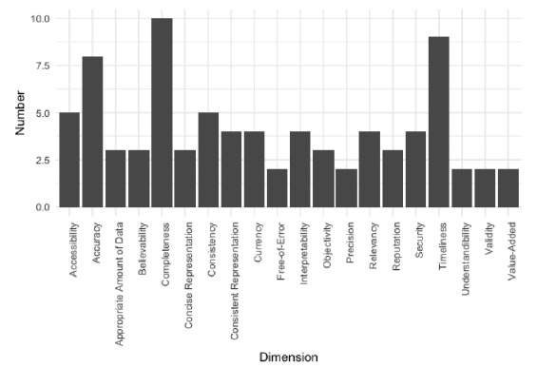
Data Quality Framework
Notes:
And this table is the overview of the used data quality dimension of each data quality framework that currently consists of 11 frameworks. For the summary, the right chart is a Number of frameworks using certain data dimensions chart. As the chart shown, the top 5 selected dimensions are Completeness, Timeliness, Accuracy, Consistency, and accessibility.

Slide 57
Data Quality with Open Government Data
An analytical framework for OGD has been suggested, and it involves the creation of a large number of metrics from a very diverse range of perspectives. It is evaluated based on factors such as availability, demand, and reuse.
Vetro et al (2016) defined each dimension of data quality and description for the OGD data quality implementation.
Notes:
An analytical framework for OGD has been suggested, and it involves the creation of a large number of metrics from a very diverse range of perspectives. It is evaluated based on factors such as availability, demand, and reuse. To specify the OGD data quality framework

Slide 58
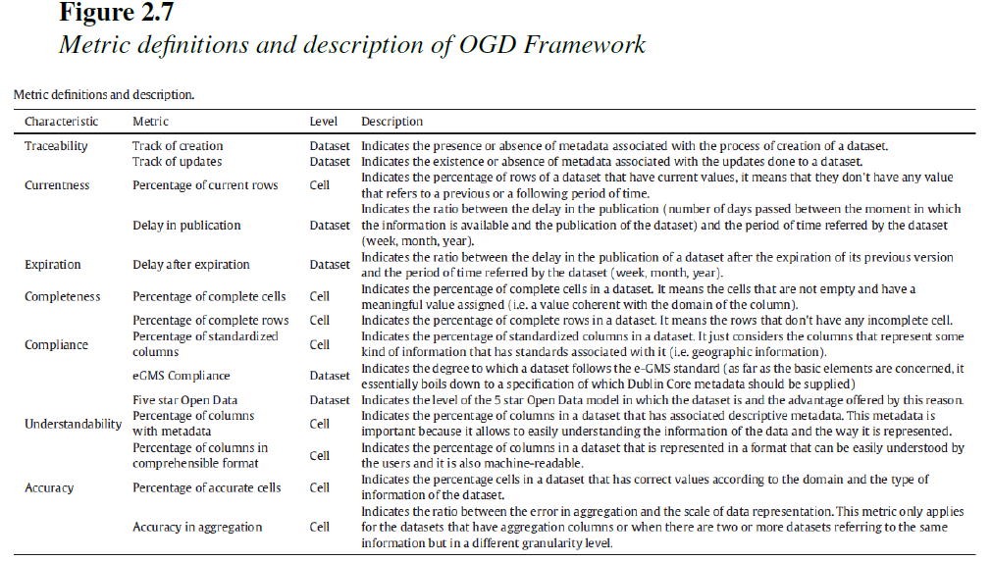
Data Quality with Open Government Data
Notes:
This figure is dimension of SPDQM (SQUARE Aligned Portal Data Quality Model) that presents a set of basic characteristics shared by almost all the
models (accuracy, completeness, timeliness or currentness), and provides characteristics as traceability, compliance and understandability, which are less considered by other frameworks
And, This framework was considered used as theoretical support of OGD framework.

Slide 59
Data Quality with Open Government Data
OGD Framework | Dimensions
The United Kingdom | Accuracy, Completeness, Consistency, Timeliness, Validity, Uniqueness
Canada | Accessibility, Accuracy, Coherence, Completeness, Consistency, Interpretability, Relevance, Reliability, Timeliness
Thailand | Accuracy, Availability, Completeness, Consistency, Timeliness, Relevancy
Notes:
In terms of Thailand's OGD Data quality framework, it is referred from United Kingdom's OGD. They chose to use six core data quality dimensions, as defined by the Data Management Association (DAMA), which are Completeness, Uniqueness, Consistency, Timeliness, Validity, and Accuracy
Another example is Canada, the framework's purpose is to strengthen government-wide capabilities in data quality management that are Improving the availability, interoperability, usability, and public value of data. There are nine dimensions defined by the Government of Canada; Accessibility, Accuracy, Coherence, Completeness, Consistency, Interpretability, Relevance, Reliability, and Timeliness
In Thailand, the Digital Government Development Agency (DGA) announced six dimensions of data quality assessment, to validate outcomes or successes from the data governance public sector, for publishing in Thailand as Accuracy, Availability, Completeness, Consistency, Timeliness, and Relevancy
In comparing the DGA's dimensions with the SPDQM framework, which is used to support the OGD data quality framework, there are five important and shared characteristics: accuracy, completeness, consistency, uniqueness, and timeliness.

Slide 60
Dimensional Modeling
Dimensional modeling is a method of data design utilized in data warehouses and business intelligence systems. It entails arranging data into fact tables and dimension tables in order to make it easier to query and evaluate data. The fundamental ideas of dimensional modeling are facts, dimensions, and characteristics.
Notes:
Dimensional modeling is a method of data design utilized in data warehouses and business intelligence systems. It entails arranging data into fact tables and dimension tables in order to make it easier to query and evaluate data. The fundamental ideas of dimensional modeling are facts, dimensions, and characteristics.

Slide 61
Dimensional Modeling
Five steps of dimension model creation:
Identify Business Process
Identify Grain (level of detail)
Identify Dimensions
Identify Facts
Build Schema
Notes:
In general, there are five steps of dimension model creation:
Identify Business Process
Identify Grain (level of detail)
Identify Dimensions
Identify Facts
Build Schema
Let’s each of step

Slide 62
Dimensional Modeling
Identify Business Process: Determining the business processes that a data warehouse should support depending on the organization's data analysis requirements.
Identify Grain: The level of detail for the business problem or solution is described as the Grain. This process exists for the identification of the lowest level of information for any table in a data warehouse.
Notes:
Identify Business Process: Determining the business processes that a data warehouse should support depending on the organization's data analysis requirements. Moreover, the selection of the business process also depends on the quality of data for that process. So, it is the most important step to create data modeling. To describe the business process, plain text, Business Process Modeling Notation, or Unified Modelling Language could be used.
Identify Grain (level of detail): The level of detail for the business problem or solution is described as the Grain. This process exists for the identification of the lowest level of information for any table in a data warehouse. For example, it should be daily granularity if a table contains data for every day.

Slide 63
Dimensional Modeling
Identify Dimensions: Dimensions categorize and define facts and measures in a data warehouse in a manner that facilitates useful responses to business inquiries. In a data warehouse, descriptive qualities are organized as columns in dimension tables.
Identify Facts: Because here is where the business users of the system receive access to the data that is kept in the data warehouse, this stage is closely related to the business users of the system. The majority of the rows in the fact table are comprised of numerical values.
Notes:
Identify Dimensions: Dimensions categorize and define facts and measures in a data warehouse in a manner that facilitates useful responses to business inquiries. In a data warehouse, descriptive qualities are organized as columns in dimension tables. For illustration, the data dimension may include information such as the year, month, and weekday.
Identify Facts: Because here is where the business users of the system receive access to the data that is kept in the data warehouse, this stage is closely related to the business users of the system. The majority of the rows in the fact table are comprised of numerical values.

Slide 64
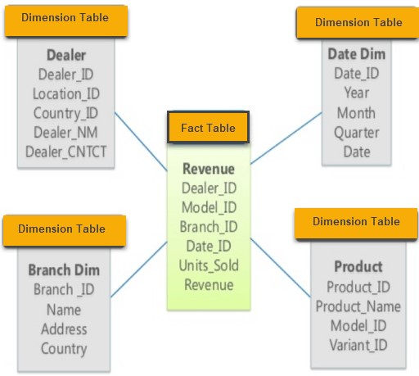
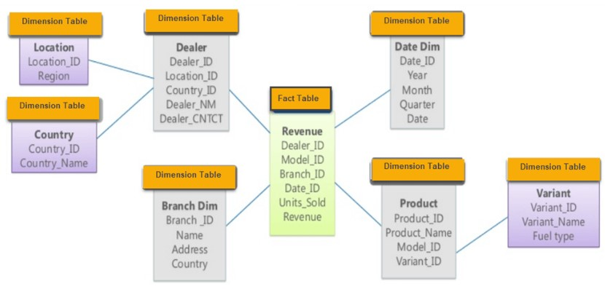
Dimensional Modeling
Build Schema: the dimension model is implemented. A schema is nothing more than the structure of a database.
Star Schema
Snowflake Schema
Notes:
Build Schema: In this step, the dimension model is implemented. A schema is nothing more than the structure of a database. In addition, there are two widely used schemas here.
Star Schema: It is known as star schema as its structure resembles a star, in which the center of the star can have one fact table and multiple associated dimension tables. The Star Schema data model is the most straightforward type of Data Warehouse schema. It is also known as Star Join Schema and is optimized for querying large data sets
Snowflake Schema: The Snowflake Schema is an expansion of the Star Schema that adds extra dimensions. Normalization of the dimension tables results in the separation of data into new tables. Therefore, this is a sophisticated database design with low-level data redundancy

Slide 65
Data Visualization
Data patterns and outliers can be quickly found using visualizations. In this regard, a simple, low-effort method of producing such visualizations might significantly enhance the use of Open Government Data.
Visual learning is one of the primary forms of interpreting information, which has combined images such as charts and Graphs. There are numerous advantages to quickly and effectively conveying information.
Notes:
Data patterns and outliers can be quickly found using visualizations. In this regard, a simple, low-effort method of producing such visualizations might significantly enhance the use of Open Government Data.
Visual learning is one of the primary forms of interpreting information, which has combined images such as charts and Graphs. There are numerous advantages to quickly and effectively conveying information. By the way, Effective figures suggest an understanding and interpretation of data while ineffective figures suggest the opposite.

Slide 66
Data Visualization
Ten principles to make Data visualization more effective:
Diagram First. Before making a visual, The information should be prioritized, then envision design it.
Software. Learning new software or expanding knowledge of software is essential to design the best figure.
Use an Effective Geometry and Show Data. Geometries are representations of the data in different forms, and often there may be more than one geometry to consider.
Notes:
There are ten principles to make Data visualization more effective. The first one,
“Diagram First”. Before making a visual, The information should be prioritized, then envision design it. Moreover, it is important to think about the core information that needs to be conveyed and what information is going to make a point.
The next one is about “Software”. It might be impossible to expect effective figures when using a simple spreadsheet program. So, learning new software or expanding knowledge of software is essential to design the best figure.
The third one is“Use an Effective Geometry and Show Data”. Geometries are representations of the data in different forms, and often there may be more than one geometry to consider. Most of them fall into categories: amounts, compositions, distributions, or relationships.

Slide 67
Data Visualization
Colors always mean something. colorful visualizations were reported as having higher memorability scores. Along with this approach, colors can be combined with symbols, line types, and other design elements to share the same information that the color was sharing.
Uncertainty Inclusion. Expressing uncertainty requires that readers be familiar with metrics of uncertainty and their interpretation.
Panel. The objective of small multiples is to make the data inevitably comparable, and effective small multiples always accomplish these comparisons.
Notes:
the fourth is about “Colors always mean something”. In a large study of what makes visualizations memorable, colorful visualizations were reported as having higher memorability scores. Along with this approach, colors can be combined with symbols, line types, and other design elements to share the same information that the color was sharing. It is also good practice to use color schemes that are effective for colorblind readers.
The fifth is “Uncertainty Inclusion”. Expressing uncertainty requires that readers be familiar with metrics of uncertainty and their interpretation.
The next is “Panel”. The objective of small multiples is to make the data inevitably comparable, and effective small multiples always accomplish these comparisons.

Slide 68
Data Visualization
Data and Models Are Different Things. any visualization of a model should be explained in the figure caption or referenced elsewhere in the document to help readers can find detail on what the model visual is representing.
Simple Visuals, Detailed Captions. Captions should do all they can to explain the visualization and representations used.
Notes:
For the seventh, “Data and Models Are Different Things”. Raw data and summarized data are often relatively straightforward, while a plotted model may require more explanation for a reader to be able to fully reproduce the work. So, any visualization of a model should be explained in the figure caption or referenced elsewhere in the document to help readers can find detail on what the model visual is representing.
The Principle No.8, “Simple Visuals, Detailed Captions”. Captions should do all they can to explain the visualization and representations used.
The ninth is about “Infographic”. Figures tend to be focused on representing data and models, whereas infographics typically incorporate text, images, and other diagrammatic elements. Even if infographics are not adopted in most cases, technical visuals often still benefit from some text or other annotations.

Slide 69
Data Visualization
Infographic. Figures tend to be focused on representing data and models, whereas infographics typically incorporate text, images, and other diagrammatic elements. Even if infographics are not adopted in most cases, technical visuals often still benefit from some text or other annotations.
Get an Opinion. Having one or more colleagues or people external to the study review figures will often provide useful feedback on what readers perceive.
Notes:
The ninth is about “Infographic”. Figures tend to be focused on representing data and models, whereas infographics typically incorporate text, images, and other diagrammatic elements. Even if infographics are not adopted in most cases, technical visuals often still benefit from some text or other annotations.
The last one, “Get an Opinion”. Having one or more colleagues or people external to the study review figures will often provide useful feedback on what readers perceive.

Slide 70
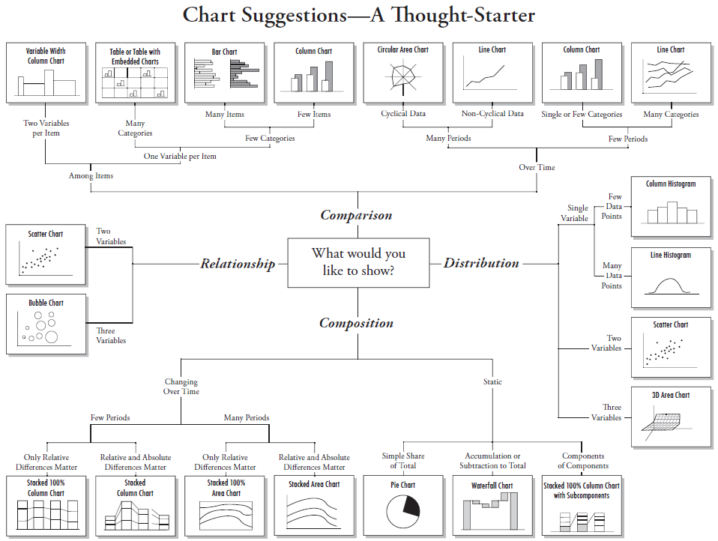
Data Visualization
Notes:
Here is a chart for visualization starter for each type of data that the user want to illustrate. It shares 4 type of illustration which are comparison, Distribution, Composition, and Relationship

Slide 71
Data Quality Dimension Selection
Consistency
To assess this dimension, the consistent column will be determined following most of the datasets that are published on the open data portal and the suitability of the pattern:
Date: should be in YYYY-MM-DD format or machine-readable format.
Content of Data: every dataset should have the same text pattern if they are the same datatype to be easy for users to implement using the same framework. Hence, the value needs to be the same text as the metadata.
Number and float: they cannot have any text in the column. In addition, they cannot be less than zero in some conditions of the data.
Notes:
To assess this dimension, the consistent column will be determined following most of the datasets that are published on the open data portal and the suitability of the pattern:
Date: should be in YYYY-MM-DD format or machine-readable format.
Content of Data: every dataset should have the same text pattern if they are the same datatype to be easy for users to implement using the same framework. Hence, the value needs to be the same text as the metadata.
Number and float: they cannot have any text in the column. In addition, they cannot be less than zero in some conditions of the data.

Slide 72

Data Quality Dimension Selection
Notes:
The fourth is "Timeliness". every dataset must be up-to-date or at least meets the announcement of an update on the web portal to assist users to access the latest information of the interested data. This dimension has no exact method, but it can be measured by comparing the latest published dataset to the metadata of a dataset.
The last one is "Uniqueness". This dimension can be calculated automatically from an overall perspective (the whole record of a dataset), but it needs to be defined the criteria to consider the duplication in case of a specific condition of duplication. In this research, the "Uniqueness" score will be defined by using the overall perspective with the calculation of the number of instinct records divided by all records of the dataset.

